Slide 1
Cellular Respiration
Chemical Energy to ATP

Slide 2
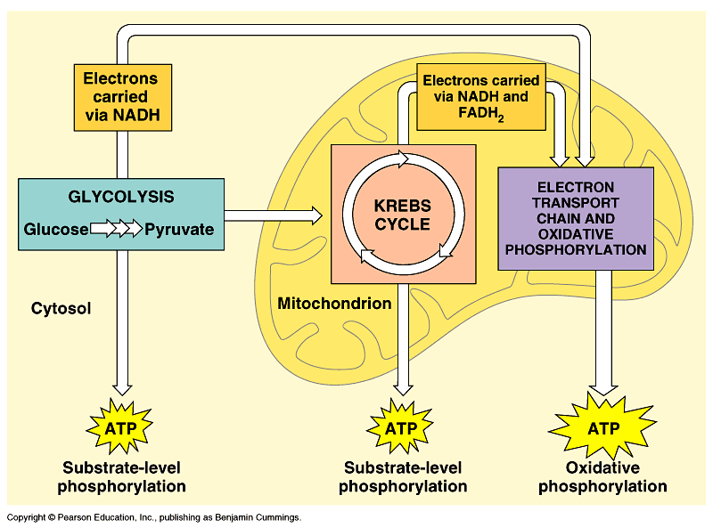

Slide 3
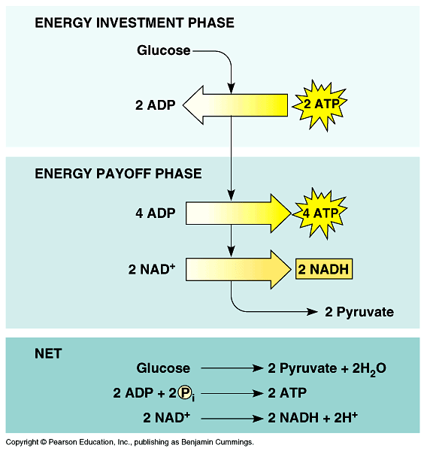

Slide 4
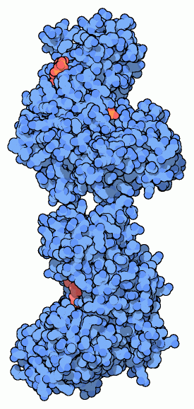
Hexokinase, human brain
Regulatory half of the molecule
Catalytic half of the molecule
Next: Phosphoglucose Isomerase

Slide 5
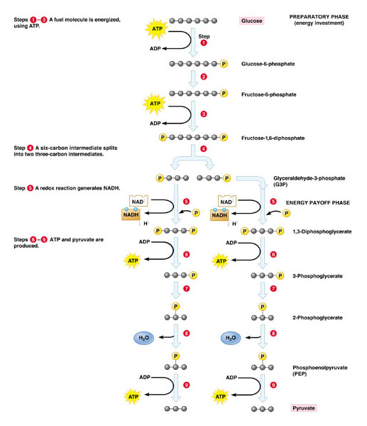

Slide 6
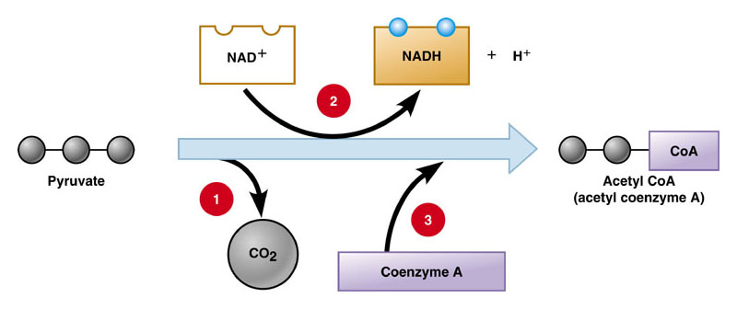

Slide 7
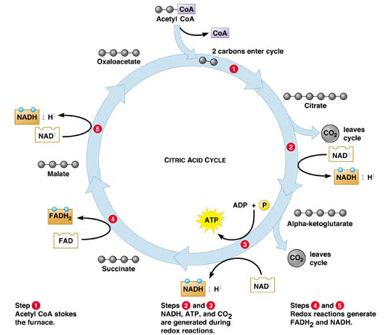

Slide 8
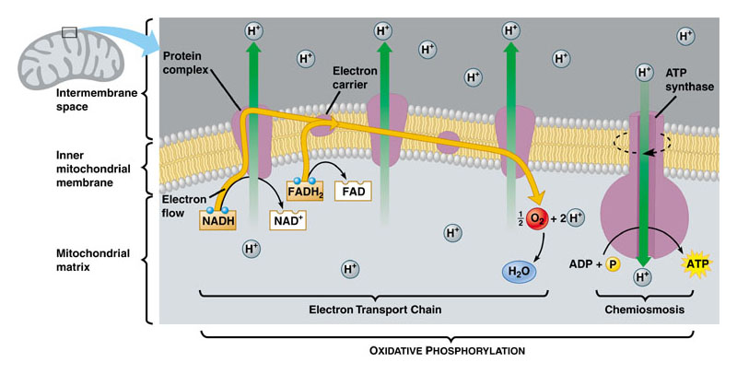

Slide 9
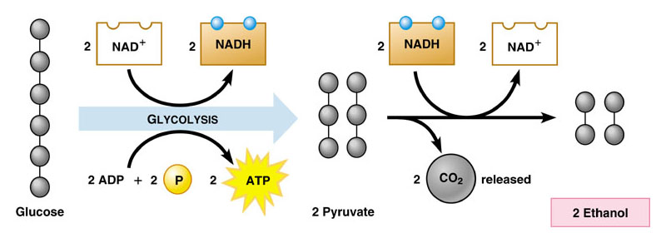
Anaerobic Pathway

Slide 10
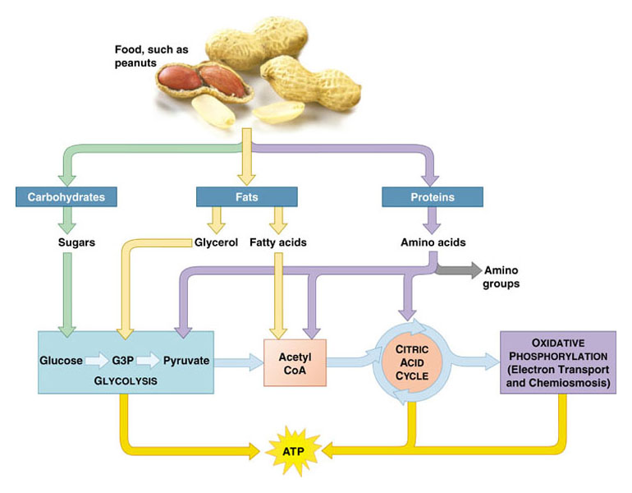

Slide 11
