Slide 1
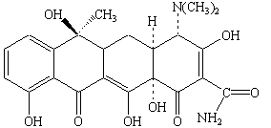
Notes:
Tetracycline
This compound contains an aromatic ring fused to three six-membered cycloalkane rings. It is also an alcohol (with five OH groups), a ketone (with C=O groups at the bottom of the second and fourth rings), an amine (the N(CH₃)₂ substituent at the top of the fourth ring), and an amide (the CONH₂ group at the bottom right-hand corner of the fourth ring.)

Slide 2
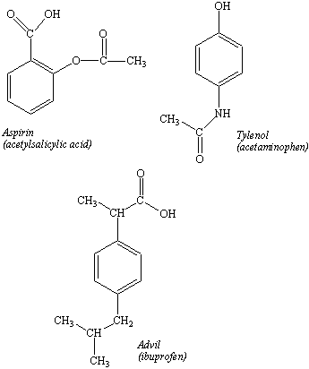
Notes:
Aspirin, tylenol, advil

Slide 3
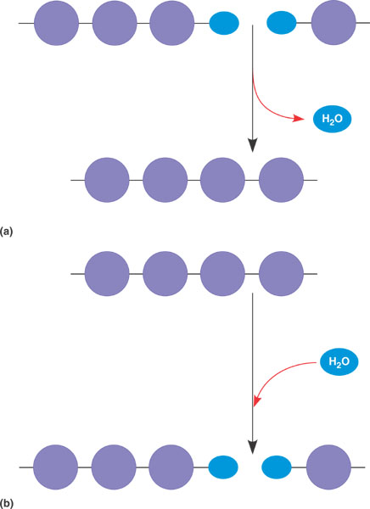
Monomer & Polymer
Dehydration Synthesis
Hydration

Slide 4
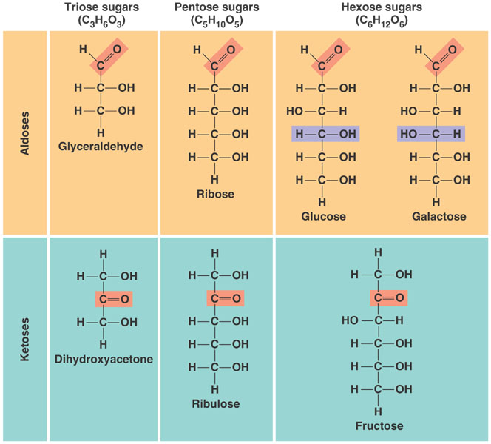
Hydrated Carbons CH2O

Slide 5
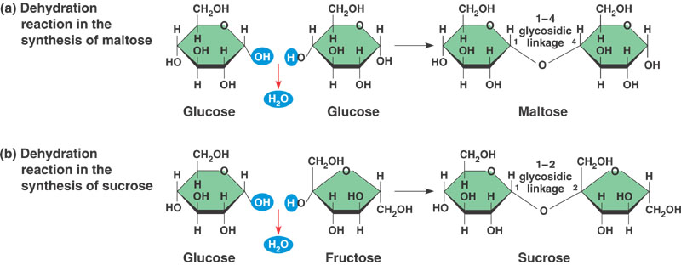
Double Sugars

Slide 6
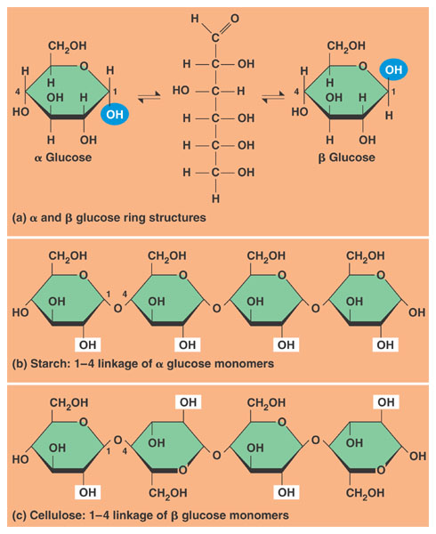

Slide 7
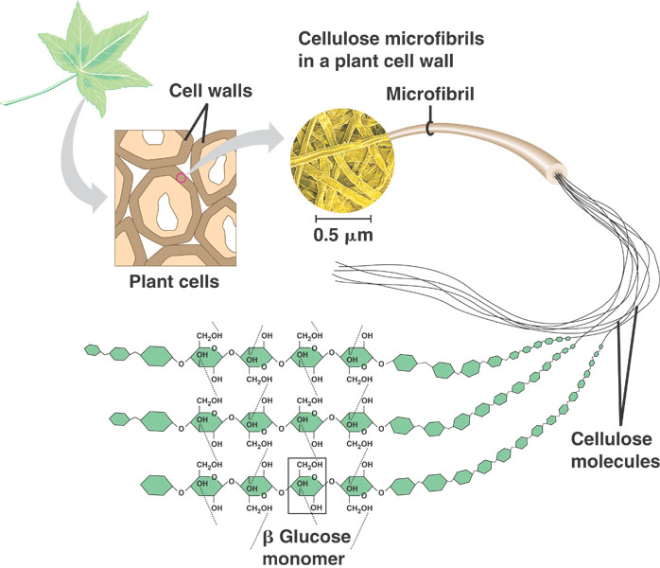
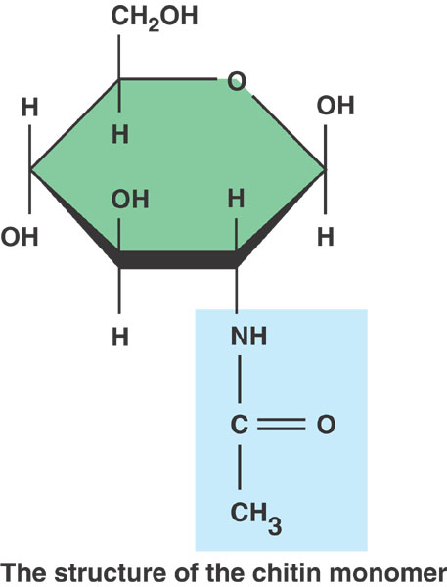
Structural
Polysaccharides

Slide 8
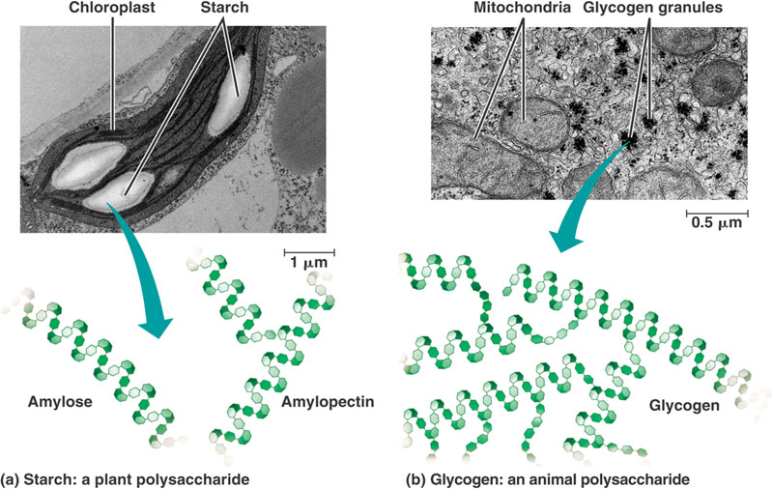
Storage Polysaccharides

Slide 9
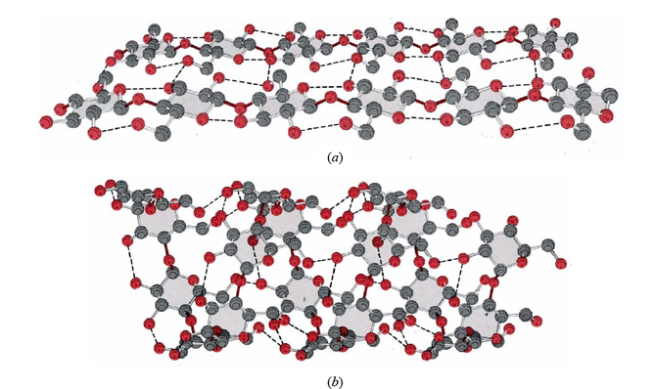
Notes:
Cellulose on Top
Starch on the bottom what is the difference

Slide 10
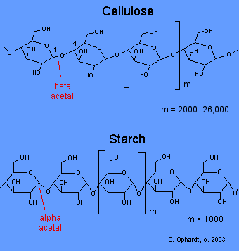

Slide 11
1. Which of the following statements concerning polymers is not true?
A Monomers are synthesized from polymers during condensation
B Polymers are synthesized from monomers during dehydration synthesis.
C Polymers consist of two types of monomers.
D Polymers are made by removing a nitrogenous enzyme
E Both C and D are false
2. Cellulose and starch are composed of the same monomers. Which of the following result in their being structurally and functionally different?
A they have different types of glycosidic linkages
B they have different number of monomer units
C they are held together by different types of bonds
D none of the above
3. Which of the following statements about carbohydrates is not true?
A. Monomers of carbohydrates always have a ring structure
B Monomers of carbohydrates are linked together by condensation
C Carbohydrates are only for energy storage
D All of the above are false

Slide 12
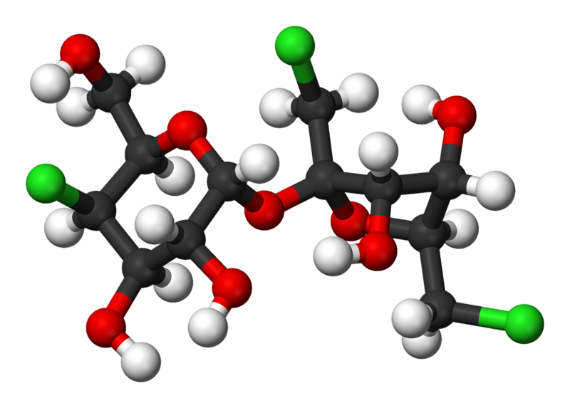
What molecule is this? Figure out the molecular formula
Notes:
Sucralose

Slide 13
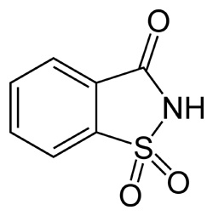
Notes:
Saccharin

Slide 14
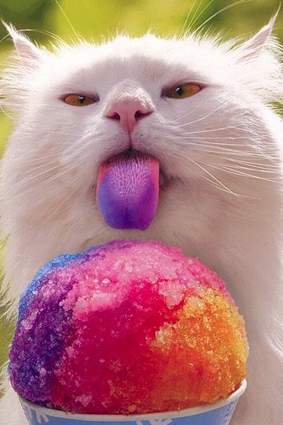
HOW SWEET IT IS!
The relative potency of sugar compared with artificial sweeteners
sugar 1x
cyclamate 45x
aspartame 180x
saccharin 300x Can taster bitter or metallic
sucralose 600x Can cook with but no sugar mouth feel
neotame 13,000x

Slide 15
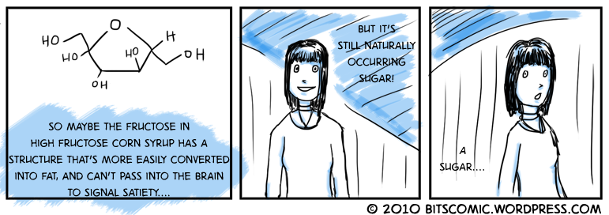
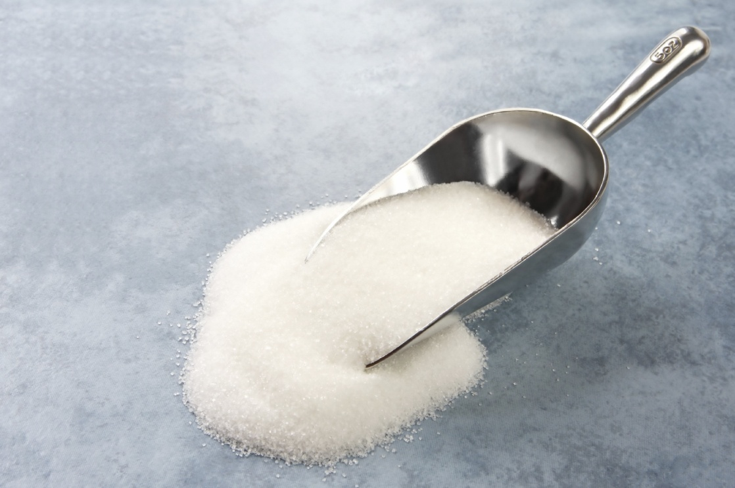
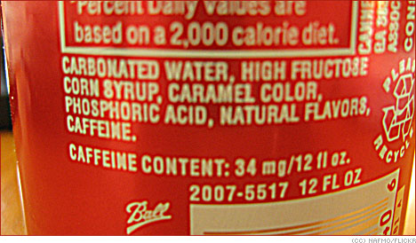

Slide 16
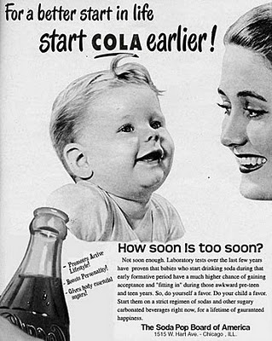

Slide 17
