Slide 1
DNA Organization
Nucleosome and DNA organization

Slide 2
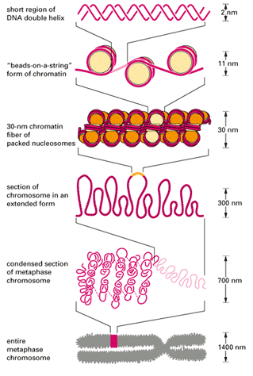

Slide 3
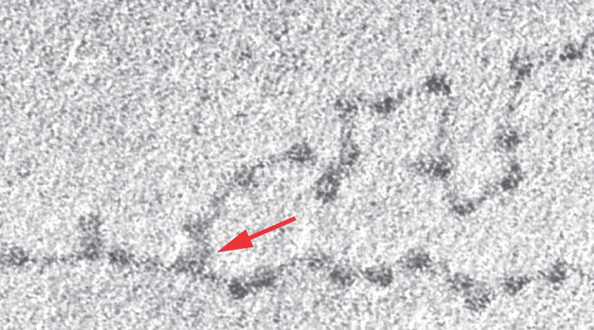

Slide 4
