Slide 1
DNA Structure & Replication
AP Biology Review
Big Idea 3

Slide 2
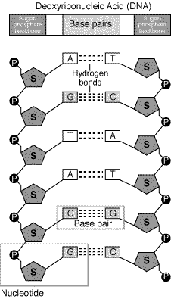
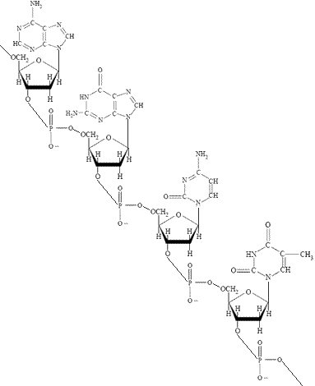
Watson and Crick 1953
NUCLEOTIDE: - P-D-B

Slide 3
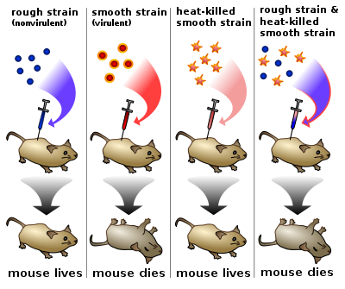
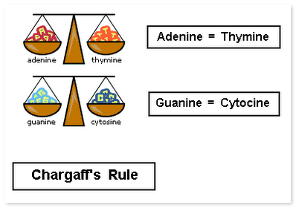
Avery, MacLeod, McCarty
1944
Chargaff Rules
1952

Slide 4
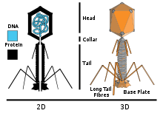
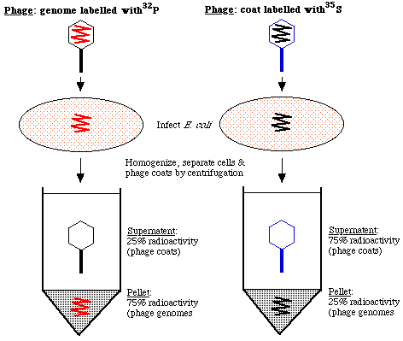
Hershey Chase Experiment: DNA or PROTEIN that transmitted information?
1952

Slide 5
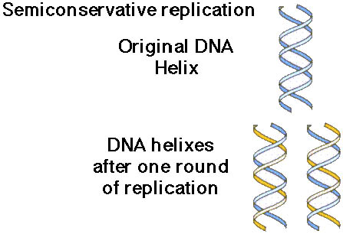
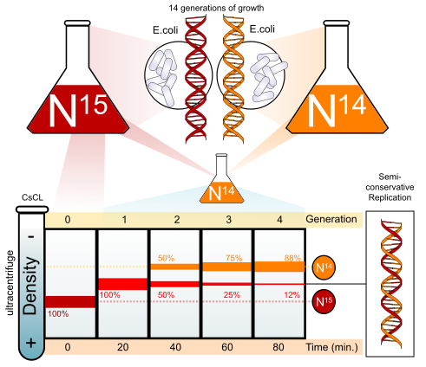
Meselson Stahl: DNA Replication is SEMI CONSERVATIVE:
Template serves to construct the daughter strand. (1958)

Slide 6
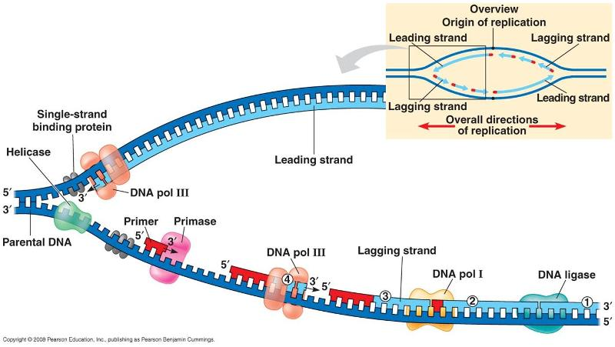
DNA Replication
Helicase, DNA polymerase, DNA Ligase, Topoisomerase
Always add at 3’ end of strand
Fragments of newly synthesized DNA called?
Lagging discontinuous and Leading continuous

Slide 7
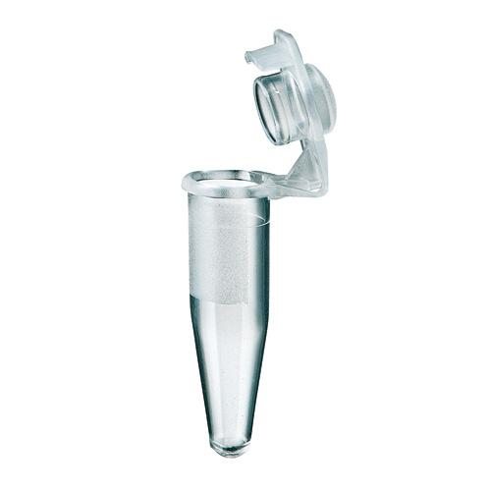
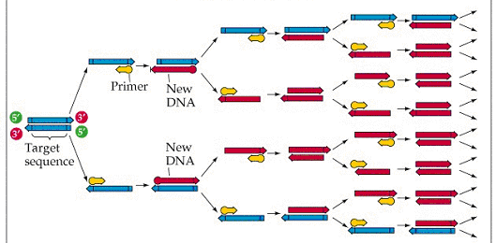
PCR Polymerase Chain Reaction – exploits the mechanism of DNA Replication
Allows for directionality of copying DNA Sequences
What ingredients are necessary for a successful PCR reaction? What is the role of each?

Slide 8
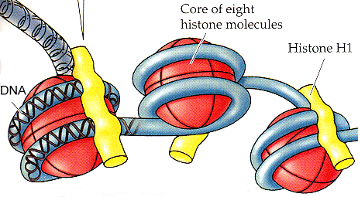
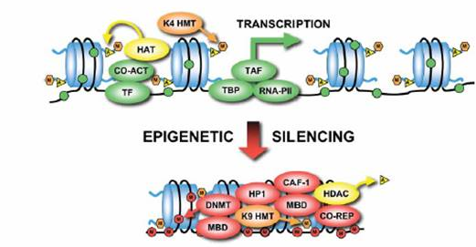
DNA organization
DNA and Protein = NUCLEOSOME
How tightly bound DNA is to nucleosome influences gene expression
Tightly bound? Up or Down regulation?
DNA Methylation= SILENCING
Barr Bodies is HETEROCHROMATIN

Slide 9
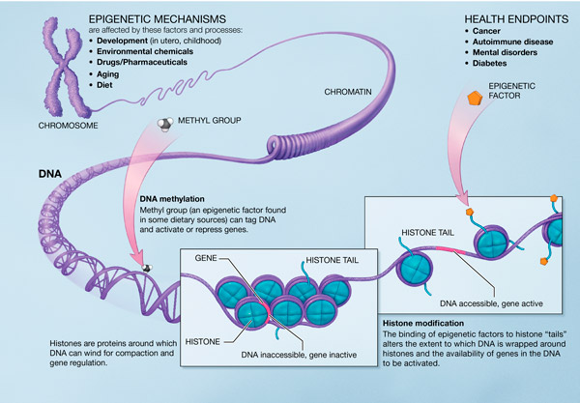
You are MORE THAN YOUR GENES….

Slide 10
Protein Synthesis & Gene Expression with Regulation
AP Biology Review
Big Idea 3

Slide 11
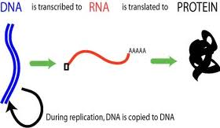
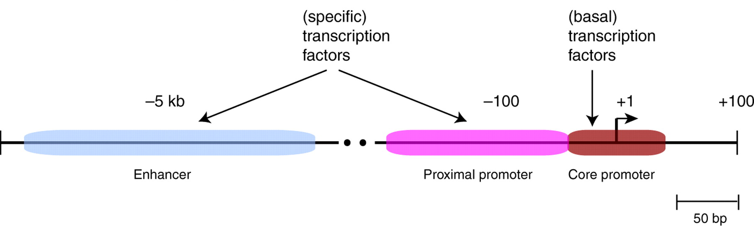
Simple Version
Regulatory Regions of DNA Influence Rate of Transcription

Slide 12
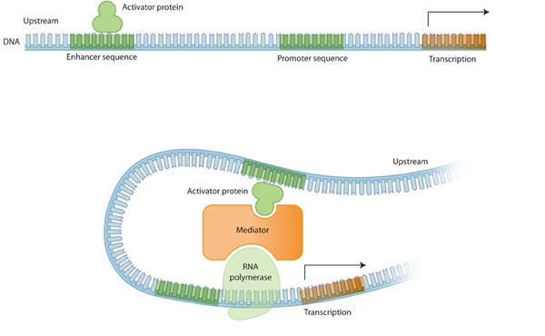
Enhancers and Transcription Factors

Slide 13
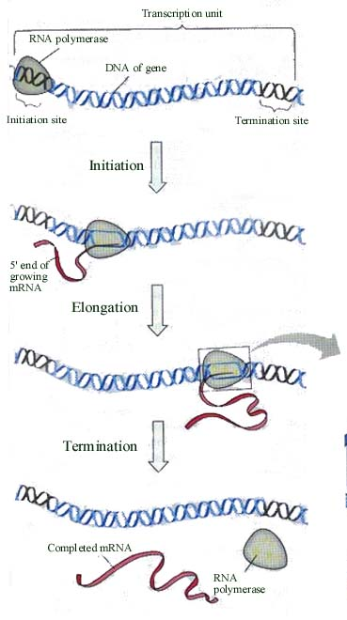
RNA pol binds to ----, with necessary ----.
Transcription begins at which nucleotide?
Transcription continues through 2 regulatory elements known as----- then stops.
Now the mRNA ready for ….
If eukaryote ----.
If prokaryote ---.

Slide 14
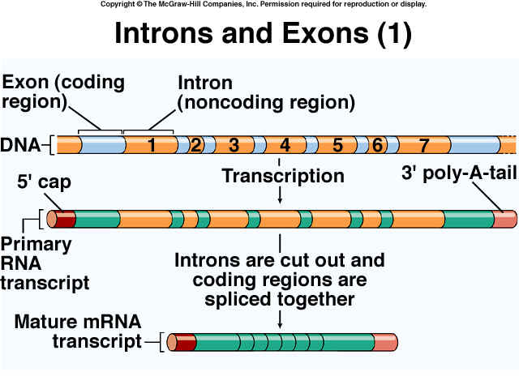
EUKARYOTES ONLY…

Slide 15
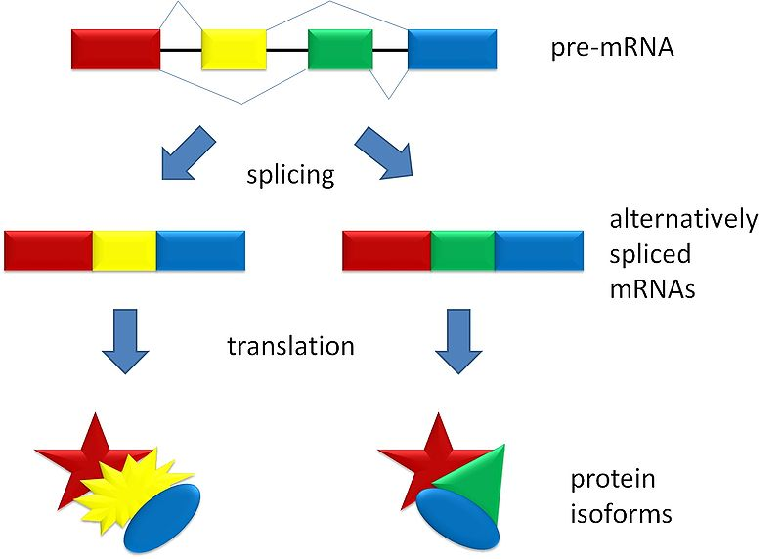
Alternative Splicing- MORE FUNCTION FROM SAME PIECE OF DNA

Slide 16
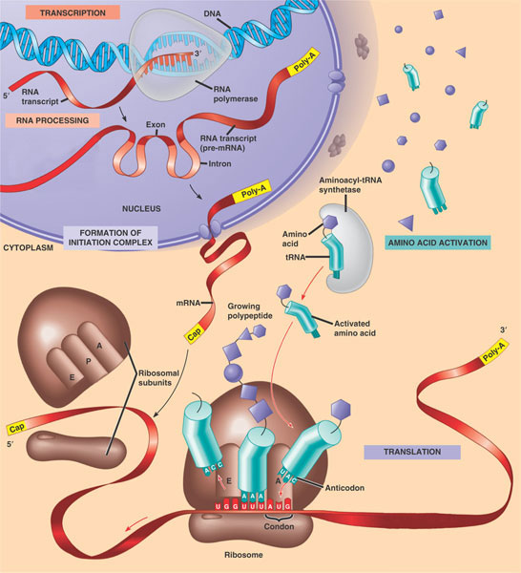

Slide 17
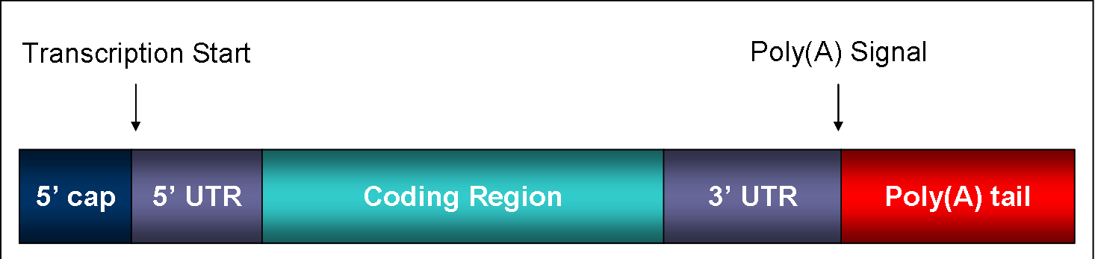
The beginning of 5’ UTR corresponds to 1+ in DNA
CAP and TAIL from mRNA processing
Where does translation begin?

Slide 18
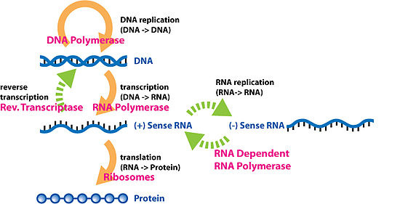
Central Dogma..... UPDATED
H.I.V.
Dengue Virus

Slide 19
Lac Operon & Trp Operon
Ara Operon
AP Biology Review
Big Idea 3

Slide 20
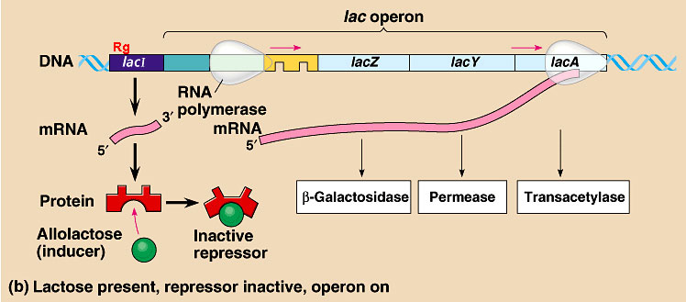
OPERONS
Generally prokaryotic, more recently found in eukaryotes
enables organisms to regulate the expression of various genes depending on environmental conditions. Operon regulation can be either negative or positive by induction or repression
LAC- OPERON Negative control involves the binding of a repressor to the operator to prevent transcription

Slide 21
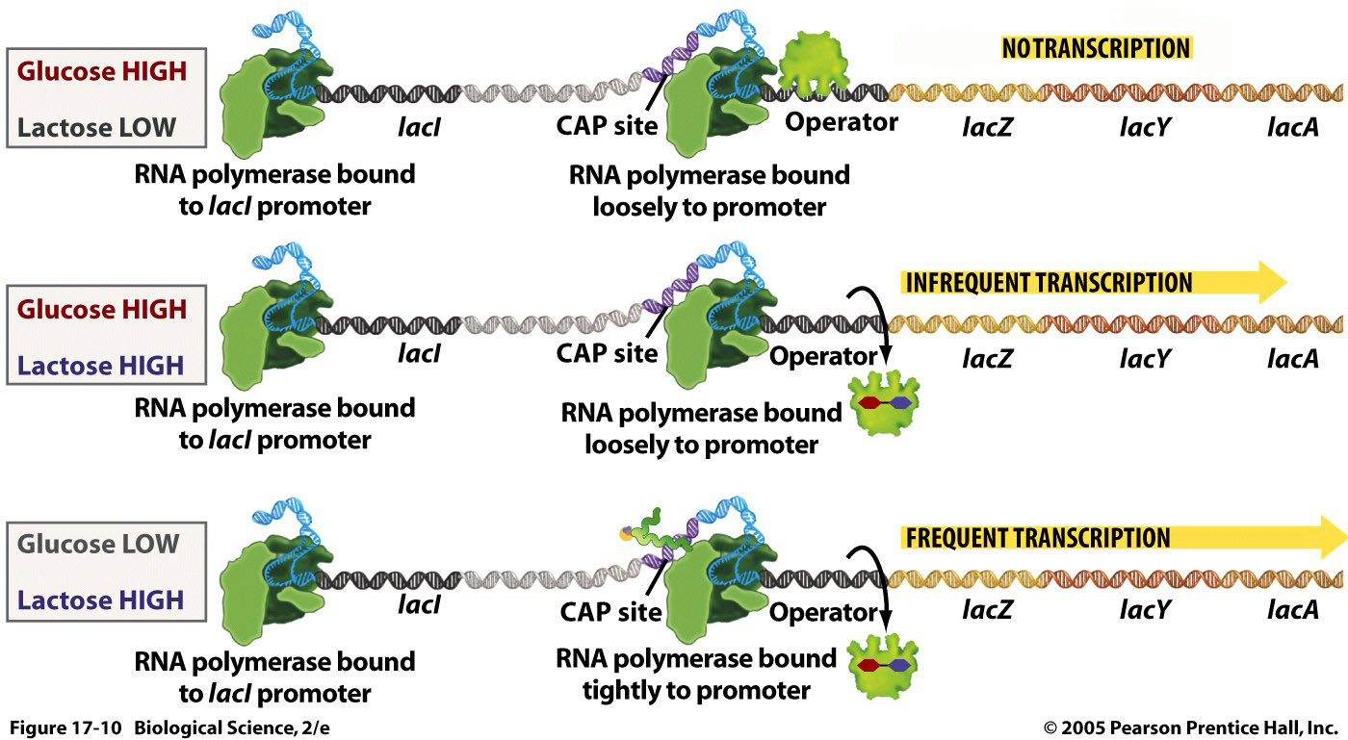

Slide 22
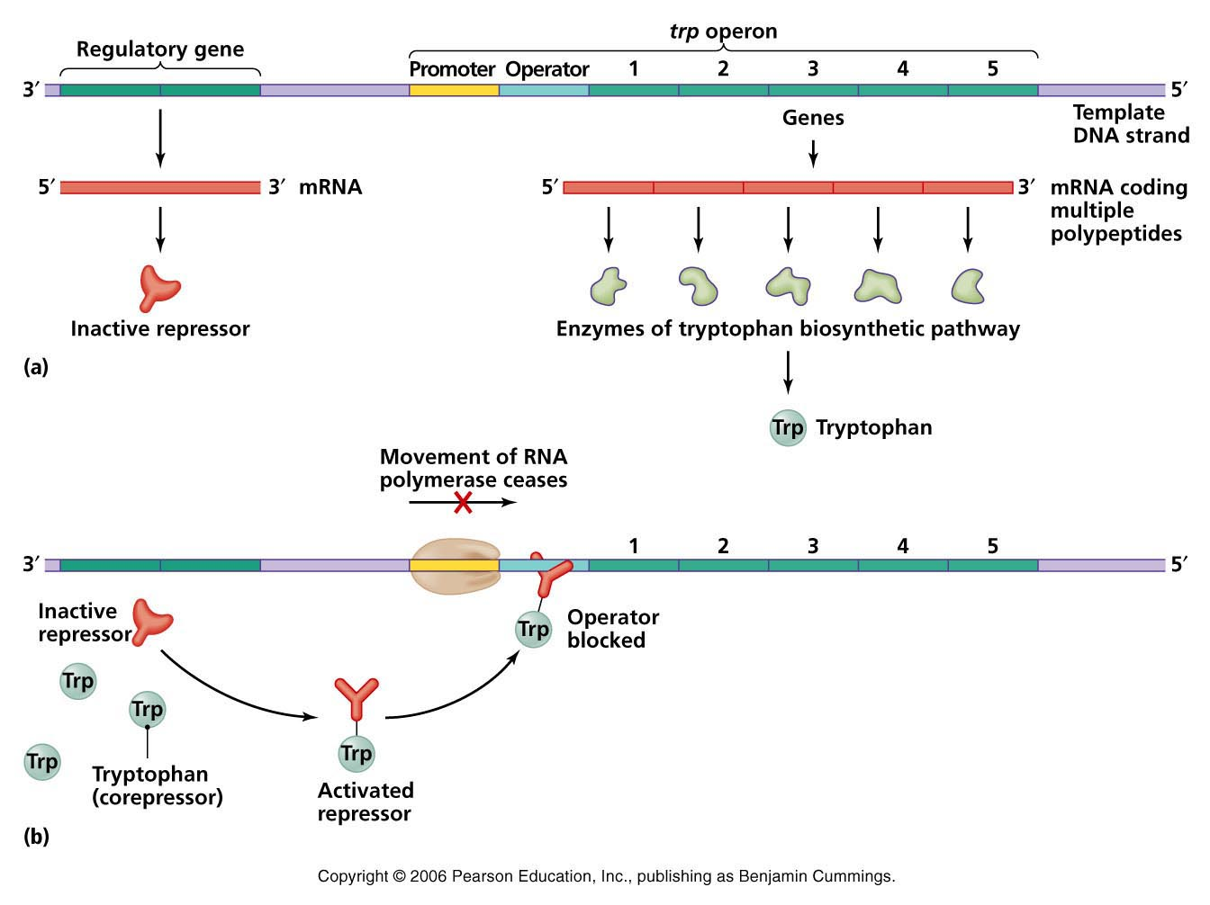

Slide 23
Bacterial Transformation & Exploiting the Operons
AP Biology Review
Big Idea 3

Slide 24
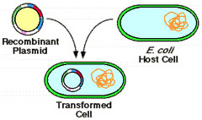
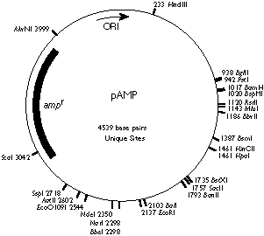

Slide 25
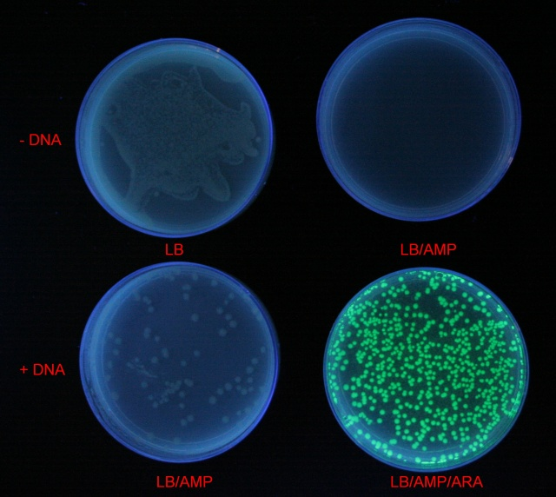

Slide 26
How can I put novel eukaryotic genes into a bacterial plasmid
and then express the genes in bacteria?

Slide 27
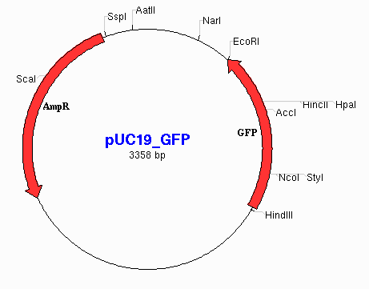
What restriction sites would you use to ligate in GFP?
After transformation,
what type of plate would you use to select for transformed cells?
LB plate
LB/ ARA
LB/ AMP
LB/ARA/ KAN

Slide 28
Gel Electrophoresis
AP Biology Review

Slide 29
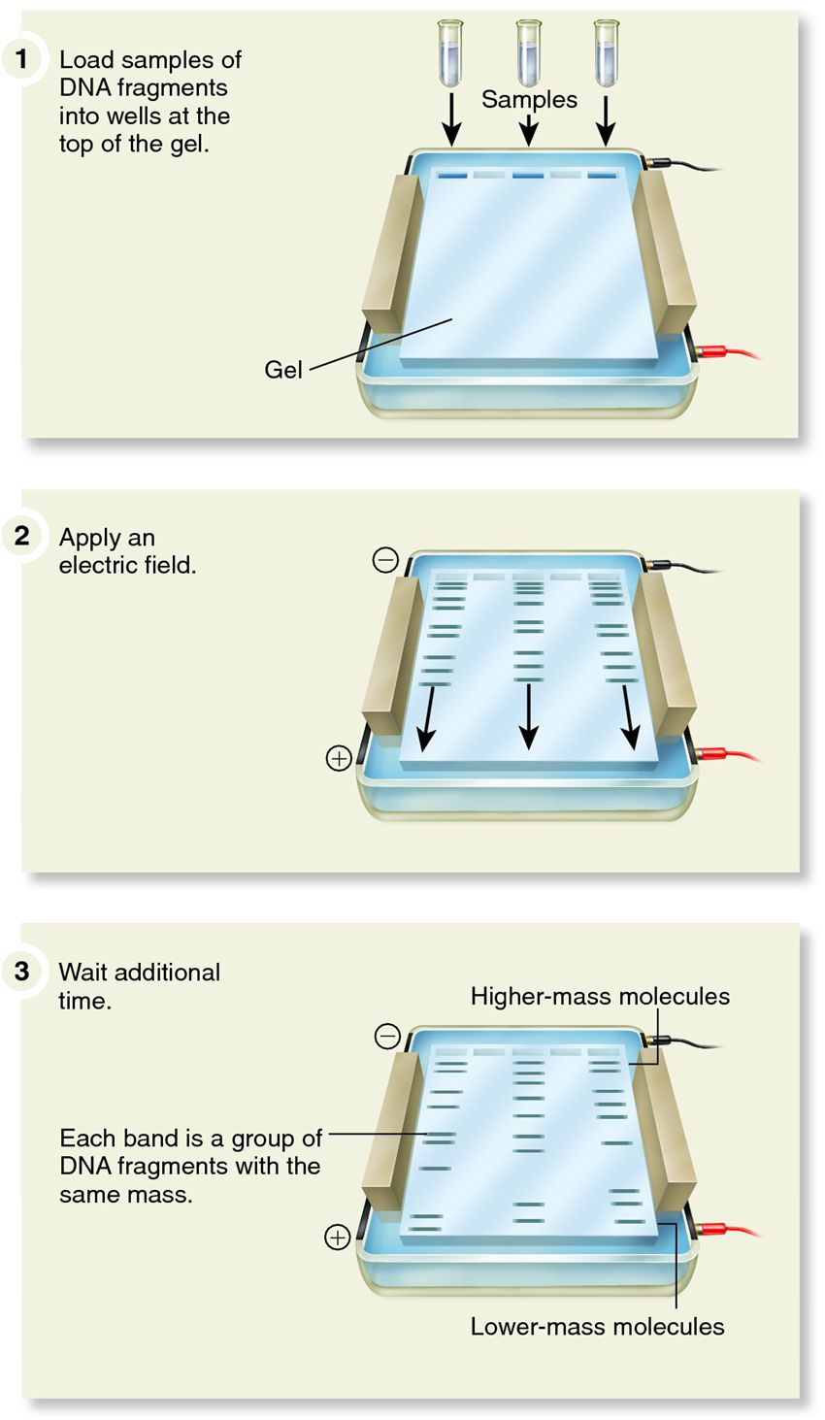
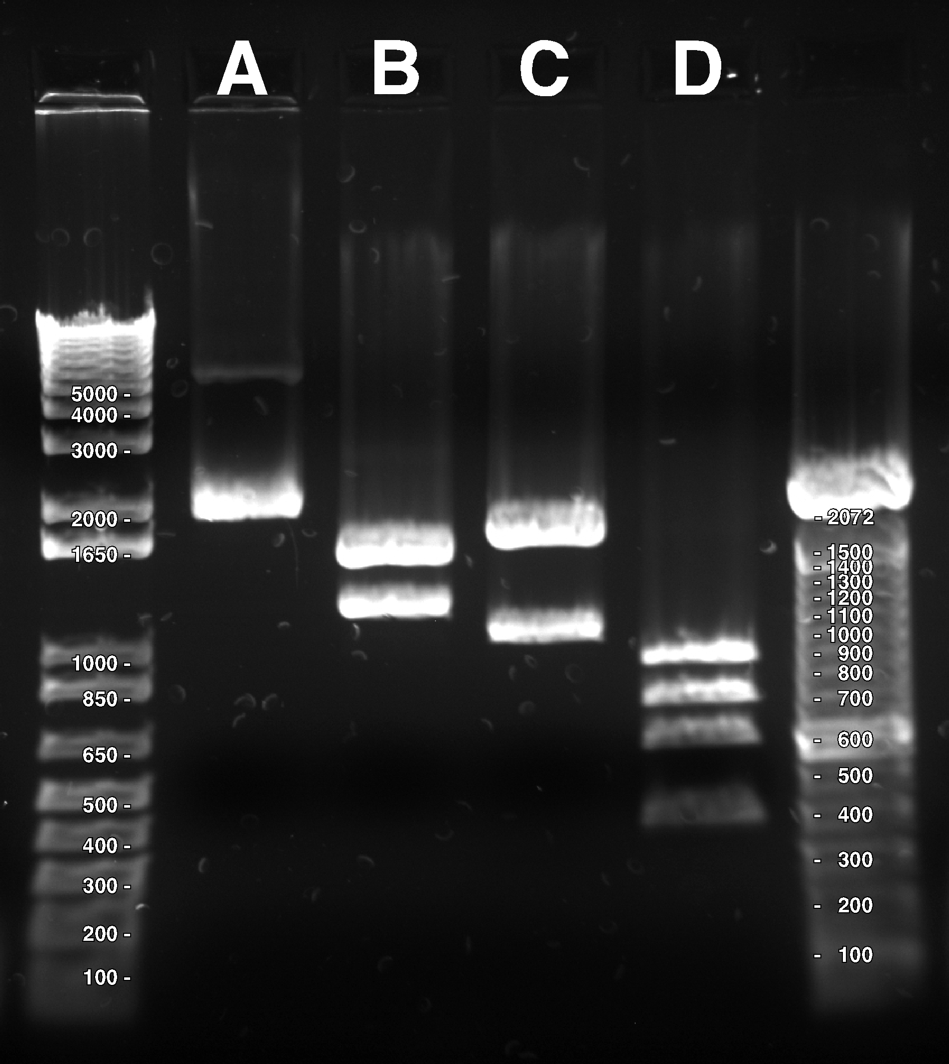

Slide 30
DNA Mutations Chromosomal Problems
AP Biology Review

Slide 31
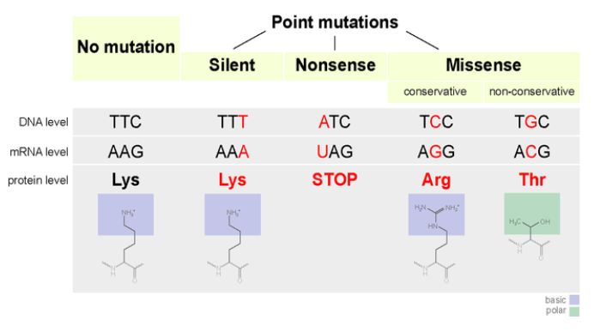
Mutations in DNA sequences generally occur through one of two processes:
DNA damage from environmental agents such as ultraviolet light (sunshine), nuclear radiation or certain chemicals
Mistakes that occur when a cell copies its DNA in preparation for cell division.
Which is the worst? Which are not so bad?

Slide 32
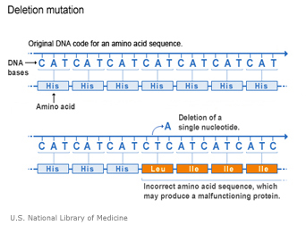
Res

Slide 33
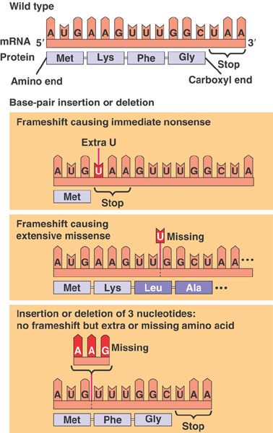
THE CAT ATE THE RAT
Insertion & Deletion
THE CAA TAT ETH ERA T
THE CTA TET HER AT

Slide 34
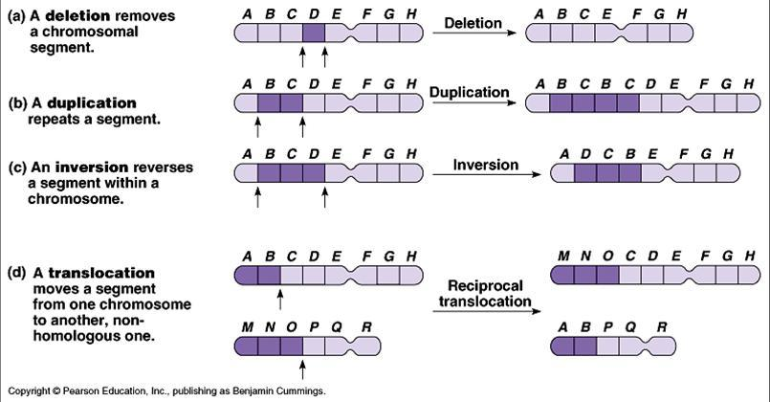
When would these most likely occur?
Which could be worst? Which is not so bad?

Slide 35
Cell Signaling & Cell Communication
AP Biology Review

Slide 36
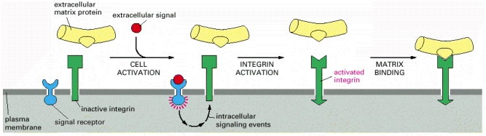
Integrins are the principal receptors used by animal cells to bind to the extracellular matrix. They are heterodimers and function as transmembrane linkers between the extracellular matrix and the actin cytoskeleton. A cell can regulate the adhesive activity of its integrins from within.
Integrins also function as signal transducers, activating various intracellular signaling pathways when activated by matrix binding.
Integrins and conventional signaling receptors often cooperate to promote cell growth, cell survival, and cell proliferation.
NCBI Bookshelf: Molecular Biology of the Cell. 4th edition.
Alberts B, Johnson A, Lewis J, et al.
New York: Garland Science; 2002.

