Slide 1
DNA Replication
DNA Polymerase and its real job!

Slide 2
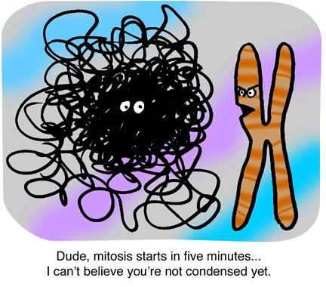
Think about organizing 6ft of DNA in a tiny cell for every division!

Slide 3
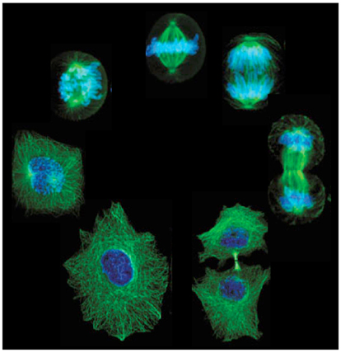

Slide 4
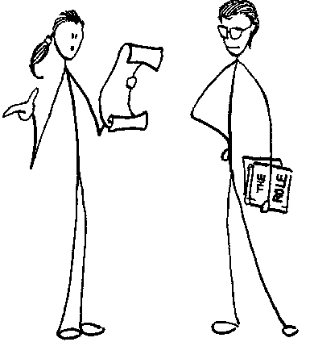

2n- diploid
1n gamete
1n gamete
2n- diploid cell
Mitosis
DNA Replication
2n- diploid

Slide 5
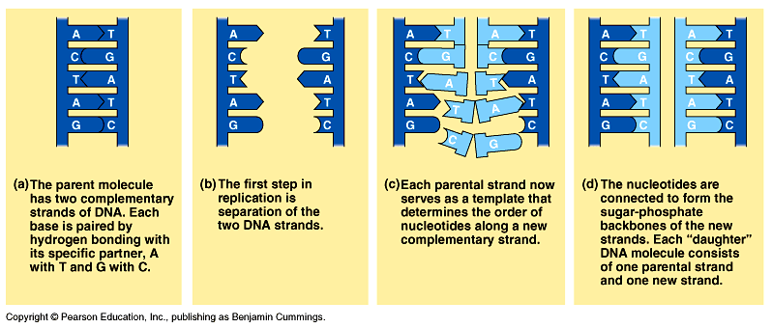
Parent Strand/ Template Strand
Synthesis of daughter strand from template strand or parent strand
Semi conservative

Slide 6
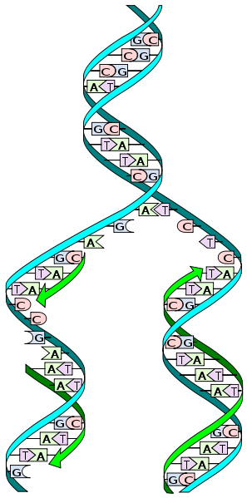
Notes:
Which is which? Template? Daughter? semiconserative

Slide 7
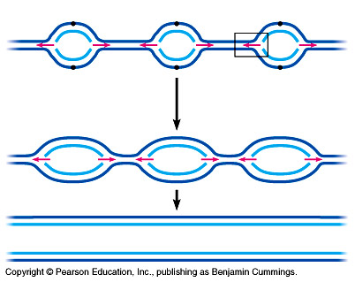

Slide 8
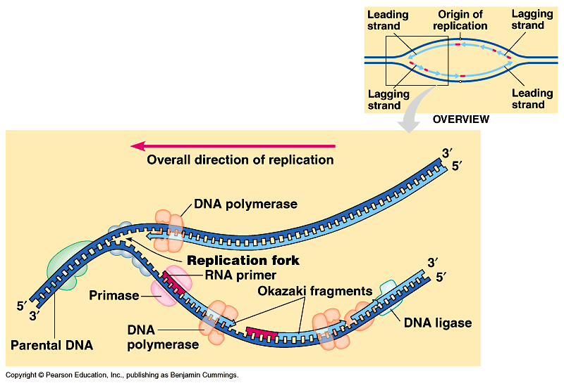

Slide 9
