Slide 1
Enzymes
teeny, tiny molecular machines that can do everything- more efficiently
Energy of activation, substrate, enzyme substrate complex, Lock and key model, active site

Slide 2
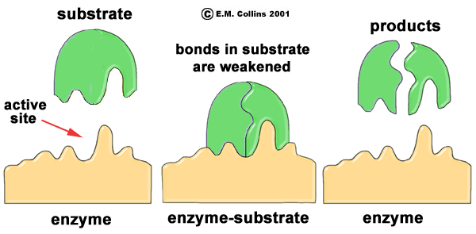
Enzyme
A
B

Slide 3
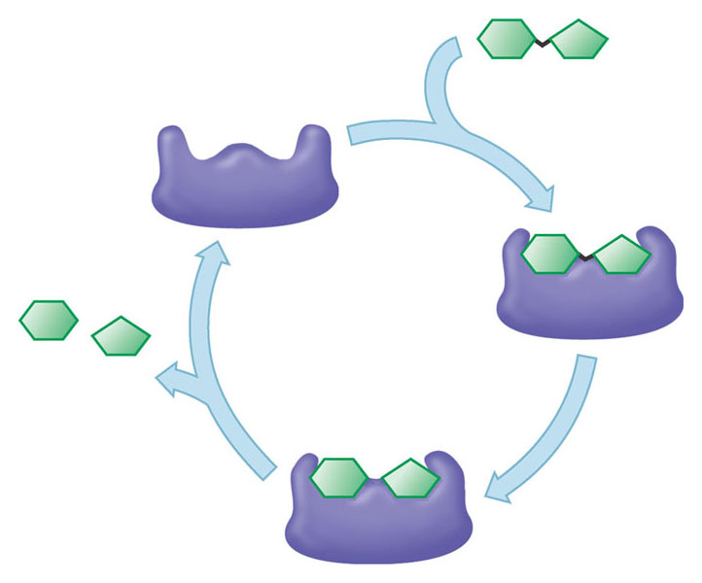

Slide 4
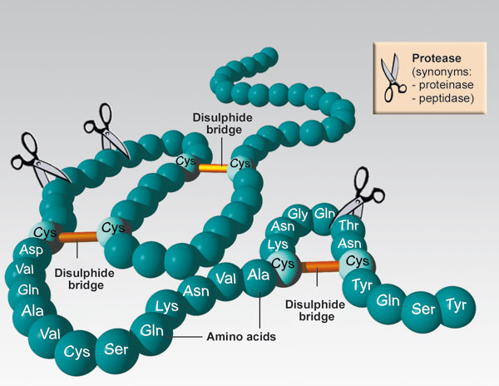

Slide 5
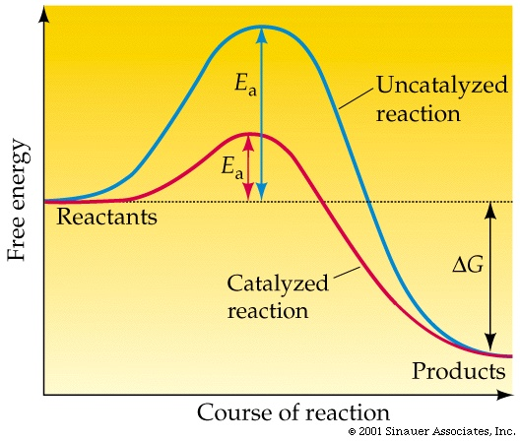
Notes:
How do enzymes work? By lowering the energy of activation necessary for a chemical reaction to occur
Blue tip matches

Slide 6
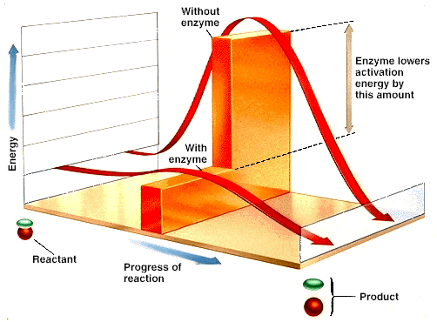

Slide 7
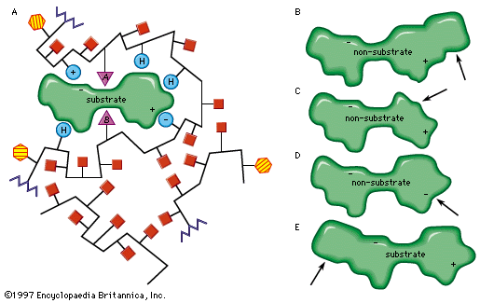

Slide 8
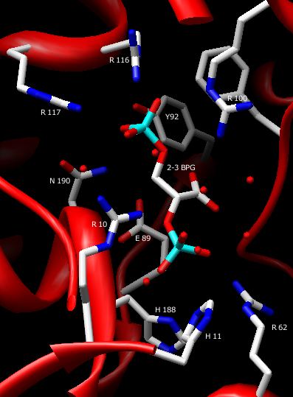

Slide 9
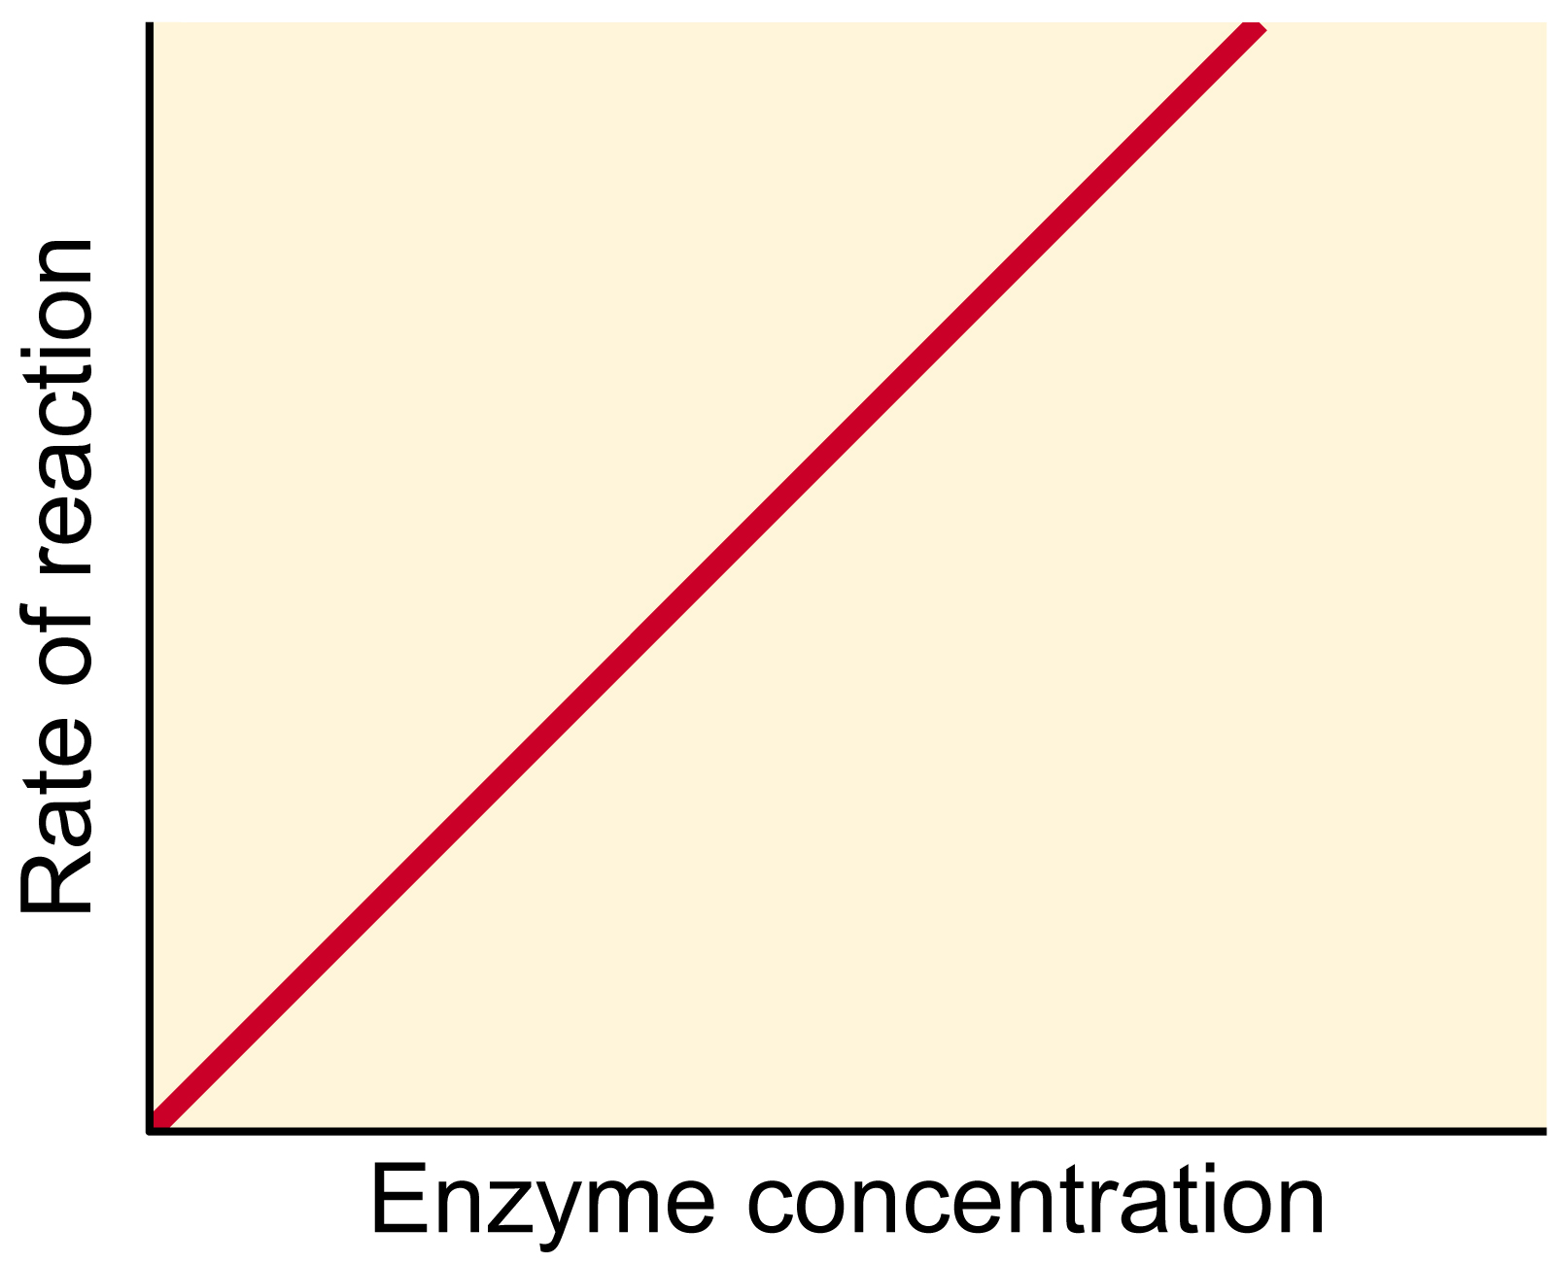
Notes:
How do enzymes work
Rate of reaction (product produced) will continue to go up as you add enzyme

Slide 10
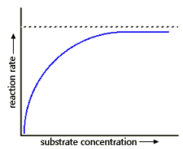

Slide 11
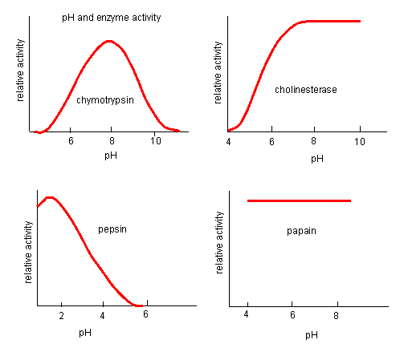
Notes:
Highly sensitive

Slide 12
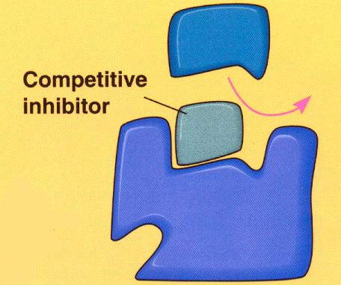
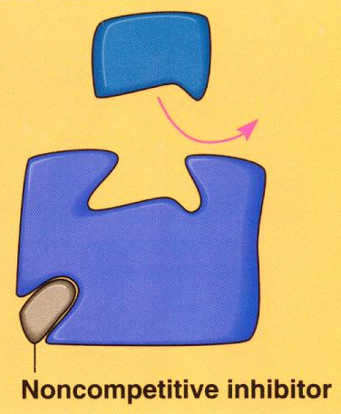

Slide 13
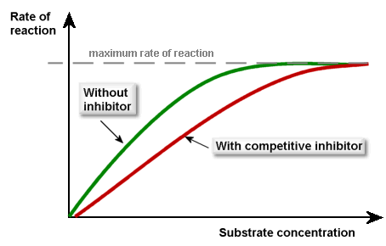

Slide 14
