Slide 1
Enzymes
teeny, tiny molecular machines that can do everything- more efficiently
Energy of activation, substrate, enzyme substrate complex, Lock and key model, active site

Slide 2
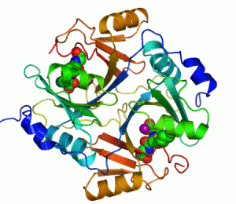
Enzymes
Catalyst
Sensitivity
pH, Temp, Heat, Salt
Lowers the energy of activation of a chemical reaction.
Specificity
Lock ‘n Key
Substrate
Active Site

Slide 3
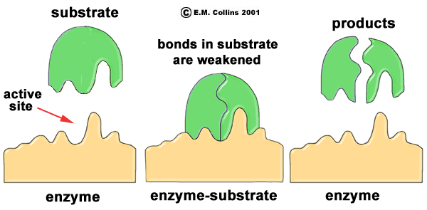
Enzyme
A
B

Slide 4
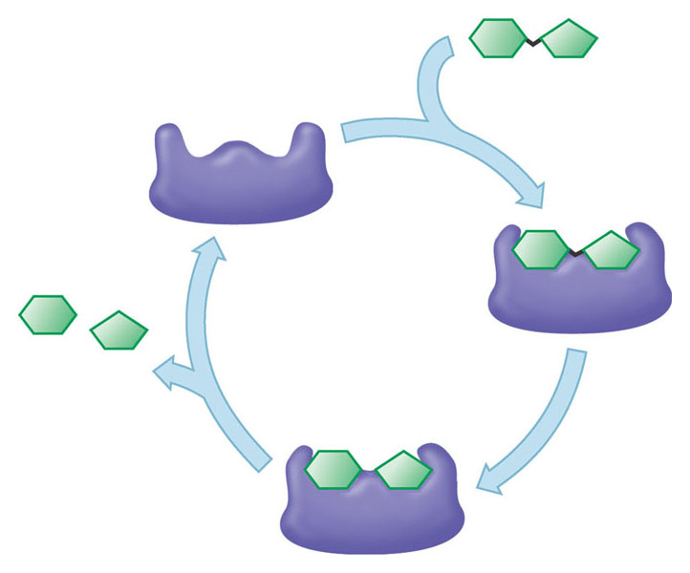

Slide 5
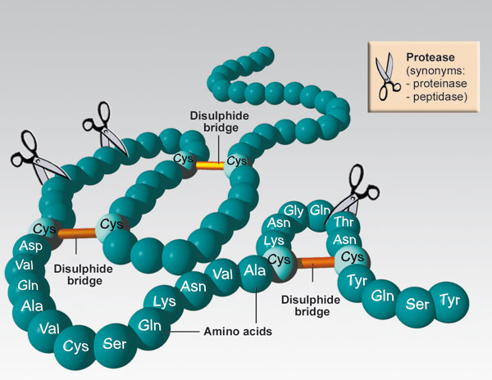
Notes:
Where is the substrate? What is the enzyme in this picture?

Slide 6
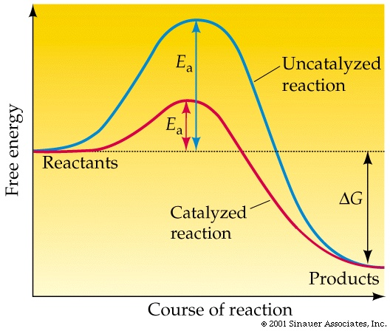
Notes:
How do enzymes work? By lowering the energy of activation necessary for a chemical reaction to occur
Blue tip matches

Slide 7
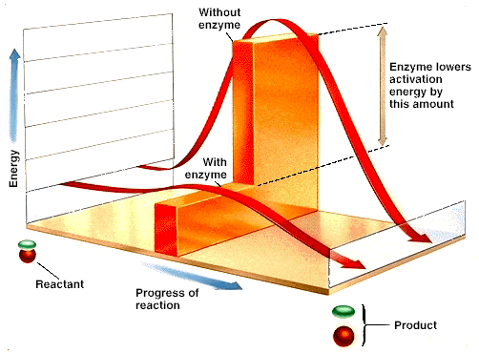

Slide 8
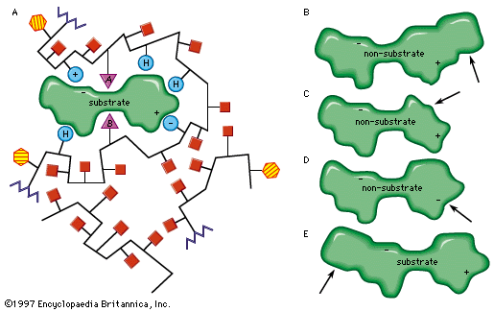

Slide 9
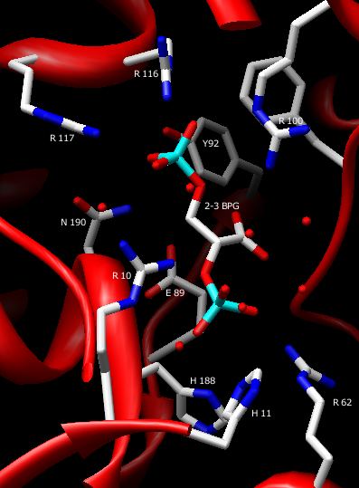

Slide 10
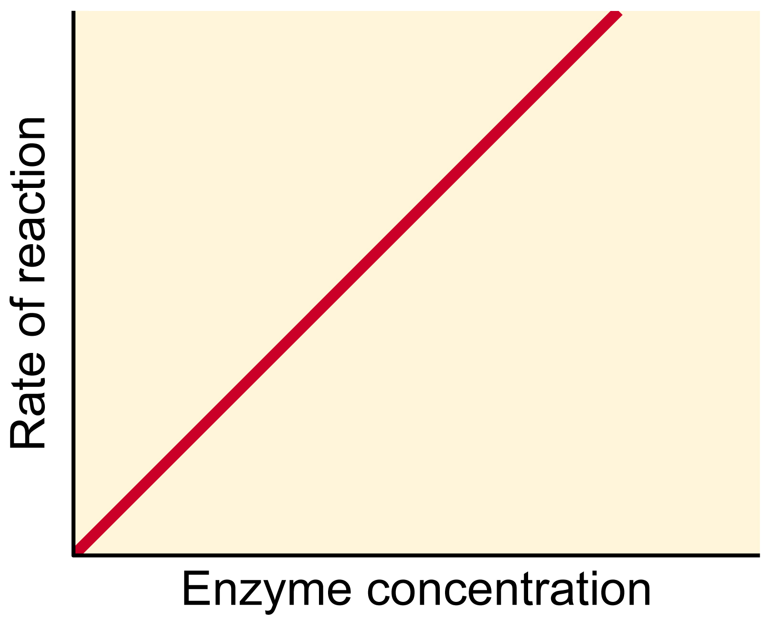
Notes:
How do enzymes work
Rate of reaction (product produced) will continue to go up as you add enzyme

Slide 11
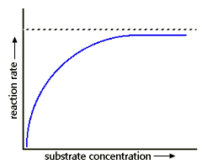

Slide 12
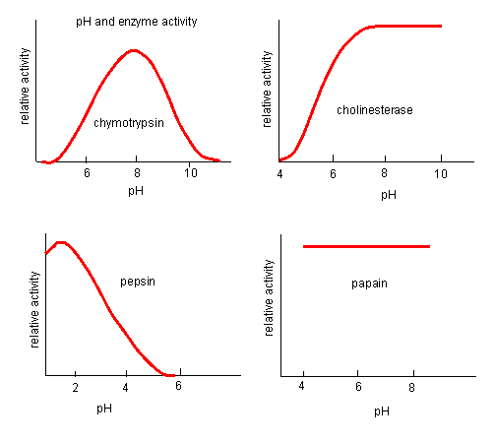
Notes:
Highly sensitive

Slide 13
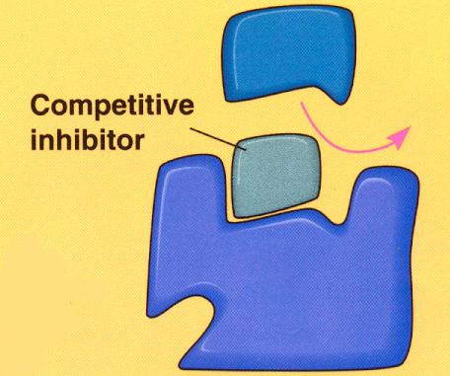
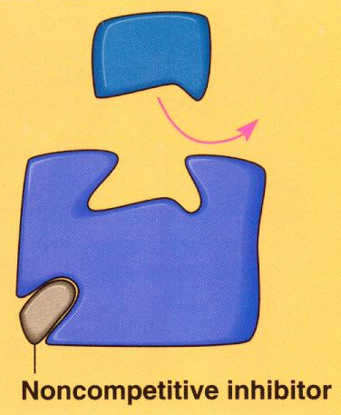

Slide 14
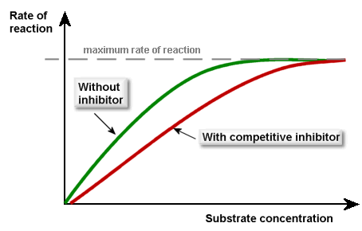

Slide 15
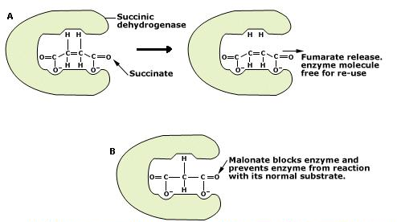
Notes:
Explain this diagram

