Slide 1
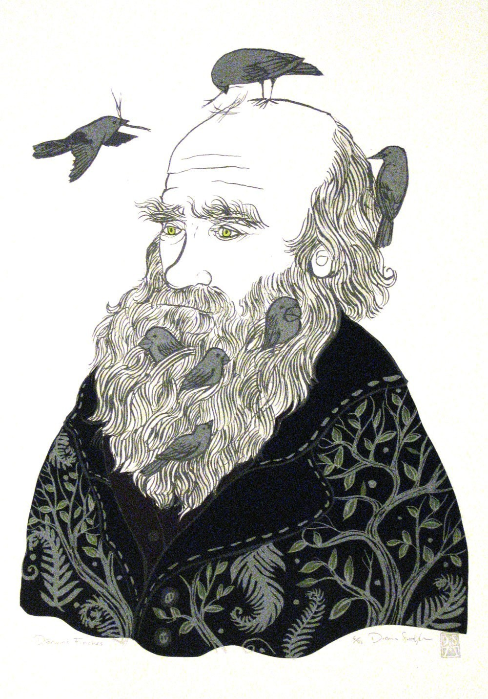
BIG IDEA 1: Evolution
Evolution as a Process
Selection as a Mechanism
Evidence for Evolution
HW Equilibrium
Speciation
Origin of Life

Slide 2
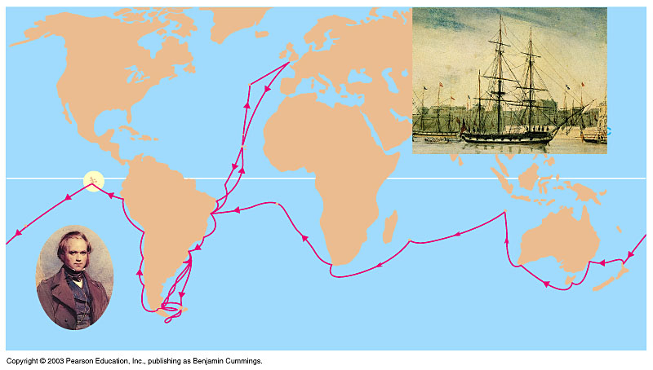
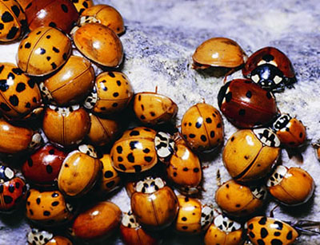
  Living things change, or evolve over generations & living species descended from earlier life-forms: descent with modification
I have called this principle, by which
each slight variation, if useful, is preserved,
by the term Natural Selection.
—Charles Darwin from "The Origin of Species"
Population → Variation → Selection→ Reproduction→ Change in population over time leading to new species

Slide 3
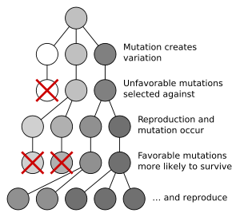
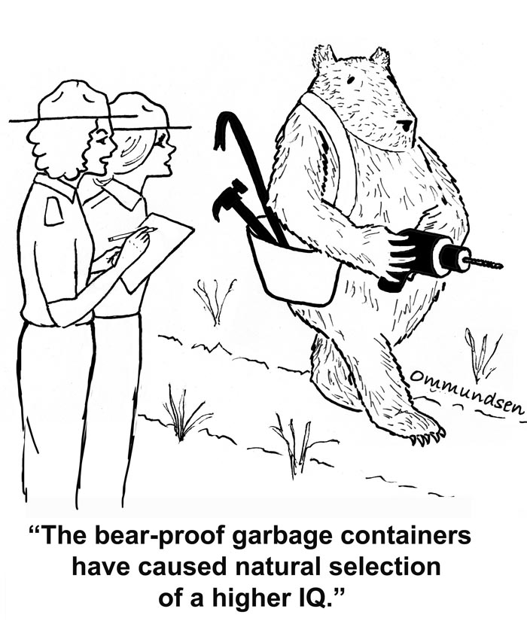
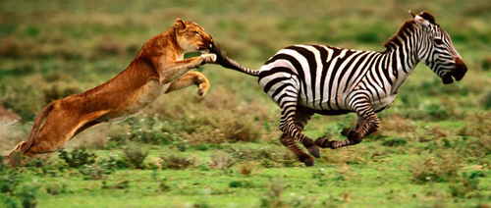
  Natural selection
  Results in favored traits being represented more and more and unfavored ones less and less in ensuing generations of organisms
0

Slide 4
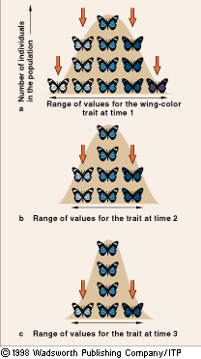
Selection Against or in Favor of Extreme Phenotypes
Stabilizing Selection
  Intermediate forms of a trait are favored
  Alleles that specify extreme forms are eliminated from a population
  Birth Weight and Clutch Size

Slide 5
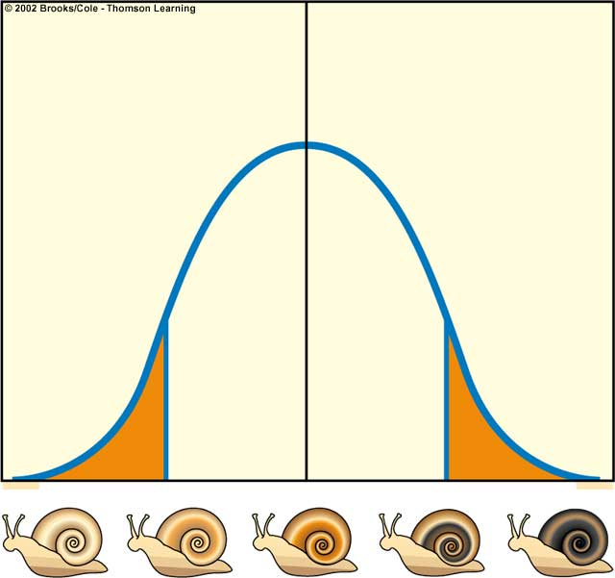
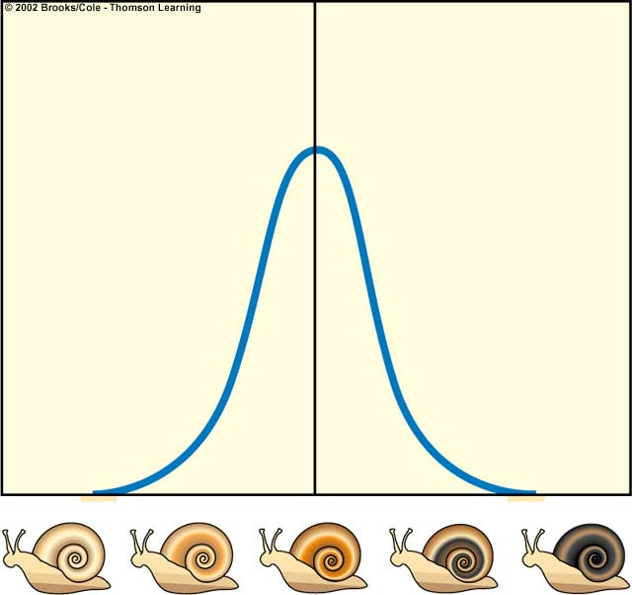
Stabilizing Selection
Light snails
eliminated
Dark snails
eliminated
Natural
selection
Snails with
extreme
coloration are
eliminated
Number of individuals
Number of individuals
Coloration of snails
Coloration of snails
Average remains the same
Number of individuals with intermediate coloration increases
Selection against extremes

Slide 6
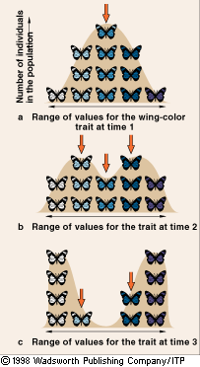
Selection Against or in Favor of Extreme Phenotypes
Disruptive Selection
  Both forms at extreme ends are favored
  Intermediate forms are eliminated

Slide 7
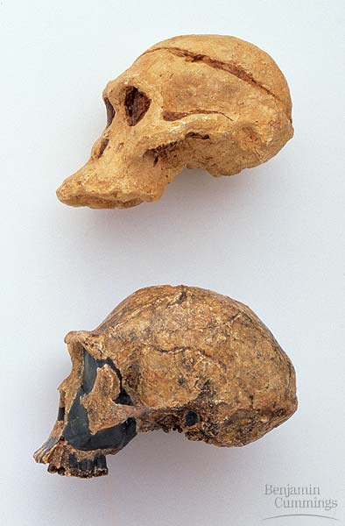
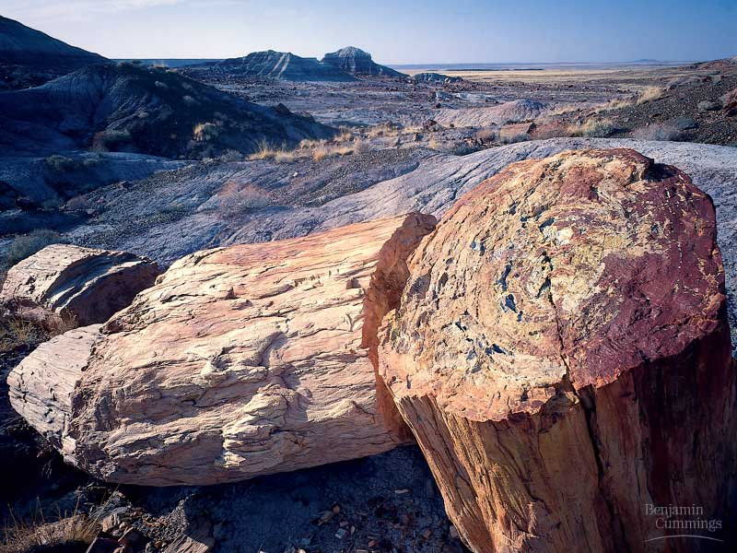
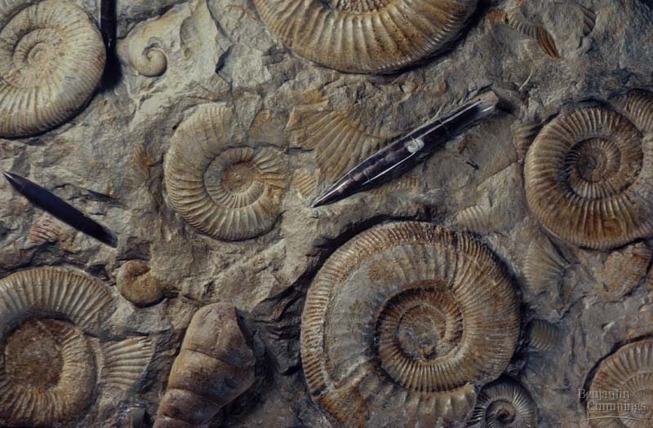
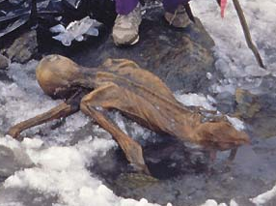
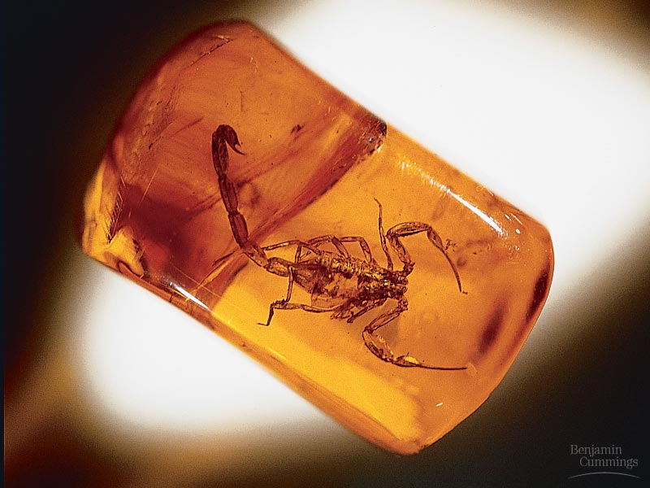
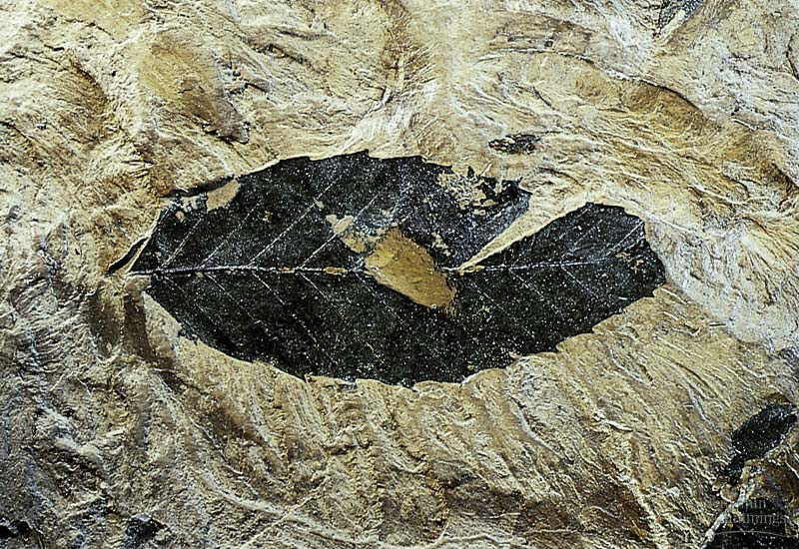
Evidence for Evolution

Slide 8
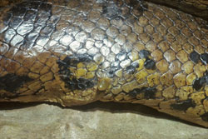
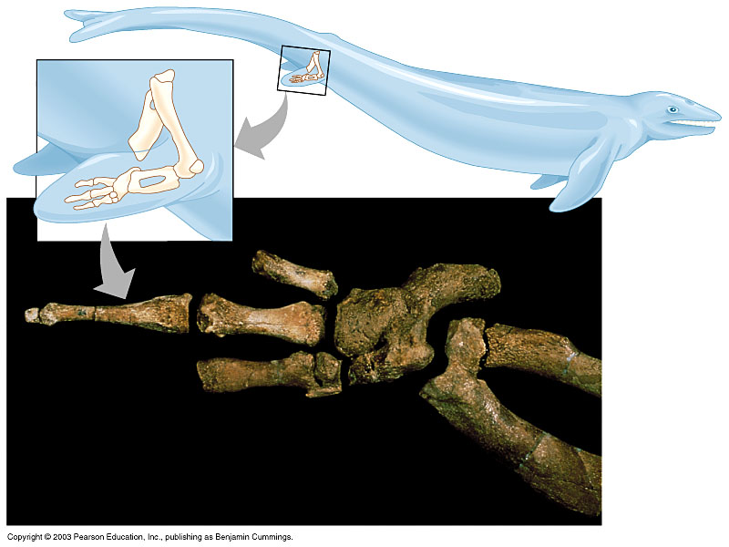
Vestigial Structures

Slide 9
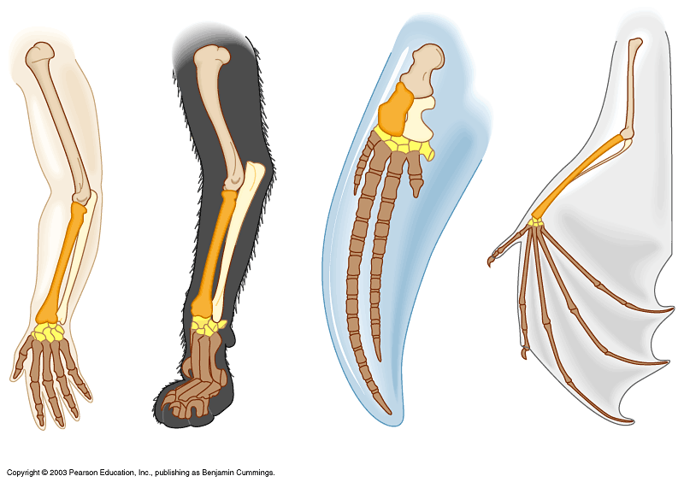
Analogous structures- same structural origin but has evolved different functions

Slide 10
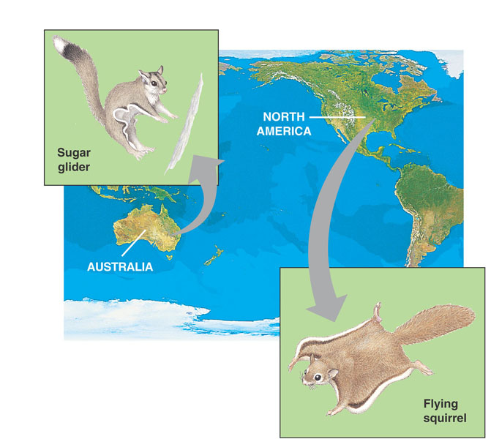
Convergent Evolution

Slide 11
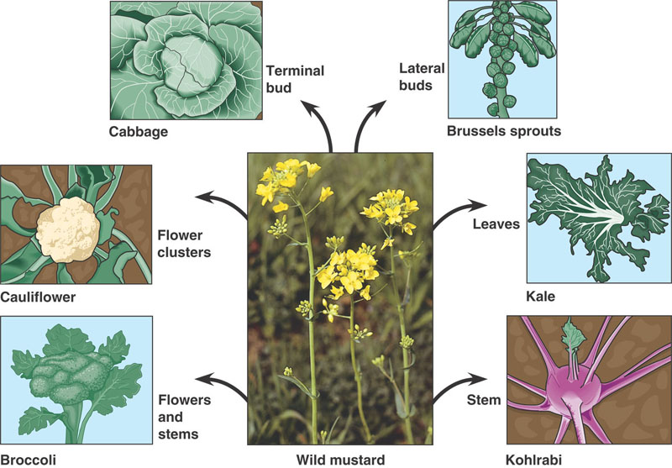
Artificial Selection

Slide 12
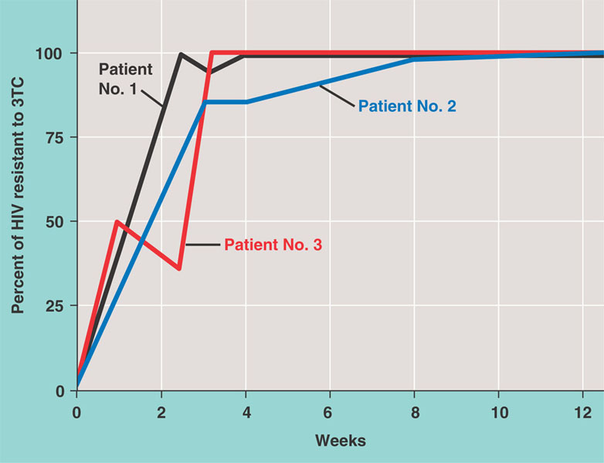
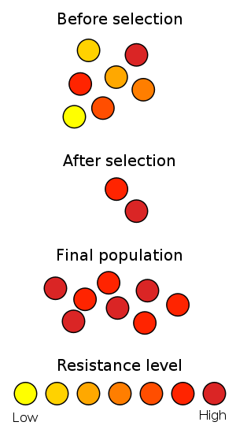
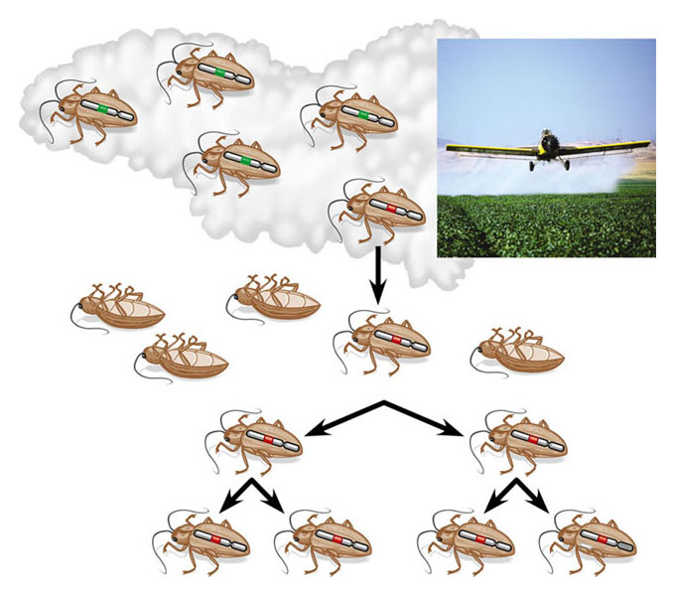
Pesticide application
Survivor

Slide 13
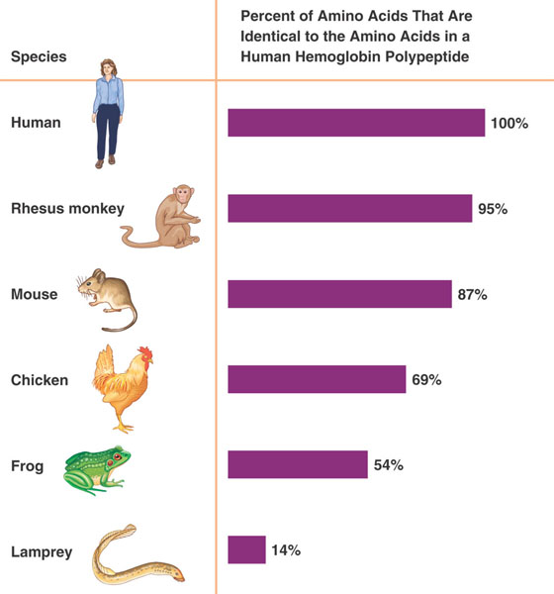

Slide 14
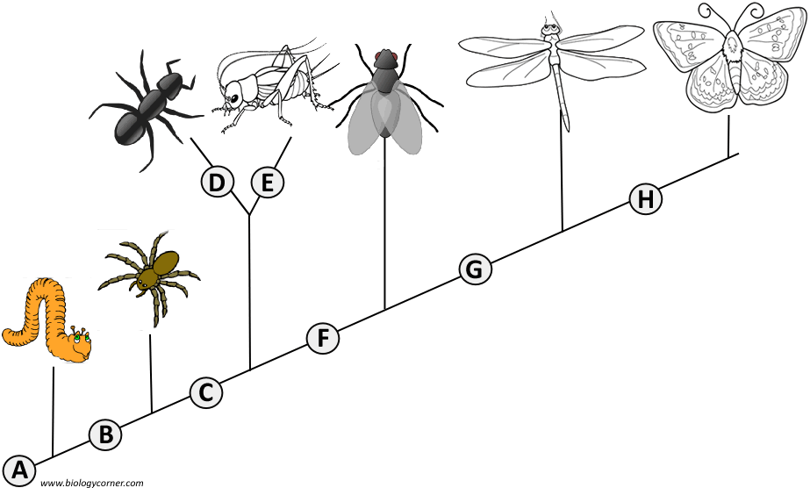
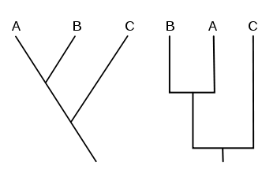
Cladograms:

Slide 15
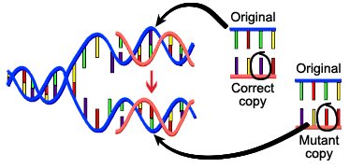
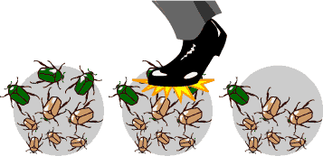
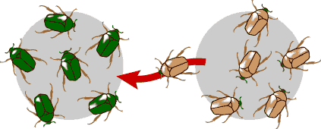
Creates new alleles
MUTATION
Chance!
GENETIC DRIFT
GENE FLOW - MIGRATION
Exchange of alleles

Slide 16
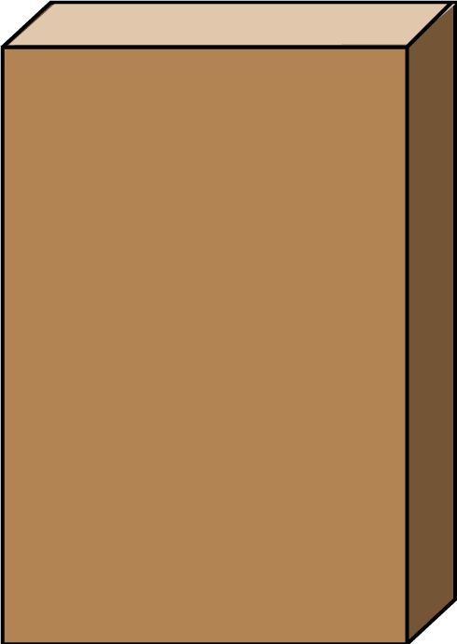


Summary of Evolution of Life
Chemical Evolution
(1 billion years)
Formation
of the
earth’s
early
crust and
atmosphere
Small
organic
molecules
form in
the seas
Large
organic
molecules
(biopolymers)
form in
the seas
First
protocells
form in
the seas
Biological Evolution
(3.7 billion years)
Single-cell
prokaryotes
form in
the seas
Single-cell
eukaryotes
form in
the seas
Variety of
multicellular
organisms
form, first
in the seas
and later
on land

