Slide 1
Membrane Dynamics
Vocabulary, ICF, ECF, Receptor, transport protein, Extracellular Matrix, Passive diffusion, Facilitated Diffusion, Active Transport, Pinocytosis, Phagocytosis, Receptor Mediated endocytosis, Turgor pressure, Hypotonic, Hypertonic, Isotonic, plasmolysis, lysis,

Slide 2
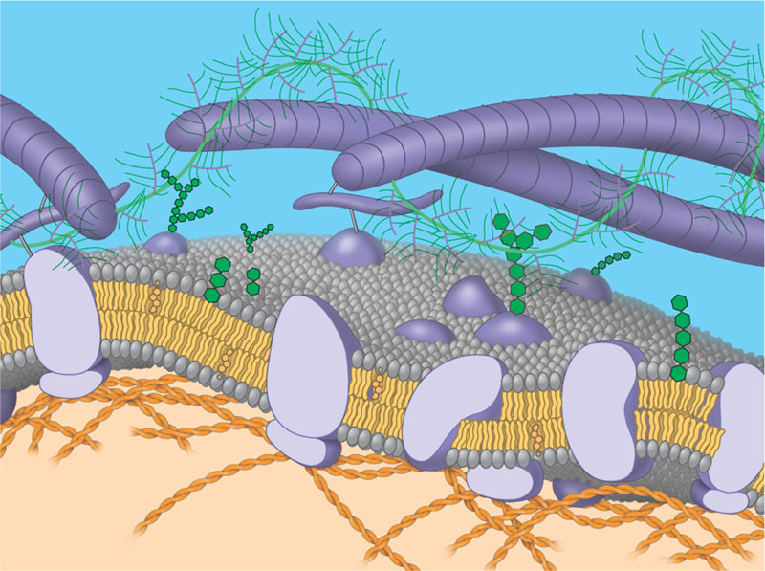

Slide 3
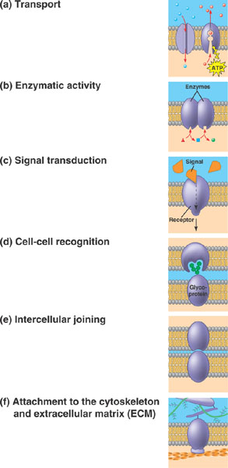

Slide 4
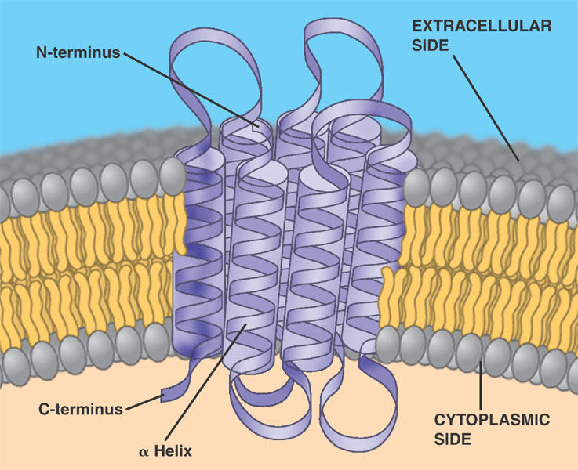

Slide 5
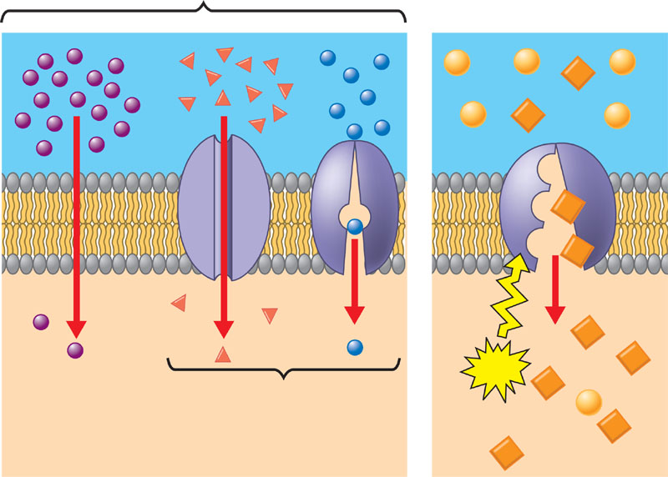

Slide 6
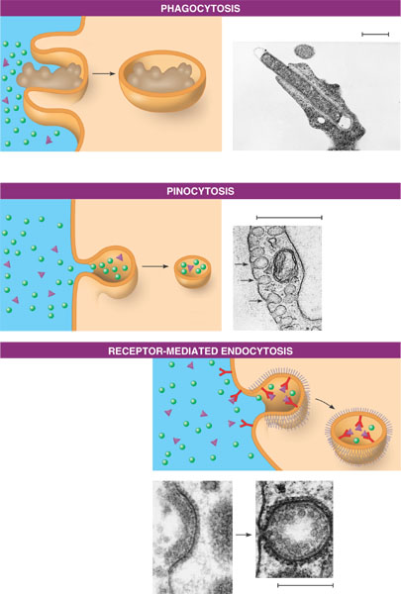

Slide 7
