Slide 1
Membrane Dynamics
Vocabulary, ICF, ECF, Receptor, transport protein, Extracellular Matrix, Passive diffusion, Facilitated Diffusion, Active Transport, Pinocytosis, Phagocytosis, Receptor Mediated endocytosis, Turgor pressure, Hypotonic, Hypertonic, Isotonic, plasmolysis, lysis,

Slide 2
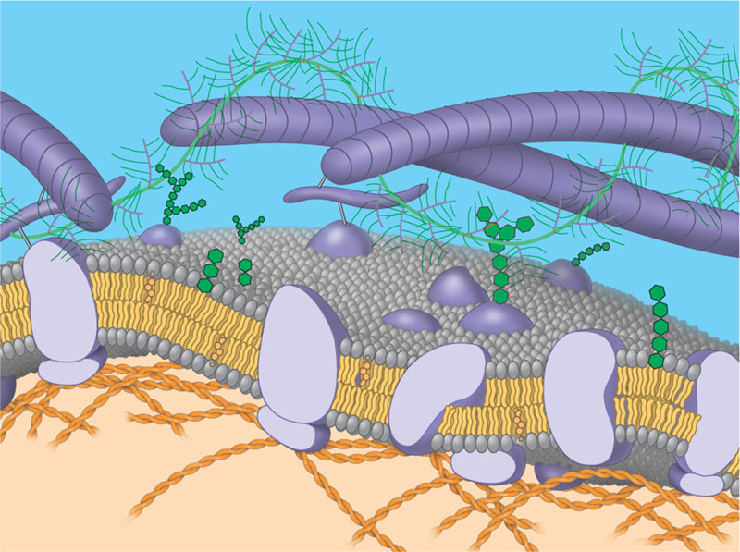

Slide 3
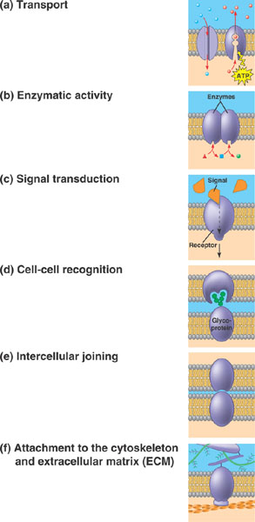
A
B
C
D
E
F
Notes:
Which matches signal transduction? Enzymatic activity? Cell recognition?

Slide 5
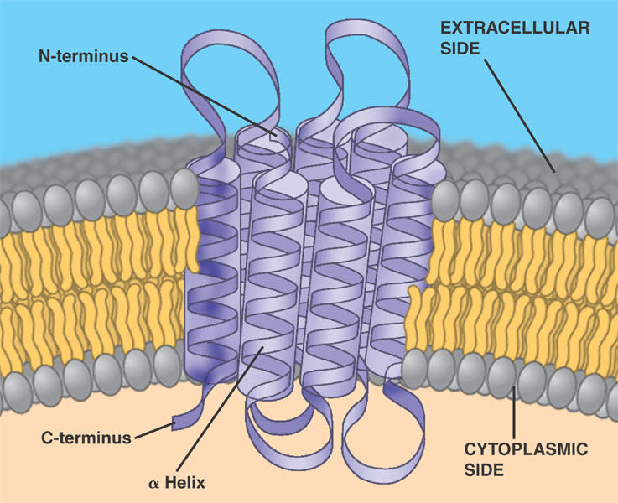

Slide 6
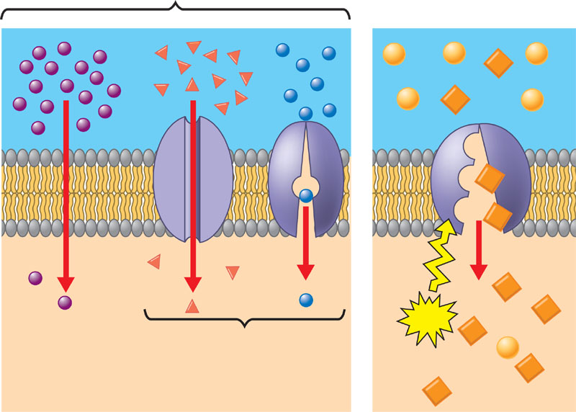

Slide 7
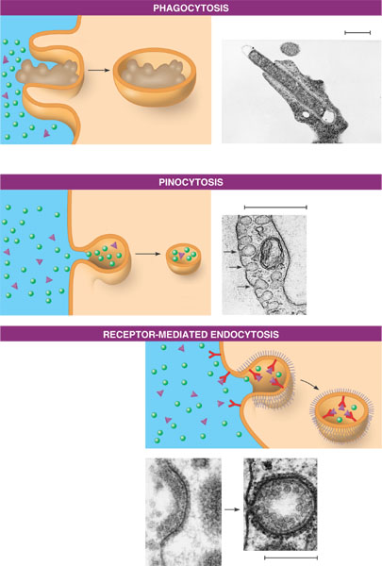

Slide 8
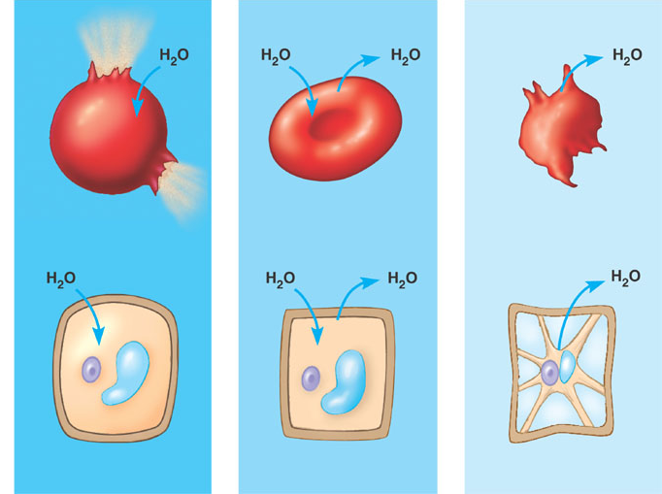
A
B
C
D.
E.
F.

