Slide 1
Genetics
Mendel and more

Slide 2
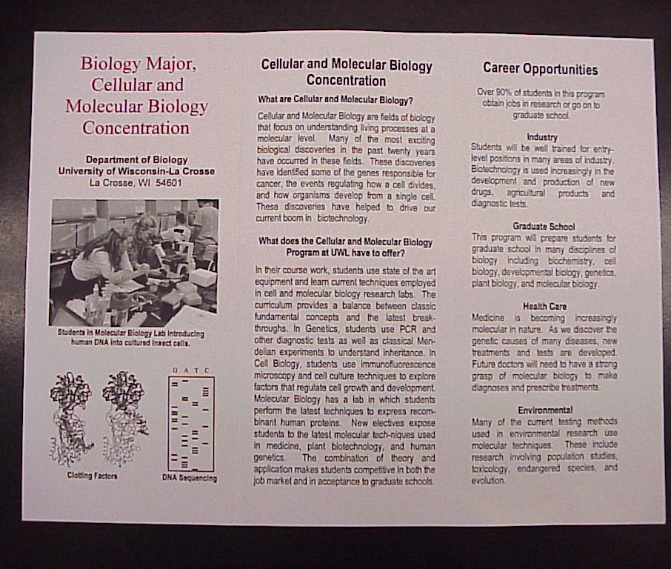
Pamphlet Project
What information should be in the brochure?
If diagnosed in my family, what should I know?
What is the disease?
What are its effects?
How is the disease inherited?
How did I/my child get this?
Likelihood of having other affected children?
Is there a genetic test for the disease?
How is disease diagnosed? Symptoms?
What is the prognosis for affected individuals?
What treatments are available?
How common is the disease?
This allele more common in particular population?
What is the current state of research for this disease?
What is the mechanism of the disorder?
What does the normal version of the gene do?
Where is the gene located?
Brochure should include list of websites, support groups, etc.
Note the paper size and six columns of information.
Text and images should well balanced.
All images should have captions and explanations.

Slide 3
CATEGORY | Excellent | Good | Satisfactory | Needs Improvement
Content - Accuracy | All facts in the pamphlet are accurate. Pamphlet contains 100% information specified by the checklist. | 75% of the facts in the pamphlet are accurate. Pamphlet contains 75% information specified by the checklist. | 50% of the facts in the pamphlet are accurate. Pamphlet contains 50% information specified by the checklist. | Fewer than 50% of the facts in the pamphlet are accurate. Pamphlet contains less that 50% of the information specified by the checklist.
Writing - Organization | Each section in the pamphlet has a clear beginning, middle, and end. The pamphlet has exceptionally attractive formatting. | Almost all sections of the pamphlet have a clear beginning, middle and end. The pamphlet has attractive formatting and well-organized information. | Most sections of the pamphlet have a clear beginning, middle and end. The pamphlet has well-organized information. | Less than half of the sections of the pamphlet have a clear beginning, middle and end. The pamphlet's formatting and organization of material are confusing to the reader.
Attractiveness Neatness | The pamphlet is neatly done. | The pamphlet has one or two areas that are sloppy. | The pamphlet has three or four areas that are sloppy. | The pamphlet's work is Illegible.
Graphics Pictures | Graphics go well with the text and there is a good mix of text and graphics All graphics are labeled and connect and support the text.. | Graphics go well with the text, but there are so many that they distract from the text. | Graphics go well with the text, but there are too few and the brochure seems "text-heavy". | Graphics do not go with the accompanying text or appear to be randomly chosen.

Slide 4
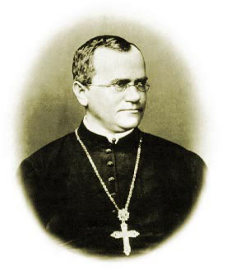
Father of Genetics

Slide 5
MENDELIAN INHERITANCE
Vocabulary: true-breeding, self-fertilize, Parent generation, F1 generation, F2 generation, Monohybrid cross, alleles, homozygous, heterozygous, recessive allele, Punnett square, genotype, phenotype, dihybrid cross, law of independent assortment, testcross
Mendel’s Law of Segregation
A gamete carries only one allele for each gene pair
BECAUSE allele pairs segregate during meiosis.
When egg and sperm unite (and diploid condition) returns each contributes its allele restoring the paired condition in the offspring.

Slide 6
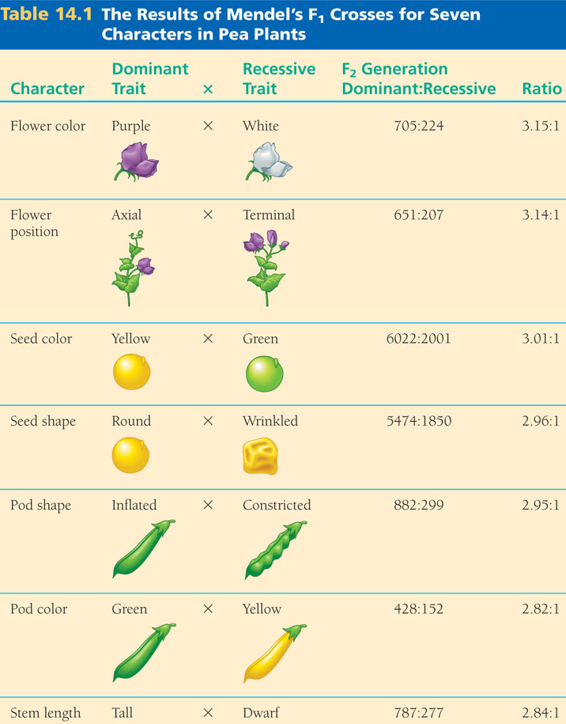

Slide 7
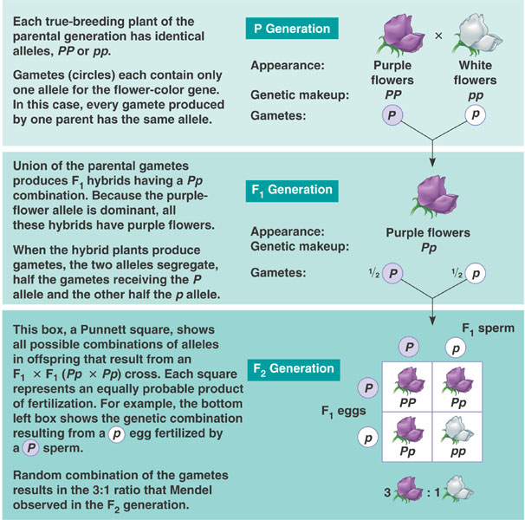

Slide 8
Edward was found to be heterozygous for sickle cell anemia trait. The alleles represented by the letter S and s are ---.
On the X and the Y chromosome
Linked
On homologous chromosomes
Both present in EACH of Edward’s gametes.
On the same chromosome but really far apart.

Slide 9
Tim and Jane both have freckles (dominant) but their son does not. Draw the correct Punnett Square representing this cross.

Slide 10
Both Tim and Jane have a widow’s peak (a dominant trait) which is inherited through a typical Mendelian pattern but Mike has a straight hairline. Which of the following best describes their genotypes, respectively?
WW, WW, Ww
WW, WW, WW
Ww, Ww, Ww
Ww, Ww, ww
Both C and D are correct

Slide 11
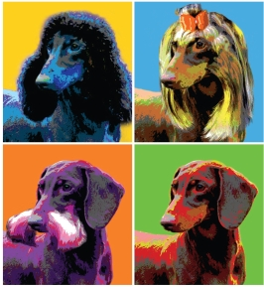
The Dog Genome
Project

Slide 12
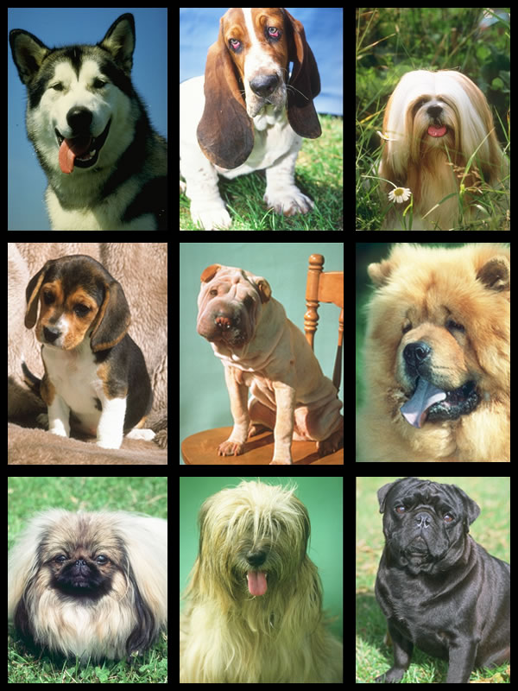
Over 150 breeds are registered with the American Kennel Club
but there are actually more than 400 different breeds.
How did this great variety occur?

