Slide 1
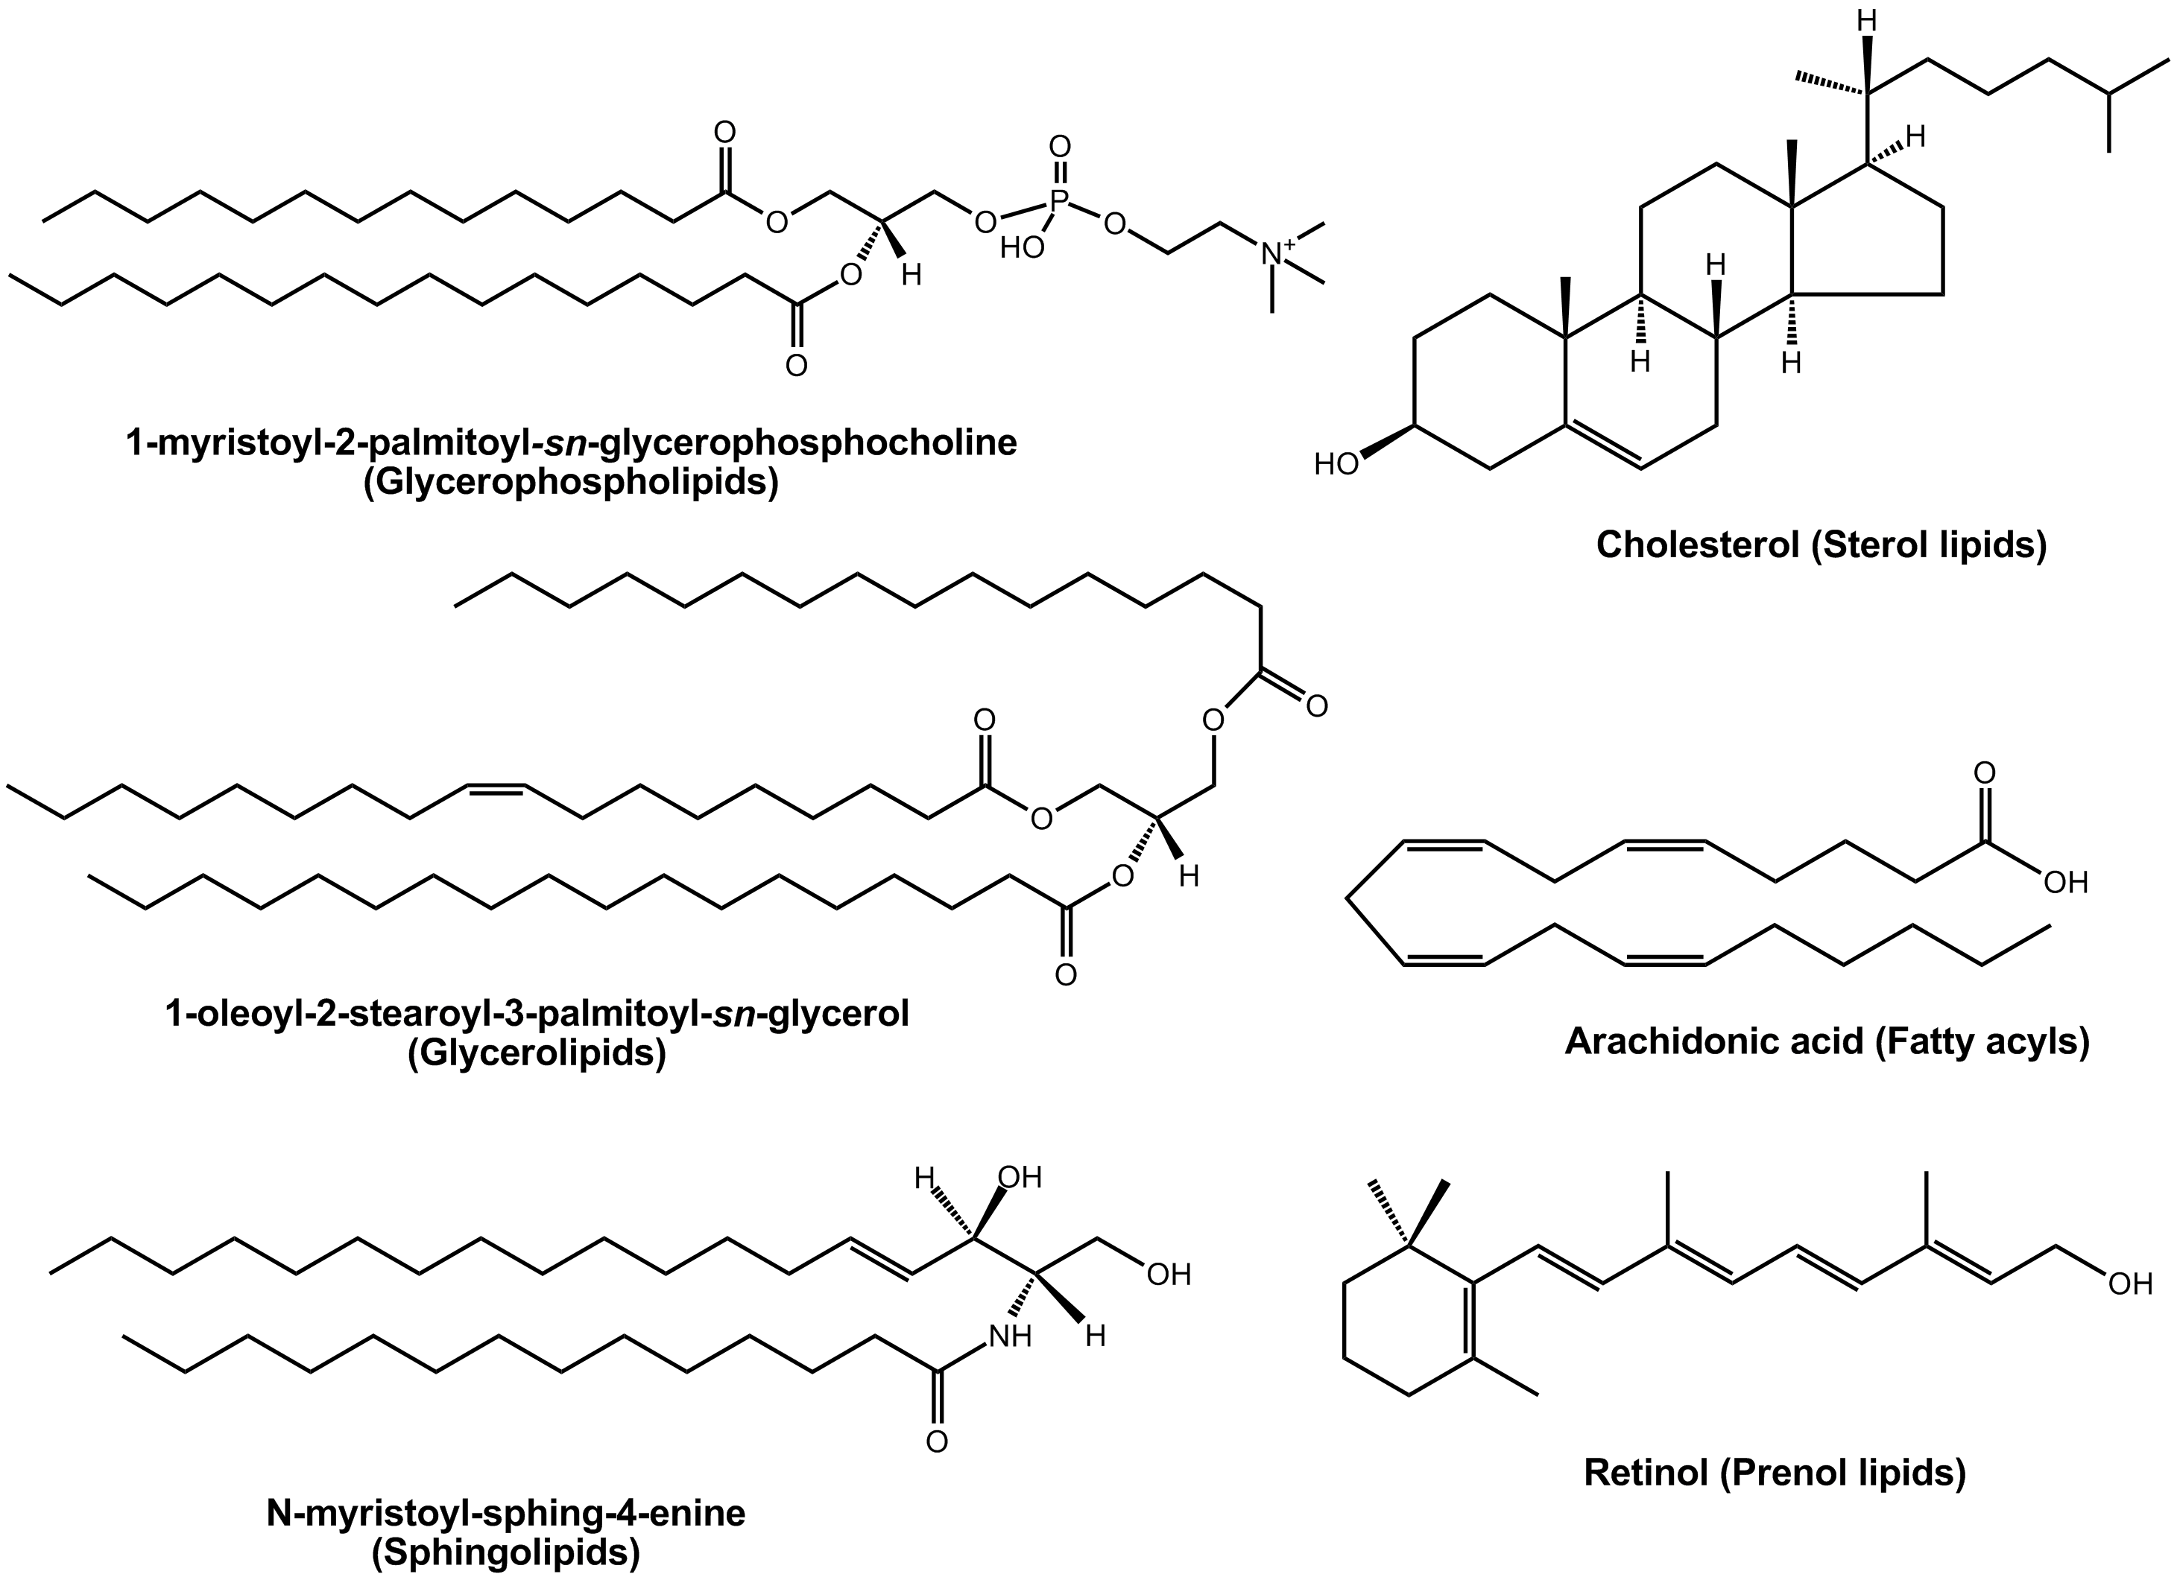

Slide 2
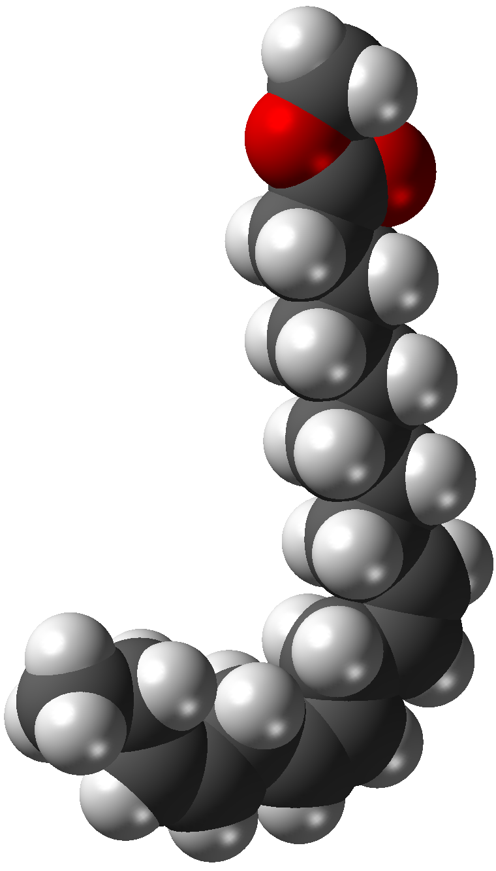
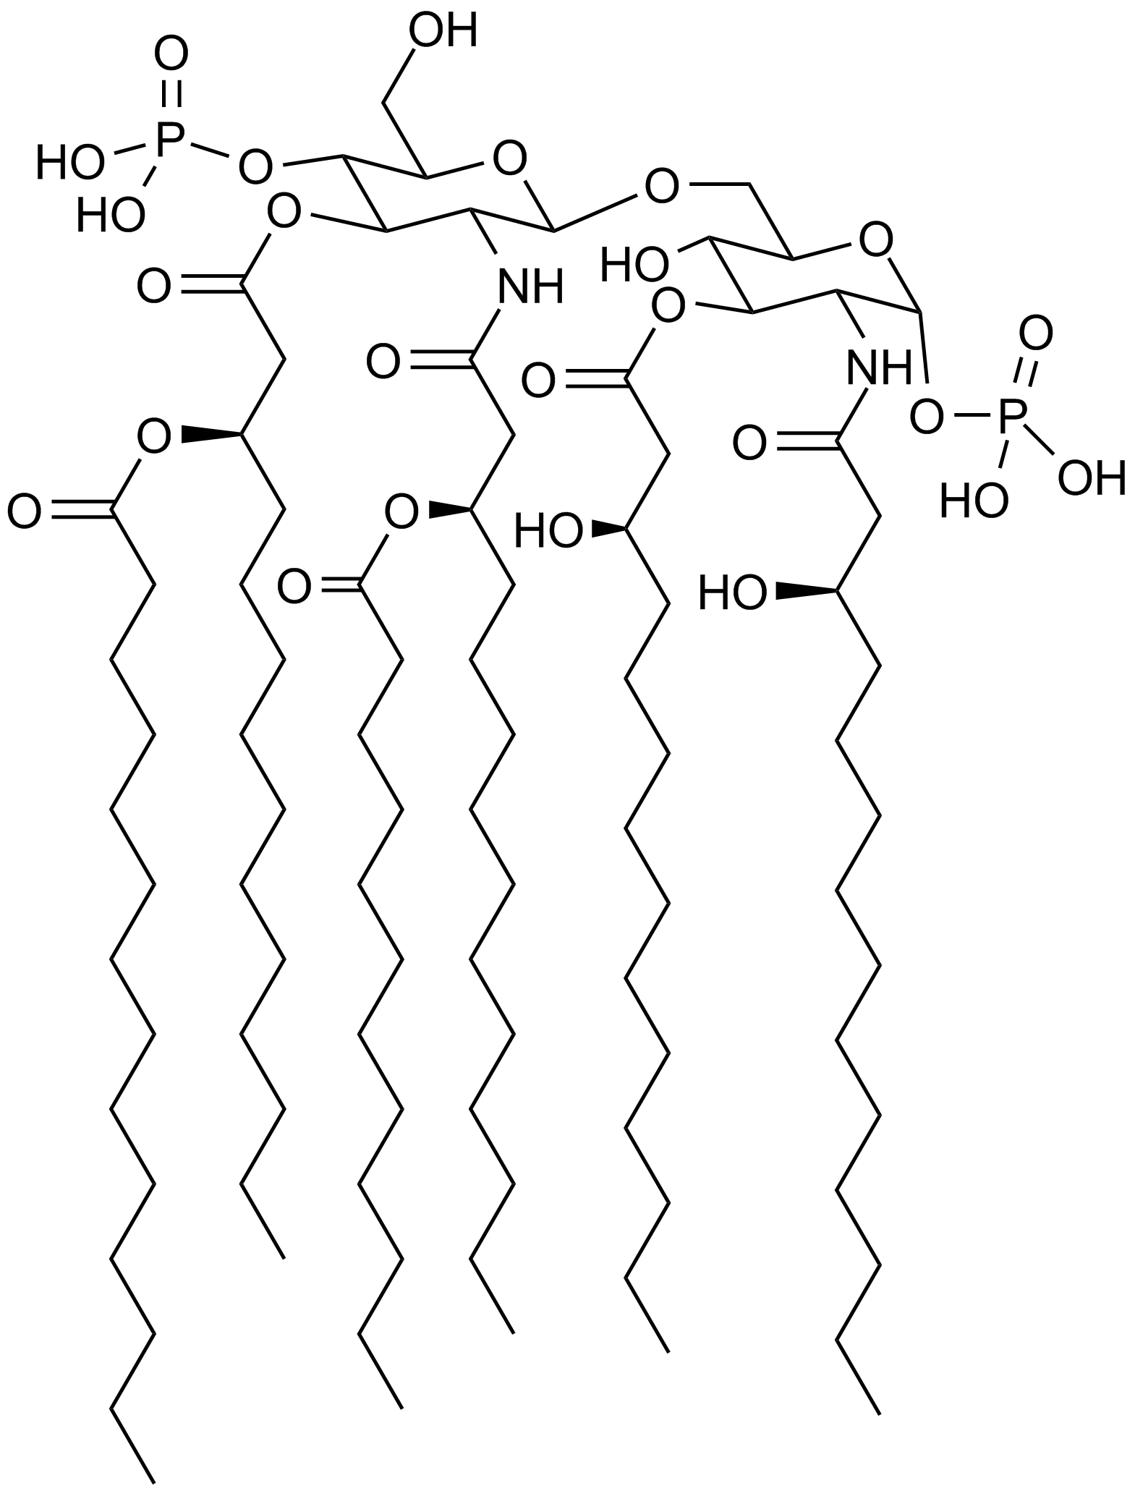
Chemical structure of the saccharolipid lipid A as found in E. Coli. Polar or Non Polar?
Methyl Linolenate

Slide 3
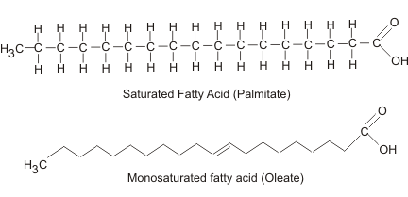

Slide 4
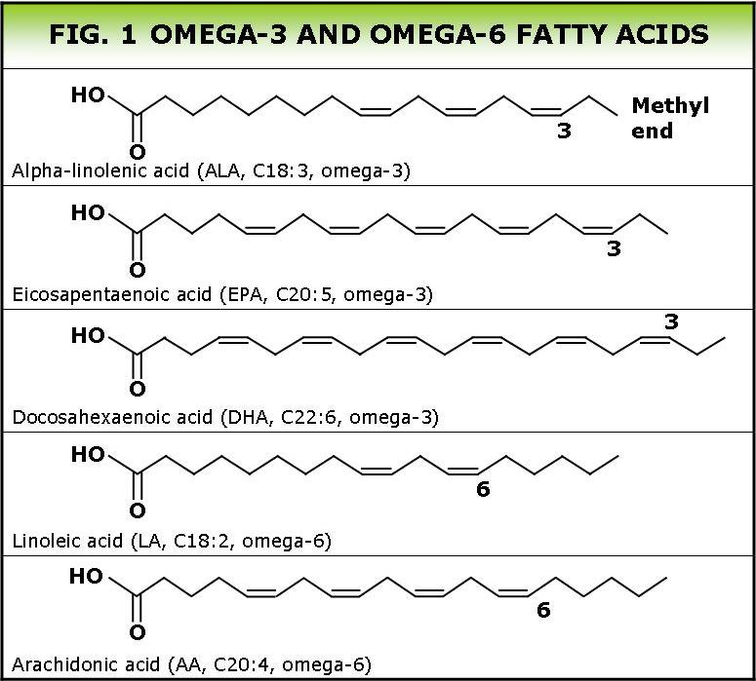

Slide 5
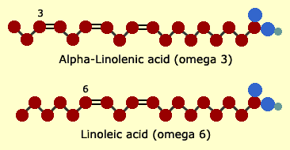

Slide 6
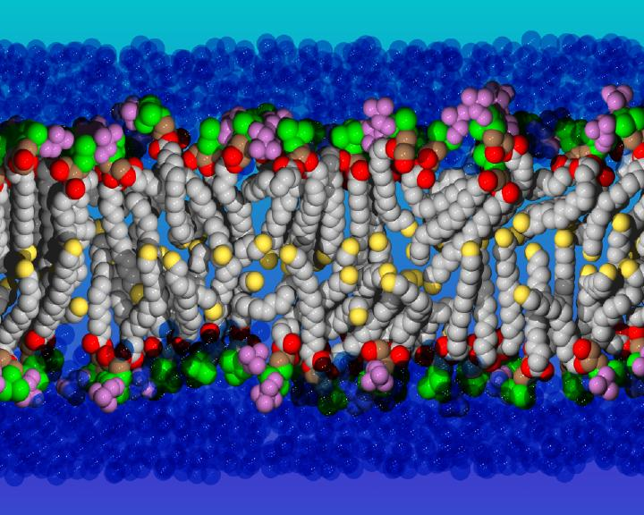
https://webspace.utexas.edu/yg387/lipid.jpg

Slide 7
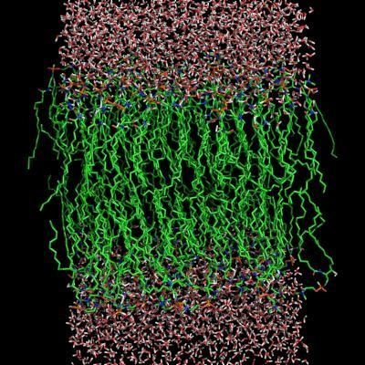

Slide 8
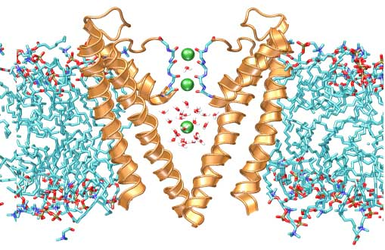
Transport Protein in a Lipid Membrane
http://sbcb.bioch.ox.ac.uk/gallery/stick_lipid.php

Slide 9
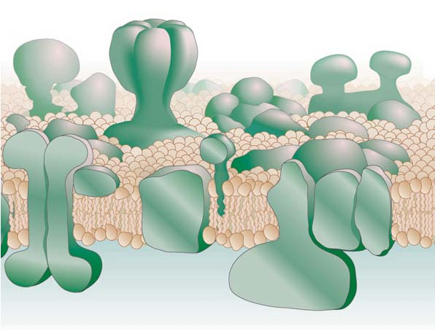

Slide 10
What elements are found in lipids?
What two chemicals combine to form a lipid?
Find three uses of lipids in living things.
What is the chemical difference between a saturated and an unsaturated fat?
What is the biological significance of unsaturated fats?
Find the structural difference of omega-3 oils or fatty acid. Why are they a “hot topic” right now?
Notes:
Several unsaturated fatty acids are essential including Oleic acid, Linoleic acid
and Linolenic acid. Fats are also required in the diet because they are used by the body to make important hormone and steroid compounds and regulators called eiconsanoids. Vitamin D can be made from cholesterol by body under certain circumstances.
Butter and Margarine contain the same amount of fat, water and other compounds. The only difference is the source of the fat. By law products containing less than 80% fat cannot be called margarine or butter but must be called spreads.
If the food industry wants to make a spread from oils that are liquid at room temperature, it raises its melting point by changing some of the double bonds in an unsaturated or polyunsaturated fatty acid (PUFA) into single bonds by adding hydrogen. This saturation process is called hydrogenation.
The terms alpha and omega are used to help identify location of structure on fatty acid structure. Alpha is used to count carbon atoms from the acid (-COOH) end of the molecule. Omega counts from the CH3 end of the molecule. An Omega 3 acid has a double bond between the third and fourth carbon from CH3 (CH3 being the 1 carbon.) An Omega 6 acid has a double bond between the sixth and seventh carbon from CH3. If there are more than one double bounds Omega refers to the location of the first double bond. If you see nomenclature like 18:3 it means the fatty acid contains 18 carbon atoms and 3 double bonds.

