Slide 2
Review from Last Week
Write the formula for a monosaccharide that has only three carbons.
Show the dehydration synthesis reaction that joins two glucose molecules.
Cow eat grass and gain energy from eating the indigestible cellulose. Mammals do not have the enzyme to digest cellulose.
What would happen if a cow were given antibiotics that killed all the naturally occuring gut fauna?

Slide 3
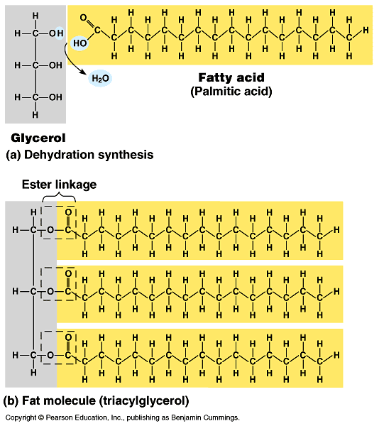
LIPIDS

Slide 4
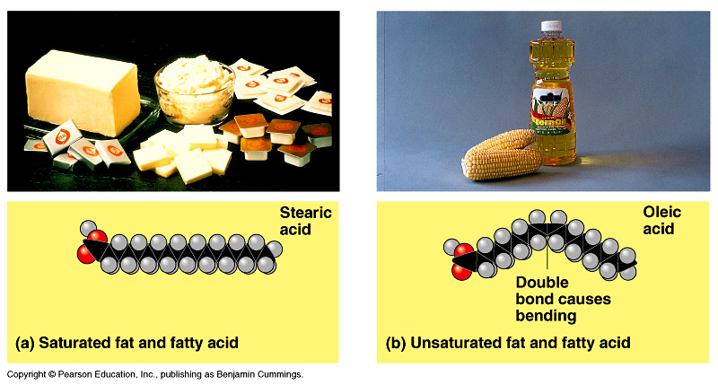
LIPIDS Fats, Oils, and Waxes

Slide 5
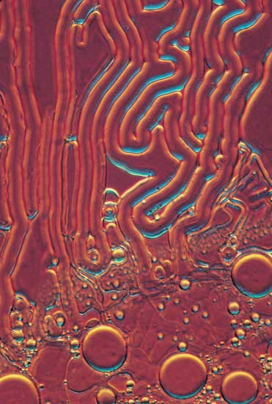
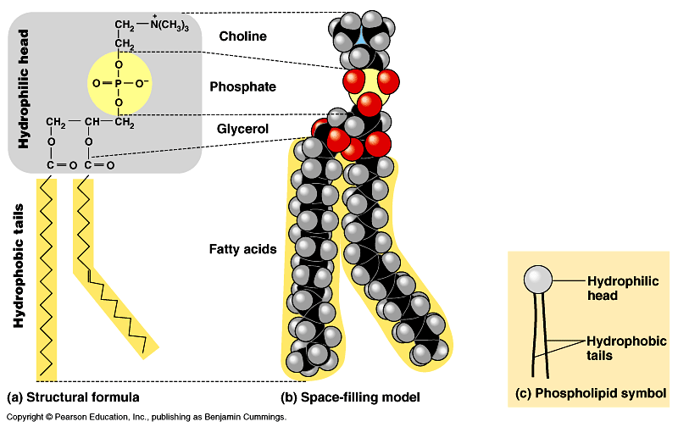

Slide 6
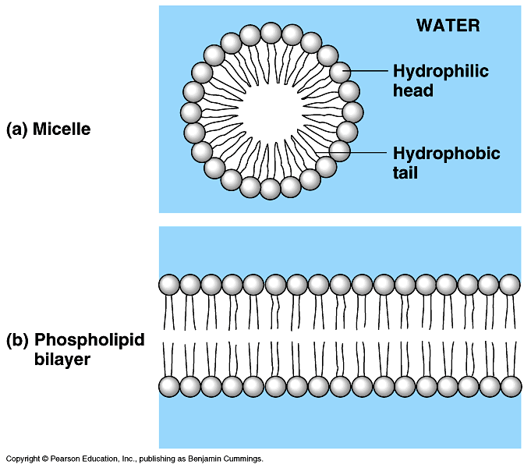

Slide 7
