Slide 1
Water, water, and more water
Why is water polar?

Slide 2
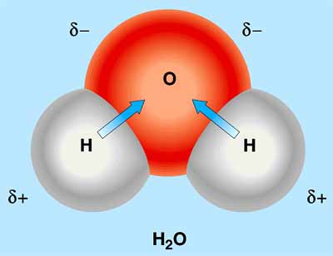

Slide 3
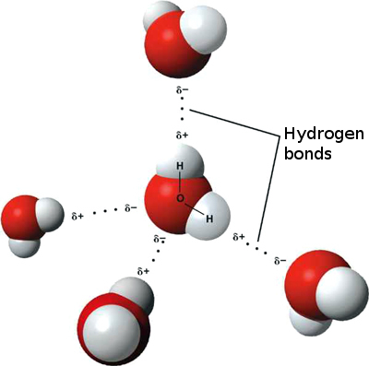

Slide 4
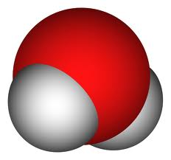
2
1
4
3
5
Which of the following NOT appropriate examples of hydrogen bonding?
1 , 2, 3, 4,
2, 3, 4, 5
3, 4, 5
4, 5,1
None of the above only show incorrect hydrogen bonding

Slide 5
Properties of Water
Polar,covalent bond within the molecule due ---------------------------------
Gives the ability to form ------------------------------
Water is cohesive and adhesive and thus will have surface tension
Hydrogen bonds forming and reforming will moderate temperature
Ice floats and cold water will hold more oxygen
Water is the solvent for life

Slide 6
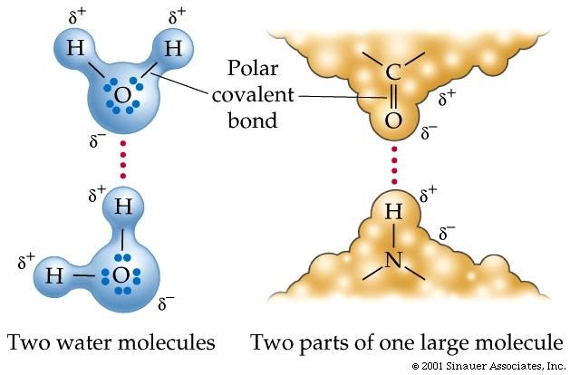
What type of bond are indicated by the arrows below?
More than one answer is correct
2 is a ionic bond
1 and 2 are both ionic bonds
1 is covalent
2 is hydrogen bond
1
2.
What type of molecule could this be?
Starch or Amylose
Protein
Lipid
Glucose
Glycolipid

Slide 8
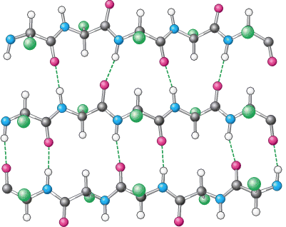
A.
B
C.
D.
E.

