Slide 1
Water, water, and more water
Why is water polar?
Why does Biology care about water?
Why do we drown in water?

Slide 2
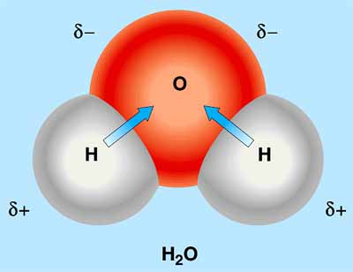

Slide 3
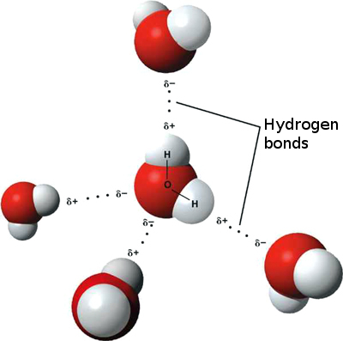
Notes:
How many Water Molecules do you see?
How many Hydrogen bonds?
How many covalent bonds are in the picture?

Slide 4
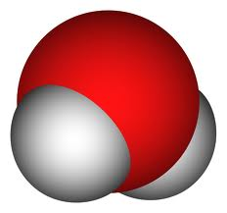
2
1
4
3
5
Which of the following NOT appropriate examples of hydrogen bonding?
1 , 2, 3, 4,
2, 3, 4, 5
3, 4, 5
4, 5,1
None of the above only show incorrect hydrogen bonding

Slide 5
Polar, covalent bond within the molecule is due to --------------.
Gives the ability to form ---.
Water is cohesive and adhesive and thus will have surface tension
Hydrogen bonds forming and reforming will moderate temperature
Ice floats and cold water will hold more oxygen
Water is the solvent for life
Properties of water

Slide 6
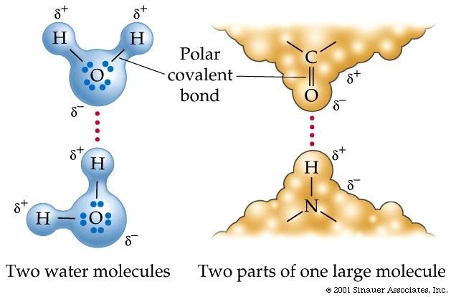
“What the?”
Explain what this picture is attempting to diagram.

Slide 8
What type of bond are indicated by the numbers?
What type of molecule(s)
could this be?
1
2.

Slide 9
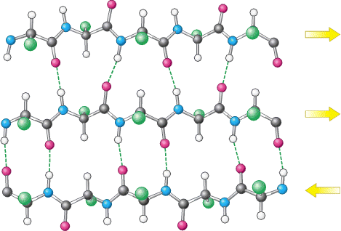
CPK coloring
Black
Blue
White
Red
Knowing CPK coloring, can you predict areas of polarity on this structure?
Can you fit the two molecules together?

Slide 10
A.
B
C.
D.
E.

Slide 11
