Slide 1
Light and Dark
Light dependent reaction + Light independent reaction = Photosynthesis

Slide 2
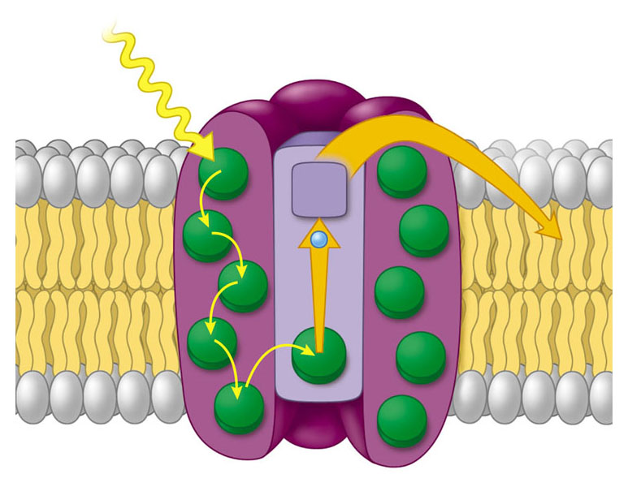

Slide 3
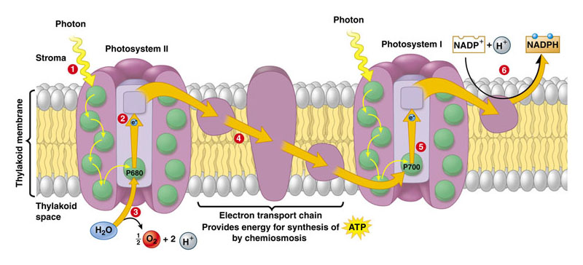

Slide 4
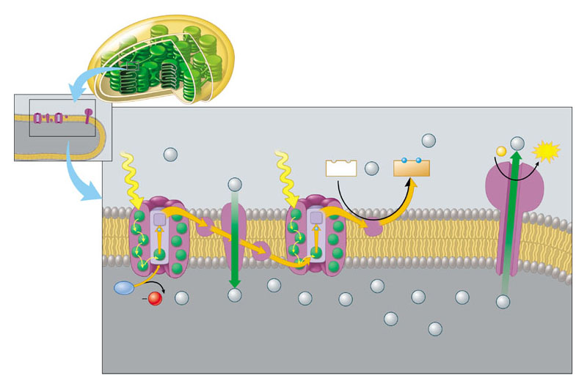

Slide 5
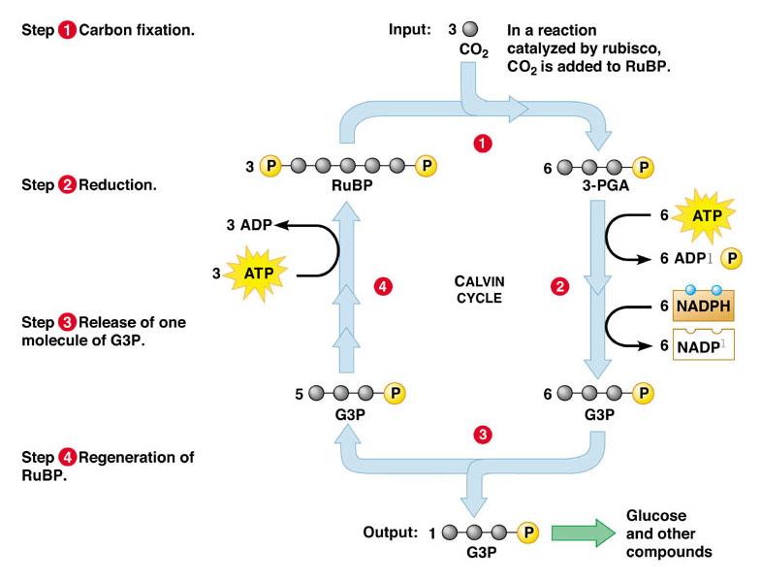

Slide 6
