Slide 1
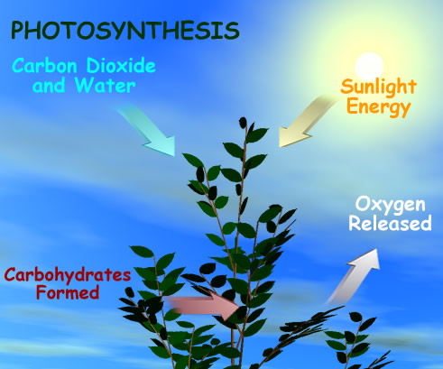
Photosynthesis: sunlight into chemical energy

Slide 2
Raw ingredients for Photosynthesis
Light
Leaf
Pigment
chloroplast

Slide 3
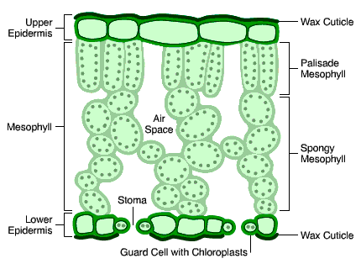
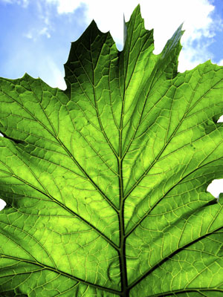
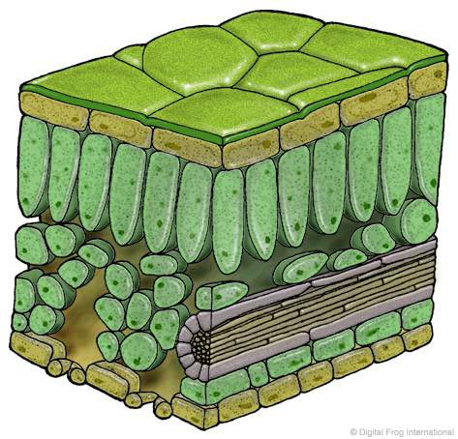
Leaf

Slide 4
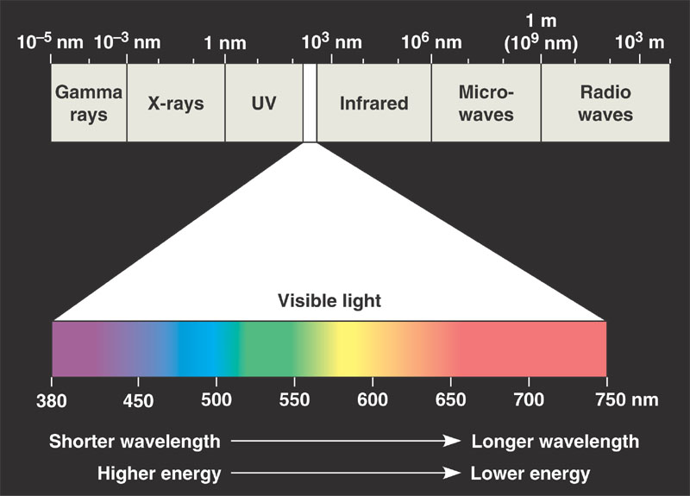

Slide 5
  Photosynthesis is not a very efficient process. Of the sunlight reaching the surface of a leaf, approximately how much is :
    75% is evaporated
    15% is reflected
    5% is transmitted through the leaf
    4% is converted to heat energy
    1% is used in photosynthesis

Slide 6
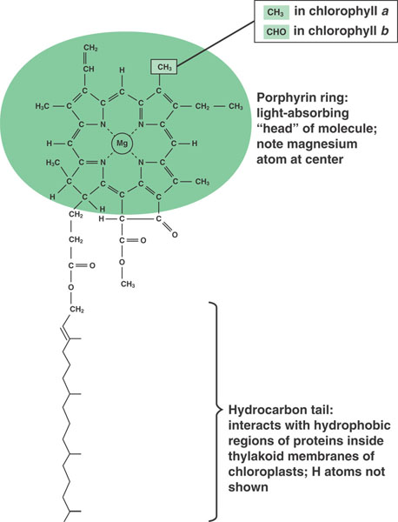
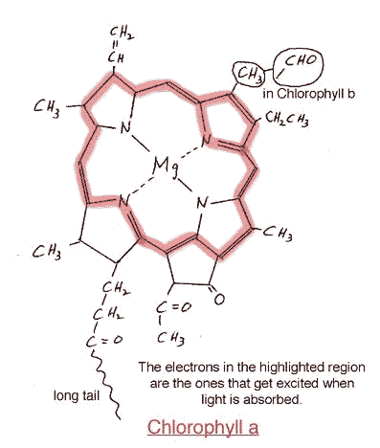

Slide 7
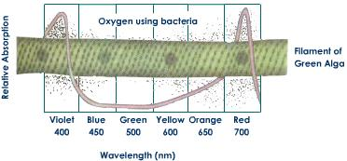
What wavelength of light is most
effective in filamentous green alga?

Slide 8
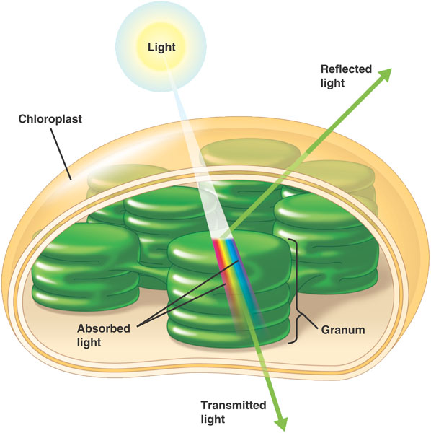

Slide 9
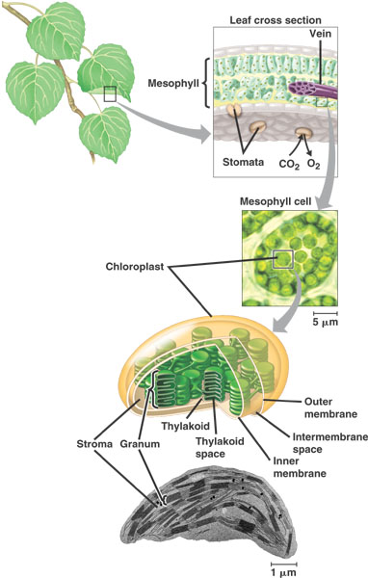

Slide 10
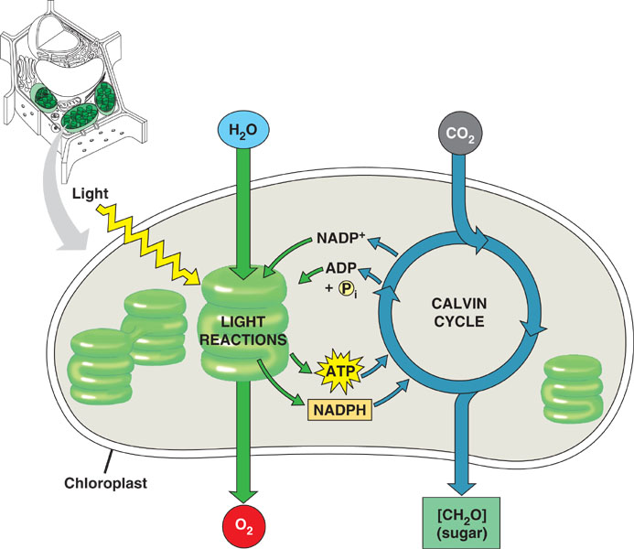

Slide 11
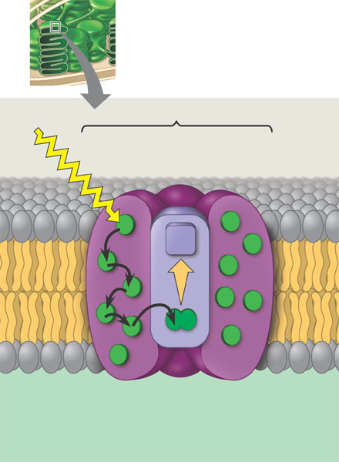

Slide 12
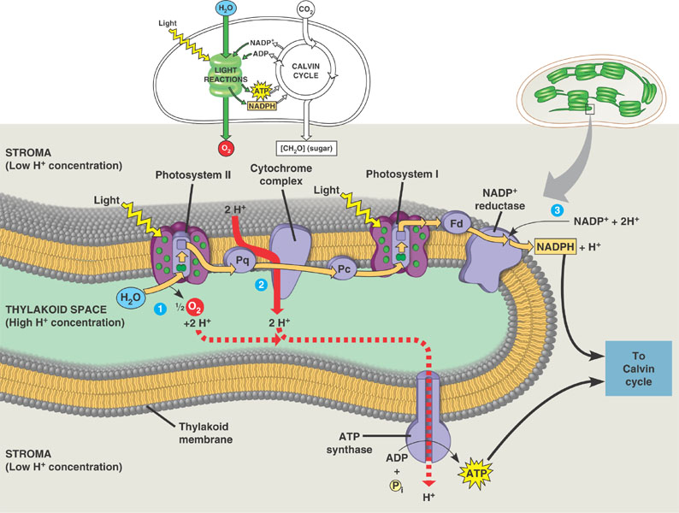

Slide 13
