Slide 1
Photosynthesis
producer, autotrophs, and the
main Ingredients to make lots of biomass

Slide 2
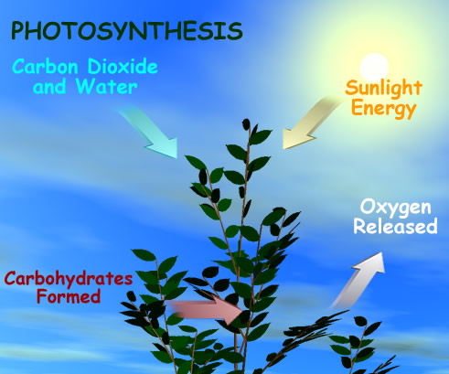
Photosynthesis: sunlight into chemical energy

Slide 3
Raw ingredients for Photosynthesis
Light
Leaf
Pigment
chloroplast

Slide 4
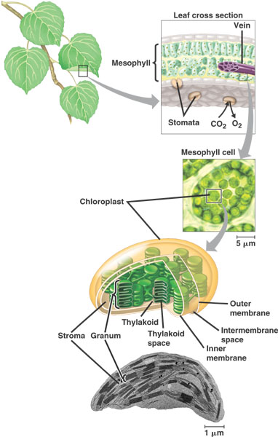
Leaf- specialized for light absorption
Chloroplast- specialized for energy conversion:
sun → H+ gradient energy →into ATP →carbs

Slide 5
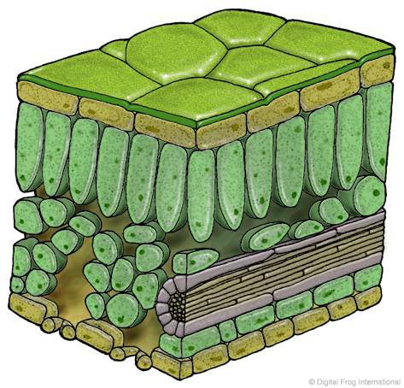
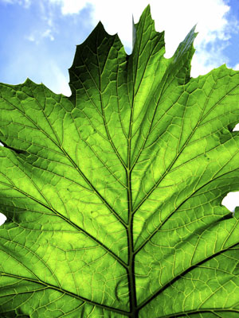
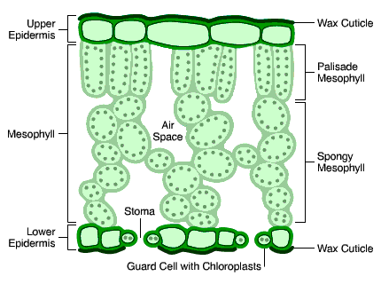
Leaf

Slide 6
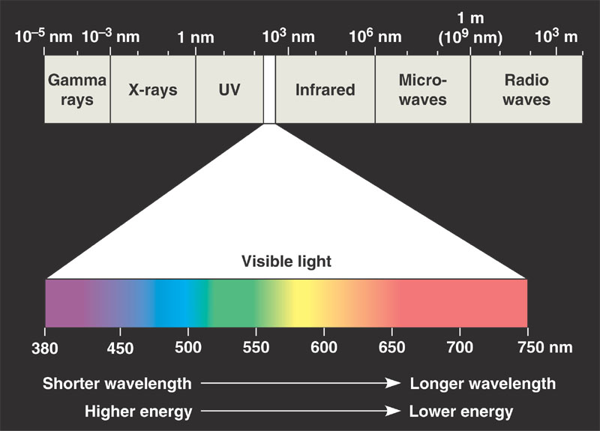

Slide 7
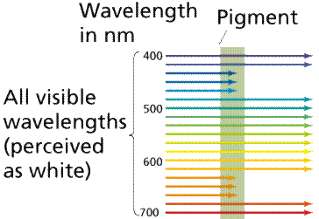
The above diagram show absorption of light by chlorophyll.
Which wavelengths of light are absorbed?
A. 400, 500, 600, 700
B. 400, 700
C. 450, 650
D. Yellow and Red
E. Both C and D

Slide 8
  Photosynthesis is not a very efficient process. Of the sunlight reaching the surface of a leaf, approximately how much is :
    A. 75% is evaporated
    B. 15% is reflected
    C. 5% is transmitted through the leaf
    D. 4% is converted to heat energy
    E. 1% is used in photosynthesis

Slide 9
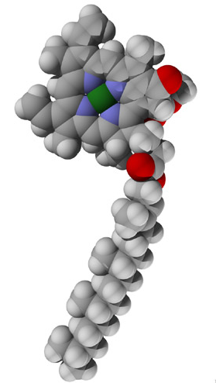
What observations can you make about this molecule?
Polar or non polar?
Why?

Slide 10
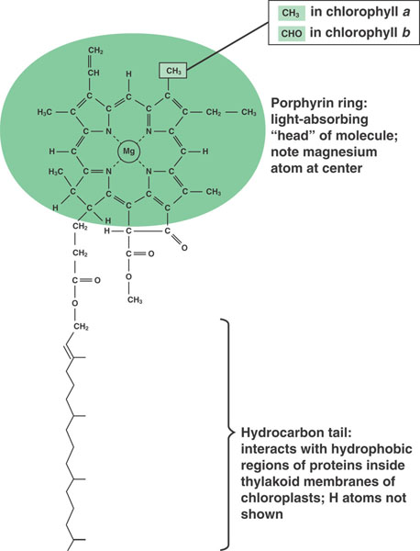
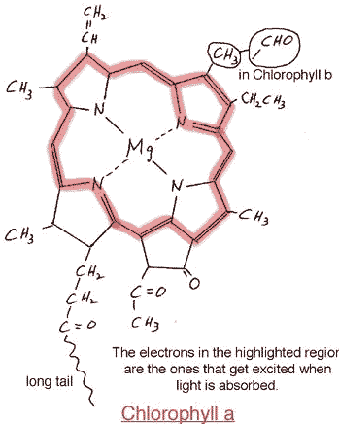

Slide 11
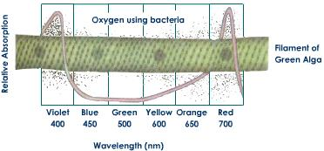
What wavelength of light is most effective for photosynthesis in filamentous green alga?
Violet and Blue
Blue and Orange
Yellow and Green
Orange and Red
Red and Violet

Slide 12
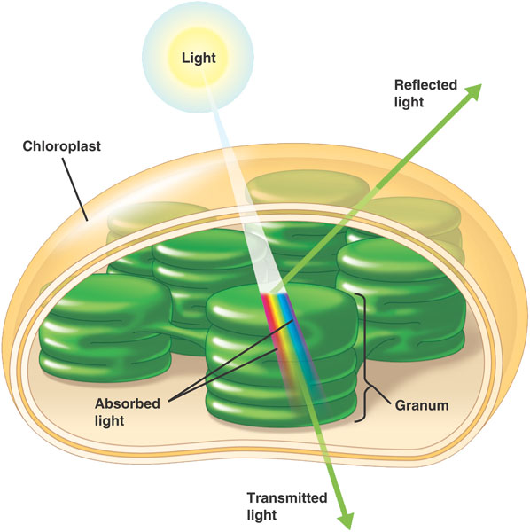

Slide 13
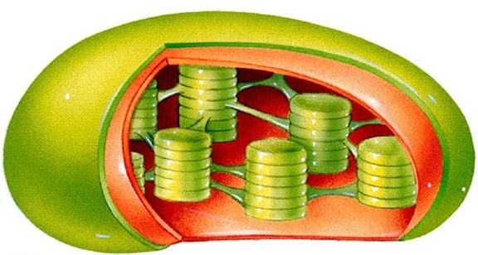
Double membrane- Which is more similar to cell membrane, inner membrane or outer?
Stroma-
Grana-
Thylakoid-
Where is chlorophyll found?
Where is light absorbed?
What happens to light when its absorbed?

Slide 14
