Slide 1
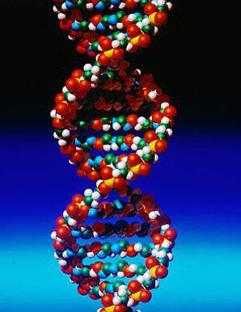
Gel Electrophoresis

Slide 2
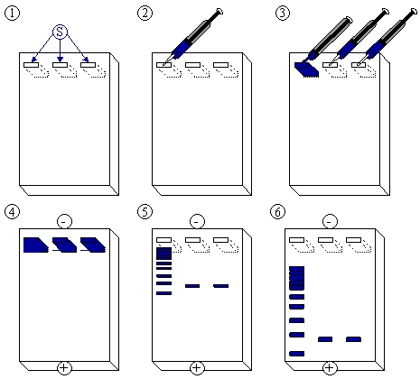

Slide 3
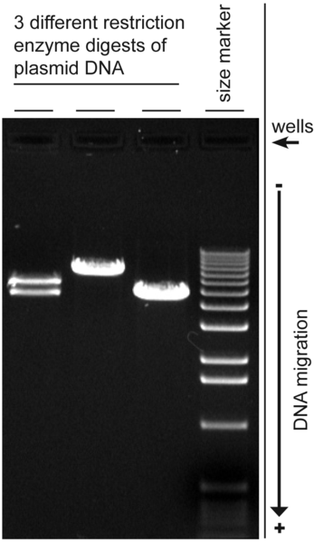
Digital image of 3 plasmid restriction digests run on a 1% w/v agarose gel, stained with ethidium bromide.
The DNA size marker is a commercial 1 kbp ladder.
The position of the wells and direction of DNA migration is noted.

Slide 4
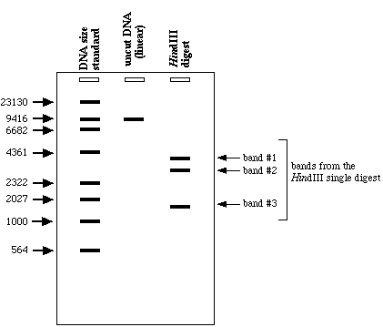

Slide 5
