Slide 2
PROBLEM:
At the time there was never enough DNA in any experiment, i.e., it was always limiting, and whatever human DNA there was in an experiment was hopelessly contaminated with itself.
When you isolated human DNA, every microgram contained three hundred and thirty thousand copies of every sequence in the genome, but each copy in the process of isolation would be broken off into its own little piece with its own molecular weight. There was no logic in the process. A mess- Kary Mullis
How can you get enough DNA of just one region of the genome?
How can you restrict amplification to only one area?
What enzymes in living systems naturally build DNA?
What other pieces would you need for this enzyme to work?

Slide 3
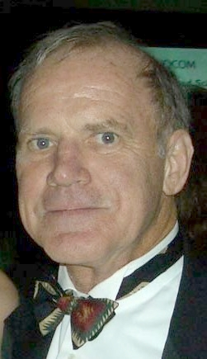
Inventor of Polymerase Chain Reaction: Kary Mullis
"Back in the 1960s and early '70s I took plenty of LSD. A lot of people were doing that in Berkeley back then. And I found it to be a mind-opening experience. It was certainly much more important than any courses I ever took."^{[18]} During a symposium held for centenarian Albert Hofmann, "Hofmann revealed that he was told by Nobel-prize-winning chemist Kary Mullis that LSD had helped him develop the polymerase chain reaction that helps amplify specific DNA sequences."^{[19]} Replying to his own postulate during an interview for BBC's Psychedelic Science documentary, "What if I had not taken LSD ever; would I have still invented PCR?" He replied, "I don't know. I doubt it. I seriously doubt it."^{[20]}
^{excerpted} from a wikipedia article

Slide 4
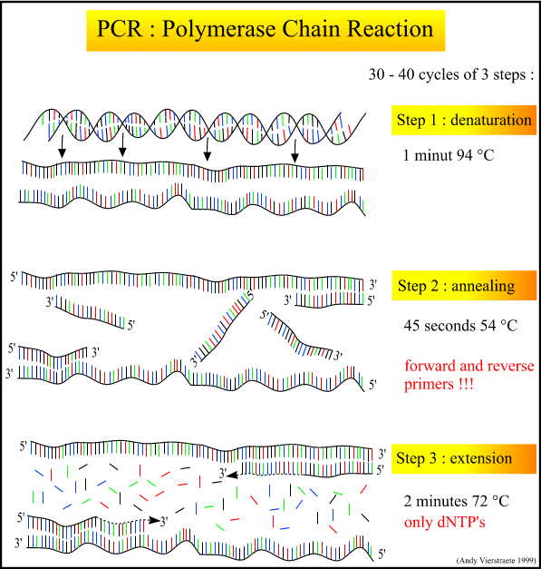
What part of DNA is
“opening” or “breaking”?
What enzyme
makes this possible?

Slide 5
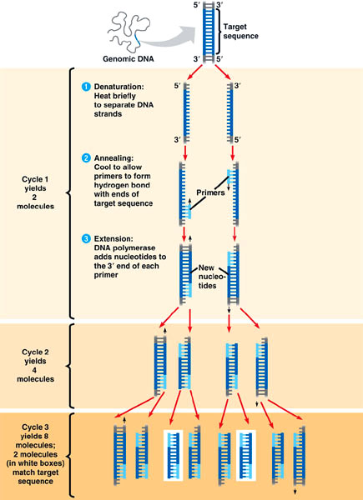

Slide 6
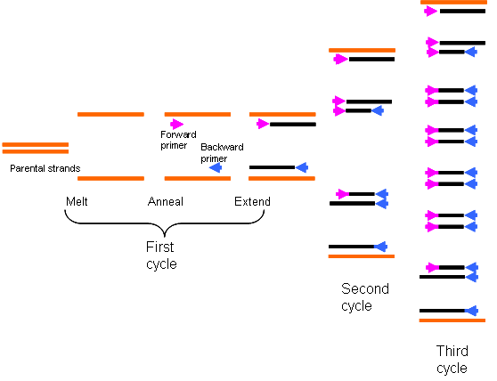
What is missing from this PCR reaction to be successful?
What can we add as label or diagrams to represent the necessary components?
Notes:
Taq polymerase, free nucleotides, and buffer that ensure the enzyme will function correctly.

Slide 7
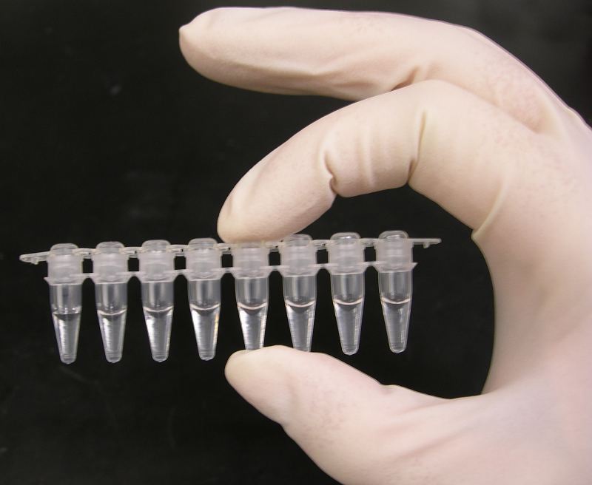
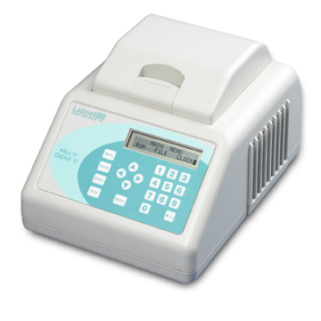
What is present in this tube for a successful PCR reaction?
Hint: 5 items!
Thermalcycler
Machine the cycles through the temperatures necessary for running PCR.
What temps do we need for a successful PCR? What is the function for each temp.?

