Slide 1
Restriction Enzymes
Natural Function of Restriction Enzymes
Restriction Enzymes
Recognition Site

Slide 2
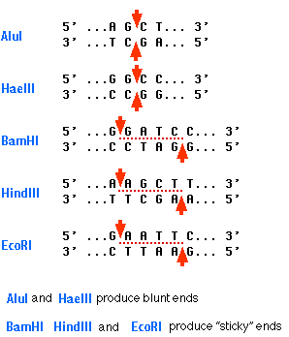
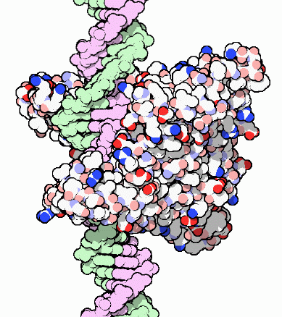

Slide 3
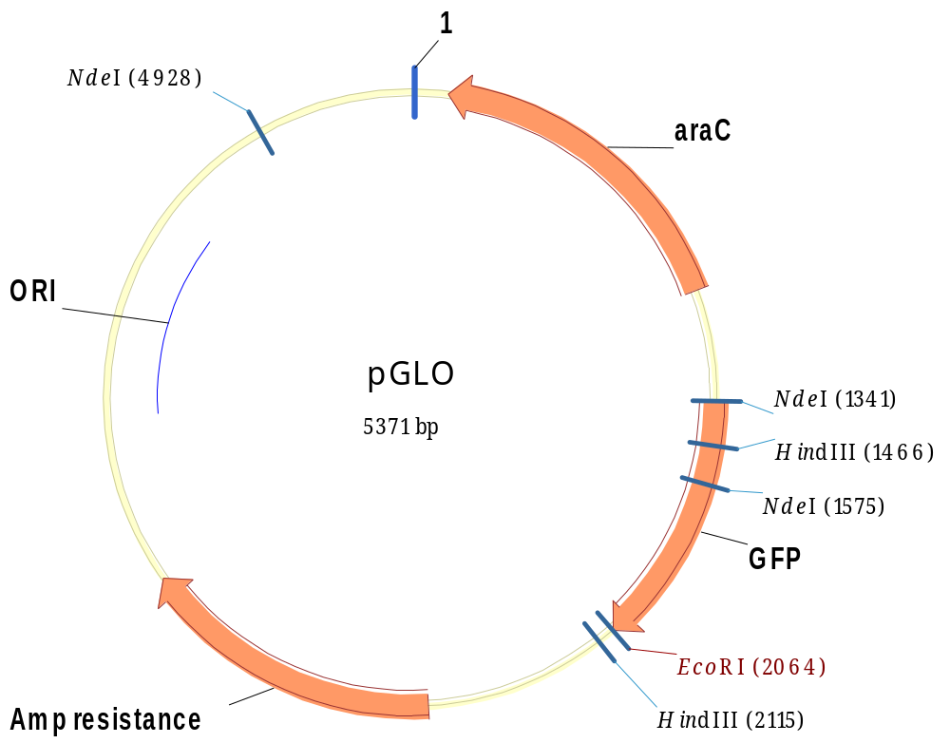

Slide 4
