Slide 1
Meiosis
Reduction Division
Independent Assortment
Crossing Over and Genetic Variation

Slide 2
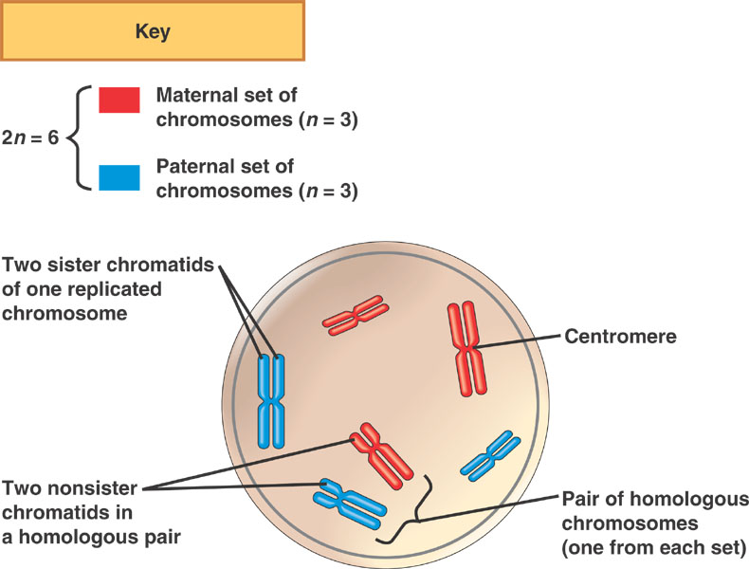

Slide 3
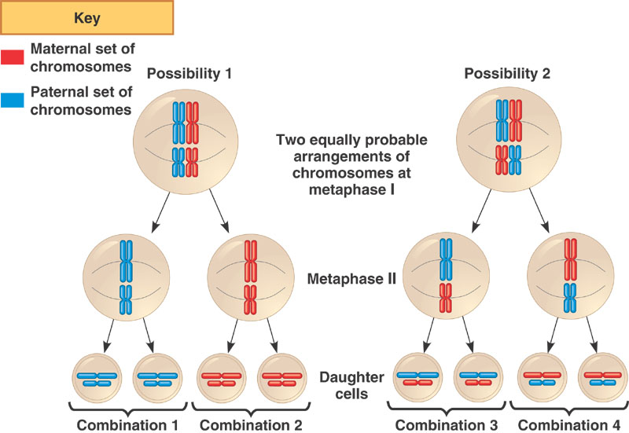

Slide 4
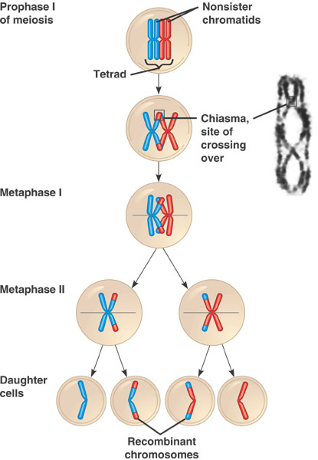
Prophase I
http://www.youtube.com/watch?v=pdJUvagZjYA

