Slide 1
Learnin’ to Read Gels
Ladders and fragments and gels…Oh My!

Slide 2
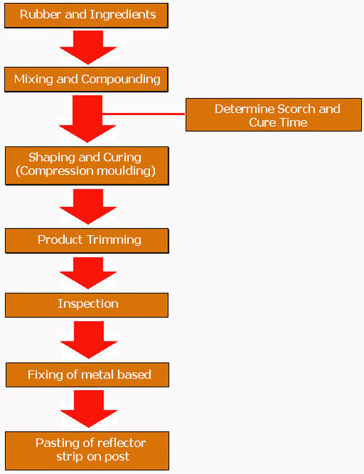
Take 3 minutes…
Make a flow chart of
everything that we have done!

Slide 3
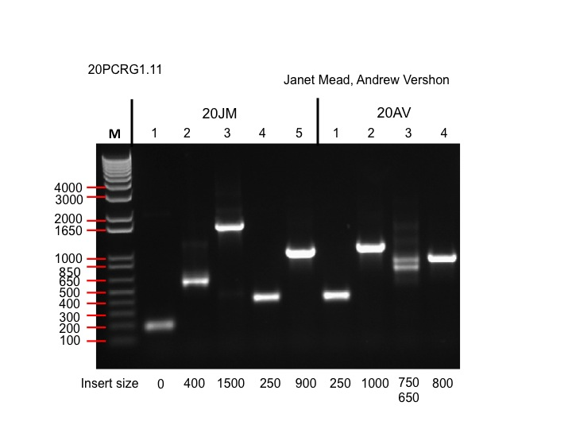

Slide 5
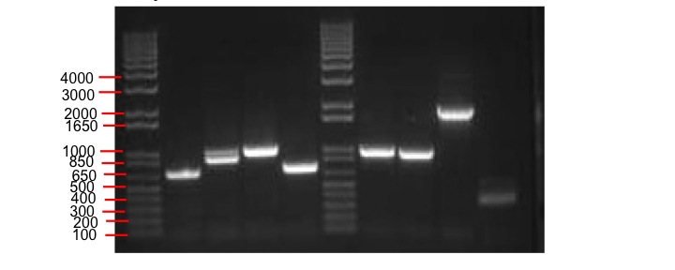
Name: _______________________ Date:_______________ Section:____________
This is a PCR gel of several clones PCR’ed this summer.
What is the size of each cDNA insert?

