Slide 1
WSSP: Duckweed
Pickin’ your colonies
Overnights
Blue and White colonies

Slide 2
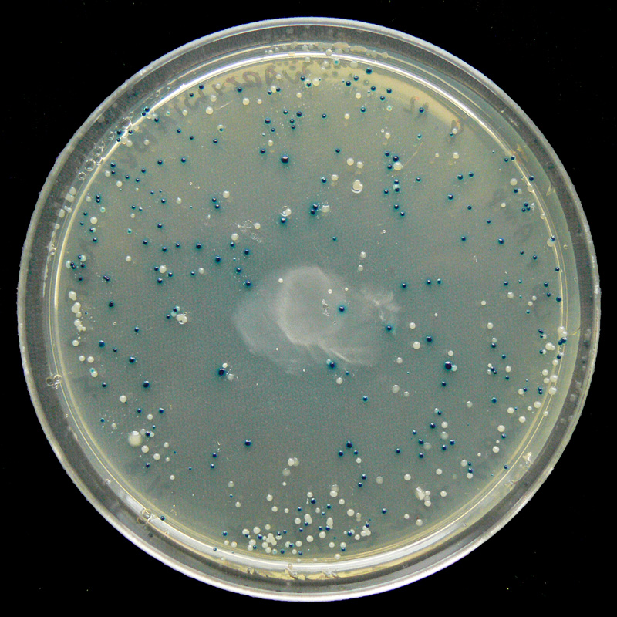
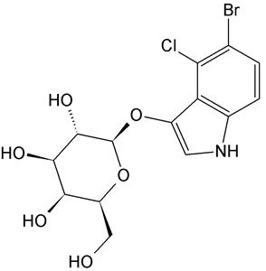
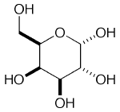
The cDNA bacteria (hopefully containing piece of the duckweed
genome) is growing on the plate.
Note the two colors of the colonies.
The bacteria is grown on a medium with X-gal. This synthetic molecule when cleaved appears blue.
The blue colonies have the ability to break down the X-gal and turn the surrounding media blue.
The white colonies cannot break down the X-gal.
Which colonies will have the “insert” of Duckweed cDNA?
B-galactosidase
X-gal
Galactose
The “other” molecule will appear blue

Slide 3
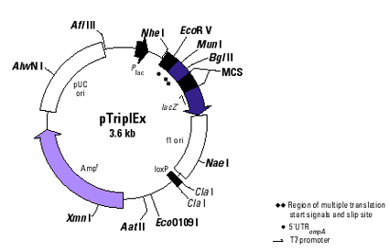
pTriplEX plasmid
This is the Lac Z gene which make B-galactosidase. Functional B-galactosidase will digest X-gal.

Slide 4
Makes B-galactosidase
Lac Z gene
What
color are the
colonies?
PtripEX plasmid
Cannot make B-galactosidase
cDNA insert
Lac Z
gene
PtripEX plasmid
What
color are the
colonies?

Slide 5
Cloned in cDNA fragment from duckweed. Possible 900 bases long.
What is the size of the plasmid with the insert?
Does this plasmid make functional B-galactosidase?
What color is the colony on the plate?

Slide 6
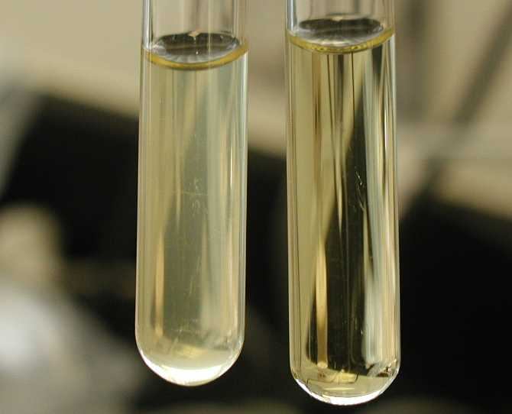
Small, freshly saturated cultures of E. coli are called overnights (ONs). Each person in each group will prepare one overnight.
Each person should label one culture tube with the proper clone name.
17DOM1.10
Your school # your Initials, your clone number, year
Write name of your clone directly on the side of the tube before you add the LB+amp.
Do not write on the caps!Caps can be switched, causing strains to be mixed up.
Cloudy culture indicates bacterial growth
Clear culture indicates NO bacterial growth

