Slide 1
WSSP
Introduction
What is Duckweed and why should I care?
Creating a cDNA Library using mRNA and this should remind you of last semester….however bad it was
What is processed mRNA and why do I care?

Slide 2


Science…by doing Science
Waksman Student Scholars Program of
The Waksman Institute, Rutgers University
Andrew Vershon, Director of WSSP
This program is developed for high school students and undergraduates to
be a part of a legitimate scientific research program. This is a legitimate attempt to
engage you in a real research project.
Sequencing the Genome of Duckweed……

Slide 3
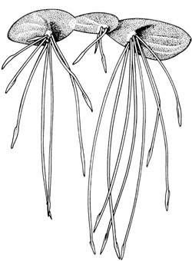
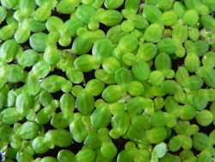
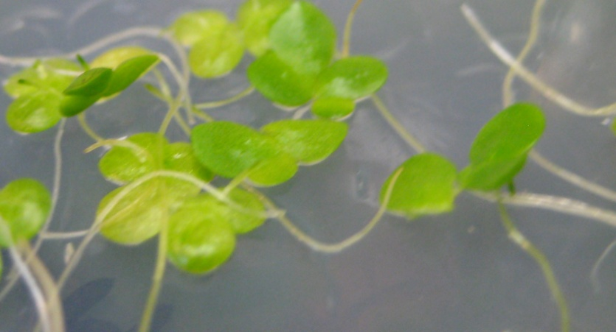
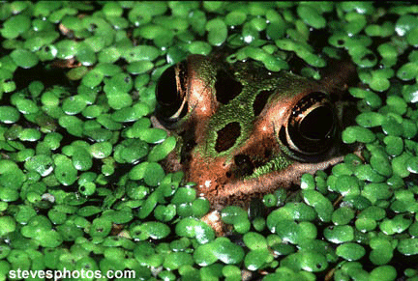
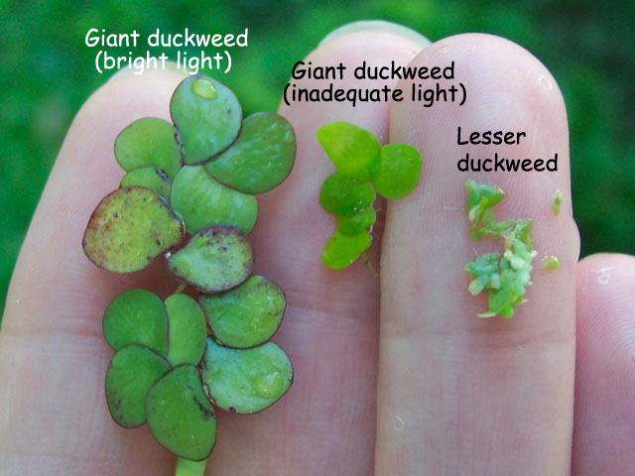
Duckweed:
Smallest flowering plants,
Grow in slow moving fresh water -world wide,
Fast growing - double in a few days

Slide 4
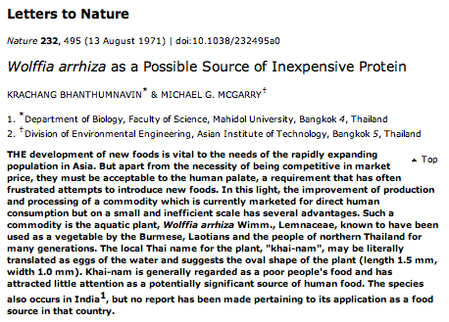
Duckweed
Potential biofuel source
  Under cold temperatures can accumulate 40%-70% starch
  Sink to bottom of ponds
  Starch can easily be converted to sugar for fermentation
  Will not compete with food crop production
Bioremediation
  Grows in contaminated water
  Sequesters or degrades contaminates such as lead, arsenate, halogenated compounds
  Extract nitrogen and phosphate from waste water
Potential food source

Slide 5

What genes are responsible for these functions?
What genes does this organism have with other plants?
Genomics….

Slide 6
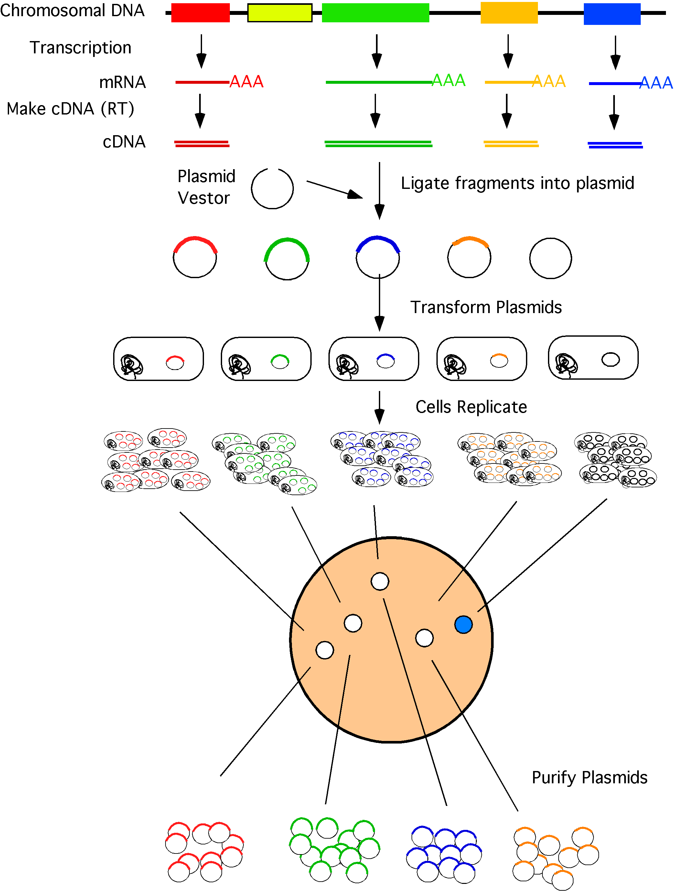
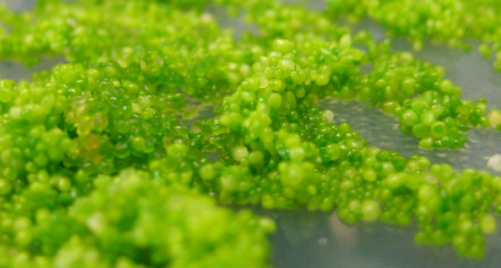

Constructing a cDNA Library
Bacteria
Students will pick bacterial colonies to purify plasmid DNA containing the duckweed genes

Slide 7
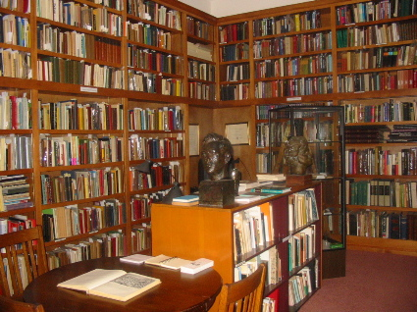
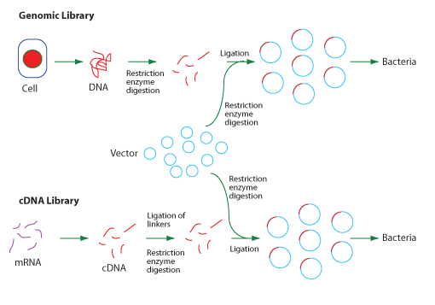
Getting all the genes from an organism
transformed in bacteria is known as a “library”
Genomic Library
Sequencing the entire genome
cDNA library
mRNA into DNA
Only expressed genes

Slide 8
What's a mRNA?
A - a "messenger" RNA that is intended for translation
B - a "major" RNA that is present in large amounts
C - a "missing" RNA that is present in low amounts
D - a "missense" RNA that can't be translated into a protein
E - a "mobile" RNA that has moved from cytoplasm to the nucleus

Slide 9
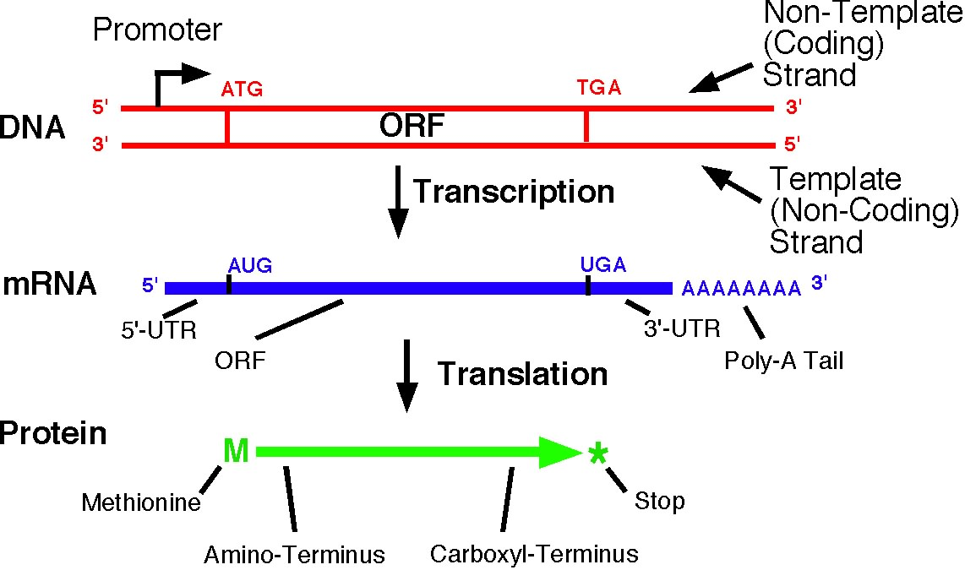
mRNA is a processed RNA transcript (in eukaryotes) to be translated into a protein.

Slide 10
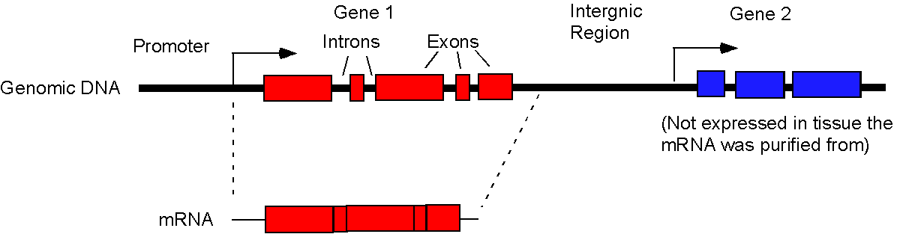
Differences between a Genomic and cDNA library
Genomic Library
Promoters
Introns
Intergenic
Non-expressed genes
cDNA Library
Expressed genes
Transcription start sites
Open reading frames (ORFs)
Splice points
p.1-7

Slide 11
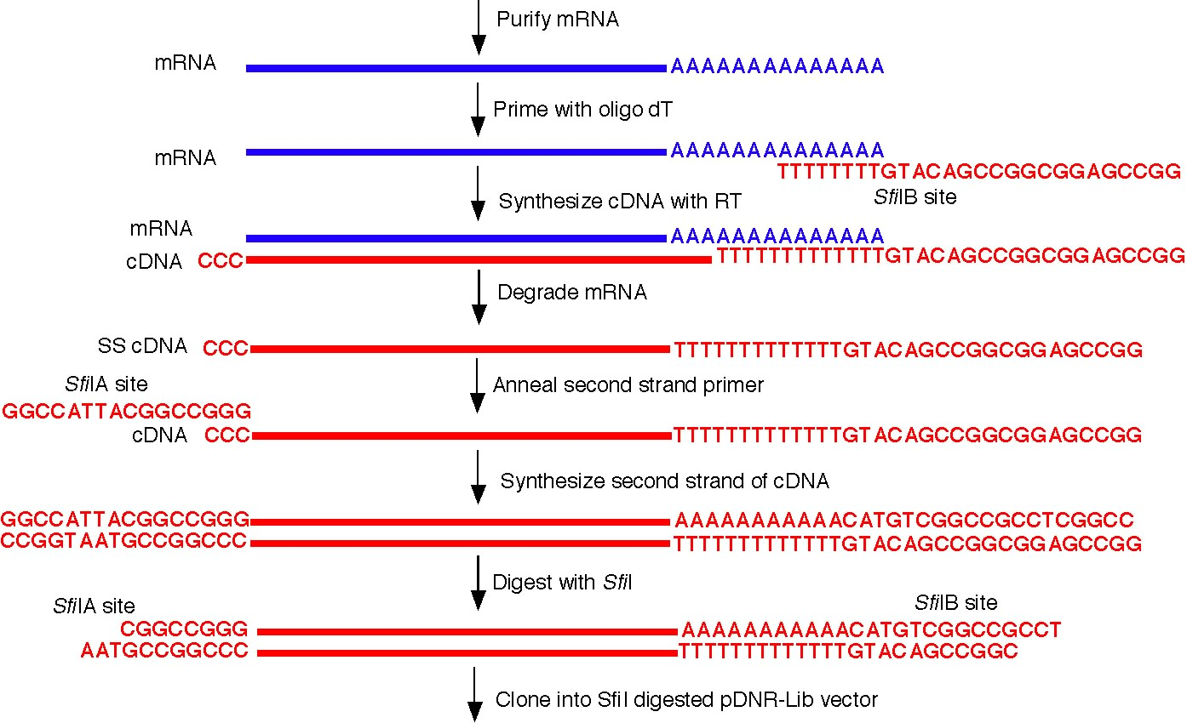
Synthesis of cDNA from mRNA

