Slide 1
Making Sense of our Restriction Digests
Or not…

Slide 2
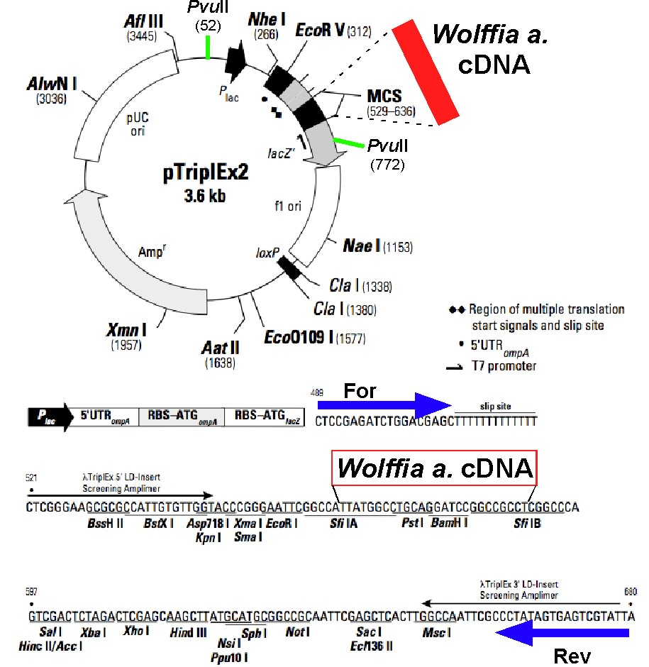

Slide 3
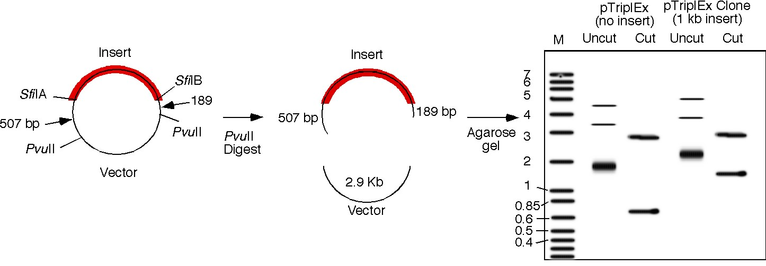
Theoretical PvuII digests of plasmids
p. 2B-10

Slide 4
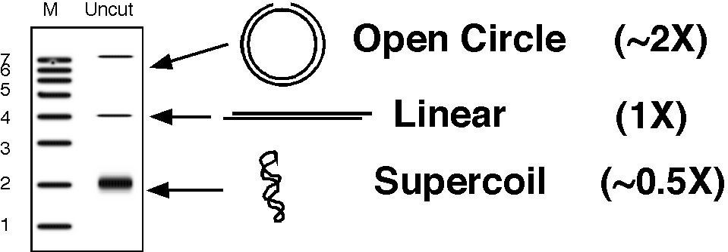
Why are there 3 bands in the uncut lane?
p. 2B-10

Slide 5
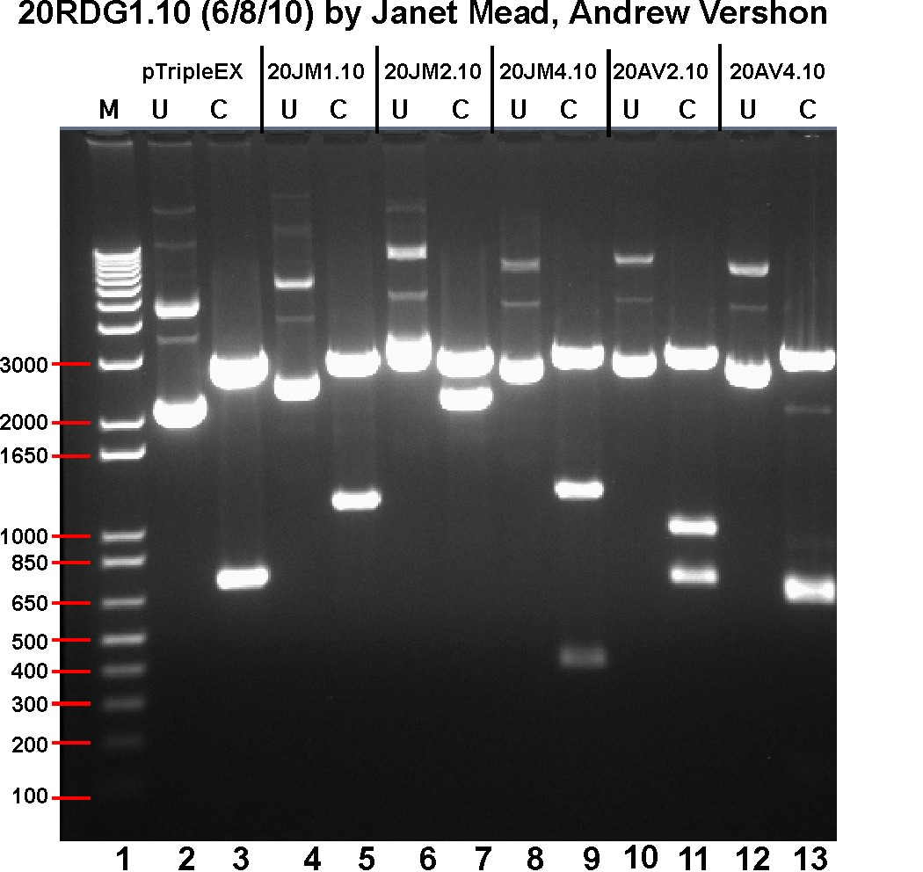
What is the size of the insert?
2.9 Kb
700 bp - 700 bp = 0 bp
p. 2B-13

Slide 6
Is there a PvuII site in the insert
Are there multiple bands?
p. 2B-13

Slide 7
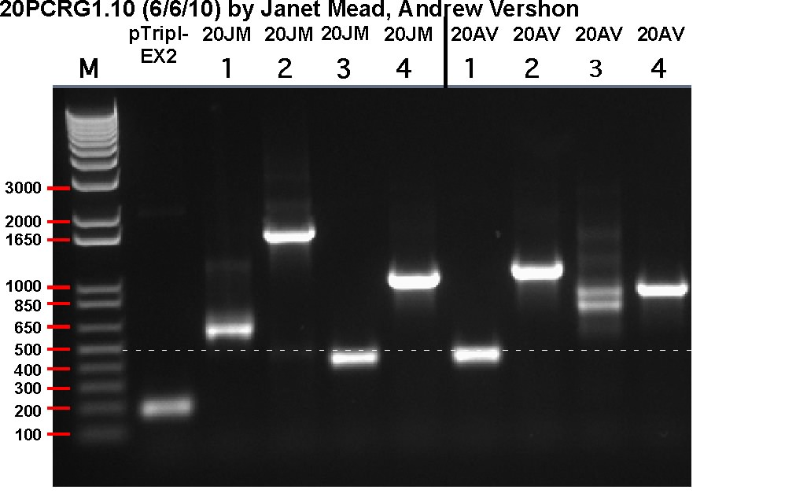
Do the results from the digest and the PCR agree?
700 bp - 700 bp = 0 bp
200 bp - 200 bp = 0 bp
p. 2B-14

Slide 8
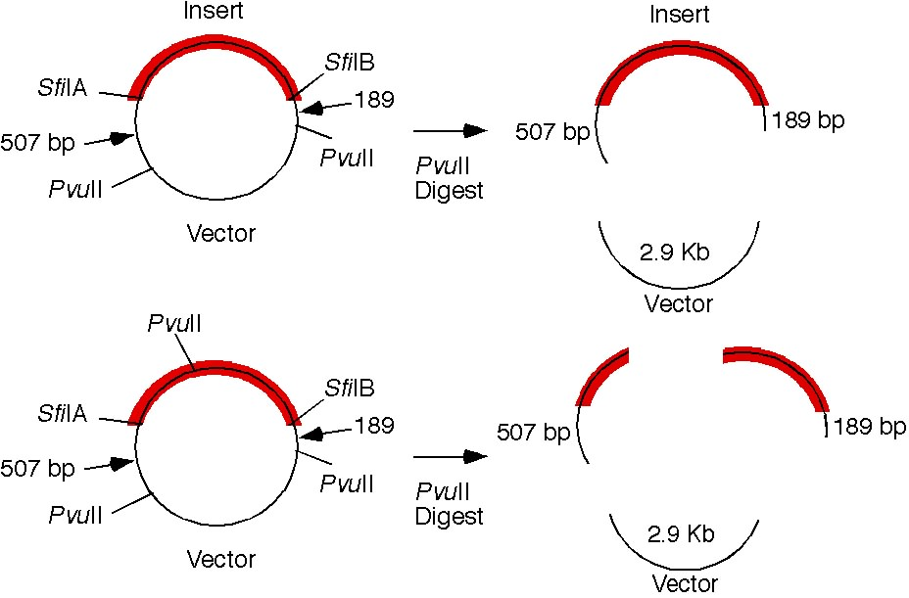
How do we figure out the insert size from the 20JM4.10 digest?
2900 bp
1200 bp
400 bp
1200 bp + 400 bp-700 bp = 900 bp

Slide 9
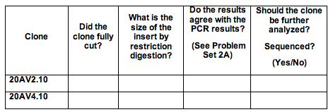

Slide 10
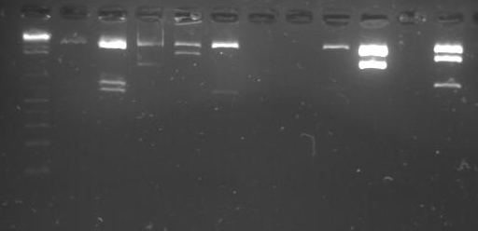
Section 12 ResDig Gel
Run 9/28

Slide 11
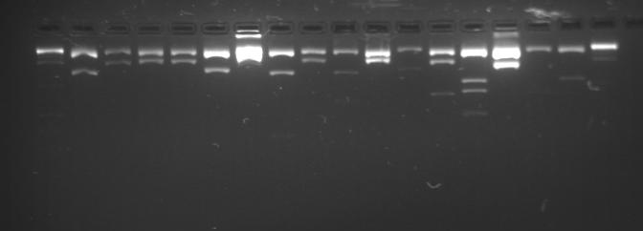
Section 34 ResDig Gel

Slide 12
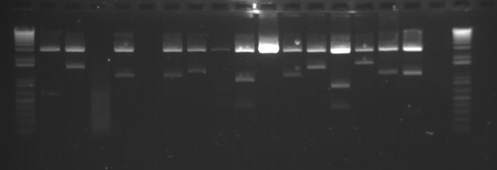
Section 58 Res Digest gel

