Slide 1
Practice Clone 3
Download and get ready!

Slide 2
After opening the sequence….
What questions do you start with?
Is the sequence of good quality?
Do you see a poly AAA tail?
What does that mean?
Where is the start of the cDNA insert?

Slide 3
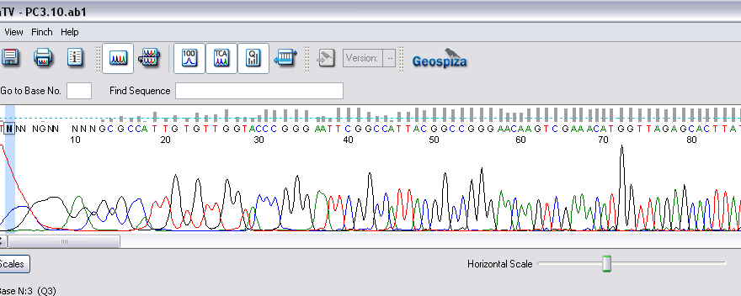
a.
b
c
d
e

Slide 4
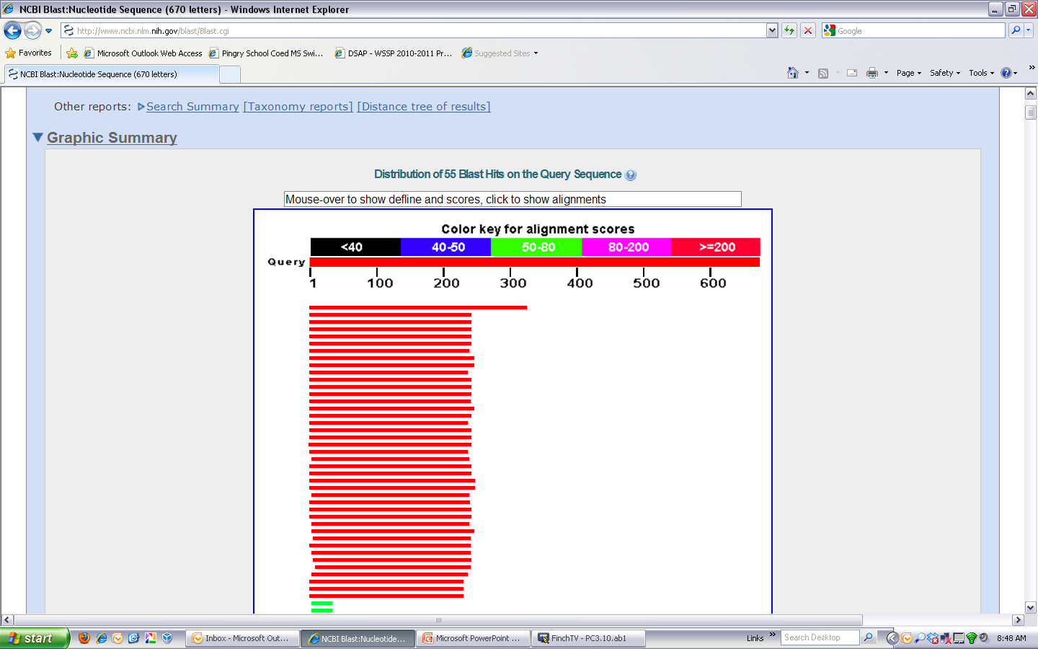
a.
b
c
d
e

Slide 5
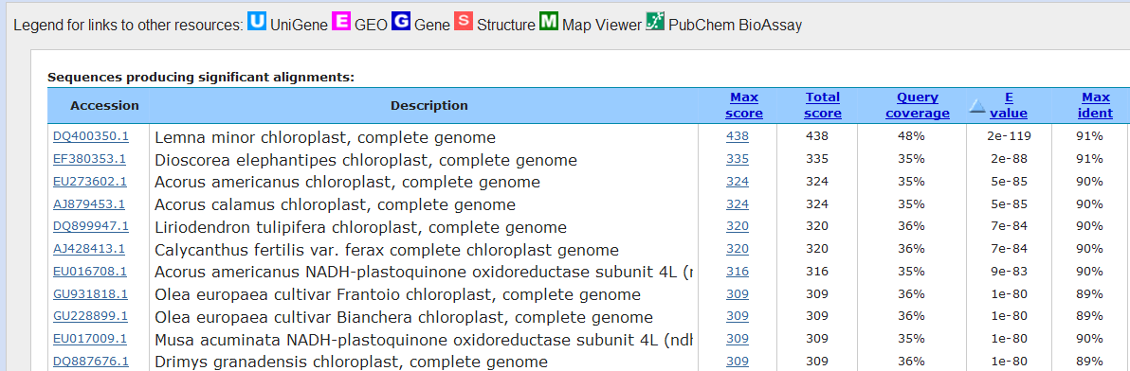
c
d
e
b

Slide 6
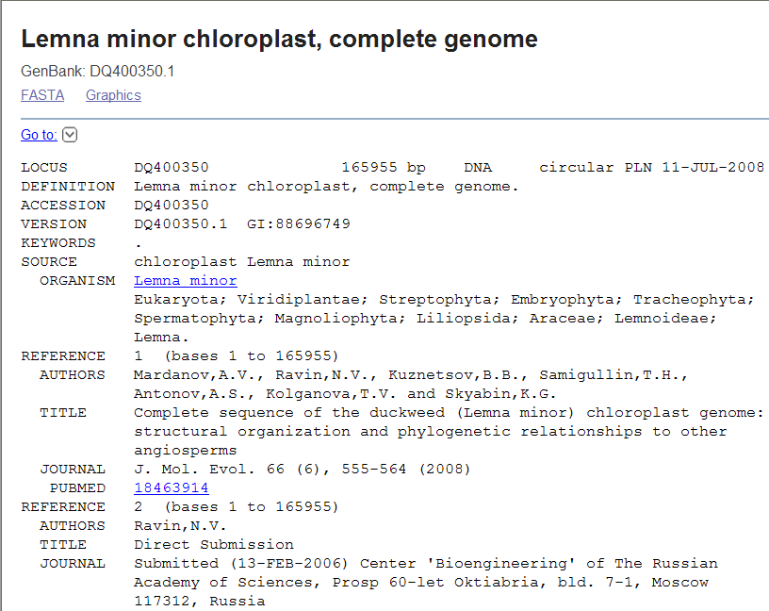
What country was this sequence published?
A. Russia B. China C. US D. Japan E. France

Slide 7
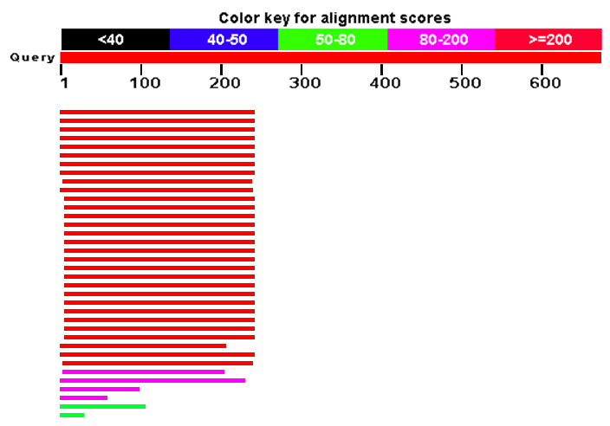
Blast N: nr/nt
Blast N: est remember from other cDNA clones!
Notes:
Blast est

Slide 8
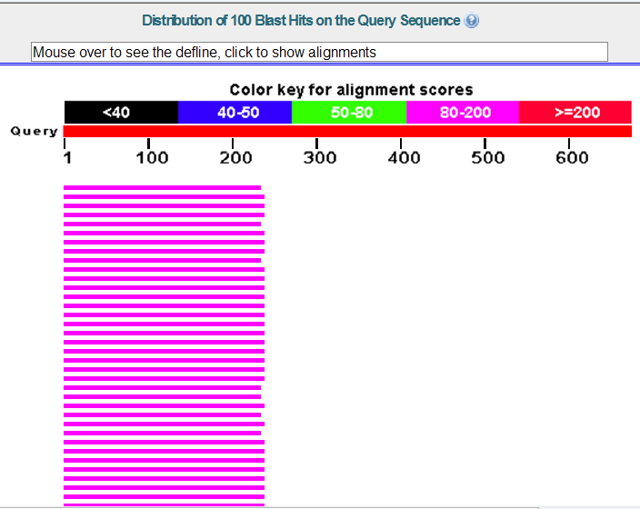
Notes:
BlastX

Slide 9
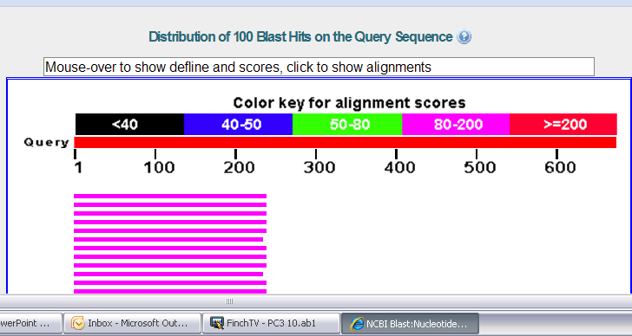
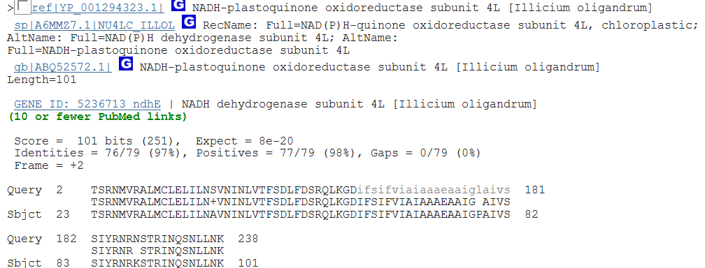

Slide 10
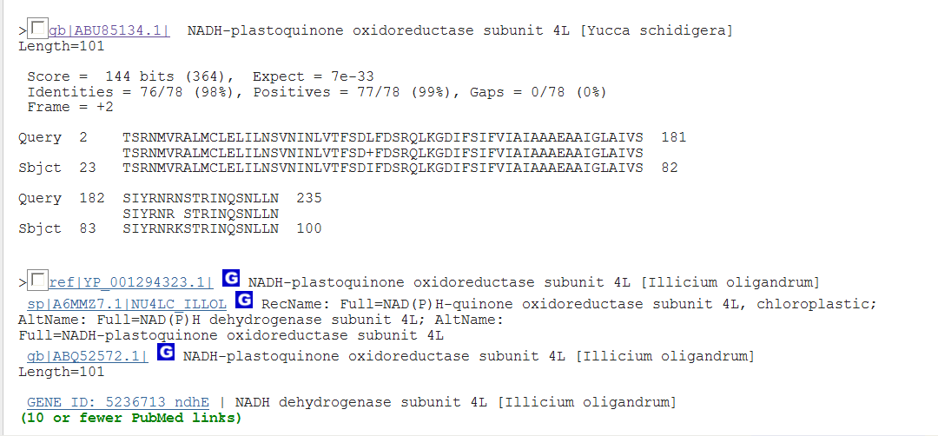
BLAST X

Slide 11
BLAST X
Note the alignment!
Where does our query start to match?
What reading frame is the BLAST X in?
A. 0 B. +1 C. +2 D. +3 E. at the Met

Slide 12
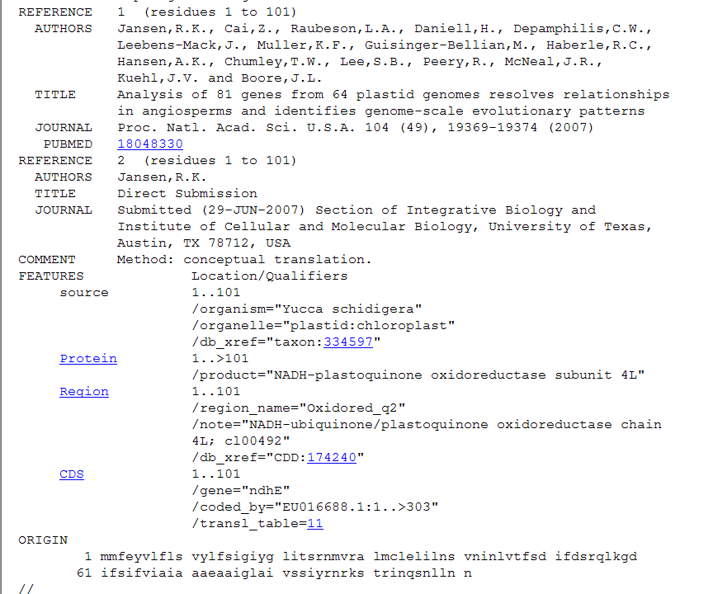
Looking at the accession number record:
Notes:
The blast X shows that our query does NOT match to the beginning of this protein…what

Slide 13
a.
b.
c
d.
1 mmfeyvlfls vylfsigiyg litsrnmvra lmclelilns vninlvtfsd ifdsrqlkgd
61 ifsifviaia aaeaaiglai vssiyrnrks trinqsnlln n
Notes:
This is the amino acid sequence of the first match (I accessed the complete aa sequence by clicking on the accession number) of the BLAST X, which of the above is the point where our TRANSLATED nucleotide sequence starts to match this protein?

Slide 14
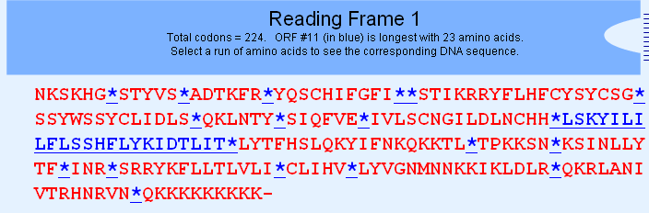
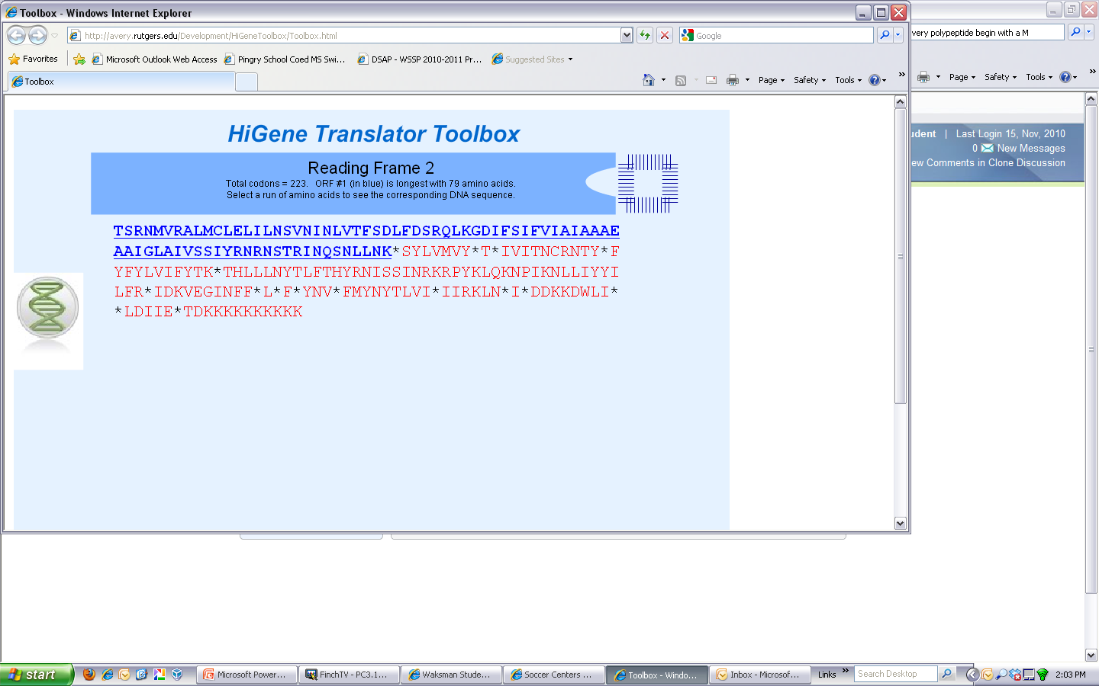
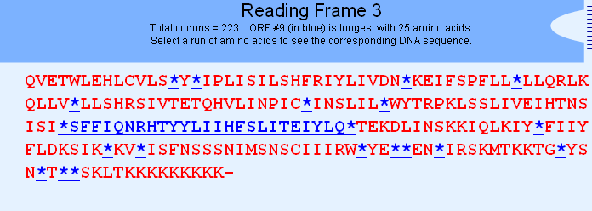
a.
b.
c.
Notes:
Which is the correct reading frame?

Slide 16
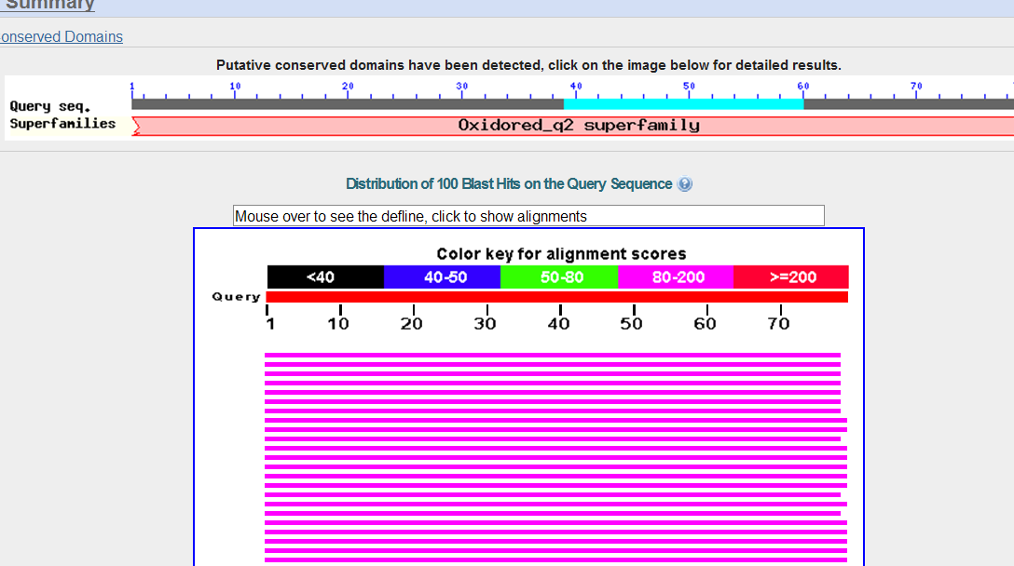
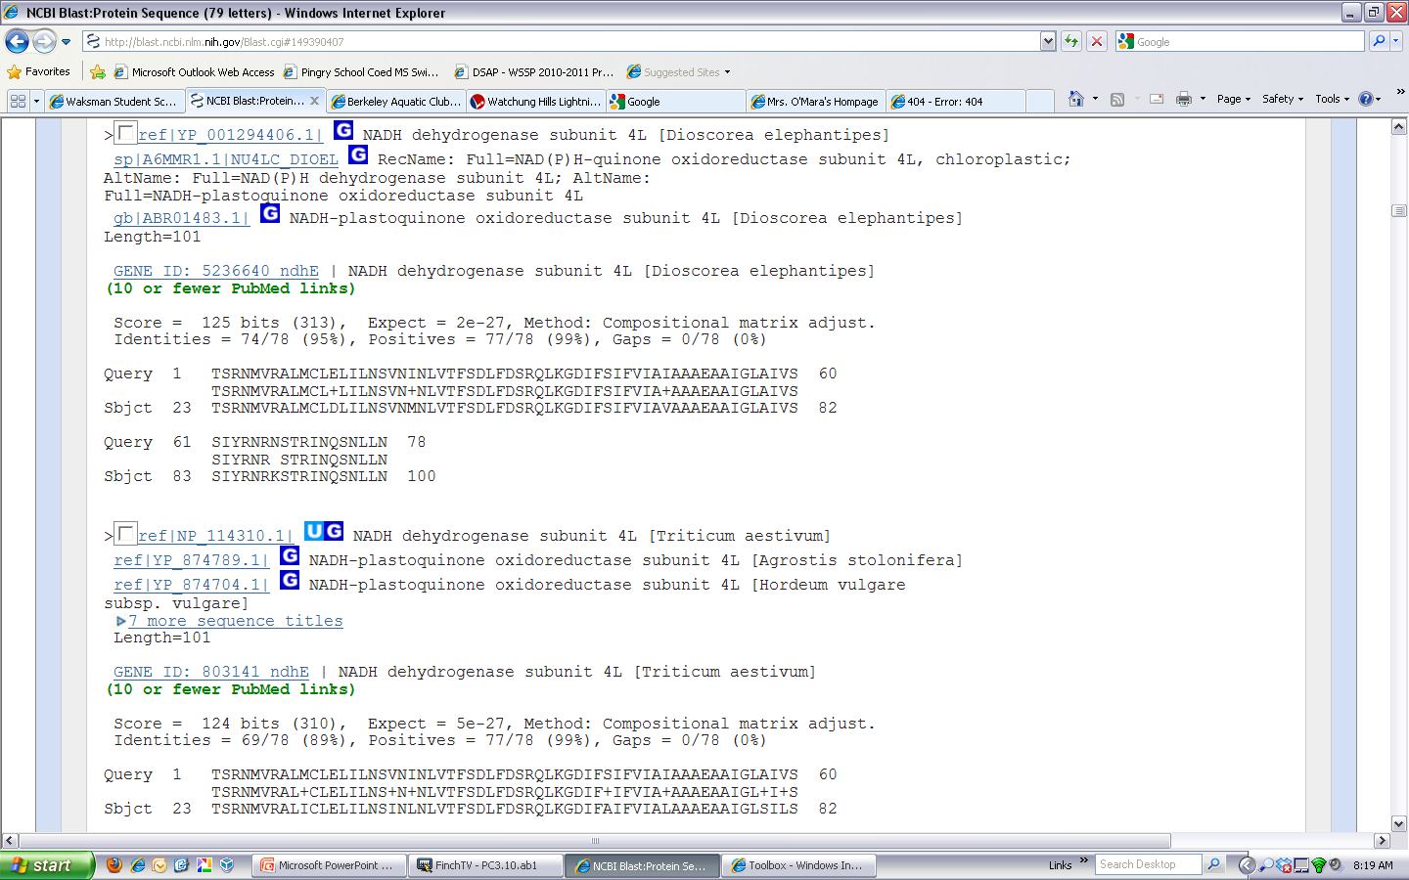
Blast P with the ENTIRE ORF

Slide 17
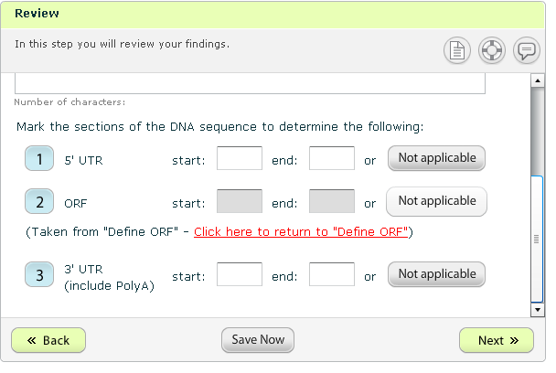
Notes:
Things go off the track at this point!

Slide 18
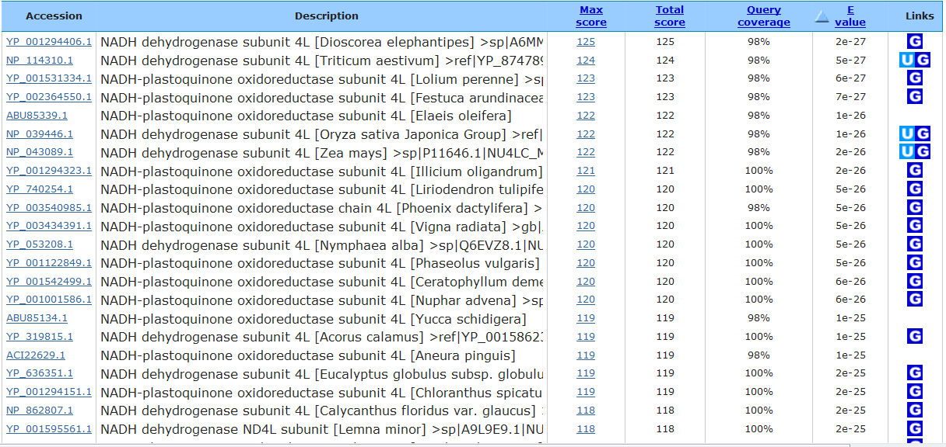
Using the information in the Blast P, what does your protein most likely code for?
Cytochrome C
NADH dehydrogenase
Acetylcholinesterase
A transcription factor
Both B and C

