Slide 1
WSSP
Picking colonies
Making OV’s

Slide 2
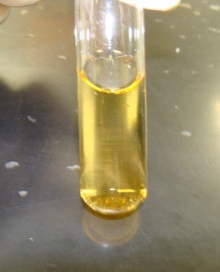
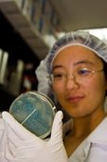
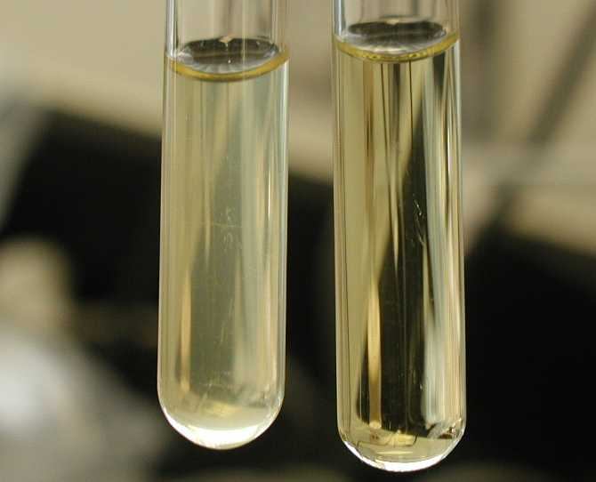
OV- liquid overnight culture of LB and AMP
With sterile stick, gently pick one colony that is isolated from its neighbors.
Remember- pick colonies that are WHITE!
Put picked colony into
labeled tube.
Shake overnight 37.5
Pick colonies with sterile stick
Gently pick up colony with stick

Slide 3
PCR
Polymerase Chain Reaction
Now we need to know the size of the cDNA insert
Remember PCR amplifies DNA. We want to amplify only the cDNA insert so we need to control what we amplify with very specific primers.
Cloudiness indicates bacterial growth
DILUTE the OV
Set up and run PCR
Run PCR out on gel

Slide 4
