Slide 1
WSSP Restriction Digest Gels
October 2010

Slide 2
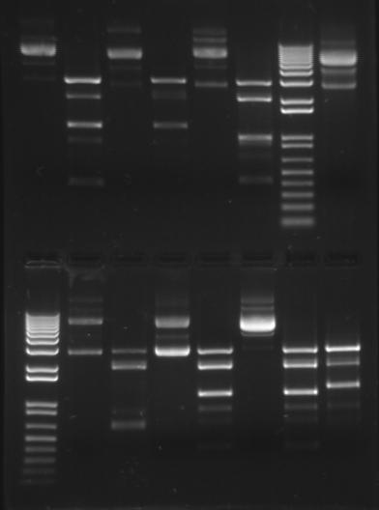
17.AXB02.10
17.SAT01.10
17.AJK01.10
17.LNU02.10
U
C
U
C
U
C
U
Section 2/7 Restriction digest Gel1
2.9
2.9
2.9
17.CJM01.10
17.DP01.10
17.GCP01.10
17.LNU02.10
U
C
U
C
U
C
C
2.9
2.9
2.9
2.9

Slide 3
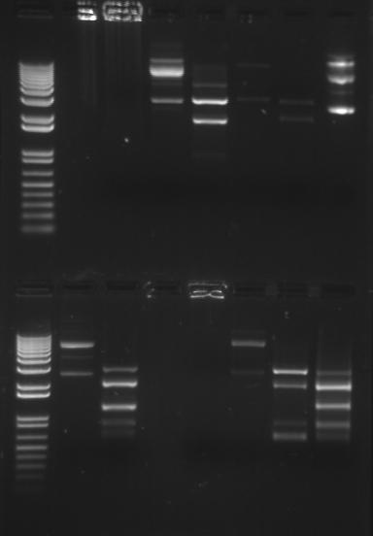
17.MEK01.10
Section 3-4
Gel 1
Sakai gel 2
17.DJA01.10
17.MCB02.10
17.EJF ??.10
U
C
U
C
U
C
U
2.9
2.9
No result,
PCR: 600
Insert 1100
No PCR result
Insert 1200
No PCR result
17.JWG01.10
17.BAH.10
17.????.10
17.MEK01.10
U
C
U
C
U
C
C
2.9??
2.9
2.9
Not sure about 2.9
Band in digest lane
Are the other bands
Internal cuts sites
No PCR result to confirm
Unsure about
Insert, which band?
No result

Slide 4
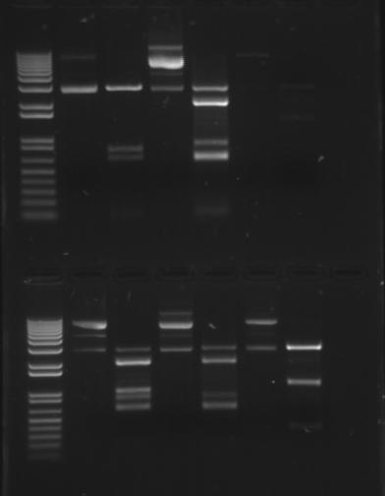
Section 34 gel 2
SAKAI GEL 3
U
C
U
C
U
C
2.9
2.9
2.9
What is the bright band at 2KB?
Internal cut site?
Star activity?
PCR result:
Internal cut site?
Star activity?
PCR result:
17.SW01.10
U
C
U
C
U
C
2.9
2.9
2.9
What is the bright band at 2KB?
Internal cut site?
Star activity?
PCR result: ??
What is the bright band at 2KB?
Internal cut site?
Star activity?
PCR result: 1350
Insert : 1200
PCR result:

Slide 5
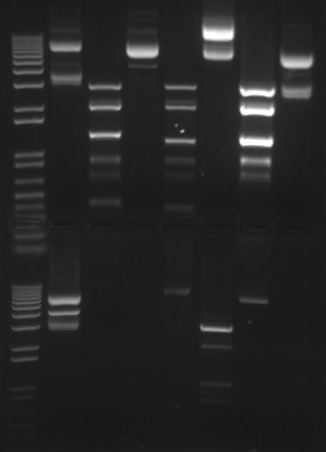
17.HMB01.10
17.NB01.10
17.MKB01.10
17.YC01.10
Section 56 gel 1
SAKAI GEL 4
U
C
U
C
C
U
2.9
2.9
2.9
Are these the inserts?
Are the other bands star activity?
PCR result: 1,000
Why is the uncut lane running so high?
Reversed tubes?
17.YC01.10
17.AF01.10
17.AF02.10
17.LGG01.10
C
U
C
U
C
U
C
2.9
Reversed tubes?
No DNA
Insert :1000
No PCR run
No digest
PCR result: 475

Slide 6
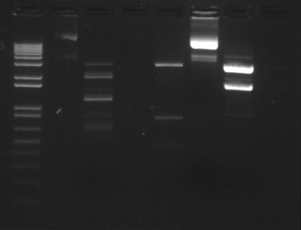
Section 56 gel 2
SAKAI GEL 5
17.AJF03.10
17.KET02.10
17.JAT02.10
2.9
2.9
2.9
Star Activity?
Large insert?
Insert too small
Insert :1050

