Slide 1
PCR of our OV
What is PCR again? I forgot…
Preparing for PCR
Running a PCR

Slide 2
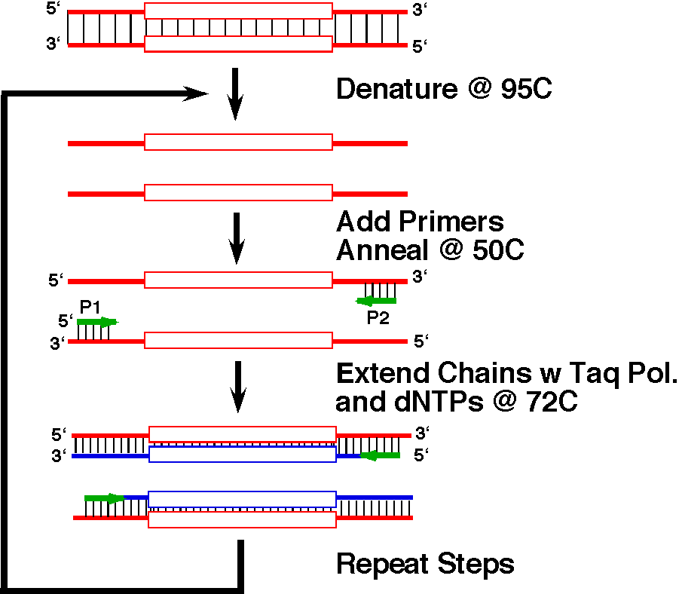
Steps in the Polymerase Chain Reaction - PCR
p. 2A-2

Slide 3
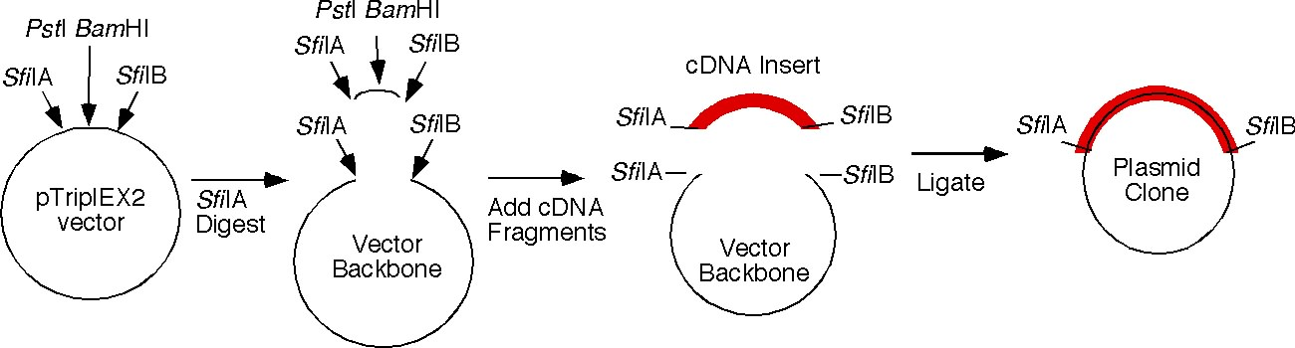
Making a cDNA Library
Open the plasmid with enzyme
Ligate in cDNA and transform
But how big is the insert?
How can we “see” the size of the cDNA?

Slide 4
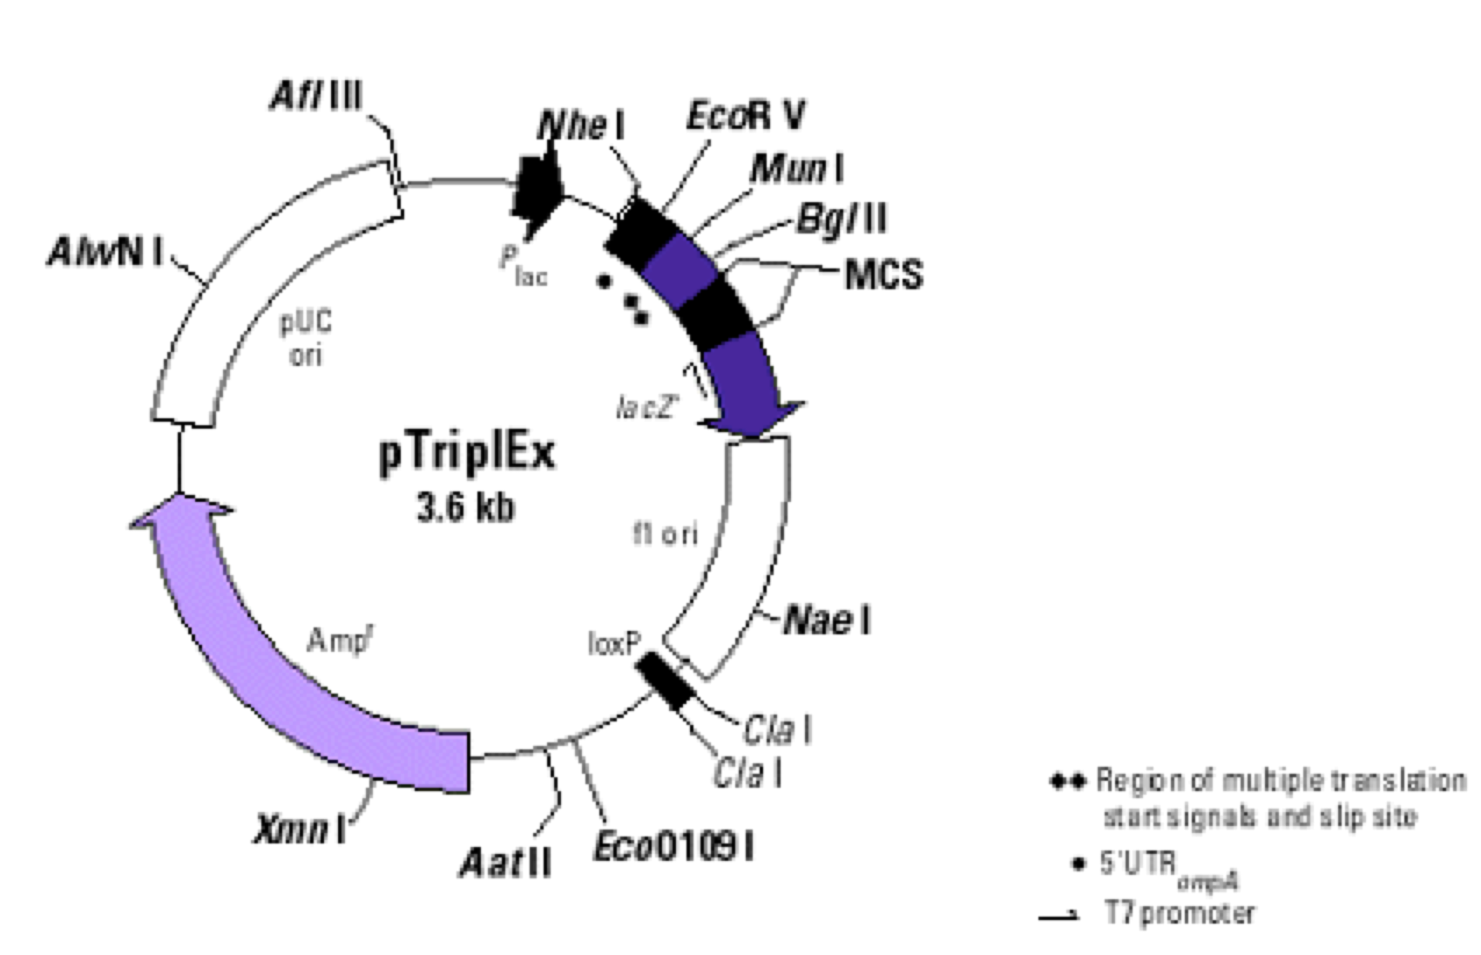
Wolffia cDNA Insert

Slide 5
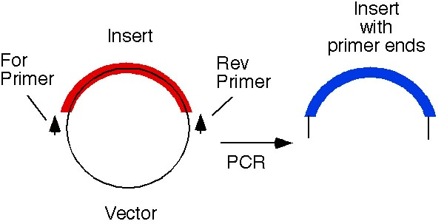
Getting ready for PCR….
To see the size we need to do PCR and amplify enough that we can see the actual fragment.
Remember that DNApol needs somewhere to START replication….you need specific PRIMERS
Add specific primers that flank the insert region.

Slide 6
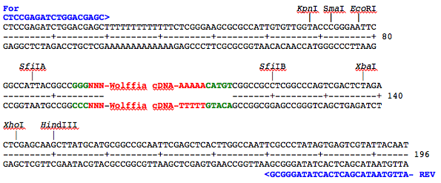
Polylinker Region of TriplEX2
Wolffia cDNA
p. 2A-3

Slide 7
Overnights to PCR
You need to dilute aliquots of your overnight culture (which contains plasmid DNA) 40-fold.
Take 5 μl of overnight culture in your labeled microtube (200ul H2O).
Mix each sample tube by tapping the side with your finger.

Slide 8
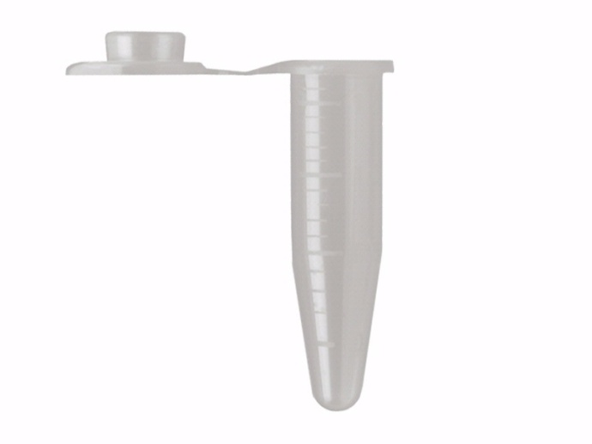
Mixing a PCR Reaction
Every PCR reaction needs
1. Template DNA- something to amplify
2. Free nucleotides- so that we can make more DNA
3. DNA Polymerase- an enzyme to do the replication process
4. Primers- to direct DNA replication
5. Buffers- so that everything works
In groups of 4 you will be making a Master mix for PCR for all four members of your group.
Master Mix Recipe for four group members
In a microtube labeled MM
Add 90 ul sterile water
Add 12.5 uL of FOR primer
Add 12.5 ul of REV primer
Mix gently by tapping
Spin if necessary
MM
Do not add bacteria
This tube is for your group

Slide 9
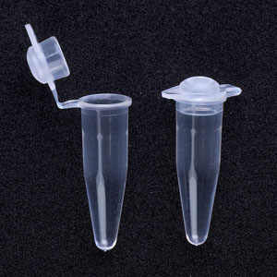
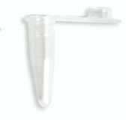
After your group has made the MM, see me for a PCR tube
Your PCR tube ALREADY contains a dehydrated stock of:
enzyme, buffer, and free nucleotides
You will need to label the tube CAREFULLY
And you will add MM and your DNA from diluted OV
Add 23ul of MM to your own PCR tube
MM
Then add 2ul of diluted OV culture
PCR tube
Total vol. 115ul

Slide 10
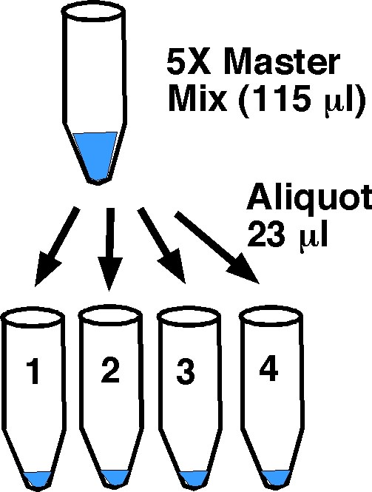
PCR tubes
One for each group member
LABEL!

