Slide 1

The Pingry School
Clone Summary Report
Since July 2009:
209 clones includes all OV
Since Oct. 23, 2009: 90 clones analyzed
31/90 above 500 bp and are being submitted for sequencing.
59/90 are below 500 bp

Slide 2
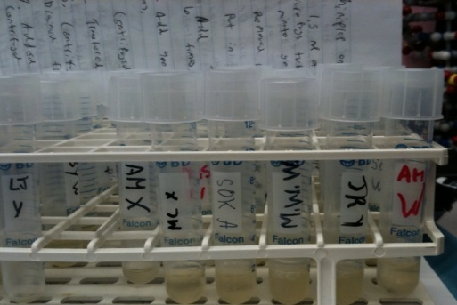
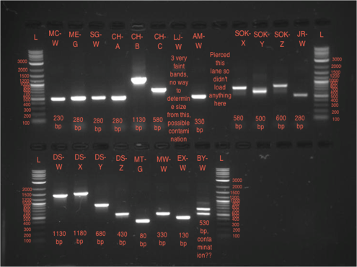
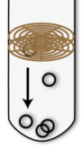
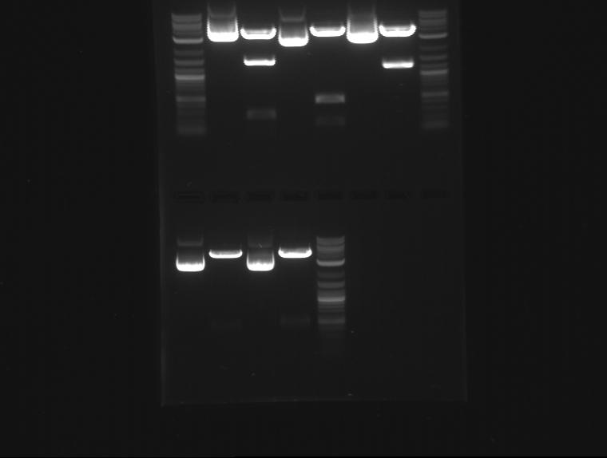
Naming Clones and Determining the Sizes of Inserts
Overnight Cultures
1. Picked Colonies and made ON (LB/Chlor)
2. ON’s were labeled Initial and a letter
A, B, C for first round
X, Y, Z on second round
Example: AM-X
Ran PCR on OV
3. From OV’s we ran PCR to check insert size
Inserts over 500 given clone name
  AM-X if over 500 became 17.AM.01.09
  4. Mini-prep OV stock
  labeled tubes with assigned clone name
  5 Digest run on clones shown through PCR to be over 500 base pairs
Miniprep ON
Restriction Digest
of clones over 500

Slide 3
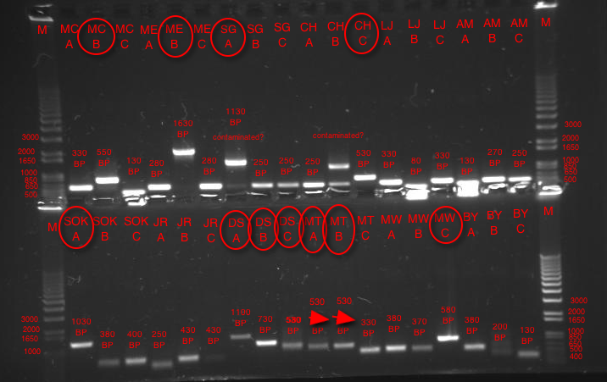
11/26 Direct Colony PCR; 11/27 Gel
Ran too long
Were not confident about some sizes because ran over into wells.
11/26 Direct Colony PCR; 11/27 Gel

Slide 4
Gel on Digests of 17ME41.09-17ME43.09 (ME-B,E,F) and 17MT41.09-17MT42.09 (MT-A,B)
November 5, 2009
U C U C U C
1,630 630 1,230
3,000 bp
1,000 bp
500 bp
17ME41.09 17ME42.09 17ME43.09
U C U C
3,000 bp
1,000 bp
500 bp
450 bp 500 bp
17MT41.09 17MT42.09
Used NEB 2K ladder
Notes:
M

Slide 5
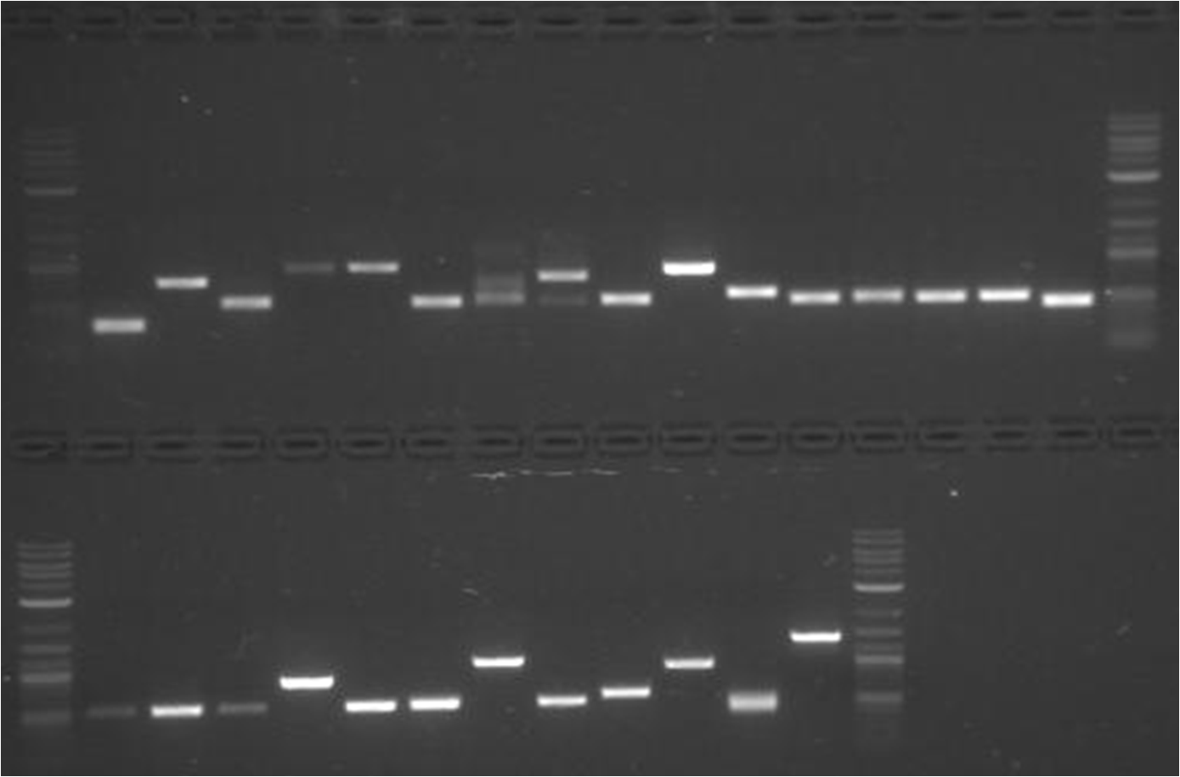
Gel of PCRs of X, Y, and Z (or D,E,F)
November 11, 2009
Used NEB 2K ladder
X
Y
Z
X
Y Z X Y Z X Y Z X X Y Z
3,000 bp
750 bp
750 bp
550 bp
530 bp
230
210bp
1,000bp
230 bp
270
220 bp
250
230
230 bp
230 bp
500 bp
80 bp
SAM
LIZ
ALEX M. S JASON
100 bp
MAEL
X Y Z X Y Z X Y Z D E F
-Liz’s X and Y look contaminated because they have multiple bands
3,000 bp
600 bp
830 bp
1,380 bp
250 bp
730 bp
330bp
340 bp
1,000 bp
310 bp
230 bp
350 bp
500 bp
MARISA BRIAN ED MADI

Slide 6
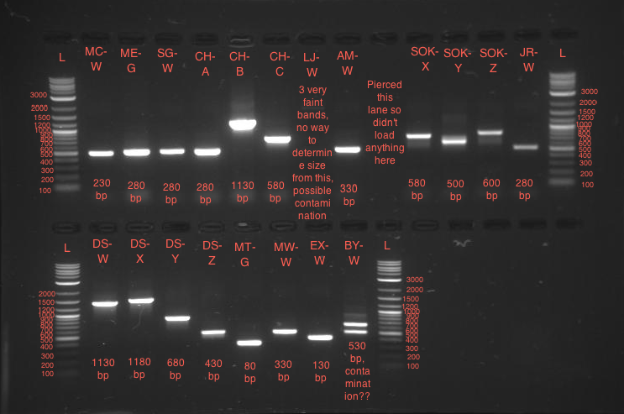
11/11 Direct Colony PCR; 11/12 Gel
Used NEB 2K ladder
BY-W and
LJ-W look contaminated

Slide 7
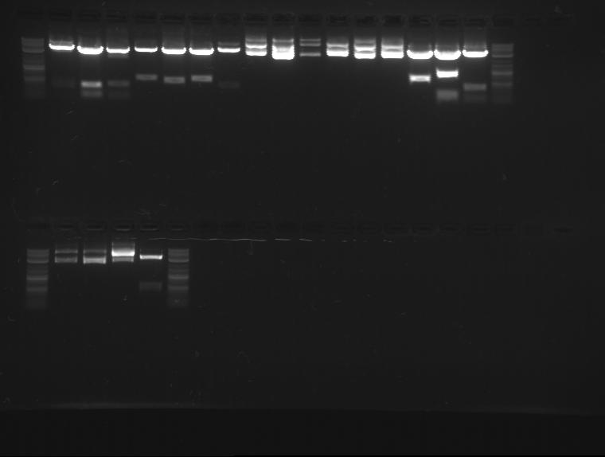
Used NEB 2K ladder
MC-02
CH-01
LJ-01
AM-01
SO-01
02
JR-01
DS-01 02 03 04 05 06
MT-43 44
MW-01
3000
1000
3000
500
Didn’t Cut
1000
500
400
500
500
500
450
500
400
850
1150
550
Very faint band
Very faint band
EX-01 02 03
BY-01
3000
1000
11/19 Mini-preps; 11/23 Gel
Didn’t Cut
500
500
-David Sukhin ran this backwards for about 10-15 mins
Mrs. O’Mara switched it before it fell off
Smaller ladder may have fallen off
Enzyme was added before buffer to master mix for EX and DS, which is why they didn’t cut

Slide 8
Complications
David ran the gel on 11/23/09 on the mini-prepped plasmids backwards.
Some clones had PCRs over 500, but digests under, but they will be sequenced
Clones CH-B, LJ-W, and BY-W were contaminated
Possible reasons:
  Bad pipetting
  Picked multiple colonies
  Other external contaminant

