Slide 1
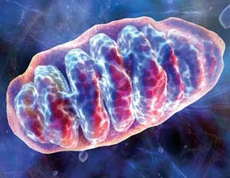
Working Cell
1,000’s of reaction in a microscopic space- some releasing energy stored in chemical compounds, others storing energy in chemical compounds

Slide 2
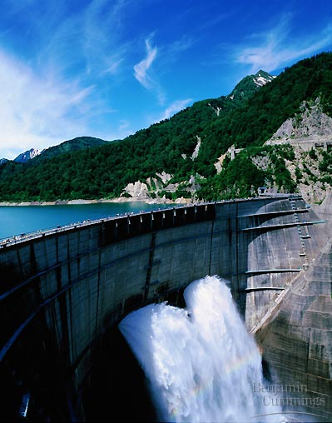
Potential Energy
Kinetic Energy

Slide 3
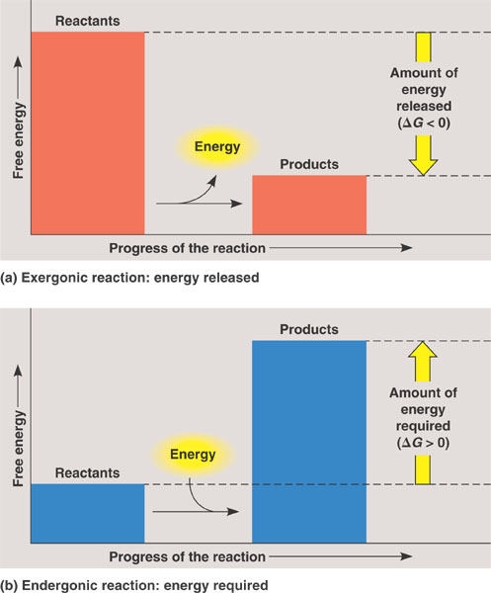
Chemical Reactions are 2 types:
Exergonic
Releasing! Releases energy to environment.
Endergonic
Storing- products rich in potential energy
Metabolism, metabolic pathway
Energy coupling

Slide 4
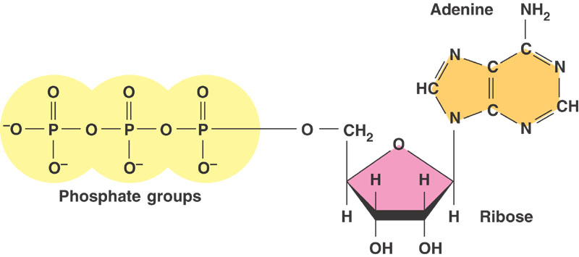
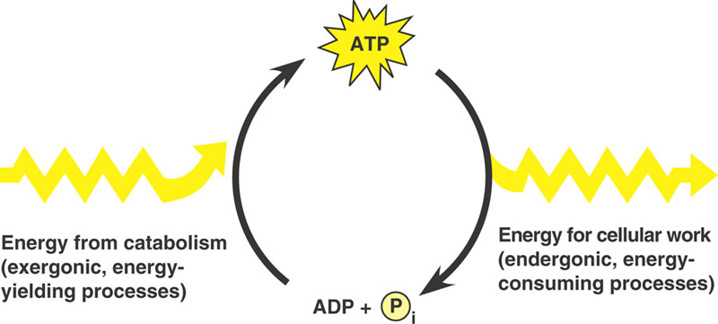
Adenosine tri-phosphate

Slide 5
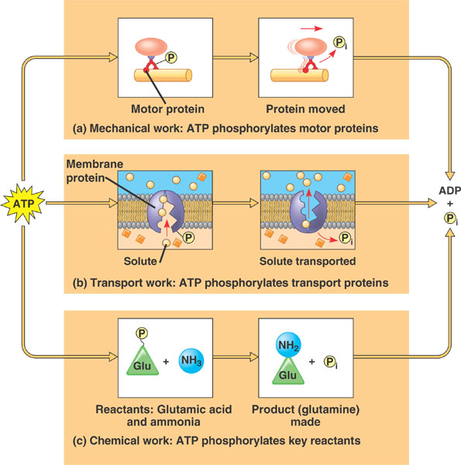

Slide 6
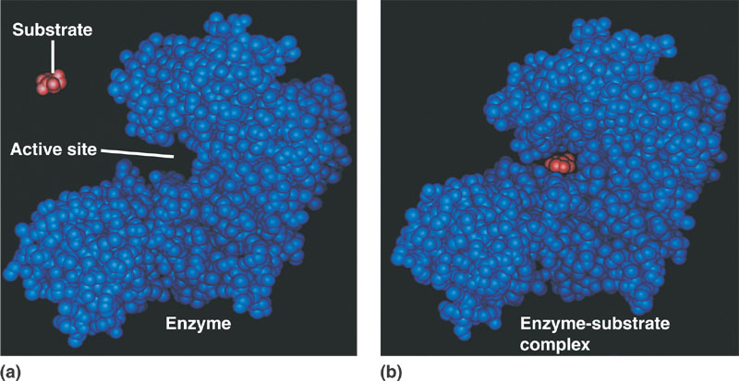
Enzymes
How do enzymes work?
Lock and key, induced fit, cofactors, specificity, enzyme substrate complex, energy of activation
Optimal Range of Activity- ph, temp, salt, denaturation
Regulation: normal binding, competitive inhibition, non. comp. inhibition

Slide 7
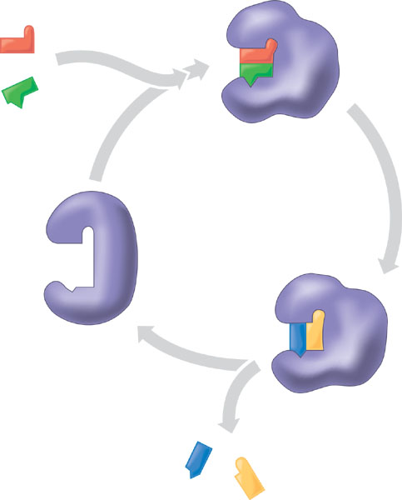

Slide 8
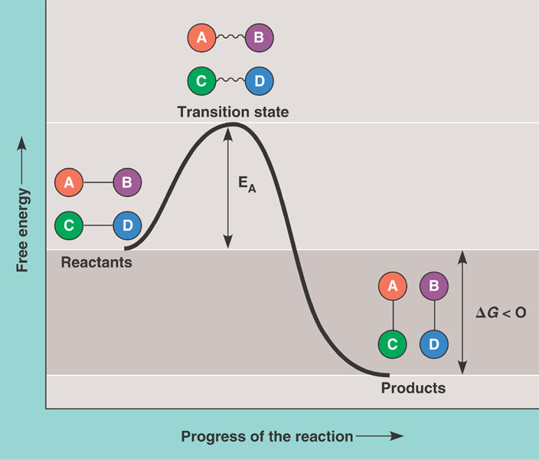

Slide 9
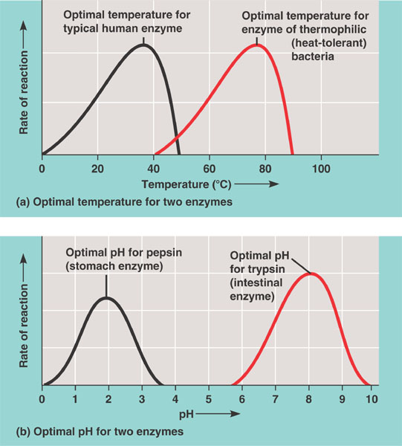

Slide 10
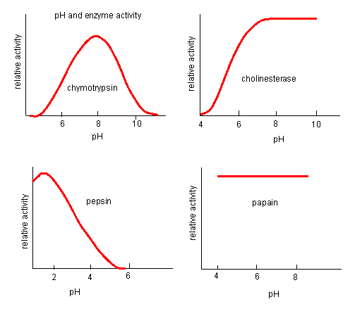

Slide 11
