Slide 1

Jeopardy!

Slide 2
Choose Category & Amount
PEMDAS | Equations | Add ‘em Up | Pot Luck | GCF,LCM,LCD | Word Problems
200 | 200 | 200 | 200 | 200 | 200
400 | 400 | 400 | 400 | 400 | 400
600 | 600 | 600 | 600 | 600 | 600
800 | 800 | 800 | 800 | 800 | 800
1000 | 1000 | 1000 | 1000 | 1000 | 1000

Slide 3
Final Jeopardy
The following pattern will continue until you arrive
at a number that is NOT prime. Name that number.
11,13,17,23,31,…
Back
What is 121 ?

Slide 4
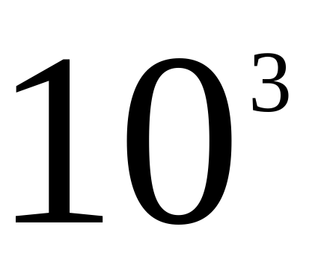
PEMDAS 200
Back
What is 1000 ?

Slide 5
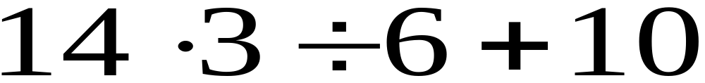
PEMDAS 400
Back
What is 17 ?

Slide 6

PEMDAS 600
Back
What is 26 ?

Slide 7
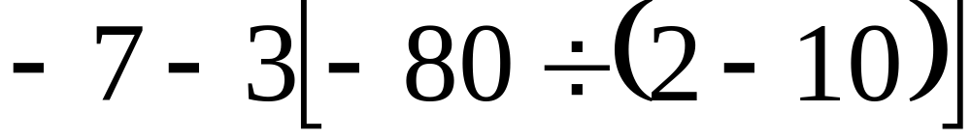
PEMDAS 800
Back
What is -37 ?

Slide 8
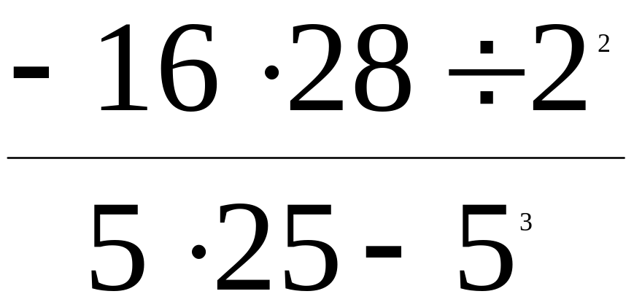
PEMDAS 1000
Back
What is undefined ?

Slide 9

Equations 200
Back
What is x = -14 ?

Slide 10
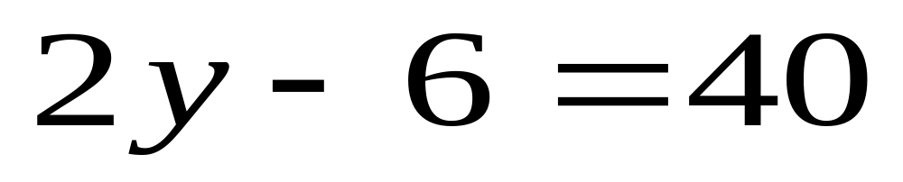
Equations 400
Back
What is y =23 ?

Slide 11
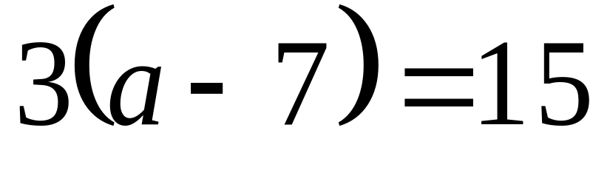
Equations 600
Back
What is a = 12 ?

Slide 12
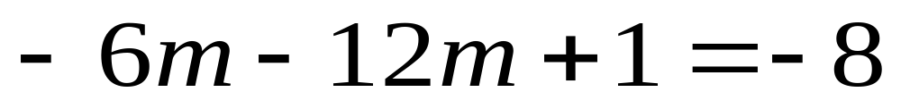
Equations 800
Back
What is m = ½ ?

Slide 13
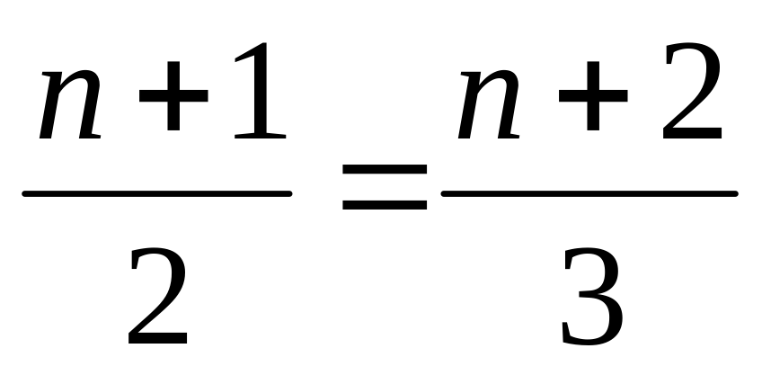
Equations 1000
Back
What is n = 1 ?

Slide 14
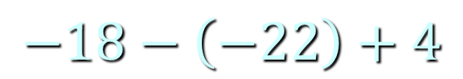
Add ‘em Up 200
$$−18−\left(−22\right)+4$$
Back
What is 8 ?

Slide 15
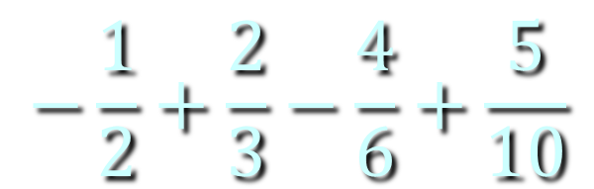
Add ‘em Up 400
$$−\frac{1}{2}+\frac{2}{3}−\frac{4}{6}+\frac{5}{10}$$
Back
What is zero ?

Slide 16
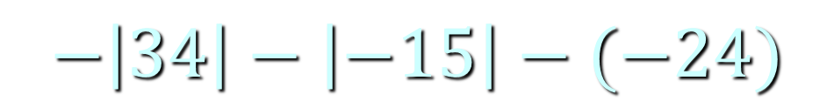
Add ‘em Up 600
$$−\left|34\right|−\left|−15\right|−(−24)$$
Back
What is -25 ?

Slide 17
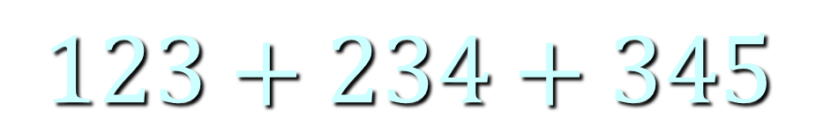
Add ‘em Up 800
$$123+234+345$$
Back
What is 702 ?

Slide 18
Add ‘em Up 1000
The number of weeks in a year plus
the opposite of the number of inches in
a yard plus the number of pints in a gallon.
Back
What is 24 ?

Slide 19
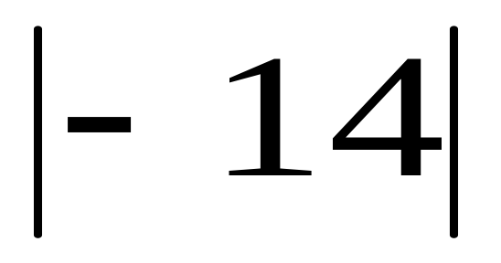
Pot Luck 200
Back
What is 14 ?

Slide 20
Pot Luck 400
The additive inverse of 35.
Back
What is -35 ?

Slide 21
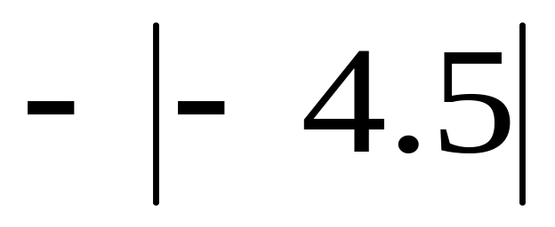
Pot Luck 600
Back
What is -4.5 ?

Slide 22
Pot Luck 800
The ratio 20 oz : 4 lbs expressed as
a fraction in lowest terms
Back
What is 5/16 ?

Slide 23
Pot Luck 1000
¼ % as a fraction in lowest terms
Back
What is 1/400 ?

Slide 24
GCF, LCM, LCD 200
5 and 15. GCF.
Back
What is 5 ?

Slide 25
GCF, LCM, LCD 400
5 and 15. LCM.
Back
What is 15 ?

Slide 26
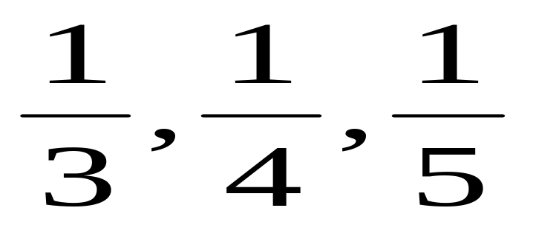
GCF, LCM, LCD 600
LCD
Back
What is 60 ?

Slide 27
GCF, LCM, LCD 800
12, 42, 54. GCF.
Back
What is 6 ?

Slide 28
GCF, LCM, LCD 1000
10, 12, 15. LCM.
Back
What is 60 ?

Slide 29
Word Problems 200
This is 10% of 250.
Back
What is 25 ?

Slide 30
Word Problems 400
A sweater is on sale for 30% off.
This would be the sale price when
the original price was $60.00.
Back
What is $42.00 ?

Slide 31
Word Problems 600
Find the mean of the following numbers:
16, 22, 54, 35, 30, 23
Back
What is 30 ?

Slide 32
Word Problems 800
If Tom traveled 72 miles in 16 hours,
what is his rate in miles per hour?
Back
What is 4.5 mph ?

Slide 33
Word Problems 1000
Chaz earned $280 selling magazine subscriptions
and his total sales were $2000. This would mean
his rate of commission was this.
Back
What is 14% ?

