Slide 1
BioEthics
An Introduction

Slide 2


Slide 3
Bioethics is the philosophical study of ethical controversies brought about by advances in biology and medicine.

Slide 4
BioEthics
Relatively new discipline (1960s)
Born in response to violations of human rights in biomedical research → focusing on protection of individuals
Informed consent
Does not tell you what to do or think
Instead provides a framework of discussion to consider different perspectives and formulate your own responses to these fascinating issues

Slide 5
BioEthics Topics
Abortion
Advance directives
Confidentiality
DNR orders
End of life issues
Informed consent
Neuroethics
Organ donation
Reproductive technologies
Research ethics
Resource allocation
Spirituality and Medicine
Treatment refusal

Slide 6
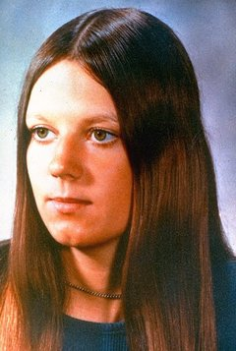
Case Studies
Karen Ann Quinlan
  Right to die controversy
  At 21 collapsed and stopped breathing for 15 minutes or more
  Parents request for removal from ventilator spurred legal battle
  Removed from ventilator in 1976, died in 1985
  Moral theology, bioethics, euthanasia, civil rights and legal guardianship

Slide 7

Case Studies
Nancy Cruzan
  After auto accident (1983) left her in a persistent vegetative state, family tried for 3 years to have feeding tube removed
  Dec 1990 feeding tube removed and passed 12 days later

Slide 8
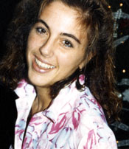
Case Studies
Terri Schiavo
  Suffered cardiac arrest Feb 1990 causing extensive brain damage
  1998 husband petioned court to have feeding tube removed
  Terri’s family objected
  First removal 2001
  Final removal March 18, 2005
  Terri passed 13 days later

Slide 9
