Slide 1
Cell Structure & Function

Slide 2
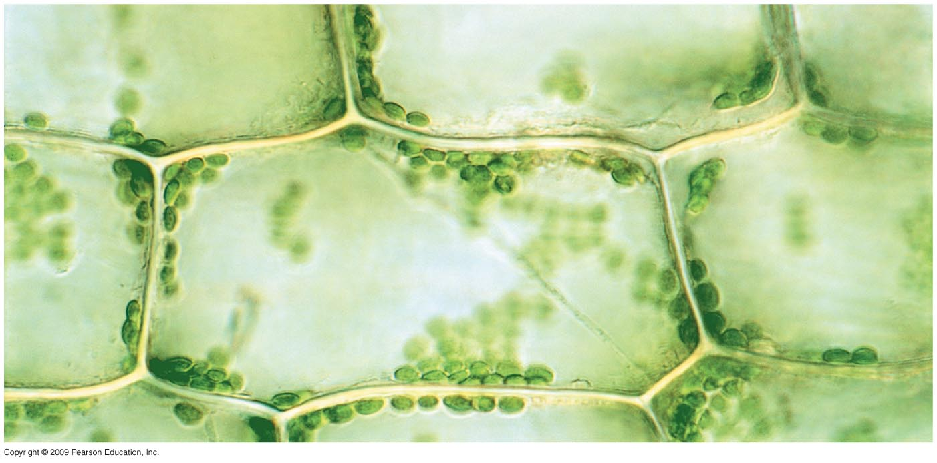
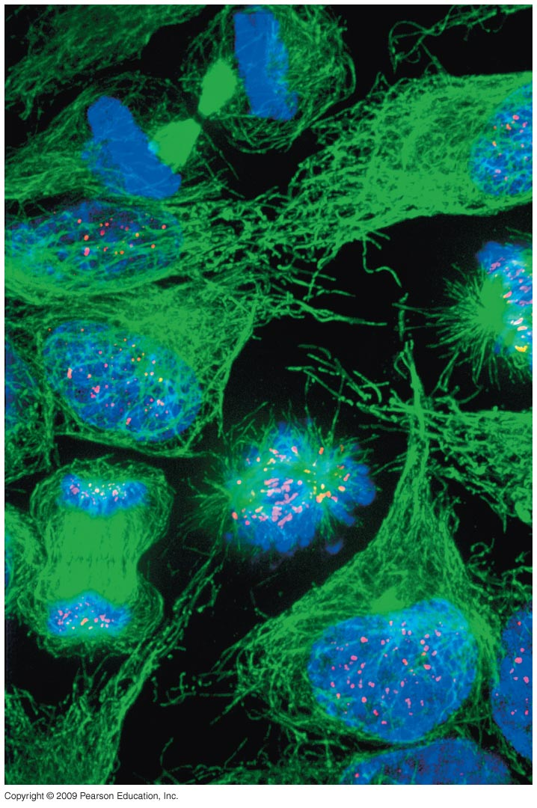
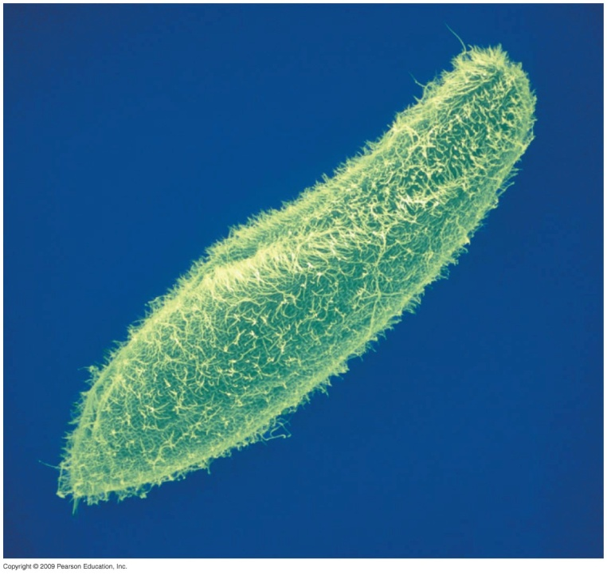
Types of Cells

Slide 3
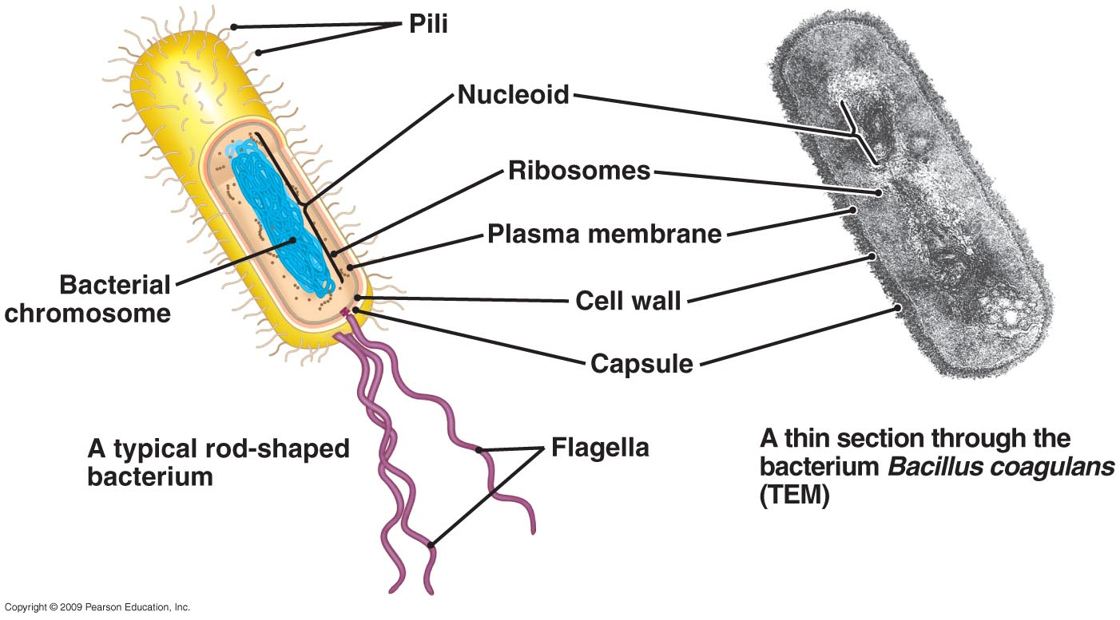
Prokaryotic Cell

Slide 4
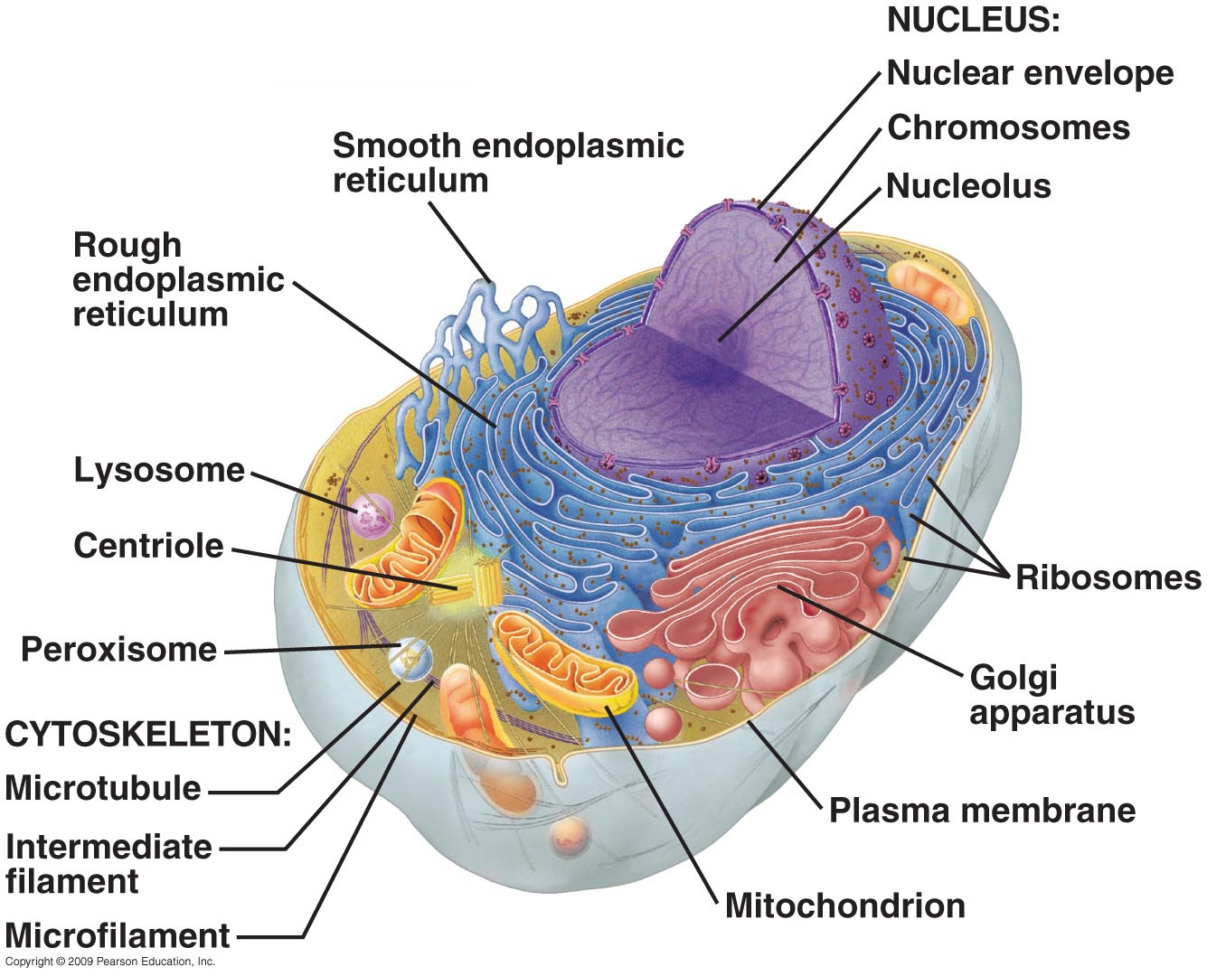
Typical Animal Cell

Slide 5
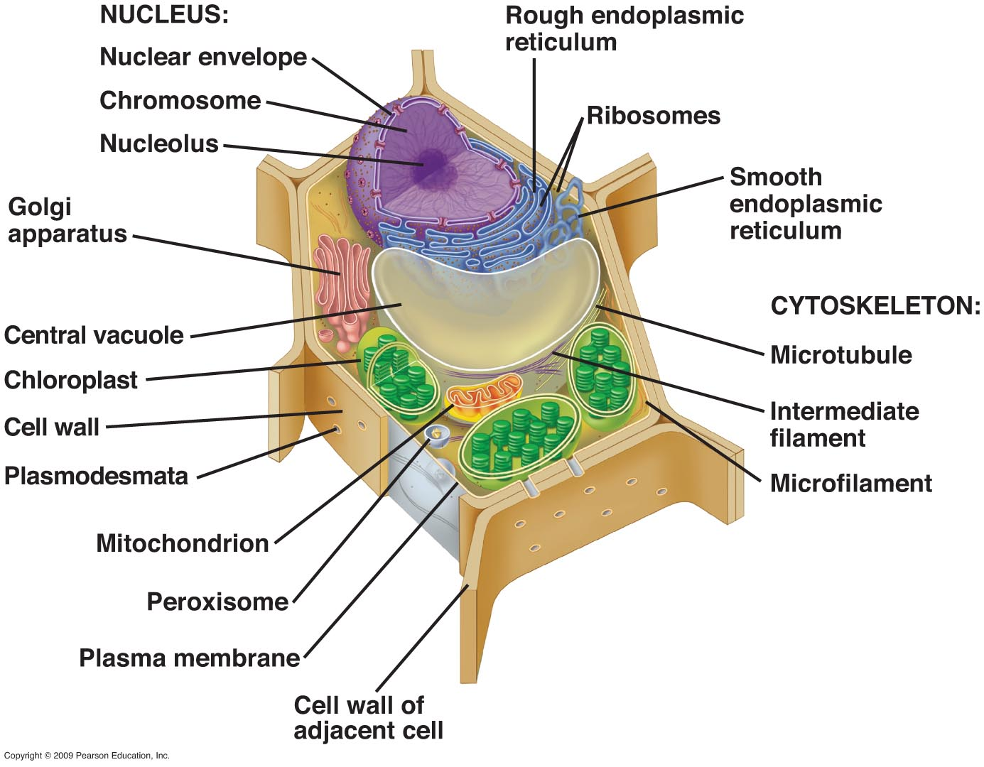
Typical Plant Cell

Slide 6
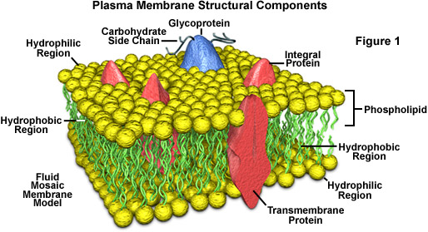
Fluid Mosaic Model of a
Plasma Membrane

Slide 7
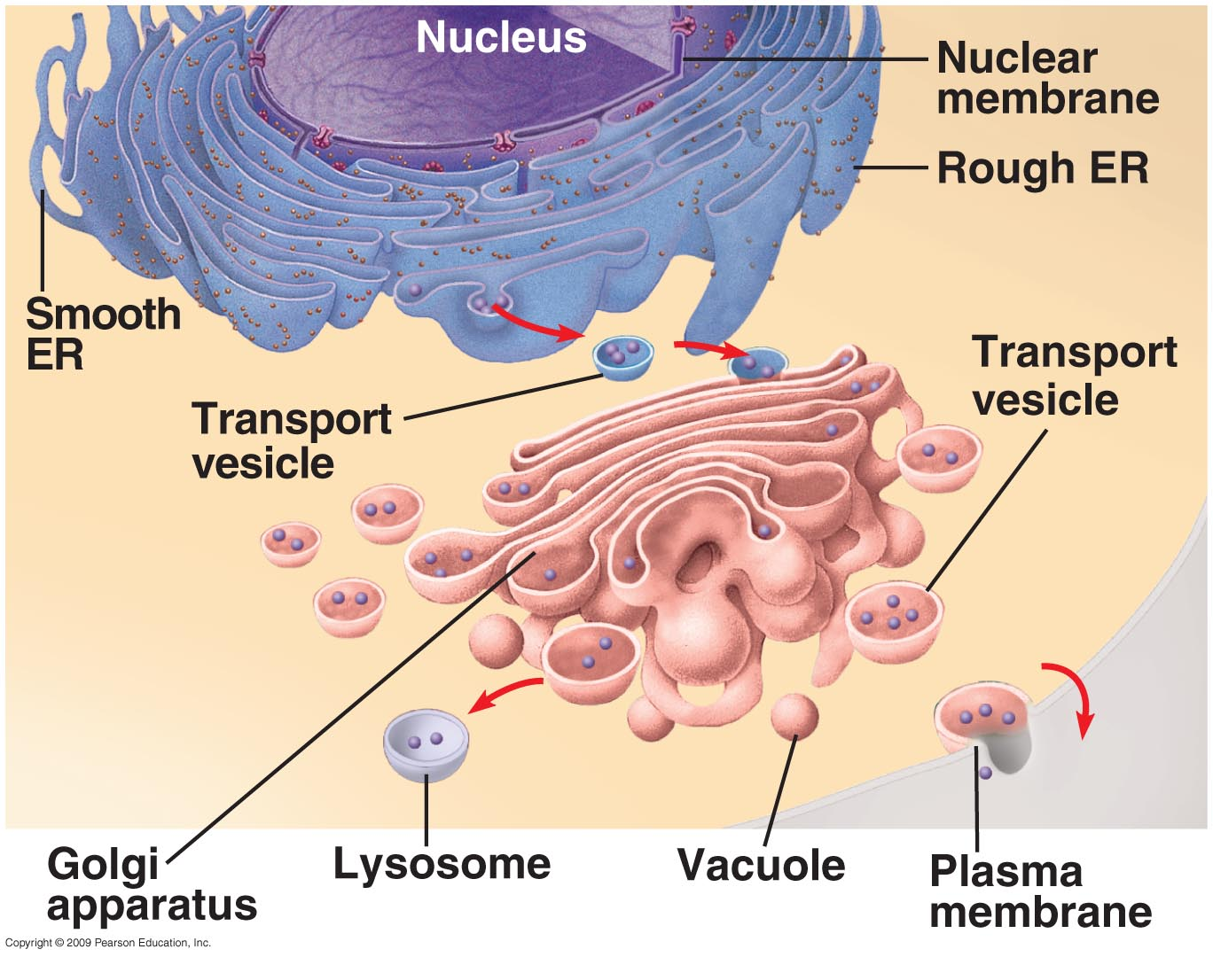
Endomembrane System

Slide 8
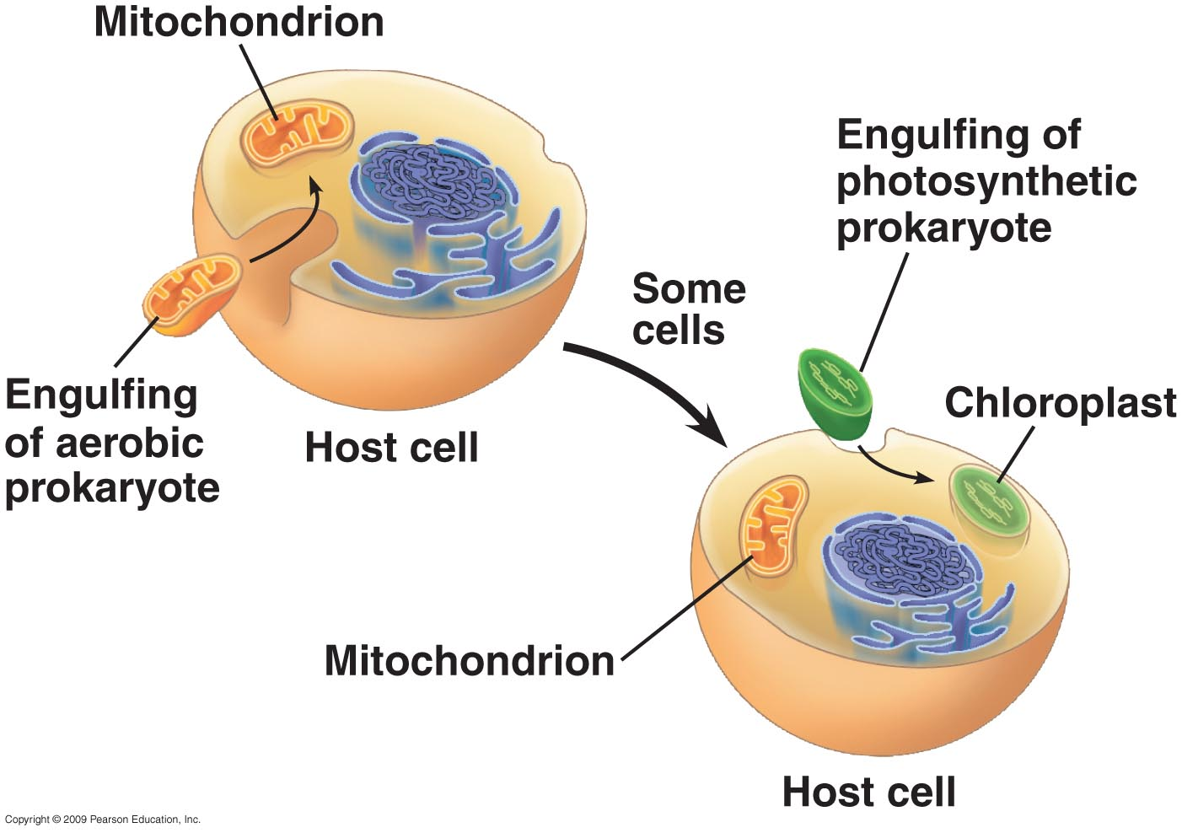
Endosymbiotic Theory

