Slide 1
Cell Transport
Enzyme Action

Slide 2
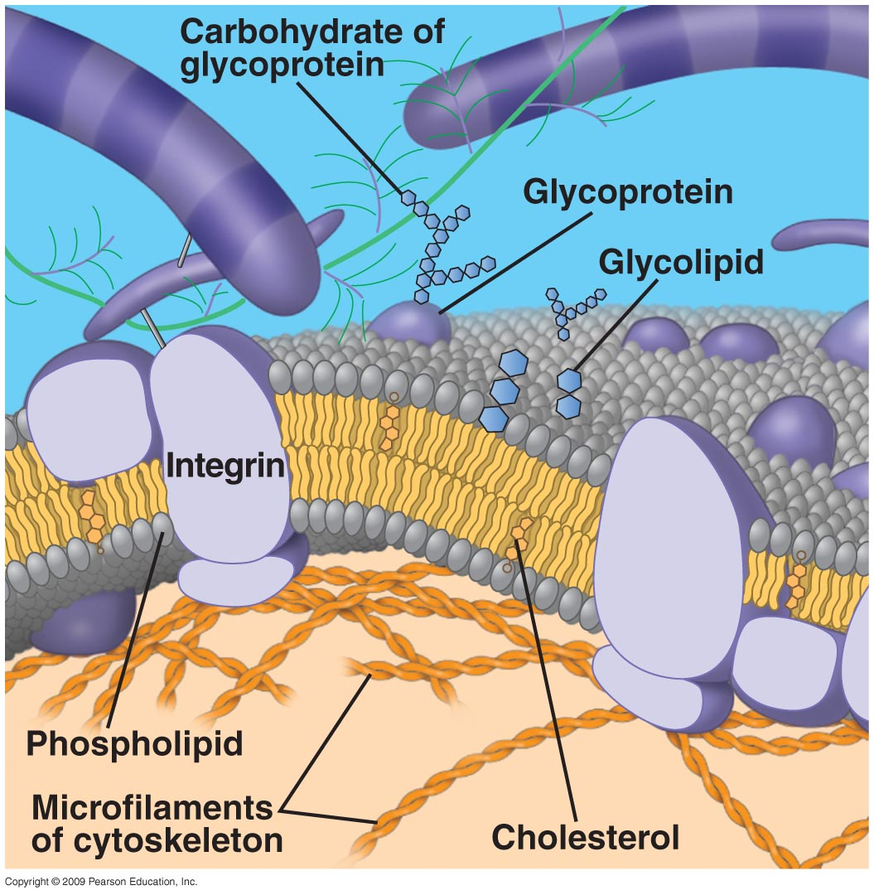

Slide 3
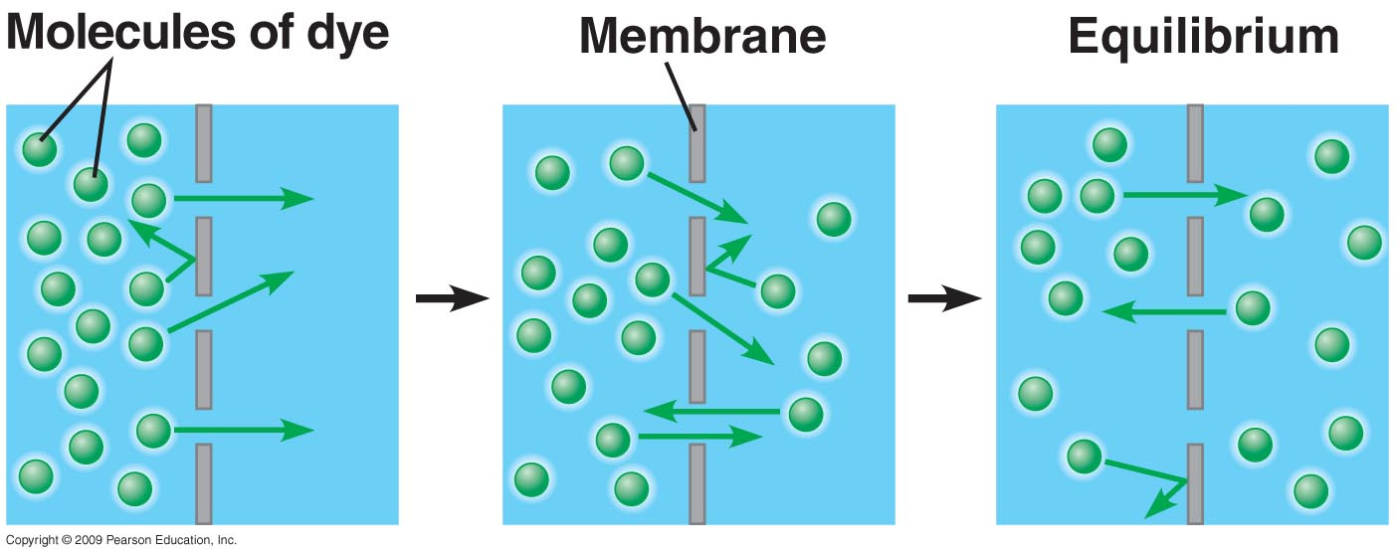
Passive Transport

Slide 4
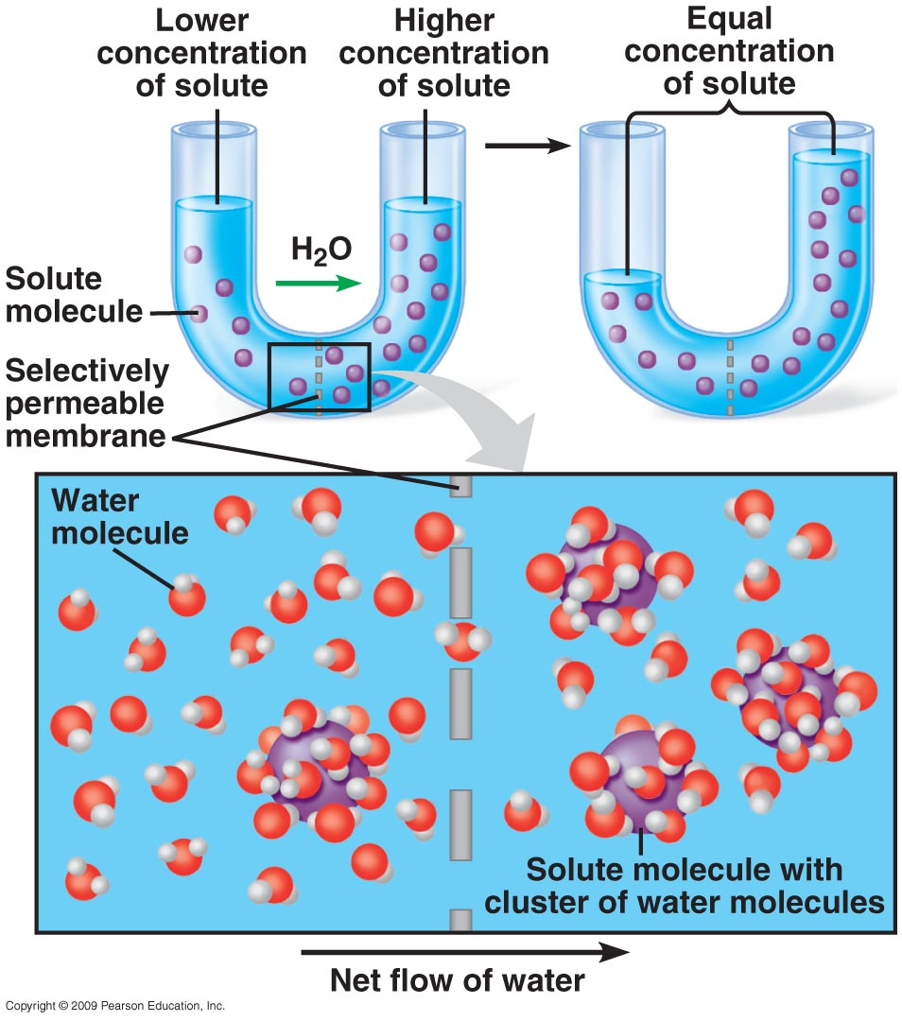
Osmosis

Slide 5
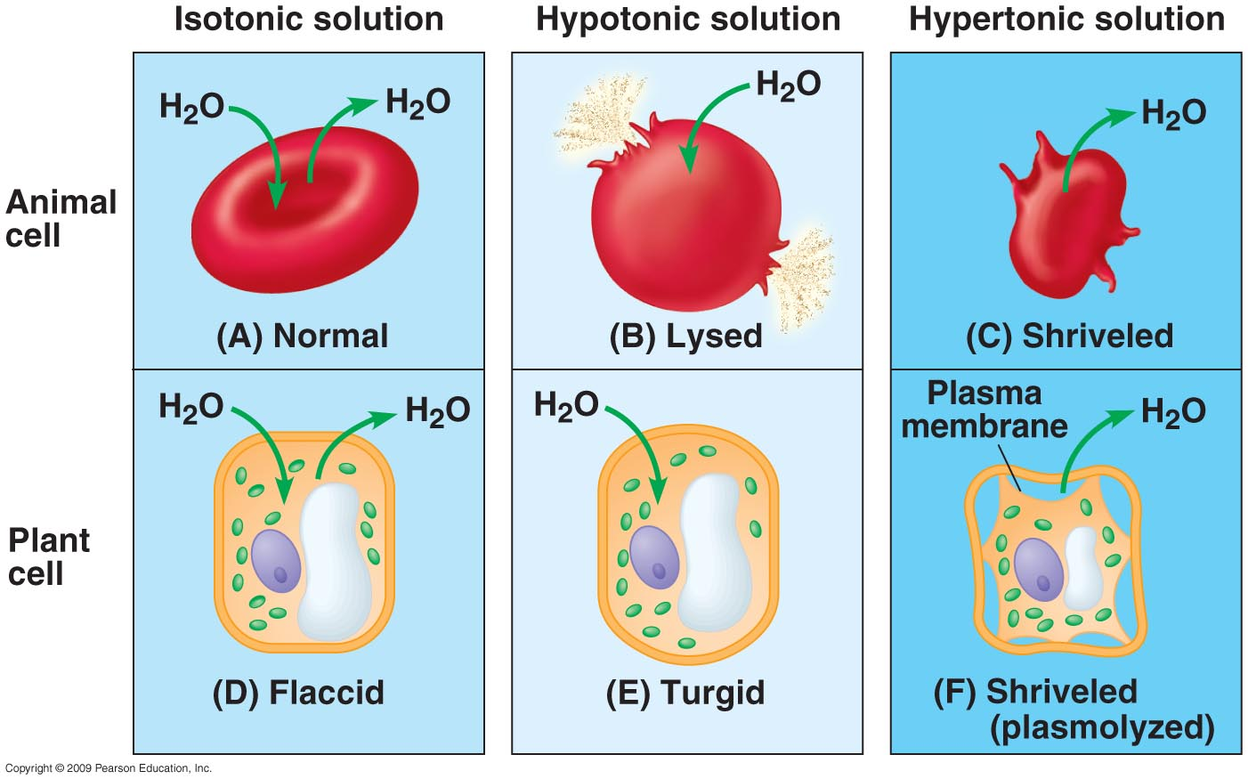
Tonicity in Animal & Plant Cells

Slide 6
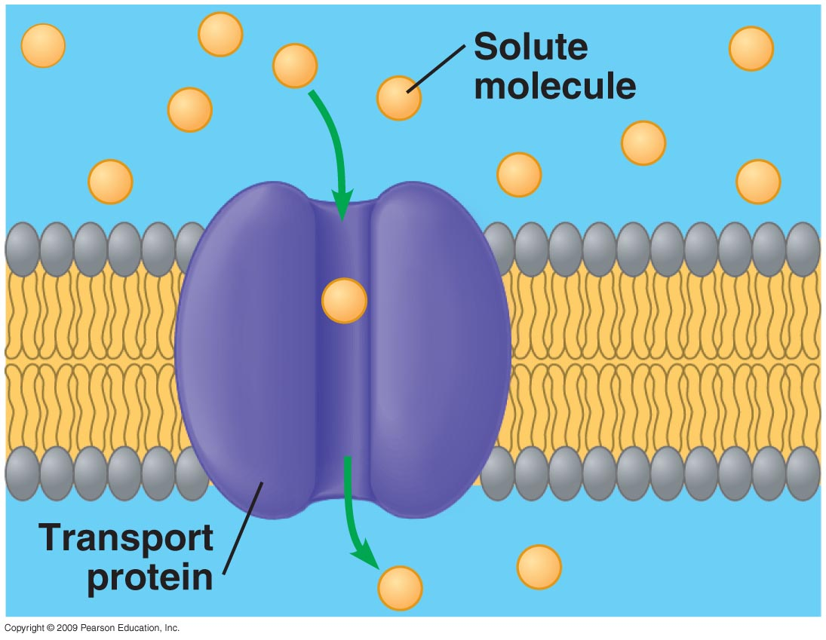
Transport Proteins – Facilitated Diffusion

Slide 7
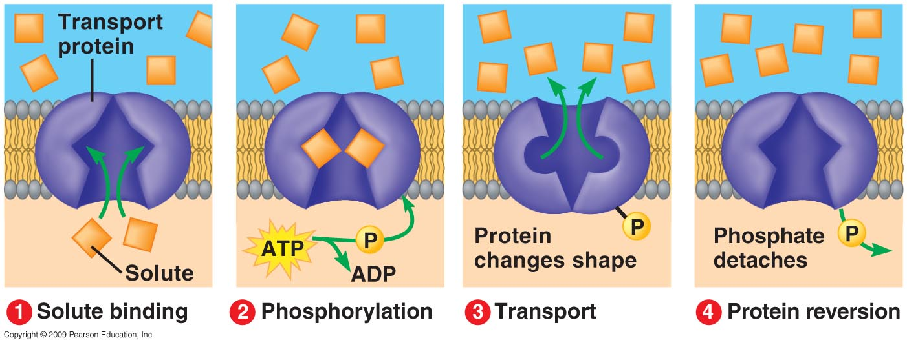
Active Transport

Slide 8
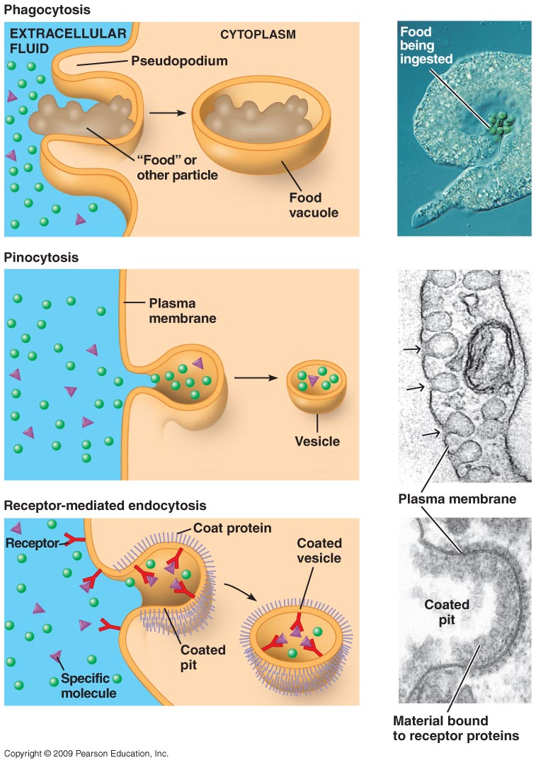
Endocytosis

Slide 9
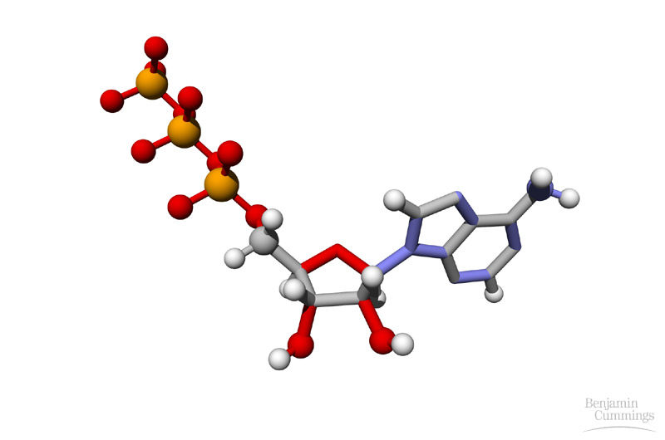
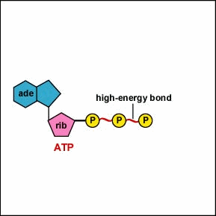
ATP – adenosine triphosphate

Slide 10
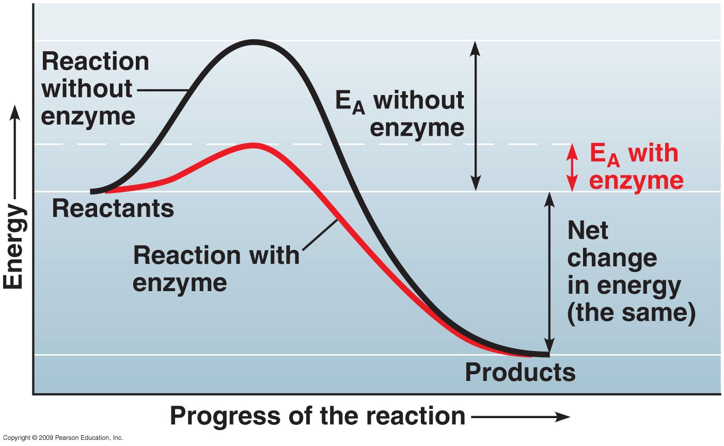
Activation Energy (E_{A})

Slide 11
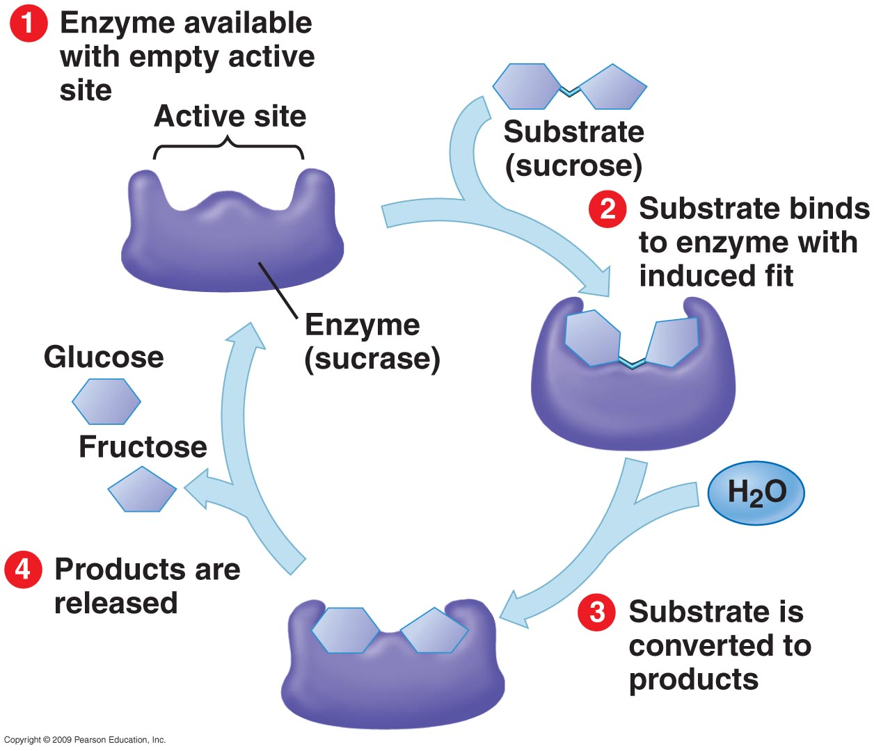
Enzyme-Substrate Interaction

Slide 12
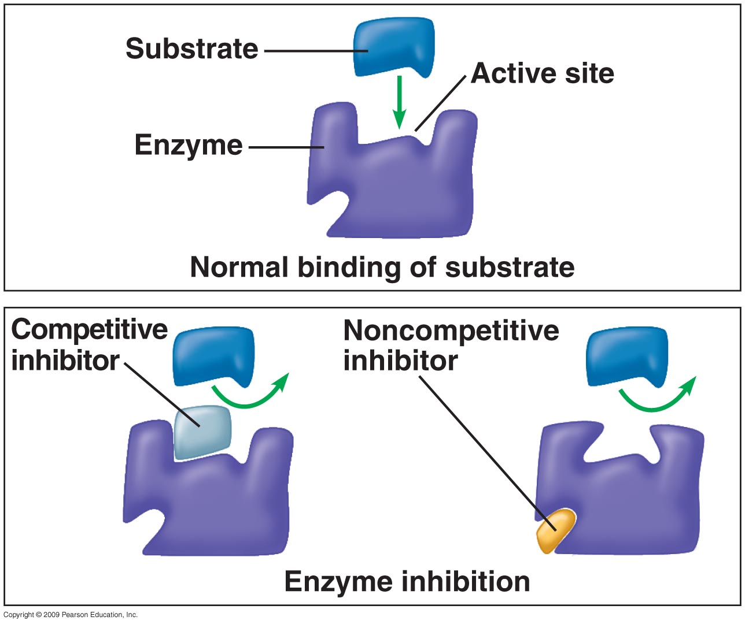
Enzyme Inhibition

