Slide 1
Chapter 5
The Working Cell
0
Lecture by Richard L. Myers

Slide 2
Introduction: Turning on the Lights to Be Invisible
Some organisms use energy-converting reactions to produce light
  Examples are organisms that live in the ocean and use light to hide themselves from predators
Energy conversion involves not only energy but also membranes and enzymes
So, production of light involves all of the topics covered in this chapter
Copyright © 2009 Pearson Education, Inc.
Notes:
This chapter describes how working cells, such as those found in a prey organism, use cellular metabolism directed by enzymes associated with membranes to convert energy.

Slide 3
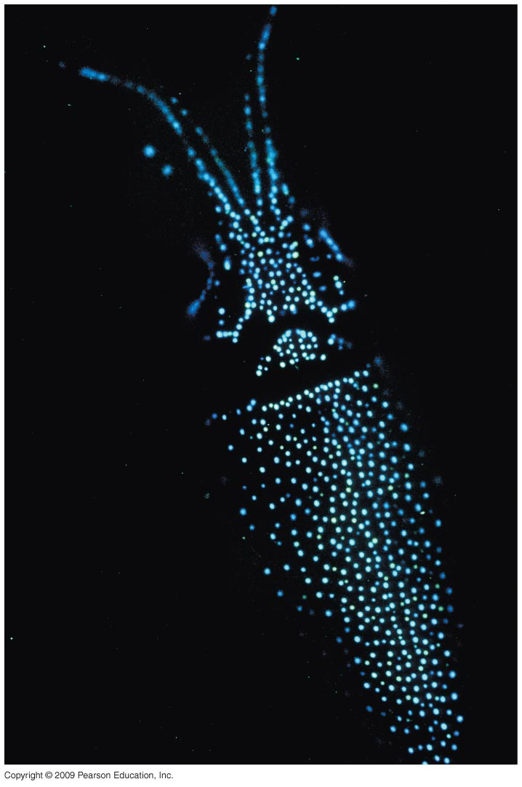
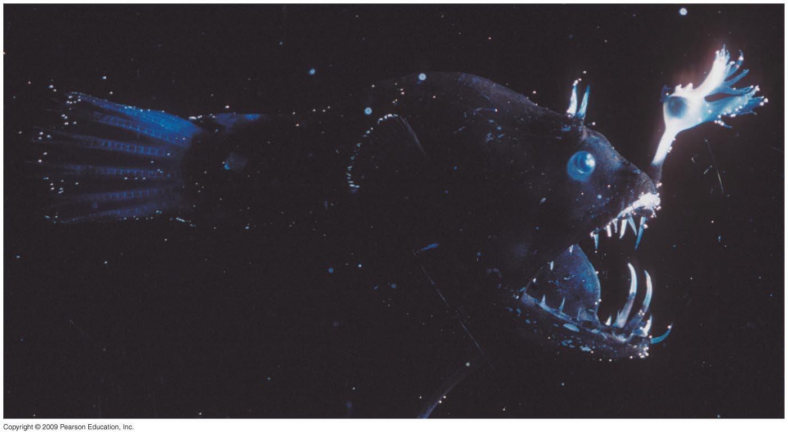

Slide 4
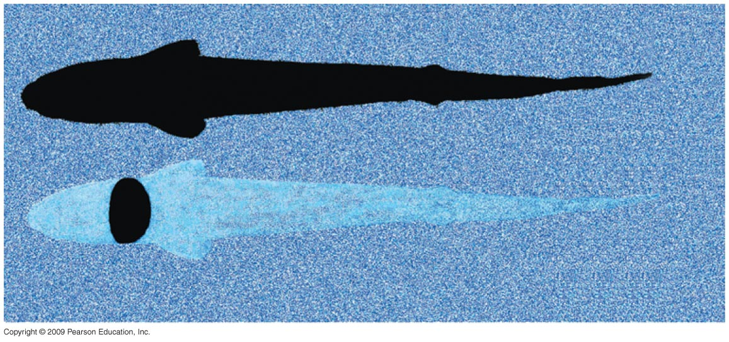

Slide 5
MEMBRANE STRUCTURE AND FUNCTION
Copyright © 2009 Pearson Education, Inc.

Slide 6
5.1 Membranes are a fluid mosaic of phospholipids and proteins
Membranes are composed of phospholipids and proteins
  Membranes are commonly described as a fluid mosaic
  This means that the surface appears mosaic because of the proteins embedded in the phospholipids and fluid because the proteins can drift about in the phospholipids
Copyright © 2009 Pearson Education, Inc.

Slide 7
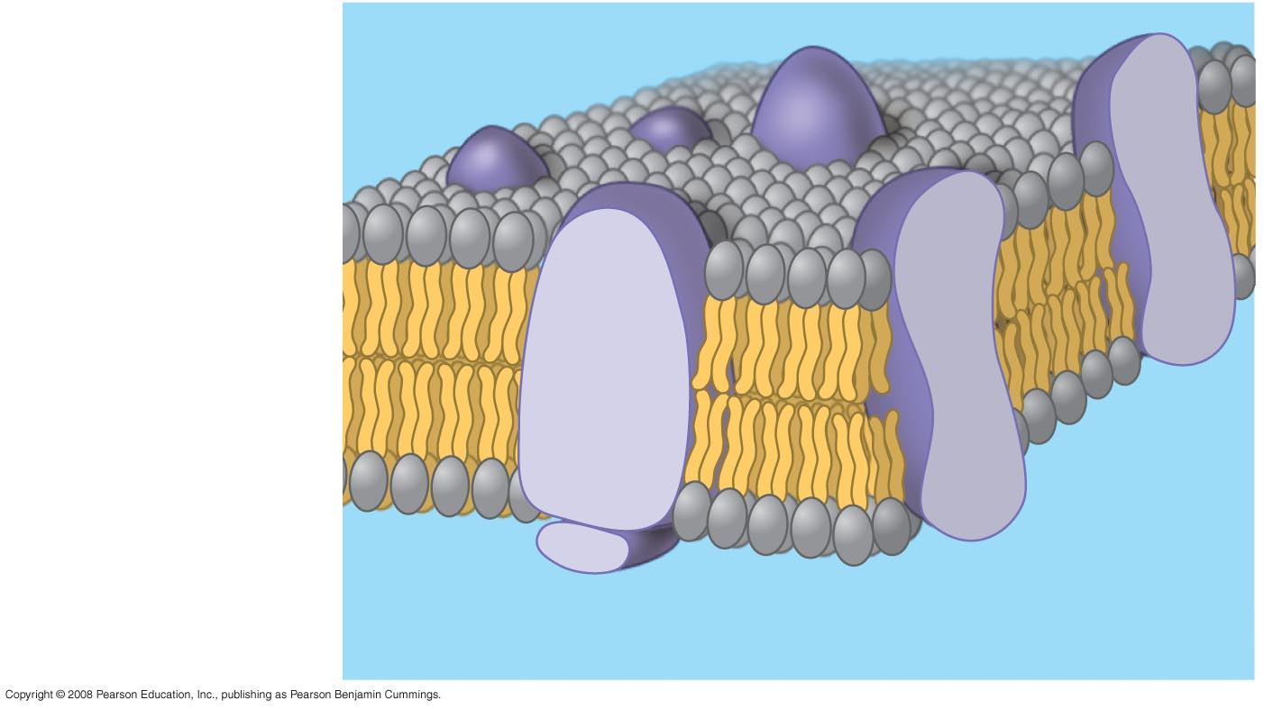
Phospholipid
bilayer
Hydrophobic regions
of protein
Hydrophilic
regions of protein
Notes:
Campbell, Neil, and Jane Reece, Biology, 8th ed., Figure 7.3 The fluid mosaic model for membranes.

Slide 8
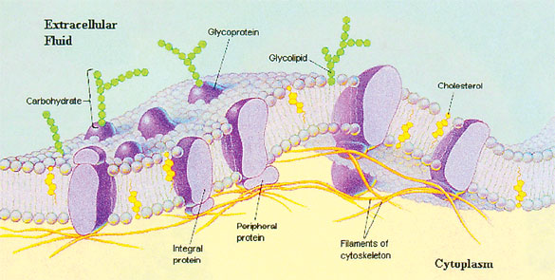
Fluid Mosaic Model Of a Plasma Membrane
Fluid Mosaic of a Cell’s Membrane

Slide 9
5.1 Membranes are a fluid mosaic of phospholipids and proteins
Many phospholipids are made from unsaturated fatty acids that have kinks in their tails
  This prevents them from packing tightly together, which keeps them liquid
  This is aided by cholesterol wedged into the bilayer to help keep it liquid at lower temperatures
Copyright © 2009 Pearson Education, Inc.
Notes:
The bilayer is about as fluid as salad or cooking oil.
Teaching Tips
1. You might wish to share a very simple analogy that seems to work well for some students. A cell membrane is a little like a peanut butter and jelly sandwich with jellybeans poked into it. The bread represents the hydrophilic portions of the bilayer (and bread does indeed quickly absorb water). The peanut butter and jelly represent the hydrophobic regions (and peanut butter, containing plenty of oil, is generally hydrophobic). The jellybeans stuck into the sandwich represent proteins variously embedded partially into or completely through the membrane. Transport proteins would be like the jellybeans that poke completely through the sandwich. Analogies are rarely perfect. Challenge your students to critique this analogy by finding exceptions. (For example, this analogy does not include a model of the carbohydrates on the cell surface.)

Slide 10
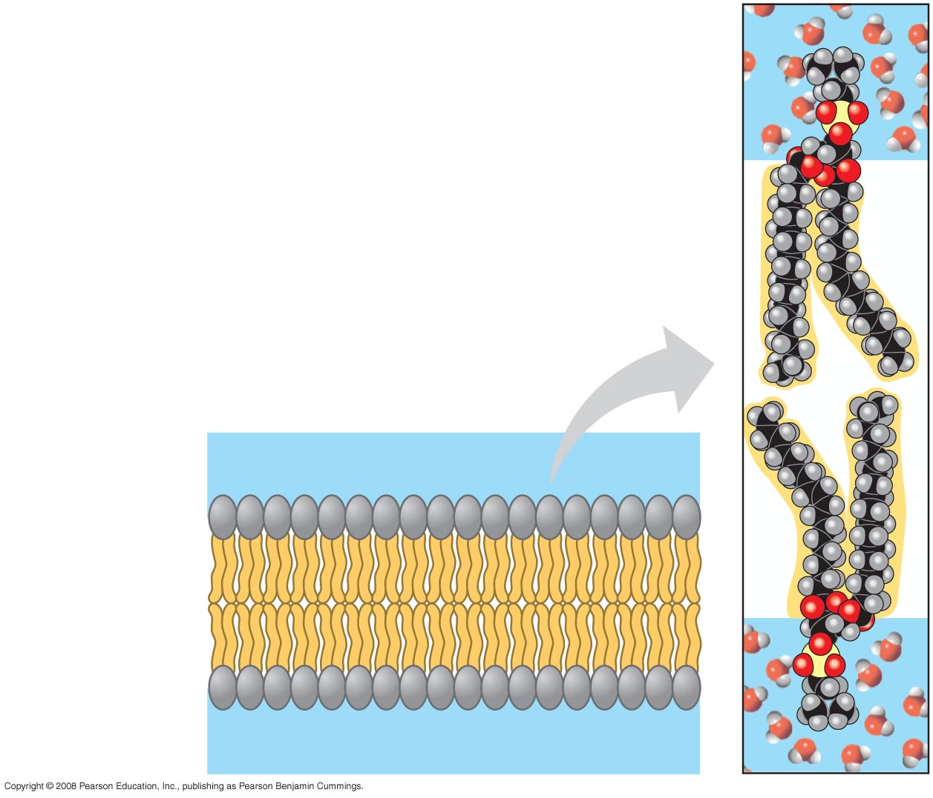
Phospholipid Bilayer
WATER
Hydrophilic
head
Hydrophobic
tail
WATER
Notes:
Campbell, Neil, and Jane Reece, Biology, 8th ed., Figure 7.2 Phospholipid bilayer (cross section).

Slide 11
5.1 Membranes are a fluid mosaic of phospholipids and proteins
Membranes contain integrins (integral proteins), which give the membrane a stronger framework
  Integrins attach to the extracellular matrix on the outside of the cell as well as span the membrane to attach to the cytoskeleton
Copyright © 2009 Pearson Education, Inc.

Slide 12
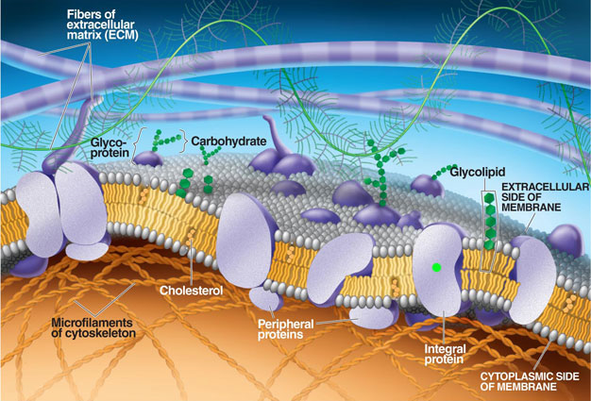

Slide 13
5.1 Membranes are a fluid mosaic of phospholipids and proteins
Some glycoproteins in the membrane serve as identification tags that are specifically recognized by membrane proteins of other cells
  For example, cell-cell recognition enables cells of the immune system to recognize and reject foreign cells, such as infectious bacteria
  Carbohydrates that are part of the extracellular matrix are significantly involved in cell-cell recognition
Copyright © 2009 Pearson Education, Inc.
Notes:
Carbohydrates vary among individual cells and function as markers. For example, the four human blood types designated A, B, AB, and O reflect variation in the carbohydrates on the surface of red blood cells.
Teaching Tips
1. You might wish to share a very simple analogy that seems to work well for some students. A cell membrane is a little like a peanut butter and jelly sandwich with jellybeans poked into it. The bread represents the hydrophilic portions of the bilayer (and bread does indeed quickly absorb water). The peanut butter and jelly represent the hydrophobic regions (and peanut butter, containing plenty of oil, is generally hydrophobic). The jellybeans stuck into the sandwich represent proteins variously embedded partially into or completely through the membrane. Transport proteins would be like the jellybeans that poke completely through the sandwich. Analogies are rarely perfect. Challenge your students to critique this analogy by finding exceptions. (For example, this analogy does not include a model of the carbohydrates on the cell surface.)

Slide 14

5.1 Membranes are a fluid mosaic of phospholipids and proteins
Many membrane proteins function as enzymes, others in signal transduction, while others are important in transport
  Because membranes allow some substances to cross or be transported more easily than others, they exhibit selectively permeability
    Nonpolar molecules (carbon dioxide and oxygen) cross easily
    Polar molecules (glucose and other sugars) do not cross easily
Animation: Signal Transduction Pathways
Animation: Overview of Cell Signaling
Copyright © 2009 Pearson Education, Inc.
Notes:
Membrane proteins called transport proteins play a “gatekeeper” role in selective permeability.
Teaching Tips
1. You might wish to share a very simple analogy that seems to work well for some students. A cell membrane is a little like a peanut butter and jelly sandwich with jellybeans poked into it. The bread represents the hydrophilic portions of the bilayer (and bread does indeed quickly absorb water). The peanut butter and jelly represent the hydrophobic regions (and peanut butter, containing plenty of oil, is generally hydrophobic). The jellybeans stuck into the sandwich represent proteins variously embedded partially into or completely through the membrane. Transport proteins would be like the jellybeans that poke completely through the sandwich. Analogies are rarely perfect. Challenge your students to critique this analogy by finding exceptions. (For example, this analogy does not include a model of the carbohydrates on the cell surface.)

Slide 15
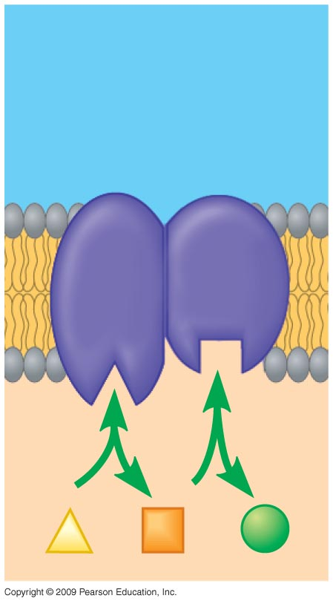
Enzymes
Notes:
Figure 5.1B Enzyme activity.

Slide 16
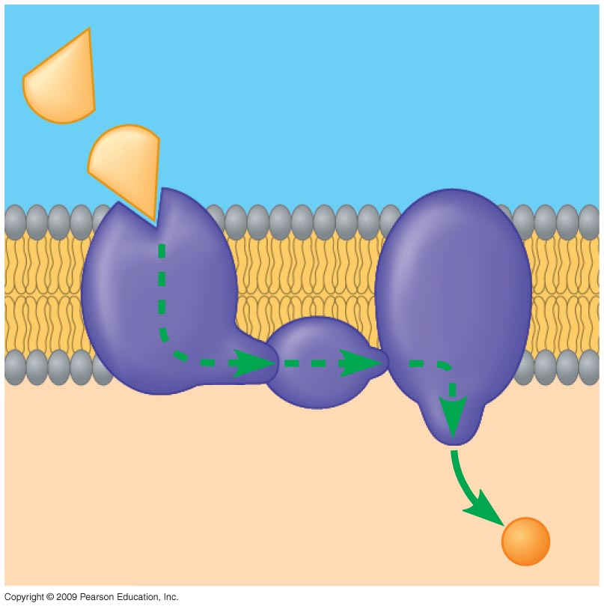
Messenger molecule
Receptor
Activated
molecule
Signal Transduction
Notes:
Figure 5.1C Signal transduction.

Slide 17
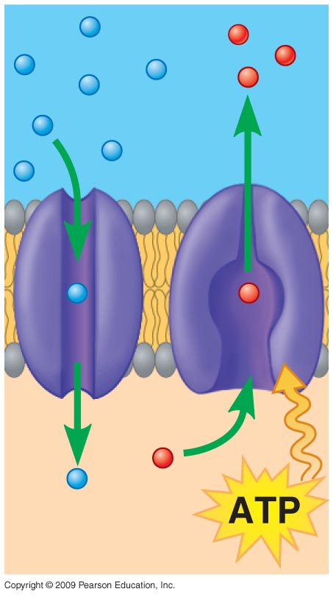
Transport across a membrane
Passive diffusion
Active diffusion
Notes:
Figure 5.1D Transport.

Slide 18
5.2 EVOLUTION CONNECTION: Membranes form spontaneously, a critical step in the origin of life
Phospholipids, the key component of biological membranes, spontaneously assemble into simple membranes
  Formation of a membrane that encloses collections of molecules necessary for life was a critical step in evolution
Copyright © 2009 Pearson Education, Inc.
Notes:
All cell membranes are similar in structure and function. This is a excellent point to illustrate the evolutionary unity of life.

Slide 19
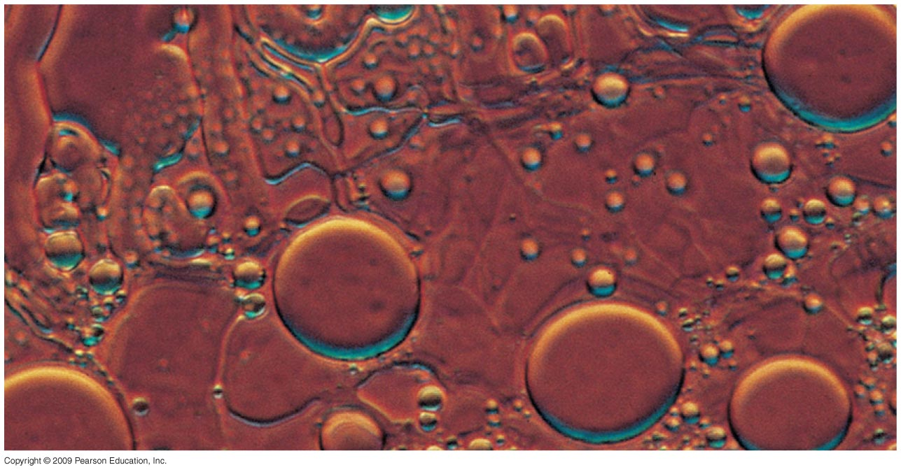
Water-filled
bubble made of
phospholipids
Notes:
Figure 5.2 Artificial membrane-bound sacs.

Slide 20
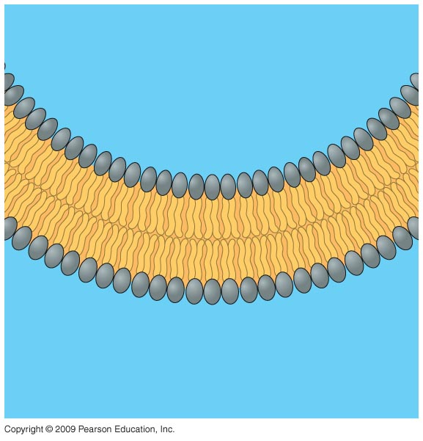
Water
Water
Notes:
Figure 5.2 Diagram of a section of a membrane sac.

Slide 21
5.3 Passive transport is diffusion across a membrane with no energy investment
Diffusion is a process in which particles spread out evenly in an available space
  Particles move from an area of more concentrated particles to an area where they are less concentrated
  This means that particles diffuse down their concentration gradient
  Eventually, the particles reach equilibrium where the concentration of particles is the same throughout
Copyright © 2009 Pearson Education, Inc.
Notes:
Much of the traffic across a membrane occurs by diffusion down its concentration gradient. This is exemplified by the diffusion of oxygen across the plasma membrane of a cell actively utilizing oxygen. As long as the cell is using the oxygen, the concentration from outside to inside will be maintained.
For the BLAST Animation Diffusion, go to Animation and Video Files.
Student Misconceptions and Concerns
1. For students with limited science backgrounds, concepts such as diffusion and osmosis can take considerable time to fully understand and apply. Instructors often struggle to remember a time in their lives when they did not know about such fundamental scientific principles. Consider spending extra time to illustrate and demonstrate these key processes to the class. Consider short interactive class exercises in which students create analogies or think of examples of these principles in their lives.
Teaching Tips
1. Students often benefit from reminders of diffusion in their lives. Smells can usually be traced back to their sources—the smell of dinner on the stove, the scent of perfume or cologne from a bottle, the smoke drifting away from a campfire. These scents are strongest nearest the source and weaker as we move away.
2. Consider demonstrating simple diffusion. A large jar of water and a few drops of ark-colored dye work well over the course of a lecture period. Alternatively, release a strong scent of cologne or peppermint or peel part of an orange in the classroom and have students raise their hands as they first detect the smell. Students nearest the source will raise their hands before students farther away. The fan from an active overhead projector or overhead vent may bias the experiment a bit, so be aware of any directed movements of air in your classroom that might disrupt this demonstration.

Slide 22
5.3 Passive transport is diffusion across a membrane with no energy investment
Diffusion across a cell membrane does not require energy, so it is called passive transport
  The concentration gradient itself represents potential energy for diffusion
Copyright © 2009 Pearson Education, Inc.
Notes:
Because membranes are selectively permeable, they have different effects on the rates of diffusion of various molecules.
For the BLAST Animation Passive Diffusion Across a Membrane, go to Animation and Video Files.
Student Misconceptions and Concerns
1. For students with limited science backgrounds, concepts such as diffusion and osmosis can take considerable time to fully understand and apply. Instructors often struggle to remember a time in their lives when they did not know about such fundamental scientific principles. Consider spending extra time to illustrate and demonstrate these key processes to the class. Consider short interactive class exercises in which students create analogies or think of examples of these principles in their lives.
Teaching Tips
1. Students often benefit from reminders of diffusion in their lives. Smells can usually be traced back to their sources—the smell of dinner on the stove, the scent of perfume or cologne from a bottle, the smoke drifting away from a campfire. These scents are strongest nearest the source and weaker as we move away.
2. Consider demonstrating simple diffusion. A large jar of water and a few drops of dark-colored dye work well over the course of a lecture period. Alternatively, release a strong scent of cologne or peppermint or peel part of an orange in the classroom and have students raise their hands as they first detect the smell. Students nearest the source will raise their hands before students farther away. The fan from an active overhead projector or overhead vent may bias the experiment a bit, so be aware of any directed movements of air in your classroom that might disrupt this demonstration.

Slide 23
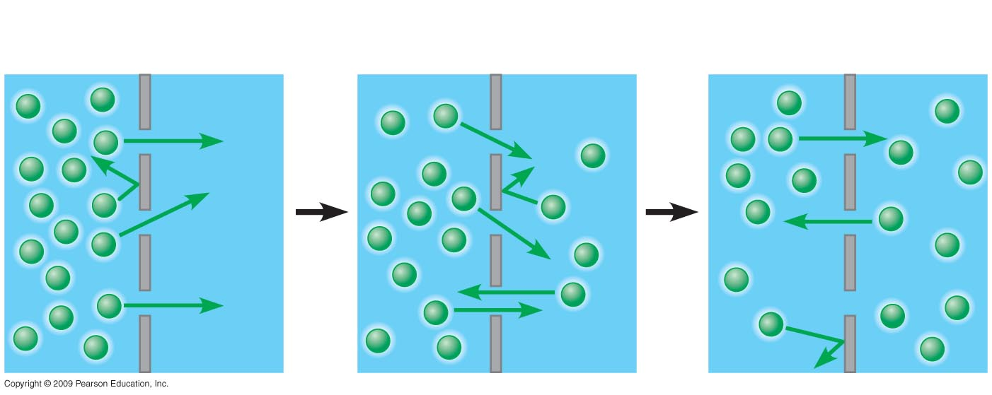
Passive Diffusion
Molecules of dye
Membrane
Equilibrium
Notes:
Figure 5.3A Passive transport of one type of molecule.

Slide 24
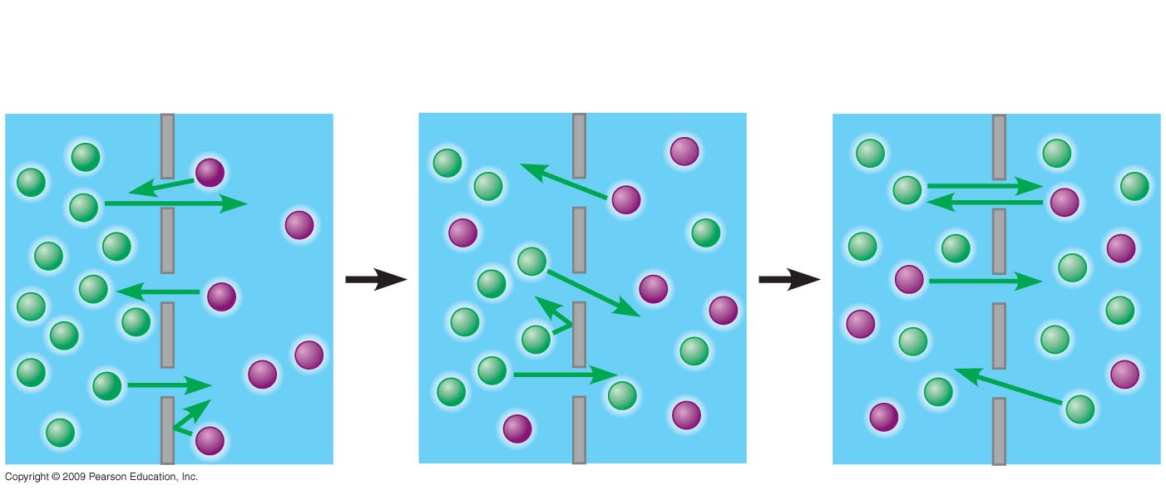
Passive Diffusion of two different types of molecules
Two different
substances
Membrane
Equilibrium
Notes:
Figure 5.3B Passive transport of two types of molecules.

Slide 25
5.4 Osmosis is the diffusion of water across a membrane
It is crucial for cells that water moves across their membrane
  Water moves across membranes in response to solute concentration inside and outside of the cell by a process called osmosis
  Osmosis will move water across a membrane down its concentration gradient until the concentration of solute is equal on both sides of the membrane
Copyright © 2009 Pearson Education, Inc.

Slide 26
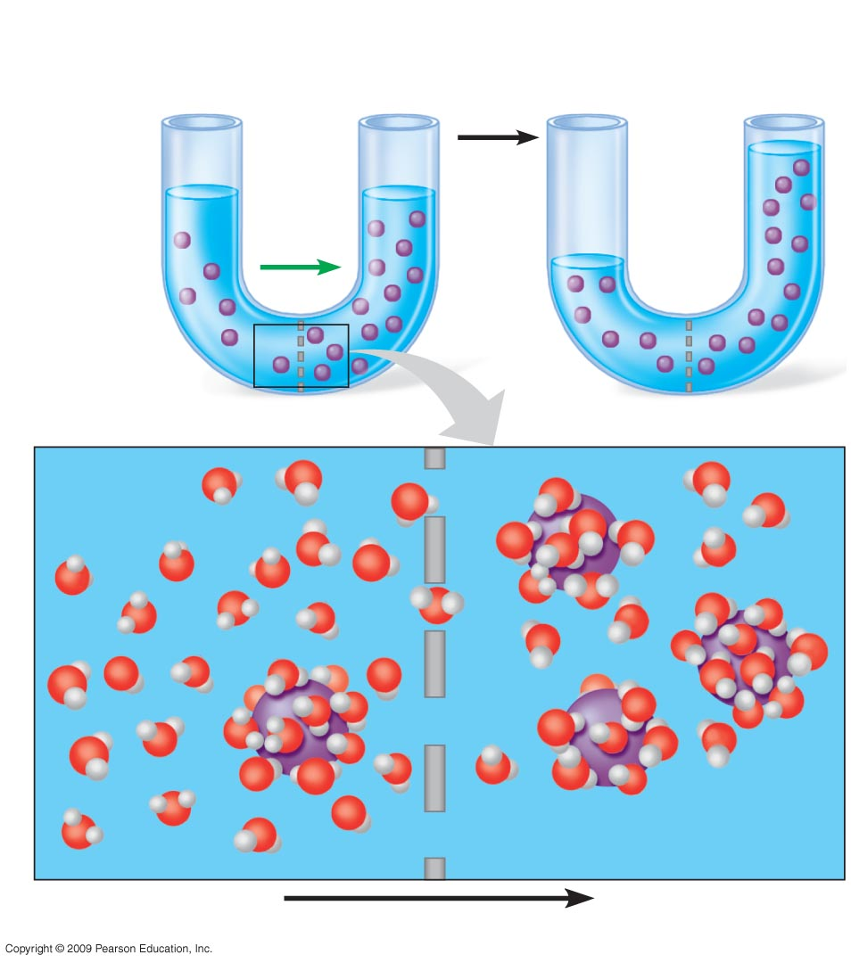
Lower
concentration
of solute
Higher
concentration
of solute
Equal
concentration
of solute
H₂O
Solute
molecule
Selectively
permeable
membrane
Water
molecule
Solute molecule with
cluster of water molecules
Net flow of water
Notes:
Figure 5.4 Osmosis, the diffusion of water across a membrane.
Note that osmosis is a force that is actually able to cause a differential in water levels in the two arms of the U-tube shown in Figure 5.4.

Slide 27
5.5 Water balance between cells and their surroundings is crucial to organisms
Tonicity is a term that describes the ability of a solution to cause a cell to gain or lose water
  Tonicity is dependent on the concentration of a nonpenetrating solute on both sides of the membrane
    Isotonic indicates that the concentration of a solute is the same on both sides
    Hypertonic indicates that the concentration of solute is higher outside the cell
    Hypotonic indicates a higher concentration of solute inside the cell
Copyright © 2009 Pearson Education, Inc.
Notes:
Seawater is isotonic to many marine invertebrates. The cells of most terrestrial animals are bathed in an extracellular fluid that is isotonic to their cells.
If cells are put into a hypotonic or hypertonic solution, the results can be dangerous for the cell.
Your students may have noticed that the skin of their fingers wrinkles after taking a long shower or bath or washing dishes. The skin wrinkles because it is swollen with water but still tacked down at some points. By osmosis, water moves into the epidermal skin cells. Our skin is hypertonic to these solutions, producing the swelling that appears as large wrinkles.
Student Misconceptions and Concerns
1. Students easily confuse the term hypertonic and hypotonic. One challenge is to get them to understand that these are relative terms, like heavier, darker, or fewer. No single object is heavier, no single cup of coffee is darker, and no single bag of M & M’s has fewer candies. Such terms only apply when comparing two or more items. A solution with a higher concentration than another solution is hypertonic to that solution. However, the same solution might also be hypotonic to a third solution.

Slide 28
5.5 Water balance between cells and their surroundings is crucial to organisms
Many organisms are able to maintain water balance within their cells by a process called osmoregulation
  This process prevents excessive uptake or excessive loss of water
  Plant, prokaryotic, and fungal cells have different issues with osmoregulation because of their cell walls
Copyright © 2009 Pearson Education, Inc.
Notes:
Organisms with cell walls are protected from lysis when exposed to a hypotonic environment.
Student Misconceptions and Concerns
1. Students easily confuse the term hypertonic and hypotonic. One challenge is to get them to understand that these are relative terms, like heavier, darker, or fewer. No single object is heavier, no single cup of coffee is darker, and no single bag of M & M’s has fewer candies. Such terms only apply when comparing two or more items. A solution with a higher concentration than another solution is hypertonic to that solution. However, the same solution might also be hypotonic to a third solution.
Teaching Tips
1. The word root hypo- means “below.” Thus, a hypodermic needle injects substances below the dermis. Students might best remember that hypotonic solutions have concentrations of solutes below that of the other solution(s).
2. After introducing the idea of hypertonic and hypotonic solutions, you may wish to challenge your students with the following: A marine salmon moves from the ocean up a freshwater stream to reproduce. The salmon is moving from a _____ environment to a _____ environment. (Answers: hypertonic, hypotonic)
3. The effects of hypertonic and hypotonic solutions can be demonstrated if students soak carrot sticks, long slices of potato, or celery in hypertonic and hypotonic solutions. These also make nice class demonstrations.

Slide 29
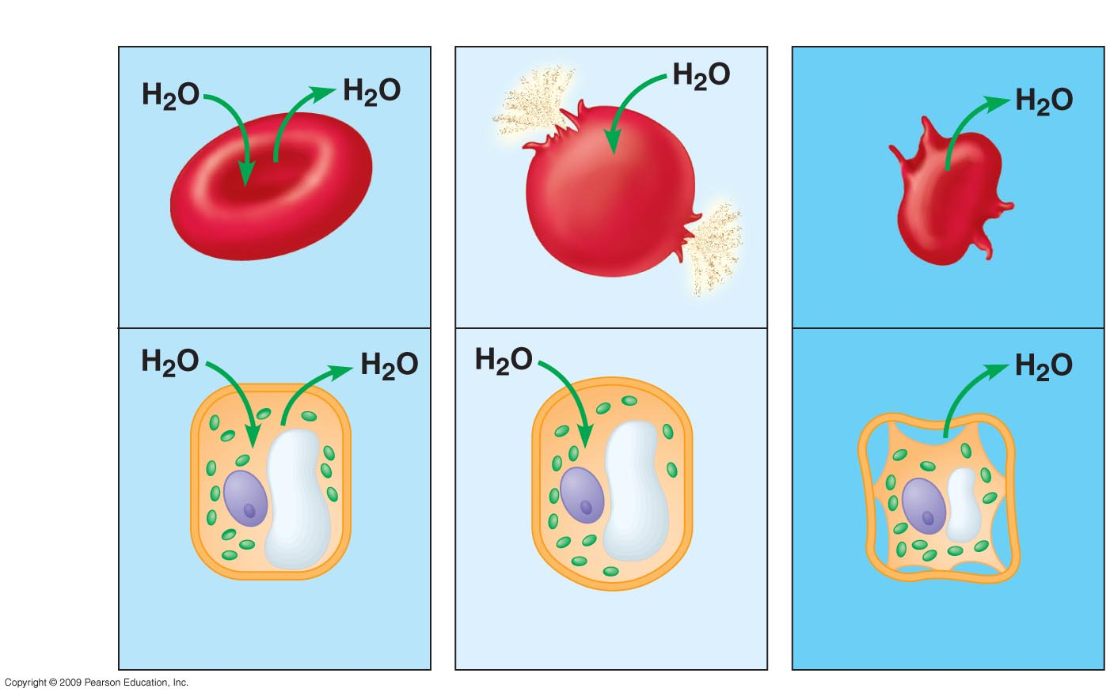
Isotonic solution
Hypotonic solution
Hypertonic solution
Animal
cell
(A) Normal
(B) Lysed
(C) Shriveled
Plasma
membrane
Plant
cell
(D) Flaccid
(E) Turgid
(F) Shriveled
(plasmolyzed)
Notes:
Figure 5.5 How animal and plant cells behave in different solutions.

Slide 30
5.6 Transport proteins may facilitate diffusion across membranes
Many substances that are necessary for viability of the cell do not freely diffuse across the membrane
  They require the help of specific transport proteins called aquaporins
  These proteins assist in facilitated diffusion, a type of passive transport that does not require energy
Copyright © 2009 Pearson Education, Inc.
Notes:
Polar molecules and ions that are impeded by the lipid bilayer diffuse with the help of transport proteins.
Teaching Tips
1. The text notes that “the greater the number of transport proteins for a particular solute present in a membrane, the faster the solute’s rate of diffusion across the membrane.” This is similar to a situation that might be more familiar to your students. The more ticket-takers present at the entrance to a stadium, the faster the rate of movement of people into the stadium.
30

Slide 31
5.6 Transport proteins may facilitate diffusion across membranes
Some proteins function by becoming a hydrophilic tunnel for passage
  Other proteins bind their passenger, change shape, and release their passenger on the other side
  In both of these situations, the protein is specific for the substrate, which can be sugars, amino acids, ions, and even water
Copyright © 2009 Pearson Education, Inc.
Notes:
Aquaporins, the water-channel proteins, facilitate the massive amount of diffusion that occurs in plant cells and red blood cells.
Teaching Tips
1. The text notes that “the greater the number of transport proteins for a particular solute present in a membrane, the faster the solute’s rate of diffusion across the membrane.” This is similar to a situation that might be more familiar to your students. The more ticket-takers present at the entrance to a stadium, the faster the rate of movement of people into the stadium.
31

Slide 32
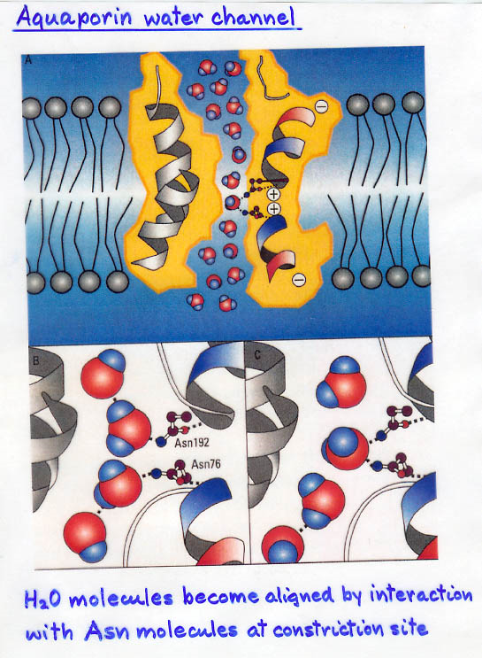

Slide 33
5.7 TALKING ABOUT SCIENCE: Peter Agre talks about aquaporins, water-channel proteins found in some cells
The cell membrane contains hourglass-shaped proteins that are responsible for entry and exit of water through the membrane
  Dr. Peter Agre, a physician at the Johns Hopkins University School of Medicine, discovered these transport proteins and called them aquaporins
Copyright © 2009 Pearson Education, Inc.
Notes:
Kidney problems can result from defective kidney cells that have defective aquaporin molecules.

Slide 34
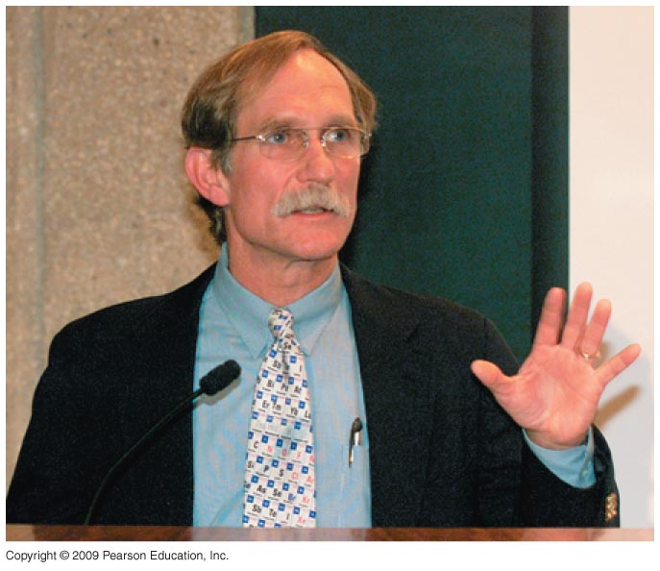
Notes:
Figure 5.7 Peter Agre.

Slide 35
5.8 Cells expend energy in the active transport of a solute against its concentration gradient
Cells have a mechanism for moving a solute against its concentration gradient
  It requires the expenditure of energy in the form of ATP
  The mechanism alters the shape of the membrane protein through phosphorylation using ATP
Copyright © 2009 Pearson Education, Inc.
Notes:
The importance of these transport proteins is their ability to move solutes from a low concentration to a high concentration. ATP energy is required.
The sodium-potassium pump that helps maintain gradients shuttles sodium and potassium across the membrane against their concentration gradients. The generation of nerve signals also depends on concentration differences.
For the BLAST Animation Active Transport, go to Animation and Video Files.
Teaching Tips
1. Active transport uses energy to move a solute against its concentration gradient. Challenge your students to think of the many possible analogies to this situation, for example, bailing out a leaky boat by moving water back to a place (outside the boat) where water is more concentrated. An alternative analogy might be the herding of animals, which requires work to keep the organisms concentrated and counteract their natural tendency to spread out.
2. Students familiar with city subway toll stations might think of some gate mechanisms that work similarly to the proteins regulating active transport. A person steps up to a barrier and inserts payment (analogous to ATP input), and the gate changes shape, permitting passage to the other side. Even a simple turnstile system that requires payment is generally similar.

Slide 36
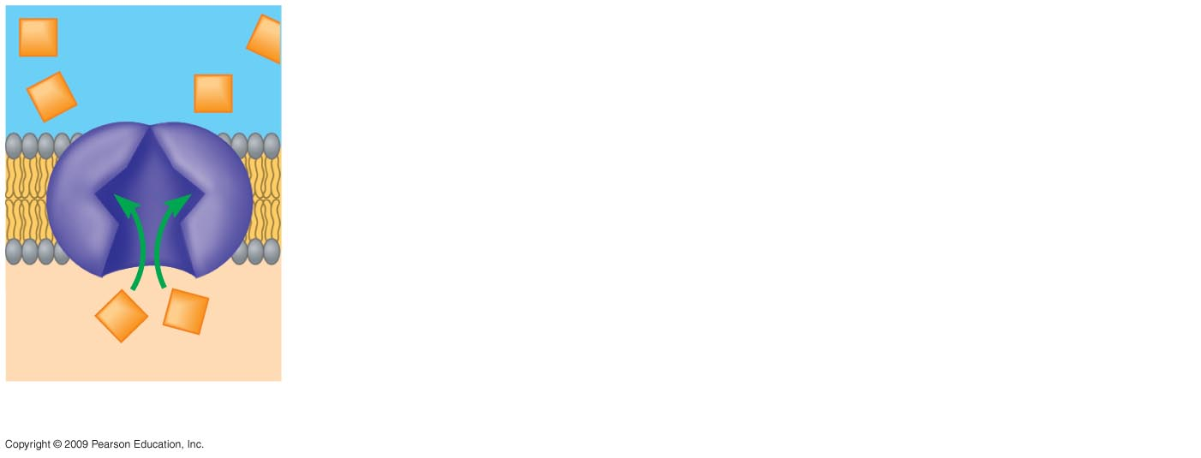
Transport
protein
Solute
1
Solute binding
Notes:
Figure 5.8 Active transport of a solute across a membrane.

Slide 37
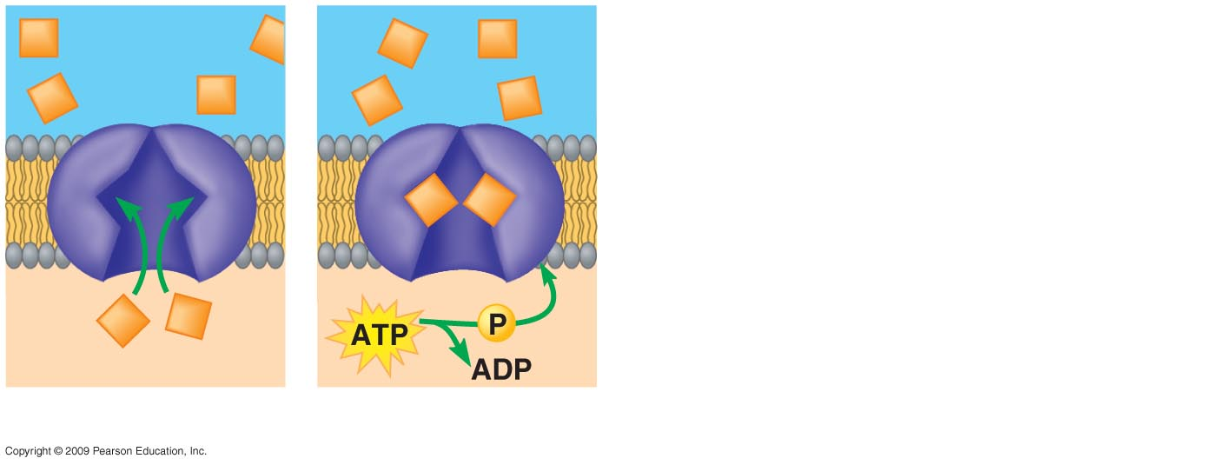
Transport
protein
Solute
1
Solute binding
2
Phosphorylation
Notes:
Figure 5.8 Active transport of a solute across a membrane.

Slide 38
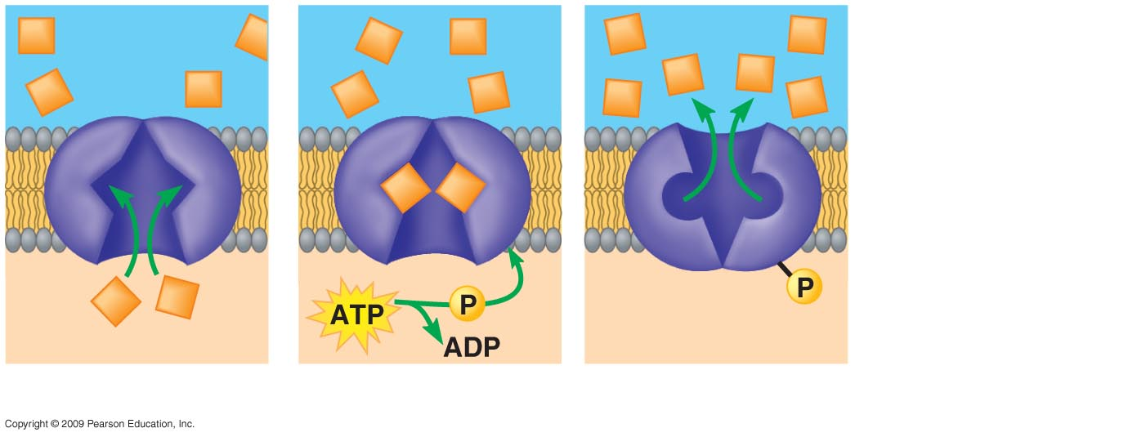
Transport
protein
Protein
changes shape
Solute
1
Solute binding
2
Phosphorylation
3
Transport
Notes:
Figure 5.8 Active transport of a solute across a membrane.

Slide 39
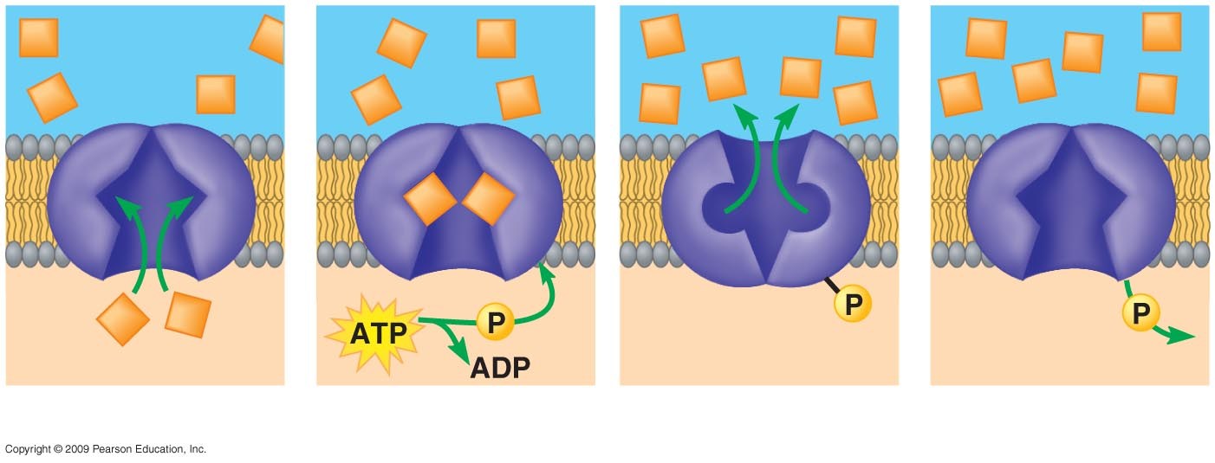
Active Transport in Cells
Transport
protein
Protein
changes shape
Phosphate
detaches
Solute
1
Solute binding
2
Phosphorylation
3
Transport
4
Protein reversion
Notes:
Figure 5.8 Active transport of a solute across a membrane.

Slide 40
5.9 Exocytosis and endocytosis transport large molecules across membranes
A cell uses two mechanisms for moving large molecules across membranes
  Exocytosis is used to export bulky molecules, such as proteins or polysaccharides
  Endocytosis is used to import substances useful to the livelihood of the cell
In both cases, material to be transported is packaged within a vesicle that fuses with the membrane
Copyright © 2009 Pearson Education, Inc.
Notes:
When the vesicles fuse with the cell membrane, the vesicle becomes part of the membrane.
An example of exocytosis is the excretion of insulin by cells within the pancreas.

Slide 41
5.9 Exocytosis and endocytosis transport large molecules across membranes
There are three kinds of endocytosis
  Phagocytosis is engulfment of a particle by wrapping cell membrane around it, forming a vacuole
  Pinocytosis is the same thing except that fluids are taken into small vesicles
  Receptor-mediated endocytosis is where receptors in a receptor-coated pit interact with a specific protein, initiating formation of a vesicle
Copyright © 2009 Pearson Education, Inc.
Notes:
These mechanisms occur continually in most eukaryotic cells with the amount of plasma membrane remaining constant in a nongrowing cell. Apparently, the addition of membrane by one process offsets the loss of membrane by the other.
For the BLAST Animation Endocytosis and Exocytosis, go to Animation and Video Files.
Teaching Tips
Students carefully considering exocytosis might notice that membrane from secretory vesicles is added to the plasma membrane.
Consider challenging your students to identify mechanisms that balance out this enlargement of the cell surface. (Endocytosis “subtracts” area from the cell surface. It is a major factor balancing out the additional membrane supplied by exocytosis.)

Slide 42
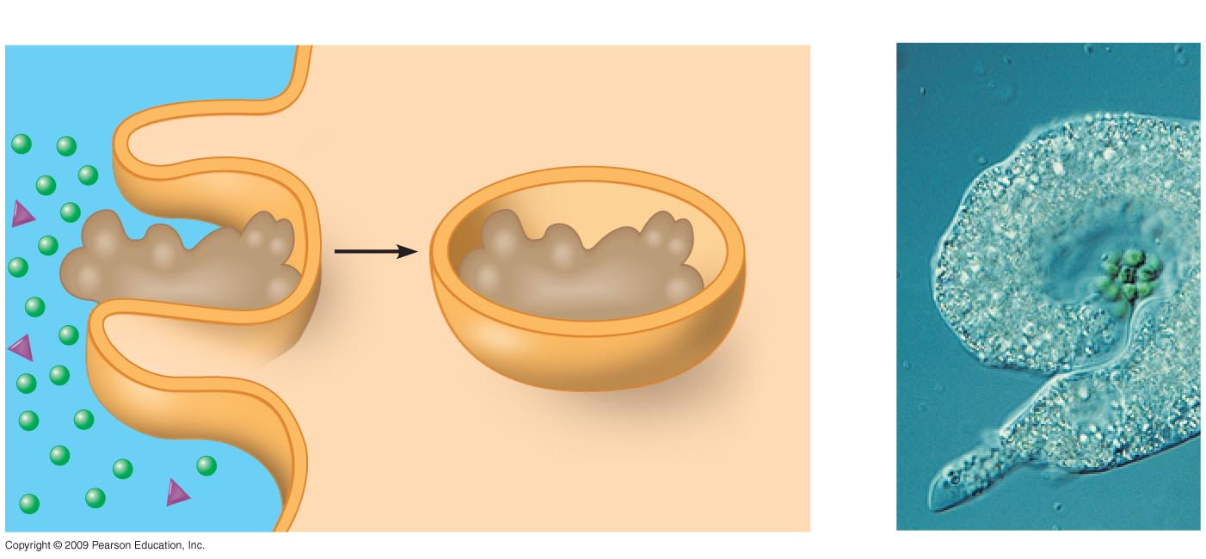
Phagocytosis
EXTRACELLULAR
FLUID
CYTOPLASM
Food
being
ingested
Pseudopodium
“Food” or
other particle
Food
vacuole
Notes:
Figure 5.9 Three kinds of endocytosis.

Slide 43
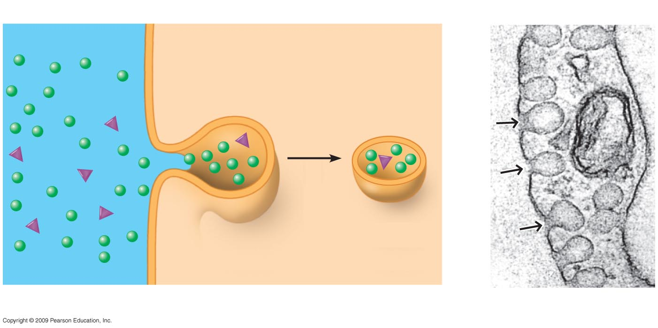
Pinocytosis
Plasma
membrane
Vesicle
Plasma membrane
Notes:
Figure 5.9 Three kinds of endocytosis.

Slide 44
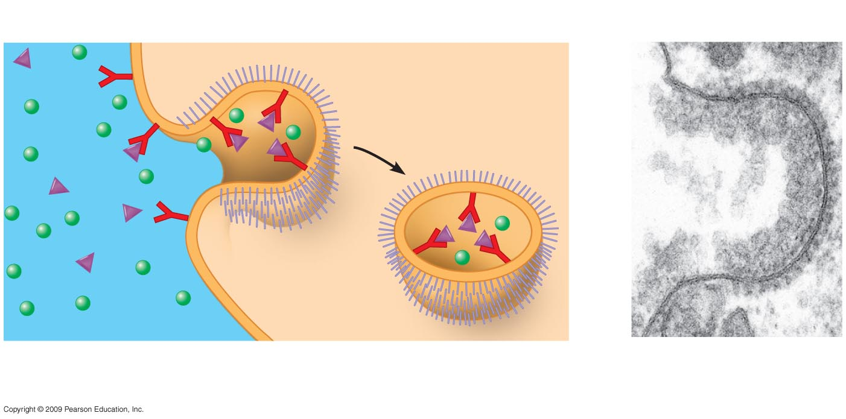
Receptor-mediated endocytosis
Plasma membrane
Coat protein
Receptor
Coated
vesicle
Coated
pit
Coated
pit
Specific
molecule
Material bound
to receptor proteins
Notes:
Figure 5.9 Three kinds of endocytosis.

Slide 45
ENERGY AND THE CELL
Copyright © 2009 Pearson Education, Inc.

Slide 46
5.10 Cells transform energy as they perform work
Cells are small units, a chemical factory, housing thousands of chemical reactions
  The result of reactions is maintenance of the cell, manufacture of cellular parts, and replication
Copyright © 2009 Pearson Education, Inc.

Slide 47
5.10 Cells transform energy as they perform work
Energy is the capacity to do work and cause change
  Work is accomplished when an object is moved against an opposing force, such as friction
  There are two kinds of energy
    Kinetic energy is the energy of motion
    Potential energy is energy that an object possesses as a result of its location
Copyright © 2009 Pearson Education, Inc.
Notes:
Energy is fundamental to all metabolic processes.
Bioenergetics is the study of how energy flows through living organisms.

Slide 48
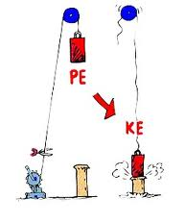
5.10 Cells transform energy as they perform work

Slide 49
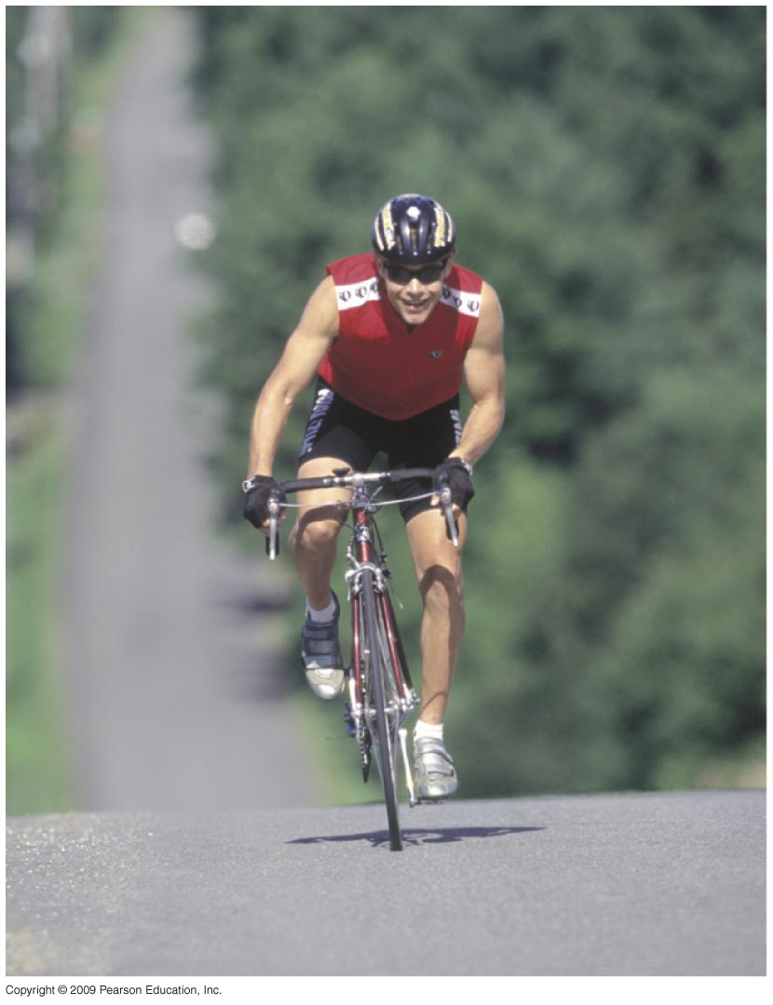
Notes:
Figure 5.10A Kinetic energy, the energy of motion.

Slide 50
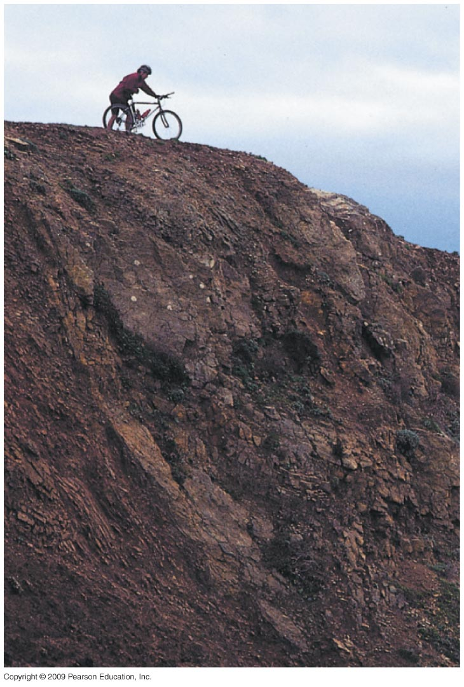
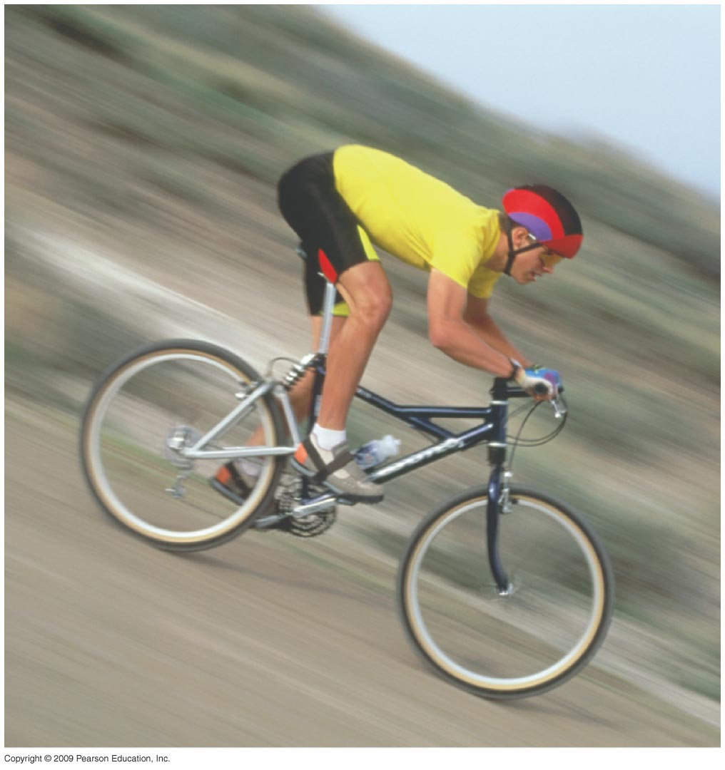
Notes:
Figure 5.10B Potential energy, stored energy as a result of location or structure.
Figure 5.10C Potential energy being converted to kinetic energy.

Slide 51
5.10 Cells transform energy as they perform work
Kinetic energy performs work by transferring motion to other matter
  For example, water moving through a turbine generates electricity
  Heat, or thermal energy, is kinetic energy associated with the random movement of atoms
Copyright © 2009 Pearson Education, Inc.

Slide 52
5.10 Cells transform energy as they perform work
An example of potential energy is water behind a dam
  Chemical energy is potential energy because of its energy available for release in a chemical reaction
Copyright © 2009 Pearson Education, Inc.

Slide 53
5.11 Two laws govern energy transformations
Energy transformations within matter are studied by individuals in the field of thermodynamics
  Biologists study thermodynamics because an organism exchanges both energy and matter with its surroundings
Copyright © 2009 Pearson Education, Inc.
Notes:
Some scientists study matter within a particular system. Some systems are isolated systems because they are unable to exchange energy or matter with their surroundings. An open system allows energy and matter to be transferred between the system and the surroundings. Organisms are open systems.

Slide 54
5.11 Two laws govern energy transformations
It is important to understand two laws that govern energy transformations in organisms
  The first law of thermodynamics—energy in the universe is constant
  The second law of thermodynamics—energy conversions increase the disorder of the universe
    Entropy is the measure of disorder, or randomness
Copyright © 2009 Pearson Education, Inc.
Notes:
In the process of carrying out chemical reactions that provide work for the cell, living cells unavoidably convert organized forms of energy to heat. Therefore, living systems increase the entropy of their surroundings.
Some students can relate well to the concept of entropy as it relates to the room where they live. Despite cleaning up and organizing the room on a regular (or irregular) basis, the room increasingly becomes disorganized, a victim of entropy, until another energy input (or effort) is exerted to make the room more orderly again. Students might even get to know “entropy” as the “dorm room effect.”

Slide 55
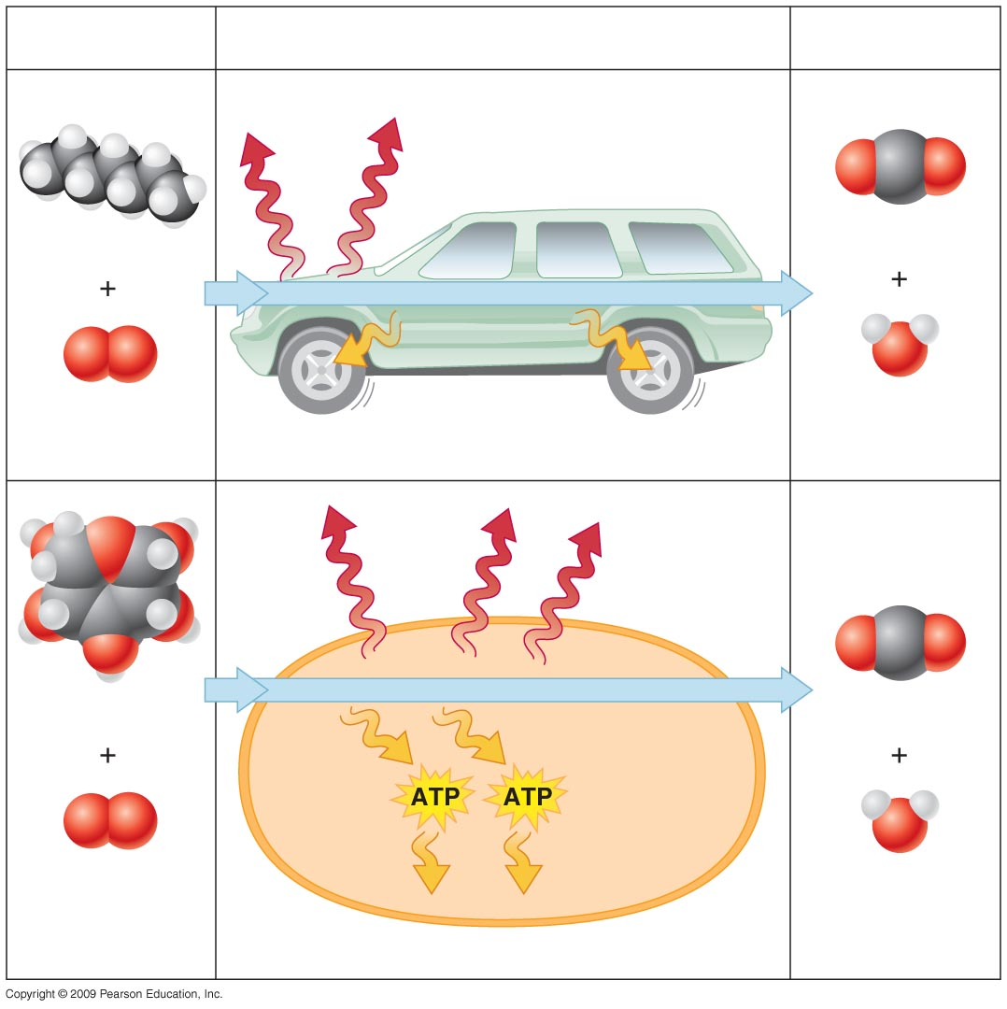
Fuel
Energy conversion
Waste products
Heat
energy
Gasoline
Carbon dioxide
Combustion
Kinetic energy
of movement
Oxygen
Water
Energy conversion in a car
Heat
Glucose
Cellular respiration
Carbon dioxide
Oxygen
Water
Energy for cellular work
Energy conversion in a cell
Notes:
Figure 5.11 Energy transformations (with an increase in entropy) in a car and a cell.

Slide 56
5.12 Chemical reactions either release or store energy
An exergonic reaction is a chemical reaction that releases energy
  This reaction releases the energy in covalent bonds of the reactants
  Burning wood releases the energy in cellulose, producing heat, light, carbon dioxide, and water
  Cellular respiration also releases energy and heat and produces products but is able to use the released energy to perform work
Copyright © 2009 Pearson Education, Inc.
Notes:
A car engine in the summer struggles to dissipate heat in the same way that a human struggles to cool off after exercising when weather is warm.

Slide 57
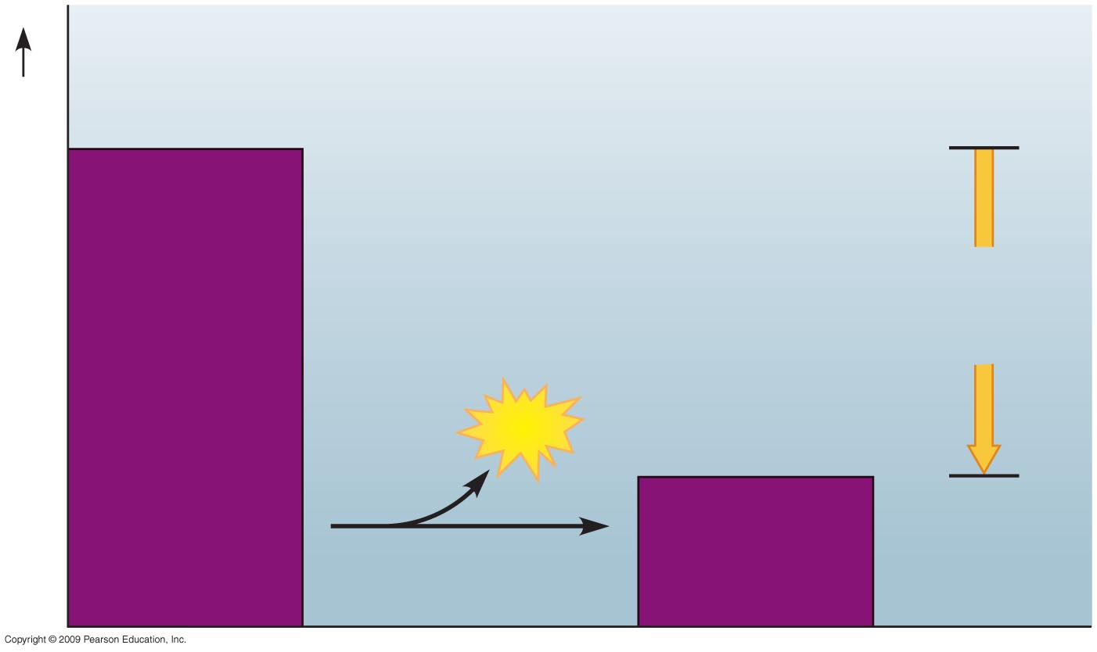
Reactants
Amount of
energy
released
Potential energy of molecules
Energy released
Products
Notes:
Figure 5.12A Exergonic reaction, energy released.

Slide 58
5.12 Chemical reactions either release or store energy
An endergonic reaction requires an input of energy and yields products rich in potential energy
  The reactants contain little energy in the beginning, but energy is absorbed from the surroundings and stored in covalent bonds of the products
  Photosynthesis makes energy-rich sugar molecules using energy in sunlight
Copyright © 2009 Pearson Education, Inc.

Slide 59
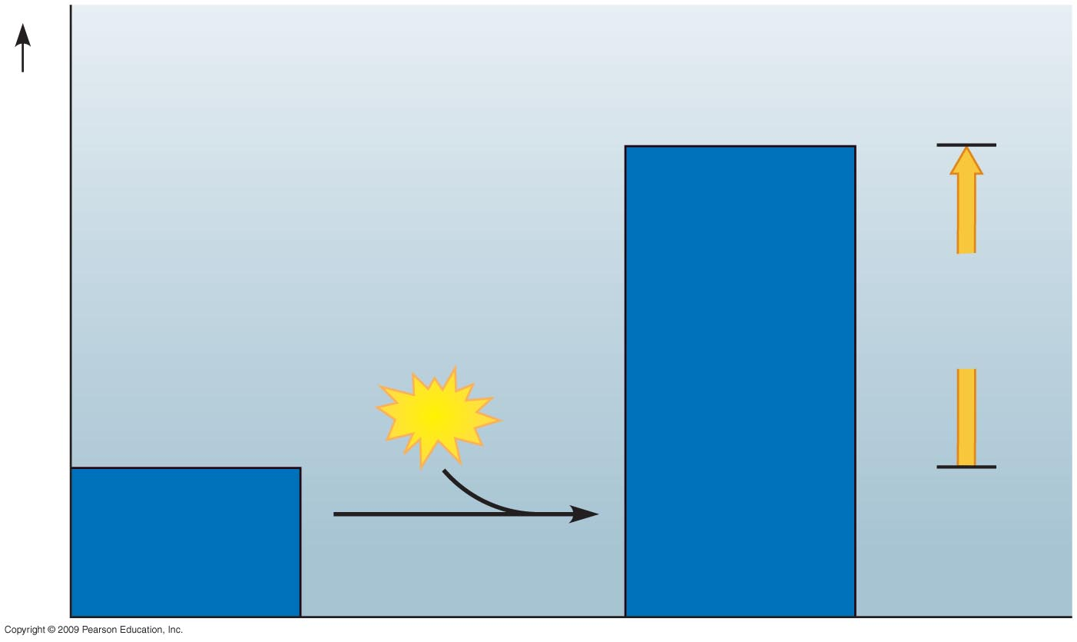
Products
Amount of
energy
required
Potential energy of molecules
Energy required
Reactants
Notes:
Figure 5.12B Endergonic reaction, energy required.

Slide 60
5.12 Chemical reactions either release or store energy
A living organism produces thousands of endergonic and exergonic chemical reactions
  All of these combined is called metabolism
  A metabolic pathway is a series of chemical reactions that either break down a complex molecule or build up a complex molecule
Copyright © 2009 Pearson Education, Inc.
Notes:
Metabolism requires energy, which is taken from sugar or other molecules containing energy.
Student Misconceptions and Concerns
1. Students with limited exposure to physics may have never understood the concepts of energy and the conservation of energy or distinguished between potential and kinetic energy. Understanding such broad and new abstract concepts requires time and concrete examples.
2. Energy coupling at the cellular level may be new to many students, but it is a familiar concept when related to the use of money in our society. Students might be discouraged if the only benefit of work was the ability to make purchases from the employer. (We all might soon tire of a fast-food job that only paid its employees in food!) Money permits the coupling of a generation of value (a paycheck, analogous to an energy-releasing reaction) to an energy-consuming reaction (money, which allows us to make purchases in distant locations). This idea of earning and spending is a common concept we all know well.
Teaching Tips
1. The same mass of fat stores nearly twice as many calories (about 9 kcal per gram) as an equivalent mass of protein or carbohydrates (about 4.5–5 kcal per gram). Thus, when comparing equal masses of fat, protein, and lipid, the fat has nearly twice the potential energy. Fat is therefore an efficient way to store energy in animals and many plants. To store an equivalent amount of energy in the form of carbohydrates or proteins would require about twice the mass, adding a significant burden to the organism’s structure. (For example, if you were 20 lbs overweight, you would be nearly 40 lbs overweight if the same energy were stored as carbohydrates or proteins instead of fat).
2. The amount of energy each adult human needs to generate the ATP required in a day is tremendous. Here is a calculation that has impressed many students. Depending upon the size and activity of a person, a human might burn 2,000 dietary calories (kilocalories) a day. This is enough energy to raise the temperature of 20 liters of liquid water from 0° to 100°C. This is something to think about the next time you heat water on the stove! If you can bring in ten 2-liter bottles, you can help students visualize how much liquid water can be raised from 0° to 100°C. (Note: 100 calories raises about 1 liter of water 100°C, but it takes much more energy to melt ice or to convert boiling water into steam.)

Slide 61
5.12 Chemical reactions either release or store energy
A cell does three main types of cellular work
  Chemical work (driving endergonic reactions)
  Transport work (pumping substances across membranes)
  Mechanical work (beating of cilia)
To accomplish work, a cell must manage its energy resources, and it does so by energy coupling—the use of exergonic processes to drive an endergonic one
Copyright © 2009 Pearson Education, Inc.
Notes:
ATP is responsible for mediating most energy coupling in cells.
Student Misconceptions and Concerns
1. Students with limited exposure to physics may have never understood the concepts of energy and the conservation of energy or distinguished between potential and kinetic energy. Understanding such broad and new abstract concepts requires time and concrete examples.
2. Energy coupling at the cellular level may be new to many students, but it is a familiar concept when related to the use of money in our society. Students might be discouraged if the only benefit of work was the ability to make purchases from the employer. (We all might soon tire of a fast-food job that only paid its employees in food!) Money permits the coupling of a generation of value (a paycheck, analogous to an energy-releasing reaction) to an energy-consuming reaction (money, which allows us to make purchases in distant locations). This idea of earning and spending is a common concept we all know well.
Teaching Tips
1. The same mass of fat stores nearly twice as many calories (about 9 kcal per gram) as an equivalent mass of protein or carbohydrates (about 4.5–5 kcal per gram). Thus, when comparing equal masses of fat, protein, and lipid, the fat has nearly twice the potential energy. Fat is therefore an efficient way to store energy in animals and many plants. To store an equivalent amount of energy in the form of carbohydrates or proteins would require about twice the mass, adding a significant burden to the organism’s structure. (For example, if you were 20 lbs overweight, you would be nearly 40 lbs overweight if the same energy were stored as carbohydrates or proteins instead of fat).
2. The amount of energy each adult human needs to generate the ATP required in a day is tremendous. Here is a calculation that has impressed many students. Depending upon the size and activity of a person, a human might burn 2,000 dietary calories (kilocalories) a day. This is enough energy to raise the temperature of 20 liters of liquid water from 0° to 100°C. This is something to think about the next time you heat water on the stove! If you can bring in ten 2-liter bottles, you can help students visualize how much liquid water can be raised from 0° to 100°C. (Note: 100 calories raises about 1 liter of water 100°C, but it takes much more energy to melt ice or to convert boiling water into steam.)

Slide 62
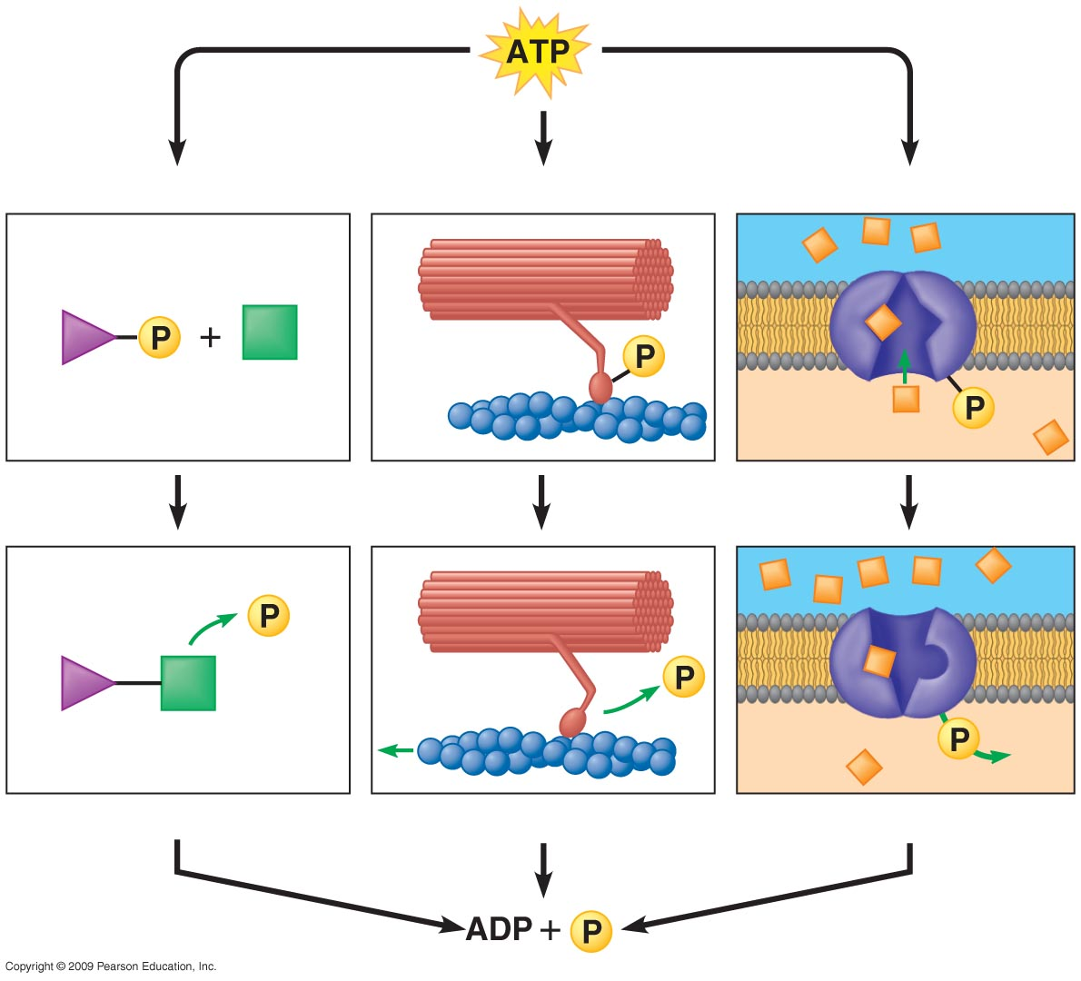
Chemical work
Mechanical work
Transport work
Solute
Motor
protein
Membrane
protein
Reactants
Product
Molecule formed
Protein moved
Solute transported
Notes:
Figure 5.13B How ATP powers cellular work.

Slide 63
5.13 ATP shuttles chemical energy and drives cellular work
ATP, adenosine triphosphate, is the energy currency of cells.
  ATP is the immediate source of energy that powers most forms of cellular work.
  It is composed of adenine (a nitrogenous base), ribose (a five-carbon sugar), and three phosphate groups.
Copyright © 2009 Pearson Education, Inc.
Notes:
The phosphate group serves as a functional group, and the hydrolysis of this group releases energy.
ATP is also one of the nucleoside triphosphates used to make RNA.
Student Misconceptions and Concerns
1. Students with limited exposure to physics may have never understood the concepts of energy and the conservation of energy or distinguished between potential and kinetic energy. Understanding such broad and new abstract concepts requires time and concrete examples.
2. Energy coupling at the cellular level may be new to many students, but it is a familiar concept when related to the use of money in our society. Students might be discouraged if the only benefit of work was the ability to make purchases from the employer. (We all might soon tire of a fast-food job that only paid its employees in food!) Money permits the coupling of a generation of value (a paycheck, analogous to an energy-releasing reaction) to an energy-consuming reaction (money, which allows us to make purchases in distant locations). This idea of earning and spending is a common concept we all know well.
Teaching Tips
1. The amount of energy each adult human needs to generate the ATP required in a day is tremendous. Here is a calculation that has impressed many students. Depending upon the size and activity of a person, a human might burn 2,000 dietary calories (kilocalories) a day. This is enough energy to raise the temperature of 20 liters of liquid water from 0° to 100°C. This is something to think about the next time you heat water on the stove! If you can bring in ten 2-liter bottles, you can help students visualize how much liquid water can be raised from 0° to 100°C. (Note: 100 calories raises about 1 liter of water 100°C, but it takes much more energy to melt ice or to convert boiling water into steam.)
2. When introducing ATP and ADP, consider having them think of the terms as A-3-P and A-2-P, noting that the word roots tri- = 3 and di- = 2. It might help students to keep track of the number of phosphates more easily.
3. Recycling is essential in cell biology. Damaged organelles are broken down intracellularly and chemical components, the monomers of the cytoskeleton, and ADP are routinely recycled. There are several advantages common to human recycling of garbage and cellular recycling. Both save energy by avoiding the need to remanufacture the basic units, and both avoid an accumulation of waste products that could interfere with other “environmental” chemistry (the environment of the cell or the environment of the human population).

Slide 64
5.13 ATP shuttles chemical energy and drives cellular work
Hydrolysis of ATP releases energy by transferring its third phosphate from ATP to some other molecule
  The transfer is called phosphorylation
  In the process, ATP energizes molecules
Copyright © 2009 Pearson Education, Inc.
Notes:
For the BLAST Animation ATP/ADP Cycle, go to Animation and Video Files.
Student Misconceptions and Concerns
1. Students with limited exposure to physics may have never understood the concepts of energy and the conservation of energy or distinguished between potential and kinetic energy. Understanding such broad and new abstract concepts requires time and concrete examples.
2. Energy coupling at the cellular level may be new to many students, but it is a familiar concept when related to the use of money in our society. Students might be discouraged if the only benefit of work was the ability to make purchases from the employer. (We all might soon tire of a fast-food job that only paid its employees in food!) Money permits the coupling of a generation of value (a paycheck, analogous to an energy-releasing reaction) to an energy-consuming reaction (money, which allows us to make purchases in distant locations). This idea of earning and spending is a common concept we all know well.
Teaching Tips
1. The amount of energy each adult human needs to generate the ATP required in a day is tremendous. Here is a calculation that has impressed many students. Depending upon the size and activity of a person, a human might burn 2,000 dietary calories (kilocalories) a day. This is enough energy to raise the temperature of 20 liters of liquid water from 0° to 100°C. This is something to think about the next time you heat water on the stove! If you can bring in ten 2-liter bottles, you can help students visualize how much liquid water can be raised from 0° to 100°C. (Note: 100 calories raises about 1 liter of water 100°C, but it takes much more energy to melt ice or to convert boiling water into steam.)
2. When introducing ATP and ADP, consider having them think of the terms as A-3-P and A-2-P, noting that the word roots tri- = 3 and di- = 2. It might help students to keep track of the number of phosphates more easily.
3. Recycling is essential in cell biology. Damaged organelles are broken down intracellularly and chemical components, the monomers of the cytoskeleton, and ADP are routinely recycled. There are several advantages common to human recycling of garbage and cellular recycling. Both save energy by avoiding the need to remanufacture the basic units, and both avoid an accumulation of waste products that could interfere with other “environmental” chemistry (the environment of the cell or the environment of the human population).

Slide 65
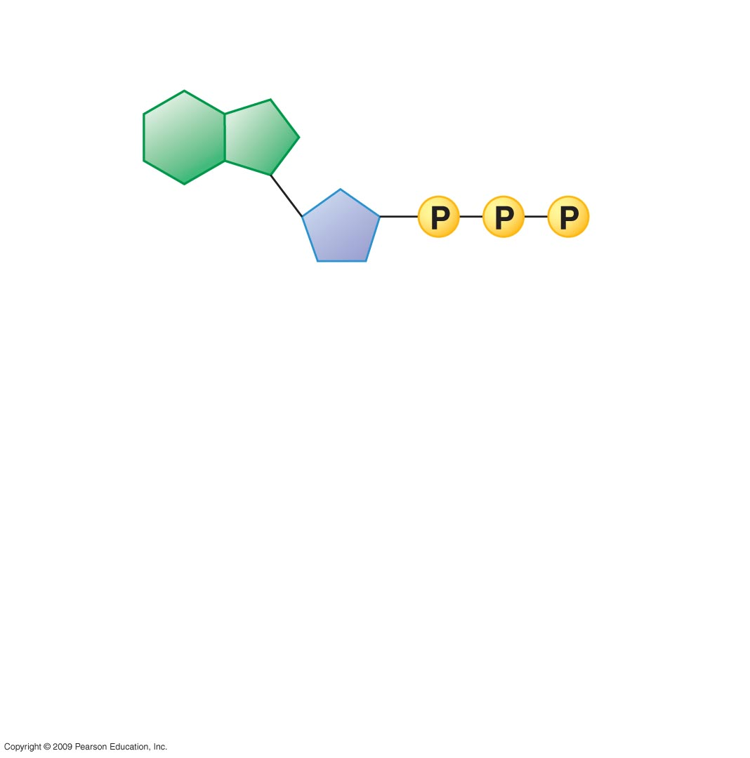
Adenosine
Triphosphate (ATP)
Phosphate
group
Adenine
Ribose
Notes:
Figure 5.13A The structure and hydrolysis of ATP. The reaction of ATP and water yields ADP, a phosphate group, and energy.

Slide 66
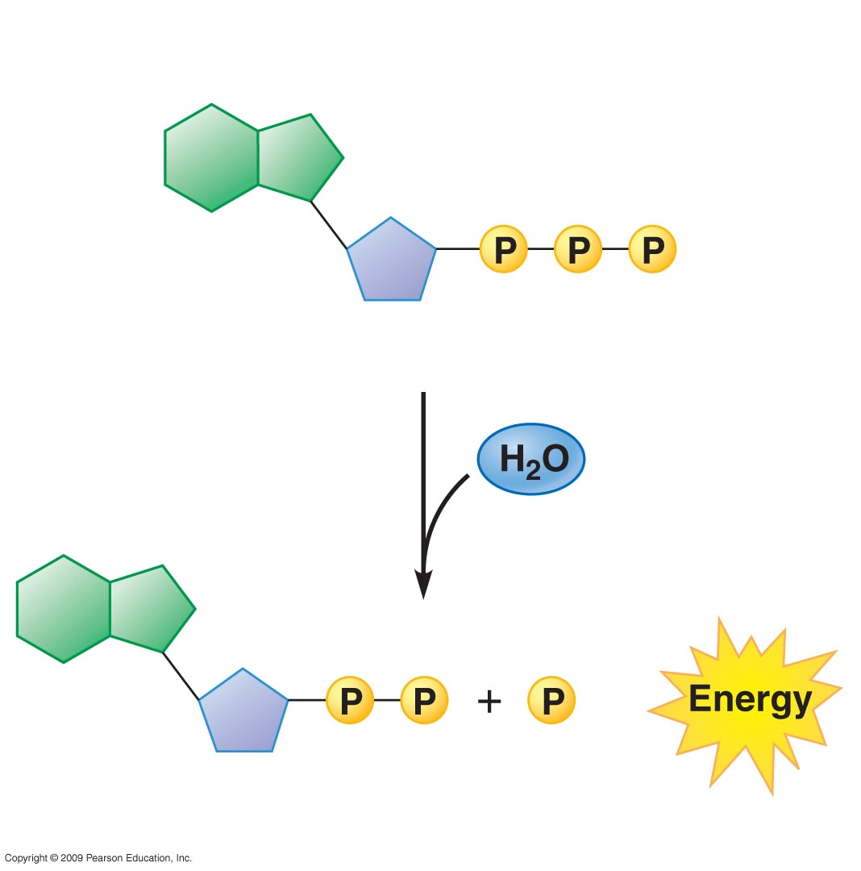
Adenosine
Triphosphate (ATP)
Phosphate
group
Adenine
Ribose
Hydrolysis
+
Adenosine
Diphosphate (ADP)
Notes:
Figure 5.13A The structure and hydrolysis of ATP. The reaction of ATP and water yields ADP, a phosphate group, and energy.

Slide 67
Chemical work
Mechanical work
Transport work
Solute
Motor
protein
Membrane
protein
Reactants
Product
Molecule formed
Protein moved
Solute transported
Notes:
Figure 5.13B How ATP powers cellular work.

Slide 68
5.13 ATP shuttles chemical energy and drives cellular work
ATP is a renewable source of energy for the cell
  When energy is released in an exergonic reaction, such as breakdown of glucose, the energy is used in an endergonic reaction to generate ATP
Copyright © 2009 Pearson Education, Inc.
Notes:
For the BLAST Animation Structure of ATP, go to Animation and Video Files.

Slide 69
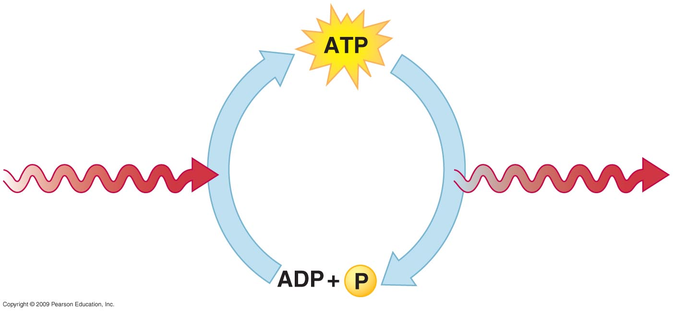
Phosphorylation
Hydrolysis
Energy from
exergonic
reactions
Energy for
endergonic
reactions
Notes:
Figure 5.13C The ATP cycle.

Slide 70
HOW ENZYMES FUNCTION
Copyright © 2009 Pearson Education, Inc.

Slide 71
5.14 Enzymes speed up the cell’s chemical reactions by lowering energy barriers
Although there is a lot of potential energy in biological molecules, such as carbohydrates and others, it is not released spontaneously
  Energy must be available to break bonds and form new ones
  This energy is called energy of activation (E_{A})
Copyright © 2009 Pearson Education, Inc.
Notes:
Heat could be used to initiate a reaction. However, heat would kill the cell and would not be specific for a particular reaction.
For the BLAST Animation Enzymes: Activation Energy, go to Animation and Video Files.

Slide 72
5.14 Enzymes speed up the cell’s chemical reactions by lowering energy barriers
The cell uses catalysis to drive (speed up) biological reactions
  Catalysis is accomplished by enzymes, which are proteins that function as biological catalysts
  Enzymes speed up the rate of the reaction by lowering the E_{A} , and they are not used up in the process
  Each enzyme has a particular target molecule called the substrate
How Enzymes Work
Copyright © 2009 Pearson Education, Inc.
Notes:
Most enzymes are proteins, but RNA enzymes, also called ribozymes, also catalyze reactions.

Slide 73
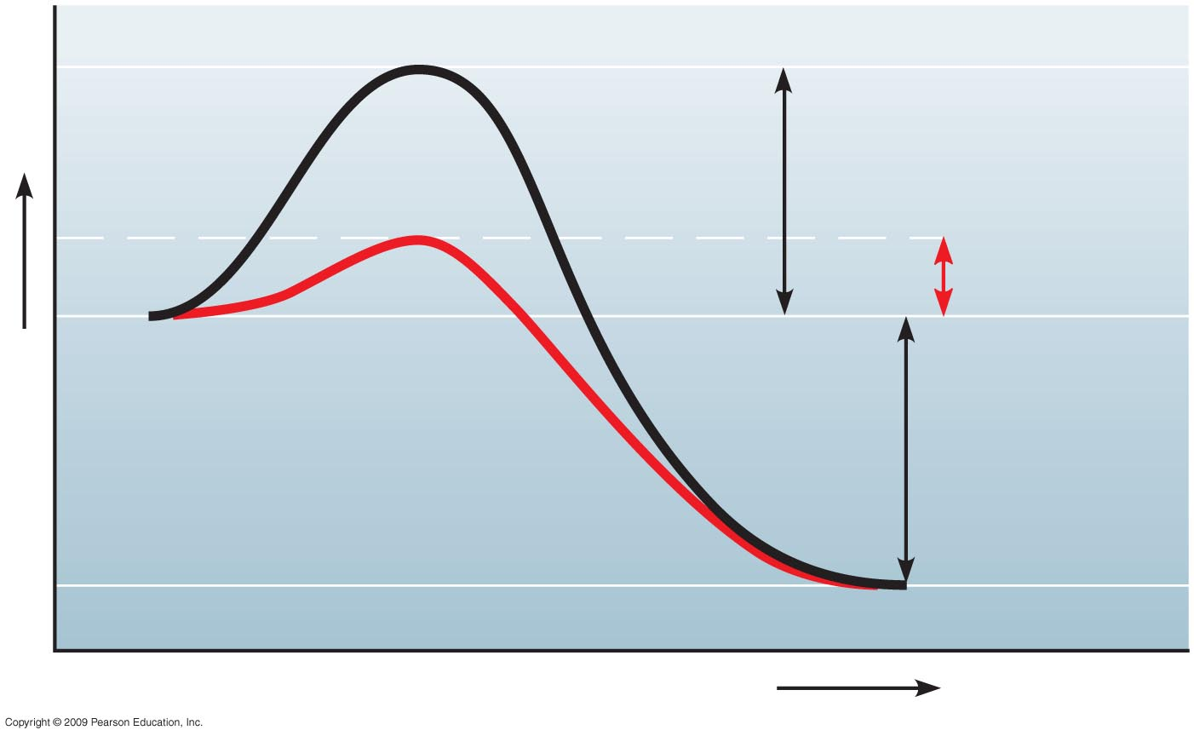
Reaction
without
enzyme
E_{A} without
enzyme
E_{A} with
enzyme
Reactants
Energy
Net
change
in energy
(the same)
Reaction with
enzyme
Products
Progress of the reaction
Notes:
Figure 5.14 The effect of an enzyme is to lower E_{A}.

Slide 74
5.15 A specific enzyme catalyzes each cellular reaction
Enzymes have unique three-dimensional shapes
  The shape is critical to their role as biological catalysts
  As a result of its shape, the enzyme has an active site where the enzyme interacts with the enzyme’s substrate
  Consequently, the substrate’s chemistry is altered to form the product of the enzyme reaction
Copyright © 2009 Pearson Education, Inc.

Slide 75
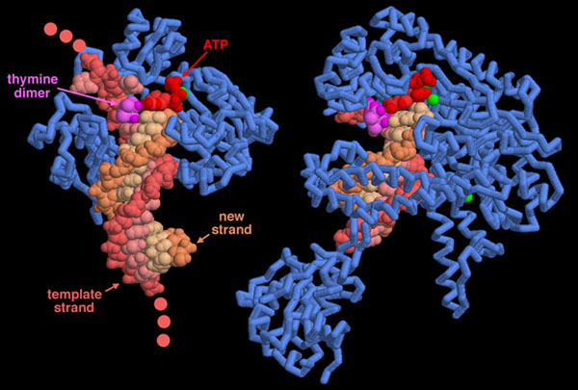
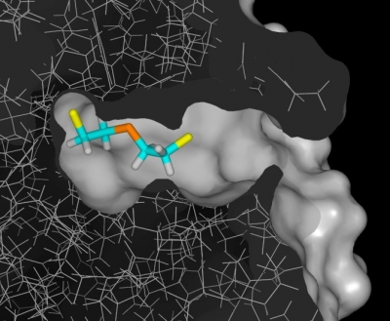
Active site on an Enzyme
Mustard gas molecule in active site of enzyme
DNA Polymerase

Slide 76
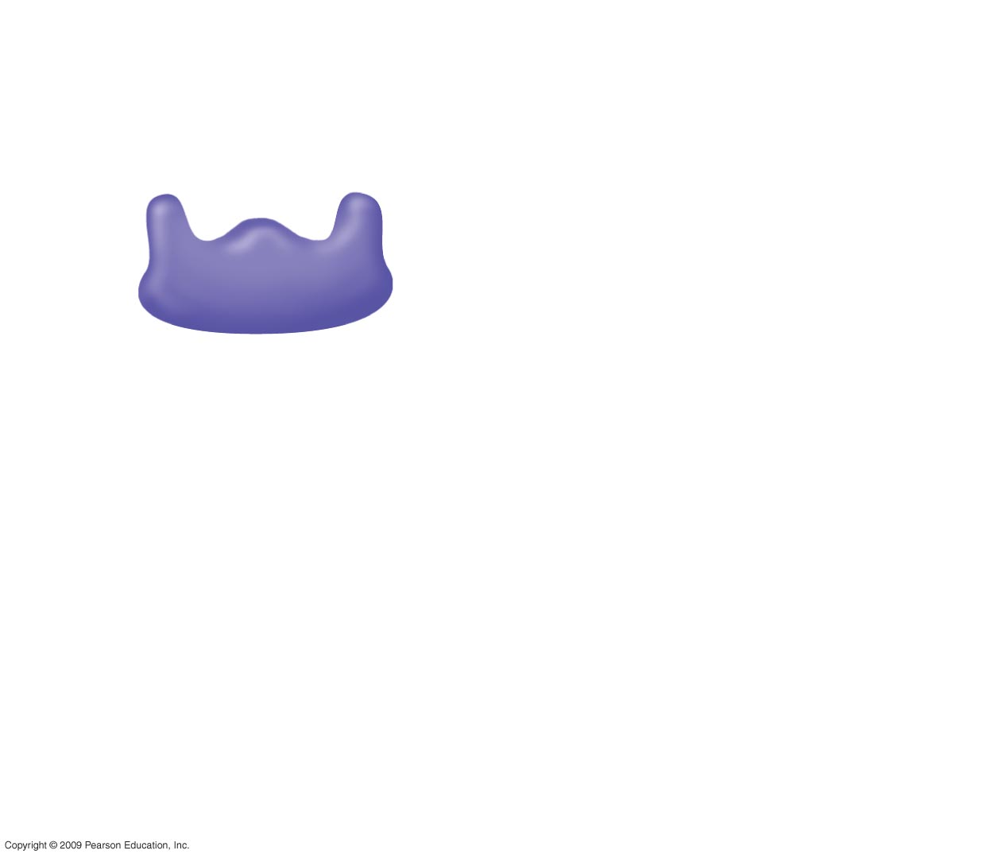
1
Enzyme available
with empty active
site
Active site
Enzyme
(sucrase)
Notes:
Figure 5.15 The catalytic cycle of an enzyme.

Slide 77
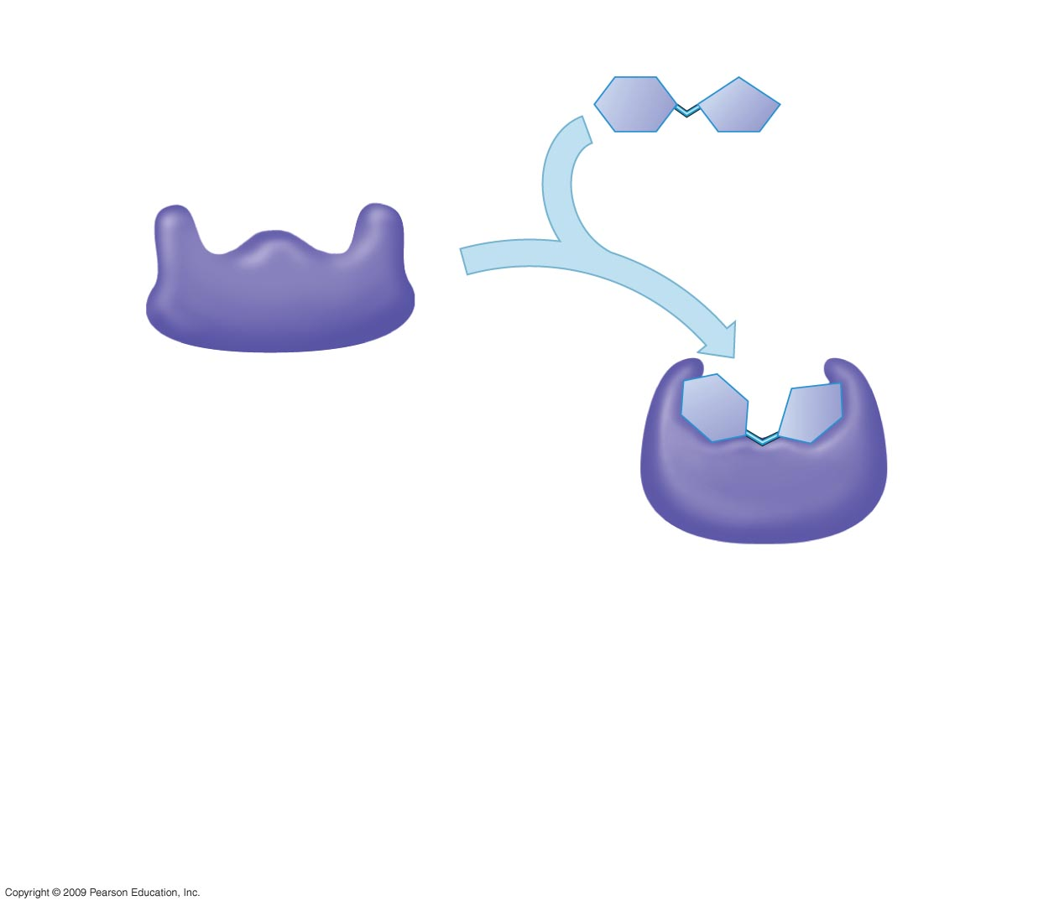
1
Enzyme available
with empty active
site
Active site
Substrate
(sucrose)
2
Substrate binds
to enzyme with
induced fit
Enzyme
(sucrase)
Notes:
Figure 5.15 The catalytic cycle of an enzyme.

Slide 78
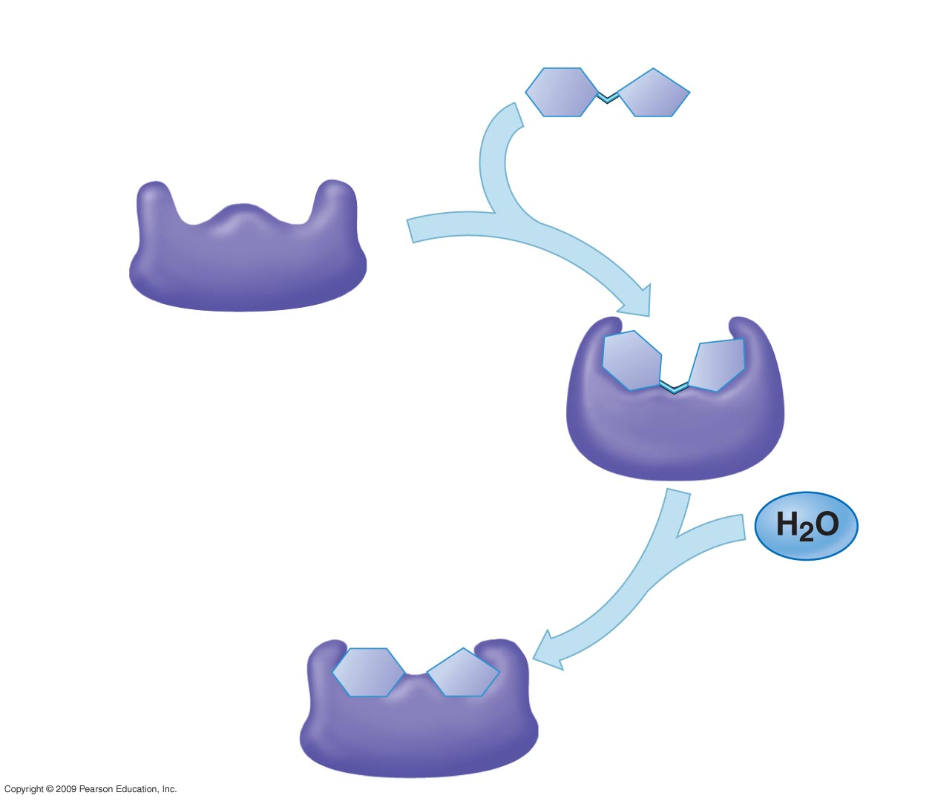
1
Enzyme available
with empty active
site
Active site
Substrate
(sucrose)
2
Substrate binds
to enzyme with
induced fit
Enzyme
(sucrase)
3
Substrate is
converted to
products
Notes:
Figure 5.15 The catalytic cycle of an enzyme.

Slide 79
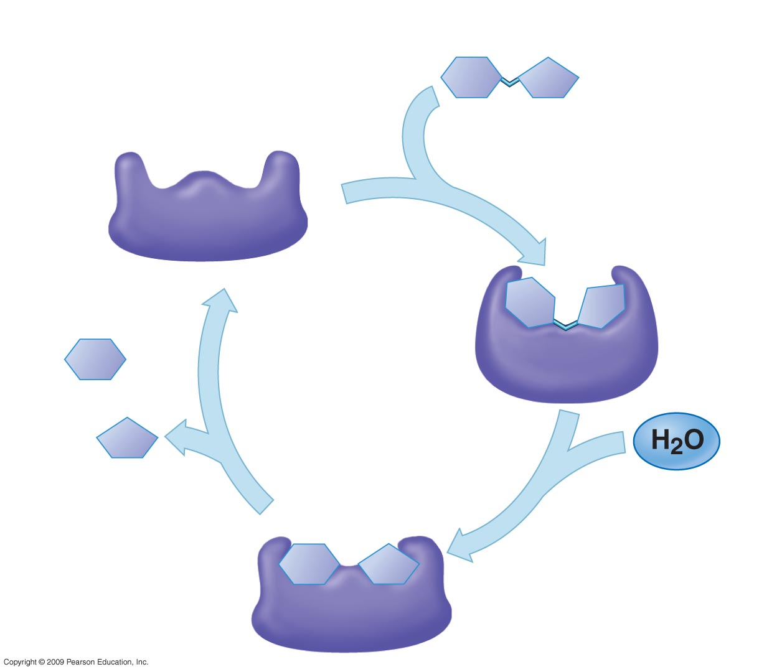
1
Enzyme available
with empty active
site
Active site
Substrate
(sucrose)
2
Substrate binds
to enzyme with
induced fit
Enzyme
(sucrase)
Glucose
Fructose
4
Products are
released
3
Substrate is
converted to
products
Notes:
Figure 5.15 The catalytic cycle of an enzyme.

Slide 80
5.15 A specific enzyme catalyzes each cellular reaction
For optimum activity, enzymes require certain environmental conditions
  Temperature is very important, and optimally, human enzymes function best at 37ºC, or body temperature
    High temperature will denature human enzymes
  Enzymes also require a pH around neutrality for best results
Copyright © 2009 Pearson Education, Inc.
Notes:
Certain chemicals also alter enzyme function and have been used to kill bacteria.
For the BLAST Animation Enzymes: Types and Specificity, go to Animation and Video Files.

Slide 81
5.15 A specific enzyme catalyzes each cellular reaction
Some enzymes require nonprotein helpers
  Cofactors are inorganic, such as zinc, iron, or copper
  Coenzymes are organic molecules and are often vitamins
Copyright © 2009 Pearson Education, Inc.
Notes:
We need vitamins in our food or as supplements because of their role in metabolism driven by enzymes.

Slide 82
5.16 Enzyme inhibitors block enzyme action and can regulate enzyme activity in a cell
Inhibitors are chemicals that inhibit an enzyme’s activity
  One group inhibits because they compete for the enzyme’s active site and thus block substrates from entering the active site
  These are called competitive inhibitors
Copyright © 2009 Pearson Education, Inc.
Notes:
Penicillin, an antibiotic, is an example of a noncompetitive inhibitor because it blocks the active site of an enzyme that some bacteria use to make their cell wall.
For the BLAST Animation Enzyme Regulation: Chemical Modification, go to Animation and Video Files.
For the BLAST Animation Enzyme Regulation: Competitive Inhibition, go to Animation and Video Files.

Slide 83
5.16 Enzyme inhibitors block enzyme action and can regulate enzyme activity in a cell
Other inhibitors do not act directly with the active site
  These bind somewhere else and change the shape of the enzyme so that the substrate will no longer fit the active site
  These are called noncompetitive inhibitors
Copyright © 2009 Pearson Education, Inc.

Slide 84
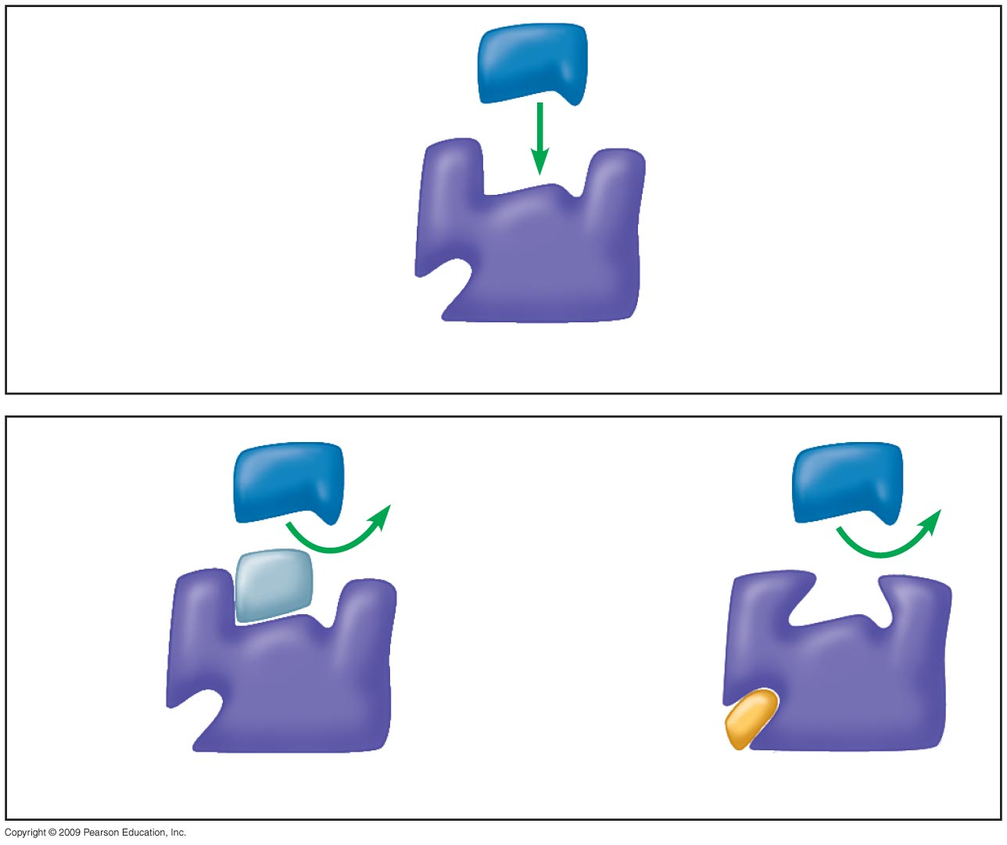
Substrate
Active site
Enzyme
Normal binding of substrate
Competitive
inhibitor
Noncompetitive
inhibitor
Enzyme inhibition
Notes:
Figure 5.16 How inhibitors interfere with substrate binding.

Slide 85
5.16 Enzyme inhibitors block enzyme action and can regulate enzyme activity in a cell
Enzyme inhibitors are important in regulating cell metabolism
  Often the product of a metabolic pathway can serve as an inhibitor of one enzyme in the pathway, a mechanism called feedback inhibition
  The more product formed, the greater the inhibition, and in this way, regulation of the pathway is accomplished
Copyright © 2009 Pearson Education, Inc.

Slide 86
Enzymes: Industrial Applications
Food Processing (Amylases, Proteases)
Baby food (Trypsin)
Brewing Industry
Fruit juices (Pectinases)
Dairy production (Renin, Lipases)
Meat tenderizers
Paper industry
Biofuel industry

