Slide 1

C h a p t e r
9
The General and Special Senses
PowerPoint® Lecture Slides prepared by Jason LaPres
Lone Star College - North Harris
Copyright © 2010 Pearson Education, Inc.

Slide 2
9-1: Sensory receptors connect our internal and external environments with the nervous system

Slide 3
Sensory Receptors
Specialized cells that monitor specific conditions in the body or external environment
When stimulated, a receptor passes information to the CNS in the form of action potentials along the axon of a sensory neuron

Slide 4
Sensory Receptors
Sensation
  The arriving information from these senses
Perception
  Conscious awareness of a sensation

Slide 5
Sensory Receptors
The Detection of Stimuli
  Receptor sensitivity:
    Each receptor has a characteristic sensitivity
  Receptive field:
    Area is monitored by a single receptor cell
    The larger the receptive field, the more difficult it is to localize a stimulus

Slide 6
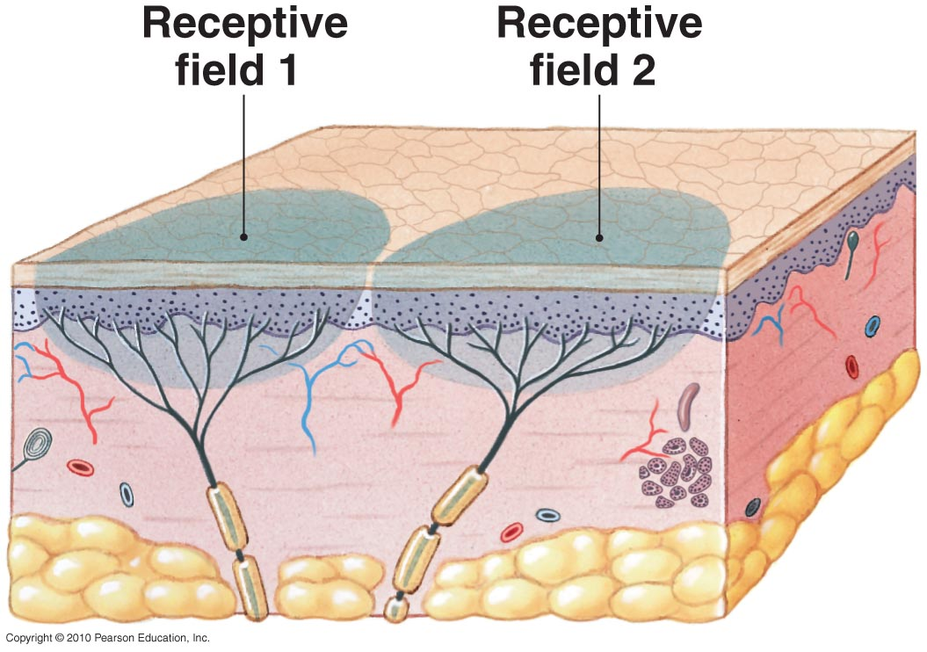
Receptors and Receptive Fields
Figure 9-1

Slide 7
Sensory Receptors
The Interpretation of Sensory Information
  Arriving stimulus:
    Takes many forms:
      physical force (such as pressure)
      dissolved chemical
      sound
      light

Slide 8
Sensory Receptors
The Interpretation of Sensory Information
  Sensations:
    Taste, hearing, equilibrium, and vision provided by specialized receptor cells
    Communicate with sensory neurons across chemical synapses

Slide 9
Sensory Receptors
Adaptation
  Reduction in sensitivity of a constant stimulus
  Your nervous system quickly adapts to stimuli that are painless and constant
  For example think about the background music at a doctor’s office

Slide 10
Sensory Receptors
General Senses
  Describe our sensitivity to:
    Temperature
    Pain
    Touch
    Pressure
    Vibration
    Proprioception

Slide 11
Sensory Receptors
Special Senses
  Olfaction (smell)
  Vision (sight)
  Gustation (taste)
  Equilibrium (balance)
  Hearing

Slide 12
Sensory Receptors
Stimulation of a receptor produces action potentials along the axon of a sensory neuron
The frequency and pattern of action potentials contain information about the strength, duration, and variation of the stimulus
Your perception of the nature of that stimulus depends on the path it takes inside the CNS

Slide 13
9-2: General sensory receptors can be classified by the type of stimulus that excites them

Slide 14
Classifying Sensory Receptors
General sensory receptors are divided into four types by the nature of the stimulus that excites them
  Nociceptors (pain)
  Thermoreceptors (temperature)

Slide 15
Classifying Sensory Receptors
  Mechanoreceptors (physical distortion)
    Tactile receptors (touch)
    Baroreceptors (pressure)
    Proprioceptors (position)
  Chemoreceptors (chemical concentration)

Slide 16
Pain
Nociceptors (also called pain receptors)
  Are common in the superficial portions of the skin, joint capsules, within the periostea of bones, and around the walls of blood vessels
  May be sensitive to temperature extremes, mechanical damage, and dissolved chemicals, such as chemicals released by injured cells
Figure 15–2

Slide 17
Pain
Nociceptors
  Are free nerve endings with large receptive fields:
    Branching tips of dendrites
    Not protected by accessory structures
    Can be stimulated by many different stimuli
    Two types of axons: Type A and Type C fibers

Slide 18
Pain
Nociceptors
  Myelinated Type A fibers:
    Carry sensations of fast pain, or prickling pain, such as that caused by an injection or a deep cut
    Sensations reach the CNS quickly and often trigger somatic reflexes
    Relayed to the primary sensory cortex and receive conscious attention

Slide 19
Pain
Nociceptors
  Type C fibers:
    Carry sensations of slow pain, or burning and aching pain
    Cause a generalized activation of the reticular formation and thalamus
    You become aware of the pain but only have a general idea of the area affected

Slide 20
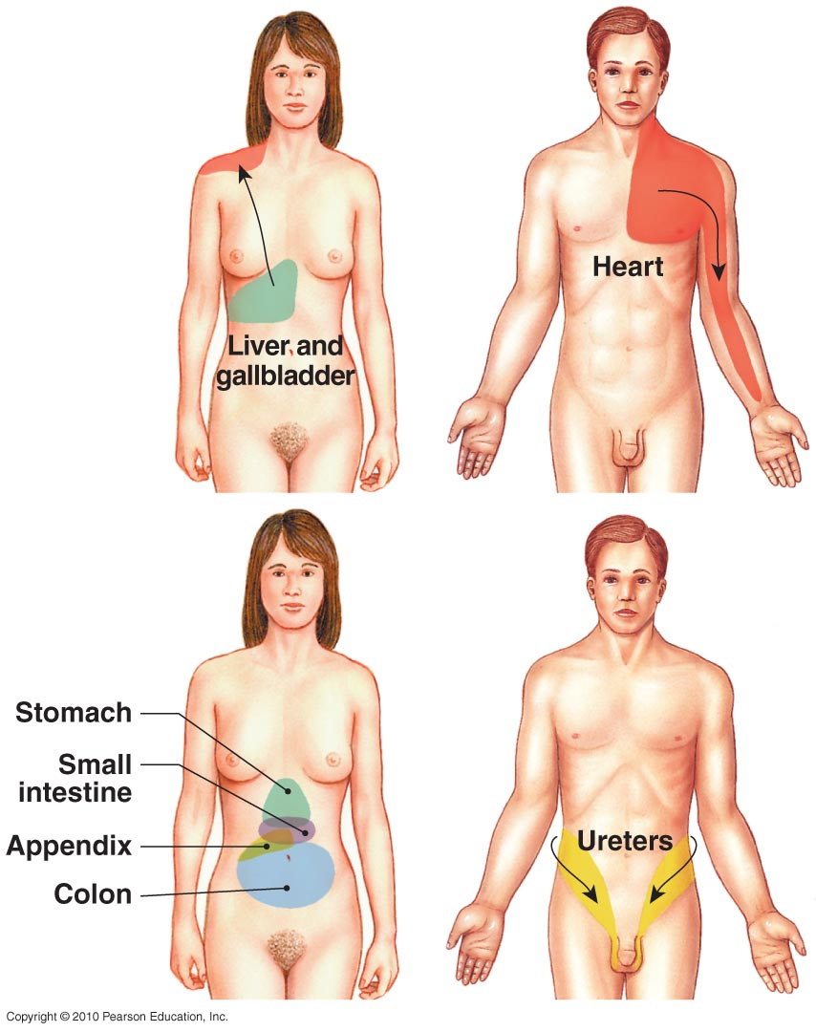
Referred Pain
Figure 9-2

Slide 21
Temperature
Thermoreceptors
  Also called temperature receptors
  Are free nerve endings located in:
    The dermis
    Skeletal muscles
    The liver
    The hypothalamus

Slide 22
Temperature
Thermoreceptors
  Temperature sensations:
    Conducted along the same pathways that carry pain sensations
    Sent to:
      the reticular formation (RAS)
      the thalamus
      the primary sensory cortex (to a lesser extent)

Slide 23
Touch, Pressure, and Position
Mechanoreceptors
  Sensitive to stimuli that distort their plasma membranes
  Contain mechanically gated ion channels whose gates open or close in response to
    Stretching
    Compression
    Twisting
    Other distortions of the membrane

Slide 24
Touch, Pressure, and Position
Tactile receptors
  Provide the sensations of touch, pressure, and vibration:
    Touch sensations provide information about shape or texture
    Pressure sensations indicate degree of mechanical distortion
    Vibration sensations indicate pulsing or oscillating pressure

Slide 25
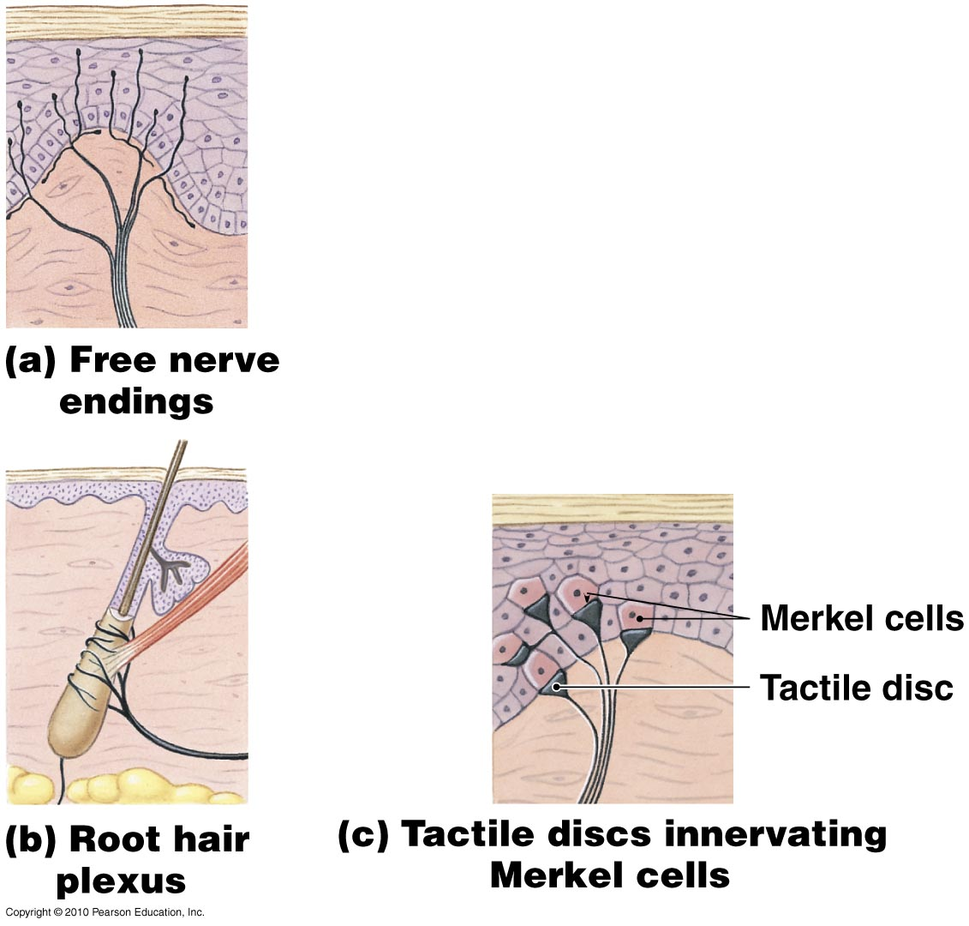
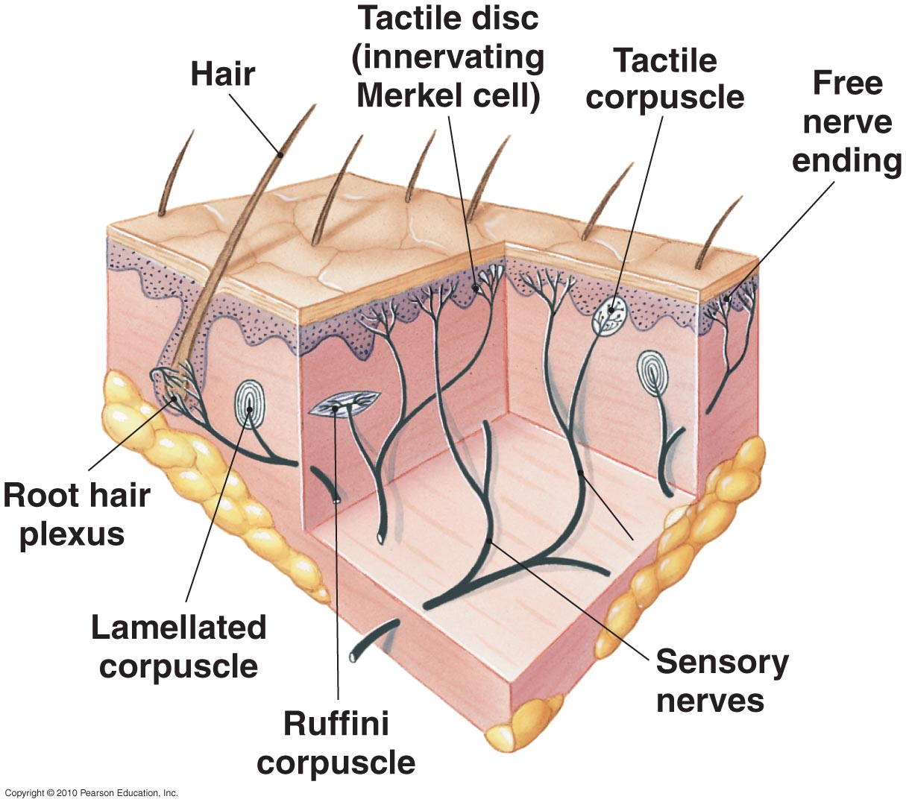
Tactile Receptors in the Skin
Figure 9-3
Sensitive to touch and pressure

Slide 26
Tactile Receptors in the Skin
Figure 9-3
Monitor movement and changes across the surface of your body

Slide 27
Tactile Receptors in the Skin
Figure 9-3
Fine touch & pressure receptors

Slide 28
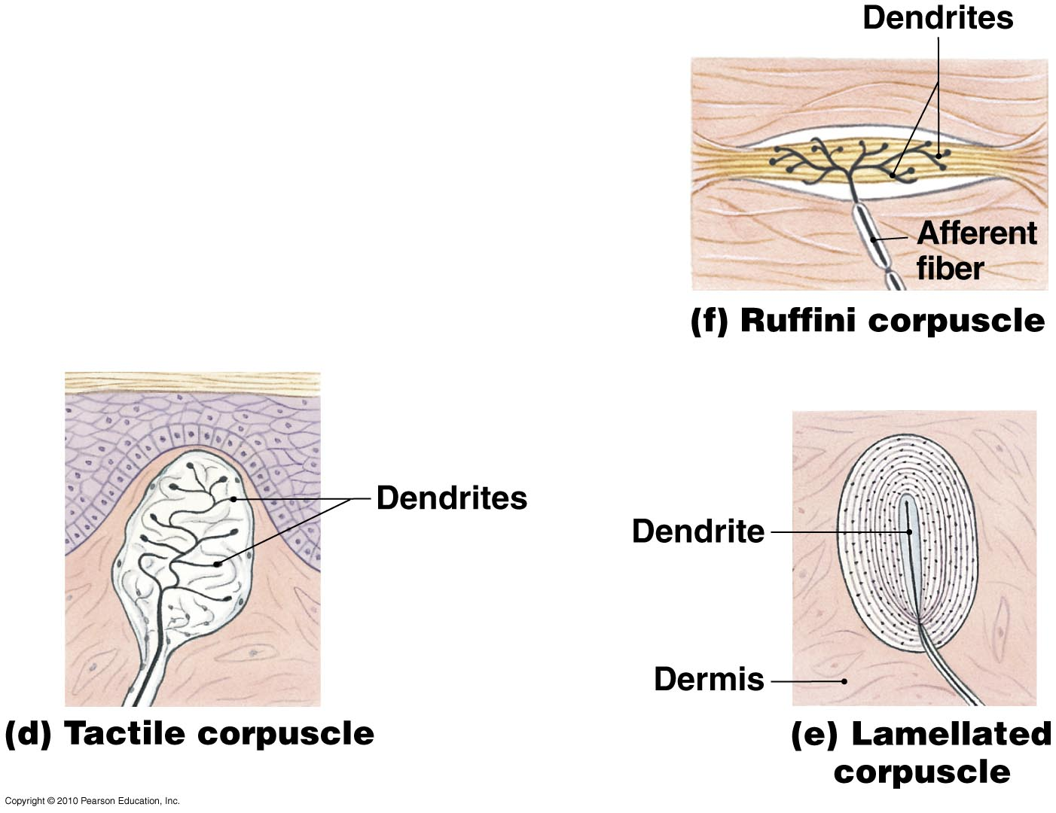
Tactile Receptors in the Skin
Aka Meissner’s corpuscles
Fine touch & pressure, low freq vibration
Figure 9-3

Slide 29
Tactile Receptors in the Skin
Aka Pacinian corpuscles
Sensitive to deep pressure, pulses or high freq vibration
Figure 9-3

Slide 30
Tactile Receptors in the Skin
Sensitive to pressure & skin distortion but located deep in the dermis
Figure 9-3

Slide 31
Touch, Pressure, and Position
Baroreceptors
  Monitor change in pressure
  Consist of free nerve endings that branch within elastic tissues in wall of distensible organ (such as a blood vessel)
  Respond immediately to a change in pressure, but adapt rapidly

Slide 32
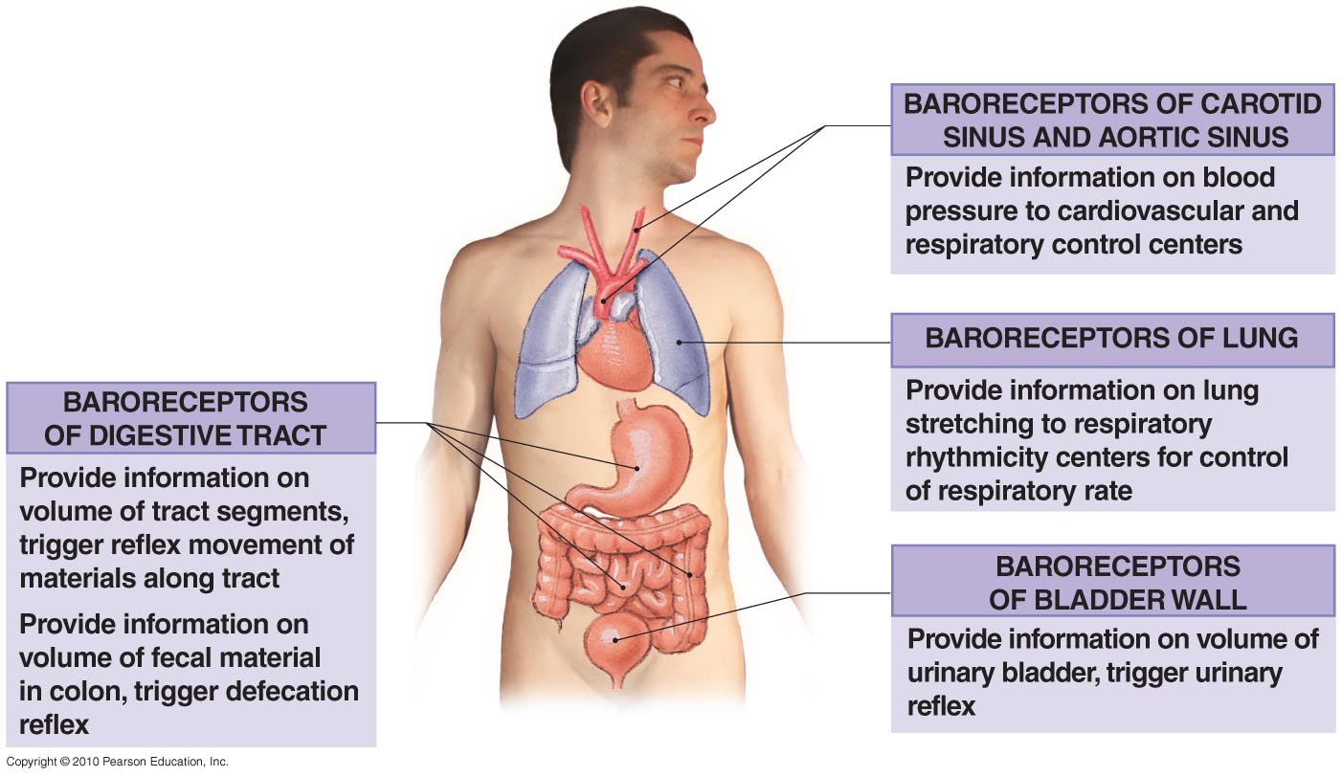
Baroreceptors
Figure 9-4

Slide 33
Touch, Pressure, and Position
Proprioceptors
  Monitor:
    Position of joints
    Tension in tendons and ligaments
    State of muscular contraction

Slide 34
Touch, Pressure, and Position
Major Groups of Proprioceptors
  Muscle spindles:
    Monitor skeletal muscle length
    Trigger stretch reflexes
  Golgi tendon organs:
    Located at the junction between skeletal muscle and its tendon
    Stimulated by tension in tendon
    Monitor external tension developed during muscle contraction

Slide 35
Chemical Detection
Chemoreceptors
  Respond only to water-soluble and lipid-soluble substances dissolved in surrounding fluid
  Receptors exhibit peripheral adaptation over period of seconds

Slide 36
Classifying Sensory Receptors
Chemoreceptors
  Located in the:
    Carotid bodies:
      near the origin of the internal carotid arteries on each side of the neck
    Aortic bodies:
      between the major branches of the aortic arch
  Receptors monitor pH, carbon dioxide, and oxygen levels in arterial blood

Slide 37
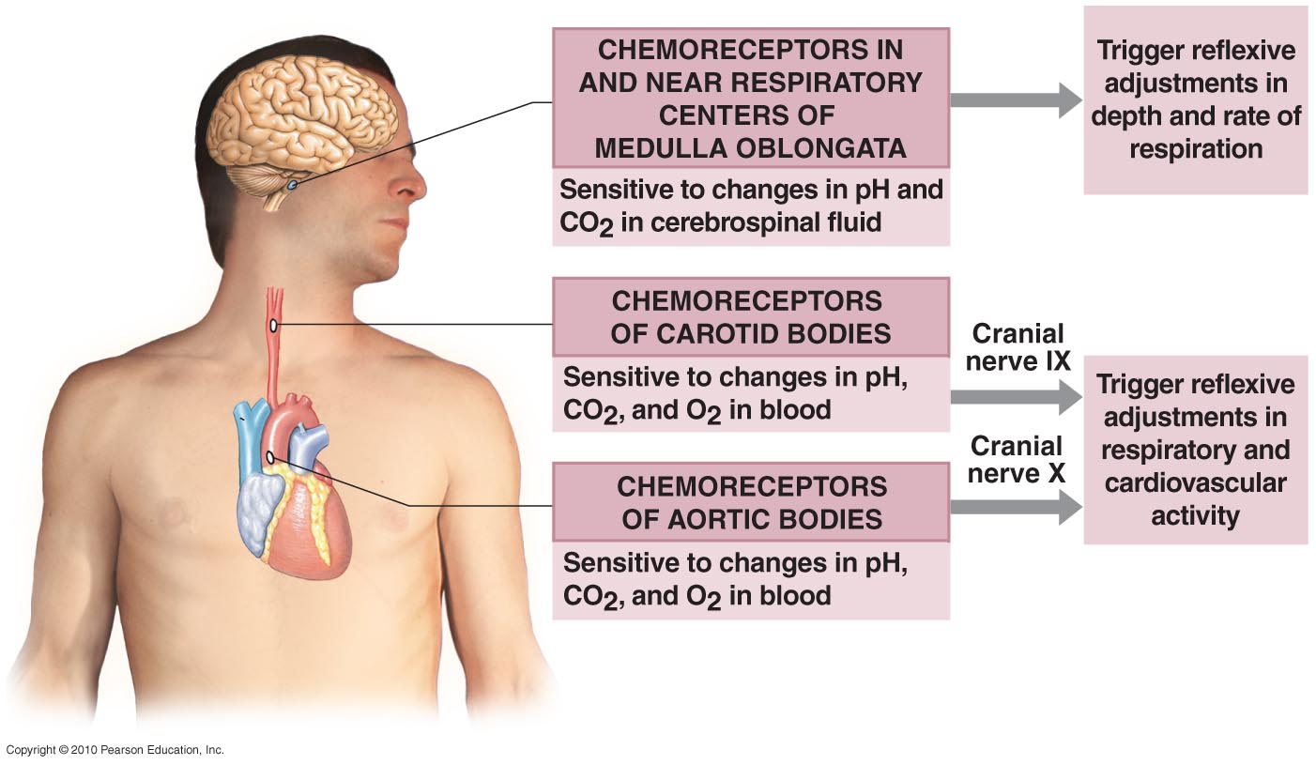
Chemoreceptors
Figure 9-5

Slide 38
9-3: Olfaction, the sense of smell, involves olfactory receptors responding to chemical stimuli

Slide 39
Smell (Olfaction)
Olfactory Organs
  Provide sense of smell
  Located in nasal cavity on either side of nasal septum
  Made up of two layers:
    Olfactory epithelium
    Lamina propria
Figure 17–1a

Slide 40
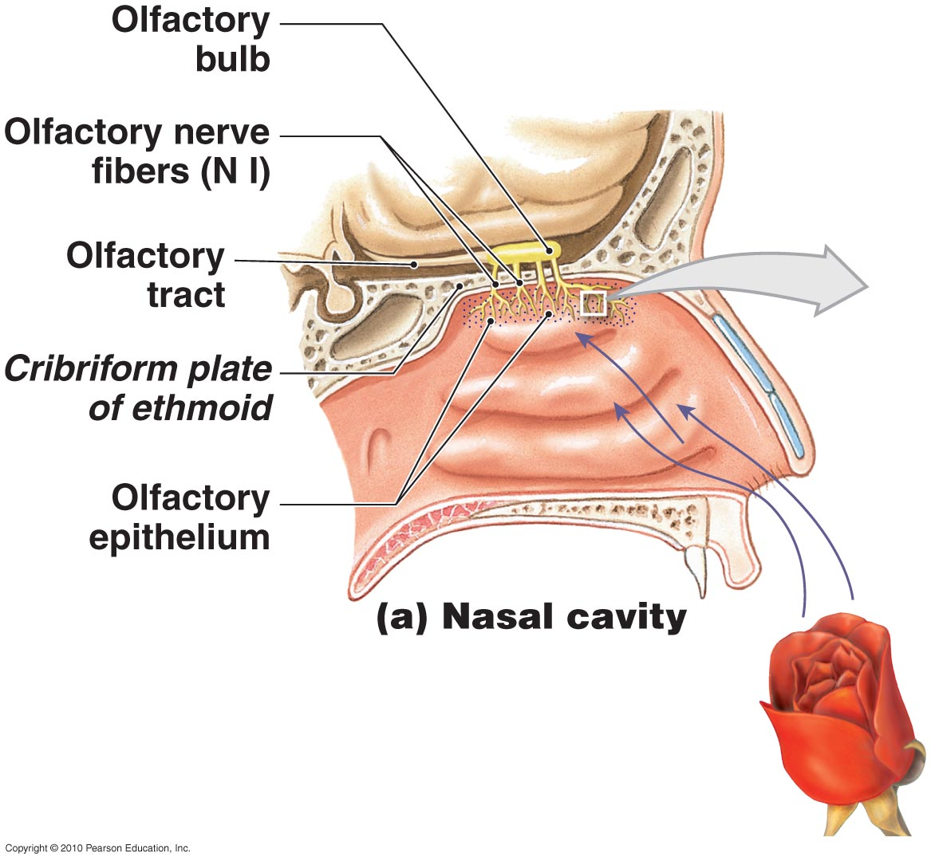
The Olfactory Organs
Figure 9-6

Slide 41
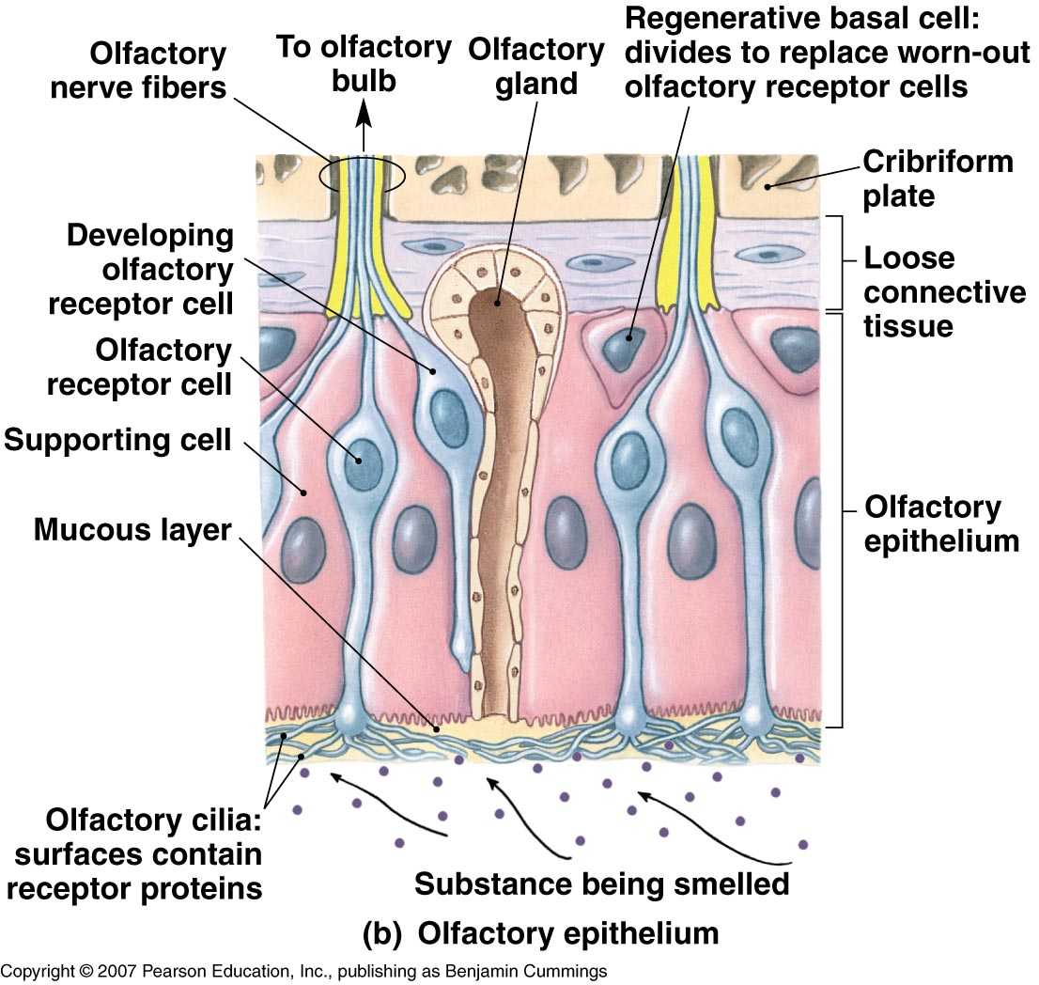
The Olfactory Organs

Slide 42
Smell (Olfaction)
Olfactory Glands
  Secretions coat surfaces of olfactory organs
Olfactory Receptors
  Highly modified neurons
  Olfactory reception:
    Involves detecting dissolved chemicals as they interact with odorant-binding proteins

Slide 43
Smell (Olfaction)
Olfactory Pathways
  Axons leaving olfactory epithelium:
    Collect into 20 or more bundles
    Penetrate cribriform plate of ethmoid
    Reach olfactory bulbs of cerebrum where first synapse occurs
    Axons leaving olfactory bulb:
      travel along olfactory tract to reach olfactory cortex, hypothalamus, and portions of limbic system

Slide 44
Smell (Olfaction)
Olfactory Discrimination
  Can distinguish thousands of chemical stimuli
  CNS interprets smells by the pattern of receptor activity
Olfactory Receptor Population
  Considerable turnover
  Number of olfactory receptors declines with age

Slide 45
9-4: Gustation, the sense of taste, involves taste receptors responding to chemical stimuli

Slide 46
Taste (Gustation)
Gustation provides information about the foods and liquids consumed
Taste receptors (or gustatory receptors) are distributed on tongue and portions of pharynx and larynx
  Clustered into taste buds

Slide 47
Taste (Gustation)
Taste buds
  Associated with epithelial projections (lingual papillae) on superior surface of tongue
  Three types of lingual papillae:
    Filiform papillae:
      provide friction
      do not contain taste buds
    Fungiform papillae:
      contain five taste buds each
    Circumvallate papillae:
      contain 100 taste buds each

Slide 48
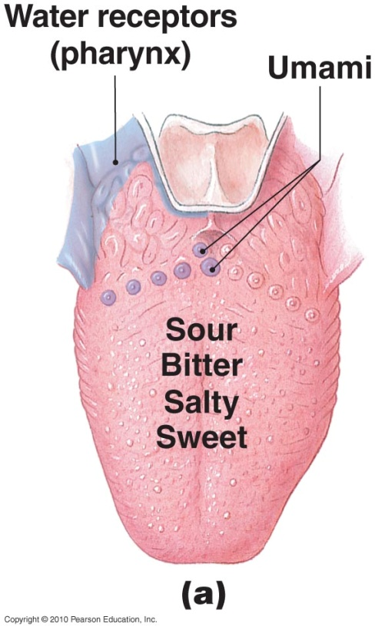
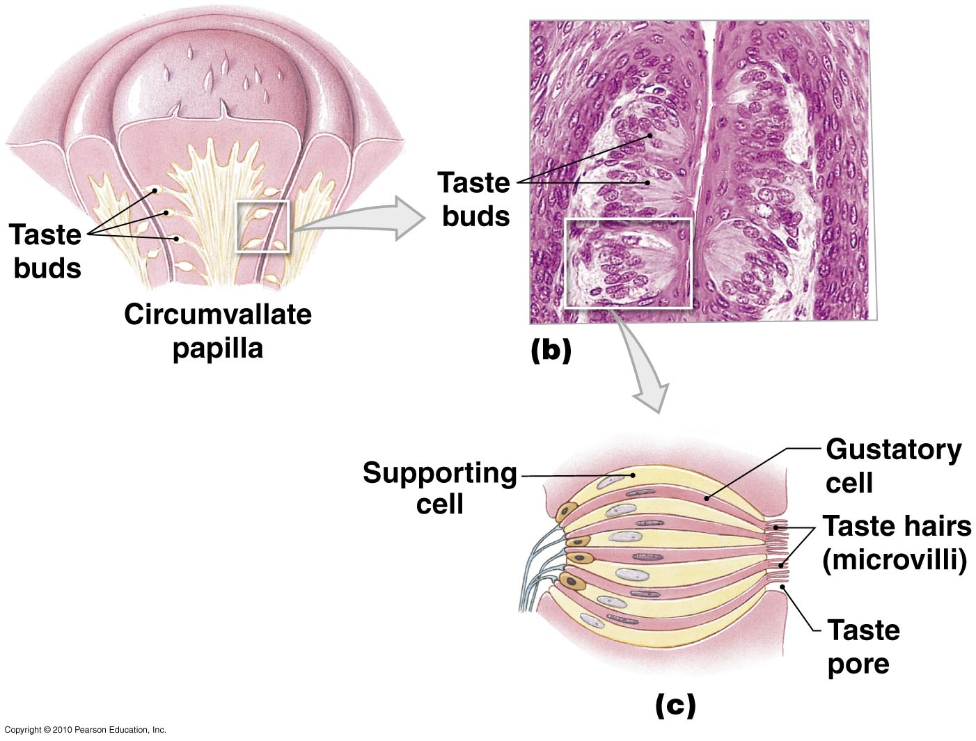
Gustatory Receptors
Figure 9-7

Slide 49
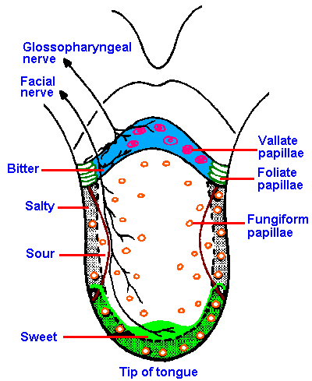
Gustatory Receptors

Slide 50
Taste (Gustation)
Gustatory Discrimination
  Primary taste sensations:
    Sweet
    Salty
    Sour
    Bitter
    Umami (savory)

Slide 51
Taste (Gustation)
Additional human taste sensations
  Water:
    Detected by water receptors in the pharynx

Slide 52
Taste (Gustation)
Gustatory Discrimination
  Dissolved chemicals contact taste hairs
  Bind to receptor proteins of gustatory cell
  Salt and sour receptors:
    Chemically gated ion channels
    Stimulation produces depolarization of cell
  Sweet, bitter, and umami stimuli:
    G proteins:
      gustducins

Slide 53
9-5: Internal eye structures contribute to vision, while accessory eye structures provide protection

Slide 54

Accessory Structures of the Eye
Provide protection, lubrication, and support
Includes
  The palpebrae (eyelids)
  The superficial epithelium of eye
  The lacrimal apparatus
The Eye: Accessory Structures

Slide 55
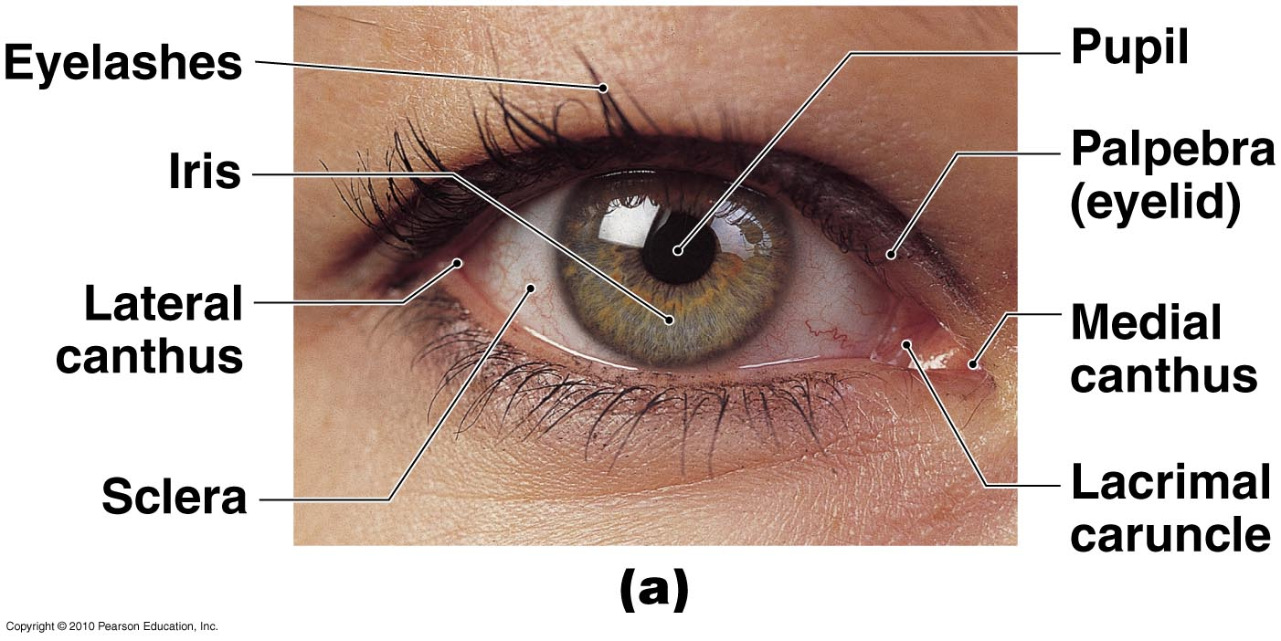
Accessory Structures of the Eye
Figure 9-8a

Slide 56
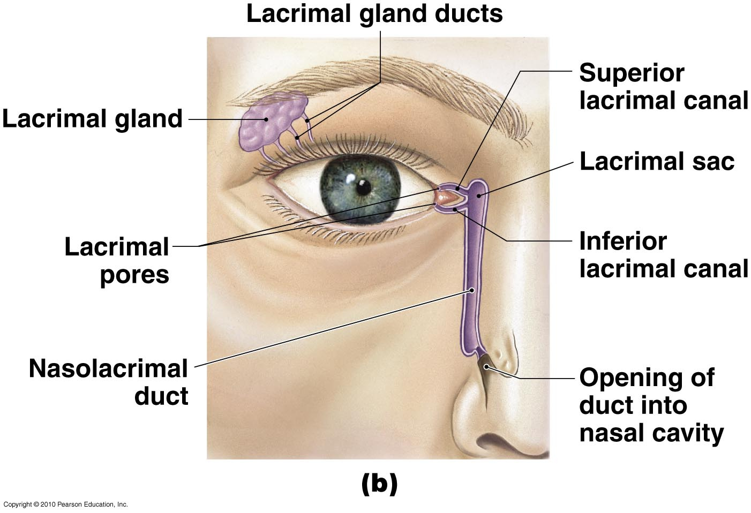
Accessory Structures of the Eye
Figure 9-8b

Slide 57
The Eye
Three Layers of the Eye
  Outer fibrous tunic
  Middle vascular tunic
  Inner neural tunic
Eyeball
  Is hollow
  Is divided into two cavities:
    Large posterior cavity
    Smaller anterior cavity

Slide 58
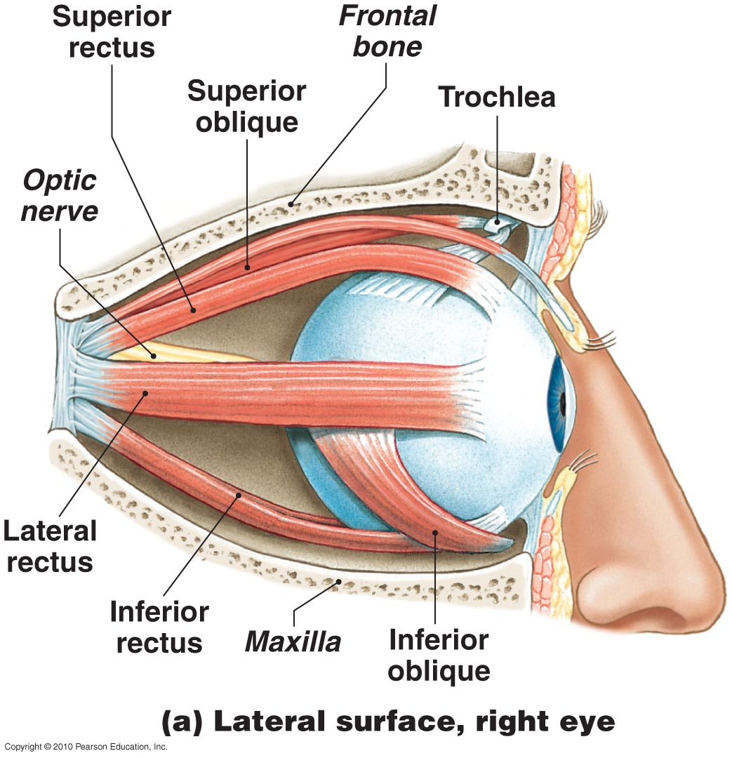
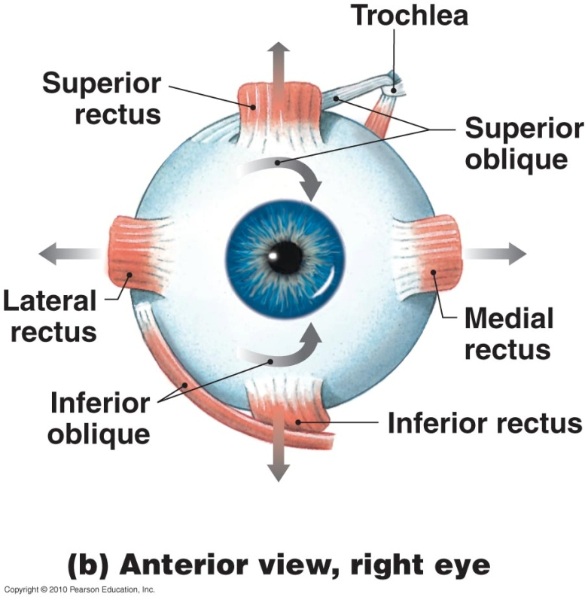
The Extrinsic Eye Muscles
Figure 9-9
Eye Muscles 3D Rotation

Slide 59
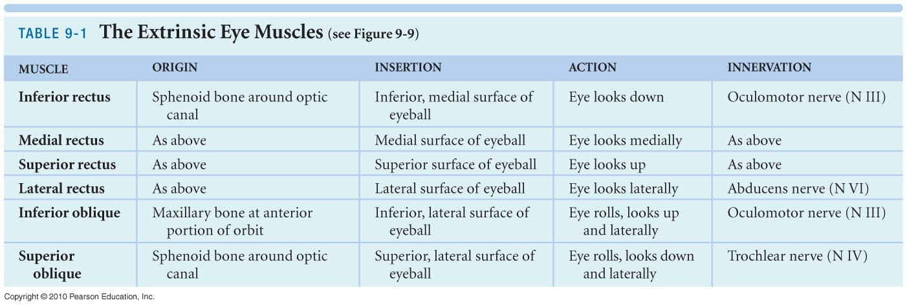

Slide 60
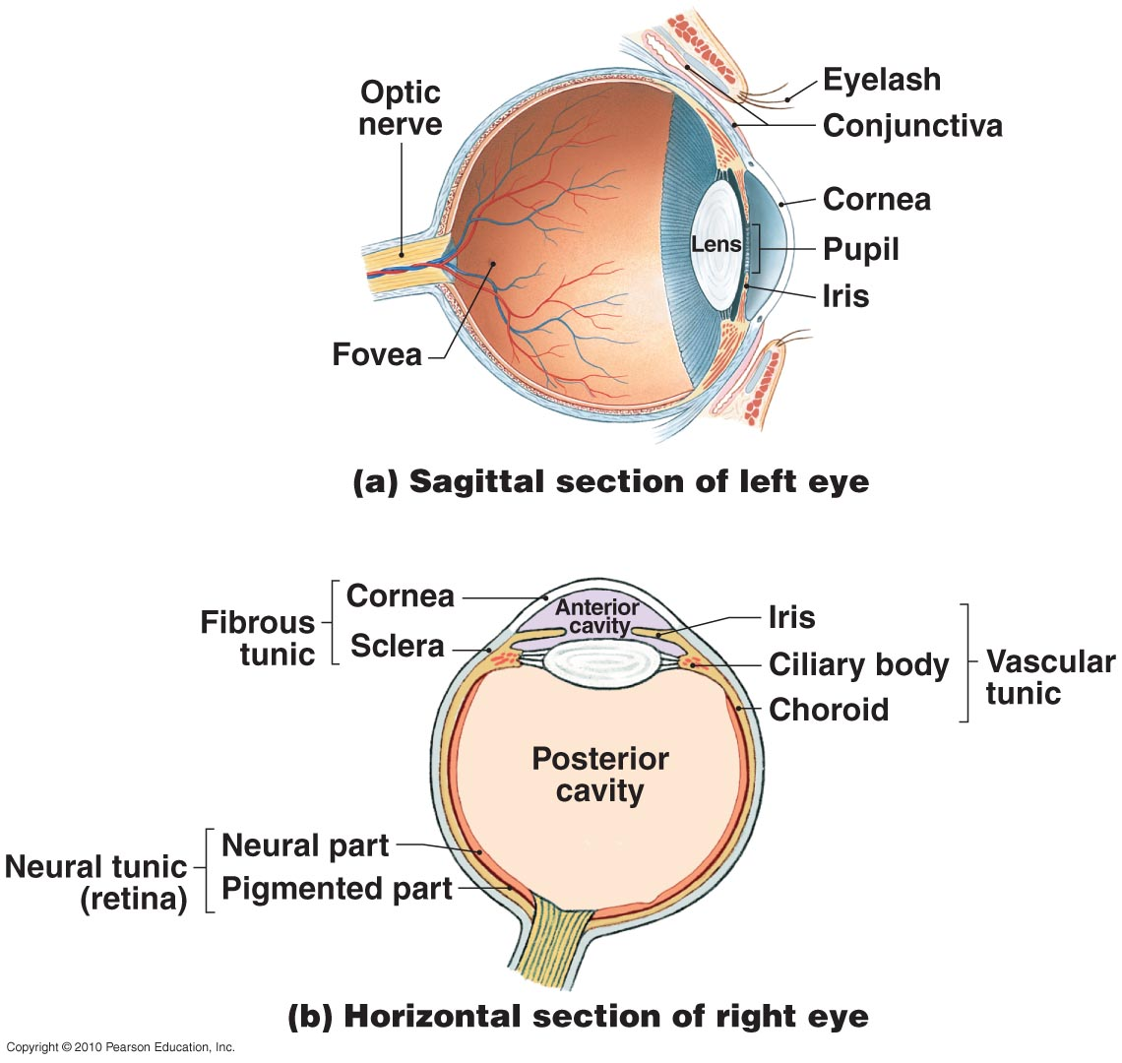
The Eye
Figure 9-10a

Slide 61
The Eye
Figure 9-10b

Slide 62
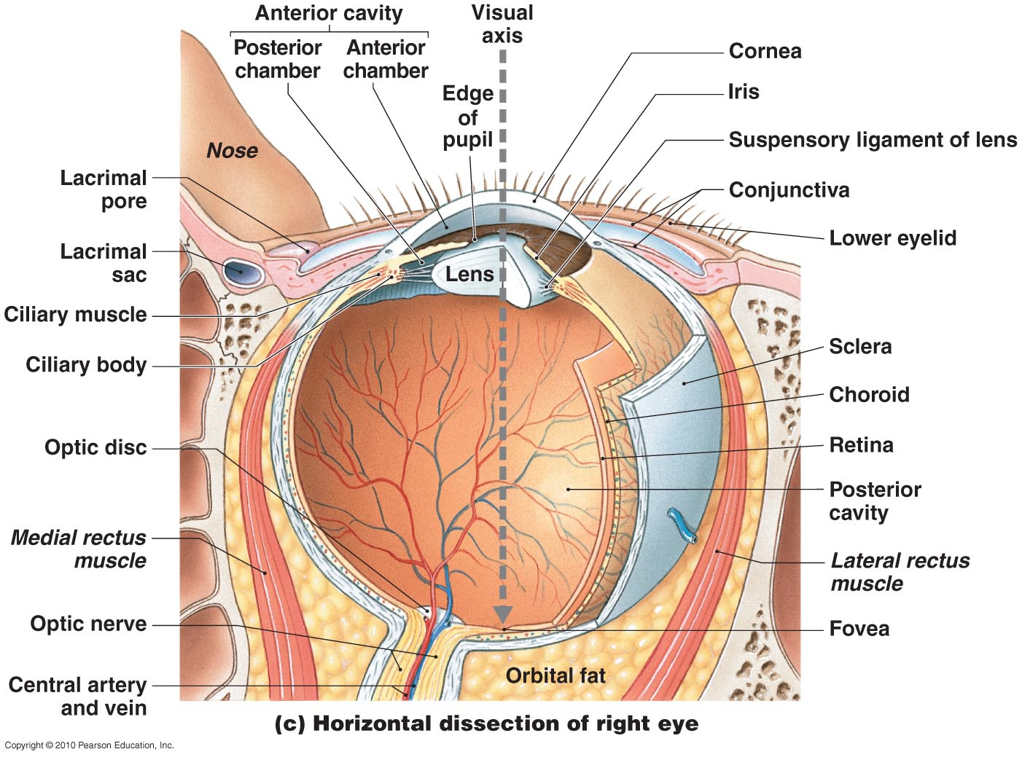
Figure 9-10c

Slide 63
The Eye
The Fibrous Tunic
  Sclera (white of eye)
  Cornea
  Limbus (border between cornea and sclera)

Slide 64
The Eye
Vascular Tunic (Uvea) Functions
  Provides route for blood vessels and lymphatics that supply tissues of eye
  Regulates amount of light entering eye
  Secretes loose and reabsorbs aqueous humor that circulates within chambers of eye
  Controls shape of lens, which is essential to focusing

Slide 65
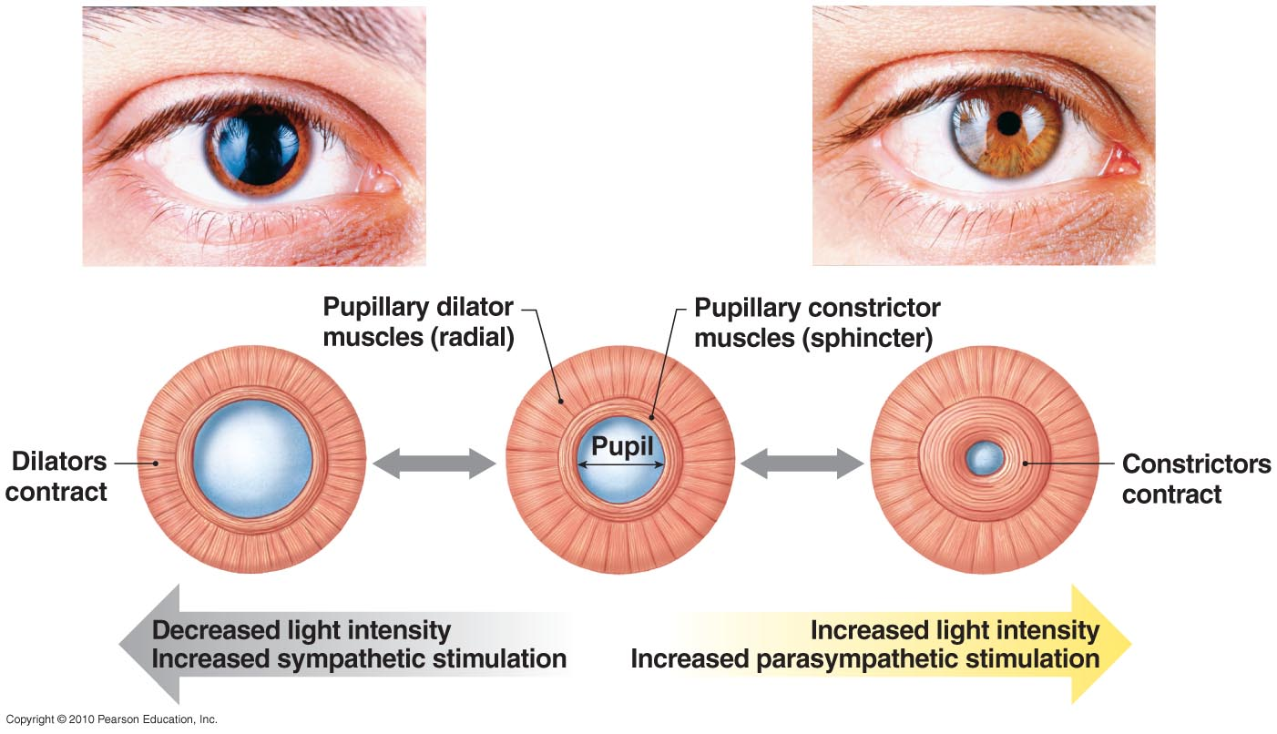
The Pupillary Muscles
Figure 9-11

Slide 66
The Eye
The Neural Tunic (Retina)
  Outer layer called pigmented part
  Inner neural part:
    Contains visual receptors and associated neurons
    Rods and cones are types of photoreceptors:
      rods:
        do not discriminate light colors
        highly sensitive to light
      cones:
        provide color vision
        densely clustered in fovea, at center of macula lutea

Slide 67
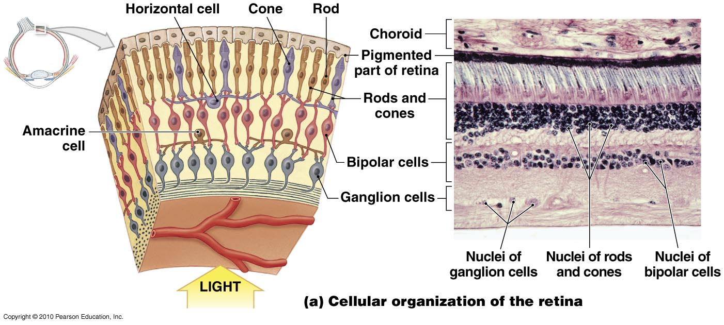
Retinal Organization
Figure 9-12

Slide 68
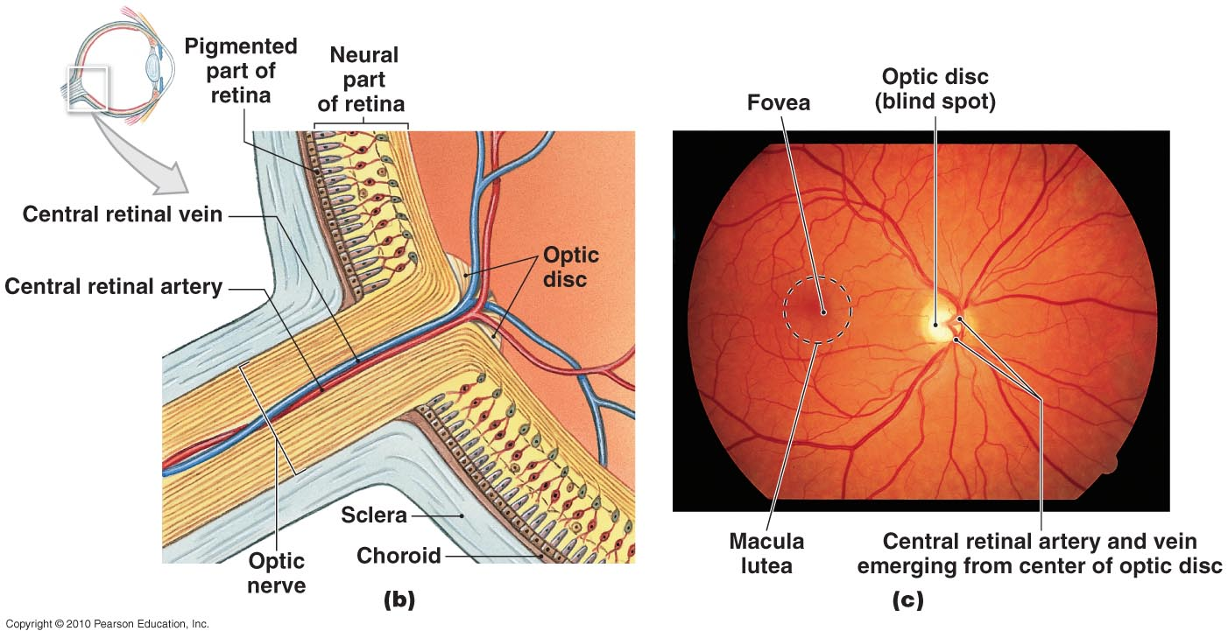
Retinal Organization
Figure 9-12

Slide 69
Retinal Organization
Figure 9-12
Blind Spot

Slide 70
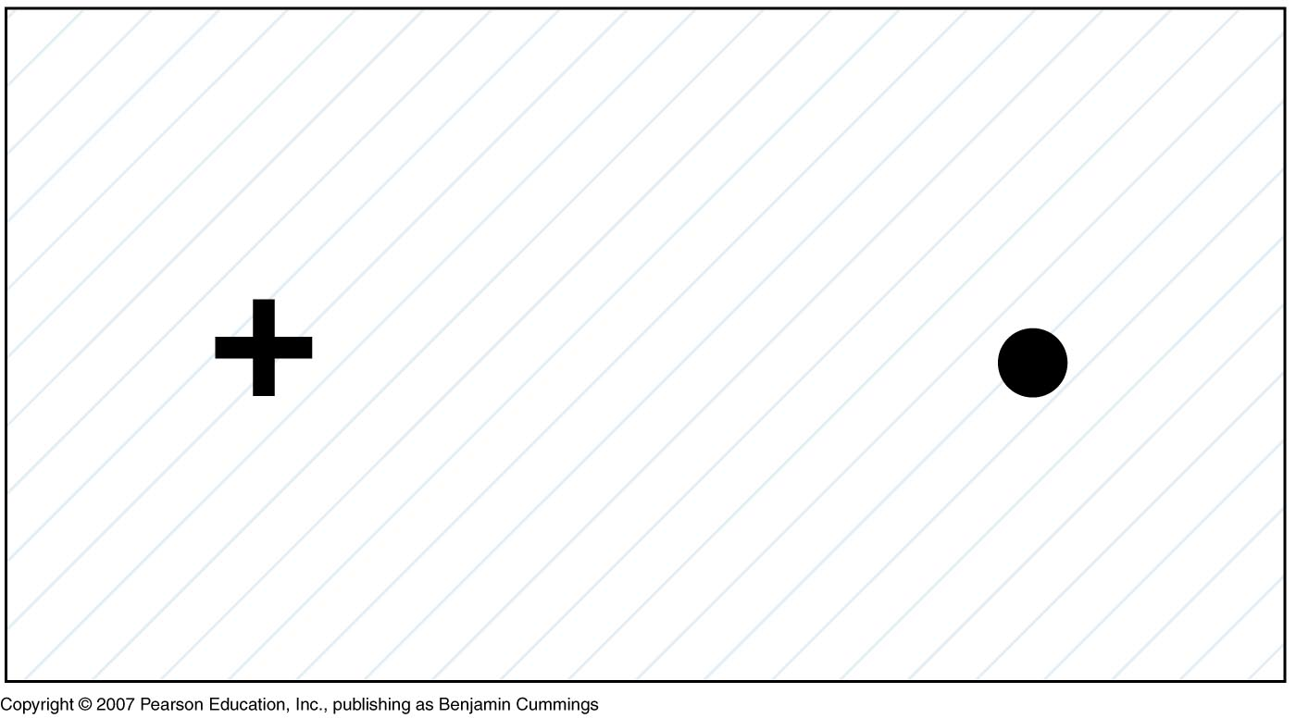
The Blind Spot

Slide 71
The Eye
The Neural Tunic (Retina)
  Inner neural part:
    Bipolar cells:
      neurons of rods and cones synapse with ganglion cells
    Horizontal cells:
      extend across outer portion of retina
    Amacrine cells:
      comparable to horizontal cell layer
      where bipolar cells synapse with ganglion cells
Figure 17–6a

Slide 72
The Eye
The Chambers of the Eye
  Ciliary body and lens divide eye into:
    Large posterior cavity (vitreous chamber)
    Smaller anterior cavity:
      anterior chamber:
        extends from cornea to iris
      posterior chamber:
        between iris, ciliary body, and lens

Slide 73
The Eye
Smaller anterior cavity
  Aqueous humor:
    Fluid circulates within eye
    Diffuses through walls of anterior chamber into canal of Schlemm
    Re-enters circulation
  Intraocular pressure:
    Fluid pressure in aqueous humor
    Helps retain eye shape

Slide 74
The Eye
Large Posterior Cavity (Vitreous Chamber)
  Vitreous body:
    Gelatinous mass
    Helps stabilize eye shape and supports retina

Slide 75
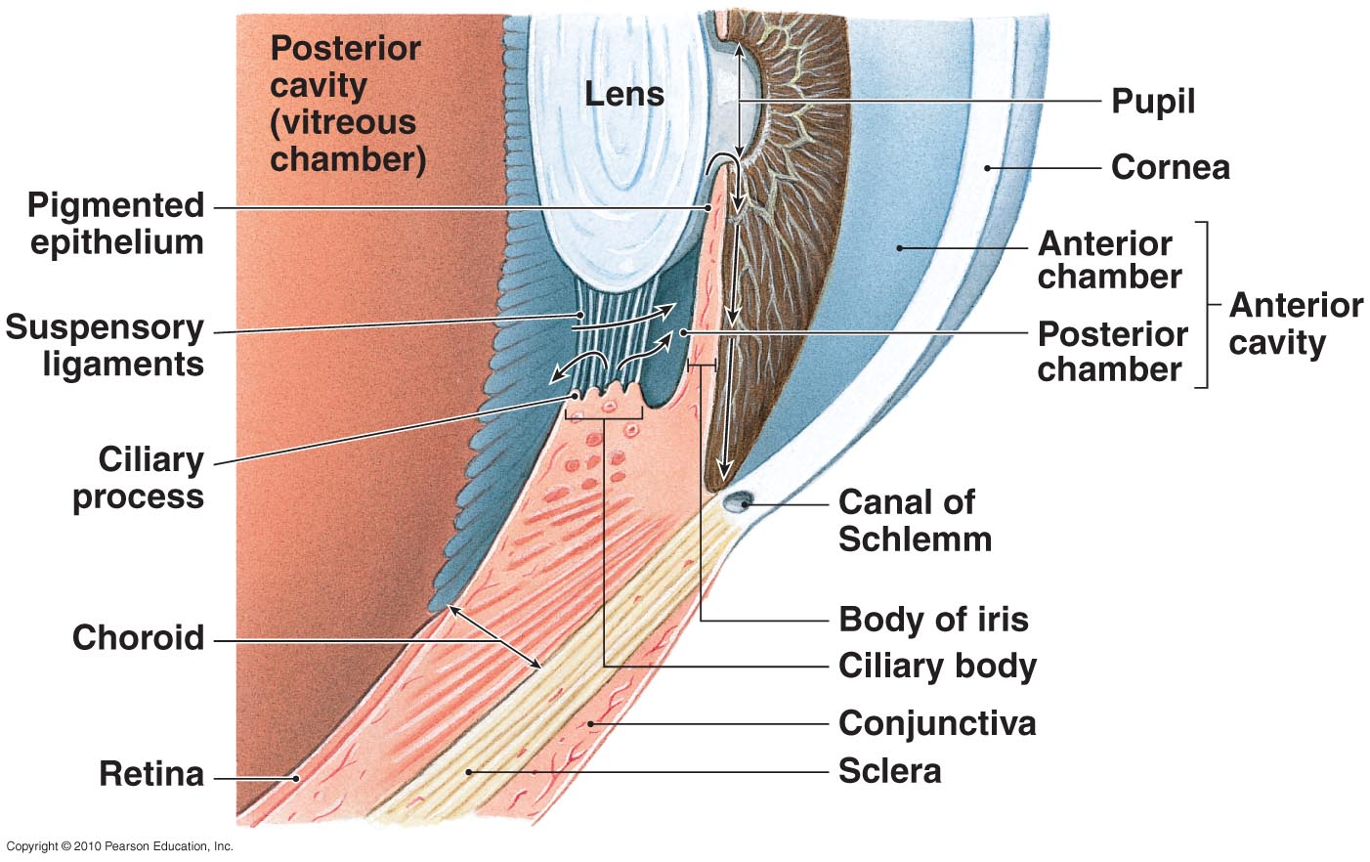
The Eye Chambers
Figure 9-14
Ciliary Muscles

Slide 76
The Eye
The Lens
  Lens fibers:
    Cells in interior of lens
    No nuclei or organelles

Slide 77
The Eye
The Lens
  Light refraction:
    Bending of light by cornea and lens
    Focal point:
      specific point of intersection on retina
    Focal distance:
      distance between center of lens and focal point

Slide 78
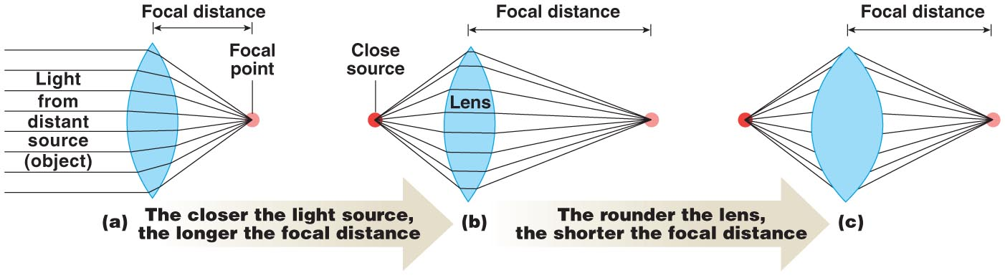
The Eye
Figure 9-15

Slide 79
The Eye
Light Refraction of Lens
  Accommodation:
    Shape of lens changes to focus image on retina
  Astigmatism:
    Condition where light passing through cornea and lens is not refracted properly
    Visual image is distorted
  Visual acuity:
    Clarity of vision
    “Normal” rating is 20/20
Path of Light

Slide 80
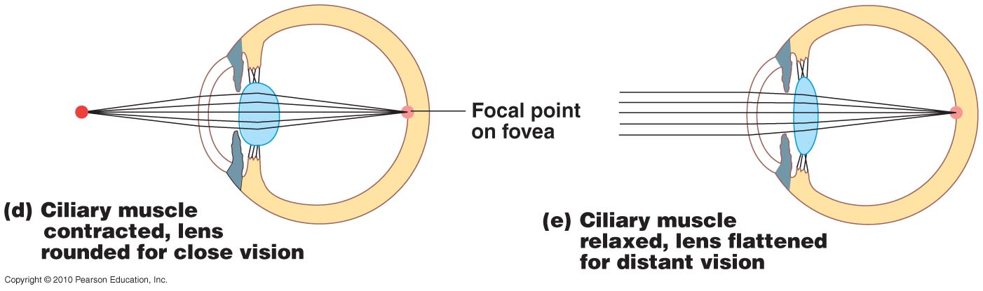
The Eye
Figure 9-15

Slide 81
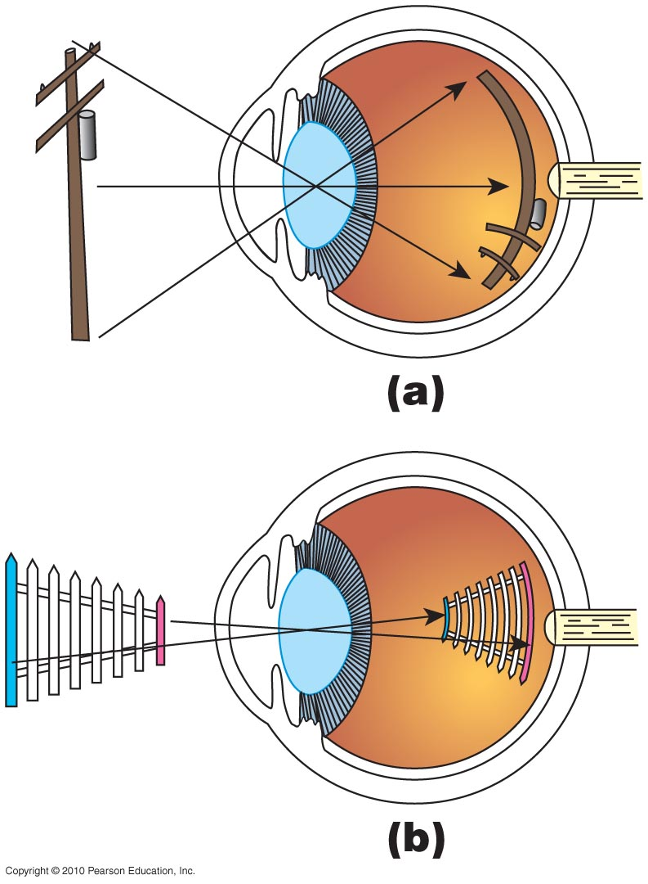
Image Formation
Figure 9-16

Slide 82
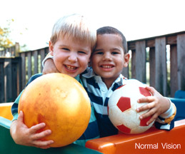
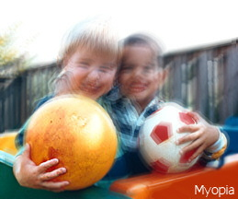
Myopia (Nearsightedness)

Slide 83

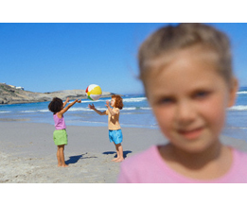
Hyperopia (Farsightedness)

Slide 84
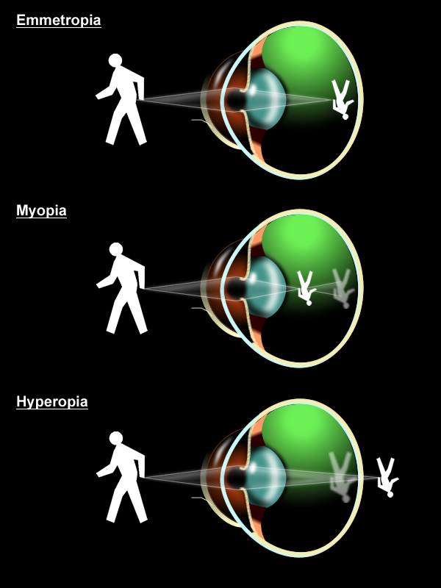
Image Formation & Visual Abnormalities
Emmetropia is normal, focused vision.

Slide 85
9-6: Photoreceptors respond to light and change it into electrical signals essential to visual physiology

Slide 86
Visual Physiology
Rods
  Respond to almost any photon, regardless of energy content
Cones
  Have characteristic ranges of sensitivity

Slide 87
Visual Physiology
Anatomy of Rods and Cones
  Outer segment with membranous discs
  Inner segment:
    Narrow stalk connects outer segment to inner segment
  Visual pigments:
    Is where light absorption occurs
    Derivatives of rhodopsin (opsin plus retinal)
    Retinal: synthesized from vitamin A

Slide 88
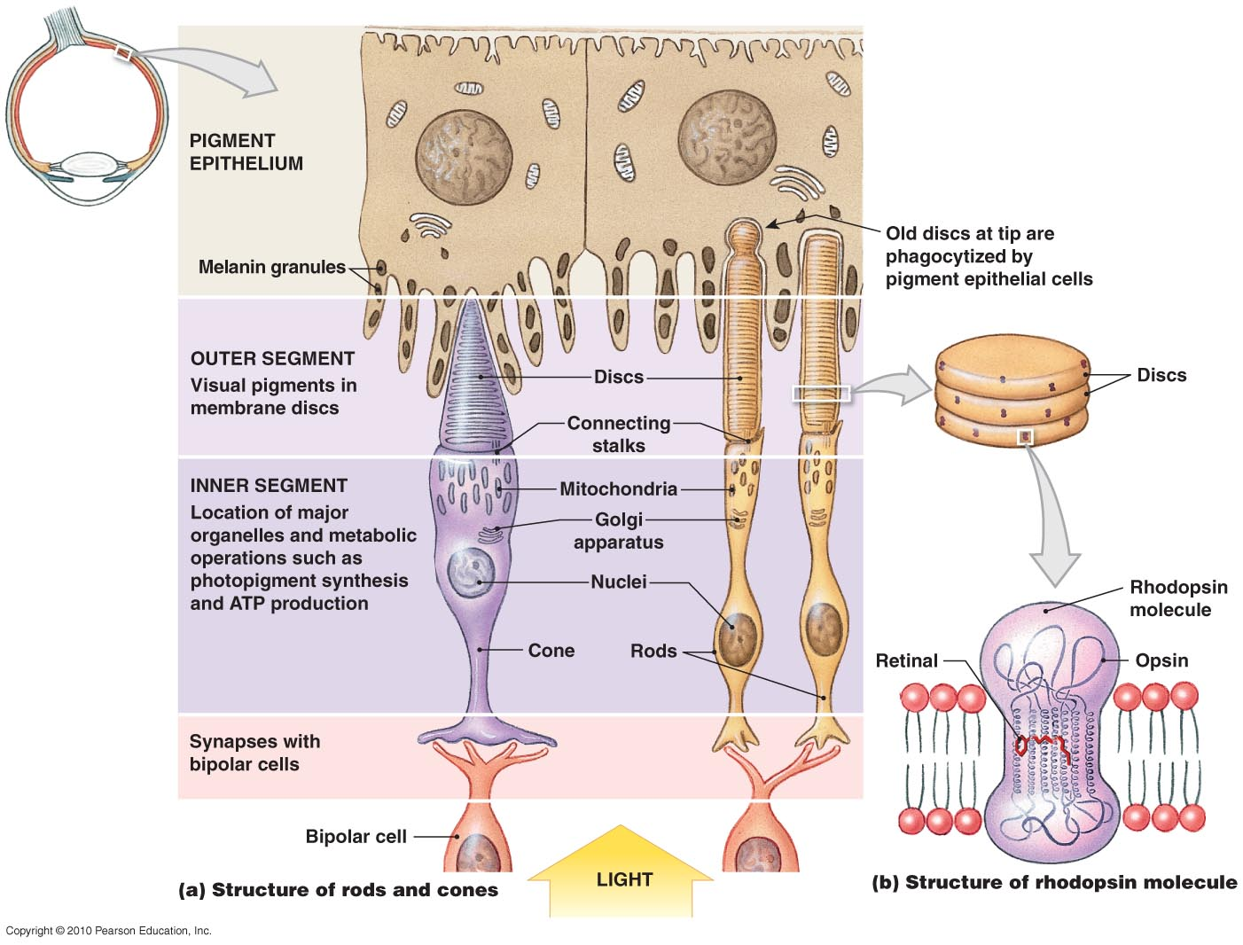
Figure 9-19

Slide 89
Visual Physiology
Photoreception
  Photon strikes retinal portion of rhodopsin molecule embedded in membrane of disc
    Opsin is activated
    Bound retinal molecule has two possible configurations:
      11-cis form
      11-trans form

Slide 90
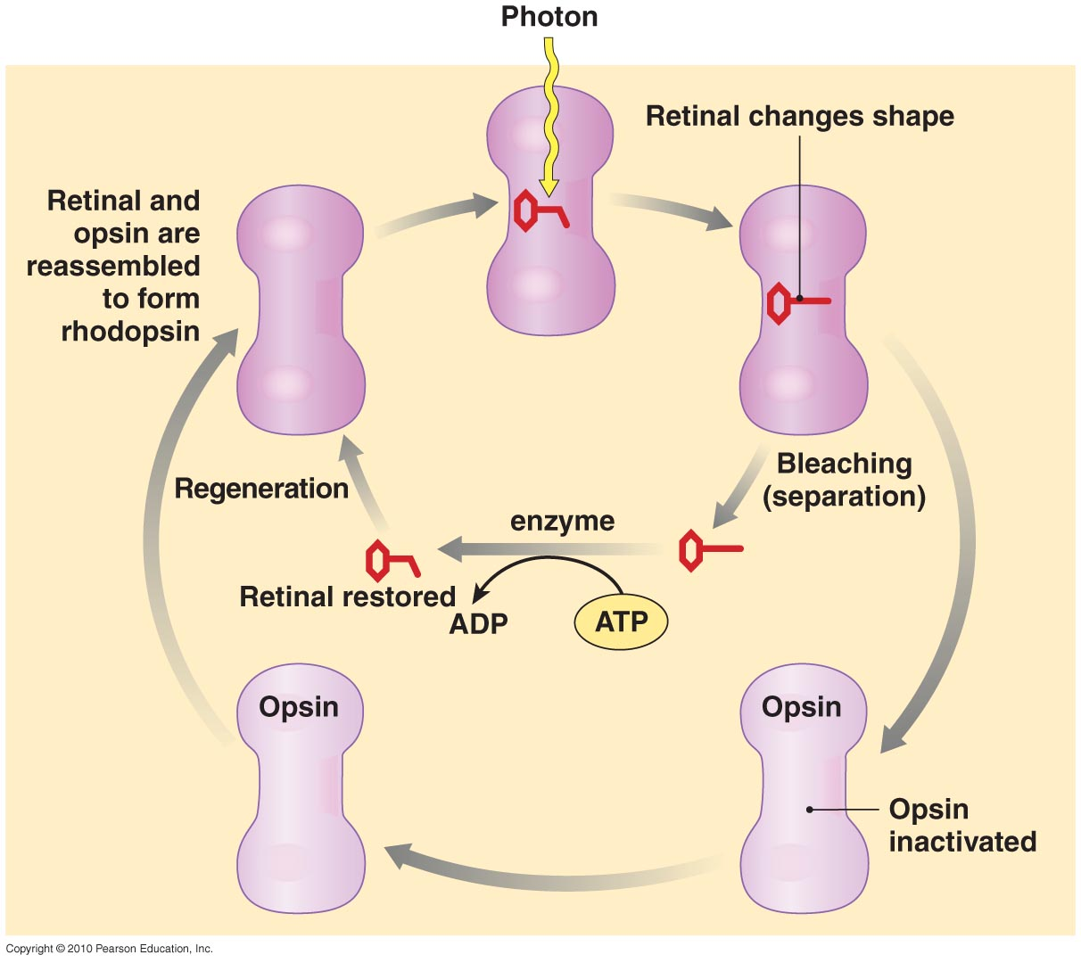
Visual Physiology
Figure 9-20

Slide 91
Visual Physiology
Color Vision
  Integration of information from red, green, and blue cones
  Color blindness:
    Inability to detect certain colors
Figure 17–16

Slide 92




Color Vision
The colors of the rainbow as viewed by a person with no color vision deficiencies.
The colors of the rainbow as viewed by a person with protanopia – affects red receptors
The colors of the rainbow as viewed by a person with deuteranopia – affects green receptors
The colors of the rainbow as viewed by a person with tritanopia – affects blue- yellow receptors

Slide 93
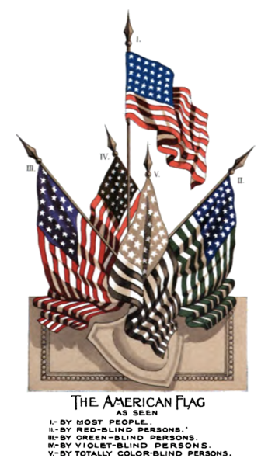
Color Blindness
Color vision deficiency, is the inability to perceive differences between some of the colors that others can distinguish. It is most often of genetic nature, but may also occur because of eye, nerve, or brain damage, or exposure to certain chemicals.

Slide 94
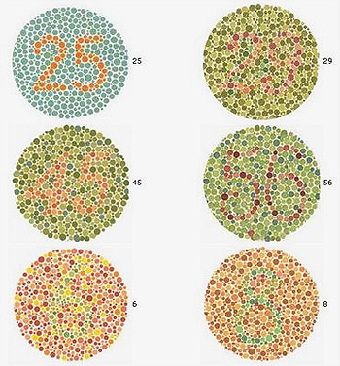
Example of an Ishihara color test plates.

Slide 95
Visual Physiology
Light and Dark Adaptation
  Dark:
    Most visual pigments are fully receptive to stimulation
  Light:
    Pupil constricts
    Bleaching of visual pigments occurs

Slide 96
Visual Physiology
The Visual Pathways
  Begin at photoreceptors
  End at visual cortex of cerebral hemispheres
  Message crosses two synapses before it heads toward brain:
    Photoreceptor to bipolar cell
    Bipolar cell to ganglion cell

Slide 97
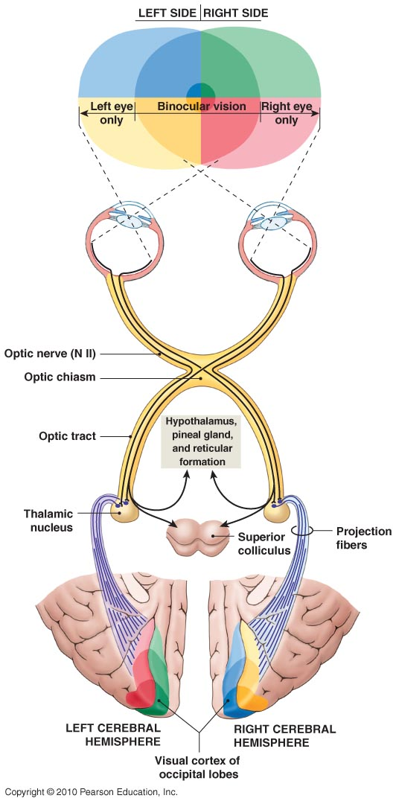
Figure 9-21

Slide 98
9-7: Equilibrium sensations originate within the inner ear, while hearing involves the detection and interpretation of sound waves

Slide 99
Anatomy of the Ear
The External Ear
  Auricle:
    Surrounds entrance to external acoustic meatus
    Protects opening of canal
    Provides directional sensitivity
  External acoustic meatus:
    Ends at tympanic membrane (eardrum)
  Tympanic membrane:
    Is a thin, semitransparent sheet
    Separates external ear from middle ear

Slide 100
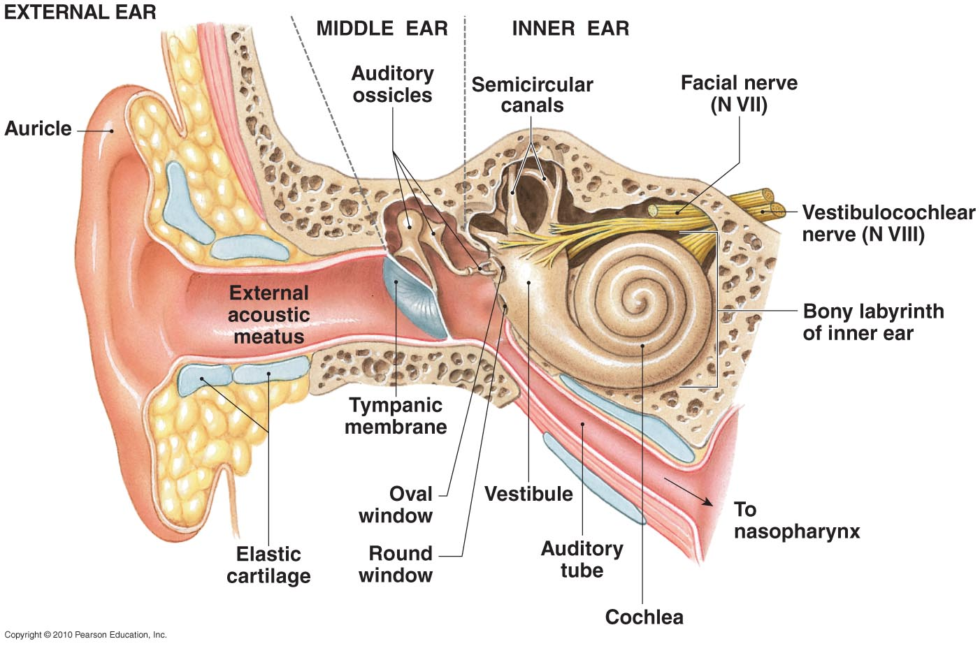
The Anatomy of the Ear
Figure 9-22
Ear Anatomy

Slide 101
The Ear
The Middle Ear
  Also called tympanic cavity
  Communicates with nasopharynx via auditory tube:
    Permits equalization of pressures on either side of tympanic membrane
  Encloses and protects three auditory ossicles:
    Malleus (hammer)
    Incus (anvil)
    Stapes (stirrup)

Slide 102
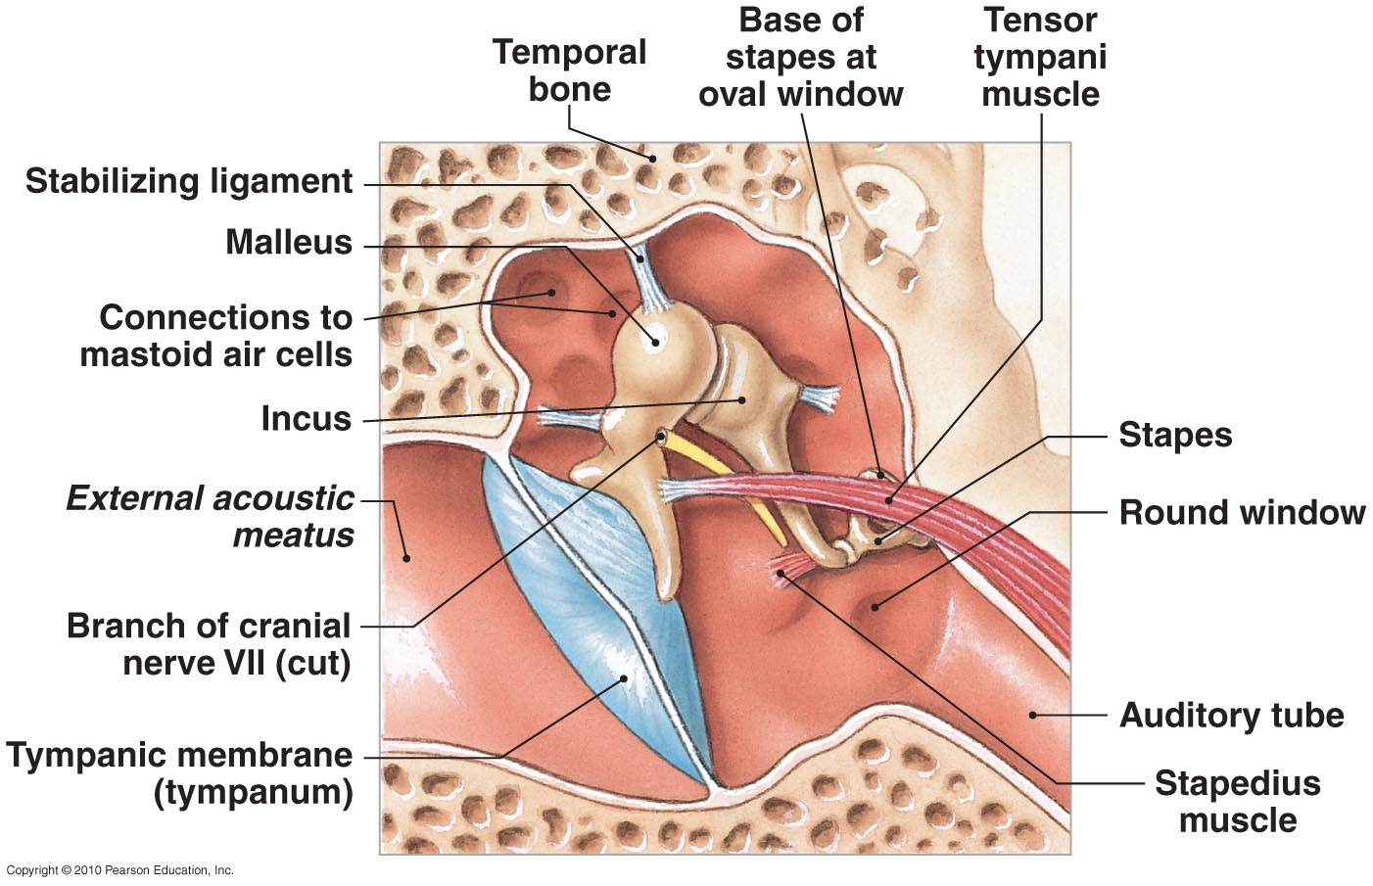
The Structure of the Middle Ear
Figure 9-23

Slide 103
The Ear
The Inner Ear
  Contains fluid called endolymph
  Bony labyrinth surrounds and protects membranous labyrinth
  Subdivided into:
    Vestibule
    Semicircular canals
    Cochlea

Slide 104
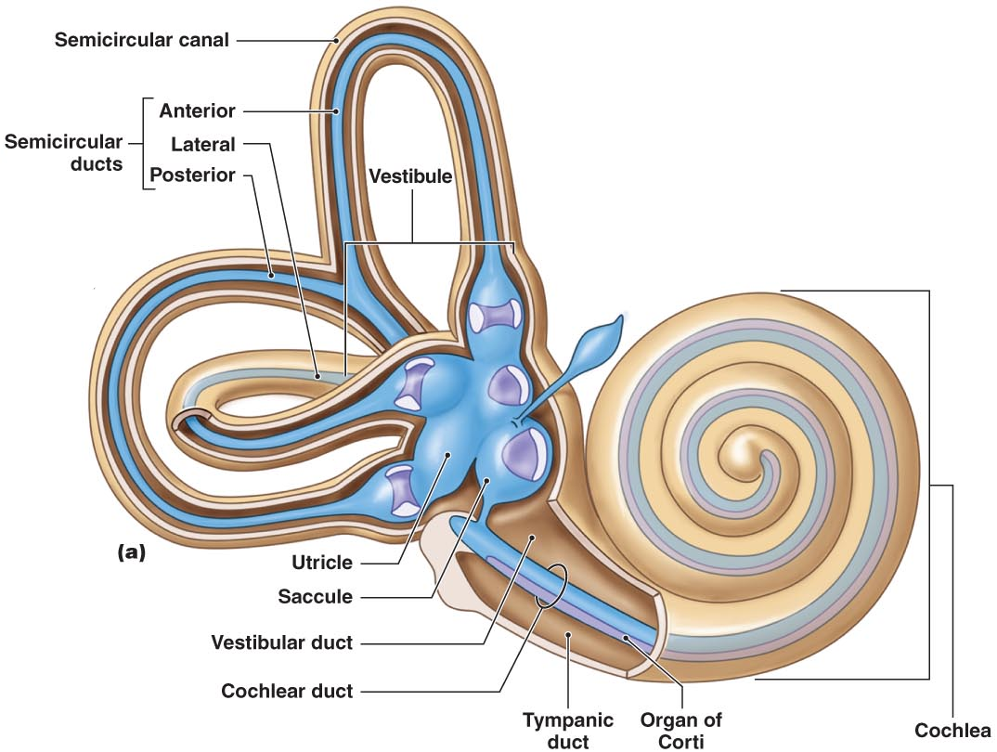
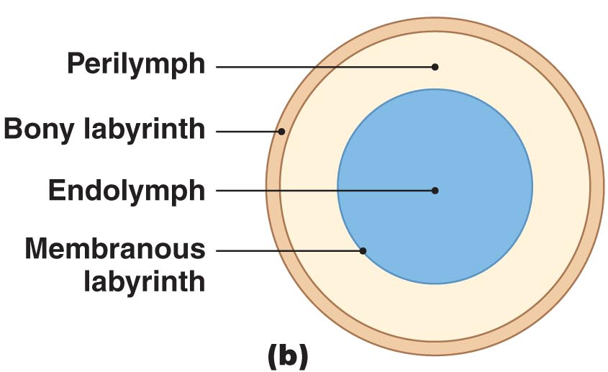
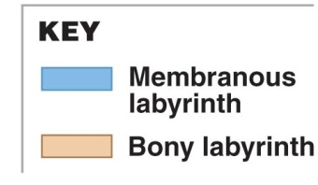
The Inner Ear
Figure 9-24

Slide 105
The Ear
The Inner Ear
  Vestibule:
    Encloses saccule and utricle
    Receptors provide sensations of gravity and linear acceleration
  Semicircular canals:
    Contain semicircular ducts
    Receptors stimulated by rotation of head
  Cochlea:
    Contains cochlear duct (elongated portion of membranous labyrinth)
    Receptors provide sense of hearing

Slide 106
The Ear
The Inner Ear
  Round window:
    Thin, membranous partition
    Separates perilymph from air spaces of middle ear
  Oval window:
    Formed of collagen fibers
    Connected to base of stapes

Slide 107
Equilibrium
Sensations provided by receptors of vestibular complex
Hair cells
  Basic receptors of inner ear
  Provide information about direction and strength of mechanical stimuli
Balance

Slide 108
Equilibrium
The Semicircular Ducts
  Are continuous with utricle
  Each duct contains:
    Ampulla with gelatinous cupula
    Associated sensory receptors
    Stereocilia — resemble long microvilli:
      are on surface of hair cell
    Kinocilium — single, large cilium

Slide 109
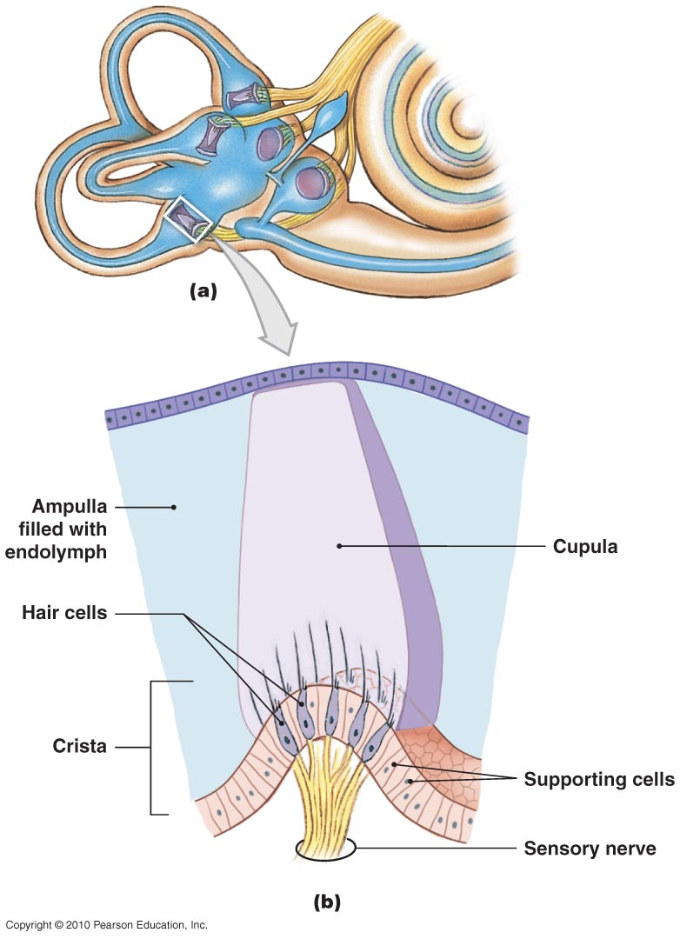
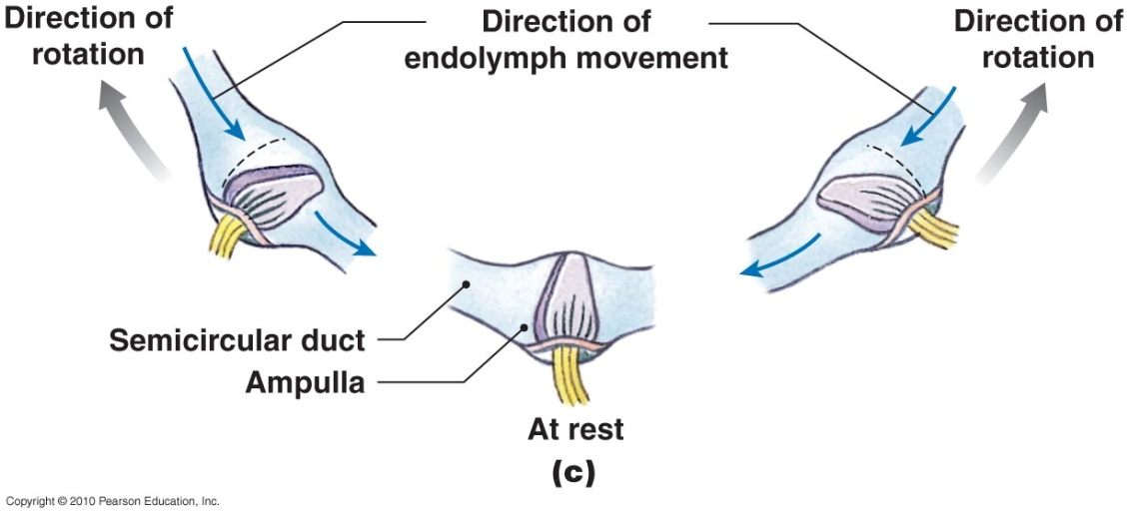
The Semicircular Ducts
Figure 9-25 a,b,c

Slide 110
Equilibrium
The Utricle and Saccule
  Provide equilibrium sensations
  Are connected with the endolymphatic duct, which ends in endolymphatic sac
  Maculae:
    Oval structures where hair cells cluster
  Statoconia:
    Densely packed calcium carbonate crystals on surface of gelatinous mass
    Otolith (ear stone) = gel and statoconia

Slide 111
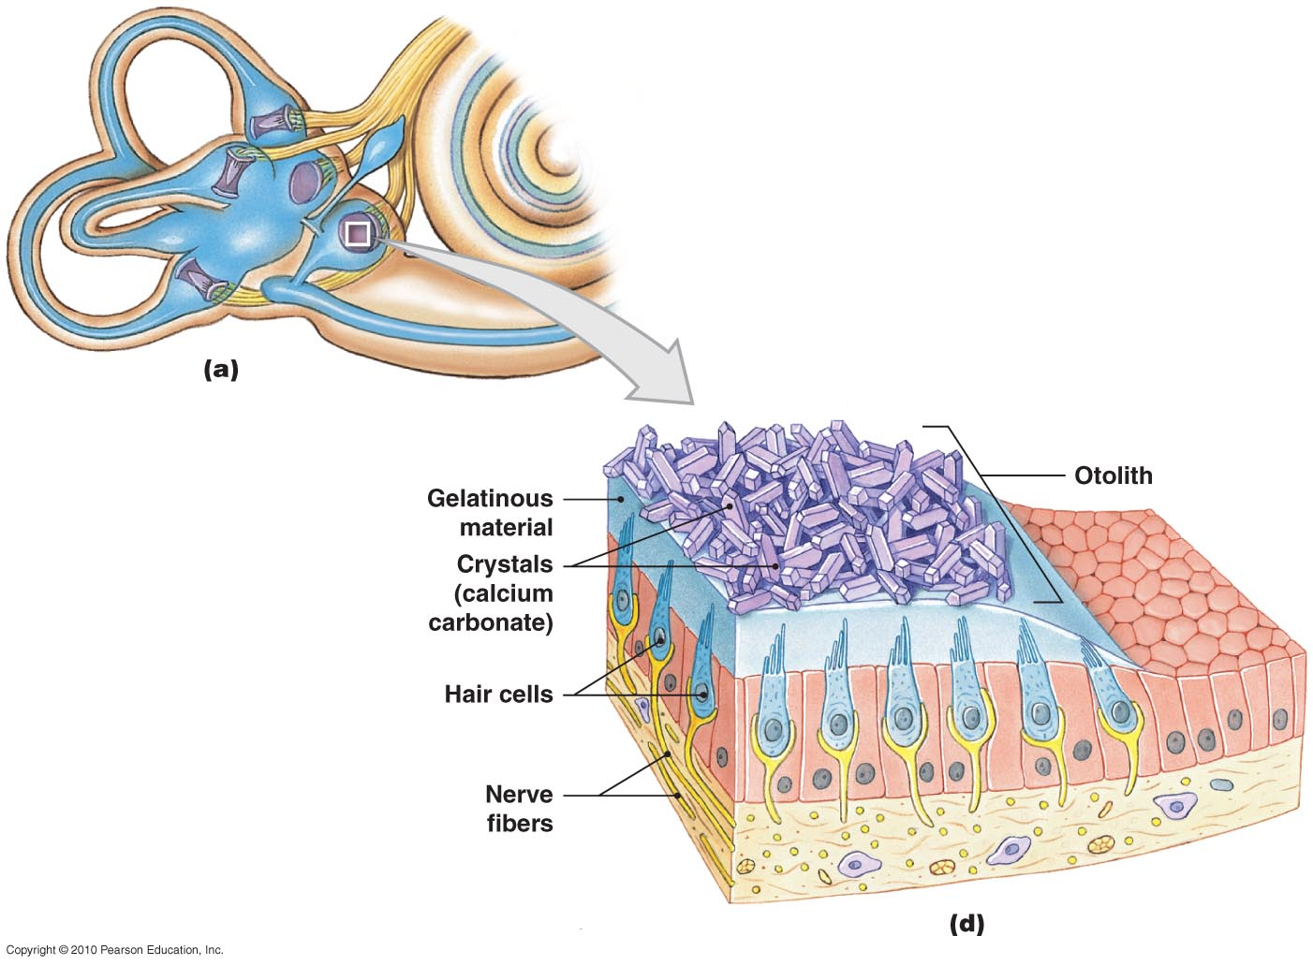
Equilibrium
Figure 9-25 a,d

Slide 112
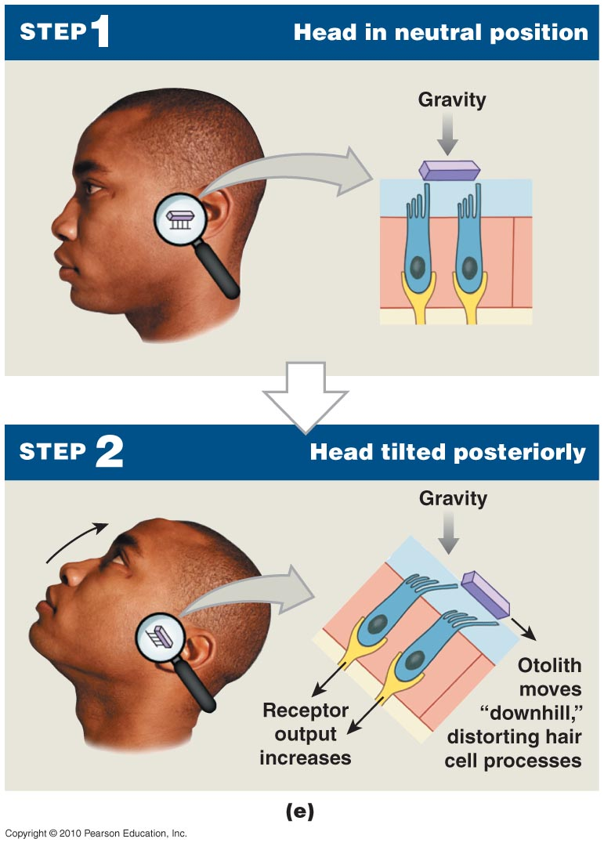
Equilibrium
Figure 9-25 e

Slide 113
Pathways for Equilibrium Sensations
Vestibular receptors
  Activate sensory neurons of vestibular ganglia
  Axons form vestibular branch of vestibulocochlear nerve (VIII)
  Synapse within vestibular nuclei

Slide 114
Hearing
Cochlear duct receptors
  Provide sense of hearing

Slide 115
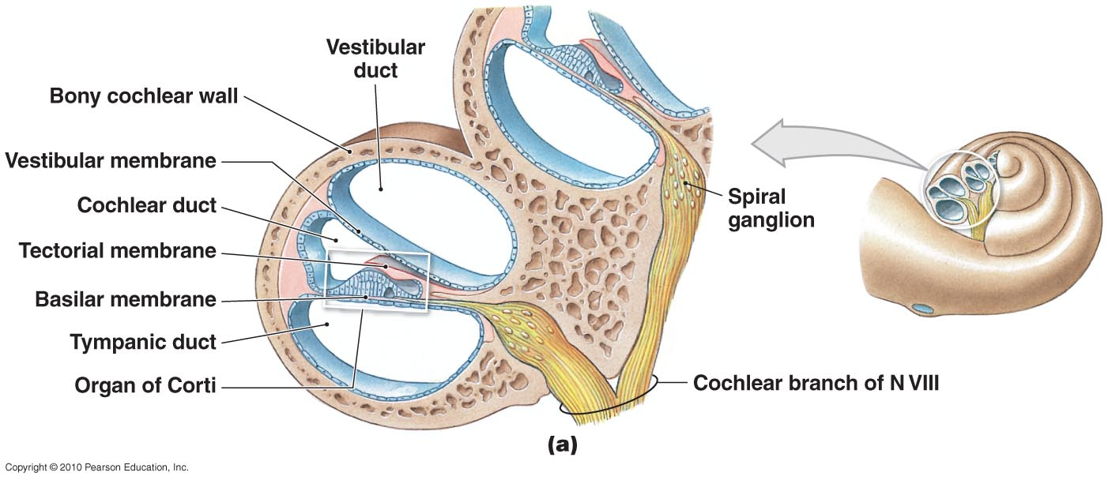
The Cochlea and Organ of Corti
Figure 9-26 a

Slide 116
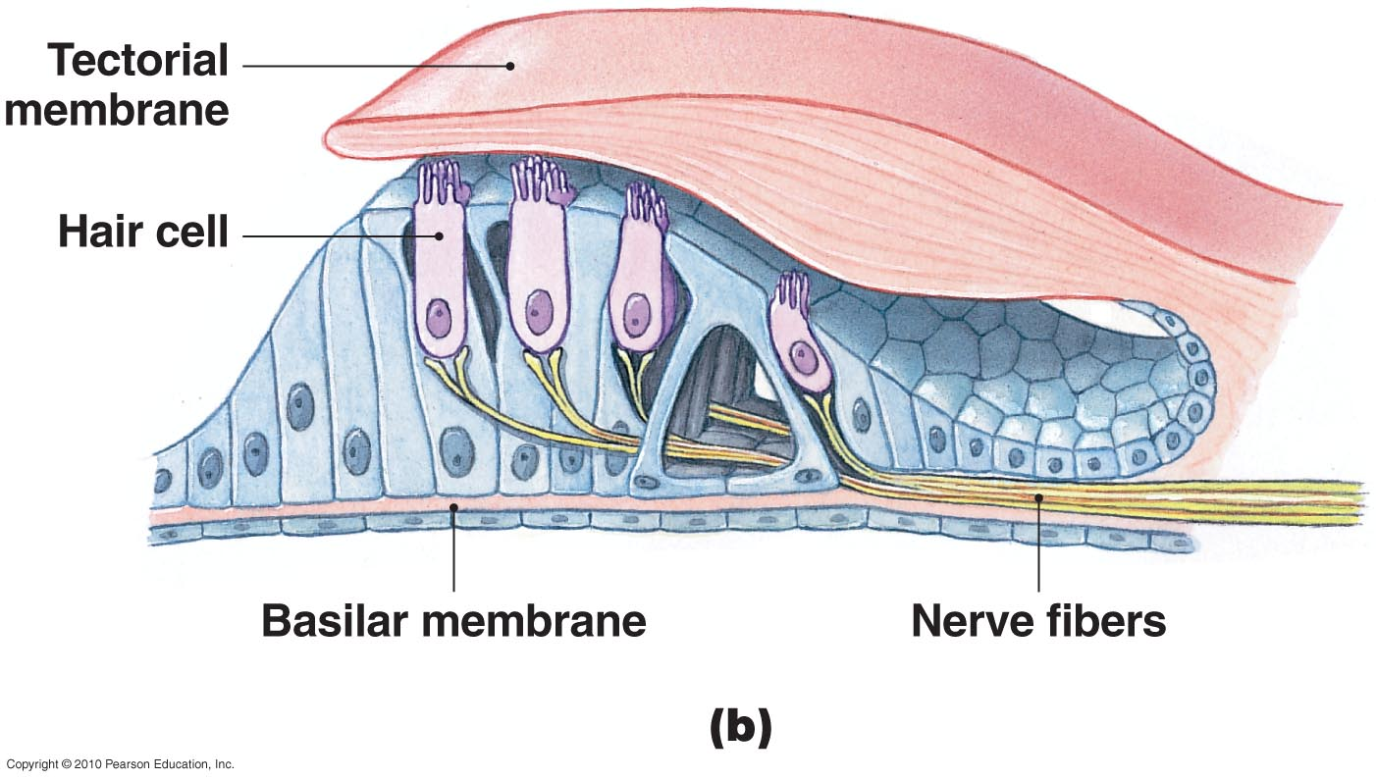
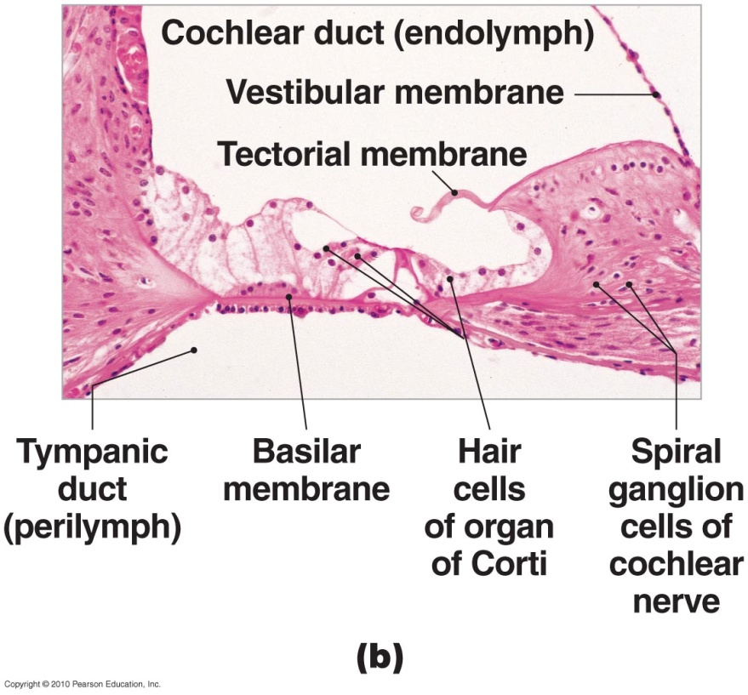
The Cochlea and Organ of Corti
Figure 9-26 b

Slide 117
Hearing
Auditory Ossicles
  Convert pressure fluctuation in air into much greater pressure fluctuations in perilymph of cochlea
  Frequency of sound:
    Determined by which part of cochlear duct is stimulated
  Intensity (volume):
    Determined by number of hair cells stimulated
Hearing Receptors

Slide 118
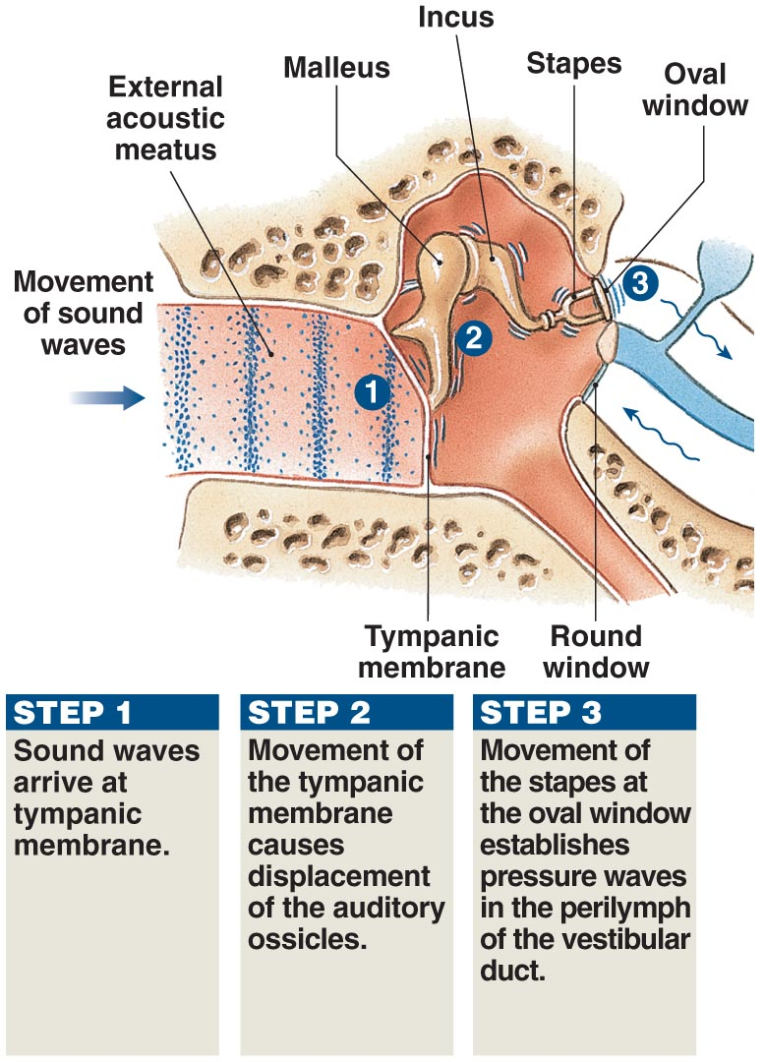
Sound and Hearing
Figure 9-27

Slide 119
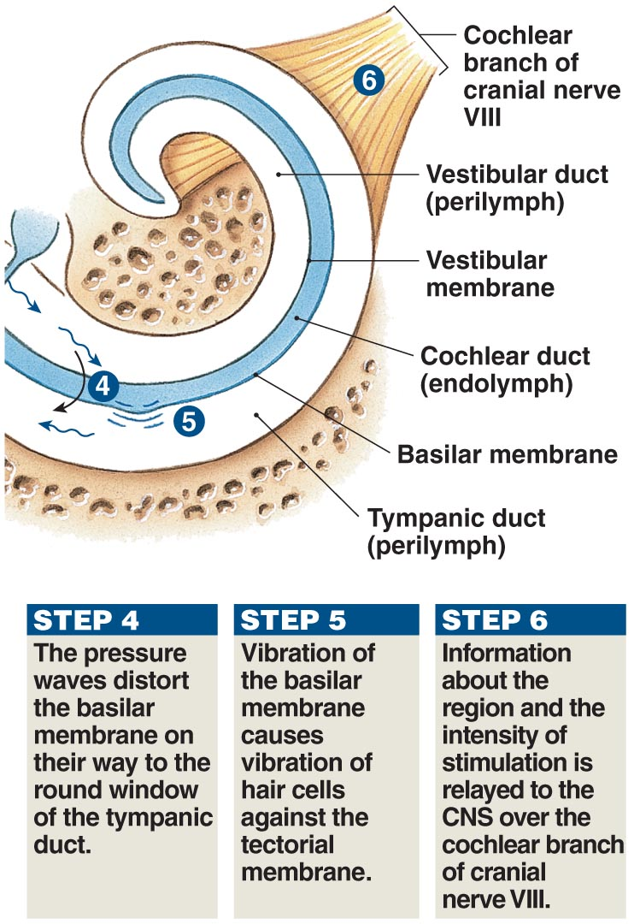
Sound and Hearing
Figure 9-27

Slide 120
Hearing
Auditory Pathways
  Cochlear branch:
    Formed by afferent fibers of spiral ganglion neurons:
      enters medulla oblongata
      synapses at dorsal and ventral cochlear nuclei
      information crosses to opposite side of brain:
        ascends to inferior colliculus of mesencephalon
Figure 17–31

Slide 121
Hearing
Auditory Pathways
  Ascending auditory sensations:
    Synapse in medial geniculate nucleus of thalamus
    Projection fibers deliver information to auditory cortex of temporal lobe

Slide 122

Pathways for Auditory Sensations
Figure 9-28

Slide 123
9-8: Aging is accompanied by a noticeable decline in the special senses

Slide 124

Smell and Aging
Olfactory neuron recycling slows, leading to decreased sensitivity

Slide 125

Taste and Aging
Number of taste buds is reduced, and sensitivity is lost

Slide 126

Vision and Aging
Lens stiffens
Lens clouds
Blood vessels grow in retina

Slide 127

Hearing and Aging
Loss of elasticity in tympanic membrane

