Slide 1
Chapter 10
0
Molecular Biology of the Gene
Lecture by Mary C. Colavito

Slide 2
Introduction: Sabotage Inside Our Cells
0
  Viruses are invaders that sabotage our cells
    Viruses have genetic material surrounded by a protein coat and, in some cases, a membranous envelope
    Viral proteins bind to receptors on a host’s target cell
    Viral nucleic acid enters the cell
      It may remain dormant by integrating into a host chromosome
      When activated, viral DNA triggers viral duplication, using the host’s molecules and organelles
    The host cell is destroyed, and newly replicated viruses are released to continue the infection
Copyright © 2009 Pearson Education, Inc.
Notes:
Herpes virus and HIV derive their membranous envelopes from the host cell. Activation of dormant viruses occurs in a time of stress for the herpes virus. For the HIV virus, this occurs during the activation of T cells during the immune response, so the insidious nature of the HIV virus is that it destroys cells at the very time they are recruited to protect the body from invaders.

Slide 3
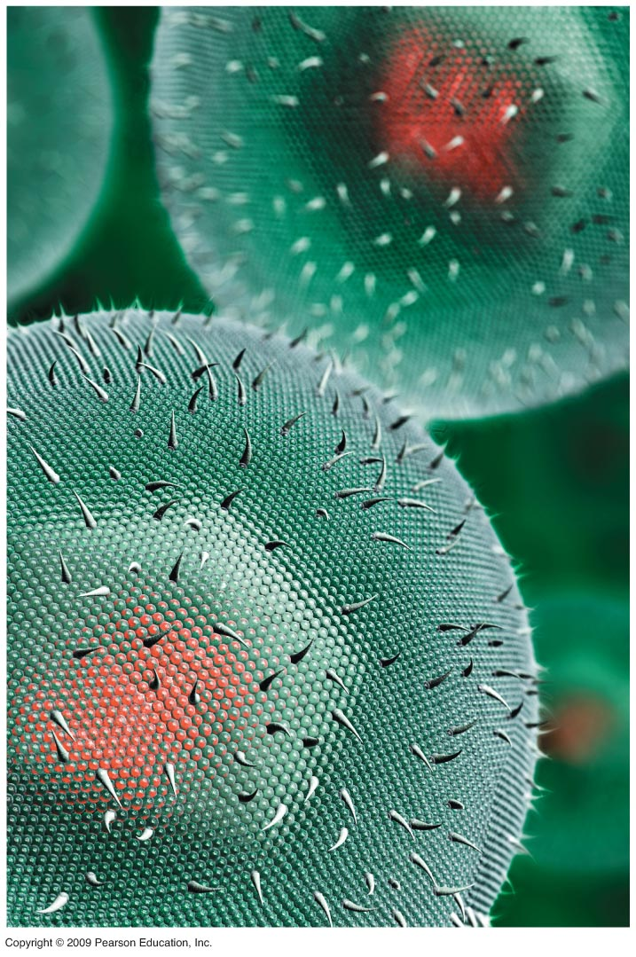
0

Slide 4
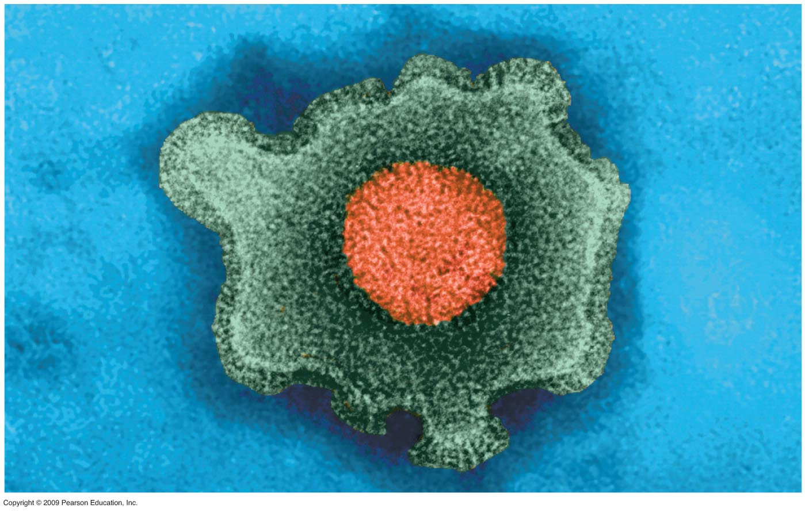
0

Slide 5
THE STRUCTURE OF THE GENETIC MATERIAL
Copyright © 2009 Pearson Education, Inc.

Slide 6
10.1 Experiments showed that DNA is the genetic material
0
  Frederick Griffith discovered that a “transforming factor” could be transferred into a bacterial cell
    Disease-causing bacteria were killed by heat
    Harmless bacteria were incubated with heat-killed bacteria
    Some harmless cells were converted to disease-causing bacteria, a process called transformation
    The disease-causing characteristic was inherited by descendants of the transformed cells
Copyright © 2009 Pearson Education, Inc.

Slide 7
10.1 Experiments showed that DNA is the genetic material
0
  Alfred Hershey and Martha Chase used bacteriophages to show that DNA is the genetic material
    Bacteriophages are viruses that infect bacterial cells
    Phages were labeled with radioactive sulfur to detect proteins or radioactive phosphorus to detect DNA
    Bacteria were infected with either type of labeled phage to determine which substance was injected into cells and which remained outside
Copyright © 2009 Pearson Education, Inc.

Slide 8
10.1 Experiments showed that DNA is the genetic material
0
    The sulfur-labeled protein stayed with the phages outside the bacterial cell, while the phosphorus-labeled DNA was detected inside cells
    Cells with phosphorus-labeled DNA produced new bacteriophages with radioactivity in DNA but not in protein
Copyright © 2009 Pearson Education, Inc.

Slide 9
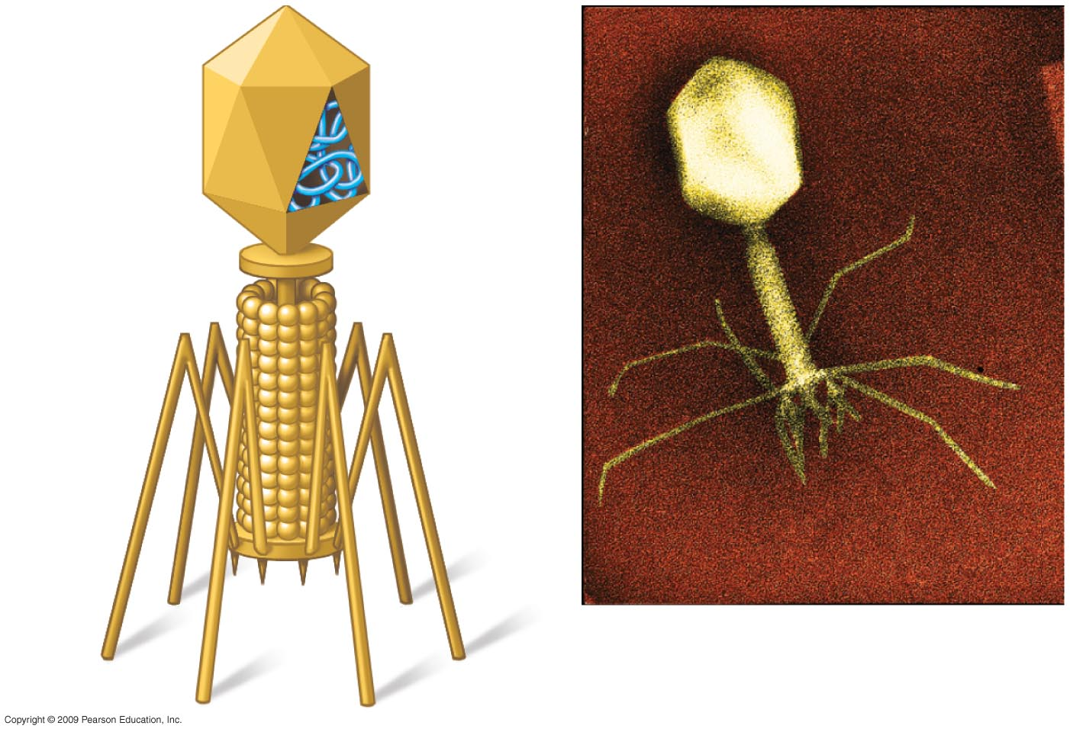
0
Head
DNA
Tail
Tail fiber
Notes:
Figure 10.1A Phage T2.
Bacteriophage T2 was used in the Hershey and Chase experiment. It consists of DNA surrounded by protein. The tail fibers attach to a bacterial cell, and some portion of the bacteriophage enters the cell to trigger production of new phages. At the time of the experiment, Hershey and Chase did not know whether the DNA or protein component entered the cells to initiate the process.

Slide 10
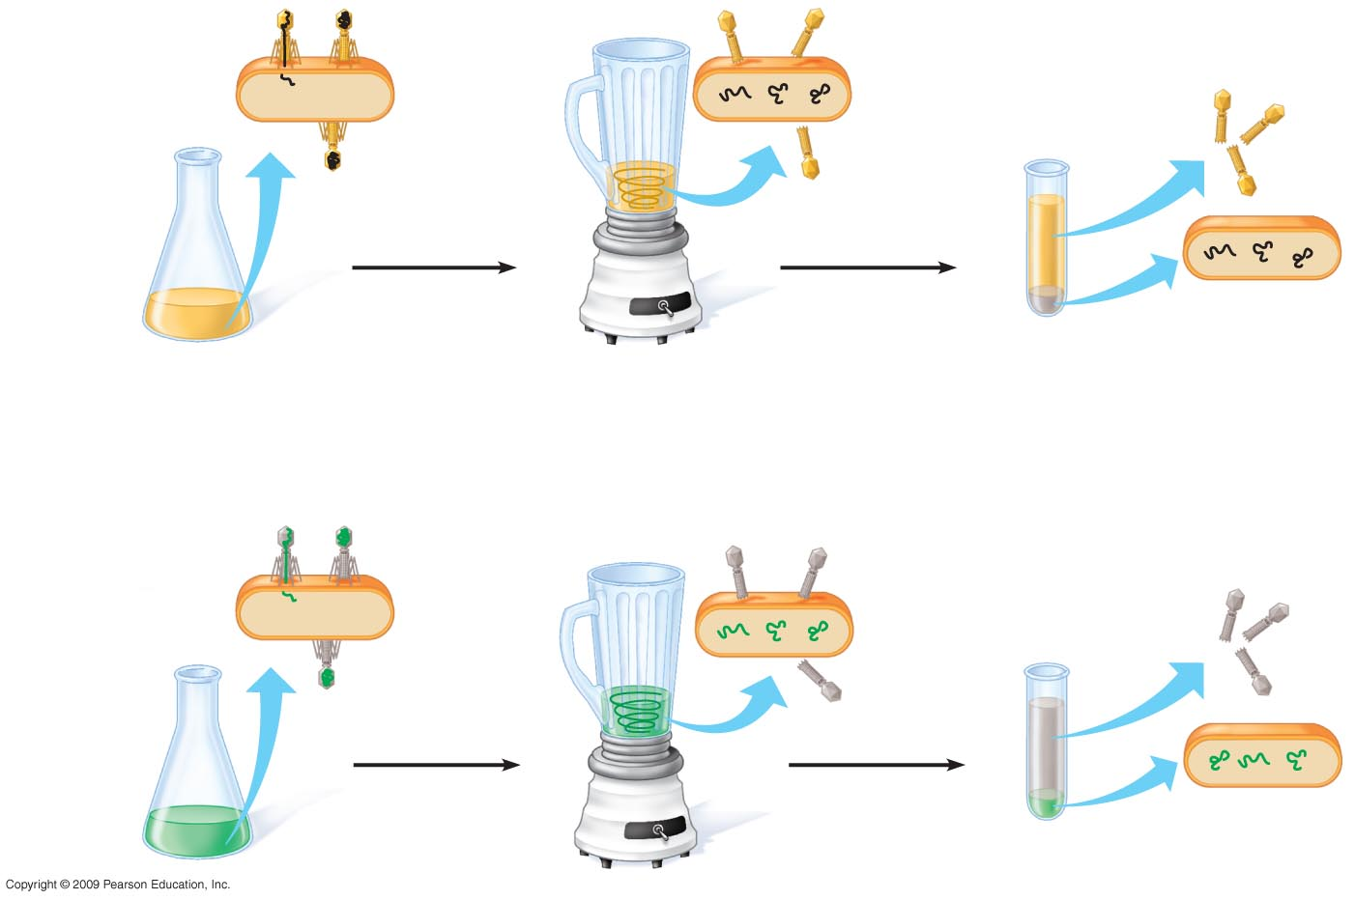
0
Phage
Radioactive
protein
Empty
protein shell
Radioactivity
in liquid
Bacterium
Phage
DNA
DNA
Batch 1
Radioactive
protein
Centrifuge
Pellet
1
Mix radioactively
labeled phages with
bacteria. The phages
infect the bacterial cells.
2
Agitate in a blender to
separate phages
outside the bacteria
from the cells and
their contents.
3
Centrifuge the mixture
so bacteria form a
pellet at the bottom of
the test tube.
4
Measure the
radioactivity in
the pellet and
the liquid.
Radioactive
DNA
Batch 2
Radioactive
DNA
Centrifuge
Radioactivity
in pellet
Pellet
Notes:
Figure 10.1B The Hershey-Chase experiment.
The presence of radioactivity was assayed in the supernatant, where phage particles would be found, and in the pellet, where bacterial cells would be located. When radioactive sulfur was used, the label was found primarily in the supernatant. Using radioactive phosphorus, the label was mainly in the pellet. This showed that DNA was the phage component that entered the host cell to bring about phage production.

Slide 11
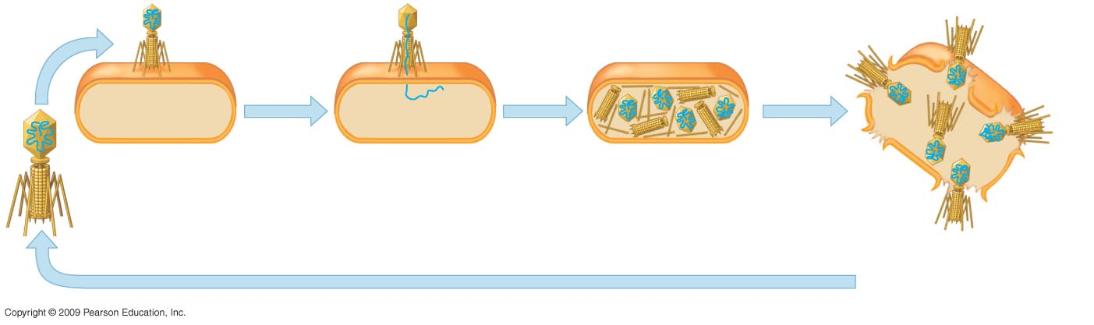
0
Phage attaches
to bacterial cell.
Phage injects DNA.
Phage DNA directs host
cell to make more phage
DNA and protein parts.
New phages assemble.
Cell lyses and
releases new phages.
Notes:
Figure 10.1C A phage reproductive cycle.

Slide 12
10.2 DNA and RNA are polymers of nucleotides
0
  The monomer unit of DNA and RNA is the nucleotide, containing
    Nitrogenous base
    5-carbon sugar
    Phosphate group
Copyright © 2009 Pearson Education, Inc.

Slide 13
0
  DNA and RNA are polymers called polynucleotides
    A sugar-phosphate backbone is formed by covalent bonding between the phosphate of one nucleotide and the sugar of the next nucleotide
    Nitrogenous bases extend from the sugar-phosphate backbone
Copyright © 2009 Pearson Education, Inc.

Slide 14
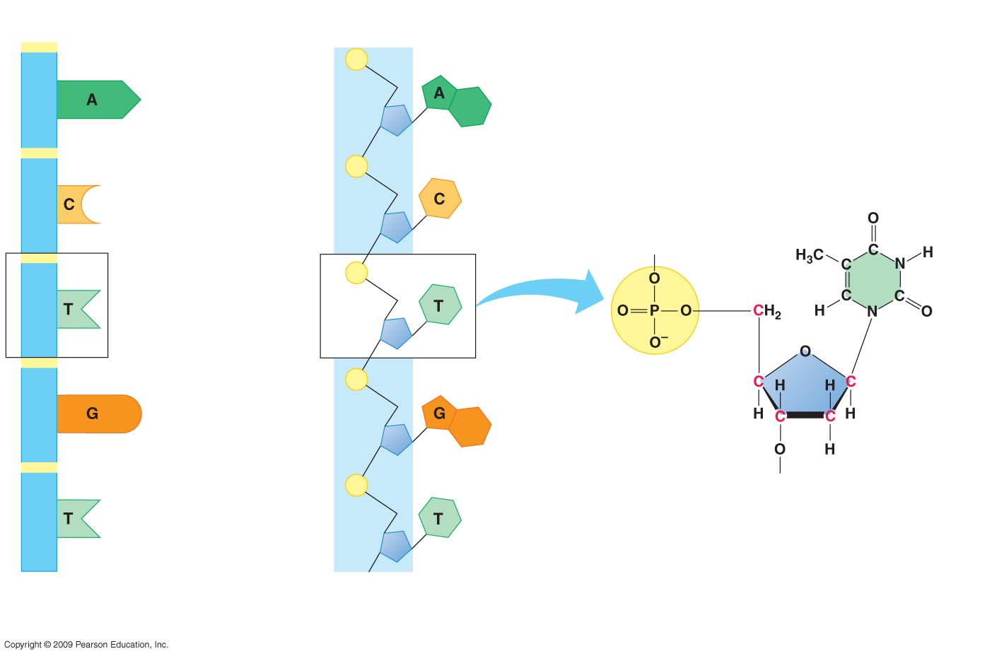
0
Sugar-phosphate backbone
Phosphate group
Nitrogenous base
Sugar
Nitrogenous base
(A, G, C, or T)
DNA nucleotide
Phosphate
group
Thymine (T)
Sugar
(deoxyribose)
DNA nucleotide
DNA polynucleotide
Notes:
Figure 10.2A The structure of a DNA polynucleotide.
This figure shows a short stretch of DNA. The nucleotides can theoretically be arranged in any order, since all nucleotides have a phosphate group that can be joined to the sugar of any other nucleotide. The order of nucleotides within a gene, however, is what provides the information for producing a specific protein.

Slide 15
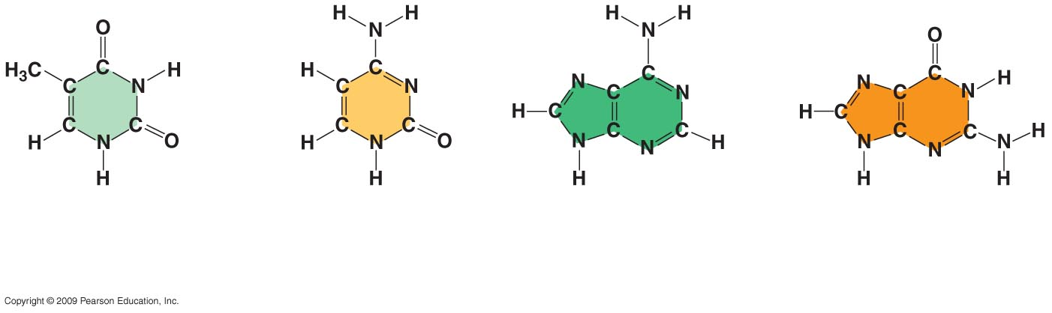
0
Thymine (T)
Cytosine (C)
Adenine (A)
Guanine (G)
Pyrimidines
Purines
Notes:
Figure 10.2B Nitrogenous bases of DNA.
Nitrogenous bases are of two types. The pyrimidines, cytosine and thymine, consist of a single ring. The purines, adenine and guanine, are double-ringed structures.

Slide 16
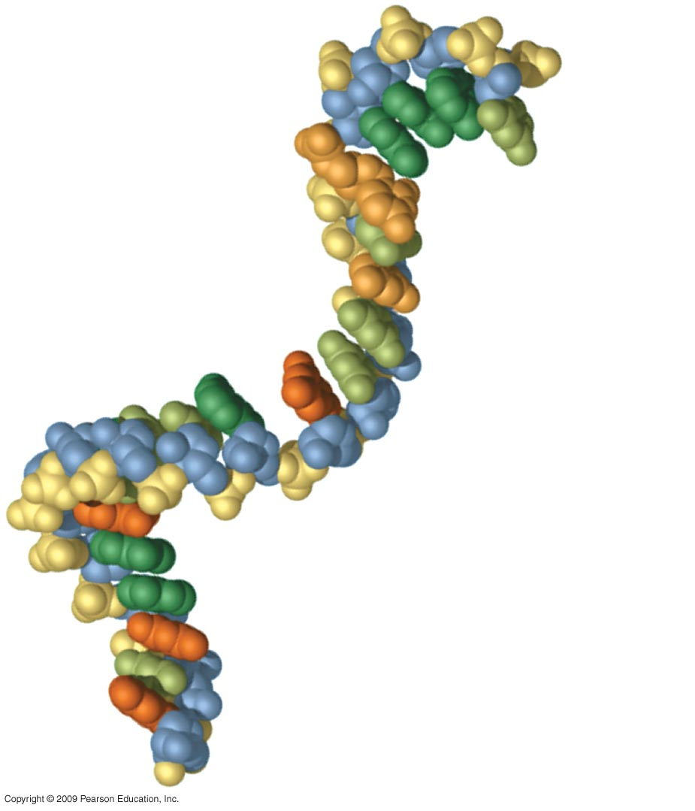
0
Uracil
Adenine
Guanine
Cytosine
Phosphate
Ribose
Notes:
Figure 10.2D Part of an RNA polynucleotide.
This figure emphasizes that RNA is a polymer of nucleotides and that the arrangement of the nucleotides can have many variations.

Slide 17
10.3 DNA is a double-stranded helix
0
  James D. Watson and Francis Crick deduced the secondary structure of DNA, with X-ray crystallography data from Rosalind Franklin and Maurice Wilkins
Copyright © 2009 Pearson Education, Inc.
Notes:
The specific nature of the base-pairing interactions not only accounted for the uniform diameter of the double helix but also conformed to the chemical characteristics of the nucleotide bases and chemical composition studies of DNA.
RNA molecules have secondary structure that involves hydrogen bonding between bases on the same polynucleotide chain. Thus the structure will be unique to RNA of a specific sequence.
The covalent bonding between nucleotides can be contrasted with the hydrogen bonding between bases. Although individual hydrogen bonds are weaker than covalent bonds, the large number of hydrogen bonds along a double helical DNA molecule stabilizes the helix. Hydrogen bonds can be temporarily disrupted so that the DNA strands separate, but each individual strand remains intact.
Student Misconceptions and Concerns
1. If your class has not yet studied Chapter 3, consider assigning module 3.16 on “Nucleic Acids” before addressing the contents of Chapter 10.
2. Students often confuse the terms nucleic acids, nucleotides, and bases. It helps to note the hierarchy of relationships: nucleic acids consist of long chains of nucleotides (polynucleotides), while nucleotides include nitrogenous bases.
Teaching Tips
1. The descriptions of the discovery of DNA’s structure are a good time to point out that science is a collaborative effort. Watson, Crick, and Wilkins earned Nobel prizes due to their historic conclusions based upon the work of many others (including Griffith, Hershey, Chase, Franklin, and Chargaff).
2. The authors note that the structure of DNA is analogous to a twisted rope ladder. In class, challenge your students to explain what the parts of the ladder represent. The wooden rungs represent pairs of nitrogenous bases joined together by hydrogen bonds. Each rope represents a sugar-phosphate backbone.

Slide 18
0
  DNA is composed of two polynucleotide chains joined together by hydrogen bonding between bases, twisted into a helical shape
    The sugar-phosphate backbone is on the outside
    The nitrogenous bases are perpendicular to the backbone in the interior
    Specific pairs of bases give the helix a uniform shape
      A pairs with T, forming two hydrogen bonds
      G pairs with C, forming three hydrogen bonds
Copyright © 2009 Pearson Education, Inc.
Notes:
The specific nature of the base-pairing interactions not only accounted for the uniform diameter of the double helix but also conformed to the chemical characteristics of the nucleotide bases and chemical composition studies of DNA.
RNA molecules have secondary structure that involves hydrogen bonding between bases on the same polynucleotide chain. Thus the structure will be unique to RNA of a specific sequence.
The covalent bonding between nucleotides can be contrasted with the hydrogen bonding between bases. Although individual hydrogen bonds are weaker than covalent bonds, the large number of hydrogen bonds along a double helical DNA molecule stabilizes the helix. Hydrogen bonds can be temporarily disrupted so that the DNA strands separate, but each individual strand remains intact.
Student Misconceptions and Concerns
1. If your class has not yet studied Chapter 3, consider assigning module 3.16 on “Nucleic Acids” before addressing the contents of Chapter 10.
2. Students often confuse the terms nucleic acids, nucleotides, and bases. It helps to note the hierarchy of relationships: nucleic acids consist of long chains of nucleotides (polynucleotides), while nucleotides include nitrogenous bases.
Teaching Tips
1. The descriptions of the discovery of DNA’s structure are a good time to point out that science is a collaborative effort. Watson, Crick, and Wilkins earned Nobel prizes due to their historic conclusions based upon the work of many others (including Griffith, Hershey, Chase, Franklin, and Chargaff).
2. The authors note that the structure of DNA is analogous to a twisted rope ladder. In class, challenge your students to explain what the parts of the ladder represent. The wooden rungs represent pairs of nitrogenous bases joined together by hydrogen bonds. Each rope represents a sugar-phosphate backbone.

Slide 19
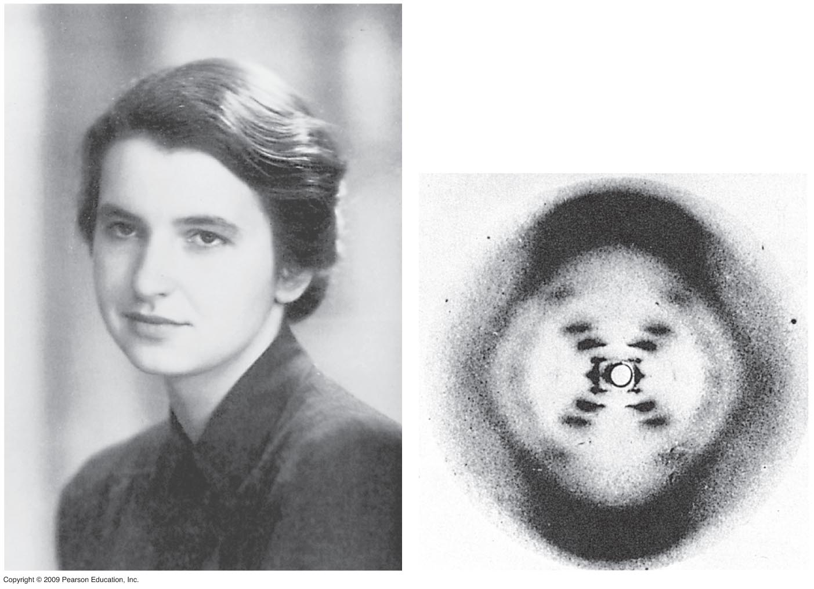
0
Notes:
Figure 10.3A Rosalind Franklin and her X-ray image.
From this X-ray crystallographic image, the shape and dimensions of the DNA molecule could be deduced.
Rosalind Franklin succumbed to cancer before she could share in the Nobel Prize for her contributions to solving the secondary structure of DNA.
For the BLAST Animation Structure of Double Helix, go to Animation and Video Files.
For the BLAST Animation Hydrogen Bonds in DNA, go to Animation and Video Files.

Slide 20
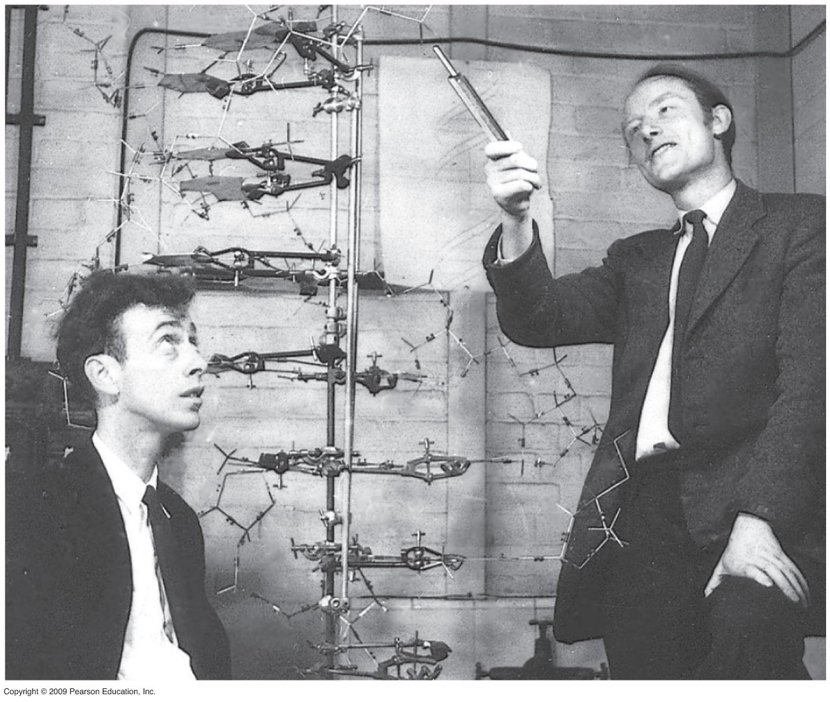
0
Notes:
Figure 10.3B Watson and Crick in 1953 with their model of the DNA double helix.

Slide 21
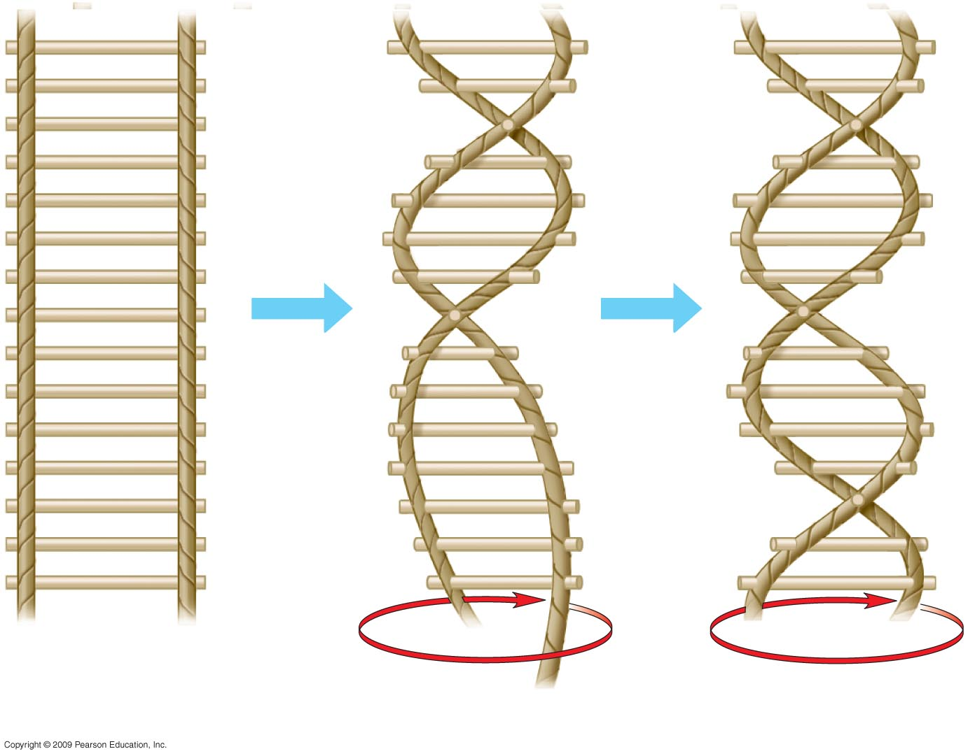
0
Twist
Notes:
Figure 10.3C A rope-ladder model for the double helix.
This model shows how the two nucleotide chains twist into a helical shape. There are 10 base pairs per turn of the helix.

Slide 22
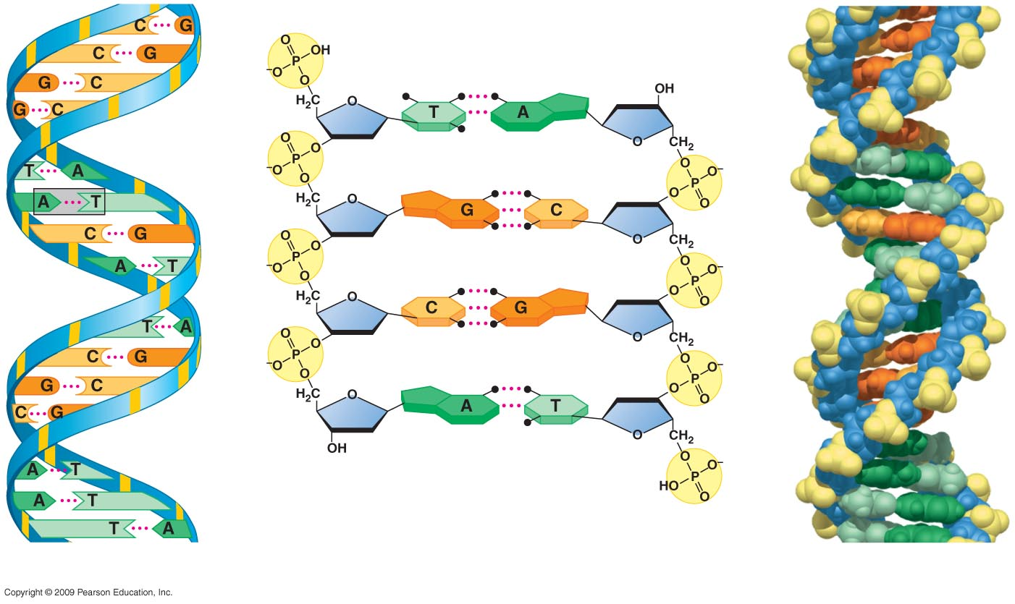
0
Hydrogen bond
Base
pair
Ribbon model
Partial chemical structure
Computer model
Notes:
Figure 10.3D Three representations of DNA.
Hydrogen bonding between bases can be seen in the partial chemical structure in the center.
This figure can also be used to point out the opposite polarity of the DNA chains as emphasized in Module 10.5. From top to bottom, the chain on the left is oriented 5′ → 3′ while the chain on the right is oriented 3′ → 5′. A 5′ end has a free phosphate group attached to the 5′ carbon of the sugar and a 3′ end has a free –OH group attached to the 3′ carbon of the sugar.

Slide 23
DNA REPLICATION
Copyright © 2009 Pearson Education, Inc.

Slide 24
10.4 DNA replication depends on specific base pairing
0
  DNA replication follows a semiconservative model
    The two DNA strands separate
    Each strand is used as a pattern to produce a complementary strand, using specific base pairing
    Each new DNA helix has one old strand with one new strand
Copyright © 2009 Pearson Education, Inc.

Slide 25
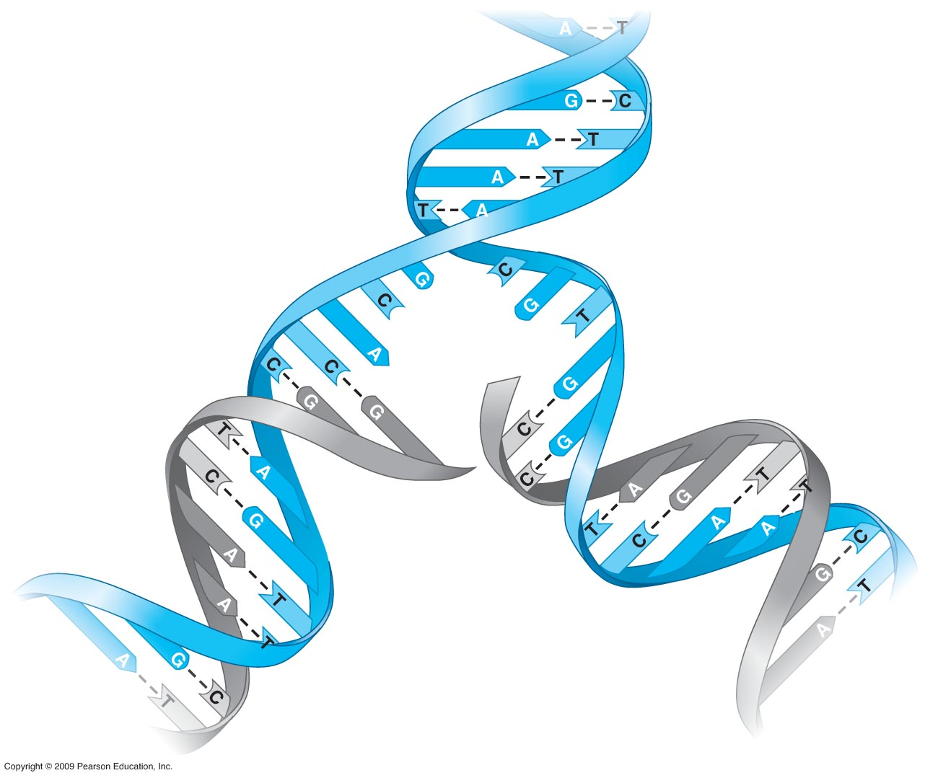
0
Notes:
Figure 10.4B Untwisting and replication of DNA.
This diagram shows an overview of DNA replication, emphasizing the semiconservative nature of the process.

Slide 26
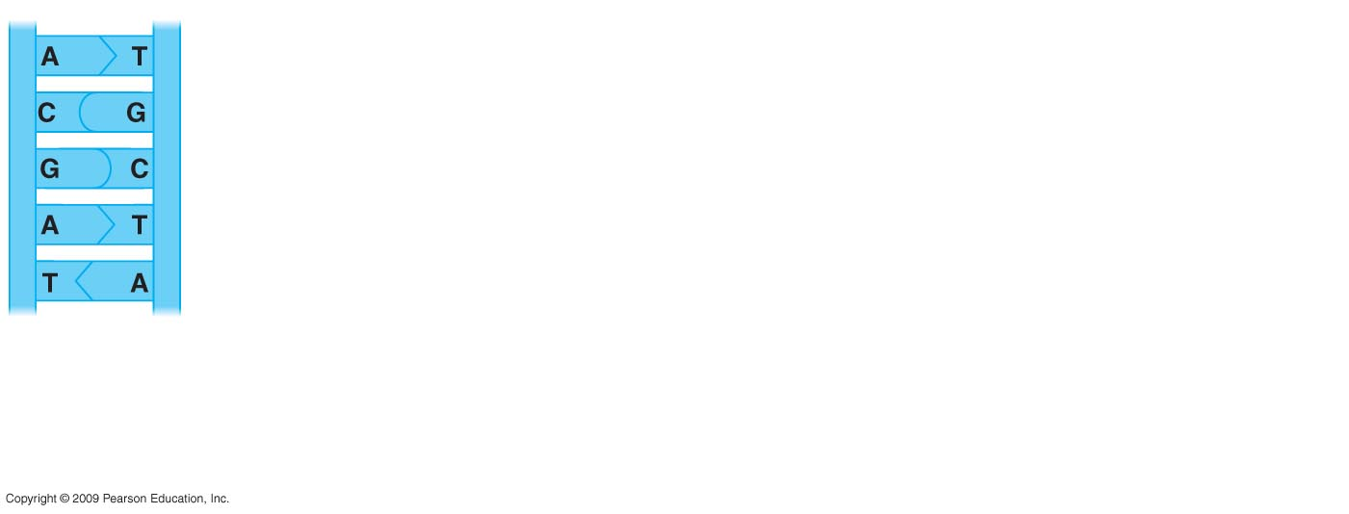
0
Parental
molecule
of DNA
Notes:
Figure 10.4A A template model for DNA replication.
This figure emphasizes the accuracy of DNA replication, due to the specific base-pairing interactions. When the strand on the left is a template, the complementary strand is identical to the one on the right and vice versa.

Slide 27
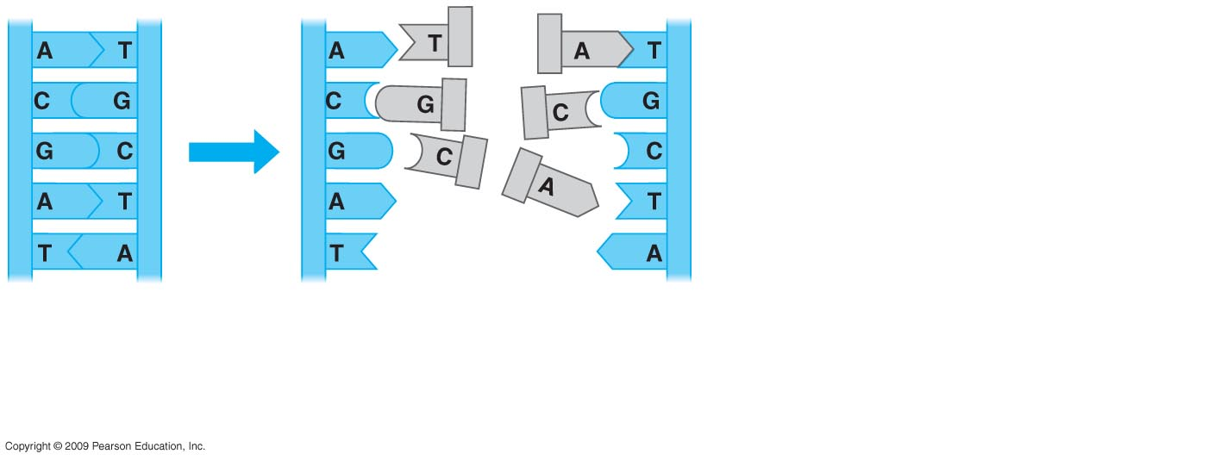
0
Nucleotides
Parental
molecule
of DNA
Both parental
strands serve
as templates
Notes:
Figure 10.4A A template model for DNA replication.
This figure emphasizes the accuracy of DNA replication, due to the specific base-pairing interactions. When the strand on the left is a template, the complementary strand is identical to the one on the right and vice versa.

Slide 28
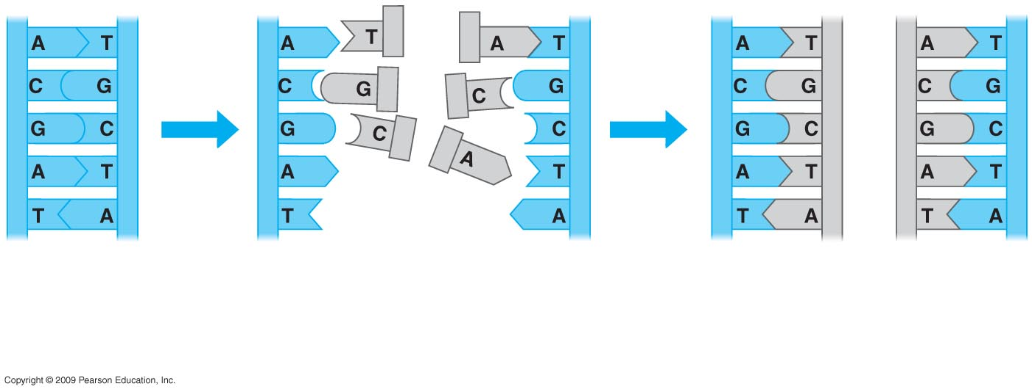
0
Nucleotides
Parental
molecule
of DNA
Both parental
strands serve
as templates
Two identical
daughter
molecules of DNA
Notes:
Figure 10.4A A template model for DNA replication.
This figure emphasizes the accuracy of DNA replication, due to the specific base-pairing interactions. When the strand on the left is a template, the complementary strand is identical to the one on the right and vice versa.

Slide 29
10.5 DNA replication proceeds in two directions at many sites simultaneously
0
  DNA replication begins at the origins of replication
    DNA unwinds at the origin to produce a “bubble”
    Replication proceeds in both directions from the origin
    Replication ends when products from the bubbles merge with each other
  DNA replication occurs in the 5’ 3’ direction
    Replication is continuous on the 3’ 5’ template
    Replication is discontinuous on the 5’ 3’ template, forming short segments
Copyright © 2009 Pearson Education, Inc.

Slide 30
10.5 DNA replication proceeds in two directions at many sites simultaneously
0
  Proteins involved in DNA replication
    DNA polymerase adds nucleotides to a growing chain
    DNA ligase joins small fragments into a continuous chain
Copyright © 2009 Pearson Education, Inc.

Slide 31
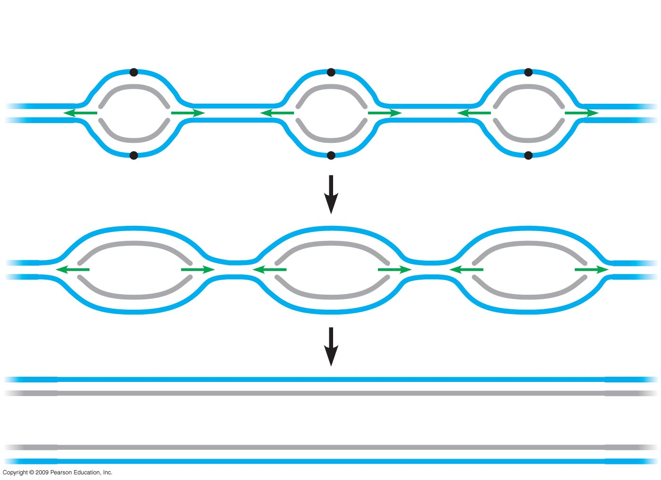
Parental strand
0
Origin of replication
Daughter strand
Bubble
Two daughter DNA molecules
Notes:
Figure 10.5A Multiple “bubbles” in replicating DNA.
Eukaryotic chromosomes have multiple replication origins, while prokaryotic chromosomes have a single origin. In both cases, replication proceeds bidirectionally from the origin.

Slide 32
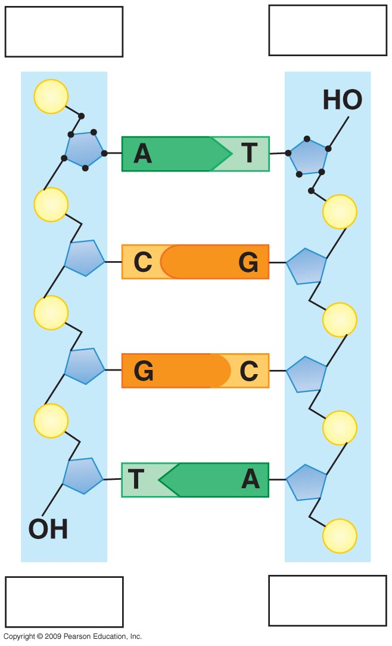
5′ end
3′ end
0
P
5′
4′
2′
3′
3′
1′
1′
4′
2′
P
5′
P
P
P
P
P
P
3′ end
5′ end
Notes:
Figure 10.5B The opposite orientations of DNA strands.
This figure emphasizes the opposite polarity of the DNA chains. The 3′ end has a free hydroxyl group attached to the 3′ carbon of the sugar, while the 5′ end has a free phosphate attached to the 5′ carbon of the sugar. DNA polymerase enzymes elongate the chain by adding to a free hydroxyl group so that synthesis occurs in the 5′ → 3′ direction.

Slide 33
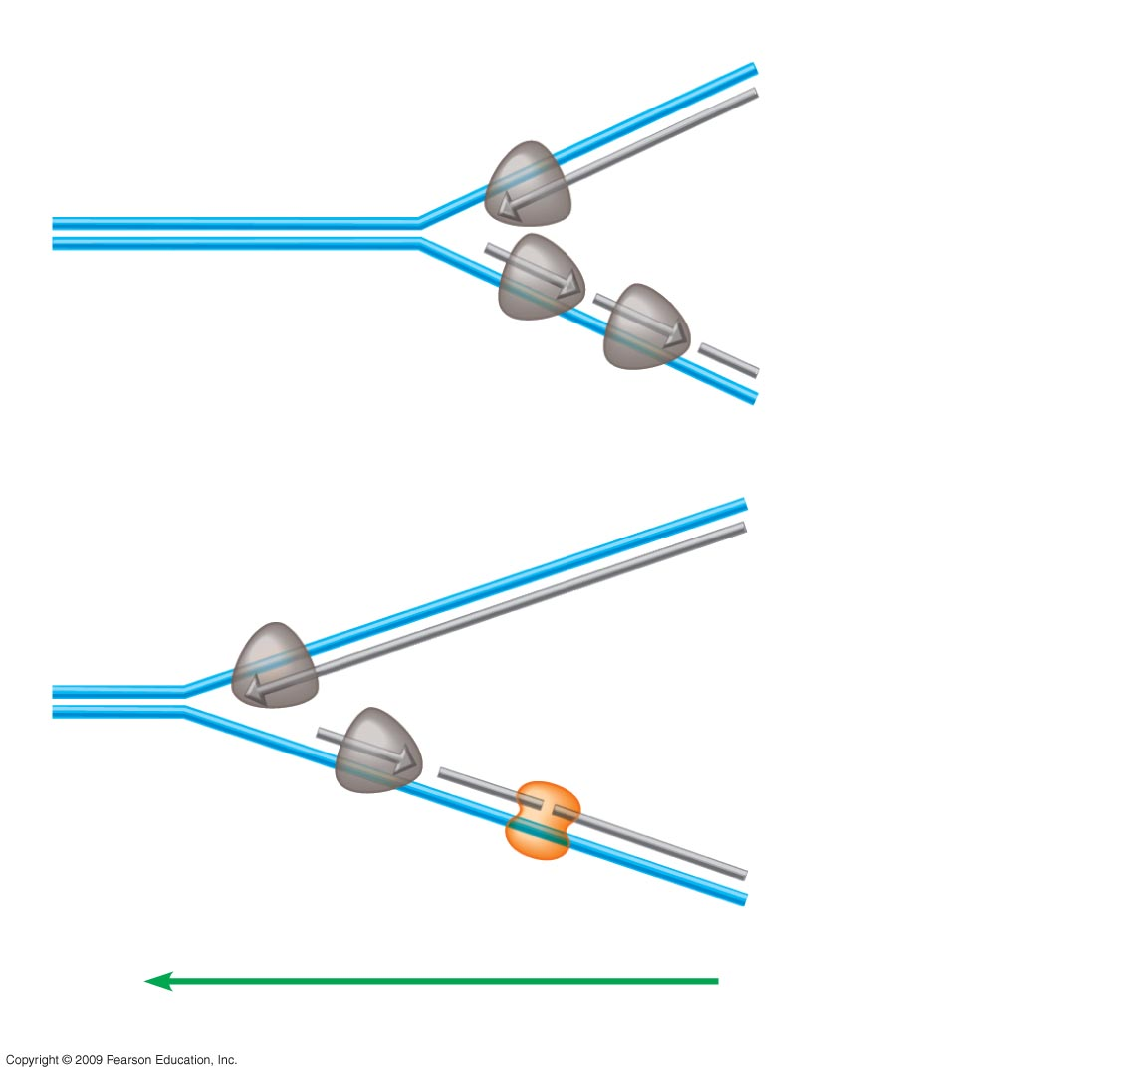
DNA polymerase
molecule
0
3′
5′
Daughter strand
synthesized
continuously
Parental DNA
5′
3′
Daughter
strand
synthesized
in pieces
3′
5′
5′
3′
DNA ligase
Overall direction of replication
Notes:
Figure 10.5C How daughter DNA strands are synthesized.
Continuous synthesis and discontinuous synthesis are depicted in this figure. DNA synthesis beginning on the template oriented in the 3′ → 5′ direction can continue as the unwinding of the replication fork provides additional template in the direction of synthesis. Enzymes synthesizing DNA on the template oriented in the 5′ → 3′ direction are moving away from the replication fork, so short discontinuous fragments are produced. As more of the template strand is unwound, an enzyme can bind and synthesize the complementary strand. These short Okasaki fragments are joined by DNA ligase to form a continuous nucleotide chain.

Slide 34
THE FLOW OF GENETIC INFORMATION FROM DNA TO RNA TO PROTEIN
Copyright © 2009 Pearson Education, Inc.

Slide 35
10.6 The DNA genotype is expressed as proteins, which provide the molecular basis for phenotypic traits
0
  A gene is a sequence of DNA that directs the synthesis of a specific protein
    DNA is transcribed into RNA
    RNA is translated into protein
  The presence and action of proteins determine the phenotype of an organism
Copyright © 2009 Pearson Education, Inc.
Notes:
The role of proteins in expression of a genotype can be connected to the experiments that established the foundations of genetics. The round-wrinkled phenotypes of Mendel’s pea plants were due to differences in the production of a Starch Branching Enzyme (SBEI). The round-seeded plants had a functional version of the SBEI enzyme, allowing the formation of amylopectin, a highly branched form of starch, from sucrose. The wrinkled-seeded plants stored excess sucrose due to their lack of a functional SBEI enzyme and accumulated excess water as a result. When both types of seeds completed a natural dehydration process in seed maturation, the round seeds retained their shape, while the wrinkled seeds shriveled from water loss.
Student Misconceptions and Concerns
1. Beginning college students are often intensely focused on writing detailed notes. The risk is that they will miss the overall patterns and the broader significance of the topics discussed. Consider a gradual approach to the subjects of transcription and translation, beginning quite generally and testing comprehension, before venturing into the finer mechanics of each process.
2. Consider placing the basic content from Figure 10.6 on the board, noting the sequence, products, and locations of transcription and translation in eukaryotic cells. This reminder can create a quick concept check for students as they learn additional detail.
Teaching Tips
1. It has been said that everything about an organism is an interaction between the genome and the environment. You might wish to challenge your students to explain the validity of this statement.
2. The information in DNA is used to direct the production of RNA, which in turn directs the production of proteins. However, in Chapter 3, four different types of biological molecules were noted as significant components of life. Students who think this through might wonder, and you could point out, that DNA does not directly control the production of carbohydrates and lipids. So how does DNA exert its influence over the synthesis of these two chemical groups? The answer is largely by way of enzymes, proteins with the ability to promote the production of carbohydrates and lipids.

Slide 36
10.6 The DNA genotype is expressed as proteins, which provide the molecular basis for phenotypic traits
0
  Demonstrating the connections between genes and proteins
    The one gene–one enzyme hypothesis was based on studies of inherited metabolic diseases
    The one gene–one protein hypothesis expands the relationship to proteins other than enzymes
    The one gene–one polypeptide hypothesis recognizes that some proteins are composed of multiple polypeptides
Copyright © 2009 Pearson Education, Inc.
Notes:
Due to alternative splicing scenarios (see Module 11.6), in which transcripts of the same gene can be used to produce different proteins, the one gene–one polypeptide hypothesis needs to be updated. Estimates suggest that at least a third of human genes are subject to alternative splicing events. Neurexins are a family of cell surface proteins involved in cell-cell adhesion and recognition in neurons. There are three neurexin genes and multiple alternative splicing sites for the transcripts from these genes, leading to the potential for more than a thousand different protein variants.
Student Misconceptions and Concerns
1. Beginning college students are often intensely focused on writing detailed notes. The risk is that they will miss the overall patterns and the broader significance of the topics discussed. Consider a gradual approach to the subjects of transcription and translation, beginning quite generally and testing comprehension, before venturing into the finer mechanics of each process.
2. Consider placing the basic content from Figure 10.6 on the board, noting the sequence, products, and locations of transcription and translation in eukaryotic cells. This reminder can create a quick concept check for students as they learn additional detail.
Teaching Tips
1. It has been said that everything about an organism is an interaction between the genome and the environment. You might wish to challenge your students to explain the validity of this statement.
2. The information in DNA is used to direct the production of RNA, which in turn directs the production of proteins. However, in Chapter 3, four different types of biological molecules were noted as significant components of life. Students who think this through might wonder, and you could point out, that DNA does not directly control the production of carbohydrates and lipids. So how does DNA exert its influence over the synthesis of these two chemical groups? The answer is largely by way of enzymes, proteins with the ability to promote the production of carbohydrates and lipids.

Slide 37
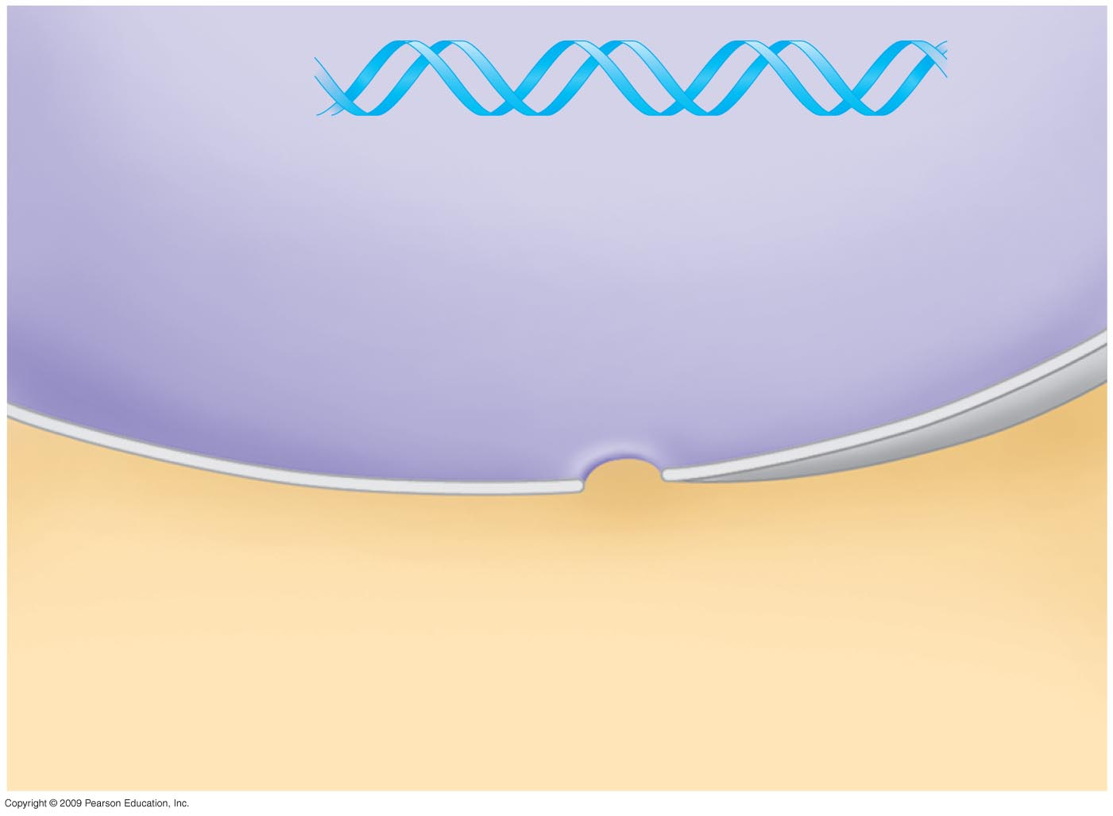
0
DNA
Nucleus
Cytoplasm
Notes:
Figure 10.6A Flow of genetic information in a eukaryotic cell.
Transcription is the production of RNA using DNA as a template. In eukaryotic cells, transcription occurs in the nucleus, and the resulting RNA (mRNA) enters the cytoplasm. Translation is the production of protein, using the sequence of nucleotides in RNA. Translation occurs in the cytoplasm for both prokaryotic and eukaryotic cells.

Slide 38
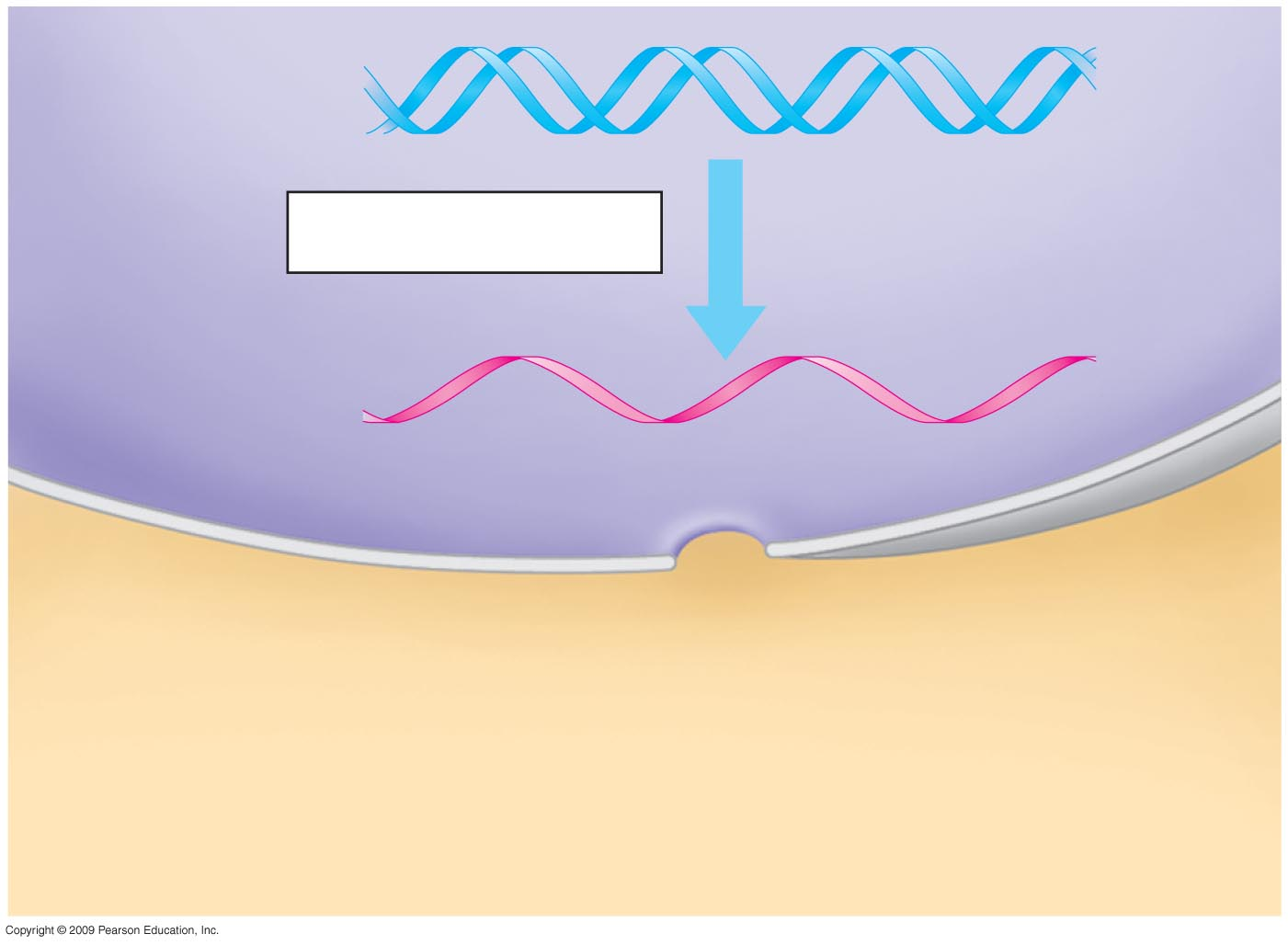
0
DNA
Transcription
RNA
Nucleus
Cytoplasm
Notes:
Figure 10.6A Flow of genetic information in a eukaryotic cell.
Transcription is the production of RNA using DNA as a template. In eukaryotic cells, transcription occurs in the nucleus, and the resulting RNA (mRNA) enters the cytoplasm. Translation is the production of protein, using the sequence of nucleotides in RNA. Translation occurs in the cytoplasm for both prokaryotic and eukaryotic cells.

Slide 39
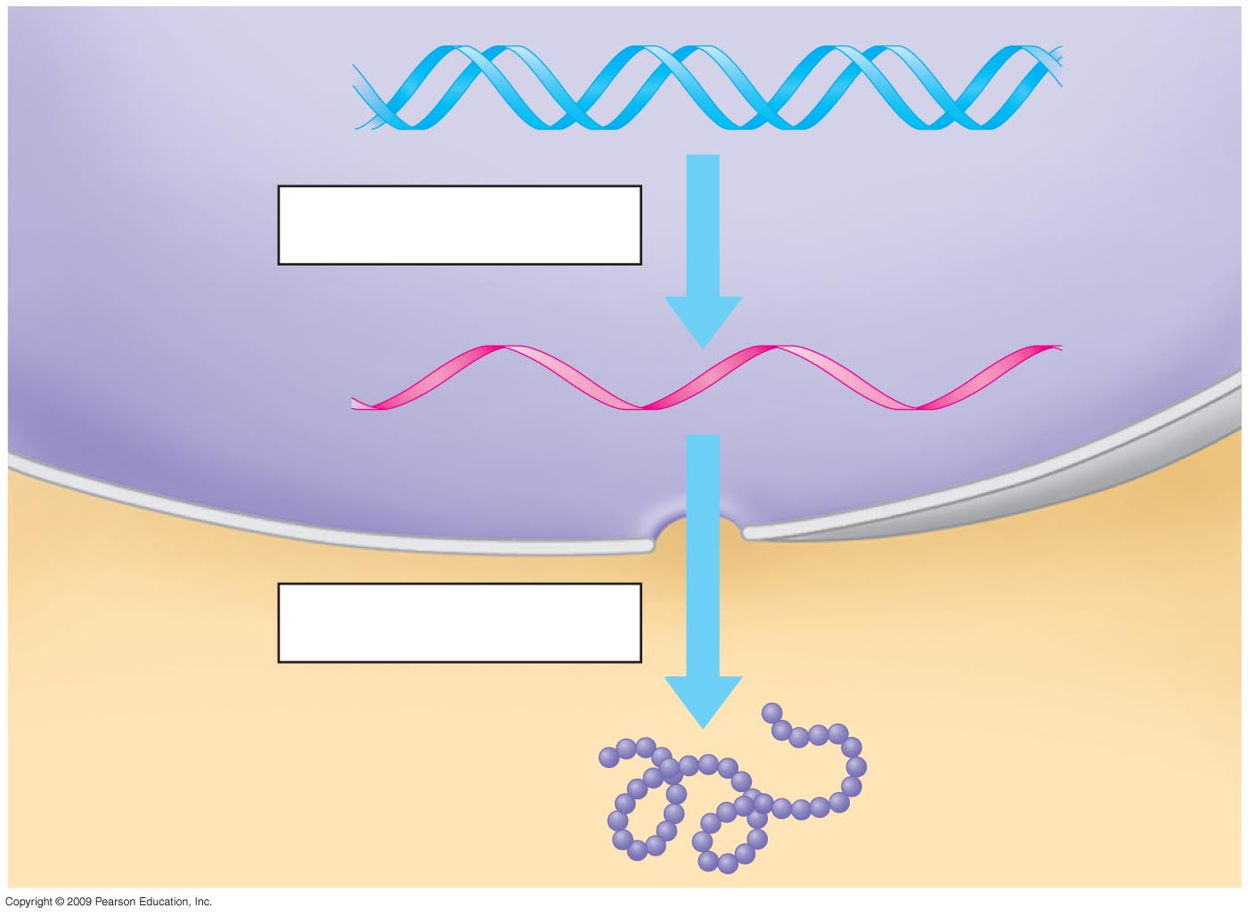
0
DNA
Transcription
RNA
Nucleus
Cytoplasm
Translation
Protein
Notes:
Figure 10.6A Flow of genetic information in a eukaryotic cell.
Transcription is the production of RNA using DNA as a template. In eukaryotic cells, transcription occurs in the nucleus, and the resulting RNA (mRNA) enters the cytoplasm. Translation is the production of protein, using the sequence of nucleotides in RNA. Translation occurs in the cytoplasm for both prokaryotic and eukaryotic cells.

Slide 40
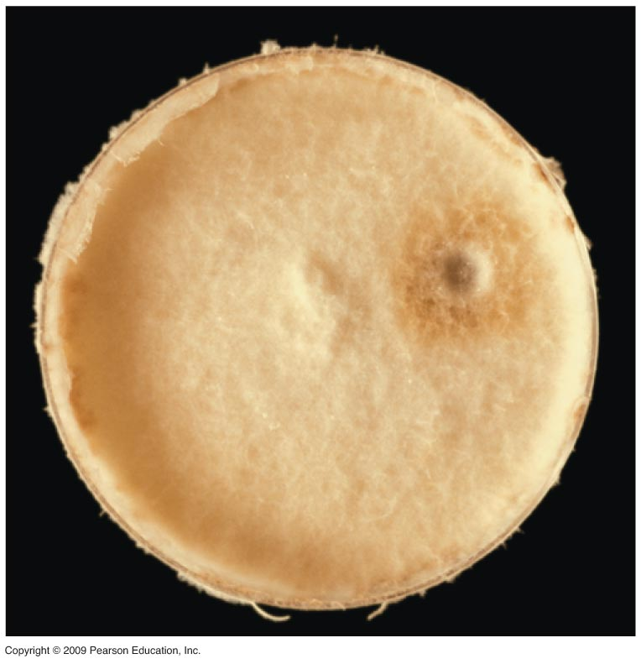
0
Notes:
Figure 10.6B Neurospora crassa growing in a culture dish.
Studies of Neurospora crassa, bread mold, led to the one gene–one enzyme hypothesis. George Beadle and Edward Tatum found a series of mutants that could not produce the amino acid arginine. Each one was deficient in an enzyme catalyzing a reaction in the arginine biosynthesis pathway. Not only were these investigators able to show that each gene coded for a different enzyme, but they were also able to determine the order of the steps in the pathway for producing arginine.

Slide 41
10.7 Genetic information written in codons is translated into amino acid sequences
0
  The sequence of nucleotides in DNA provides a code for constructing a protein
    Protein construction requires a conversion of a nucleotide sequence to an amino acid sequence
    Transcription rewrites the DNA code into RNA, using the same nucleotide “language”
    Each “word” is a codon, consisting of three nucleotides
    Translation involves switching from the nucleotide “language” to amino acid “language”
    Each amino acid is specified by a codon
      64 codons are possible
      Some amino acids have more than one possible codon
Copyright © 2009 Pearson Education, Inc.
Notes:
Comparing the linguistic meaning of transcription and translation is a useful analogy for the biochemical processes. Transcription involves staying in the nucleic acid language, while translation involves converting nucleotide codes into the amino acid language of proteins. I suggest that a student whose native language is not English may transcribe the words of an instructor during the lecture presentation, and then translate those words into his or her native language for better understanding. I also relate a story about purchasing a recipe book in French and not being able to make any of the dishes without translating the information into English!
Student Misconceptions and Concerns
1. Beginning college students are often intensely focused on writing detailed notes. The risk is that they will miss the overall patterns and the broader significance of the topics discussed. Consider a gradual approach to the subjects of transcription and translation, beginning quite generally and testing comprehension, before venturing into the finer mechanics of each process.
Teaching Tips
1. The transcription of DNA into RNA is like a reporter who transcribes a political
speech. In both situations, the language remains the same, although in the case of the reporter, it changes its form from spoken to written language.
2. The sequential information in DNA and RNA is analogous to the sequential information in the letters of a sentence. This analogy is also helpful when explaining the impact of insertion or deletion mutations that cause a shift in the reading frame (see Module 10.16).

Slide 42
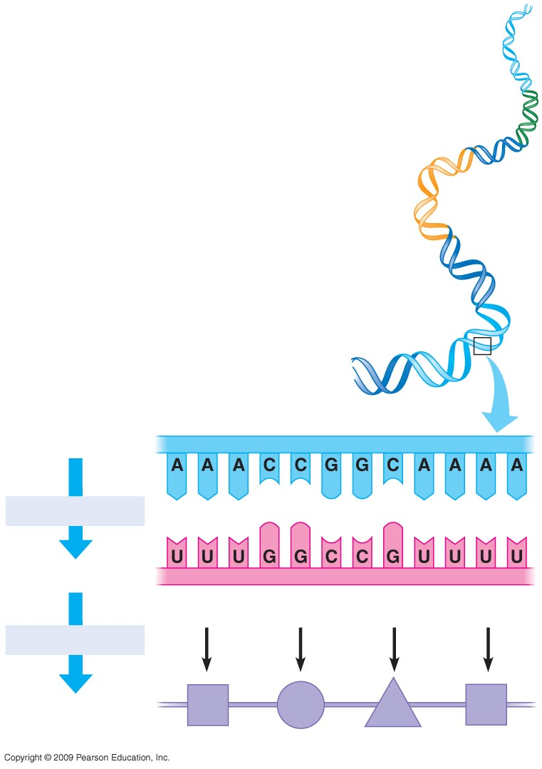
0
DNA molecule
Gene 1
Gene 2
Gene 3
DNA strand
Transcription
RNA
Codon
Translation
Polypeptide
Amino acid
Notes:
Figure 10.7 Transcription and translation of codons.

Slide 43
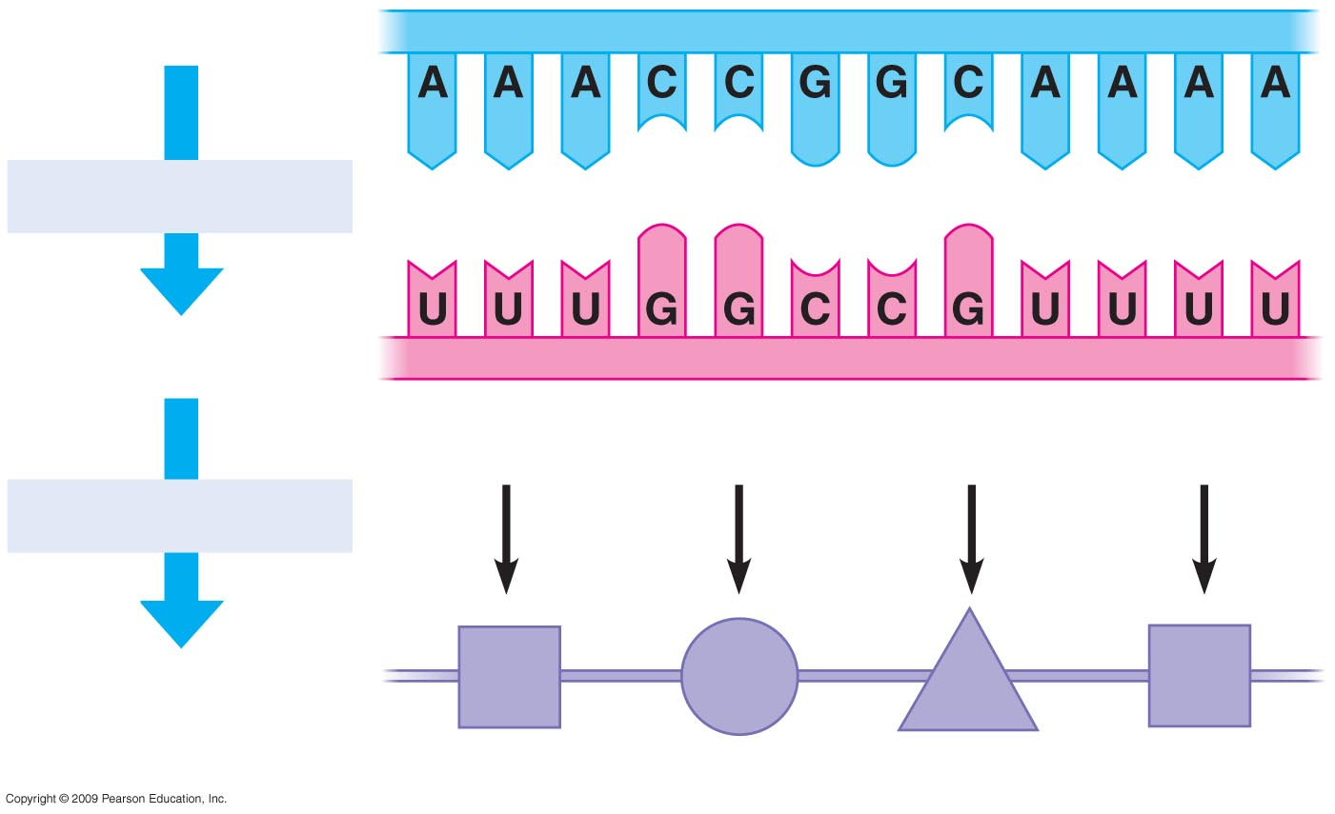
0
DNA strand
Transcription
RNA
Codon
Translation
Polypeptide
Amino acid
Notes:
Figure 10.7 Transcription and translation of codons.

Slide 44
10.8 The genetic code is the Rosetta stone of life
0
  Characteristics of the genetic code
    Triplet: Three nucleotides specify one amino acid
      61 codons correspond to amino acids
      AUG codes for methionine and signals the start of transcription
      3 “stop” codons signal the end of translation
Copyright © 2009 Pearson Education, Inc.
Notes:
Exceptions to the universality of the genetic code are found for both mitochondrial and nuclear genes. In mitochondria from animals and microorganisms such as yeast, UGA codes for tryptophan rather than stop. In vertebrate mitochondria, AGA and AGG are stop codons instead of specifying arginine. In yeast mitochondria, all codons beginning with CU code for threonine instead of leucine, while the codons UUA and UUG still specify leucine. For the nuclear genes of the ciliated protozoan Tetrahymena thermophila, UAA and UAG code for glutamine rather than stop.

Slide 45
10.8 The genetic code is the Rosetta stone of life
0
    Redundant: More than one codon for some amino acids
    Unambiguous: Any codon for one amino acid does not code for any other amino acid
    Does not contain spacers or punctuation: Codons are adjacent to each other with no gaps in between
    Nearly universal
Copyright © 2009 Pearson Education, Inc.
Notes:
Exceptions to the universality of the genetic code are found for both mitochondrial and nuclear genes. In mitochondria from animals and microorganisms such as yeast, UGA codes for tryptophan rather than stop. In vertebrate mitochondria, AGA and AGG are stop codons instead of specifying arginine. In yeast mitochondria, all codons beginning with CU code for threonine instead of leucine, while the codons UUA and UUG still specify leucine. For the nuclear genes of the ciliated protozoan Tetrahymena thermophila, UAA and UAG code for glutamine rather than stop.

Slide 46
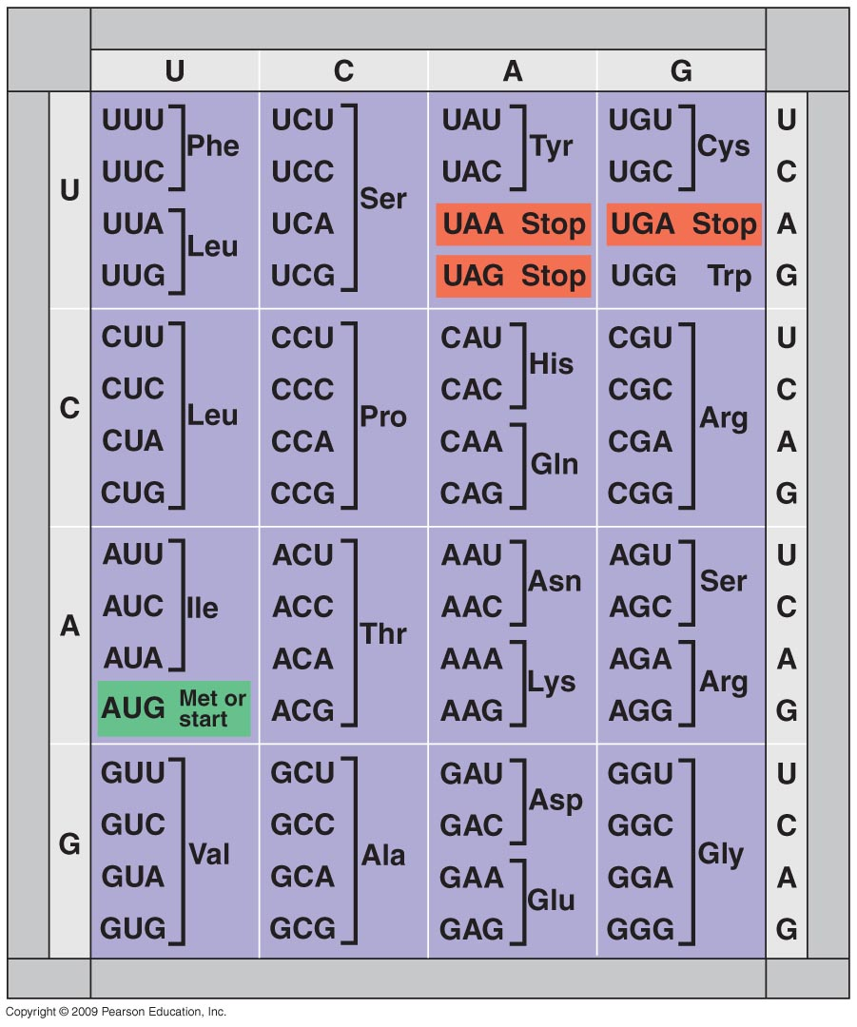
Second base
0
First base
Third base
Notes:
Figure 10.8A Dictionary of the genetic code (RNA codons).
This listing of the codon “dictionary” can be used to illustrate the triplet and redundant nature of the code. While methionine and tryptophan have only one codon each, leucine, serine, and arginine each have six codons.
It can also be pointed out that codons for the same amino acid often differ in the third nucleotide, a phenomenon described as “wobble.” The base pairing of the first two nucleotides of the codon with corresponding positions in the anticodon is stringent, but pairing of the third is weaker and more flexible. The wobble hypothesis proposed by Francis Crick allows for some nonstandard pairings that account for some of the redundancy of the genetic code. For example, if the third position of the codon is a U or C, it can pair with a G on the anticodon. This would mean that one tRNA, rather than two, could be used to translate UUU and UUC, for example. Estimates of 30–50 tRNAs necessary to pair with 61 codons are borne out by studies that identify 45 different tRNAs in some cell types.

Slide 47
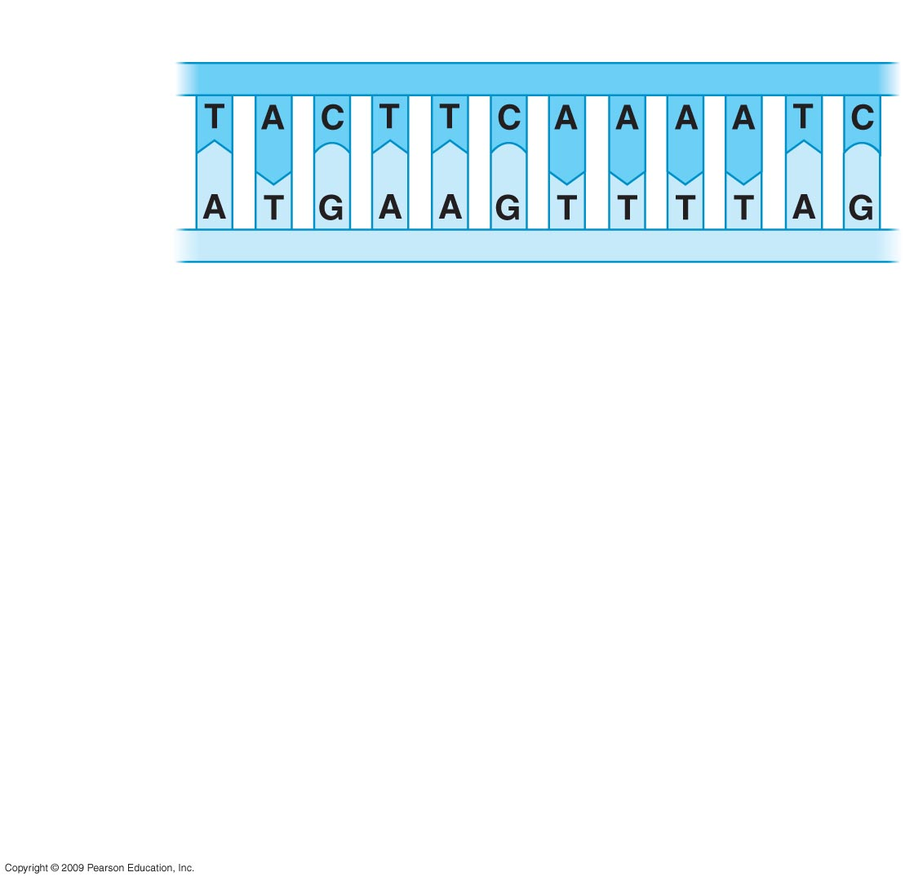
Strand to be transcribed
0
DNA
Notes:
Figure 10.8B Deciphering the genetic information in DNA.

Slide 48
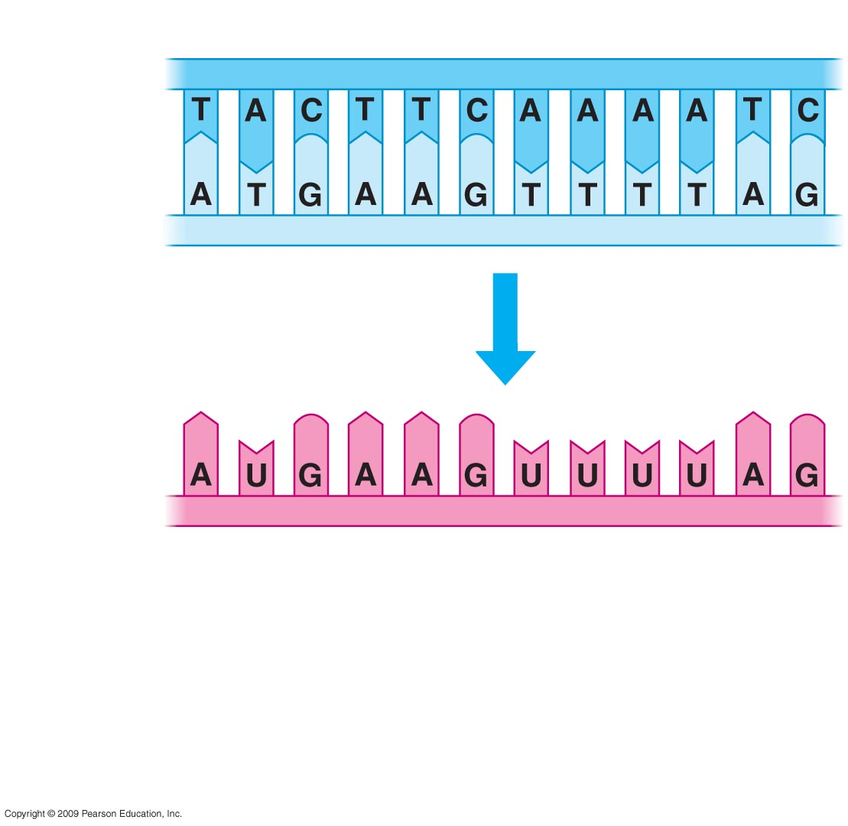
Strand to be transcribed
0
DNA
Transcription
RNA
Start
codon
Stop
codon
Notes:
Figure 10.8B Deciphering the genetic information in DNA.

Slide 49
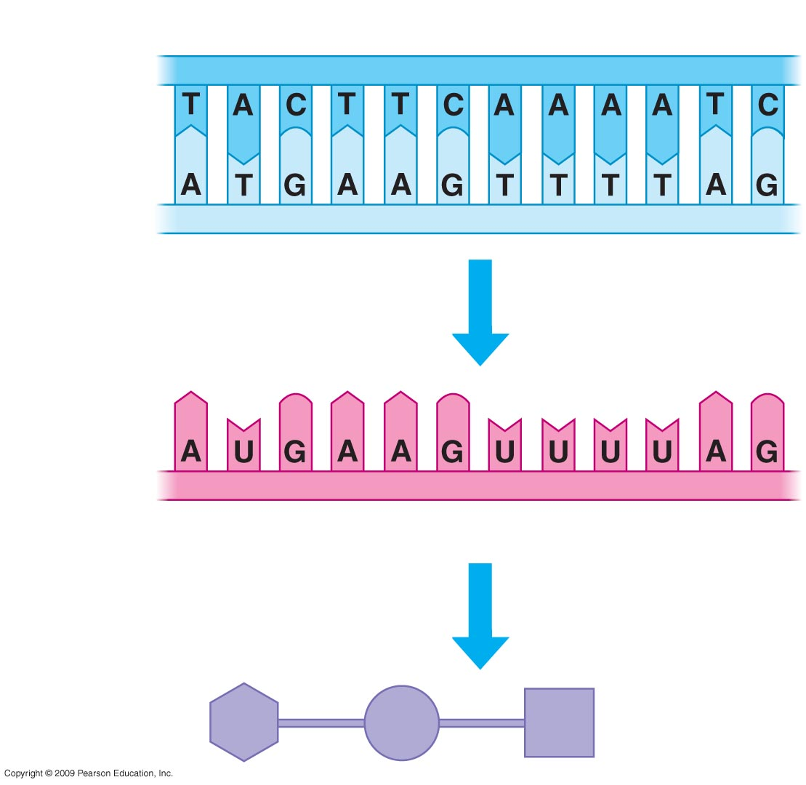
Strand to be transcribed
0
DNA
Transcription
RNA
Start
codon
Stop
codon
Translation
Polypeptide
Met
Lys
Phe
Notes:
Figure 10.8B Deciphering the genetic information in DNA.

Slide 50
10.9 Transcription produces genetic messages in the form of RNA
0
  Overview of transcription
    The two DNA strands separate
    One strand is used as a pattern to produce an RNA chain, using specific base pairing
      For A in DNA, U is placed in RNA
    RNA polymerase catalyzes the reaction
Copyright © 2009 Pearson Education, Inc.
Notes:
The location of the promoter determines which strand will be used as a template. Once RNA polymerase binds to the promoter, the strand oriented 3′ → 5′ is used as a template, since transcription occurs in a 5′ → 3′ direction.
It is important to emphasize that the start and stop transcription signals differ from the start and stop codons of translation. The start and stop codons are located at the ends of the protein-coding sequence. Messenger RNAs contain additional sequences both before and after the protein-coding region because transcription begins in the upstream promoter and ends at the downstream terminator. For operons in prokaryotic cells (see Module 11.1), transcription of multiple genes will be controlled by one promoter and one terminator, but each gene will have a start and stop codon for translation of its corresponding protein.

Slide 51
10.9 Transcription produces genetic messages in the form of RNA
0
  Stages of transcription
    Initiation: RNA polymerase binds to a promoter, where the helix unwinds and transcription starts
    Elongation: RNA nucleotides are added to the chain
    Termination: RNA polymerase reaches a terminator sequence and detaches from the template
Copyright © 2009 Pearson Education, Inc.
Notes:
The location of the promoter determines which strand will be used as a template. Once RNA polymerase binds to the promoter, the strand oriented 3′ → 5′ is used as a template, since transcription occurs in a 5′ → 3′ direction.
It is important to emphasize that the start and stop transcription signals differ from the start and stop codons of translation. The start and stop codons are located at the ends of the protein-coding sequence. Messenger RNAs contain additional sequences both before and after the protein-coding region because transcription begins in the upstream promoter and ends at the downstream terminator. For operons in prokaryotic cells (see Module 11.1), transcription of multiple genes will be controlled by one promoter and one terminator, but each gene will have a start and stop codon for translation of its corresponding protein.
For the BLAST Animation Roles of RNA, go to Animation and Video Files.
For the BLAST Animation Transcription, go to Animation and Video Files.

Slide 52
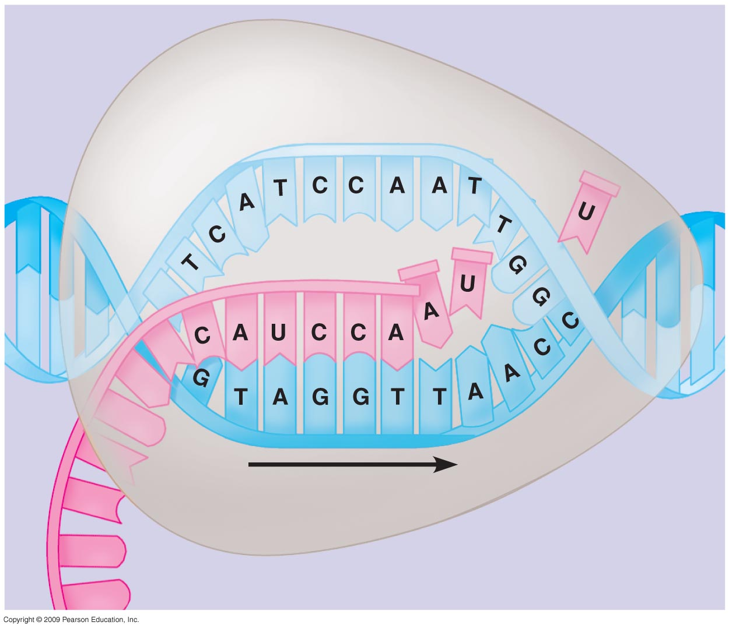
0
RNA nucleotides
RNA
polymerase
Direction of
transcription
Template
strand of DNA
Newly made RNA
Notes:
Figure 10.9A A close-up view of transcription.

Slide 53
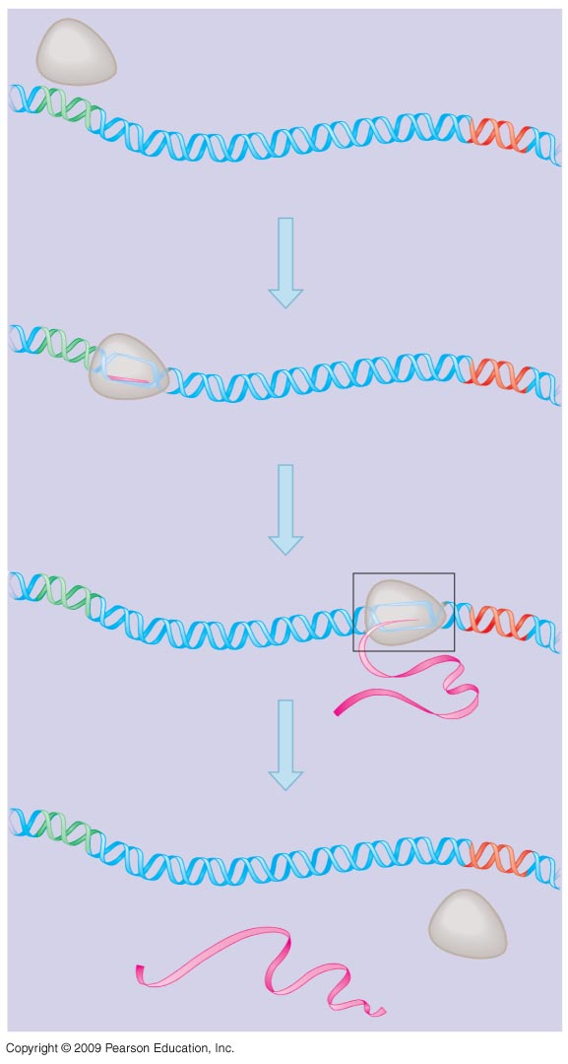
RNA polymerase
0
DNA of gene
Promoter
DNA
Terminator
DNA
1
Initiation
Area shown
in Figure 10.9A
2
Elongation
3
Growing
RNA
Termination
Completed
RNA
RNA
polymerase
Notes:
Figure 10.9B Transcription of a gene.

Slide 54
10.10 Eukaryotic RNA is processed before leaving the nucleus
0
  Messenger RNA (mRNA) contains codons for protein sequences
  Eukaryotic mRNA has interrupting sequences called introns, separating the coding regions called exons
  Eukaryotic mRNA undergoes processing before leaving the nucleus
    Cap added to 5’ end: single guanine nucleotide
    Tail added to 3’ end: Poly-A tail of 50–250 adenines
    RNA splicing: removal of introns and joining of exons to produce a continuous coding sequence
Copyright © 2009 Pearson Education, Inc.
Notes:
RNA splicing is carried out by a spliceosome, a complex of several RNA and protein molecules. RNA components of the spliceosome base pair with sequences of the intron to facilitate removal.
The function of introns is often questioned. Mixing and matching of exon sequences has been documented for some genes, suggesting that introns act as spacers to prevent the loss of exon sequences during DNA rearrangements. Alternative RNA splicing, discussed in Module 11.6, demonstrates that introns provide a way to produce more than one protein from a single gene sequence.
Ribosomal and transfer RNAs also contain introns and undergo splicing reactions.

Slide 55
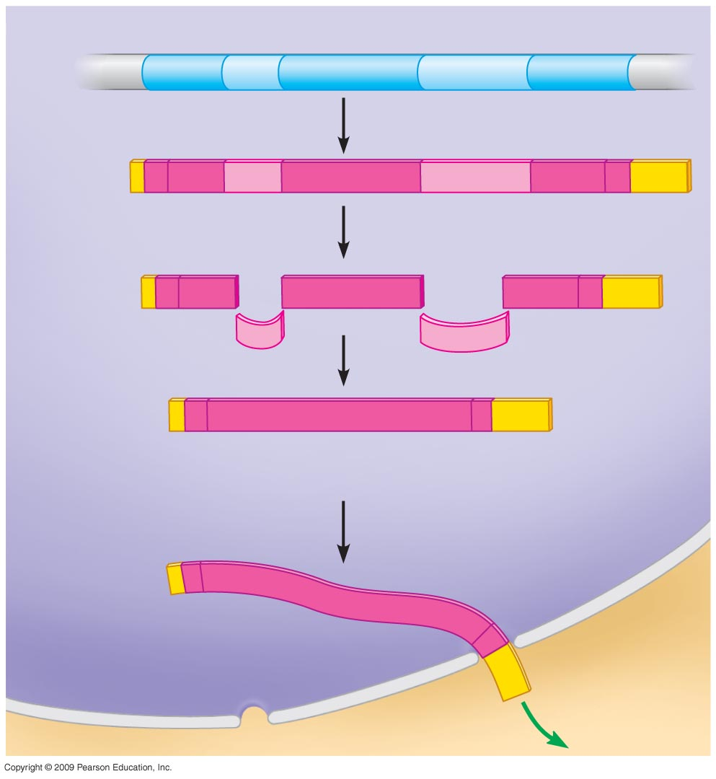
Exon
Intron
Exon
Intron
Exon
0
DNA
Cap
Transcription
Addition of cap and tail
RNA
transcript
with cap
and tail
Introns removed
Tail
Exons spliced together
mRNA
Coding sequence
Nucleus
Cytoplasm
Notes:
Figure 10.10 The production of eukaryotic mRNA.

Slide 56
10.11 Transfer RNA molecules serve as interpreters during translation
0
  Transfer RNA (tRNA) molecules match an amino acid to its corresponding mRNA codon
    tRNA structure allows it to convert one language to the other
      An amino acid attachment site allows each tRNA to carry a specific amino acid
      An anticodon allows the tRNA to bind to a specific mRNA codon, complementary in sequence
        A pairs with U, G pairs with C
Copyright © 2009 Pearson Education, Inc.
Notes:
Like any good interpreter, tRNA speaks both “languages.” The anticodon represents the nucleotide language, and the amino acid attached to the opposite end represents the conversion to amino acid language.

Slide 57
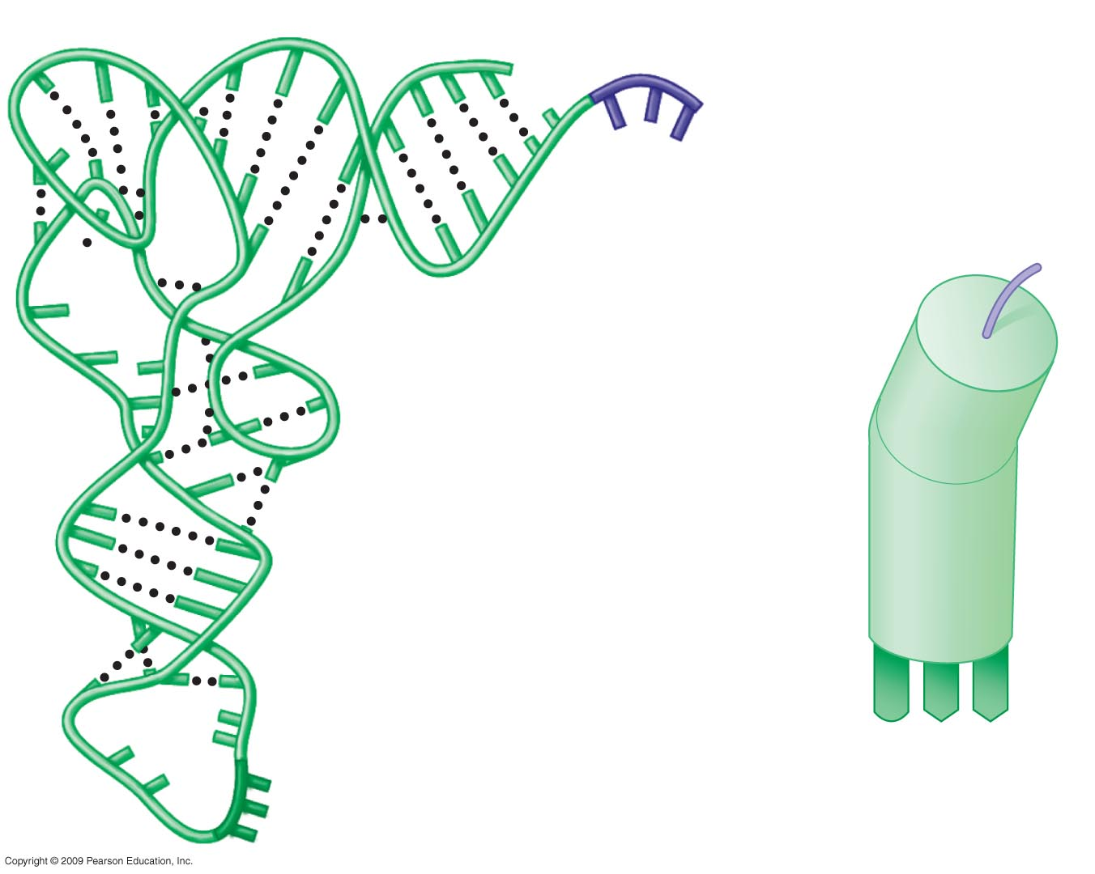
Amino acid attachment site
0
Hydrogen bond
RNA polynucleotide chain
Anticodon
Notes:
Figure 10.11A The structure of tRNA.
tRNA takes on its characteristic shape as a result of hydrogen bonding between bases on the same RNA chain.

Slide 58
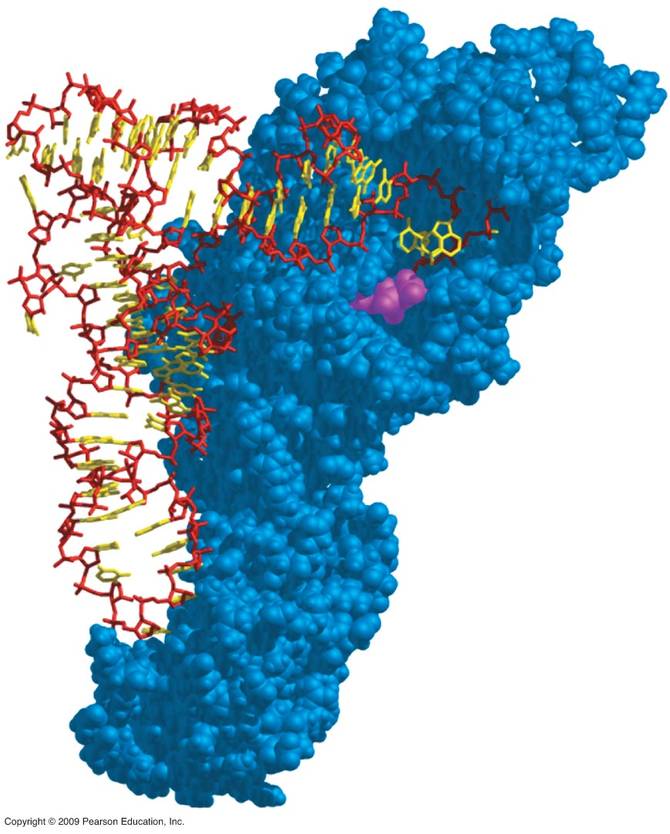
0
Notes:
Figure 10.11B A molecule of tRNA binding to an enzyme molecule (blue).
The specificity of the genetic code depends on enzymes called tRNA synthetases that recognize the anticodon and catalyze the reaction that attaches the appropriate amino acid to the opposite end of the tRNA. ATP provides energy for the reaction.

Slide 59
10.12 Ribosomes build polypeptides
0
  Translation occurs on the surface of the ribosome
    Ribosomes have two subunits: small and large
    Each subunit is composed of ribosomal RNAs and proteins
    Ribosomal subunits come together during translation
    Ribosomes have binding sites for mRNA and tRNAs
Copyright © 2009 Pearson Education, Inc.

Slide 60
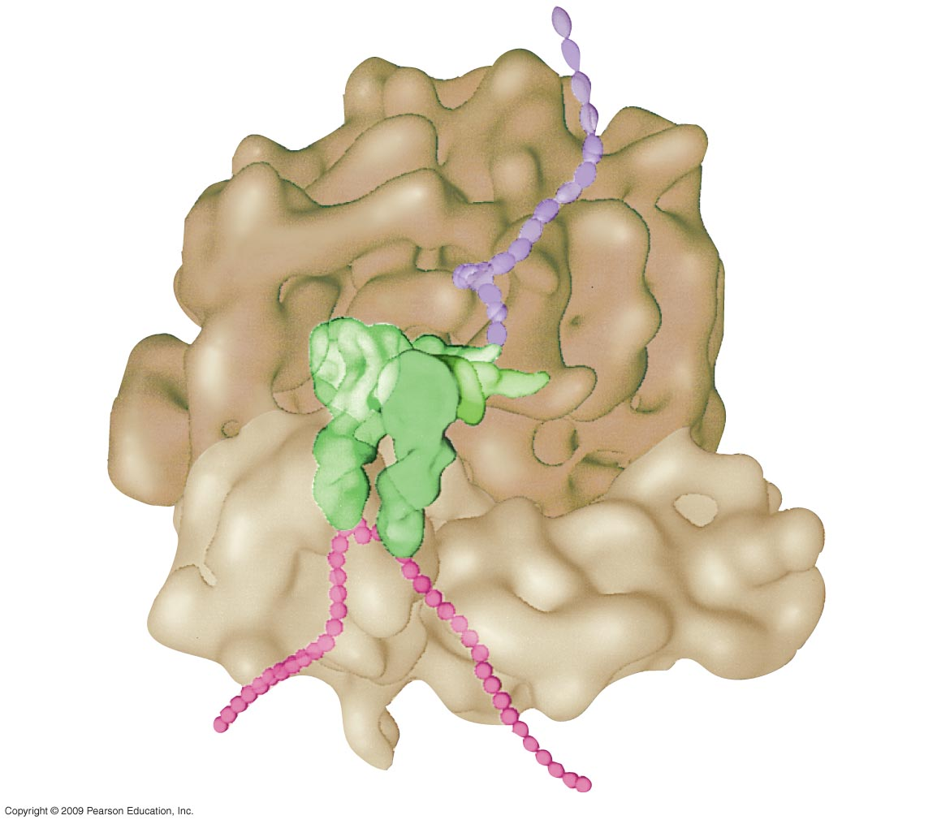
Growing
polypeptide
0
tRNA
molecules
Large
subunit
mRNA
Small
subunit
Notes:
Figure 10.12A The true shape of a functioning ribosome.
This figure emphasizes the positioning of the small and large ribosomal subunits, along with mRNA and tRNA molecules.

Slide 61
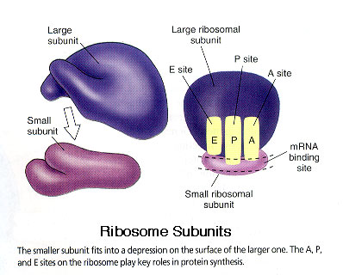

Slide 62
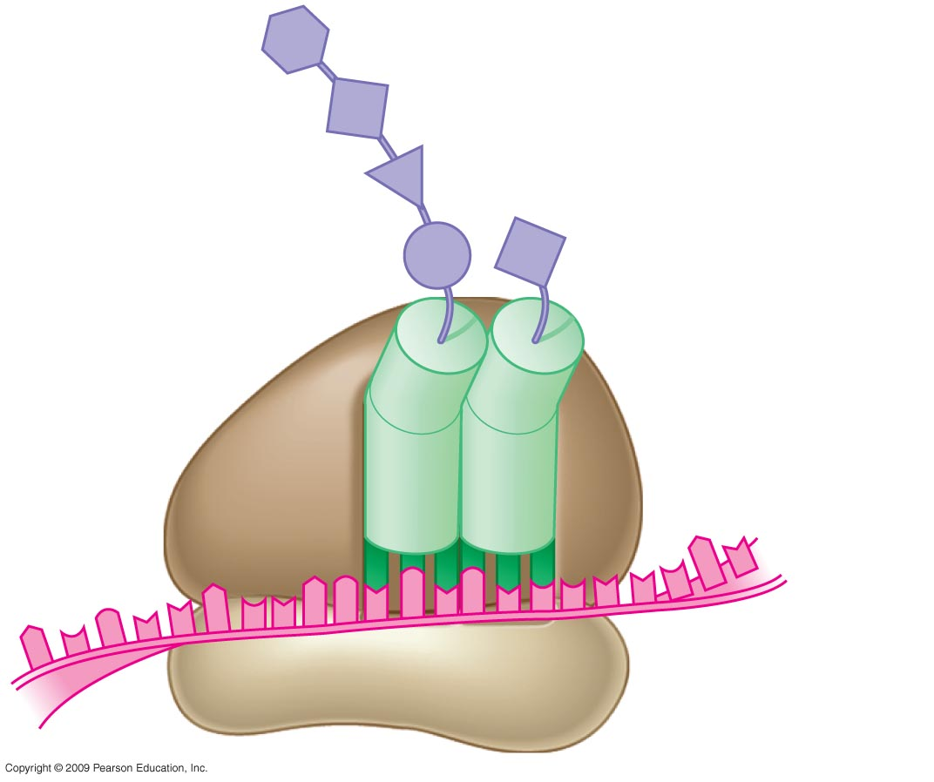
0
Next amino acid
to be added to
polypeptide
Growing
polypeptide
tRNA
mRNA
Codons
Notes:
Figure 10.12C A ribosome with occupied binding sites.
This figure shows that one of the tRNA binding sites (P site) holds the growing peptide chain while the adjacent site (A site) holds the tRNA carrying the next amino acid to be added to the chain.

Slide 63
10.13 An initiation codon marks the start of an mRNA message
0
  Initiation brings together the components needed to begin RNA synthesis
  Initiation occurs in two steps
    mRNA binds to a small ribosomal subunit, and the first tRNA binds to mRNA at the start codon
      The start codon reads AUG and codes for methionine
      The first tRNA has the anticodon UAC
    A large ribosomal subunit joins the small subunit, allowing the ribosome to function
      The first tRNA occupies the P site, which will hold the growing peptide chain
      The A site is available to receive the next tRNA
Copyright © 2009 Pearson Education, Inc.

Slide 64
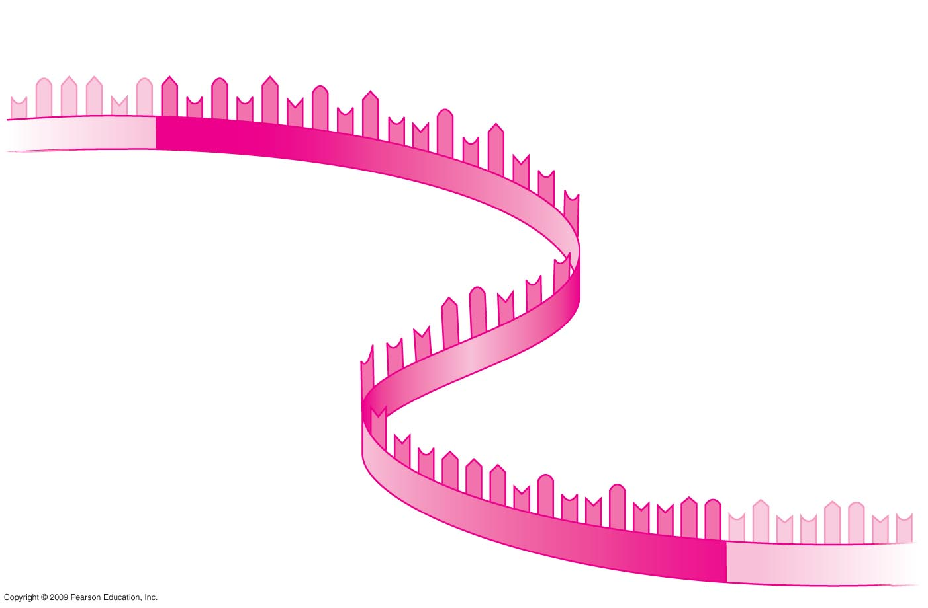
0
Start of genetic message
End
Notes:
Figure 10.13A A molecule of mRNA.
This figure shows that the bases of the codons are arranged linearly along an mRNA.

Slide 65
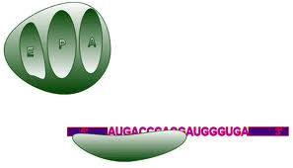
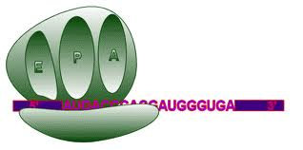

Slide 66
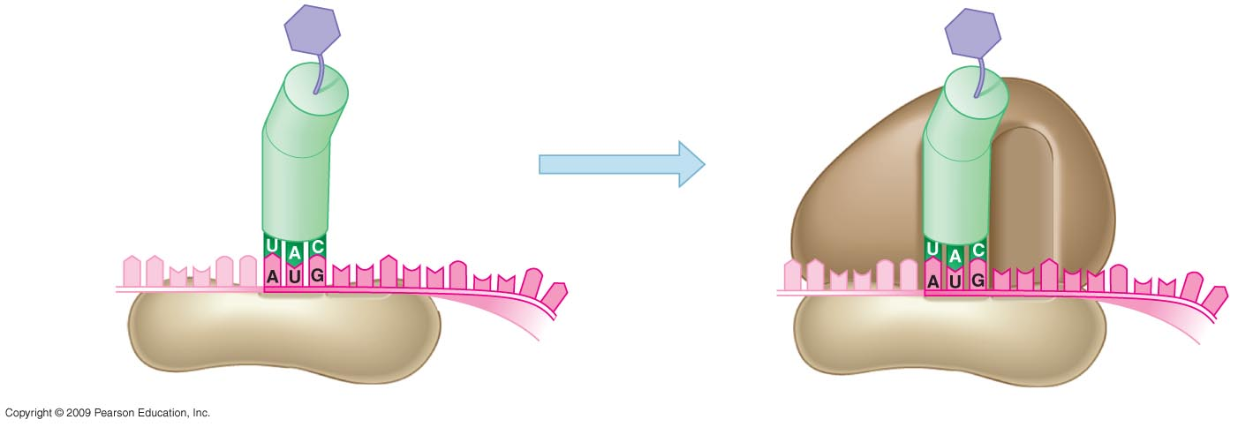
0
Met
Met
Large
ribosomal
subunit
Initiator tRNA
P site
A site
Start
codon
mRNA
Small ribosomal
subunit
1
2
Notes:
Figure 10.13B The initiation of translation.
The two-step process of initiation is shown in this figure. In prokaryotic cells, the binding of the first tRNA, formyl-methionine (f-met) tRNA has been shown to stabilize the initiation complex.

Slide 67
10.14 Elongation adds amino acids to the polypeptide chain until a stop codon terminates translation
0
  Elongation is the addition of amino acids to the polypeptide chain
  Each cycle of elongation has three steps
    Codon recognition: next tRNA binds to the mRNA at the A site
    Peptide bond formation: joining of the new amino acid to the chain
      Amino acids on the tRNA at the P site are attached by a covalent bond to the amino acid on the tRNA at the A site
Copyright © 2009 Pearson Education, Inc.
Notes:
Peptide bond formation represents another dehydration synthesis reaction. It is catalyzed by the enzyme peptidyl transferase.
Translocation has also been described as a movement of the ribosome. Since the tRNA/mRNA hydrogen bonding remains intact, a shift of the ribosome would cause the tRNA in the A site to occupy the P site. There is also an E site, to the left of the P site. When the ribosome shifts positions, the tRNA from the P site moves into the E site and then is released to the cytoplasm.
Student Misconceptions and Concerns
1. Beginning college students are often intensely focused on writing detailed notes. The risk is that they will miss the overall patterns and the broader significance of the topics discussed. Consider a gradual approach to the subjects of transcription and translation, beginning quite generally and testing comprehension, before venturing into the finer mechanics of each process.
Teaching Tips
1. If you use a train analogy for the assembly of monomers into polymers, the DNA and RNA trains are traded in on a three-for-one basis for the polypeptide train during translation. In general, this produces polypeptides that have about one-third as many monomers as the mRNA that coded for them.
2. Students might want to think of the A and P sites as stages in an assembly line. The A site is where a new amino acid is brought in, according to the blueprint of the codon on the mRNA. The P site is where the growing product/polypeptide is anchored as it is being built. To help them better remember details of translation, students might think of the letters for the two sites as meaning A for addition, where an amino acid is added, and P for polypeptide, where the growing polypeptide is located.

Slide 68
10.14 Elongation adds amino acids to the polypeptide chain until a stop codon terminates translation
0
    Translocation: tRNA is released from the P site and the ribosome moves tRNA from the A site into the P site
Copyright © 2009 Pearson Education, Inc.
Notes:
Peptide bond formation represents another dehydration synthesis reaction. It is catalyzed by the enzyme peptidyl transferase.
Translocation has also been described as a movement of the ribosome. Since the tRNA/mRNA hydrogen bonding remains intact, a shift of the ribosome would cause the tRNA in the A site to occupy the P site. There is also an E site, to the left of the P site. When the ribosome shifts positions, the tRNA from the P site moves into the E site and then is released to the cytoplasm.

Slide 69
10.14 Elongation adds amino acids to the polypeptide chain until a stop codon terminates translation
0
  Elongation continues until the ribosome reaches a stop codon
  Applying Your Knowledge
  How many cycles of elongation are required to produce a protein with 100 amino acids?
  Termination
    The completed polypeptide is released
    The ribosomal subunits separate
    mRNA is released and can be translated again
Copyright © 2009 Pearson Education, Inc.
Notes:
Applying Your Knowledge
How many cycles of elongation are required to produce a protein with 100 amino acids? This requires 99 elongation cycles. The first amino acid is put in place during the initiation step, and the remaining 99 amino acids are added to it, one at a time.
As described in the review module 10.15, an mRNA is usually translated simultaneously by multiple ribosomes.
For the BioFlix Animation Protein Synthesis, go to Animation and Video Files.
For the BLAST Animation Translation, go to Animation and Video Files.
Student Misconceptions and Concerns
1. Beginning college students are often intensely focused on writing detailed notes. The risk is that they will miss the overall patterns and the broader significance of the topics discussed. Consider a gradual approach to the subjects of transcription and translation, beginning quite generally and testing comprehension, before venturing into the finer mechanics of each process.
Teaching Tips
1. If you use a train analogy for the assembly of monomers into polymers, the DNA and RNA trains are traded in on a three-for-one basis for the polypeptide train during translation. In general, this produces polypeptides that have about one-third as many monomers as the mRNA that coded for them.
2. Students might want to think of the A and P sites as stages in an assembly line. The A site is where a new amino acid is brought in, according to the blueprint of the codon on the mRNA. The P site is where the growing product/polypeptide is anchored as it is being built. To help them better remember details of translation, students might think of the letters for the two sites as meaning A for addition, where an amino acid is added, and P for polypeptide, where the growing polypeptide is located.

Slide 70
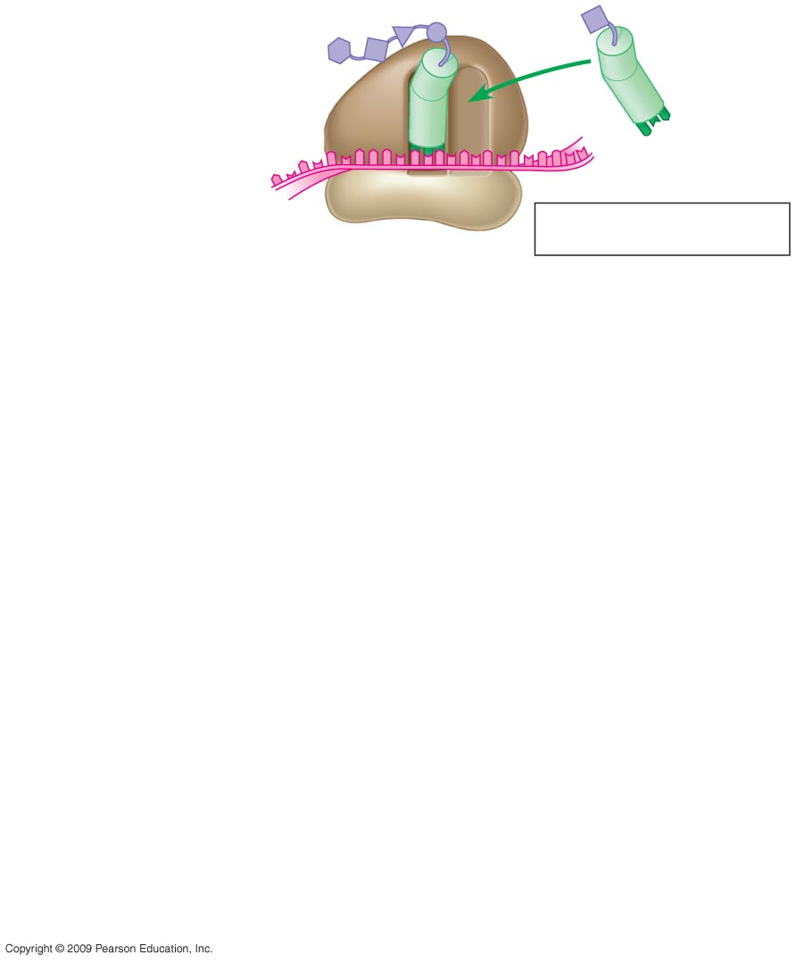
Amino
acid
0
Polypeptide
P site
A site
Anticodon
mRNA
Codons
1
Codon recognition
Notes:
Figure 10.14 Polypeptide elongation.

Slide 71
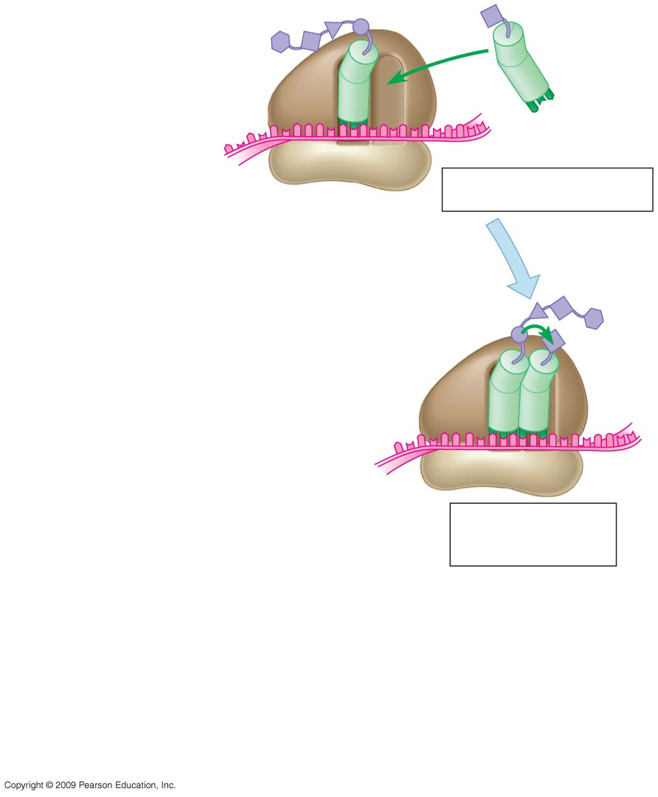
Amino
acid
0
Polypeptide
P site
A site
Anticodon
mRNA
Codons
1
Codon recognition
2
Peptide bond
formation
Notes:
Figure 10.14 Polypeptide elongation.

Slide 72
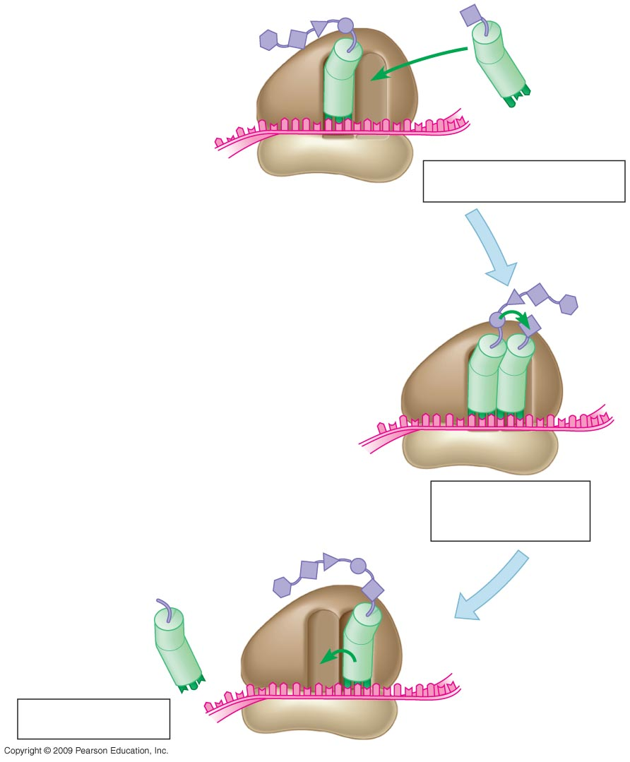
Amino
acid
0
Polypeptide
P site
A site
Anticodon
mRNA
Codons
1
Codon recognition
2
Peptide bond
formation
New
peptide
bond
3
Translocation
Notes:
Figure 10.14 Polypeptide elongation.

Slide 73
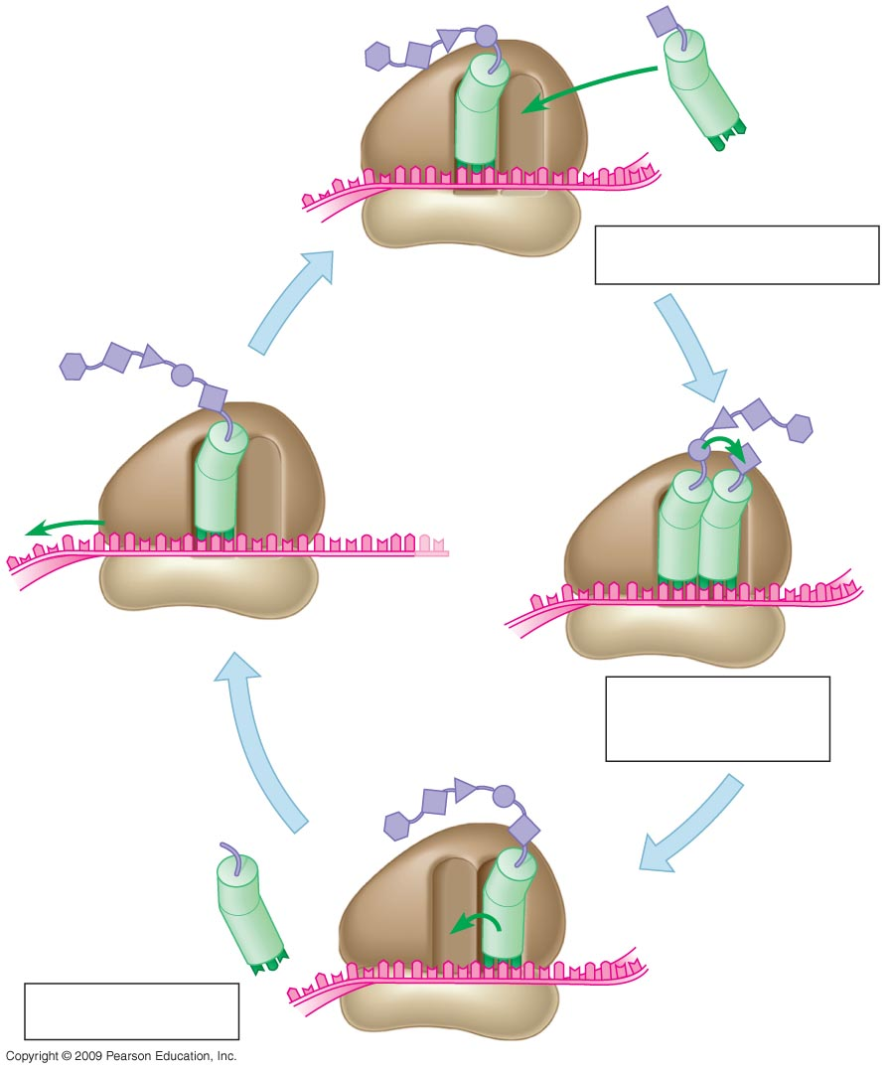
Amino
acid
0
Polypeptide
P site
A site
Anticodon
mRNA
Codons
1
Codon recognition
mRNA
movement
Stop
codon
2
Peptide bond
formation
New
peptide
bond
3
Translocation
Notes:
Figure 10.14 Polypeptide elongation.

Slide 74
10.15 Review: The flow of genetic information in the cell is DNA → RNA → protein
0
  Does translation represent:
    DNA → RNA or RNA → protein?
  Where does the information for producing a protein originate:
    DNA or RNA?
  Which one has a linear sequence of codons:
    rRNA, mRNA, or tRNA?
  Which one directly influences the phenotype:
    DNA, RNA, or protein?
Copyright © 2009 Pearson Education, Inc.
Notes:
Does translation represent:
DNA → RNA or RNA → protein? Answer: RNA → protein
Where does the information for producing a protein originate:
DNA or RNA? Answer: DNA
Which one has a linear sequence of codons:
rRNA, mRNA, or tRNA? Answer: mRNA
Which one directly influences the phenotype:
DNA, RNA, or protein? Answer: protein

Slide 75
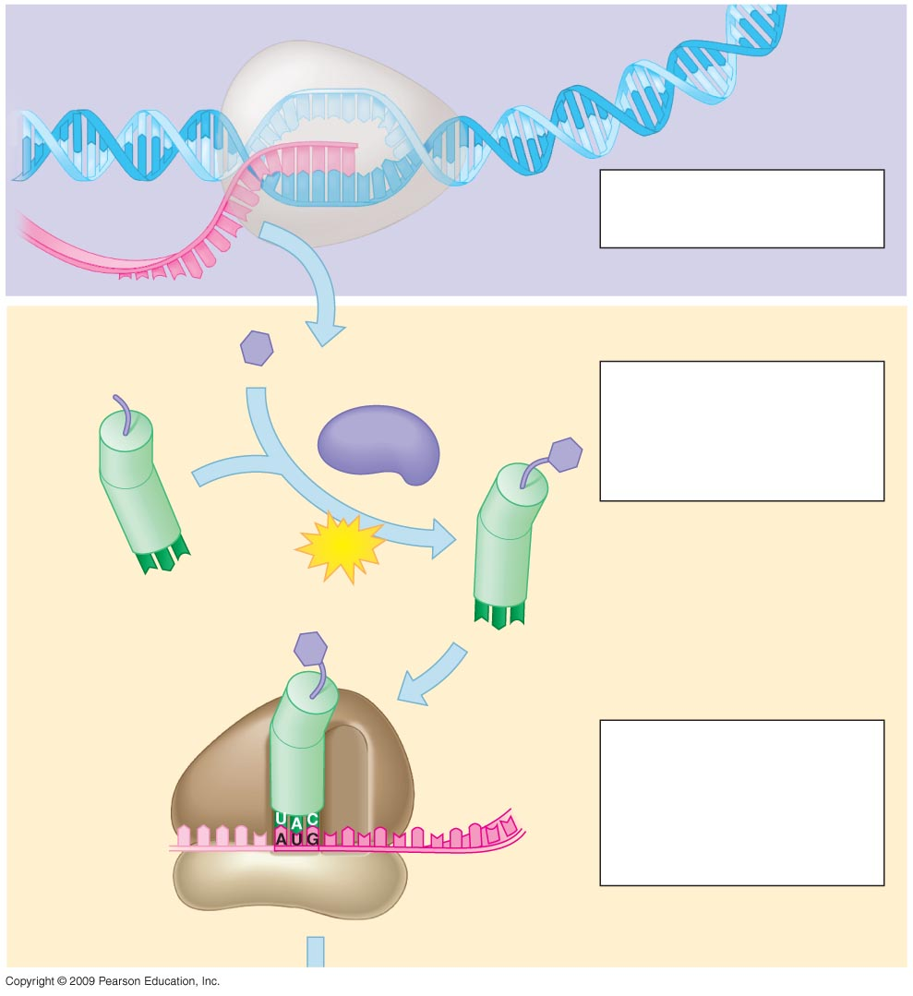
DNA
Transcription
0
mRNA is transcribed
from a DNA template.
1
mRNA
RNA
polymerase
Amino acid
Translation
Each amino acid
attaches to its proper
tRNA with the help of a
specific enzyme and
ATP.
2
Enzyme
ATP
tRNA
Anticodon
Initiator
tRNA
Large
ribosomal
subunit
Initiation of
polypeptide synthesis
3
The mRNA, the first
tRNA, and the ribosomal
sub-units come together.
Start Codon
Small
ribosomal
subunit
mRNA
Notes:
Figure 10.15 Summary of transcription and translation.
This figure is an overview of the processes, emphasizing the participation of enzymes and the requirement of an energy source. Beyond its use for attaching amino acids to tRNAs, phosphate-bond energy is also needed during initiation, elongation, and termination of translation.
The need to obtain amino acids from the diet could be described along with this slide. If amino acids are present in sufficient amounts, they will be continually attached to tRNAs and available for protein synthesis. If one or more amino acids is low in quantity, the translation of any protein containing those amino acids will be terminated prematurely when the corresponding codon is reached and a tRNA fails to bind to the A site. For humans, animal protein sources have an appropriate profile of essential amino acids. Plant proteins can be combined to provide an adequate amino acid balance.

Slide 76
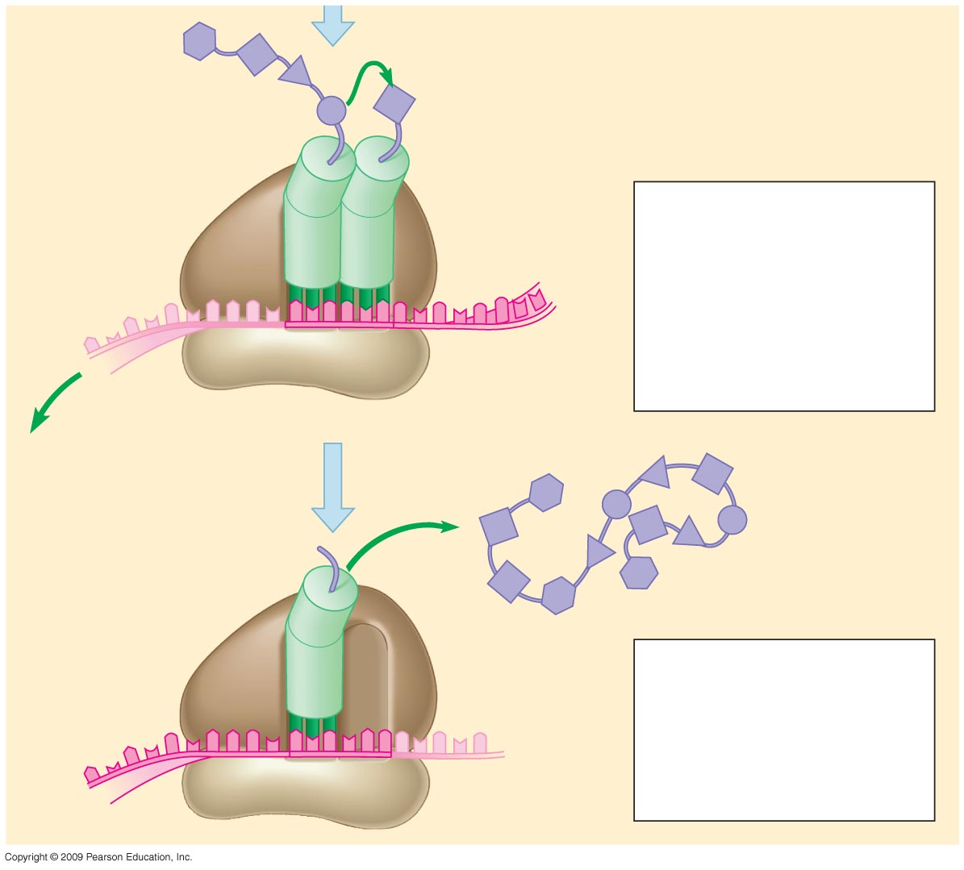
0
New peptide
bond forming
Growing
polypeptide
4
Elongation
A succession of tRNAs
add their amino acids
to the polypeptide chain
as the mRNA is moved
through the ribosome,
one codon at a time.
Codons
mRNA
Polypeptide
5
Termination
The ribosome
recognizes a stop
codon. The polypeptide
is terminated and
released.
Stop codon
Notes:
Figure 10.15 Summary of transcription and translation.
This figure is an overview of the processes, emphasizing the participation of enzymes and the requirement of an energy source. Beyond its use for attaching amino acids to tRNAs, phosphate-bond energy is also needed during initiation, elongation, and termination of translation.
The need to obtain amino acids from the diet could be described along with this slide. If amino acids are present in sufficient amounts, they will be continually attached to tRNAs and available for protein synthesis. If one or more amino acids is low in quantity, the translation of any protein containing those amino acids will be terminated prematurely when the corresponding codon is reached and a tRNA fails to bind to the A site. For humans, animal protein sources have an appropriate profile of essential amino acids. Plant proteins can be combined to provide an adequate amino acid balance.

Slide 77
10.16 Mutations can change the meaning of genes
0
  A mutation is a change in the nucleotide sequence of DNA
    Base substitutions: replacement of one nucleotide with another
      Effect depends on whether there is an amino acid change that alters the function of the protein
    Deletions or insertions
      Alter the reading frame of the mRNA, so that nucleotides are grouped into different codons
      Lead to significant changes in amino acid sequence downstream of mutation
      Cause a nonfunctional polypeptide to be produced
Copyright © 2009 Pearson Education, Inc.

Slide 78
10.16 Mutations can change the meaning of genes
0
  Mutations can be
    Spontaneous: due to errors in DNA replication or recombination
    Induced by mutagens
      High-energy radiation
      Chemicals
Copyright © 2009 Pearson Education, Inc.

Slide 79
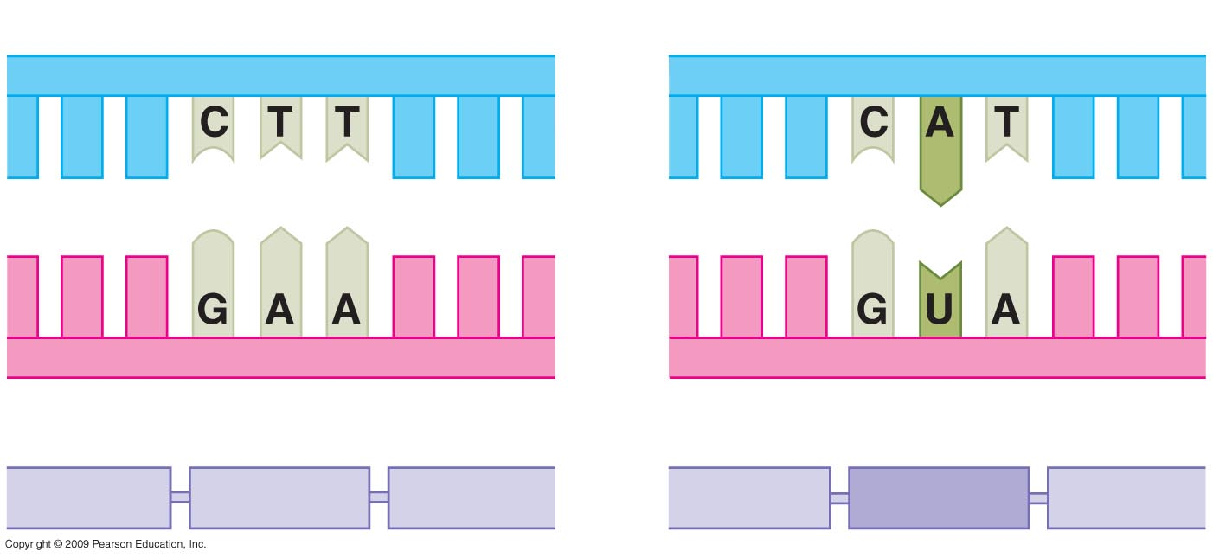
0
Normal hemoglobin DNA
Mutant hemoglobin DNA
mRNA
mRNA
Normal hemoglobin
Sickle-cell hemoglobin
Glu
Val
Notes:
Figure 10.16A The molecular basis of sickle-cell disease.
This figure shows the base pair change that leads to the formation of sickle cell hemoglobin. This results in an amino acid change in the protein, from glutamic acid to valine. This substitution of a hydrophobic amino acid for a hydrophilic one causes a significant difference in the activity of the β-hemoglobin chain. Normal hemoglobin molecules exist as individual units whether they are bound to oxygen or not. Sickle cell hemoglobin molecules are also single entities when oxygen is bound, but they form large polymers that distort the shape of the cell when oxygen is released to the tissues. The cells may have an irregular appearance or assume the crescent or sickle shape for which the disease is named. These misshapen cells tend to clog blood vessels, leading to pain, infection, and damage to organs. Cells with sickle cell hemoglobin have a shorter lifetime than normal cells (10–20 days as opposed to 3 months) so anemia sets in because the bone marrow is unable to produce new cells as rapidly as they are removed from the population. This example demonstrates that a seemingly small change, a difference of one base pair leading to a change in a single amino acid (out of 147), can have severe effects.

Slide 80
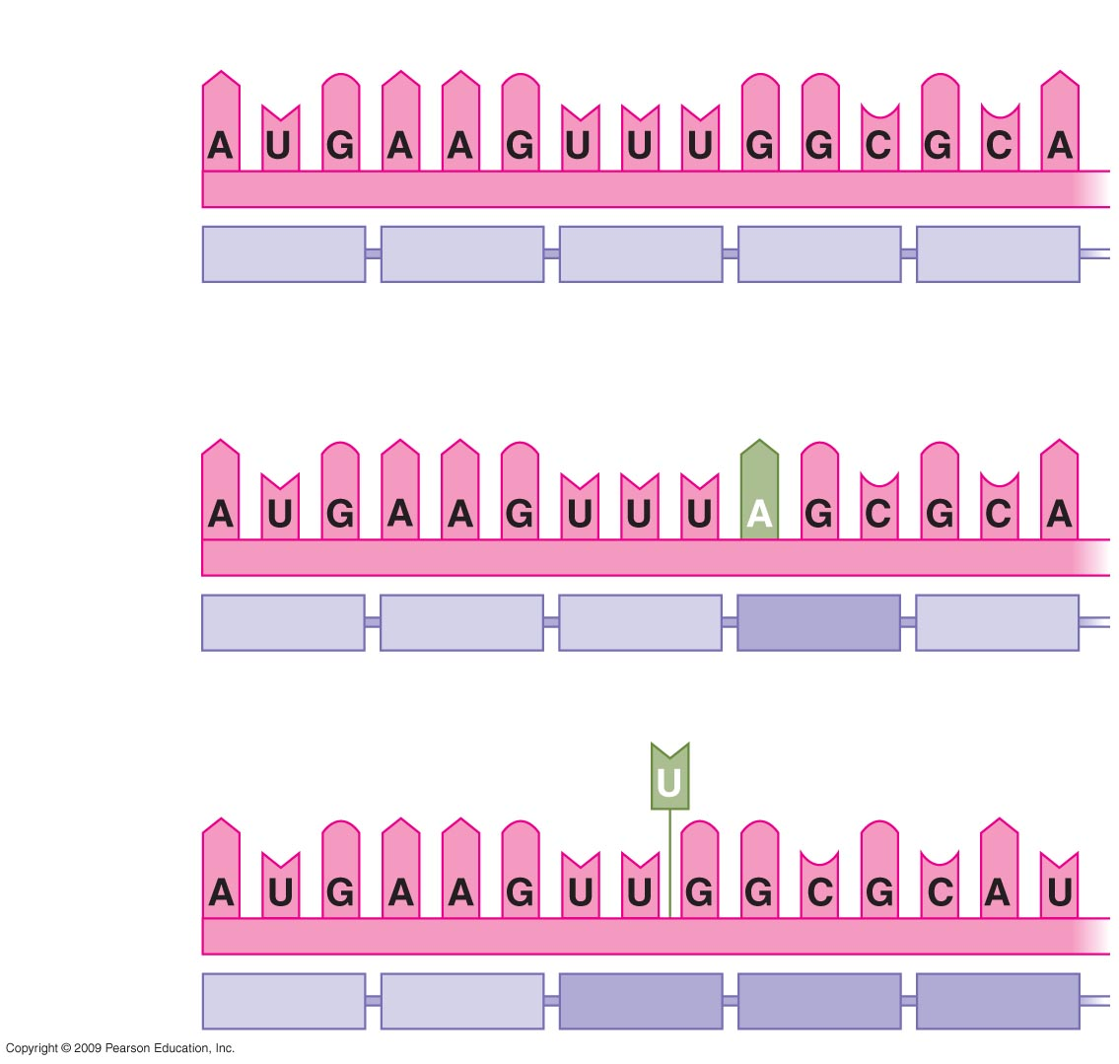
Normal gene
0
mRNA
Protein
Met
Lys
Phe
Gly
Ala
Base substitution
Met
Lys
Phe
Ser
Ala
Base deletion
Missing
Met
Lys
Leu
Ala
His
Notes:
Figure 10.16B Types of mutations and their effects.
This figure contrasts the multiple amino acid changes caused by a deletion with the single amino acid change caused by a substitution.

Slide 81
MICROBIAL GENETICS
Copyright © 2009 Pearson Education, Inc.

Slide 82
10.17 Viral DNA may become part of the host chromosome
0
  Viruses have two types of reproductive cycles
    Lytic cycle
      Viral particles are produced using host cell components
      The host cell lyses, and viruses are released
Copyright © 2009 Pearson Education, Inc.

Slide 83
10.17 Viral DNA may become part of the host chromosome
0
  Viruses have two types of reproductive cycles
    Lysogenic cycle
      Viral DNA is inserted into the host chromosome by recombination
      Viral DNA is duplicated along with the host chromosome during each cell division
      The inserted phage DNA is called a prophage
      Most prophage genes are inactive
      Environmental signals can cause a switch to the lytic cycle
Copyright © 2009 Pearson Education, Inc.

Slide 84
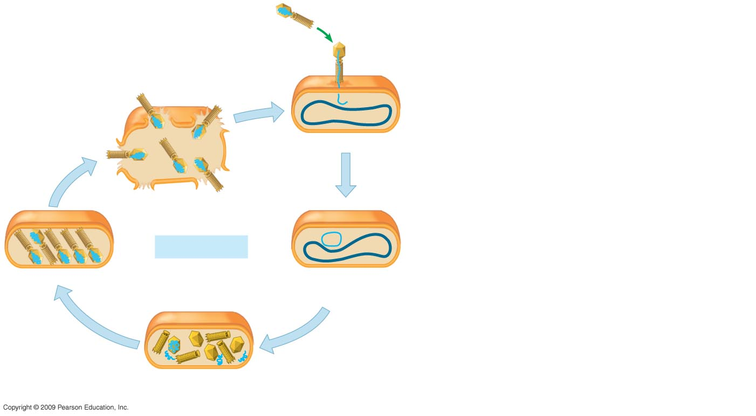
0
Phage
Attaches
to cell
1
Phage DNA
Bacterial
chromosome
Cell lyses,
releasing phages
Phage injects DNA
2
4
Lytic cycle
Phages assemble
Phage DNA
circularizes
3
New phage DNA and
proteins are synthesized
Notes:
Figure 10.17 Two types of phage reproductive cycles.
The transfer of phage DNA via transduction was shown to convert a nontoxigenic strain of the botulism-causing bacterium Clostridium to a toxigenic strain.

Slide 85

0
Phage
Attaches
to cell
1
Phage DNA
Bacterial
chromosome
Cell lyses,
releasing phages
Phage injects DNA
2
7
Many cell
divisions
4
Lytic cycle
Lysogenic cycle
Phages assemble
Phage DNA
circularizes
Lysogenic bacterium reproduces
normally, replicating the
prophage at each cell division
Prophage
3
5
6
OR
New phage DNA and
proteins are synthesized
Phage DNA inserts into the bacterial
chromosome by recombination
Notes:
Figure 10.17 Two types of phage reproductive cycles.
The transfer of phage DNA via transduction was shown to convert a nontoxigenic strain of the botulism-causing bacterium Clostridium to a toxigenic strain.

Slide 86

Phage
0
1
Attaches
to cell
Bacterial
chromosome
Phage DNA
Cell lyses,
releasing phages
Phage injects DNA
2
4
Lytic cycle
Phages assemble
Phage DNA
circularizes
3
New phage DNA and
proteins are synthesized
Notes:
Figure 10.17 Two types of phage reproductive cycles.
The transfer of phage DNA via transduction was shown to convert a nontoxigenic strain of the botulism-causing bacterium Clostridium to a toxigenic strain.

Slide 87

Phage
0
1
Attaches
to cell
Bacterial
chromosome
Phage DNA
Phage injects DNA
7
2
Many cell
divisions
Lysogenic cycle
Phage DNA
circularizes
Lysogenic bacterium reproduces
normally, replicating the
prophage at each cell division
Prophage
5
6
Phage DNA inserts into the bacterial
chromosome by recombination
Notes:
Figure 10.17 Two types of phage reproductive cycles.
The transfer of phage DNA via transduction was shown to convert a nontoxigenic strain of the botulism-causing bacterium Clostridium to a toxigenic strain.

Slide 88
10.18 CONNECTION: Many viruses cause disease in animals and plants
0
  Both DNA viruses and RNA viruses cause disease in animals
  Reproductive cycle of an RNA virus
    Entry
      Glycoprotein spikes contact host cell receptors
      Viral envelope fuses with host plasma membrane
    Uncoating of viral particle to release the RNA genome
    mRNA synthesis using a viral enzyme
    Protein synthesis
    RNA synthesis of new viral genome
    Assembly of viral particles
Copyright © 2009 Pearson Education, Inc.
Notes:
Mumps is an RNA virus that does not have a DNA phase in its reproductive cycle. The RNA genome is complementary to mRNA, so the virion particles contain an RNA-dependent RNA polymerase (from a viral gene) to produce the mRNA once the genome is inside the cell. This enzyme will also produce copies of the genome from the mRNA (step 5).

Slide 89
10.18 CONNECTION: Many viruses cause disease in animals and plants
0
  Some animal viruses reproduce in the cell nucleus
  Most plant viruses are RNA viruses
    They breach the outer protective layer of the plant
    They spread from cell to cell through plasmodesmata
    Infection can spread to other plants by animals, humans, or farming practices
Copyright © 2009 Pearson Education, Inc.
Notes:
While the mumps virus is produced in the cell cytoplasm, copies of the herpes virus are produced in the nucleus of a host cell.

Slide 90

VIRUS
Glycoprotein spike
0
Viral RNA
(genome)
Protein coat
Membranous
envelope
Plasma membrane
of host cell
1
Entry
2
Uncoating
Viral RNA
(genome)
3
RNA synthesis
by viral enzyme
4
Protein
synthesis
5
RNA synthesis
(other strand)
mRNA
Template
New viral
genome
New
viral proteins
6
Assembly
Exit
7
Notes:
Figure 10.18 The reproductive cycle of an enveloped virus.

Slide 91
10.19 EVOLUTION CONNECTION: Emerging viruses threaten human health
0
  How do emerging viruses cause human diseases?
    Mutation
      RNA viruses mutate rapidly
    Contact between species
      Viruses from other animals spread to humans
    Spread from isolated populations
Copyright © 2009 Pearson Education, Inc.

Slide 92
10.19 EVOLUTION CONNECTION: Emerging viruses threaten human health
0
  Examples of emerging viruses
    HIV
    Ebola virus
    West Nile virus
    RNA coronavirus causing severe acute respiratory syndrome (SARS)
    Avian flu virus
Copyright © 2009 Pearson Education, Inc.
Notes:
For the Discovery Video Emerging Diseases, go to Animation and Video Files.

Slide 93

0
Notes:
Figure 10.19 Ducks in Vietnam being checked for infection by the Avian flu virus.

Slide 94
10.20 The AIDS virus makes DNA on an RNA template
0
  AIDS is caused by HIV, human immunodeficiency virus
  HIV is a retrovirus, containing
    Two copies of its RNA genome
    Reverse transcriptase, an enzyme that produces DNA from an RNA template
Copyright © 2009 Pearson Education, Inc.
Notes:
One of the approaches for treating HIV-positive patients involves inhibiting reverse transcriptase to prevent the formation of the DNA copy of the RNA genome. AZT (azidothymidine, zidovudine) is a thymidine analog that acts as a chain terminator, since its 3′OH group has been replaced with an azido group. When reverse transcriptase incorporates AZT into the chain, DNA synthesis stops. Since humans do not produce reverse transcriptase, AZT should affect only the viral enzyme. However, a DNA polymerase within mitochondria has a greater sensitivity to AZT than other host cell DNA polymerases, which may account for some of the side effects of the drug.
Another unique aspect of HIV duplication is that the initial product of translation needs to be cleaved into individual proteins. A viral-encoded protease carries out this function. Protease inhibitors are used to prevent the formation of active viral proteins from the translated product. Therapies combining a reverse transcriptase inhibitor and a protease inhibitor have been highly effective in reducing the amount of viral production in HIV-positive patients.

Slide 95
10.20 The AIDS virus makes DNA on an RNA template
0
  HIV duplication
    Reverse transcriptase uses RNA to produce one DNA strand
    Reverse transcriptase produces the complementary DNA strand
    Viral DNA enters the nucleus and integrates into the chromosome, becoming a provirus
    Provirus DNA is used to produce mRNA
    mRNA is translated to produce viral proteins
    Viral particles are assembled and leave the host cell
Copyright © 2009 Pearson Education, Inc.
Notes:
For the BLAST Animation AIDS Treatment Strategies, go to Animation and Video Files.
For the BLAST Animation HIV Structure, go to Animation and Video Files.
Student Misconceptions and Concerns
1. Students and many parents with young children expect antibiotics to be used to treat many respiratory infections, even though such infections may result from a virus. Students will benefit from a thorough explanation of why antibiotics are inappropriate for viral infections as well as the rising numbers of antibiotic-resistant bacteria that have evolved as a result of the overprescription of antibiotics.
2. The success of modern medicine has perhaps led to overconfidence in our ability to treat disease. Students often do not understand that there are few successful treatments for viral infections. Instead, the best defense against viruses is prevention, by reducing the chances of contacting the virus and the use of vaccines.
3. Many misconceptions about AIDS exist. A list of 18 common misconceptions is located at www.gng.org/currents/teachers/hiv101/misconceptions.html.
Teaching Tips
1. The Centers for Disease Control and Prevention has extensive information about AIDS at www.cdc.gov/hiv/.
2. Students often do not understand the disproportionate distribution of HIV infections and AIDS in our world. Consider an Internet assignment, asking students to identify the regions of the world most affected by HIV-AIDS.

Slide 96

0
Envelope
Glycoprotein
Protein
coat
RNA
(two identical
strands)
Reverse
transcriptase
Notes:
Figure 10.20A A model of HIV structure.

Slide 97

0
Viral RNA
CYTOPLASM
1
NUCLEUS
DNA
strand
Chromosomal
DNA
2
Double-
stranded
DNA
3
Provirus
DNA
4
Viral
RNA
and
proteins
5
RNA
6
Notes:
Figure 10.20B The behavior of HIV nucleic acid in a host cell.

Slide 98
10.21 Viroids and prions are formidable pathogens in plants and animals
0
  Some infectious agents are made only of RNA or protein
    Viroids: circular RNA molecules that infect plants
      Replicate within host cells without producing proteins
      Interfere with plant growth
    Prions: infectious proteins that cause brain diseases in animals
      Misfolded forms of normal brain proteins
      Convert normal protein to misfolded form
Copyright © 2009 Pearson Education, Inc.

Slide 99
10.22 Bacteria can transfer DNA in three ways
0
  Three mechanisms allow transfer of bacterial DNA
    Transformation is the uptake of DNA from the surrounding environment
    Transduction is gene transfer through bacteriophages
    Conjugation is the transfer of DNA from a donor to a recipient bacterial cell through a cytoplasmic bridge
  Recombination of the transferred DNA with the host bacterial chromosome leads to new combinations of genes
Copyright © 2009 Pearson Education, Inc.

Slide 100

0
DNA enters
cell
Fragment of
DNA from
another
bacterial cell
Bacterial chromosome
(DNA)
Notes:
Figure 10.22A Transformation.
Transformation has been proposed as a method for transferring antibiotic resistance for the ulcer-causing bacteria Helicobacter pylori, both for members within this species and between species in the Helicobacter genus. This could undermine the currently successful use of antibiotics to treat ulcers.

Slide 101

0
Phage
Fragment of
DNA from
another
bacterial cell
(former phage
host)
Notes:
Figure 10.22B Transduction.
During phage infection, the bacterial chromosome becomes fragmented. Bacterial DNA molecules of a size similar to the phage DNA can be packaged into phage particles. These phage particles inject bacterial DNA into another cell, leading to a possible change in genotype for the host. Phage particles carrying bacterial DNA do not continue the infection.

Slide 102

0
Mating bridge
Sex pili
Donor cell
(“male”)
Recipient cell
(“female”)
Notes:
Figure 10.22C Conjugation.
As described in Module 10.23, conjugation depends on a plasmid called the F factor (fertility factor) that is either separate from the chromosome in an F+ cell or integrated into the chromosome in an Hfr cell (High frequency of recombination). The F plasmid can integrate at random locations, so different Hfr cells will have the factor at a unique position on the chromosome. This figure shows conjugation for an Hfr cell. During conjugation, one strand of DNA containing a portion of the F factor and its adjacent bacterial genes is transferred to the donor. The number of bacterial genes transferred will depend on the length of time that the cytoplasmic bridge is maintained. It is unlikely that the cells would remain attached long enough to transfer the entire bacterial chromosome and all portions of the F factor. This process uses “rolling circle” replication, whereby the donor replaces the donated strand using the strand remaining in the cell as a template. Recombination is required to integrate transferred genes into the recipient cell’s chromosome.

Slide 103

0
Donated DNA
Crossovers
Degraded DNA
Recipient cell’s
chromosome
Recombinant
chromosome
Notes:
Figure 10.22D Integration of donated DNA into the recipient cell’s chromosome.
Since the bacterial chromosome is a circle, two crossovers are needed to integrate transferred genes. If there were only one crossover event, the chromosome would be opened up into a linear structure, which would be subject to nuclease digestion within the cell.

Slide 104
10.23 Bacterial plasmids can serve as carriers for gene transfer
0
  Plasmids are small circular DNA molecules that are separate from the bacterial chromosome
    F factor is involved in conjugation
      When integrated into the chromosome, transfers bacterial genes from donor to recipient
      When separate, transfers F-factor plasmid
    R plasmids transfer genes for antibiotic resistance by conjugation
Copyright © 2009 Pearson Education, Inc.
Notes:
The R plasmid has genes for sex pilus formation along with genes for antibiotic resistance.
For the BLAST Animation Plasmid, go to Animation and Video Files.

Slide 105

F factor
(integrated)
Male (donor)
cell
0
Origin of F
replication
Bacterial
chromosome
F factor starts
replication and
transfer of chromosome
Recipient
cell
Only part of the
chromosome
transfers
Recombination
can occur
Notes:
Figure 10.23A Transfer of chromosomal DNA by an integrated F factor.
This shows the transfer of a portion of the F factor and adjacent bacterial genes from a cell where the F factor has integrated into the bacterial chromosome.

Slide 106

F factor (plasmid)
0
Male (donor)
cell
Bacterial
chromosome
F factor starts
replication
and transfer
Plasmid completes
transfer and
circularizes
Cell now male
Notes:
Figure 10.23B Transfer of an F-factor plasmid.
This figure shows that the F-factor plasmid can be transferred from donor to recipient. At the end of the process the recipient is now a donor.

Slide 107

0
Plasmids
Notes:
Figure 10.23C Plasmids and part of a bacterial chromosome released from a ruptured E. coli cell.

Slide 108

Sugar-
phosphate
backbone
Nitrogenous base
Phosphate
group
Sugar
Nucleotide
DNA
RNA
C
G
A
T
C
G
A
U
Nitrogenous
base
Sugar
Deoxy-
ribose
Ribose
DNA
Polynucleotide

Slide 109

Growing polypeptide
Large
ribosomal
subunit
Amino acid
tRNA
mRNA
Anticodon
Small
ribosomal
subunit
Codons

Slide 110

is a polymer
made from
monomers called
DNA
(a)
(b)
is performed by
enzyme called
(c)
(d)
comes
in three
kinds called
RNA
(e)
(f)
molecules are
components of
(g)
use amino-acid-bearing
molecules called
is performed by
organelles called
(h)
one or more polymers
made from
monomers called
Protein
(i)

Slide 111
You should now be able to
0
  Compare and contrast the structures of DNA and RNA
  Describe how DNA replicates
  Explain how a protein is produced
  Distinguish between the functions of mRNA, tRNA, and rRNA in translation
  Determine DNA, RNA, and protein sequences when given any complementary sequence
Copyright © 2009 Pearson Education, Inc.

Slide 112
You should now be able to
0
  Distinguish between exons and introns and describe the steps in RNA processing that lead to a mature mRNA
  Explain the relationship between DNA genotype and the action of proteins in influencing phenotype
  Distinguish between the effects of base substitution and insertion or deletion mutations
Copyright © 2009 Pearson Education, Inc.

Slide 113
You should now be able to
0
  Distinguish between lytic and lysogenic viral reproductive cycles and describe how RNA viruses are duplicated within a host cell
  Explain how an emerging virus can become a threat to human health
  Identify three methods of transfer for bacterial genes
  Distinguish between viroids and prions
  Describe the effects of transferring plasmids from donor to recipient cells
Copyright © 2009 Pearson Education, Inc.

