Slide 1
Chapter 11
0
How Genes Are Controlled
Lecture by Mary C. Colavito

Slide 2
Introduction: Cloning to the Rescue?
0
  Cloning has been attempted to save endangered species
    A clone is produced by asexual reproduction and is genetically identical to its parent
    Dolly the sheep was the first cloned mammal
    Endangered animals that were cloned include cows, oxen, sheep, wildcats, and wolves
  Disadvantages of cloning
    Does not increase genetic diversity
    Cloned animals may have health problems related to abnormal gene regulation
Copyright © 2009 Pearson Education, Inc.

Slide 3
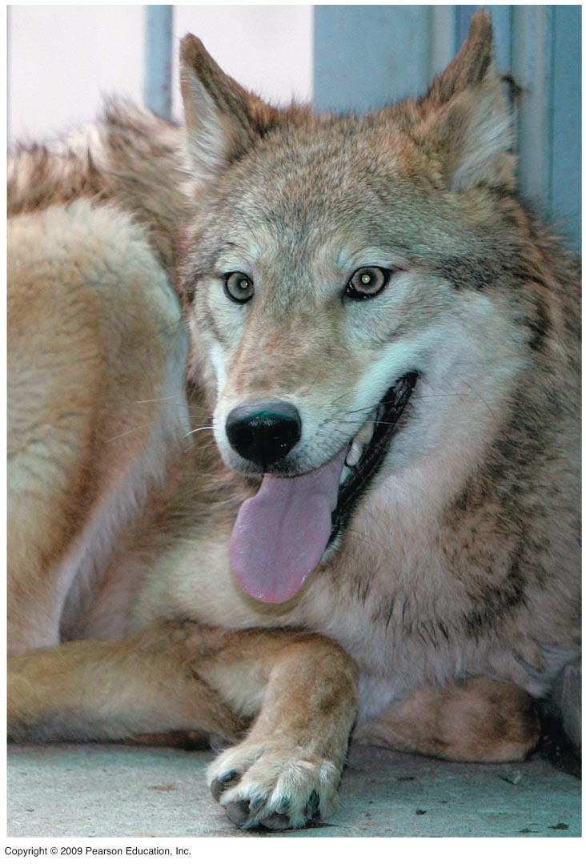
0
Notes:
This gray wolf is one of two cloned animals produced in 2006 by scientists in Korea. This species faced extinction in the United States during the early 20th century.

Slide 4
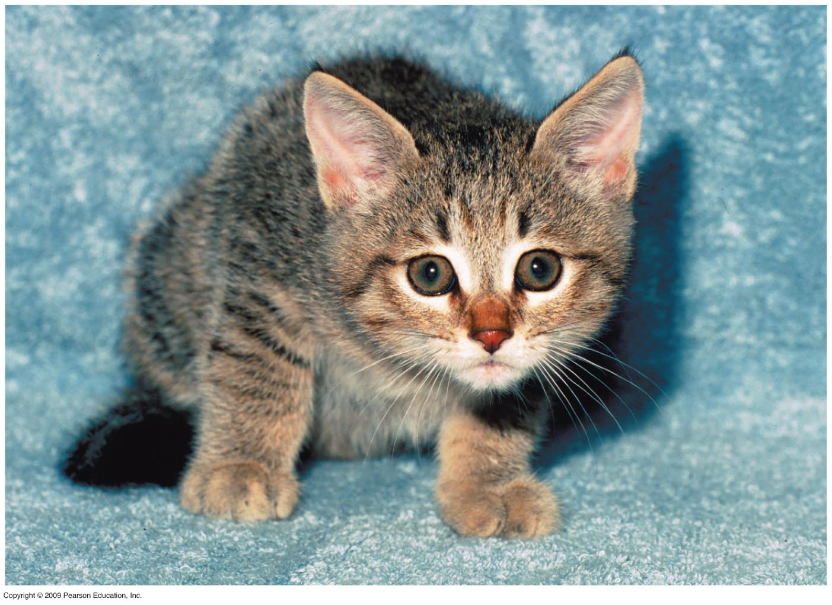
0
Notes:
This cloned African wildcat resulted from efforts at the Audubon Center for Research of Endangered Species in New Orleans.

Slide 5
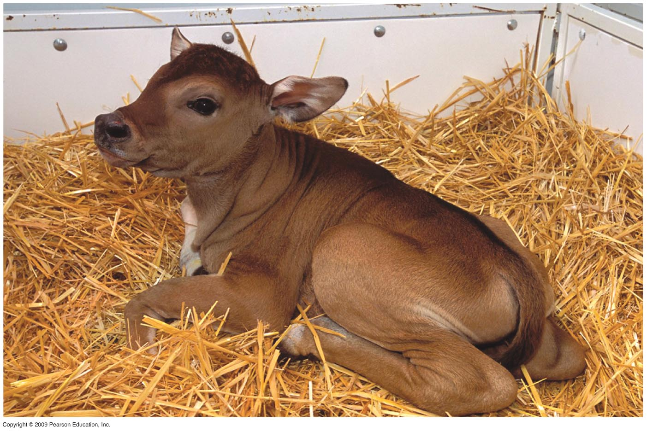
0
Notes:
The banteng, a Javanese cow, is in danger of extinction in the wild. This animal was cloned from frozen skin cells of a deceased zoo-raised animal. Nuclei from the banteng skin cells were transferred into enucleated eggs from another cow species. Embryos completed development in an Angus cow surrogate. This cross-species approach provides a method for cloning an endangered animal even if a female from that species is not available.

Slide 6
CONTROL OF GENE EXPRESSION
Copyright © 2009 Pearson Education, Inc.

Slide 7
11.1 Proteins interacting with DNA turn prokaryotic genes on or off in response to environmental changes
0
  Gene expression is the overall process of information flow from genes to proteins
    Mainly controlled at the level of transcription
    A gene that is “turned on” is being transcribed to produce mRNA that is translated to make its corresponding protein
    Organisms respond to environmental changes by controlling gene expression
Copyright © 2009 Pearson Education, Inc.

Slide 8
11.1 Proteins interacting with DNA turn prokaryotic genes on or off in response to environmental changes
0
  An operon is a group of genes under coordinated control in bacteria
  The lactose (lac) operon includes
    Three adjacent genes for lactose-utilization enzymes
    Promoter sequence where RNA polymerase binds
    Operator sequence is where a repressor can bind and block RNA polymerase action
Copyright © 2009 Pearson Education, Inc.

Slide 9
11.1 Proteins interacting with DNA turn prokaryotic genes on or off in response to environmental changes
0
  Regulation of the lac operon
    Regulatory gene codes for a repressor protein
    In the absence of lactose, the repressor binds to the operator and prevents RNA polymerase action
    Lactose inactivates the repressor, so the operator is unblocked
Copyright © 2009 Pearson Education, Inc.

Slide 10
11.1 Proteins interacting with DNA turn prokaryotic genes on or off in response to environmental changes
0
  Types of operon control
    Inducible operon (lac operon)
      Active repressor binds to the operator
      Inducer (lactose) binds to and inactivates the repressor
    Repressible operon (trp operon)
      Repressor is initially inactive
      Corepressor (tryptophan) binds to the repressor and makes it active
    For many operons, activators enhance RNA polymerase binding to the promoter
Copyright © 2009 Pearson Education, Inc.
Notes:
The lac operon has an activator called catabolite activator protein (CAP). CAP responds to levels of glucose, the main energy source for the cell. If glucose supplies are abundant, CAP is inactive. If glucose levels fall, cyclic AMP is produced as a by-product of the declining energy levels. Cyclic AMP binds to and activates CAP protein. Activated CAP protein binds to the promoter region and enhances the binding of RNA polymerase, increasing the rate of transcription of the lactose-utilization genes. The following table summarizes lac operon control with various levels of lactose and glucose present.

Slide 11
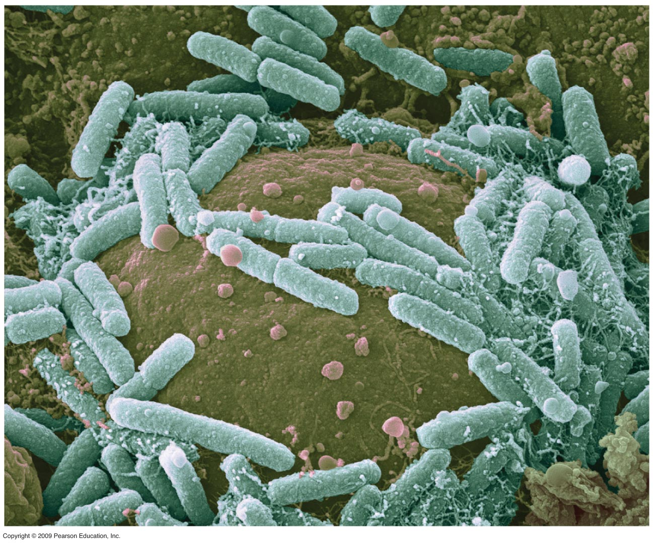
0
Notes:
Figure 11.1A Cells of E.coli bacteria.

Slide 12
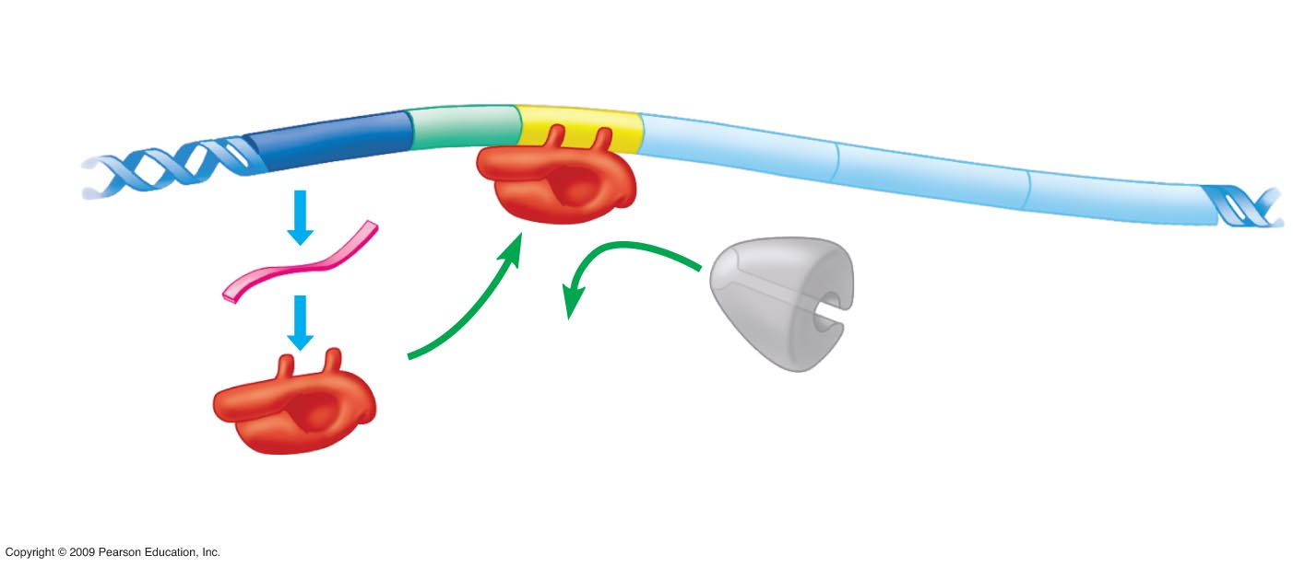
0
OPERON
Regulatory
gene
Promoter Operator
Lactose-utilization genes
DNA
mRNA
RNA polymerase
cannot attach to
promoter
Active
repressor
Protein
Operon turned off (lactose absent)
Notes:
Figure 11.1B The lac operon.
The lac operon is inducible, usually off, unless the inducer, lactose, is present.
In the absence of lactose, active repressor binds to the operator and prevents transcription from the promoter sequence. It should be noted that small amounts of repressor are always present in the cell, since there is no operator region between the regulatory gene promoter (not shown) and the regulatory gene. The repressor binds reversibly to the operator region upstream of the lactose-utilization enzyme genes. When repressor is bound, RNA polymerase cannot initiate transcription from the promoter region.
If lactose is present in the environment, some can diffuse into the cell and bind to free repressors, inactivating them. Inactivated repressors cannot bind to the operator region. Therefore, RNA polymerase can bind to the promoter and initiate transcription of the lactose-utilization enzyme genes. An mRNA with coding regions for all three genes is produced and then three separate proteins are translated from this mRNA. These proteins allow the cell to use lactose as an energy source.

Slide 13
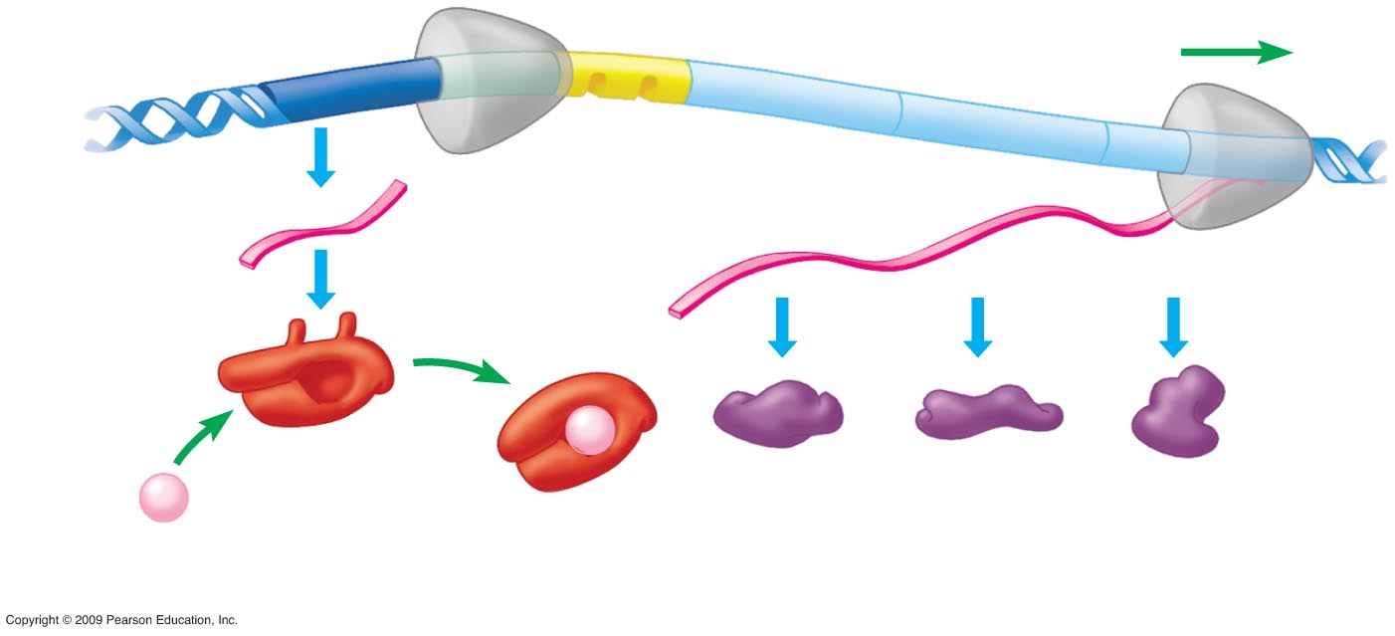
0
DNA
RNA polymerase
bound to promoter
mRNA
Protein
Lactose
Inactive
repressor
Enzymes for lactose utilization
Operon turned on (lactose inactivates repressor)
Notes:
Figure 11.1B The lac operon.
The lac operon is inducible, usually off, unless the inducer, lactose, is present.
In the absence of lactose, active repressor binds to the operator and prevents transcription from the promoter sequence. It should be noted that small amounts of repressor are always present in the cell, since there is no operator region between the regulatory gene promoter (not shown) and the regulatory gene. The repressor binds reversibly to the operator region upstream of the lactose-utilization enzyme genes. When repressor is bound, RNA polymerase cannot initiate transcription from the promoter region.
If lactose is present in the environment, some can diffuse into the cell and bind to free repressors, inactivating them. Inactivated repressors cannot bind to the operator region. Therefore, RNA polymerase can bind to the promoter and initiate transcription of the lactose-utilization enzyme genes. An mRNA with coding regions for all three genes is produced and then three separate proteins are translated from this mRNA. These proteins allow the cell to use lactose as an energy source.

Slide 14
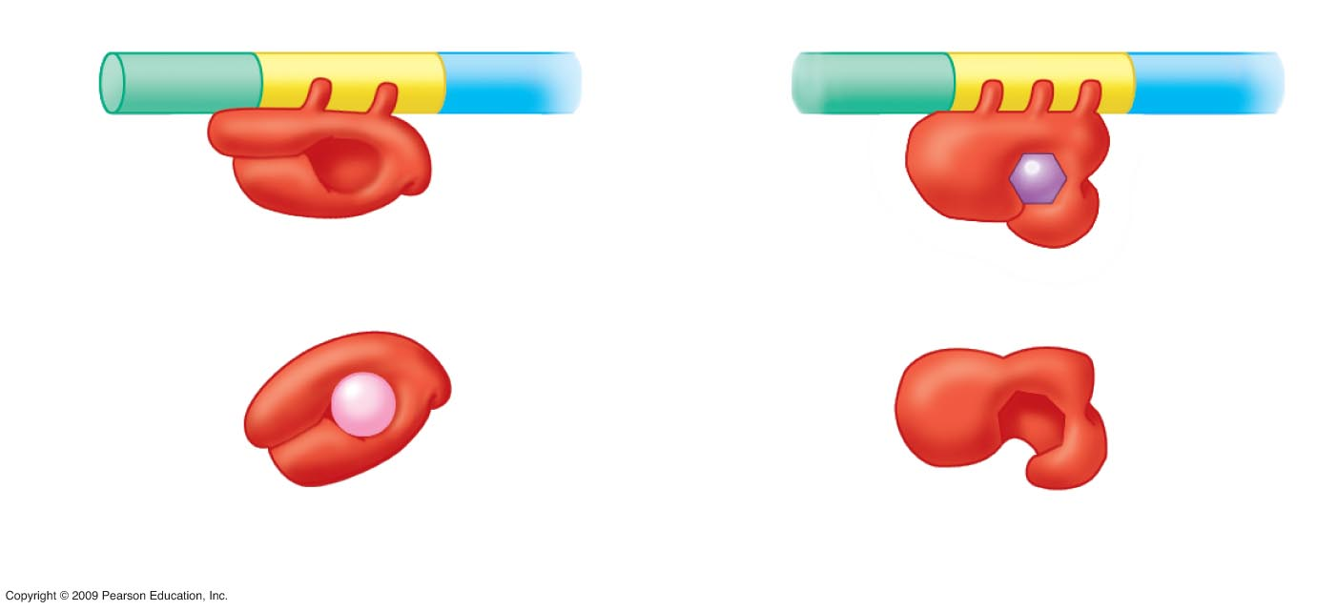
0
Promoter
Operator
Gene
DNA
Active
repressor
Active
repressor
Tryptophan
Inactive
repressor
Inactive
repressor
Lactose
lac operon
trp operon
Notes:
Figure 11.1C Two types of repressor-controlled operons.
This figure contrasts the control of the tryptophan (trp) operon with the lac operon. The trp operon is repressible, usually turned on unless an active repressor is available to switch it off. When first produced, the trp repressor is inactive so that it does not block transcription of the tryptophan-producing enzymes of the operon. As a result, tryptophan is generally produced by the cell. But if tryptophan is available in the environment, it is energetically efficient for the cell to use the externally supplied amino acid. Tryptophan binds to the inactive repressor, converting it to an active repressor that blocks transcription.
Both operons show adaptive responses to changes in the environment. Unless lactose is present as an alternative energy source, it is not advantageous to produce the enzymes for lactose utilization. Therefore, the lac operon is switched on only in the presence of lactose. On the other hand, the cell requires tryptophan in a continuous supply for protein synthesis. So the trp operon is switched on unless tryptophan can be supplied by the surrounding environment.

Slide 15
11.2 Differentiation results from the expression of different combinations of genes
0
  Differentiation involves cell specialization, in both structure and function
  Differentiation is controlled by turning specific sets of genes on or off
Copyright © 2009 Pearson Education, Inc.
Notes:
For the BLAST Animation Signaling Across Membranes, go to Animation and Video Files.

Slide 16
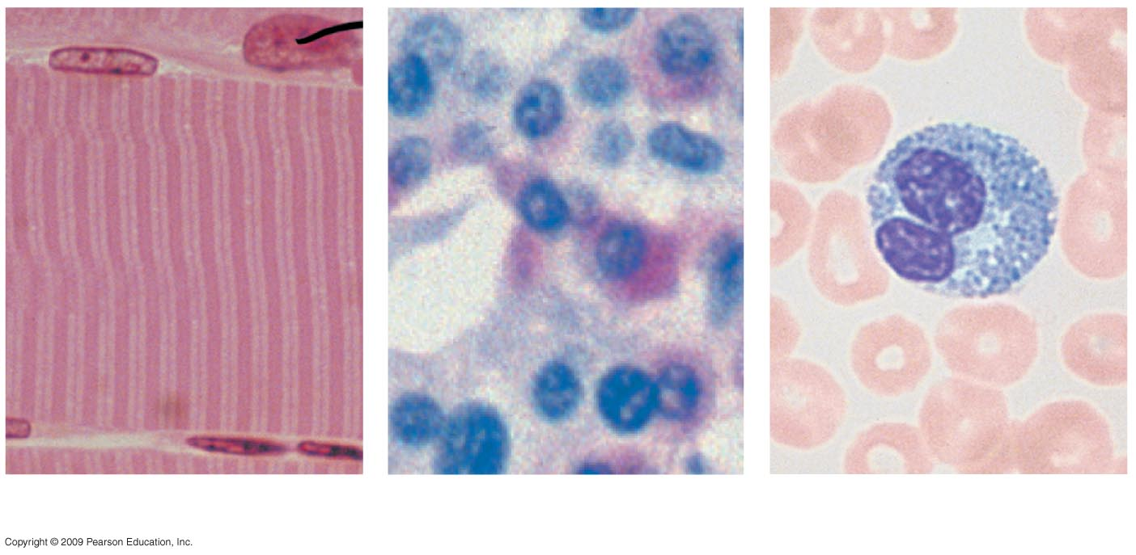
0
Muscle cell
Pancreas cells
Blood cells
Notes:
Figure 11.2 Some types of human cells.
This figure compares the appearance of muscle, pancreas, and blood cells. It can be used to emphasize that different genes are active in each cell type, coding for the specific proteins related to the function of the cell.
In muscle cells, proteins such as actin and myosin that are responsible for contraction are produced.
Insulin is produced in beta cells of the pancreas while glucagon is produced in alpha cells.
Hemoglobin is produced in tremendous quantities in red blood cells.

Slide 17
11.3 DNA packing in eukaryotic chromosomes helps regulate gene expression
0
  Eukaryotic chromosomes undergo multiple levels of folding and coiling, called DNA packing
    Nucleosomes are formed when DNA is wrapped around histone proteins
      “Beads on a string” appearance
      Each bead includes DNA plus 8 histone molecules
      String is the linker DNA that connects nucleosomes
    Tight helical fiber is a coiling of the nucleosome string
    Supercoil is a coiling of the tight helical fiber
    Metaphase chromosome represents the highest level of packing
  DNA packing can prevent transcription
Copyright © 2009 Pearson Education, Inc.

Slide 18

11.3 DNA packing in eukaryotic chromosomes helps regulate gene expression
0
Animation: DNA Packing
Copyright © 2009 Pearson Education, Inc.

Slide 19
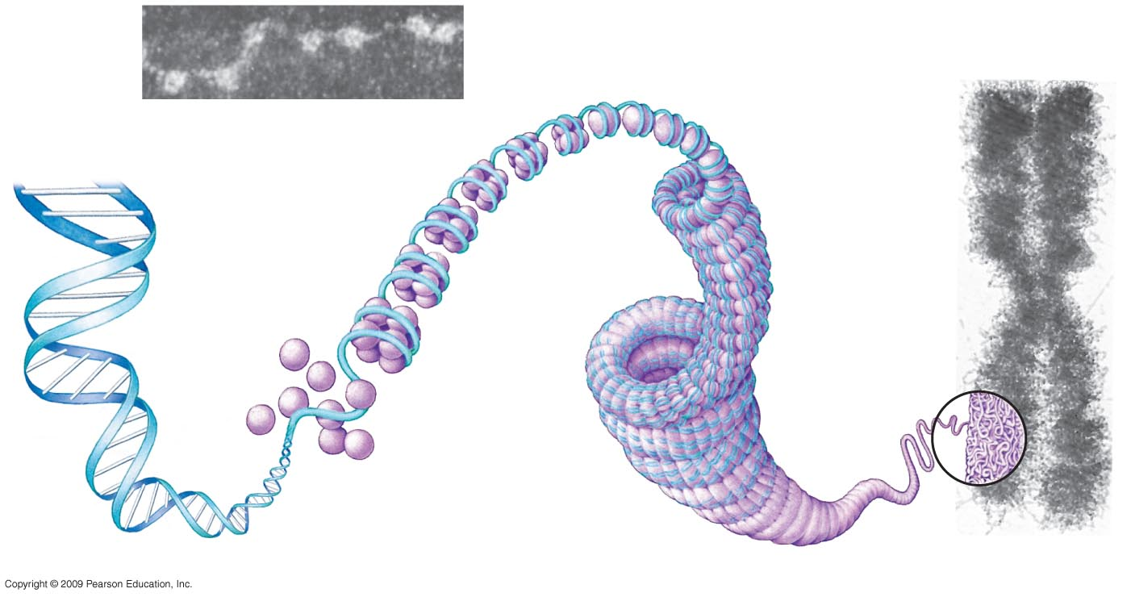
0
Metaphase
chromosome
Tight helical fiber
(30-nm diameter)
DNA double helix
(2-nm diameter)
Linker
“Beads on
a string”
Nucleosome
(10-nm
diameter)
Histones
Supercoil
(300-nm diameter)
700 nm
Notes:
Figure 11.3 DNA packing in a eukaryotic chromosome.
This figure shows the increasing levels of DNA packing. The initial level of the nucleosome involves ~140 base pairs of DNA surrounding 8 molecules of histone proteins. A linker region of 40–60 nucleotides is found between nucleosomes. Histones are highly evolutionarily conserved proteins, with only two amino acid changes between histone H4 molecules in pea plants and cows. The combination of histones with DNA has long been associated with the inhibition of transcription. Histones have sites for acetylation in their amino-terminal regions that can reduce binding between positively charged lysine residues and negatively charged DNA. Histone acetylation has been correlated with increased transcriptional activity as it would allow for transient removal of the histone-protein portion of the nucleosome during transcription.

Slide 20
11.4 In female mammals, one X chromosome is inactive in each somatic cell
0
  X-chromosome inactivation
    In female mammals, one of the two X chromosomes is highly compacted and transcriptionally inactive
    Random inactivation of either the maternal or paternal chromosome
    Occurs early in embryonic development and all cellular descendants have the same inactivated chromosome
    Inactivated X chromosome is called a Barr body
    Tortoiseshell fur coloration is due to inactivation of X chromosomes in heterozygous female cats
Copyright © 2009 Pearson Education, Inc.
Notes:
Human athletes are tested for the presence of a Barr body to be sure they are appropriately competing as males and females.
The number of Barr bodies is equal to the number of X chromosomes minus 1.
Related to Module 8.22, females with Turner syndrome will have 0 Barr bodies and males with Klinefelter syndrome will have 1 Barr body.

Slide 21
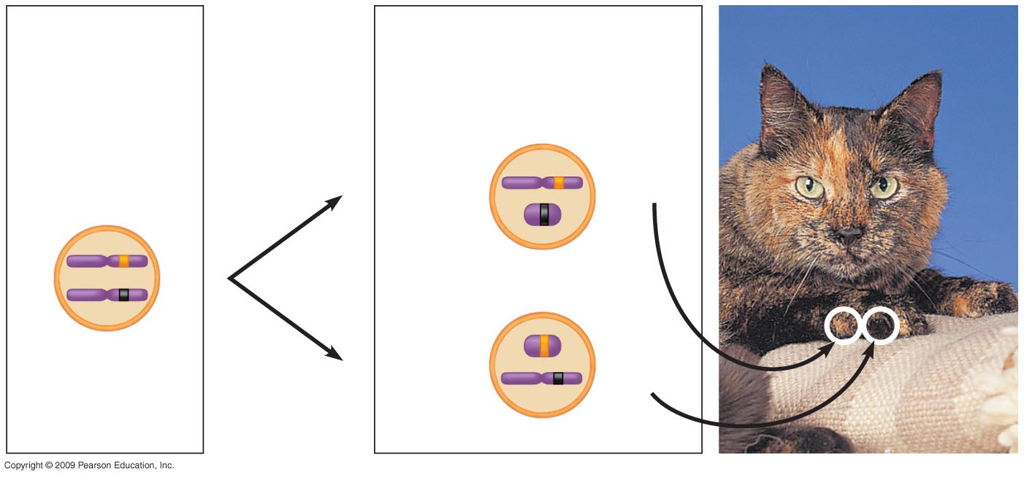
0
Early embryo
Two cell populations
in adult
Cell division
and random
X chromosome
inactivation
Active X
Orange
fur
X chromosomes
Inactive X
Allele for
orange fur
Inactive X
Active X
Black fur
Allele for
black fur
Notes:
Figure 11.4 Tortoiseshell pattern on a cat, a result of X chromosome inactivation.
Alternative inactivation of X chromosomes can produce patches of black and orange fur in a female cat heterozygous for these two alleles.
Can a male cat show the tortoiseshell phenotype? Yes, if he has an XXY chromosome composition!

Slide 22
11.5 Complex assemblies of proteins control eukaryotic transcription
0
  Eukaryotic genes
    Each gene has its own promoter and terminator
    Are usually switched off and require activators to be turned on
    Are controlled by interactions between numerous regulatory proteins and control sequences
Copyright © 2009 Pearson Education, Inc.
Notes:
It is useful to compare gene organization in eukaryotes to prokaryotes, where genes are found in operons so that a cluster of genes is under the control of the same promoter and terminator. Many genes in prokaryotes are continually active and are only switched off in response to environmental circumstances. Prokaryotic genes have repressors and activators as regulatory proteins and promoters and operators as control sequences, but this represents a smaller array of control elements than found in eukaryotic nuclei.

Slide 23
11.5 Complex assemblies of proteins control eukaryotic transcription
0
  Regulatory proteins that bind to control sequences
    Transcription factors promote RNA polymerase binding to the promoter
    Activator proteins bind to DNA enhancers and interact with other transcription factors
    Silencers are repressors that inhibit transcription
  Control sequences
    Promoter
    Enhancer
      Related genes located on different chromosomes can be controlled by similar enhancer sequences
Copyright © 2009 Pearson Education, Inc.
Notes:
Enhancer sequences can be located either upstream or downstream from the promoter. They can be found in close proximity or at great distances from the promoter region. Sequences called insulators can be positioned between an enhancer and a promoter to prevent enhancer action on that promoter.

Slide 24
11.5 Complex assemblies of proteins control eukaryotic transcription
0
Animation: Initiation of Transcription
Copyright © 2009 Pearson Education, Inc.

Slide 25
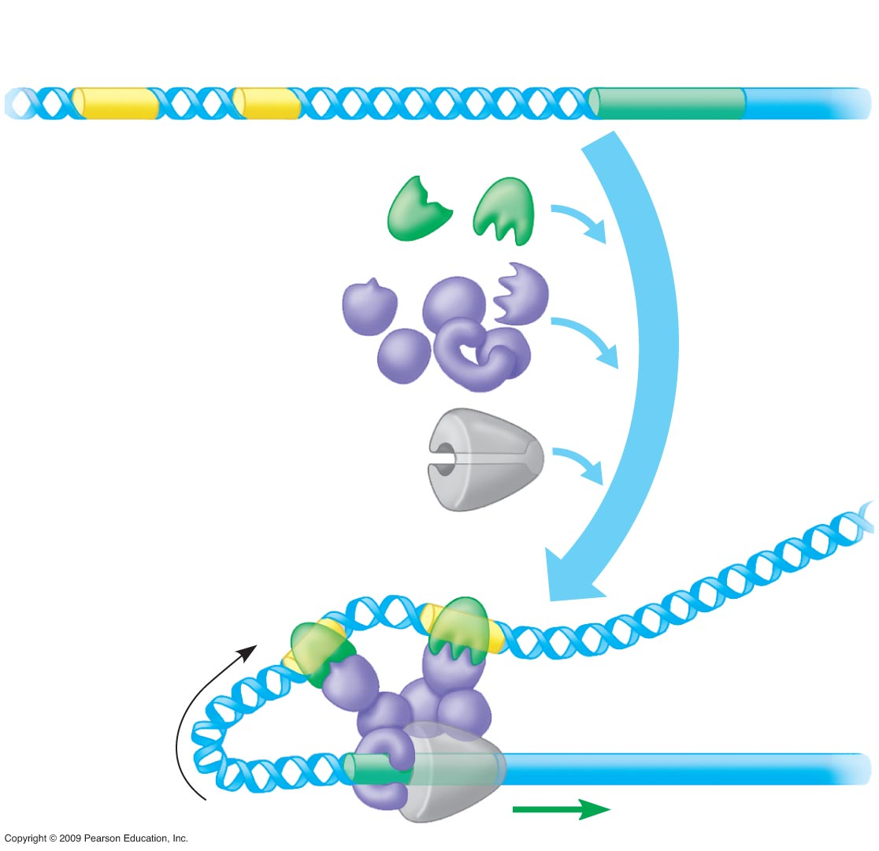
Enhancers
Promoter
0
Gene
DNA
Activator
proteins
Transcription
factors
Other
proteins
RNA polymerase
Bending
of DNA
Transcription
Notes:
Figure 11.5 A model for the turning on of a eukaryotic gene.
Sequence of events:
Activator proteins bind to an enhancer sequence.
DNA bends to bring the enhancer sequence closer to the promoter region.
Activators interact with other transcription factors that bind to the promoter.
RNA polymerase is properly positioned on the promoter and transcription is initiated.

Slide 26
11.6 Eukaryotic RNA may be spliced in more than one way
0
  Alternative RNA splicing
    Production of different mRNAs from the same transcript
    Results in production of more than one polypeptide from the same gene
    Can involve removal of an exon with the introns on either side
Animation: RNA Processing
Copyright © 2009 Pearson Education, Inc.
Notes:
Modes of alternative splicing can include exon skipping (as shown in Figure 11.6), intron retention, or the use of an alternative splice donor or acceptor site located within an exon region.
Some diseases are caused by mutations that promote alternative splicing. For example, one form of β-thalassemia is due to mutations in exons 1 and 2 of the β-globin gene that cause aberrant splicing and production of an abnormal hemoglobin chain. The use of small nucleotide chains complementary to the mRNA (antisense oligonucleotides) to block the incorrect splice sites has been demonstrated in cultured human cells, indicating promise as a possible therapy for thalassemia patients.

Slide 27
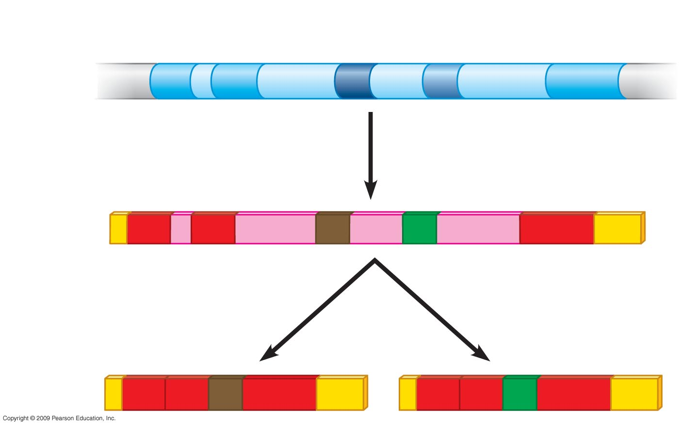
0
Exons
DNA
1
2
3
4
5
RNA
transcript
1
2
3
4
5
RNA splicing
or
mRNA
1
2
3
5
1
2
4
5
Notes:
Figure 11.6 Production of two different mRNAs from the same gene.
This figure shows exon skipping, one mode of alternative splicing.
One product contains exon 3 and involved the removal of exon 4 with introns on either side. This splicing start site (5′) was on the intron between 3 and 4 and the splicing end site (3′) was on the intron between 4 and 5.
The other product contains exon 4 and involved the removal of exon 3 with the introns on either side.

Slide 28
11.7 Small RNAs play multiple roles in controlling gene expression
0
  RNA interference (RNAi)
    Prevents expression of a gene by interfering with translation of its RNA product
    Involves binding of small, complementary RNAs to mRNA molecules
    Leads to degradation of mRNA or inhibition of translation
  MicroRNA
    Single-stranded chain about 20 nucleotides long
    Binds to protein complex
    MicroRNA + protein complex binds to complementary mRNA to interfere with protein production
Copyright © 2009 Pearson Education, Inc.
Notes:
RNAi involves microRNA and small interfering RNA. Both are transcribed from the genome and form double-stranded structures by folding on themselves. An enzyme called Dicer cuts them into small molecules, and the strands then separate for binding to mRNA.
Low levels of a specific microRNA were shown to be associated with acute myeloid leukemia. Due to a reduction in miR-204, two genes of the Hox group show increased expression. Hox genes are involved in both embryonic development and blood cell development.
In previous views of gene control, the transcription of a gene was paramount. Now the transcription of an inhibitor of mRNA function is also a factor to consider.

Slide 29
11.7 Small RNAs play multiple roles in controlling gene expression
0
Such as RNAi or RNAsi molecules
Animation: Blocking Translation
Animation: mRNA Degradation
Copyright © 2009 Pearson Education, Inc.

Slide 30
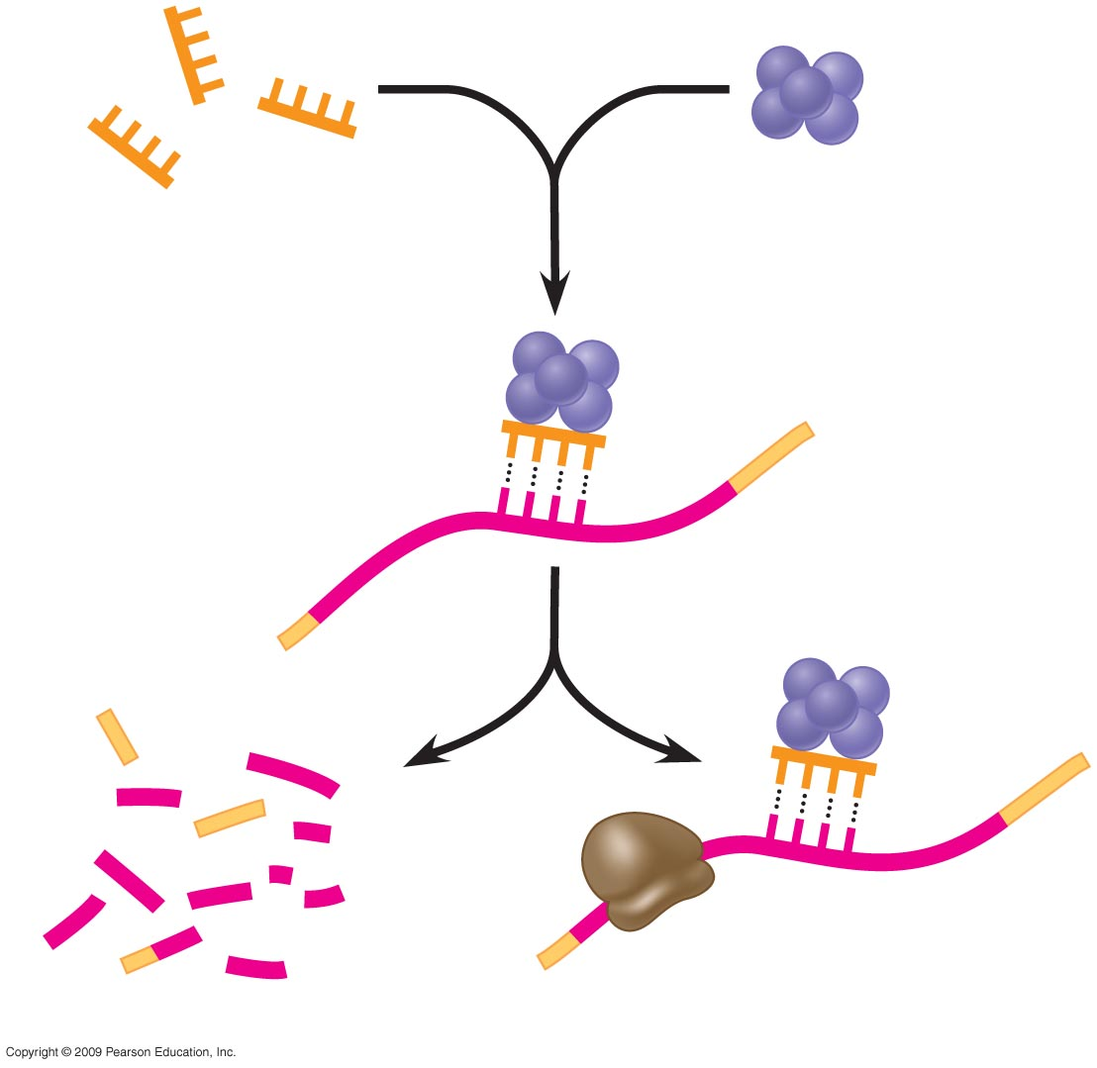
0
Protein
miRNA
1
miRNA-
protein
complex
2
Target mRNA
3
4
mRNA degraded
OR
Translation blocked
Notes:
Figure 11.7 The mechanism of RNA interference.
This figure shows the steps involved in RNA interference with microRNA.
MicroRNA binds to a large protein complex.
MicroRNA protein complex binds to complementary mRNA.
This triggers mRNA degradation or interferes with translation.

Slide 31
11.8 Translation and later stages of gene expression are also subject to regulation
0
  Control of gene expression also occurs with
    Breakdown of mRNA
    Initiation of translation
    Protein activation
    Protein breakdown
Copyright © 2009 Pearson Education, Inc.
Notes:
Hormones have been shown to cause an increase in the half-lives of specific mRNAs. For example, estrogen was shown to stabilize the mRNA for the estrogen receptor in sheep endometrial tissue. Prolactin caused a 20-fold increase in the half-life of casein mRNA in mammary tissue.
The sequence of reactions in blood clotting shows protein activation through cleavage of amino acids from polypeptide chains. One example is the conversion of prothrombin to thrombin, involving two cleavage reactions. Thrombin is then involved in the activation of fibrinogen to fibrin, which forms the blood clot.

Slide 32
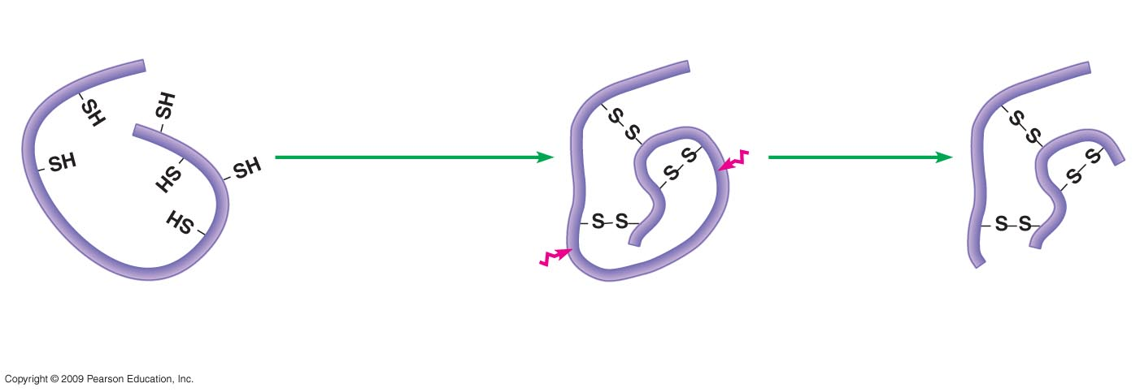
0
Folding of
polypeptide and
formation of
S—S linkages
Cleavage
Initial polypeptide
(inactive)
Folded polypeptide
(inactive)
Active form
of insulin
Notes:
Figure 11.8 Protein activation: The role of polypeptide cleavage in producing the active insulin protein.
This figure shows the activation of insulin involving cleavage of a long polypeptide chain to form two covalently linked chains.

Slide 33
11.9 Review: Multiple mechanisms regulate gene expression in eukaryotes
0
  Many possible control points exist; a given gene may be subject to only a few of these
    Chromosome changes (1)
      DNA unpacking
    Control of transcription (2)
      Regulatory proteins and control sequences
    Control of RNA processing
      Addition of 5’ cap and 3’ poly-A tail (3)
      Splicing (4)
    Flow through nuclear envelope (5)
Copyright © 2009 Pearson Education, Inc.

Slide 34
11.9 Review: Multiple mechanisms regulate gene expression in eukaryotes
0
  Many possible control points exist; a given gene may be subject to only a few of these
    Breakdown of mRNA (6)
    Control of translation (7)
    Control after translation
      Cleavage/modification/activation of proteins (8)
      Breakdown of protein (9)
Copyright © 2009 Pearson Education, Inc.

Slide 35
11.9 Review: Multiple mechanisms regulate gene expression in eukaryotes
0
  Applying Your Knowledge
  For each of the following, determine whether an increase or decrease in the amount of gene product is expected
    The mRNA fails to receive a poly-A tail during processing in the nucleus
    The mRNA becomes more stable and lasts twice as long in the cell cytoplasm
    The region of the chromatin containing the gene becomes tightly compacted
    An enzyme required to cleave and activate the protein product is missing
Copyright © 2009 Pearson Education, Inc.
Notes:
Applying Your Knowledge
For each of the following, determine whether an increase or decrease in the amount of gene product is expected:
The mRNA fails to receive a poly-A tail during processing in the nucleus. Answer: Decrease
The mRNA becomes more stable and lasts twice as long in the cell cytoplasm. Answer: Increase
The region of the chromatin containing the gene becomes tightly compacted. Answer: Decrease
An enzyme required to cleave and activate the protein product is missing. Answer: Decrease
Student Misconceptions and Concerns
1. The broad concept of selective reading of the genetic code associated with differentiation and types of cellular activity can be missed when concentrating on the extensive details of regulation. Analogies, noted below in the teaching tips, can help students relate this overall selective process to their own experiences. Students already understand the selective reading of relevant chapters in textbooks and the selective referencing of software manuals to get answers to different questions. These experiences are similar in many ways to the broad processes of gene regulation.
2. The many levels of gene regulation in eukaryotic cells can be confusing and frustrating. The water pipe analogy depicted in Figure 11.9 can be a helpful reference to organize the potential sites of regulation.
Teaching Tips
1. The authors develop an analogy between the regulation of transcription and the series of water pipes that carry water from your local water supply, perhaps a reservoir, to a faucet in your home. At various points, valves control the flow of water. Similarly, the expression of genes is controlled at many points along the process. Figure 11.9 illustrates the flow of genetic information from a chromosome—a reservoir of genetic information—to an active protein that has been made in the cell’s cytoplasm. The multiple mechanisms that control gene expression are analogous to the control valves in water pipes. In the figure, a possible control knob indicates each gene expression “valve.” In the figure, the large size of the transcription control knob highlights its crucial role.

Slide 36
11.9 Review: Multiple mechanisms regulate gene expression in eukaryotes
0
These mechanisms may occur
During transcription
After transcription
Before translation
During translation or
After translation
Animation: Protein Degradation
Copyright © 2009 Pearson Education, Inc.

Slide 37
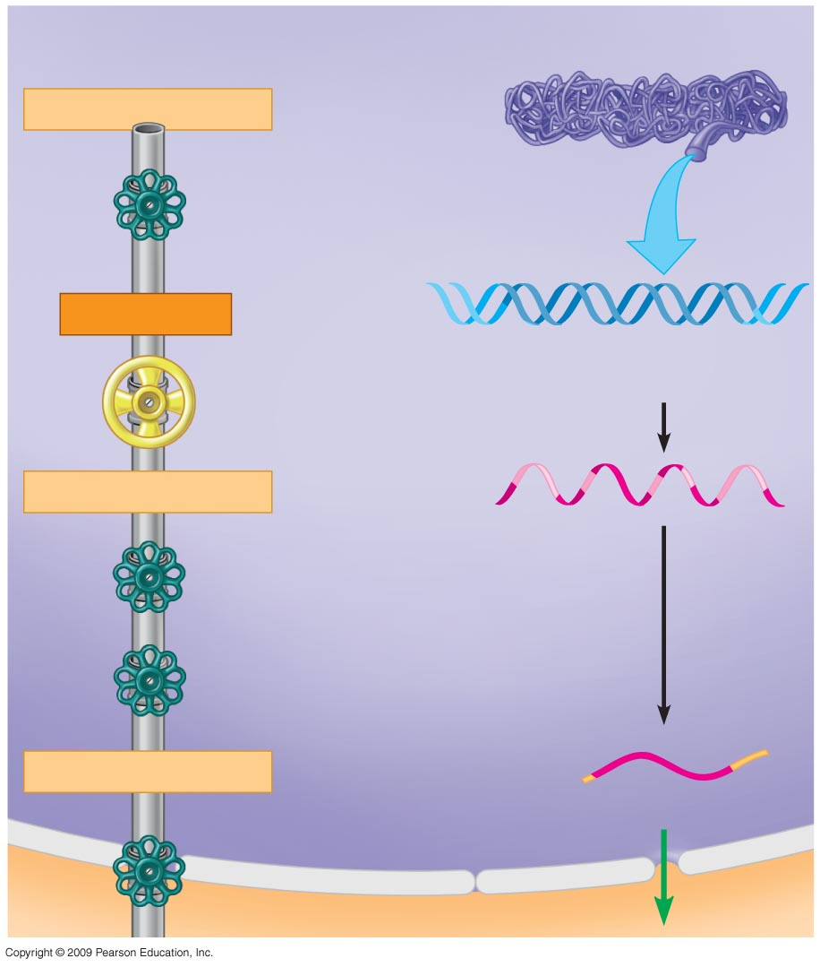
NUCLEUS
Chromosome
DNA unpacking
Other changes to DNA
Gene
Transcription
Gene
Exon
RNA transcript
Intron
Addition of cap and tail
Splicing
Tail
mRNA in nucleus
Cap
Flow through
nuclear envelope
Notes:
Figure 11.9 The gene expression “pipeline” in a eukaryotic cell.

Slide 38
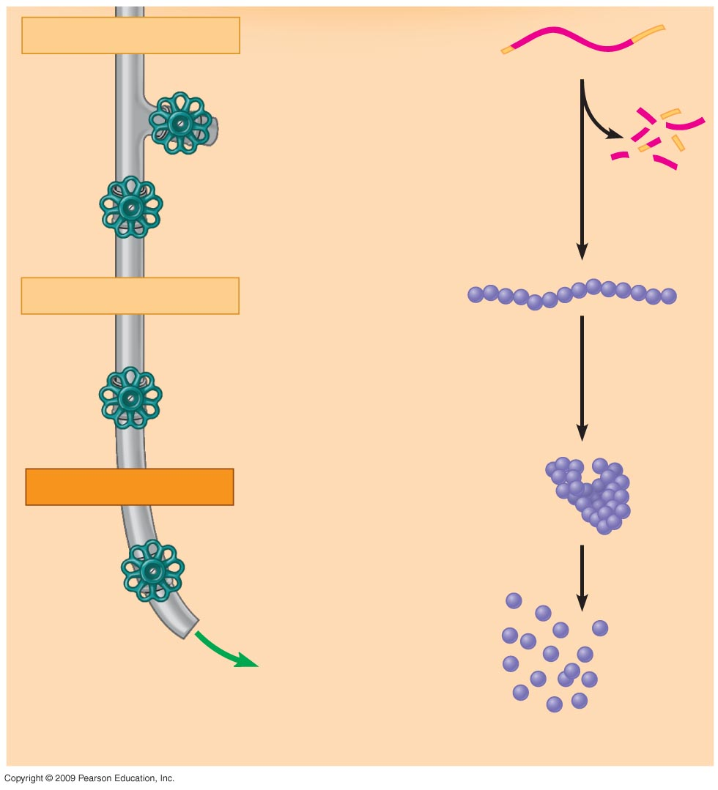
mRNA in cytoplasm
CYTOPLASM
Breakdown of mRNA
Broken-
down
mRNA
Translation
Polypeptide
Cleavage / modification /
activation
Active protein
Breakdown
of protein
Broken-
down
protein
Notes:
Figure 11.9 The gene expression “pipeline” in a eukaryotic cell.

Slide 39
11.10 Cascades of gene expression direct the development of an animal
0
  Role of gene expression in fruit fly development
    Orientation from head to tail
      Maternal mRNAs present in the egg are translated and influence formation of head to tail axis
    Segmentation of the body
      Protein products from one set of genes activate other sets of genes to divide the body into segments
    Production of adult features
      Homeotic genes are master control genes that determine the anatomy of the body, specifying structures that will develop in each segment
Copyright © 2009 Pearson Education, Inc.
Notes:
The gene expression cascade in Drosophila involves maternal effect genes, gap genes, pair-rule genes, segment polarity genes, and homeotic genes. These genes act in sequential order, with products of one set of genes influencing the activity of the next set of genes, to define and organize smaller and smaller regions of the embryo. Gradients of mRNAs from the maternal effect genes are set up in the egg, and their protein products determine head to tail polarity. The maternal effect gene products influence the gap genes, which define broad sections of the embryo along the anterior-posterior axis. The gap genes influence pair-rule genes that affect the development of alternating segments. Pair-rule genes influence segment polarity genes that define segment boundaries and affect the organization of individual segments. Homeotic genes specify the fates of cells within a segment, regulating segment differentiation.

Slide 40
11.10 Cascades of gene expression direct the development of an animal
0
Copyright © 2009 Pearson Education, Inc.

Slide 41
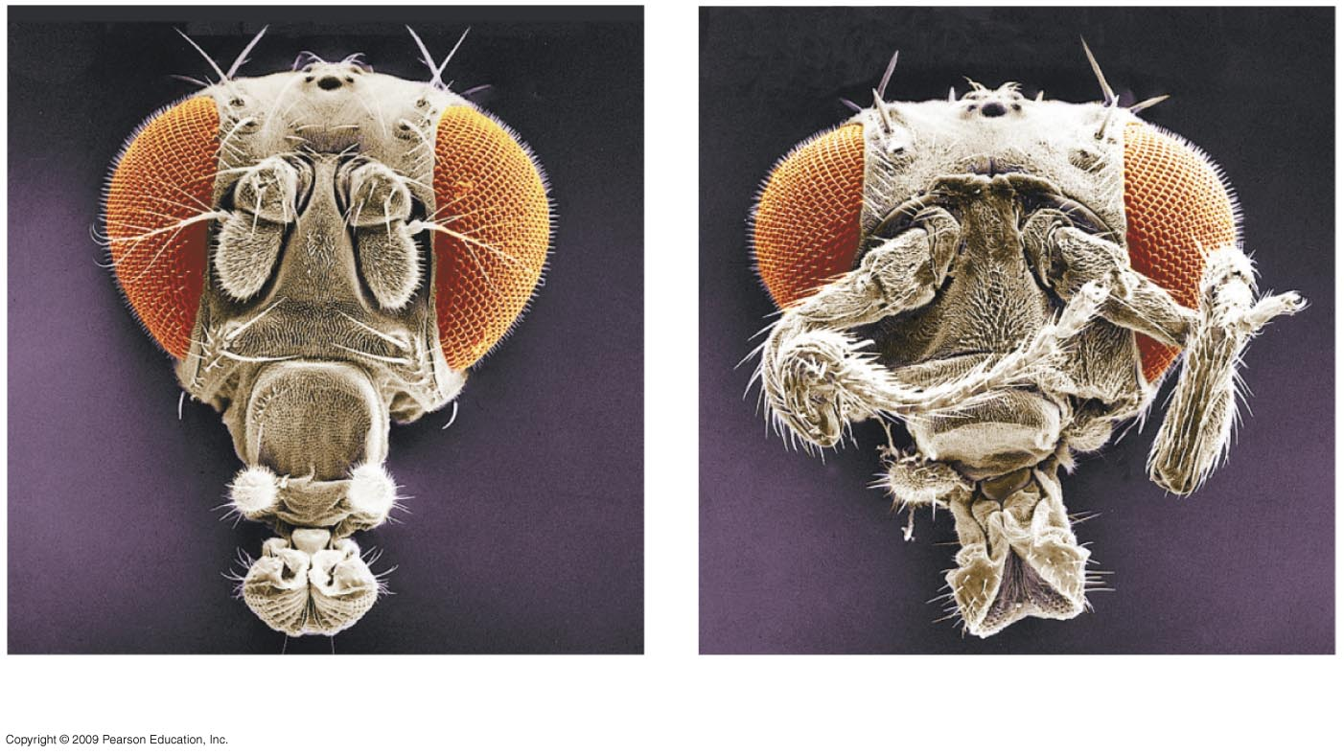
0
Eye
Antenna
Leg
Head of a normal fruit fly
Head of a developmental mutant
Notes:
Figure 11.10A A mutant fruit fly with legs coming out of its head, compared with a normal fruit fly.
The fly on the right has a mutation in one of the homeotic genes, Antennapedia, causing the formation of legs where the antennae should be.

Slide 42
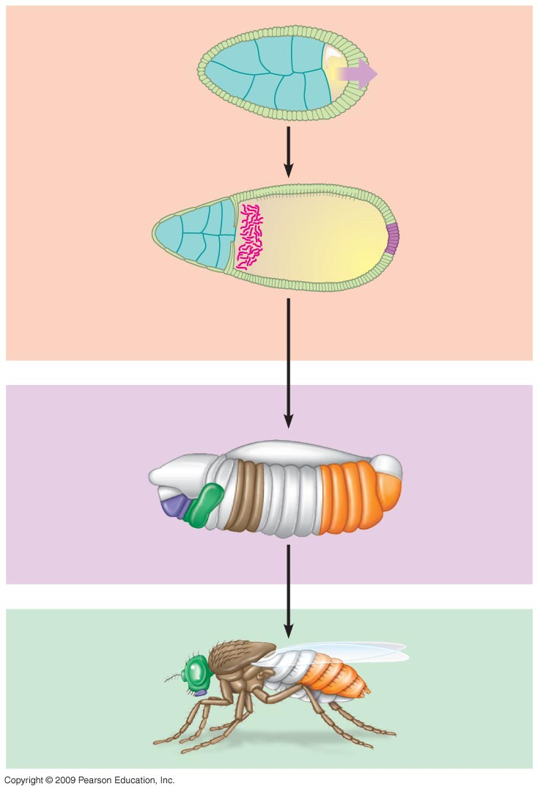
Egg cell
within ovarian
follicle
Egg cell
0
Protein
signal
Follicle cells
1
Gene expression
“Head”
mRNA
Cascades of
gene expression
2
Embryo
Body
segments
3
Gene expression
Adult fly
4
Notes:
Figure 11.10B Key steps in the early development of head-tail polarity in a fruit fly.
This figure shows the progressive stages of gene expression. The action of maternal effect genes are illustrated in the top panel. Concentration of the mRNA for the gene bicoid, or “head” mRNA, determines the anterior end of the fly. The middle panel combines the effects of gap genes, pair-rule genes, and segment polarity genes. The bottom panel shows the action of homeotic genes.

Slide 43
11.12 Signal transduction pathways convert messages received at the cell surface to responses within the cell
0
  Signal transduction pathway is a series of molecular changes that converts a signal at the cell’s surface to a response within the cell
    Signal molecule is released by a signaling cell
    Signal molecule binds to a receptor on the surface of a target cell
Copyright © 2009 Pearson Education, Inc.
Notes:
An increase in cell division is one example of a cellular response at the end of a signal transduction pathway. Epidermal growth factor (EGF) is a signal molecule that leads to an increase in the activity of transcription factor NF-kappaB. NF-kappaB increases transcription of the gene for cyclin D1. Cyclin D1 promotes progress through the cell cycle at the G1 → S transition, through deactivation of retinoblastoma (Rb) protein. This pathway leads to the uncontrolled growth of estrogen-receptor negative (ER-negative) breast cancer cells. ER-negative cells have higher levels of EGF receptors and thus produce elevated levels of NF-kappaB and cyclin D1. The possibility of inhibiting the action of NF-kappaB as a cancer therapy is being pursued.

Slide 44
11.12 Signal transduction pathways convert messages received at the cell surface to responses within the cell
0
    Relay proteins are activated in a series of reactions
    A transcription factor is activated and enters the nucleus
    Specific genes are transcribed to initiate a cellular response
Copyright © 2009 Pearson Education, Inc.
Notes:
An increase in cell division is one example of a cellular response at the end of a signal transduction pathway. Epidermal growth factor (EGF) is a signal molecule that leads to an increase in the activity of transcription factor NF-kappaB. NF-kappaB increases transcription of the gene for cyclin D1. Cyclin D1 promotes progress through the cell cycle at the G1 → S transition, through deactivation of retinoblastoma (Rb) protein. This pathway leads to the uncontrolled growth of estrogen-receptor negative (ER-negative) breast cancer cells. ER-negative cells have higher levels of EGF receptors and thus produce elevated levels of NF-kappaB and cyclin D1. The possibility of inhibiting the action of NF-kappaB as a cancer therapy is being pursued.

Slide 45
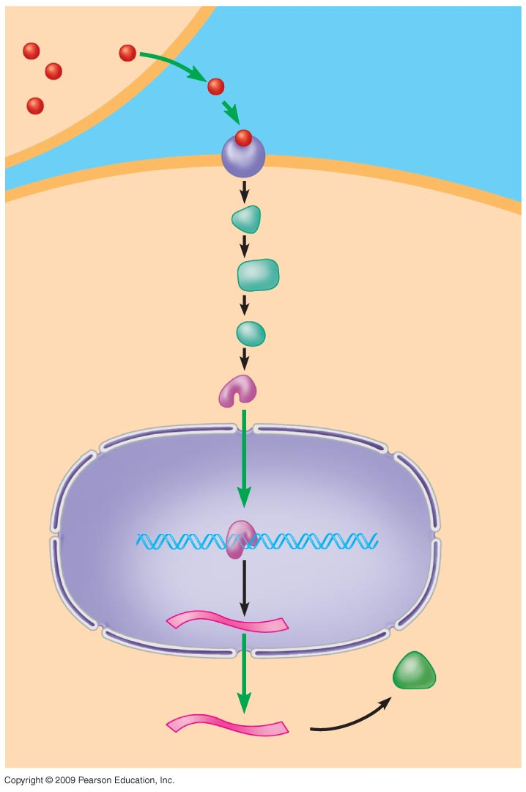
Signaling cell
0
Signaling
molecule
1
Plasma
membrane
2
Receptor
protein
3
Target cell
Relay
proteins
Transcription
factor
(activated)
4
Nucleus
DNA
5
Transcription
mRNA
New
protein
6
Translation
Notes:
Figure 11.12 A signal transduction pathway that turns on a gene.
This figure represents a signal transduction pathway that leads to transcription of a specific gene to promote a cellular response.

Slide 46
CLONING OF PLANTS AND ANIMALS
Copyright © 2009 Pearson Education, Inc.

Slide 47
11.14 Plant cloning shows that differentiated cells may retain all of their genetic potential
0
  Most differentiated cells retain a full set of genes, even though only a subset may be expressed
    Evidence is available from
      Plant cloning
        A root cell can divide to form an adult plant
      Animal limb regeneration
        Remaining cells divide to form replacement structures
      Involved dedifferentiation followed by redifferentiation into specialized cells
Copyright © 2009 Pearson Education, Inc.

Slide 48
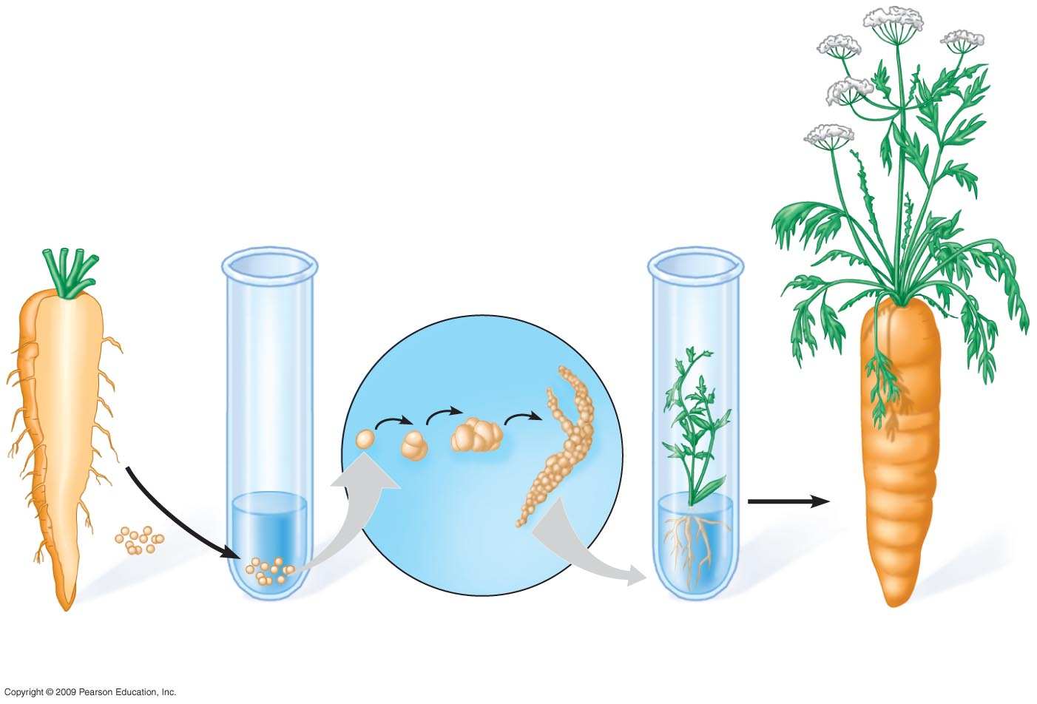
0
Root of
carrot plant
Single
cell
Root cells cultured
in nutrient medium
Cell division
in culture
Plantlet
Adult plant
Notes:
Figure 11.14 Growth of a carrot plant from a differentiated root cell.
This figure shows how an entire plant can be produced from a single root cell.

Slide 49
11.15 Nuclear transplantation can be used to clone animals
0
  Nuclear transplantation
    Replacing the nucleus of an egg cell or zygote with a nucleus from an adult somatic cell
    Early embryo (blastocyst) can be used in
      Reproductive cloning
        Implant embryo in surrogate mother for development
        New animal is genetically identical to nuclear donor
      Therapeutic cloning
        Remove embryonic stem cells and grow in culture for medical treatments
        Induce stem cells to differentiate
Copyright © 2009 Pearson Education, Inc.
Notes:
Since nuclear transplantation requires both an egg and nuclear donor, the resulting cloned animal may have differences in mitochondrial genes, as these are derived from the egg donor.
While nuclear changes related to differentiation were successfully reversed in producing Dolly, the chromosomes she received retained a significant characteristic from the donor adult that may have shortened her lifespan. These chromosomes were reduced in size, having lost DNA at the ends, or telomeres. The telomeres tend to shorten over successive cell divisions, as lagging strand synthesis may not be completed during DNA replication. Telomeres are repeated sequences that do not carry genes, but the loss can continue into the adjacent gene regions. Shortening of telomeres has been related to aging and to limiting of cell division. Dolly lived to about half her full life expectancy, contracting a contagious lung disease caused by a virus. It has been proposed that the shorter length of her chromosomes may have contributed to her reduced lifespan.
For the Discovery Video Cloning, go to Animation and Video Files.
For the BLAST Animation Stem Cells, go to Animation and Video Files.

Slide 50
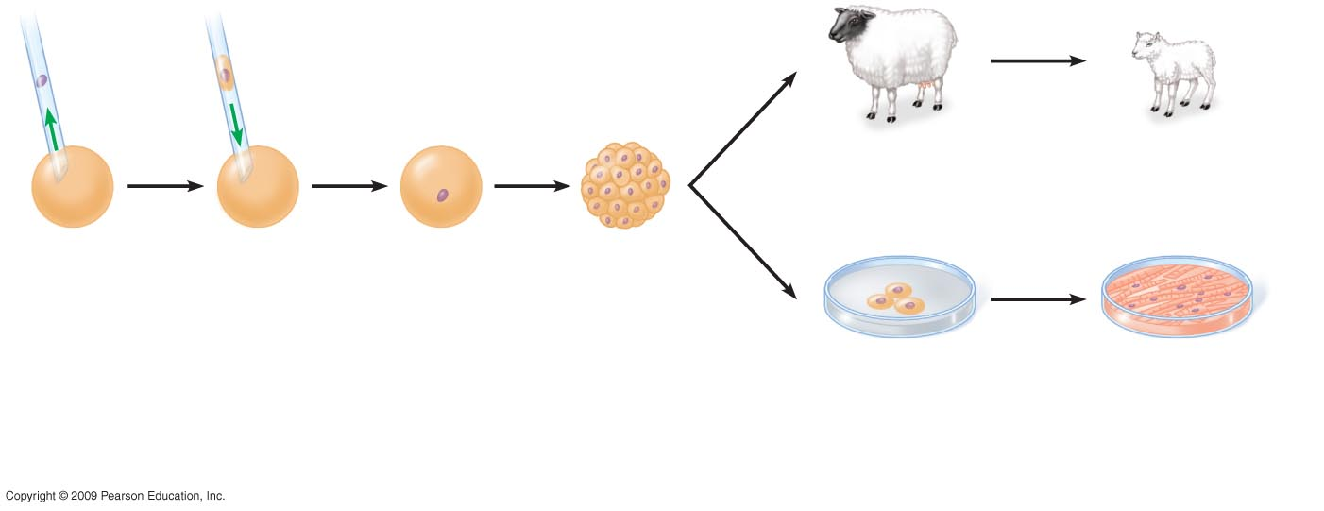
0
Donor
cell
Nucleus from
donor cell
Reproductive
cloning
Implant blastocyst in
surrogate mother
Clone of
donor is born
Remove
nucleus
from egg
cell
Add somatic cell
from adult donor
Grow in culture
to produce an
early embryo
(blastocyst)
Therapeutic
cloning
Remove embryonic
stem cells from
blastocyst and
grow in culture
Induce stem
cells to form
specialized cells
Notes:
Figure 11.15 Nuclear transplantation for cloning.
This figure distinguishes between reproductive and therapeutic cloning.

Slide 51
11.16 CONNECTION: Reproductive cloning has valuable applications, but human reproductive cloning raises ethical issues
0
  Cloned animals can show differences from their parent due to a variety of influences during development
  Reproductive cloning is used to produce animals with desirable traits
    Agricultural products
    Therapeutic agents
    Restoring endangered animals
  Human reproductive cloning raises ethical concerns
Copyright © 2009 Pearson Education, Inc.

Slide 52
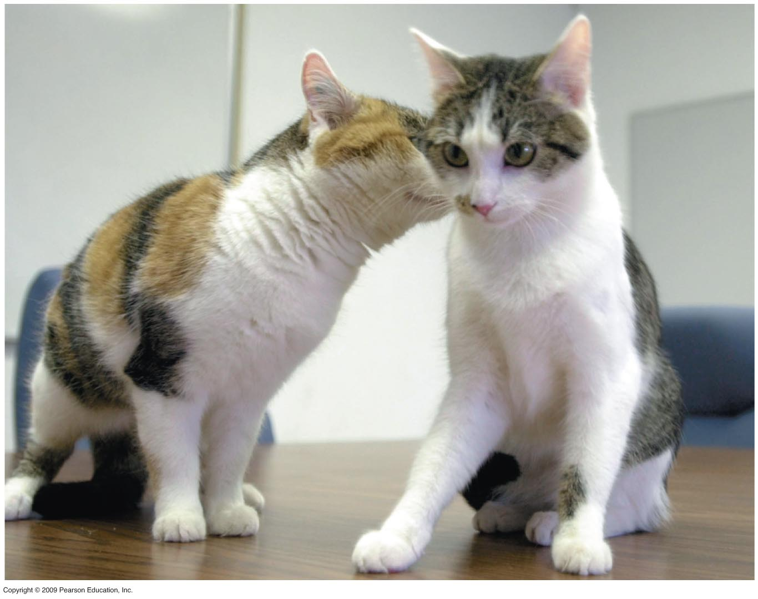
0
Notes:
Figure 11.16 CC, the world’s first cloned cat (right), and her lone parent (left).
The cat named CC (Carbon Copy) inherited a calico coat from her parent, but the pattern differs due to random inactivation of X chromosomes (see Module 11.4). This shows that developmental differences can occur between a clone and its parent.

Slide 53
11.17 CONNECTION: Therapeutic cloning can produce stem cells with great medical potential
0
  Stem cells can be induced to give rise to differentiated cells
    Embryonic stem cells can differentiate into a variety of types
    Adult stem cells can give rise to many but not all types of cells
  Therapeutic cloning can supply cells to treat human diseases
  Research continues into ways to use and produce stem cells
Copyright © 2009 Pearson Education, Inc.

Slide 54
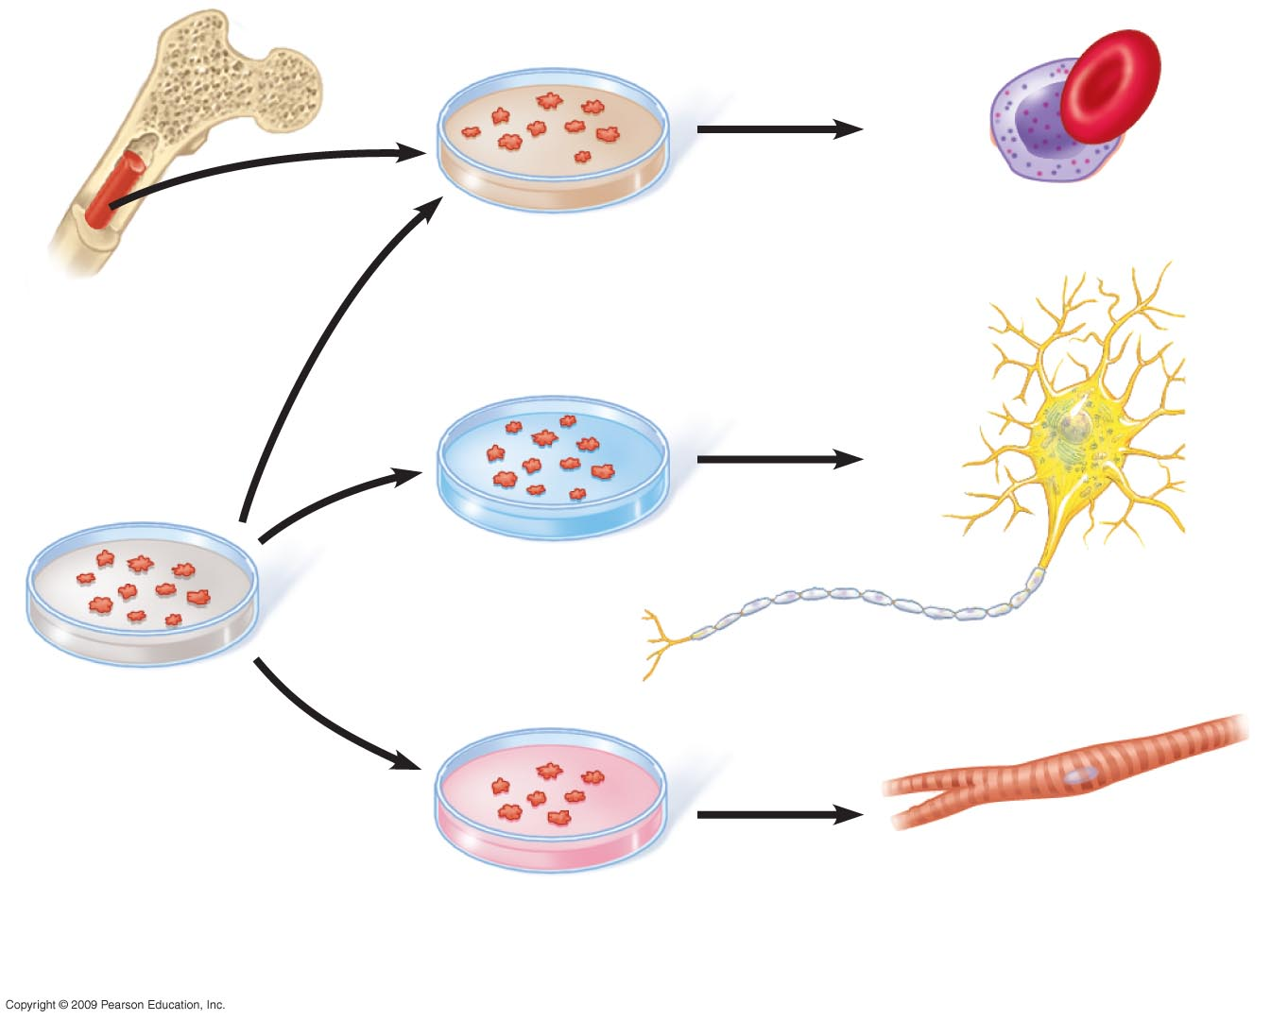
0
Blood cells
Adult stem
cells in bone
marrow
Nerve cells
Cultured
embryonic
stem cells
Heart muscle cells
Different culture
conditions
Different types of
differentiated cells
Notes:
Figure 11.17 Differentiation of stem cells in culture.
This figure emphasizes the versatility of embryonic stem cells in producing multiple cell types, in contrast to the more limited potential of adult stem cells.

Slide 55
THE GENETIC BASIS
OF CANCER
Copyright © 2009 Pearson Education, Inc.

Slide 56
11.18 Cancer results from mutations in genes that control cell division
0
  Mutations in two types of genes can cause cancer
    Oncogenes
      Proto-oncogenes normally promote cell division
      Mutations to oncogenes enhance activity
    Tumor-suppressor genes
      Normally inhibit cell division
      Mutations inactivate the genes and allow uncontrolled division to occur
Copyright © 2009 Pearson Education, Inc.
Notes:
The following analogy can be used to compare the rate of cell division to the speed of a car. A proto-oncogene is like the accelerator. When mutated to form an oncogene, it is as if the accelerator is pushed to the floor so that the speed of cell growth is even faster. Tumor-suppressor genes are like the brakes. If the brake lines are cut, the speed increases as the vehicle is out of control.

Slide 57
11.18 Cancer results from mutations in genes that control cell division
0
  Oncogenes
    Promote cancer when present in a single copy
    Can be viral genes inserted into host chromosomes
    Can be mutated versions of proto-oncogenes, normal genes that promote cell division and differentiation
    Converting a proto-oncogene to an oncogene can occur by
      Mutation causing increased protein activity
      Increased number of gene copies causing more protein to be produced
      Change in location putting the gene under control of new promoter for increased transcription
Copyright © 2009 Pearson Education, Inc.
Notes:
Myc is an example of an oncogene. The Myc gene codes for a transcription factor that influences the activity of 15% of human genes. If mutated, the effect is to increase transcription and accelerate cell division.

Slide 58
11.18 Cancer results from mutations in genes that control cell division
0
  Tumor-suppressor genes
    Promote cancer when both copies are mutated
Copyright © 2009 Pearson Education, Inc.
Notes:
An example of a tumor suppressor is the gene for retinoblastoma (Rb). Rb protein controls the G1 → S transition. Heterozygous individuals that have one mutated copy and one normal copy of Rb can develop the disease when their normal copy undergoes mutation. This happens in the tissue of the eye, where tumors of the retina form.

Slide 59
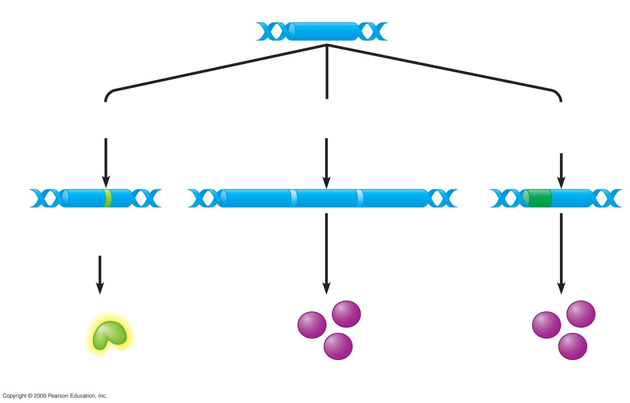
0
Proto-oncogene DNA
Mutation within
the gene
Multiple copies
of the gene
Gene moved to
new DNA locus,
under new controls
Oncogene
New promoter
Hyperactive
growth-
stimulating
protein in
normal
amount
Normal growth-
stimulating
protein
in excess
Normal growth-
stimulating
protein
in excess
Notes:
Figure 11.18A Alternative ways to make oncogenes from a proto-oncogene (all leading to excessive cell growth).
This figure shows three ways that proto-oncogenes can be converted to oncogenes.

Slide 60
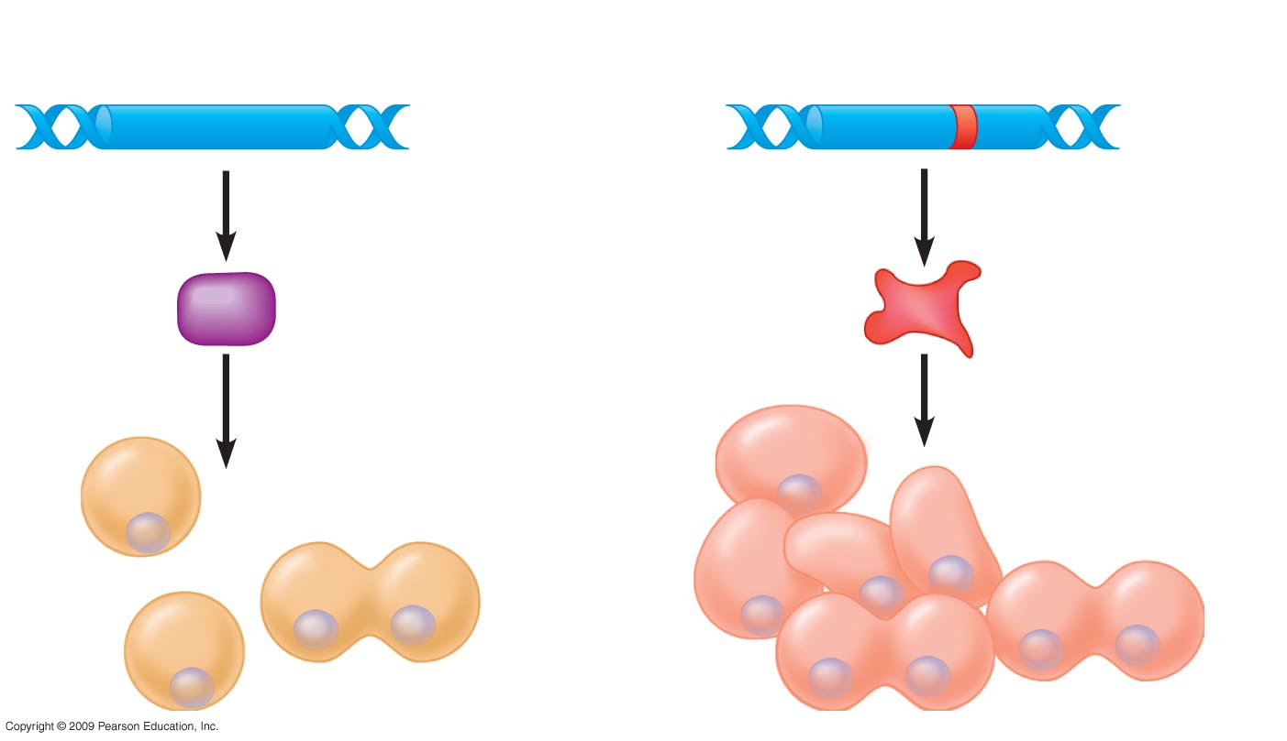
0
Tumor-suppressor gene
Mutated tumor-suppressor gene
Normal
growth-
inhibiting
protein
Defective,
nonfunctioning
protein
Cell division
under control
Cell division not
under control
Notes:
Figure 11.18B The effect of a mutation in a tumor-supressor gene.
Tumor suppressor genes usually code for proteins that inhibit cell division. A mutated form causes the production of a nonfunctional protein that no longer controls cell growth.

Slide 61
11.19 Multiple genetic changes underlie the development of cancer
0
  Four or more somatic mutations are usually required to produce a cancer cell
  One possible scenario for colorectal cancer includes
    Activation of an oncogene increases cell division
    Inactivation of tumor suppressor gene causes formation of a benign tumor
    Additional mutations lead to a malignant tumor
Copyright © 2009 Pearson Education, Inc.

Slide 62
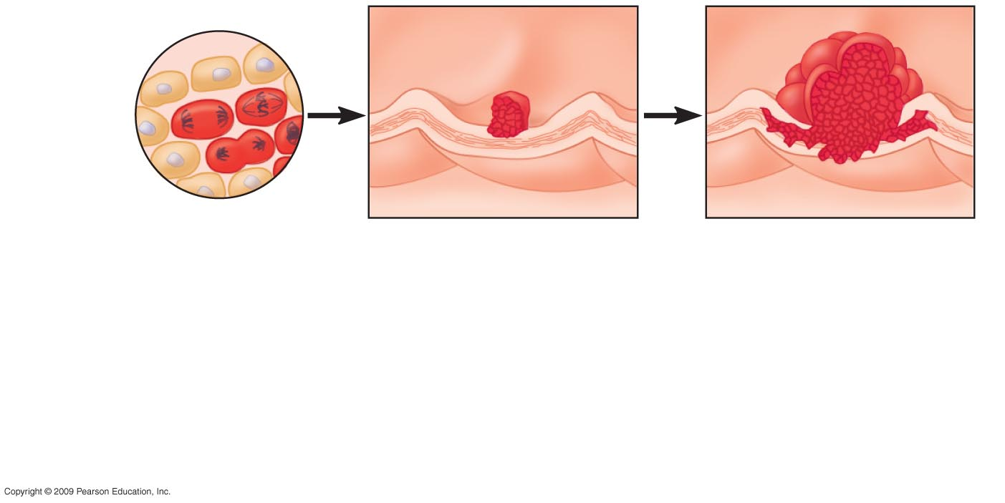
0
Colon wall
1
2
3
Cellular
changes:
Increased
cell division
Growth of polyp
Growth of malignant
tumor (carcinoma)
DNA
changes:
Oncogene
activated
Tumor-suppressor
gene inactivated
Second tumor-
suppressor gene
inactivated
Notes:
Figure 11.19A Stepwise development of a typical colon cancer.
This figure shows the activation of an oncogene and deactivation of tumor suppressor genes in a progression to malignant colon cancer.

Slide 63
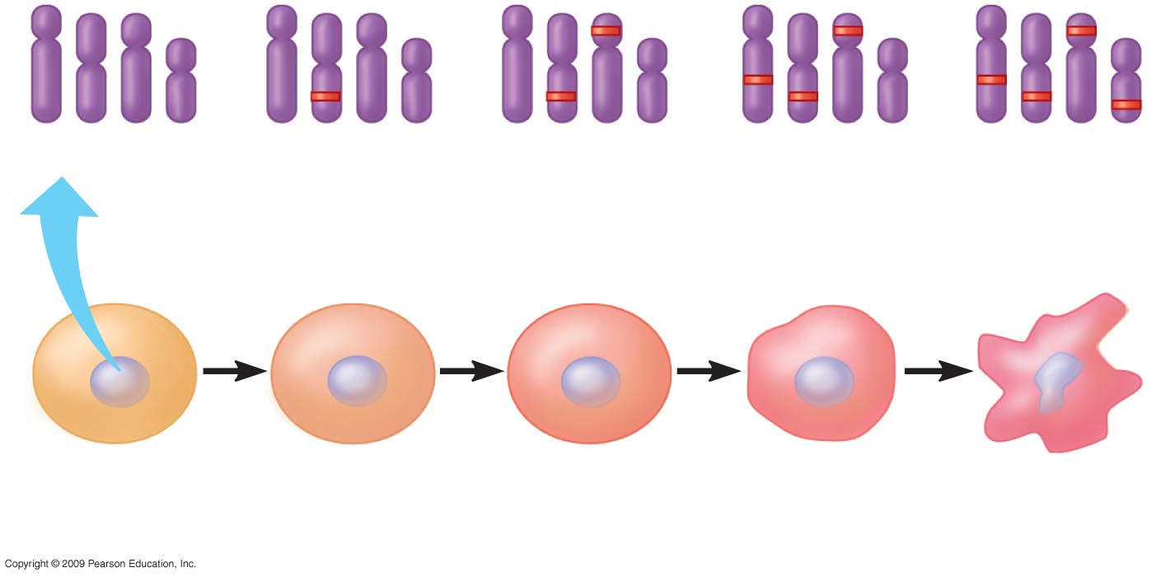
0
Chromosomes
1
mutation
2
mutations
3
mutations
4
mutations
Normal
cell
Malignant
cell
Notes:
Figure 11.19B Accumulation of mutations in the development of a cancer cell.
This figure emphasizes that the accumulation of mutations contributes to cancer development.

Slide 64
11.20 Faulty proteins can interfere with normal signal transduction pathways
0
  Path producing a product that stimulates cell division
    Product of ras proto-oncogene relays a signal when growth hormone binds to receptor
    Product of ras oncogene relays the signal in the absence of hormone binding, leading to uncontrolled growth
Copyright © 2009 Pearson Education, Inc.
Notes:
The ras gene product is a G protein (guanine nucleotide-binding protein) that is located on the inner surface of the plasma membrane. When a signal binds to a G protein-linked receptor on the outer surface, ras becomes activated by guanosine triphosphate (GTP) and in turn activates other proteins in a signal transduction pathway. The ras gene product normally responds to growth hormone binding to the receptor as part of a pathway leading to cell division. Mutations in the ras gene change the ras protein to a configuration that is always active, so that growth stimulation occurs even in the absence of hormone binding.
The p53 protein is a transcription factor that becomes activated when cells are subjected to stress, triggering responses that prevent damaged cells from duplicating. For example, active p53 stimulates transcription of the gene for p21, a protein that causes cell cycle arrest during G1 phase. Cells are therefore prevented from entering S phase where duplicating damaged DNA would lead to additional mutations. The p53 protein also influences apoptosis, or programmed cell death, giving a signal to eliminate cells with extensive DNA damage. Li-Fraumeni syndrome is caused by mutations in the p53 gene. Individuals who are heterozygous for a p53 mutation have a greater chance of developing cancer when their functional p53 allele becomes mutated.

Slide 65
11.20 Faulty proteins can interfere with normal signal transduction pathways
0
  Path producing a product that inhibits cell division
    Product of p53 tumor-suppressor gene is a transcription factor
    p53 transcription factor normally activates genes for factors that stop cell division
    In the absence of functional p53, cell division continues because the inhibitory protein is not produced
Copyright © 2009 Pearson Education, Inc.
Notes:
The ras gene product is a G protein (guanine nucleotide-binding protein) that is located on the inner surface of the plasma membrane. When a signal binds to a G protein-linked receptor on the outer surface, ras becomes activated by guanosine triphosphate (GTP) and in turn activates other proteins in a signal transduction pathway. The ras gene product normally responds to growth hormone binding to the receptor as part of a pathway leading to cell division. Mutations in the ras gene change the ras protein to a configuration that is always active, so that growth stimulation occurs even in the absence of hormone binding.
The p53 protein is a transcription factor that becomes activated when cells are subjected to stress, triggering responses that prevent damaged cells from duplicating. For example, active p53 stimulates transcription of the gene for p21, a protein that causes cell cycle arrest during G1 phase. Cells are therefore prevented from entering S phase where duplicating damaged DNA would lead to additional mutations. The p53 protein also influences apoptosis, or programmed cell death, giving a signal to eliminate cells with extensive DNA damage. Li-Fraumeni syndrome is caused by mutations in the p53 gene. Individuals who are heterozygous for a p53 mutation have a greater chance of developing cancer when their functional p53 allele becomes mutated.

Slide 66
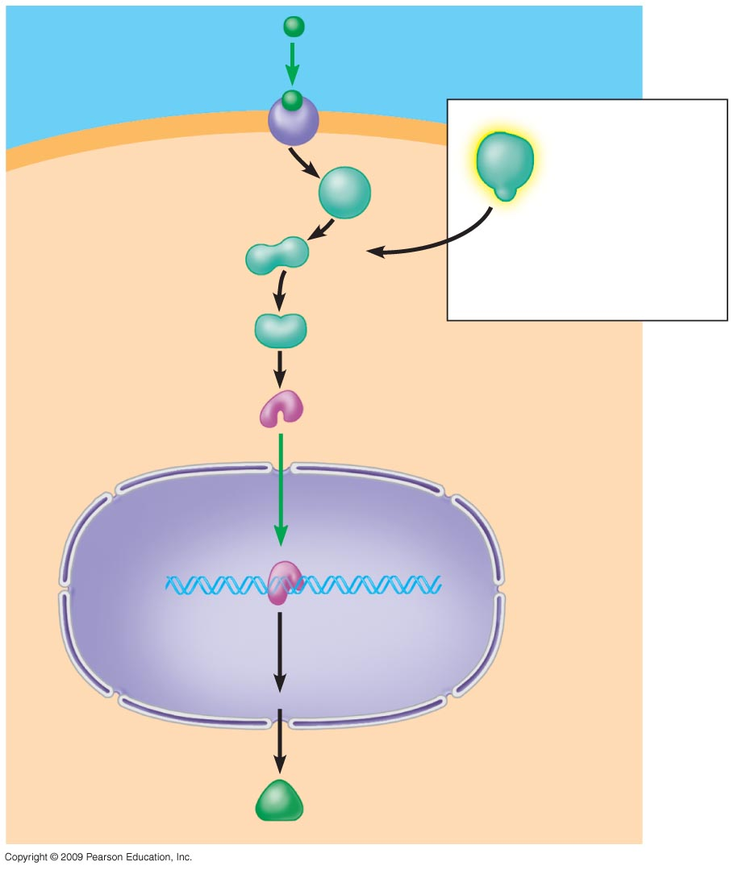
Growth factor
0
Receptor
Target cell
Hyperactive
relay protein
(product of
ras oncogene)
issues signals
on its own
Normal product
of ras gene
Relay
proteins
Transcription
factor
(activated)
DNA
Nucleus
Transcription
Protein that
Stimulates
cell division
Translation
Notes:
Figure 11.20A A stimulatory signal transduction pathway and the effect of an oncogene protein.

Slide 67
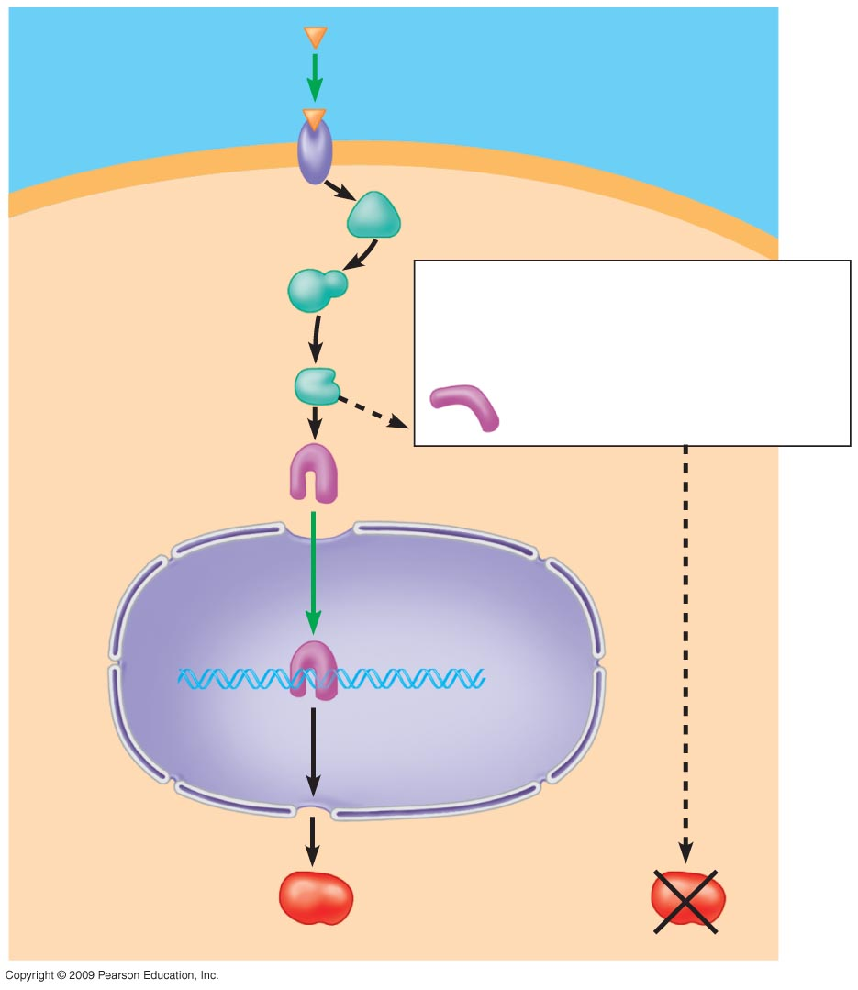
Growth-inhibiting
factor
0
Receptor
Relay
proteins
Nonfunctional transcription
factor (product of faulty p53
tumor-suppressor gene)
cannot trigger
transcription
Transcription
factor
(activated)
Normal product
of p53 gene
Transcription
Translation
Protein that
inhibits
cell division
Protein absent
(cell division
not inhibited)
Notes:
Figure 11.20B An inhibitory signal transduction pathway and the effect of a faulty tumor-supressor protein.

Slide 68
11.21 CONNECTION: Lifestyle choices can reduce the risk of cancer
0
  Carcinogens are cancer-causing agents that damage DNA and promote cell division
    X-rays and ultraviolet radiation
    Tobacco
  Healthy lifestyle choices
    Avoiding carcinogens
    Avoiding fat and including foods with fiber and antioxidants
    Regular medical checkups
Copyright © 2009 Pearson Education, Inc.

Slide 69
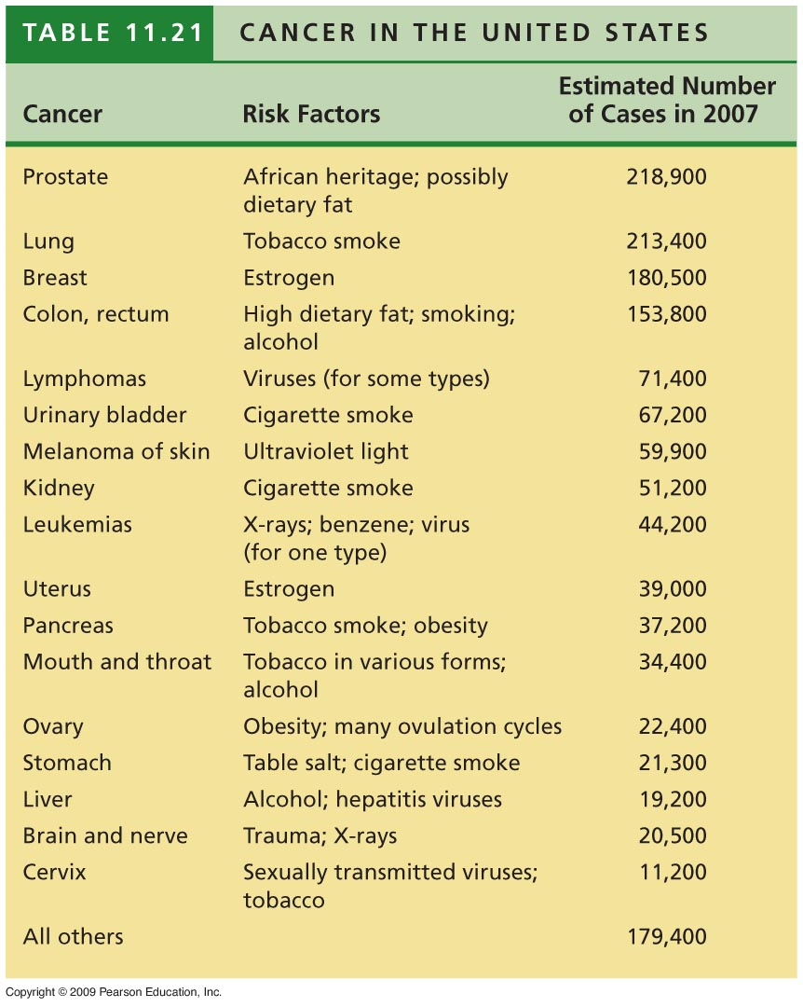
0
Notes:
Table 11.21 Cancer in the United States.

Slide 70
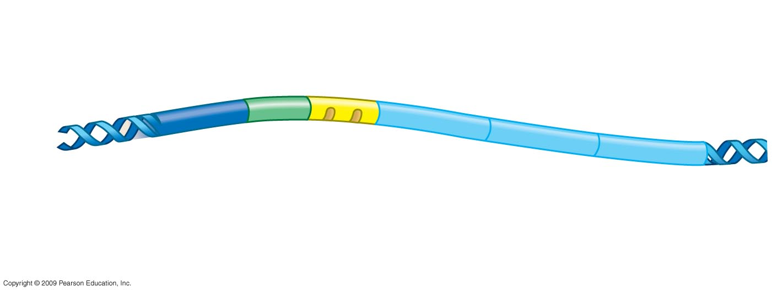
0
A typical operon
Regulatory
gene
Promoter
Operator
Gene 1
Gene 2
Gene 3
DNA
Encodes repressor
that in active form
attaches to operator
RNA
polymerase
binding site
Switches operon
on or off

Slide 71
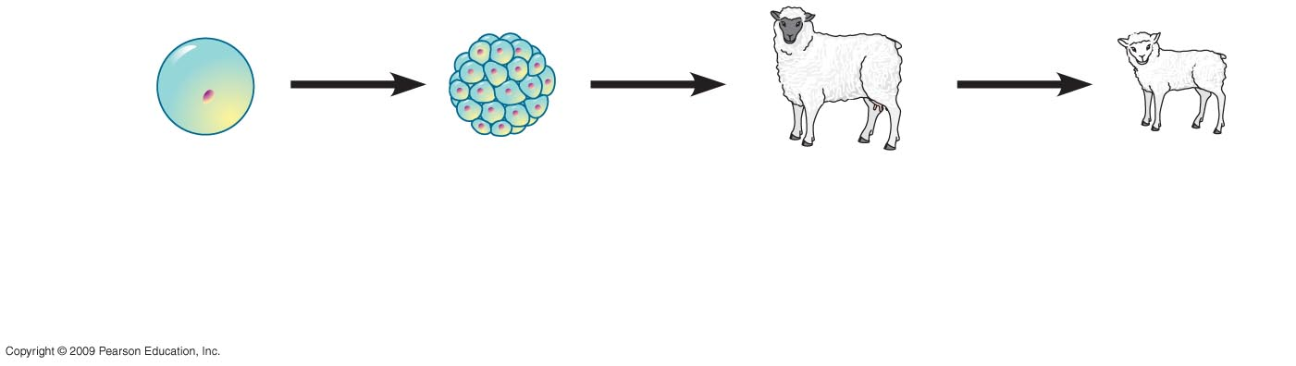
0
Early embryo
resulting from
nuclear trans-
plantation
Surrogate
mother
Clone
of donor
Nucleus from
donor cell

Slide 72
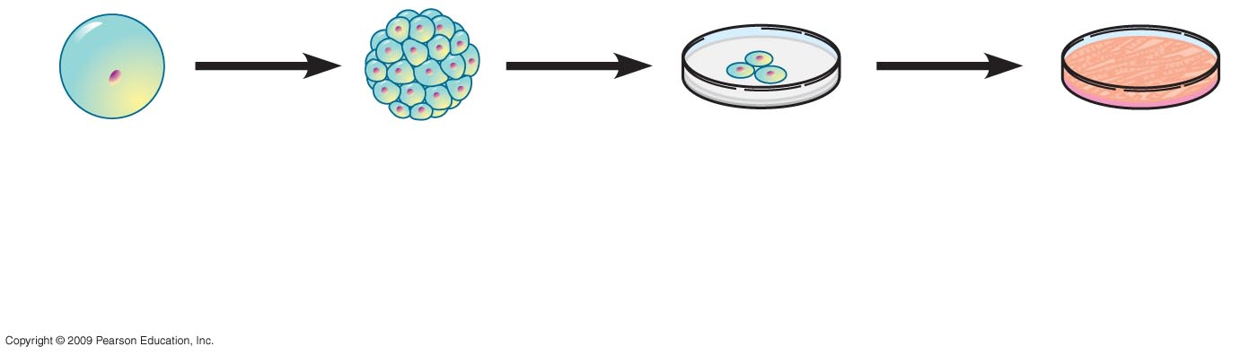
0
Early embryo
resulting from
nuclear trans-
plantation
Embryonic
stem cells
in culture
Specialized
cells
Nucleus from
donor cell

Slide 73
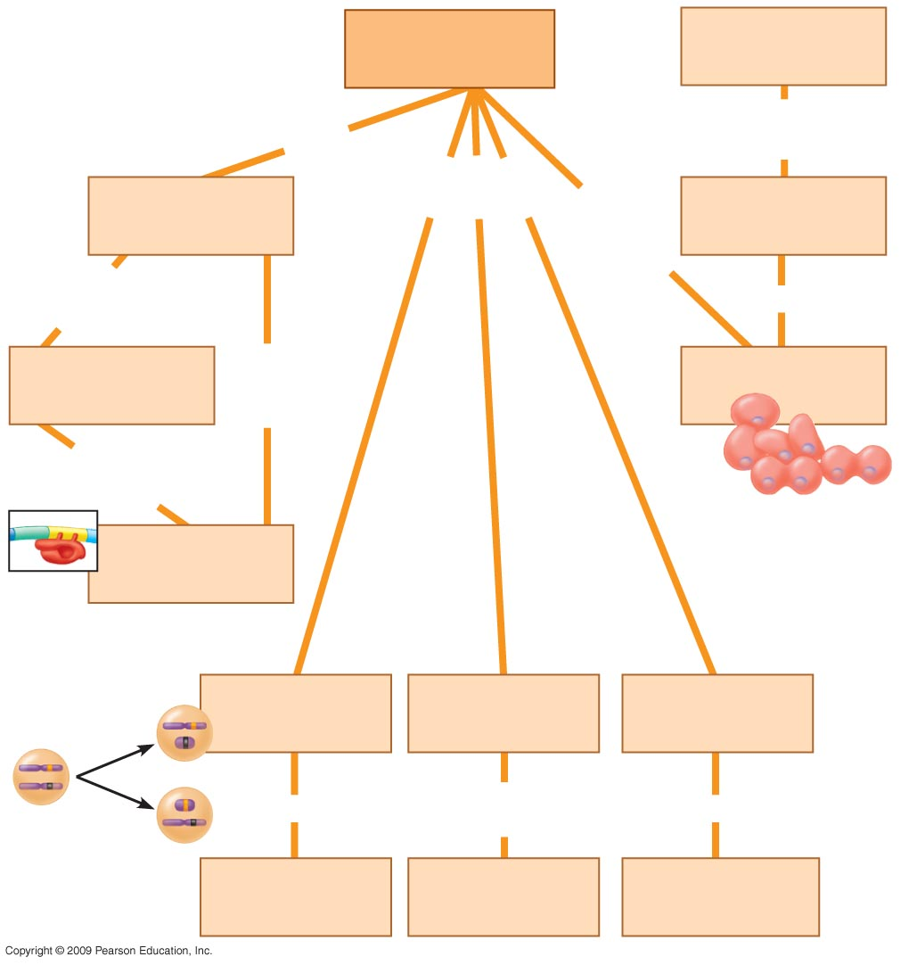
Gene
regulation
(a)
0
prokaryotic
genes often
grouped into
is a normal gene that
can be mutated to an
in eukaryotes
may involve
operons
when
abnormal
may lead to
oncogene
controlled by
protein called
can cause
are
switched
on/off by
(b)
(c)
in active
form binds to
(d)
(e)
(f)
(g)
occurs in
are proteins
that promote
can produce
female
mammals
transcription
multiple mRNAs
per gene

Slide 74
You should now be able to
0
  Explain how prokaryotic gene control occurs in the operon
  Describe the control points in expression of a eukaryotic gene
  Describe DNA packing and explain how it is related to gene expression
  Explain how alternative RNA splicing and microRNAs affect gene expression
  Compare and contrast the control mechanisms for prokaryotic and eukaryotic genes
Copyright © 2009 Pearson Education, Inc.

Slide 75
You should now be able to
0
  Distinguish between terms in the following groups: promoter—operator; oncogene—tumor suppressor gene; reproductive cloning— therapeutic cloning
  Define the following terms: Barr body, carcinogen, DNA microarray, homeotic gene; stem cell; X-chromosome inactivation
  Describe the process of signal transduction, explain how it relates to yeast mating, and explain how it is disrupted in cancer development
Copyright © 2009 Pearson Education, Inc.

Slide 76
You should now be able to
0
  Explain how cascades of gene expression affect development
  Compare and contrast techniques of plant and animal cloning
  Describe the types of mutations that can lead to cancer
  Identify lifestyle choices that can reduce cancer risk
Copyright © 2009 Pearson Education, Inc.

