Slide 1
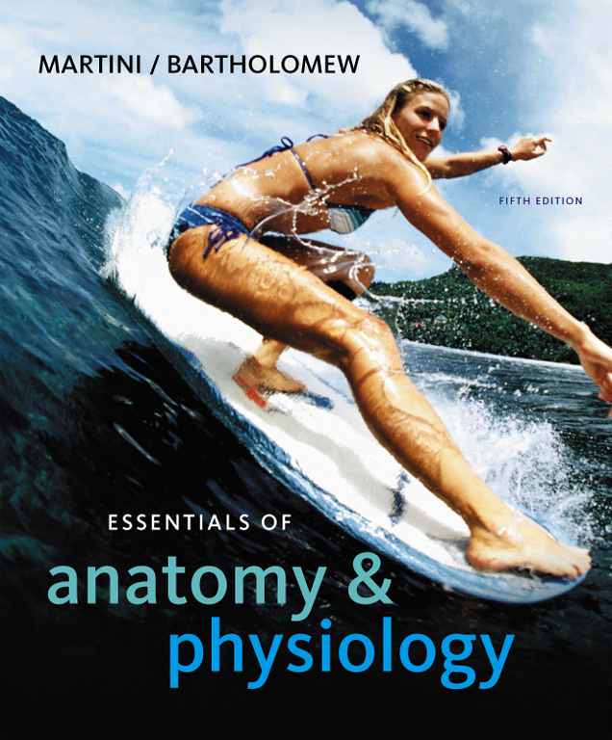
C h a p t e r
11
The Cardiovascular System:
Blood
PowerPoint® Lecture Slides prepared by Jason LaPres
Lone Star College - North Harris
Copyright © 2010 Pearson Education, Inc.

Slide 2
Introduction to the Cardiovascular System
A circulating transport system
  A pump (the heart)
  A conducting system (blood vessels)
  A fluid medium (blood):
    Is specialized fluid of connective tissue
    Contains cells suspended in a fluid matrix

Slide 3
Introduction to the Cardiovascular System
To transport materials to and from cells
  O₂ and CO₂
  Nutrients
  Hormones
  Immune system components
  Waste products

Slide 4
11-1: Blood has several important functions and unique physical characteristics

Slide 5
Functions of Blood
Transport of dissolved substances
Regulation of pH and ions
Restriction of fluid losses at injury sites
Defense against toxins and pathogens
Stabilization of body temperature

Slide 6
Composition of Blood
Whole Blood
  Plasma:
    Fluid consisting of:
      water
      dissolved plasma proteins
      other solutes
  Formed elements:
    All cells and solids

Slide 7
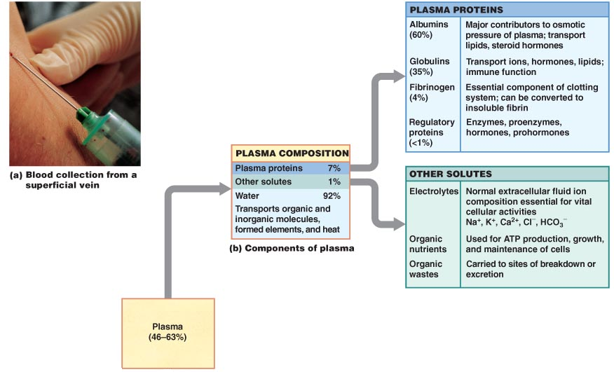
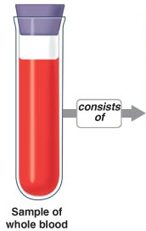
The Composition of Whole Blood
Figure 11-1

Slide 8
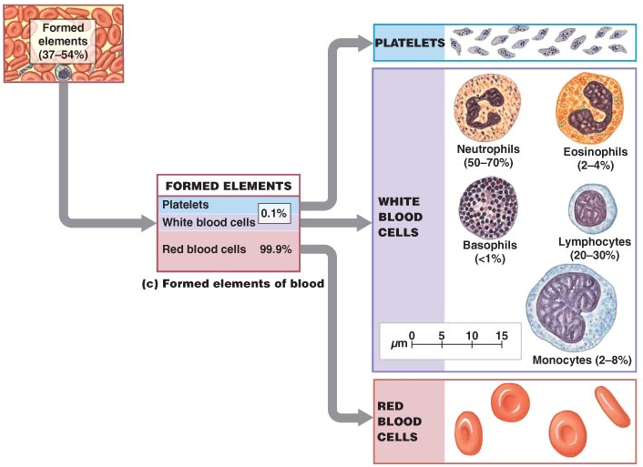
The Composition of Whole Blood
Figure 11-1

Slide 9
The Composition of Whole Blood
Three Types of Formed Elements
  Red blood cells (RBCs) or erythrocytes:
    Transport oxygen
  White blood cells (WBCs) or leukocytes:
    Part of the immune system
  Platelets:
    Cell fragments involved in clotting

Slide 10
The Composition of Whole Blood
Hemopoiesis
  Process of producing formed elements
  By myeloid and lymphoid stem cells
Fractionation
  Process of separating whole blood for clinical analysis:
    Into plasma and formed elements

Slide 11
The Composition of Whole Blood
Blood volume (liters) = 7% of body weight (kilograms)
  Adult male: 5 to 6 liters
  Adult female: 4 to 5 liters

Slide 12
Blood Collection and Analysis
Three General Characteristics of Blood
  38°C (100.4°F) is normal temperature
  High viscosity
  Slightly alkaline pH (7.35–7.45)

Slide 13
11-2: Plasma, the fluid portion of blood, contains significant quantities of plasma proteins

Slide 14
The Composition of Plasma
Makes up 46% to 63% of blood volume
More than 90% of plasma is water
Extracellular fluids
  Interstitial fluid (IF) and plasma
  Materials plasma and IF exchange across capillary walls:
    Water
    Ions
    Small solutes

Slide 15
The Composition of Plasma
Differences between Plasma and IF
  Levels of O₂ and CO₂ (due to respiratory activities inside the cell)
  Concentrations and types of dissolved proteins:
    Plasma proteins do not pass through capillary walls

Slide 16
Plasma Proteins
Albumins (60%)
  Transport substances such as fatty acids, thyroid hormones, and steroid hormones
Globulins (35%)
  Antibodies, also called immunoglobulins
  Transport globulins (small molecules): hormone-binding proteins, metalloproteins, apolipoproteins (lipoproteins), and steroid-binding proteins
Fibrinogen (4%)
  Molecules that form clots and produce long, insoluble strands of fibrin

Slide 17
Plasma Proteins
Serum
  Liquid part of a blood sample:
    In which dissolved fibrinogen has converted to solid fibrin
Other Plasma Proteins
  1% of plasma:
    Changing quantities of specialized plasma proteins
    Enzymes and hormones

Slide 18
Plasma Proteins
Origins of Plasma Proteins
  90% + made in liver
  Antibodies made by plasma cells
  Peptide hormones made by endocrine organs

Slide 19
11-3: Red blood cells, formed by erythropoiesis, contain hemoglobin that can be recycled

Slide 20
Red Blood Cells
Red blood cells (RBCs) make up 99.9% of blood’s formed elements
Hemoglobin
  The red pigment that gives whole blood its color
  Binds and transports oxygen and carbon dioxide

Slide 21
Abundance of RBCs
Red blood cell count: the number of RBCs in 1 microliter of whole blood
  Male: 4.5–6.3 million
  Female: 4.2–5.5 million
Hematocrit (packed cell volume, PCV): percentage of RBCs in centrifuged whole blood
  Male: 40–54
  Female: 37–47

Slide 22
Structure of RBCs
Small and highly specialized discs
Thin in middle and thicker at edge
  Importance of RBC shape and size:
    High surface-to-volume ratio:
      Quickly absorbs and releases oxygen
    Discs bend and flex entering small capillaries
Figure 19–2d

Slide 23
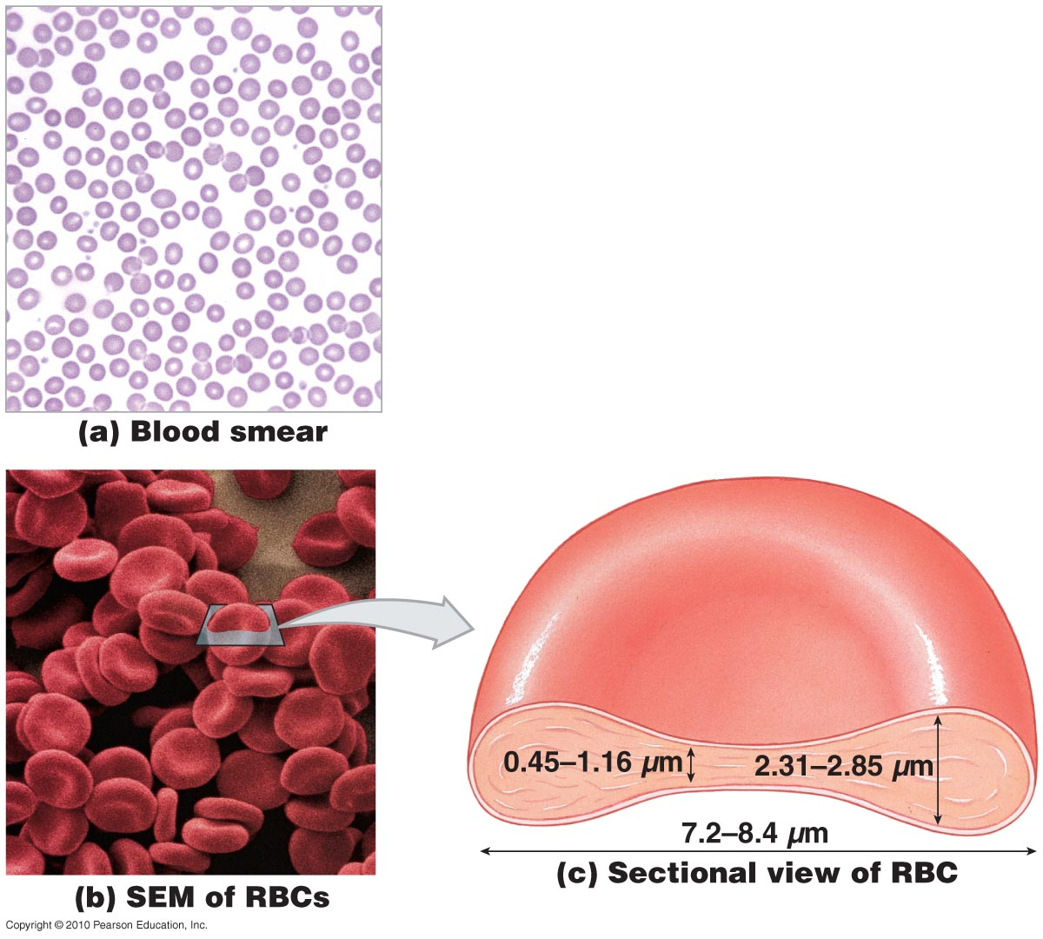
Red Blood Cells
Figure 11-2

Slide 24
Hemoglobin Structure and Function
Hemoglobin (Hb)
  Protein molecule that transports respiratory gases
  Normal hemoglobin (adult male):
    14–18 g/dL whole blood
  Normal hemoglobin (adult female):
    12–16 g/dL whole blood

Slide 25
Hemoglobin Structure and Function
Hemoglobin Structure
  Complex quaternary structure
  Four globular protein subunits:
    Each with one molecule of heme
    Each heme contains one iron ion
  Iron ions:
    Associate easily with oxygen (oxyhemoglobin)
        OR
    Dissociate easily from oxygen (deoxyhemoglobin)
Figure 19–3

Slide 26
Hemoglobin Structure and Function
Lack nuclei, mitochondria, and ribosomes
  Means no repair and anaerobic metabolism
  Live about 120 days

Slide 27
Hemoglobin Structure and Function
Hemoglobin Function
  Carries oxygen
  With low oxygen (peripheral capillaries):
    Hemoglobin releases oxygen
    Binds carbon dioxide and carries it to the lungs

Slide 28
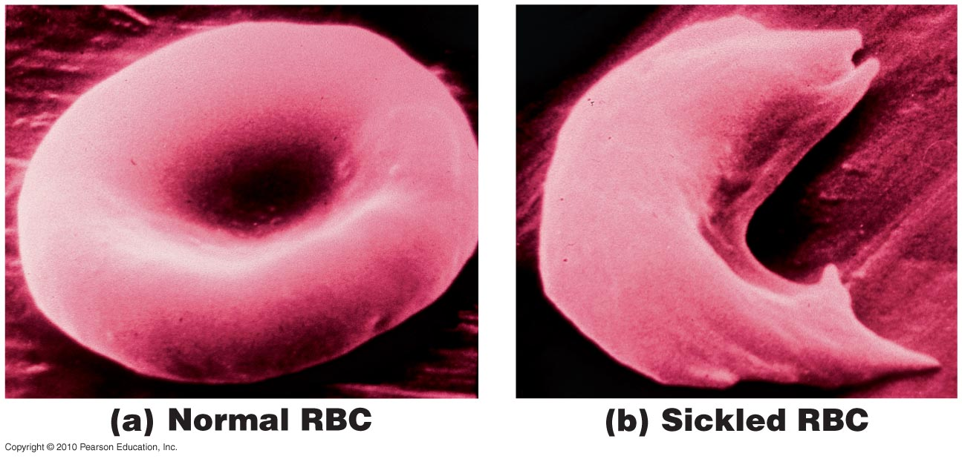
Abnormal Hemoglobin
Figure 11-3

Slide 29
RBC Life Span and Circulation
RBC Formation and Turnover
  1% of circulating RBCs wear out per day:
    About 3 million RBCs per second
  Macrophages of liver, spleen, and bone marrow:
    Monitor RBCs
    Engulf RBCs before membranes rupture (hemolyze)

Slide 30
RBC Life Span and Circulation
Hemoglobin Recycling
  Phagocytes break hemoglobin into components:
    Globular proteins to amino acids
    Heme to biliverdin
    Iron
  Hemoglobinuria:
    Hemoglobin breakdown products in urine due to excess hemolysis in bloodstream
  Hematuria:
    Whole red blood cells in urine due to kidney or tissue damage

Slide 31
RBC Life Span and Circulation
Iron Recycling
  Iron removed from heme leaving biliverdin
  To transport proteins (transferrin)
  To storage proteins (ferritin and hemosiderin)

Slide 32
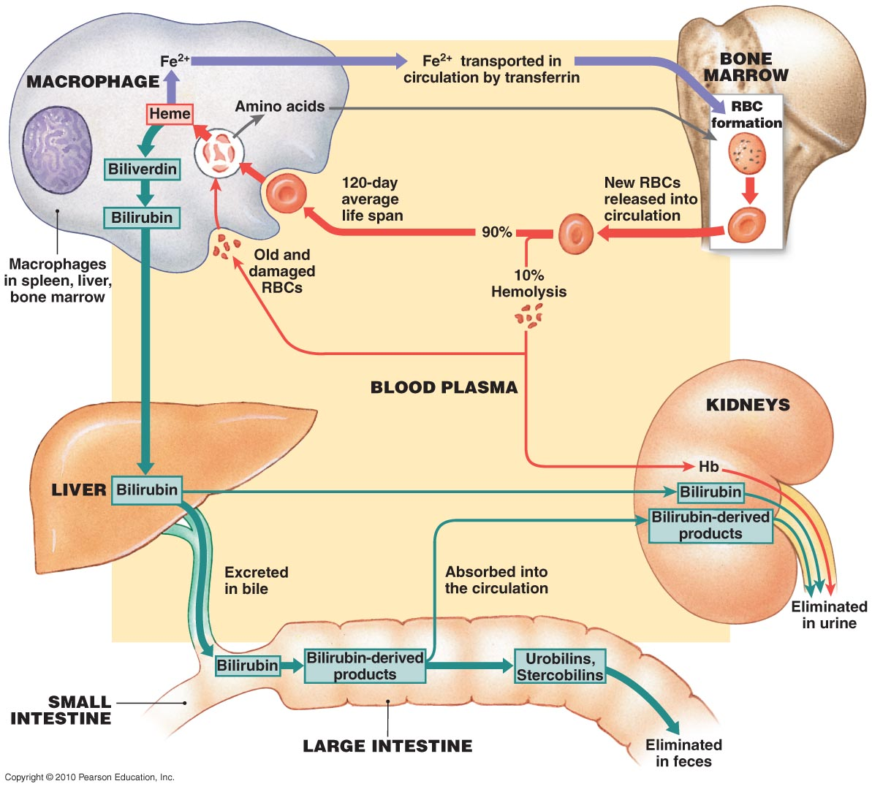
Figure 11-4

Slide 33
RBC Formation
RBC Production
  Erythropoiesis:
    Occurs only in myeloid tissue (red bone marrow) in adults
    Stem cells mature to become RBCs
Hemocytoblasts
  Stem cells in myeloid tissue divide to produce:
    Myeloid stem cells: become RBCs, some WBCs
    Lymphoid stem cells: become lymphocytes

Slide 34
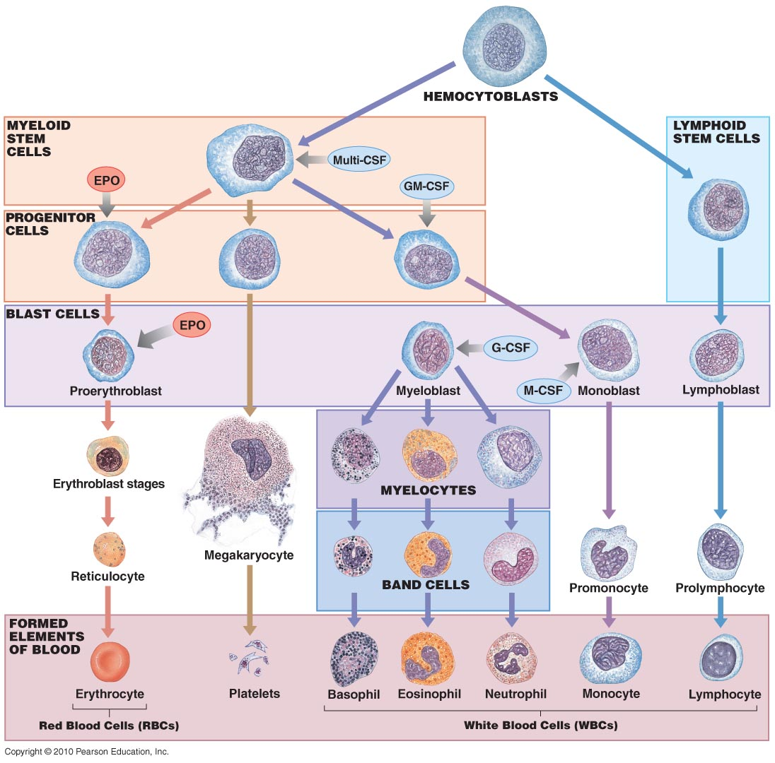
Figure 11-5

Slide 35
Red Blood Cells
Regulation of Erythropoiesis
  Building red blood cells requires:
    Amino acids
    Iron
    Vitamins B₁₂, B₆, and folic acid:
      pernicious anemia:
        low RBC production
        due to unavailability of vitamin B₁₂

Slide 36
Red Blood Cells
Stimulating Hormones
  Erythropoietin (EPO):
    Also called erythropoiesis-stimulating hormone
    Secreted when oxygen in peripheral tissues is low (hypoxia)
    Due to disease or high altitude

Slide 37
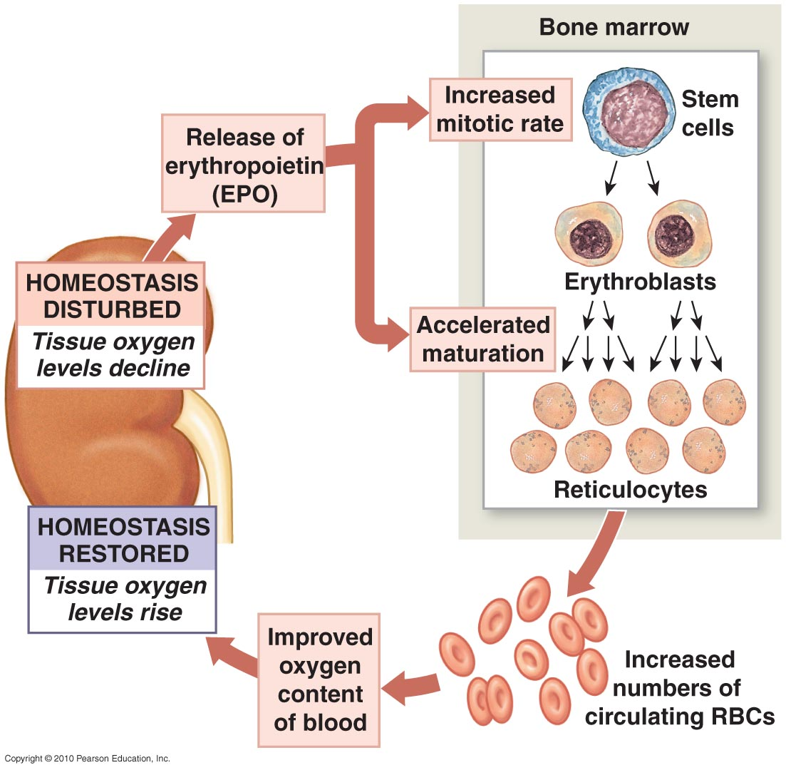
Erythropoiesis
Figure 11-6

Slide 38
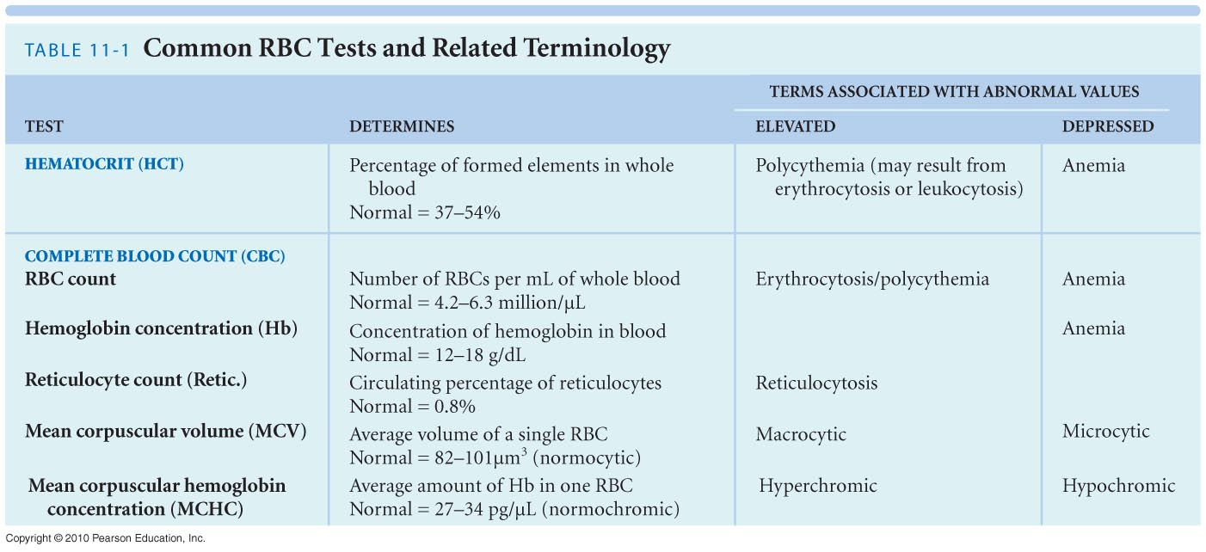

Slide 39
11-4: The ABO blood types and Rh system are based on antigen–antibody responses

Slide 40
Blood Typing
Cell surface proteins identify cells to immune system
Normal cells are ignored and foreign cells attacked
Blood types
  Are genetically determined
  By presence or absence of RBC surface antigens A, B, Rh (or D)

Slide 41
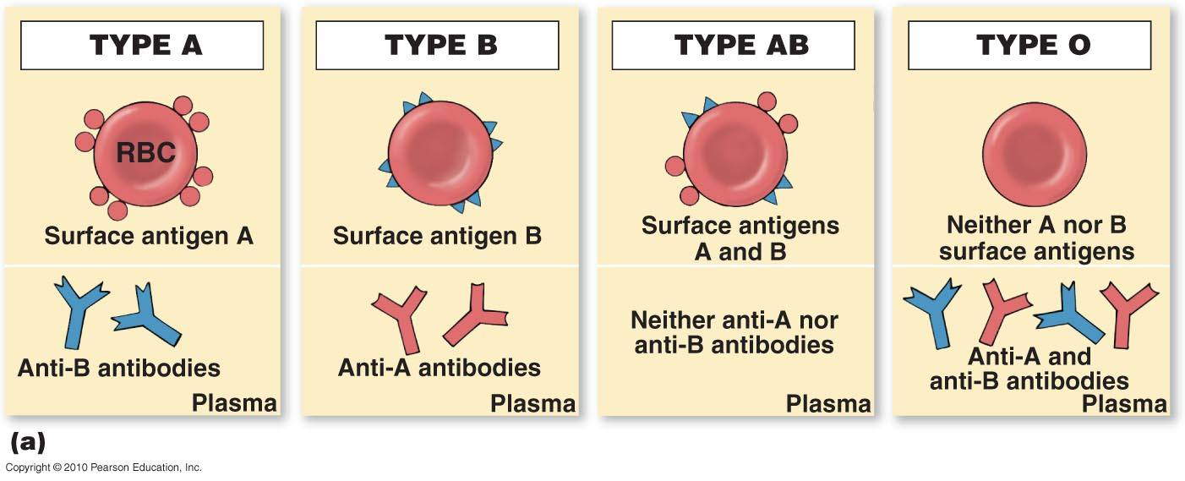
Blood Types and Cross-Reactions
Figure 11-7a

Slide 42
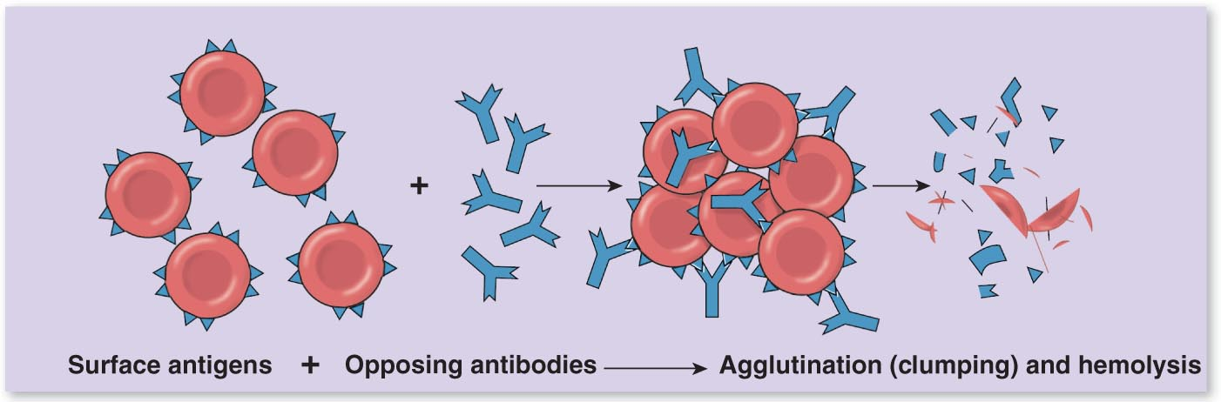
Blood Types and Cross-Reactions
Figure 11-7b

Slide 43
Blood Typing
The Rh Factor
  Also called D antigen
  Either Rh positive (Rh⁺) or Rh negative (Rh⁻):
    Only sensitized Rh⁻ blood has anti-Rh antibodies

Slide 44
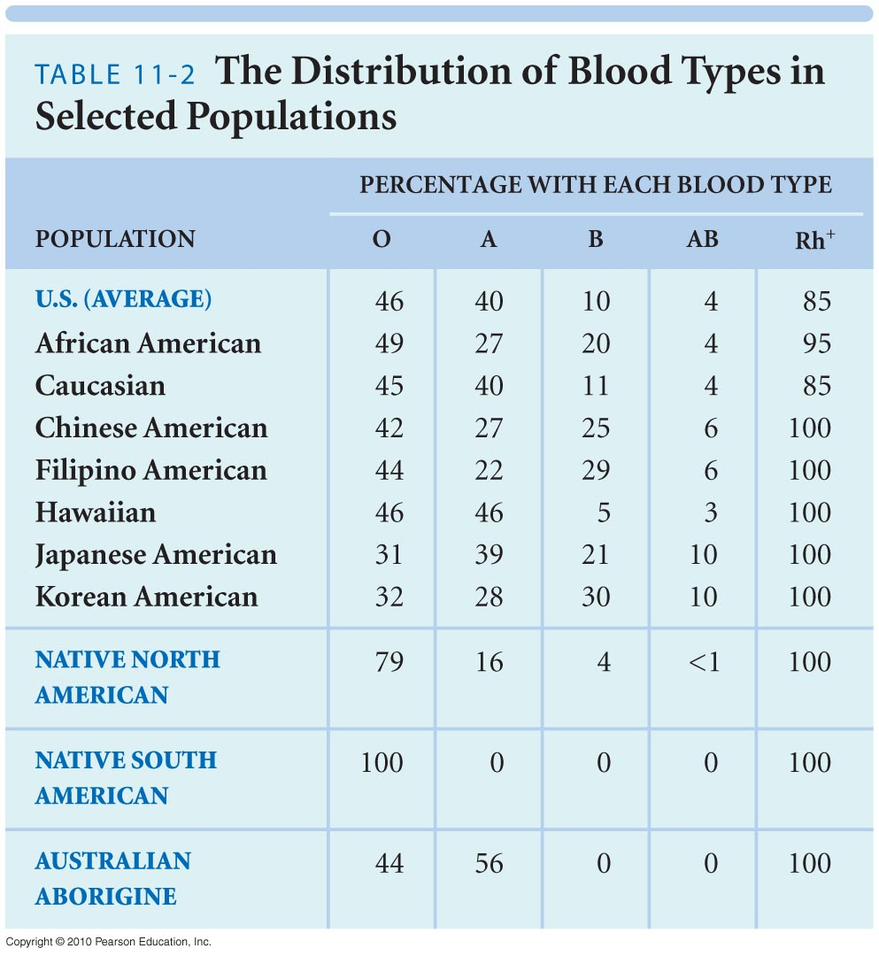

Slide 45
11-5: The various types of white blood cells contribute to the body’s defenses

Slide 46
White Blood Cells
Also called leukocytes
Do not have hemoglobin
Have nuclei and other organelles
WBC functions
  Defend against pathogens
  Remove toxins and wastes
  Attack abnormal cells

Slide 47
WBC Circulation and Movement
Most WBCs found in
  Connective tissue proper
  Lymphoid system organs
Small numbers in blood
  5000 to 10,000 per microliter

Slide 48
WBC Circulation and Movement
Characteristics of circulating WBCs
  Can migrate out of bloodstream
  Have amoeboid movement
  Attracted to chemical stimuli (positive chemotaxis)
  Some are phagocytic:
    Neutrophils, eosinophils, and monocytes

Slide 49
White Blood Cells
Types of WBCs
  Neutrophils
  Eosinophils
  Basophils
  Monocytes
  Lymphocytes

Slide 50
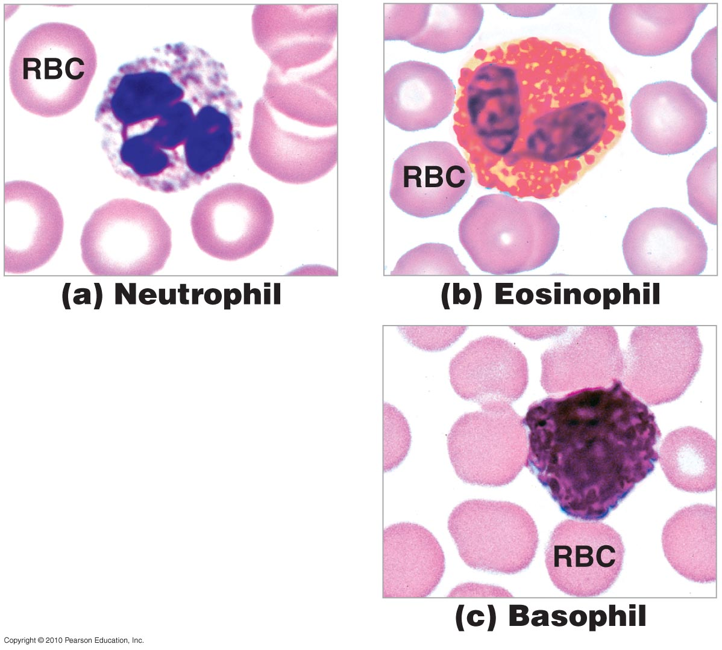
Types of WBCs
Figure 11-8

Slide 51
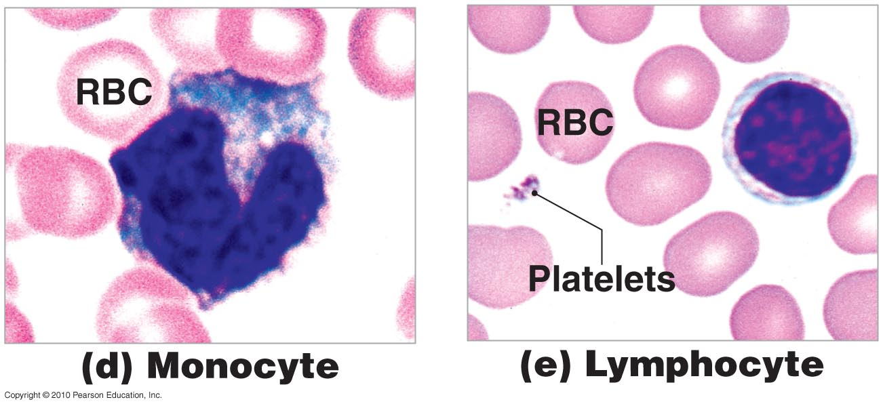
Types of WBCs
Figure 11-8

Slide 52
Types of WBCs
Neutrophils
  Also called polymorphonuclear leukocytes
  50% to 70% of circulating WBCs
  Pale cytoplasm granules with:
    Lysosomal enzymes
    Bactericides (hydrogen peroxide and superoxide)

Slide 53
Types of WBCs
Eosinophils
  Also called acidophils
  2% to 4% of circulating WBCs
  Attack large parasites
  Excrete toxic compounds:
    Nitric oxide
    Cytotoxic enzymes
  Are sensitive to allergens
  Control inflammation with enzymes that counteract inflammatory effects of neutrophils and mast cells

Slide 54
Types of WBCs
Basophils
  Are less than 1% of circulating WBCs
  Are small
  Accumulate in damaged tissue
  Release histamine:
    Dilates blood vessels
  Release heparin:
    Prevents blood clotting

Slide 55
Types of WBCs
Monocytes
  2% to 8% of circulating WBCs
  Are large and spherical
  Enter peripheral tissues and become macrophages
  Engulf large particles and pathogens
  Secrete substances that attract immune system cells and fibrocytes to injured area

Slide 56
Types of WBCs
Lymphocytes
  20% to 30% of circulating WBCs
  Are larger than RBCs
  Migrate in and out of blood
  Mostly in connective tissues and lymphoid organs
  Are part of the body’s specific defense system

Slide 57
Differential Counts
Detects changes in WBC populations
Infections, inflammation, and allergic reactions

Slide 58
WBC Formation
All blood cells originate from hemocytoblasts
  Which produce myeloid stem cells and lymphoid stem cells
Myeloid Stem Cells
  Differentiate into progenitor cells, which produce all WBCs except lymphocytes
Lymphoid Stem Cells
  Lymphopoiesis: the production of lymphocytes

Slide 59
Figure 11-5

Slide 60
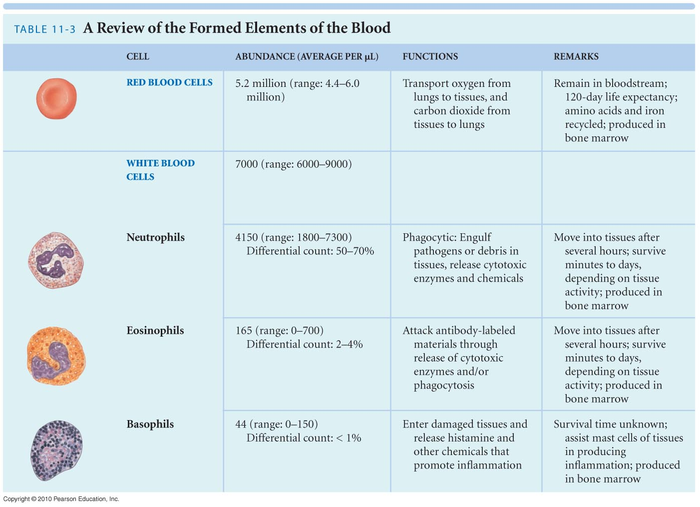

Slide 62
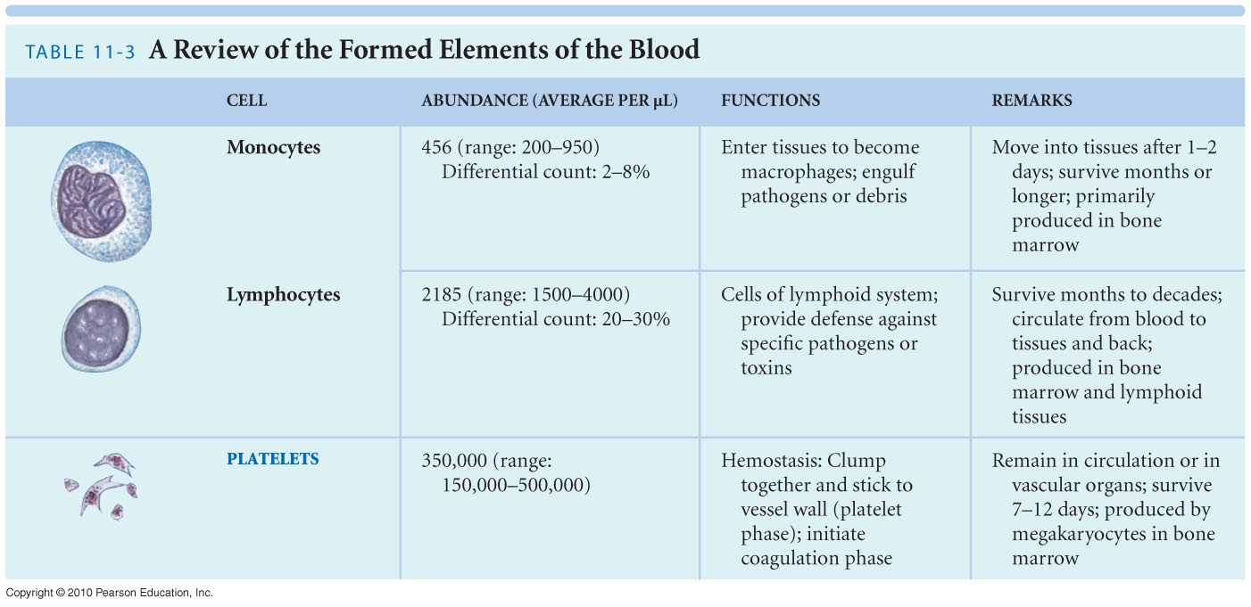

Slide 64
11-6: Platelets, disc-shaped structures formed from megakaryocytes, function in the clotting process

Slide 65
Platelets
Cell fragments involved in human clotting system
  Nonmammalian vertebrates have thrombocytes (nucleated cells)
Circulate for 9 to 12 days
Are removed by spleen
Two-thirds are reserved for emergencies

Slide 66
Platelets
Platelet Counts
  150,000 to 500,000 per microliter
  Thrombocytopenia:
    Abnormally low platelet count
  Thrombocytosis:
    Abnormally high platelet count

Slide 67
11-7: Hemostasis involves vascular spasm, platelet plug formation, and blood coagulation

Slide 68
Phases of Hemostasis
Hemostasis is the cessation of bleeding
Consists of three phases
  Vascular phase
  Platelet phase
  Coagulation phase

Slide 69
Phases of Hemostasis
The Vascular Phase
  A cut triggers vascular spasm that lasts 30 minutes
  Three steps of the vascular phase:
    Endothelial cells contract:
      expose basal lamina to bloodstream
    Endothelial cells release:
      chemical factors: ADP, tissue factor, and prostacyclin
      local hormones: endothelins
      stimulate smooth muscle contraction and cell division
    Endothelial plasma membranes become “sticky”:
      seal off blood flow

Slide 70
Phases of Hemostasis
The Platelet Phase
  Begins within 15 seconds after injury
  Platelet adhesion (attachment):
    To sticky endothelial surfaces
    To basal laminae
    To exposed collagen fibers
  Platelet aggregation (stick together):
    Forms platelet plug
    Closes small breaks
Figure 19–11b

Slide 71
Phases of Hemostasis
The Coagulation Phase
  Begins 30 seconds or more after the injury
  Blood clotting (coagulation):
    Cascade reactions:
      chain reactions of enzymes and proenzymes
      form three pathways
      convert circulating fibrinogen into insoluble fibrin
Figure 19–12a

Slide 72
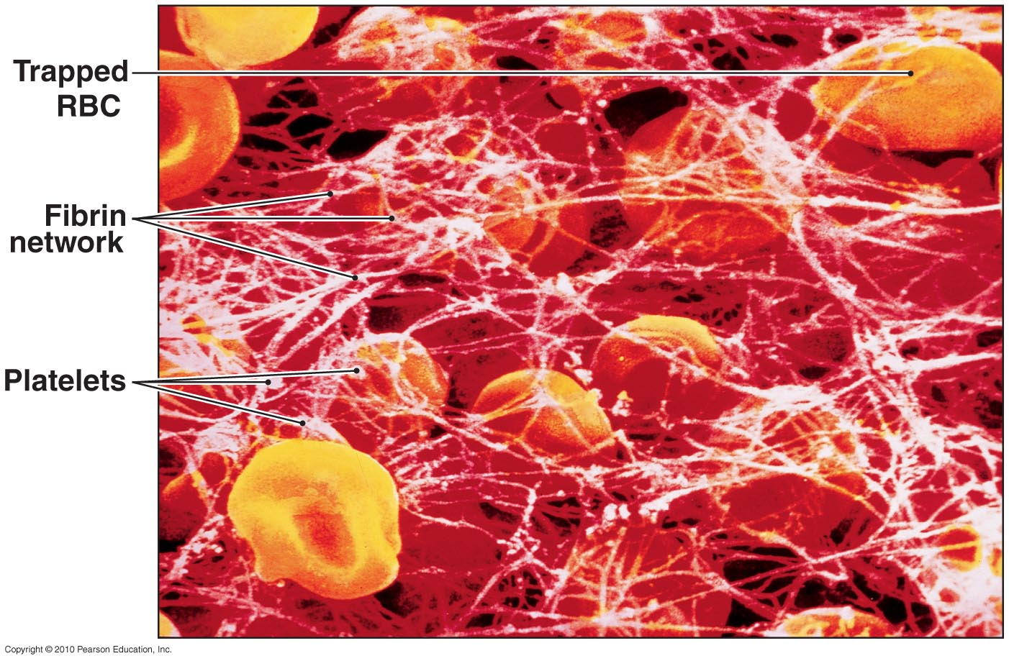
The Coagulation Phase of Hemostasis
Figure 11-9

Slide 73
Hemostasis
Three Coagulation Pathways
  Extrinsic pathway:
    Begins in the vessel wall
    Outside bloodstream
  Intrinsic pathway:
    Begins with circulating proenzymes
    Within bloodstream
  Common pathway:
    Where intrinsic and extrinsic pathways converge

Slide 74
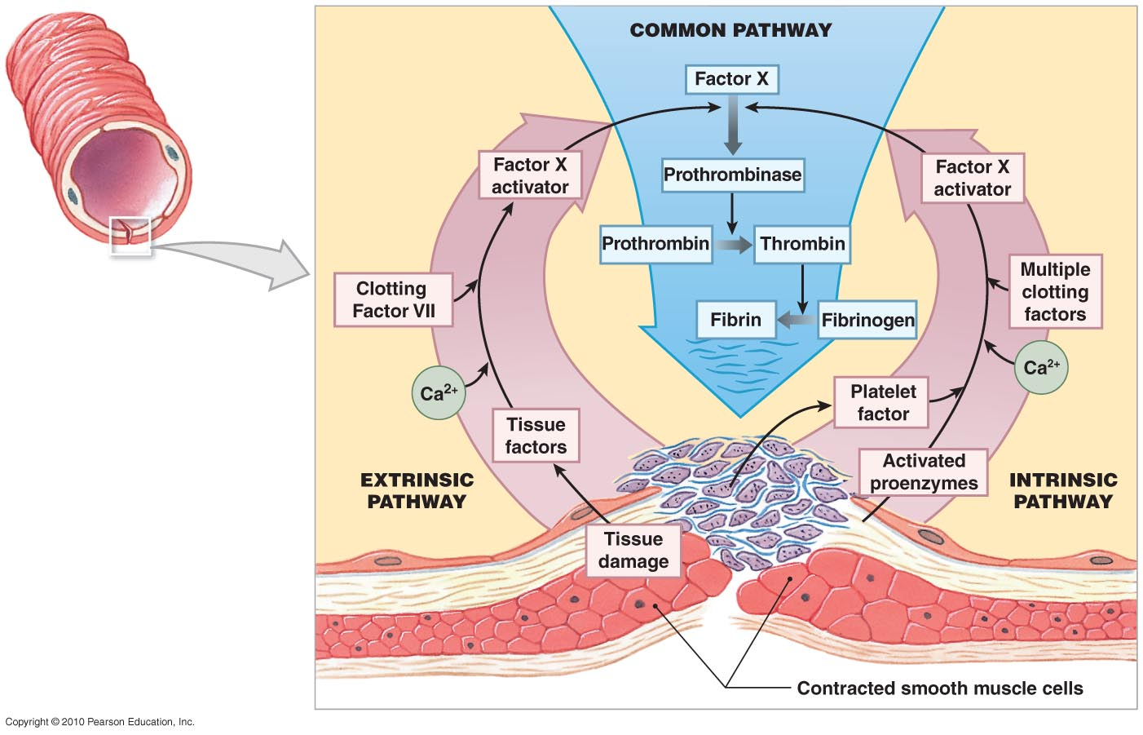
The Coagulation Phase of Hemostasis
Figure 11-10

Slide 75
Clot Retraction and Removal
Clot Retraction
  After clot has formed:
    Platelets contract and pull torn area together
  Takes 30 to 60 minutes

Slide 76
Clot Retraction and Removal
Fibrinolysis
  Slow process of dissolving clot:
    Thrombin and tissue plasminogen activator (t-PA):
      activate plasminogen
  Plasminogen produces plasmin:
    Digests fibrin strands

