Slide 1
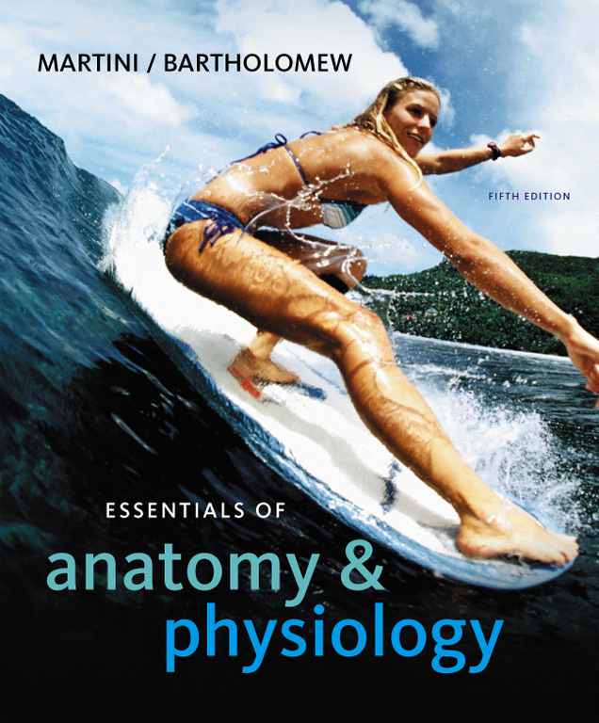
C h a p t e r
12
The Cardiovascular System: The Heart
PowerPoint® Lecture Slides prepared by Jason LaPres
Lone Star College - North Harris
Copyright © 2010 Pearson Education, Inc.

Slide 2
Introduction to Cardiovascular System
The Pulmonary Circuit
  Carries blood to and from gas exchange surfaces of lungs
The Systemic Circuit
  Carries blood to and from the body
Blood alternates between pulmonary circuit and systemic circuit

Slide 3
Introduction to Cardiovascular System
Three Types of Blood Vessels
  Arteries:
    Carry blood away from the heart
  Veins:
    Carry blood to the heart
  Capillaries:
    Networks between arteries and veins

Slide 4
Introduction to Cardiovascular System
Capillaries
  Also called exchange vessels
  Exchange materials between blood and tissues
  Materials include dissolved gases, nutrients, wastes

Slide 5
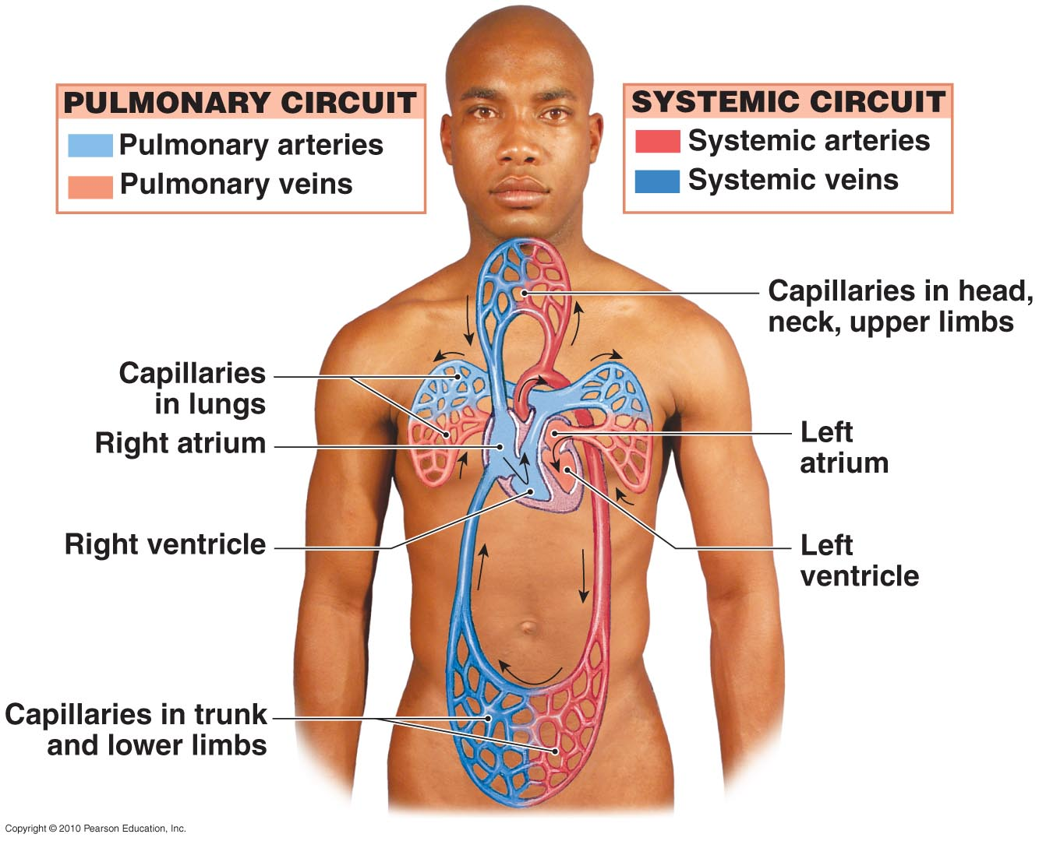
Overview of the Cardiovascular System
Figure 12-1

Slide 6
12-1: The heart is a four-chambered organ, supplied by coronary circulation, that pumps oxygen-poor blood to the lungs and oxygen-rich blood to the rest of the body

Slide 7
Four Chambers of the Heart
Right Atrium
  Collects blood from systemic circuit
Right Ventricle
  Pumps blood to pulmonary circuit
Left Atrium
  Collects blood from pulmonary circuit
Left Ventricle
  Pumps blood to systemic circuit

Slide 8
Anatomy of the Heart
Great veins and arteries at the base
Pointed tip is apex
Surrounded by pericardial sac
Sits between two pleural cavities in the mediastinum
Figure 20–2c

Slide 9
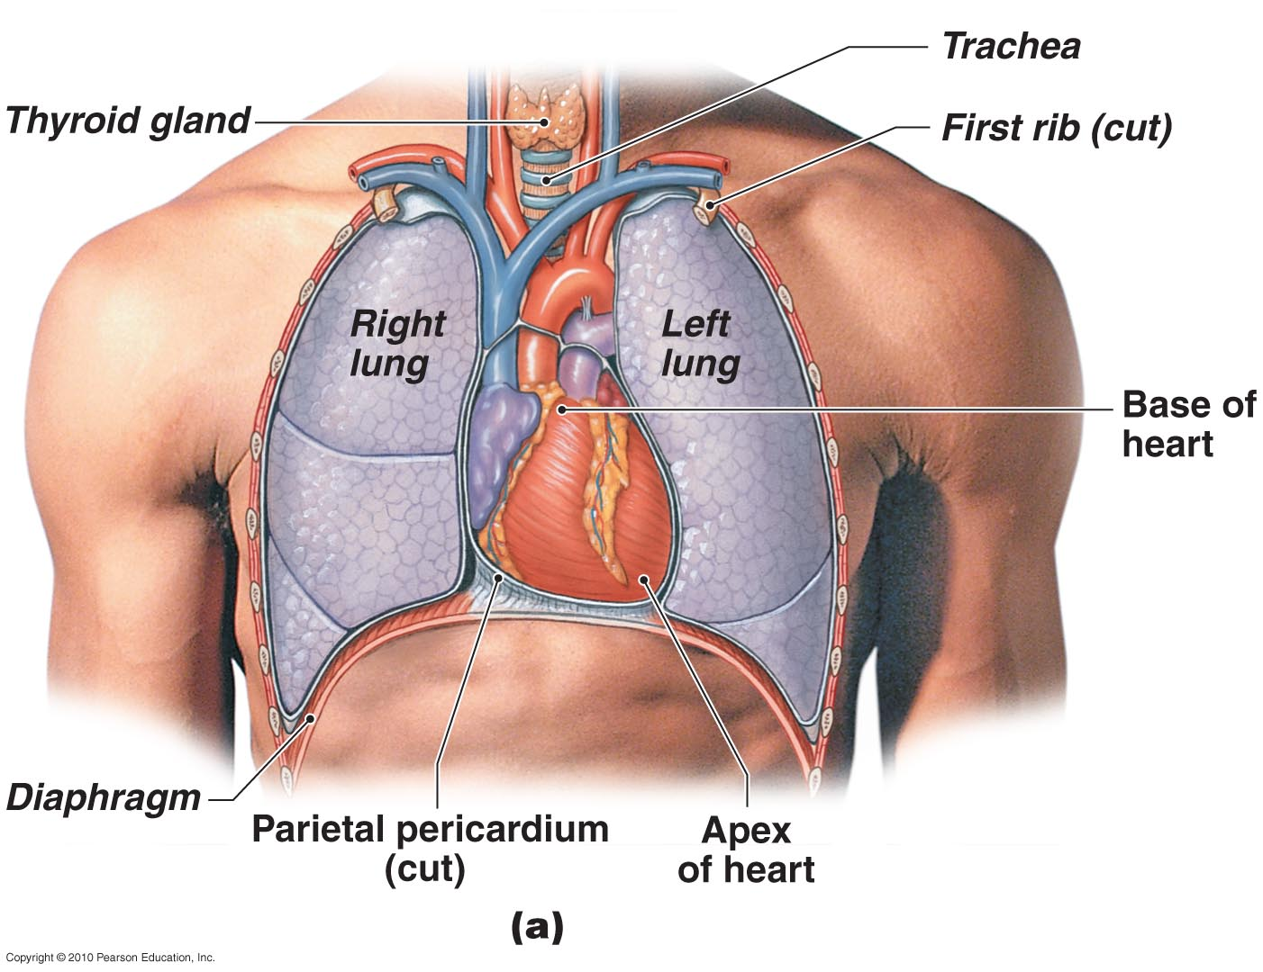
The Location of the Heart in the Thoracic Cavity
Figure 12-2a

Slide 10
Anatomy of the Heart
The Pericardium
  Double lining of the pericardial cavity
  Parietal pericardium:
    Outer layer
    Forms inner layer of pericardial sac
  Visceral pericardium:
    Inner layer of pericardium
Figure 20–2c

Slide 11
Anatomy of the Heart
The Pericardium
  Pericardial cavity:
    Is between parietal and visceral layers
    Contains pericardial fluid
  Pericardial sac:
    Fibrous tissue
    Surrounds and stabilizes the heart

Slide 12
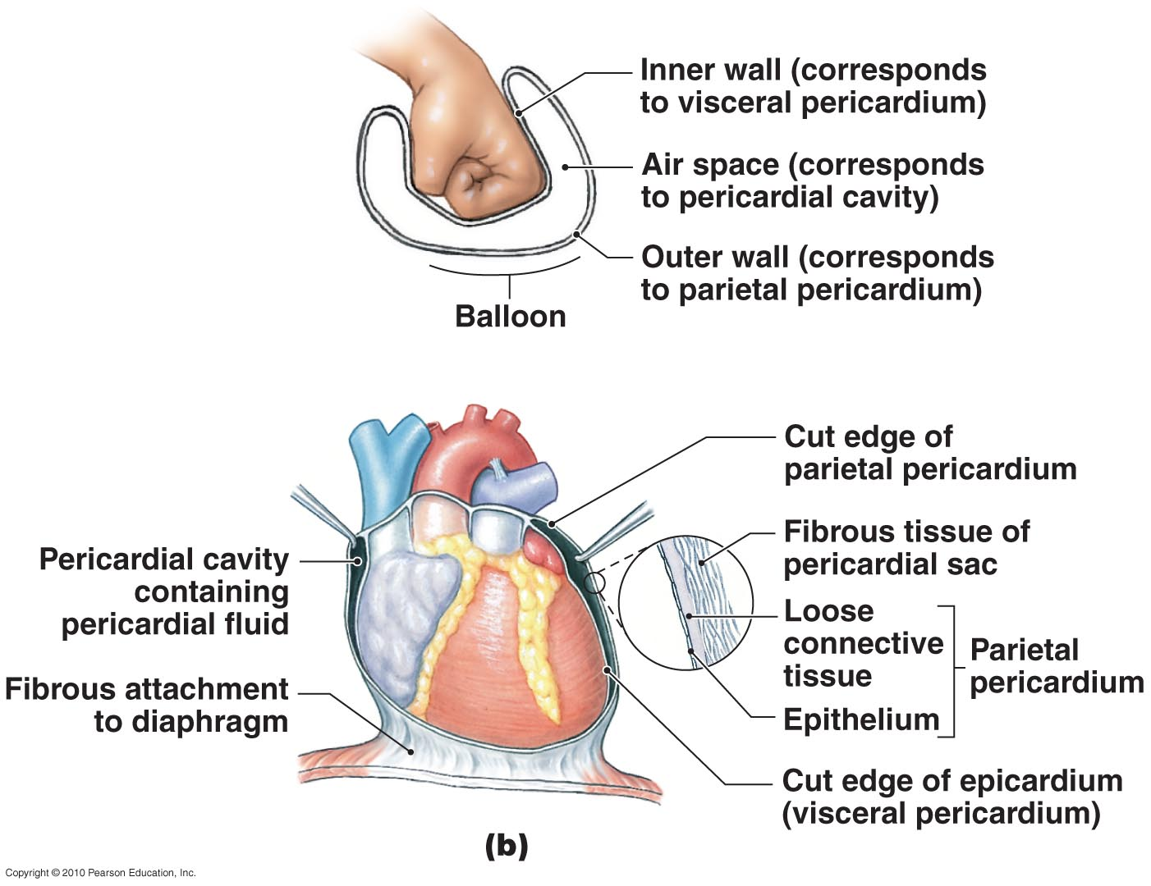
The Location of the Heart in the Thoracic Cavity
Figure 12-2b

Slide 13
The Surface Anatomy of the Heart
Atria
  Thin walled
  Expandable outer auricle (atrial appendage)
Sulci
  Coronary sulcus: divides atria and ventricles
  Anterior interventricular sulcus and posterior interventricular sulcus:
    separate left and right ventricles
    contain blood vessels of cardiac muscle

Slide 14
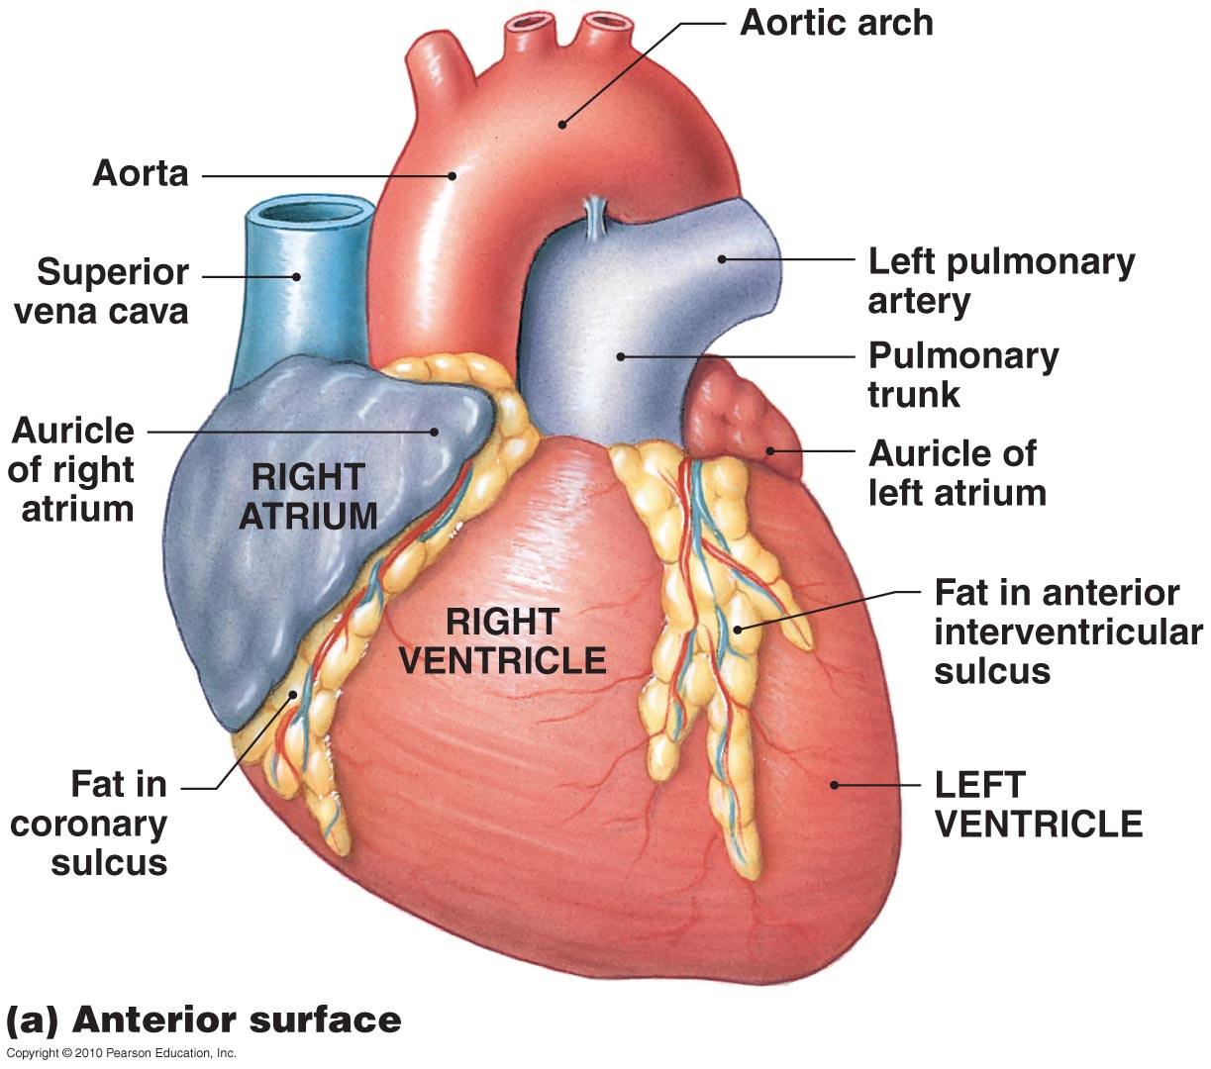
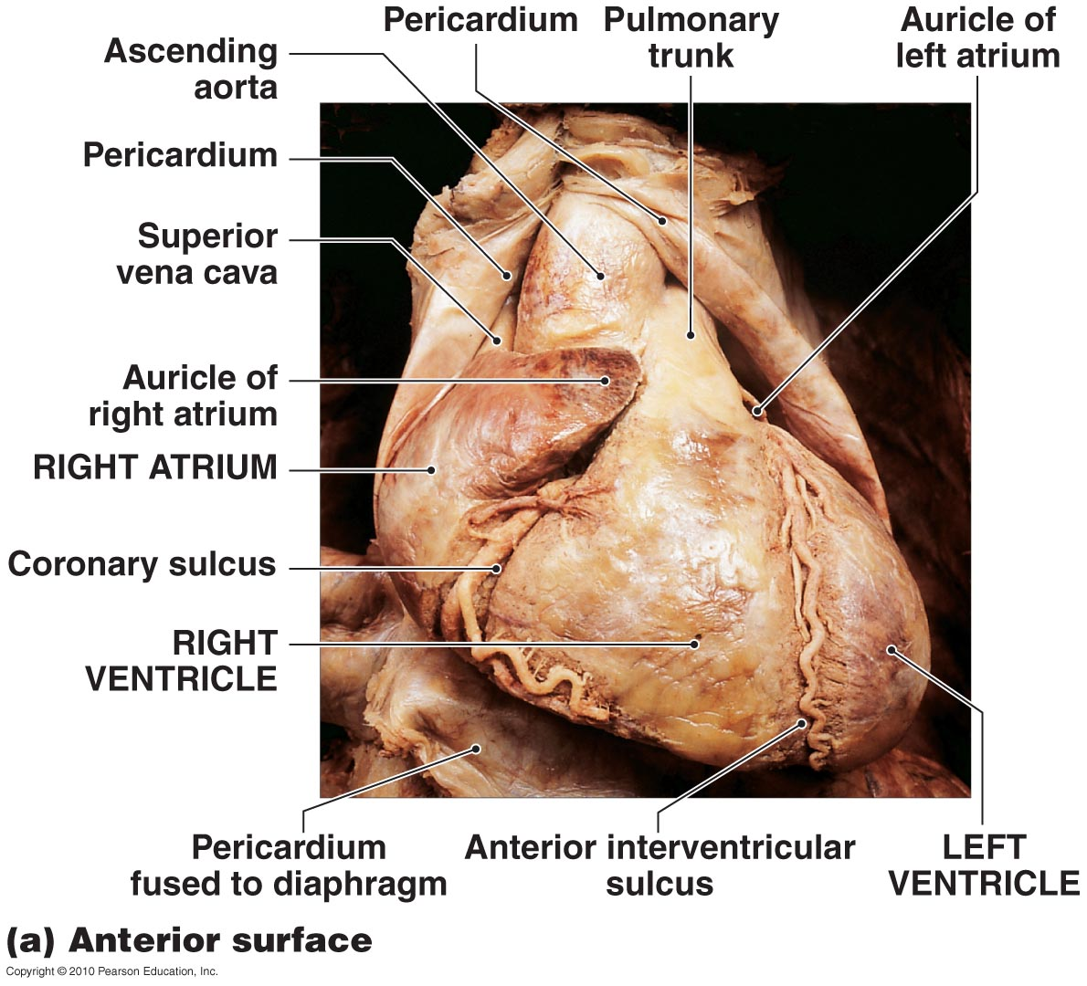
The Surface Anatomy of the Heart
Figure 12-3a

Slide 15
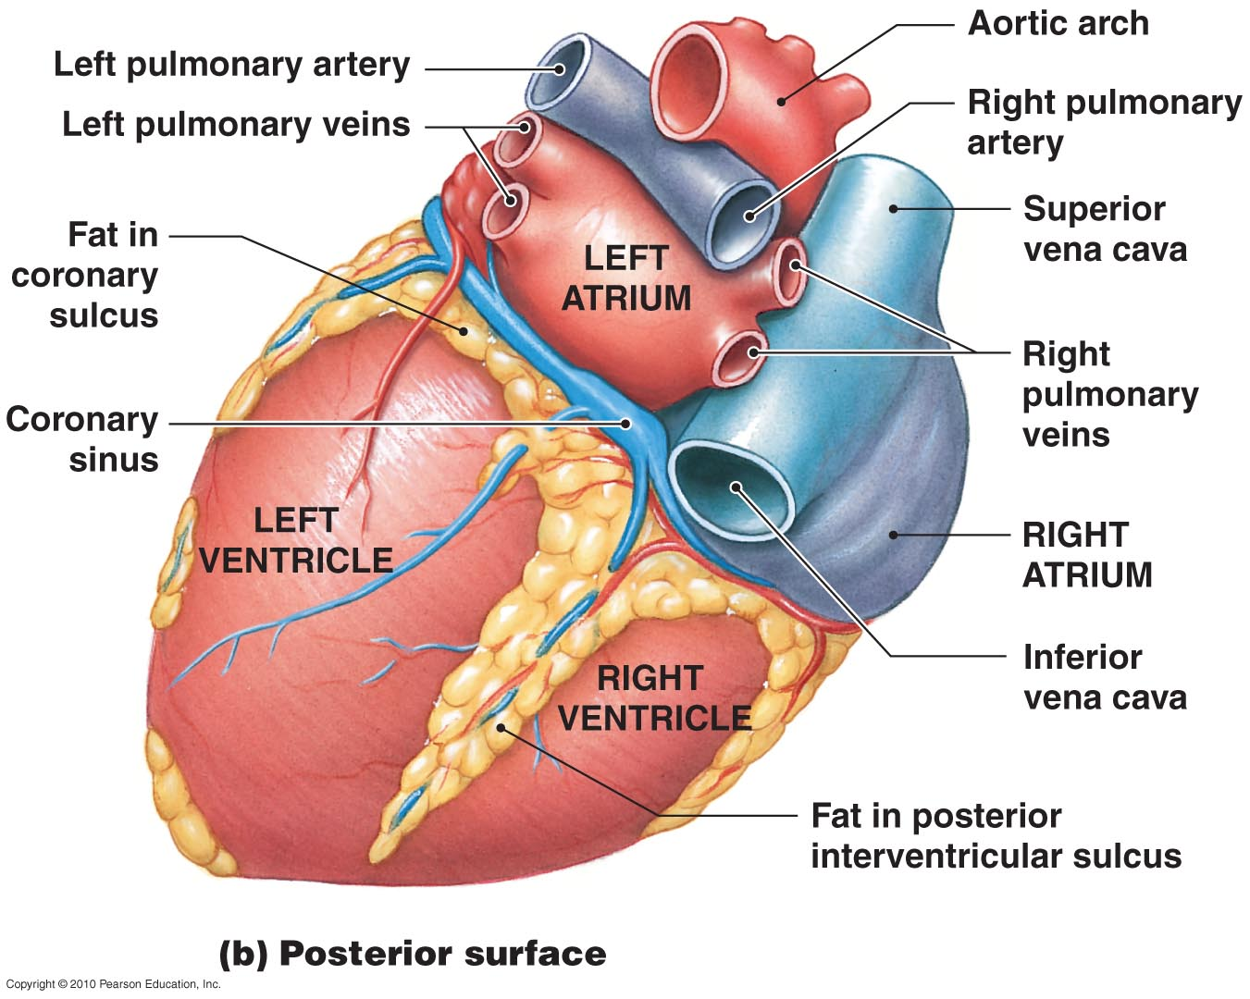
The Surface Anatomy of the Heart
Figure 12-3b

Slide 16
The Heart Wall
Epicardium (Outer Layer)
  Visceral pericardium
  Covers the heart
Myocardium (Middle Layer)
  Muscular wall of the heart
  Concentric layers of cardiac muscle tissue
  Atrial myocardium wraps around great vessels
  Two divisions of ventricular myocardium
Endocardium (Inner Layer)
  Simple squamous epithelium

Slide 17
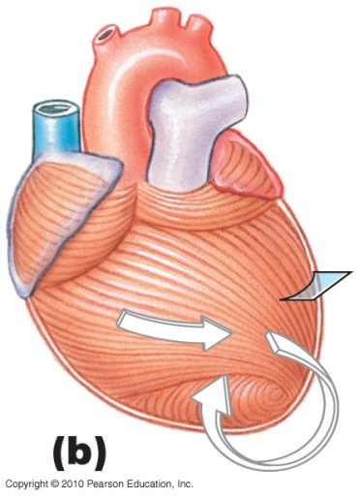
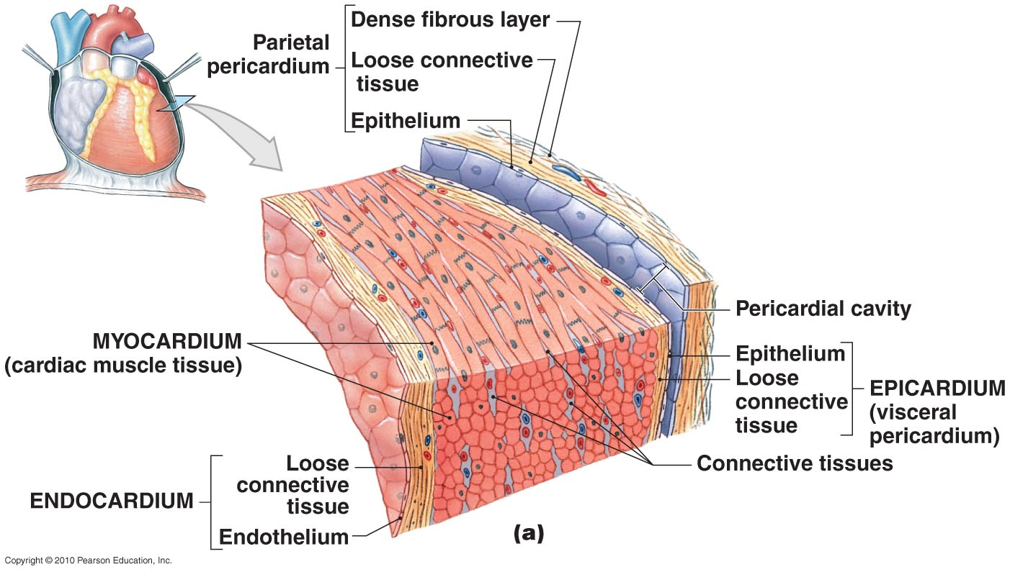
The Heart Wall and Cardiac Muscle
Figure 12-4 a,b

Slide 18
The Heart Wall
Cardiac Muscle Tissue
  Intercalated discs:
    Interconnect cardiac muscle cells
    Secured by desmosomes
    Linked by gap junctions
    Convey force of contraction
    Propagate action potentials

Slide 19
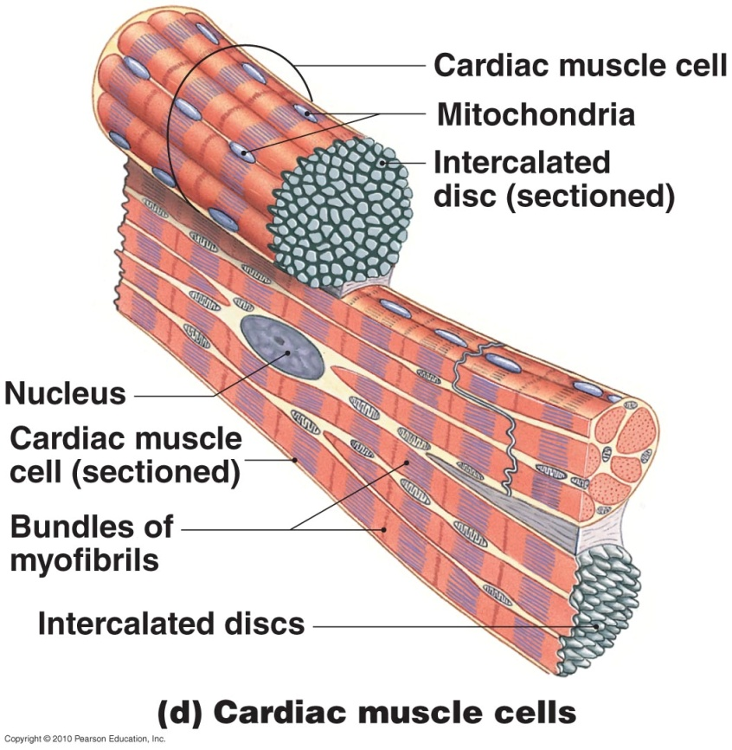
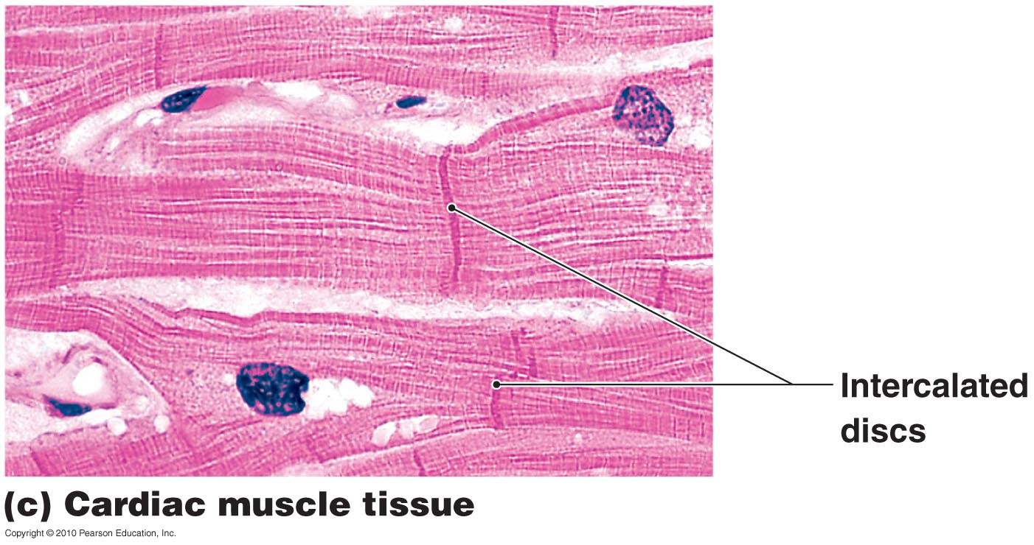
Cardiac Muscle Cells
Figure 12-4 c,d

Slide 20
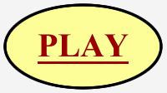
Internal Anatomy and Organization
Interatrial septum: separates atria
Interventricular septum: separates ventricles
Atrioventricular (AV) valves
  Connect right atrium to right ventricle and left atrium to left ventricle
  The fibrous flaps that form bicuspid (2) and tricuspid (3) valves
  Permit blood flow in one direction: atria to ventricles
The Heart: Valves

Slide 21
Internal Anatomy and Organization
The Right Atrium
  Superior vena cava:
    Receives blood from head, neck, upper limbs, and chest
  Inferior vena cava:
    Receives blood from trunk, viscera, and lower limbs
  Coronary sinus:
    Cardiac veins return blood to coronary sinus
    Coronary sinus opens into right atrium

Slide 22
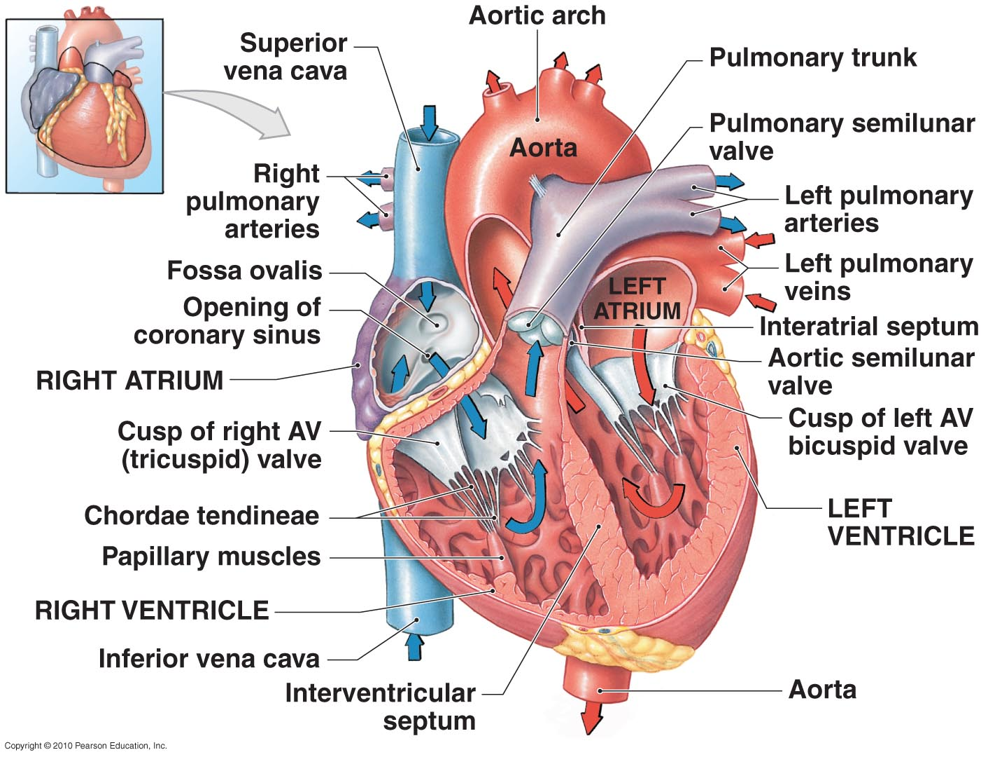
Sectional Anatomy of the Heart
Figure 12-5

Slide 23
Internal Anatomy and Organization
The Right Ventricle
  Free edges attach to chordae tendineae from papillary muscles of ventricle
  Prevent valve from opening backward
  Right atrioventricular (AV) valve:
    Also called tricuspid valve
    Opening from right atrium to right ventricle
    Has three cusps
    Prevents backflow

Slide 24
Internal Anatomy and Organization
The Left Atrium
  Blood gathers into left and right pulmonary veins
  Pulmonary veins deliver to left atrium
  Blood from left atrium passes to left ventricle through left atrioventricular (AV) valve
  A two-cusped bicuspid valve or mitral valve

Slide 25
Internal Anatomy and Organization
The Left Ventricle
  Holds same volume as right ventricle
  Is larger; muscle is thicker and more powerful
  Similar internally to right ventricle but does not have moderator band
  Systemic circulation:
    Blood leaves left ventricle through aortic valve into ascending aorta
    Ascending aorta turns (aortic arch) and becomes descending aorta

Slide 26
Internal Anatomy and Organization
Structural Differences between the Left and Right Ventricles
  Right ventricle wall is thinner, develops less pressure than left ventricle
  Right ventricle is pouch-shaped; left ventricle is round

Slide 27
Internal Anatomy and Organization
The Heart Valves
  Two pairs of one-way valves prevent backflow during contraction
  Atrioventricular (AV) valves:
    Between atria and ventricles
    Blood pressure closes valve cusps during ventricular contraction
    Papillary muscles tense chordae tendineae: prevent valves from swinging into atria
Figure 20–8

Slide 28
Internal Anatomy and Organization
The Heart Valves
  Semilunar valves:
    Pulmonary and aortic tricuspid valves
    Prevent backflow from pulmonary trunk and aorta into ventricles
    Have no muscular support
    Three cusps support like tripod
Figure 20–8

Slide 29
Internal Anatomy and Organization
Aortic Sinuses
  At base of ascending aorta
  Sacs that prevent valve cusps from sticking to aorta
  Origin of right and left coronary arteries

Slide 30
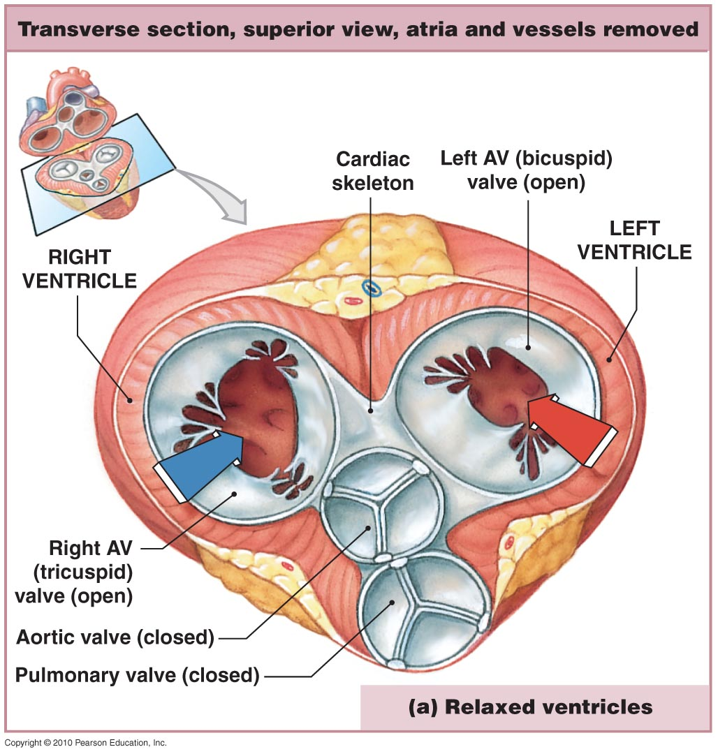
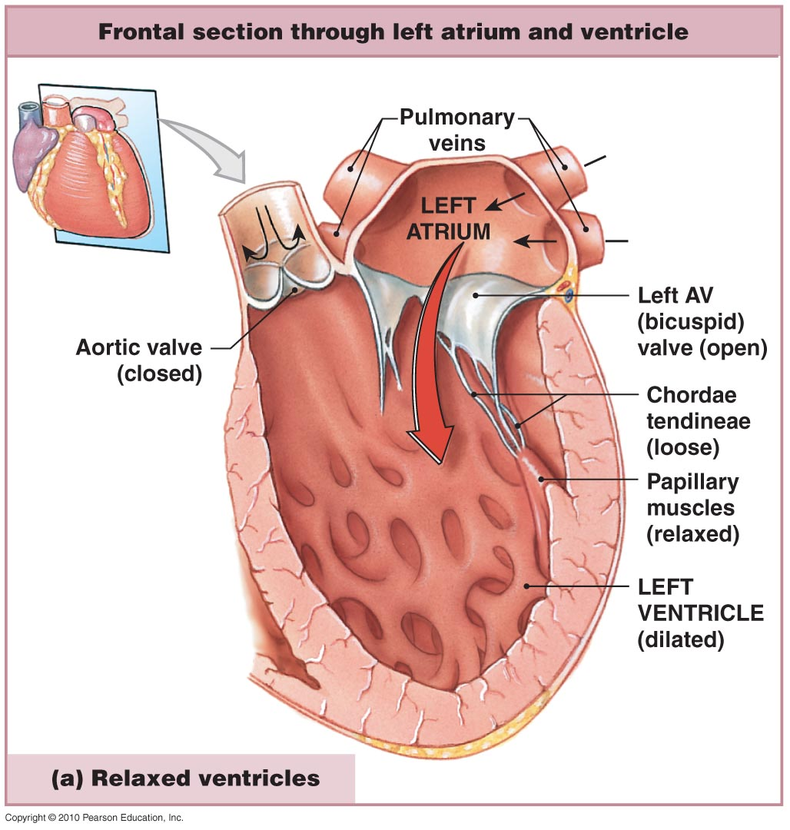
The Valves of the Heart
Figure 12-6a

Slide 31
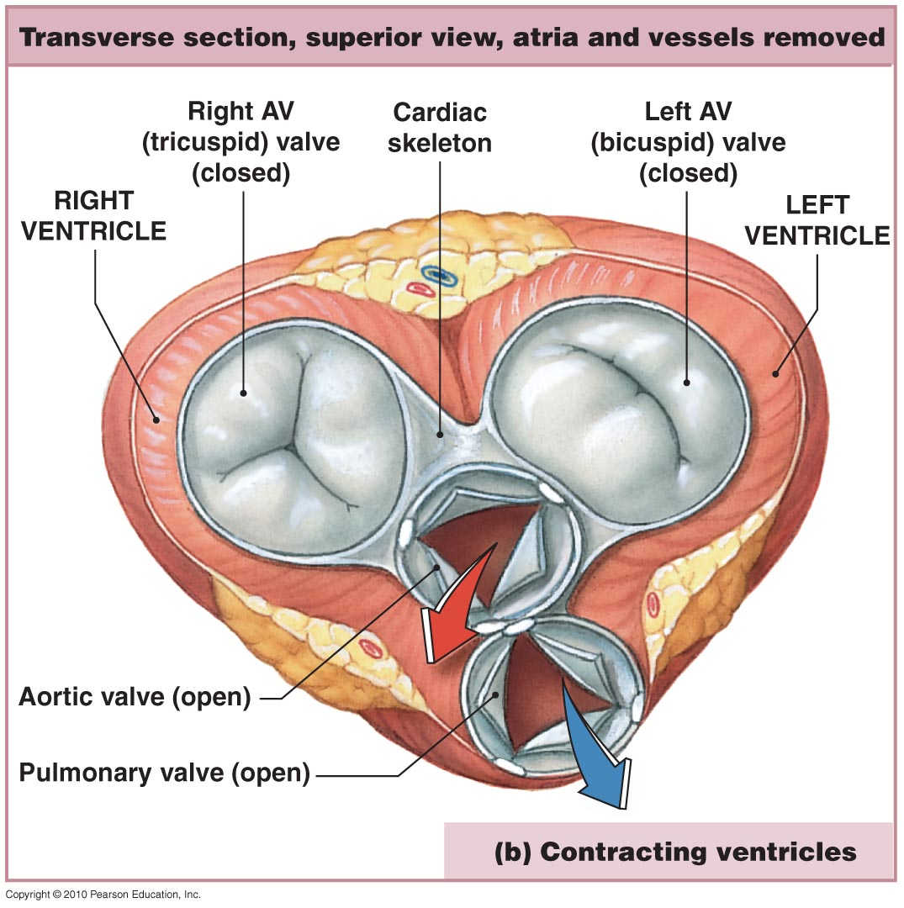
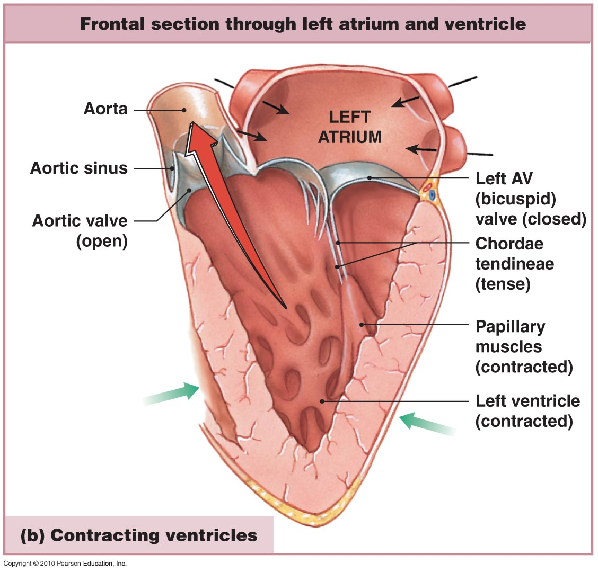
The Valves of the Heart
Figure 12-6b

Slide 32
Internal Anatomy and Organization
The Cardiac Skeleton of the Heart
  Physically support cardiac muscle fibers
  Distribute forces of contraction
  Add strength and prevent overexpansion of heart
  Elastic fibers return heart to original shape after contraction

Slide 33
Internal Anatomy and Organization
The Cardiac (Fibrous) Skeleton
  Four bands around heart valves and bases of pulmonary trunk and aorta
  Stabilize valves
  Electrically insulate ventricular cells from atrial cells

Slide 34
Internal Anatomy and Organization
The Blood Supply to the Heart = Coronary Circulation
  Coronary arteries and cardiac veins
  Supplies blood to muscle tissue of heart

Slide 35
Internal Anatomy and Organization
The Coronary Arteries
  Left and right
  Originate at aortic sinuses
  High blood pressure, elastic rebound forces blood through coronary arteries between contractions

Slide 36
Internal Anatomy and Organization
Right Coronary Artery
  Supplies blood to:
    Right atrium
    Portions of both ventricles
    Cells of sinoatrial (SA) and atrioventricular nodes
    Marginal arteries (surface of right ventricle)
    Posterior interventricular artery

Slide 37
Internal Anatomy and Organization
Left Coronary Artery
  Supplies blood to:
    Left ventricle
    Left atrium
    Interventricular septum

Slide 38
Internal Anatomy and Organization
Two main branches of left coronary artery
  Circumflex artery
  Anterior interventricular artery
Arterial Anastomoses
  Interconnect anterior and posterior interventricular arteries
  Stabilize blood supply to cardiac muscle

Slide 39
Internal Anatomy and Organization
The Cardiac Veins
  Great cardiac vein:
    Drains blood from area of anterior interventricular artery into coronary sinus
  Anterior cardiac veins:
    Empties into right atrium
  Posterior cardiac vein, middle cardiac vein, and small cardiac vein:
    Empty into great cardiac vein or coronary sinus

Slide 40
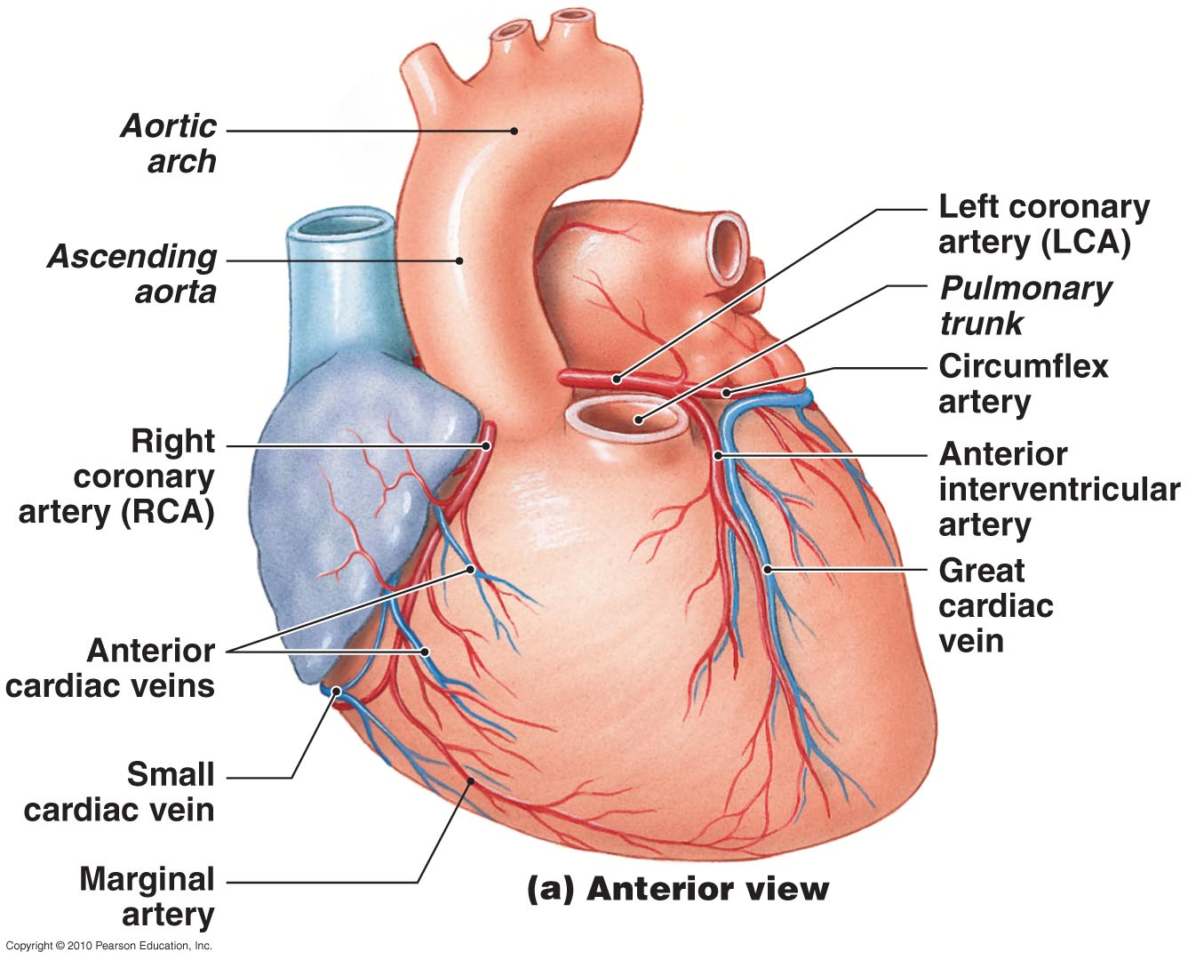
Coronary Circulation
Figure 12-7a

Slide 41
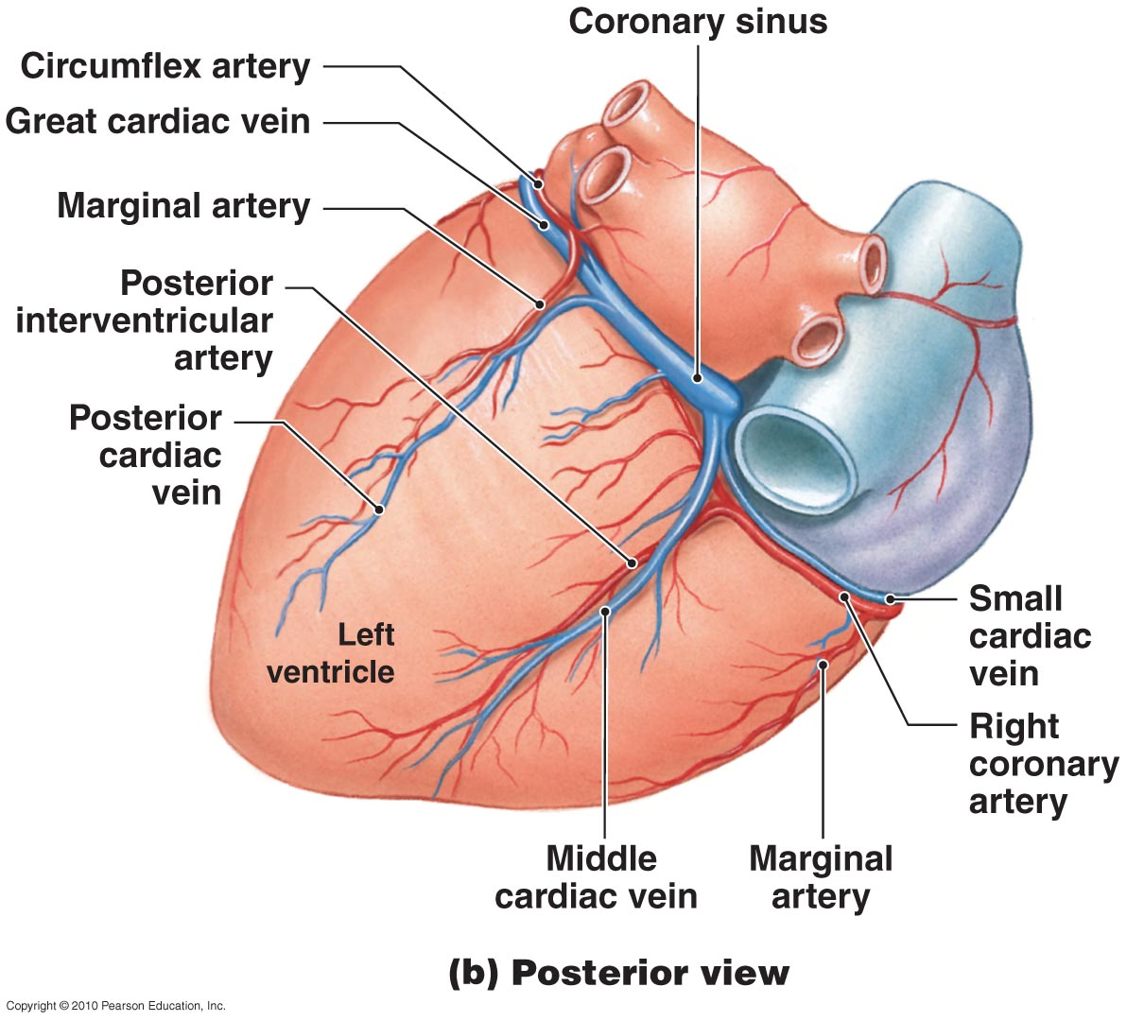
Coronary Circulation
Figure 12-7b

Slide 42
12-2: Contractile cells and the conducting system produce each heartbeat, and an electrocardiogram records the associated electrical events

Slide 43
The Conducting System
Heartbeat
  A single contraction of the heart
  The entire heart contracts in series:
    First the atria
    Then the ventricles

Slide 44
The Conducting System
Two Types of Cardiac Muscle Cells
  Contractile cells:
    Produce contractions that propel blood
  Conducting system:
    Controls and coordinates heartbeat

Slide 45
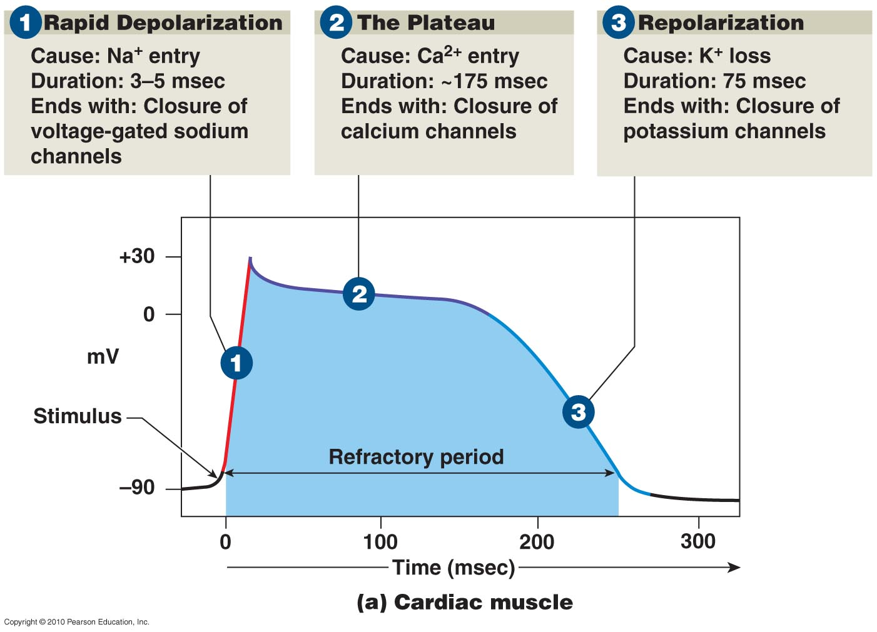
The Action Potential in Skeletal and Cardiac Muscle
Figure 12-8a

Slide 46
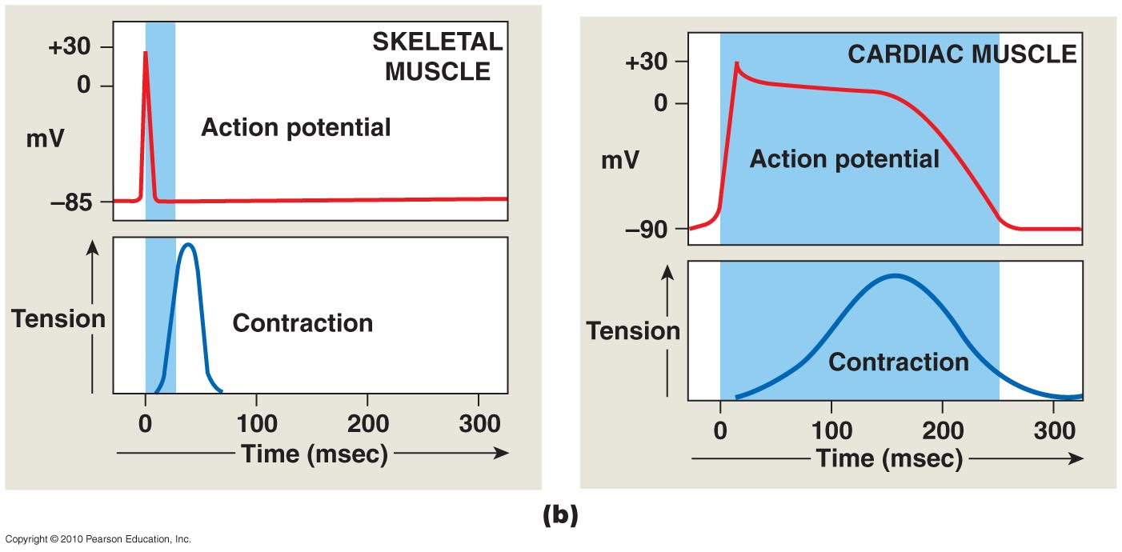
The Action Potential in Skeletal and Cardiac Muscle
Figure 12-8b

Slide 47
Contractile Cells
The Role of Calcium Ions in Cardiac Contractions
  Contraction of a cardiac muscle cell is produced by an increase in calcium ion concentration around myofibrils

Slide 48
Contractile Cells
The Role of Calcium Ions in Cardiac Contractions
  20% of calcium ions required for a contraction:
    Calcium ions enter plasma membrane during plateau phase
  Arrival of extracellular Ca²⁺:
    Triggers release of calcium ion reserves from sarcoplasmic reticulum

Slide 49
The Conducting System
A system of specialized cardiac muscle cells
  Initiates and distributes electrical impulses that stimulate contraction
Automaticity
  Cardiac muscle tissue contracts automatically

Slide 50
The Conducting System
Structures of the Conducting System
  Sinoatrial (SA) node — wall of right atrium
  Atrioventricular (AV) node — junction between atria and ventricles
  Conducting cells — throughout myocardium

Slide 51
The Conducting System
Conducting Cells
  Interconnect SA and AV nodes
  Distribute stimulus through myocardium
  In the atrium:
    Internodal pathways
  In the ventricles:
    AV bundle and the bundle branches

Slide 52
The Conducting System
Heart Rate
  SA node generates 70 to 80 action potentials per minute
  AV node generates 40 to 60 action potentials per minute

Slide 53
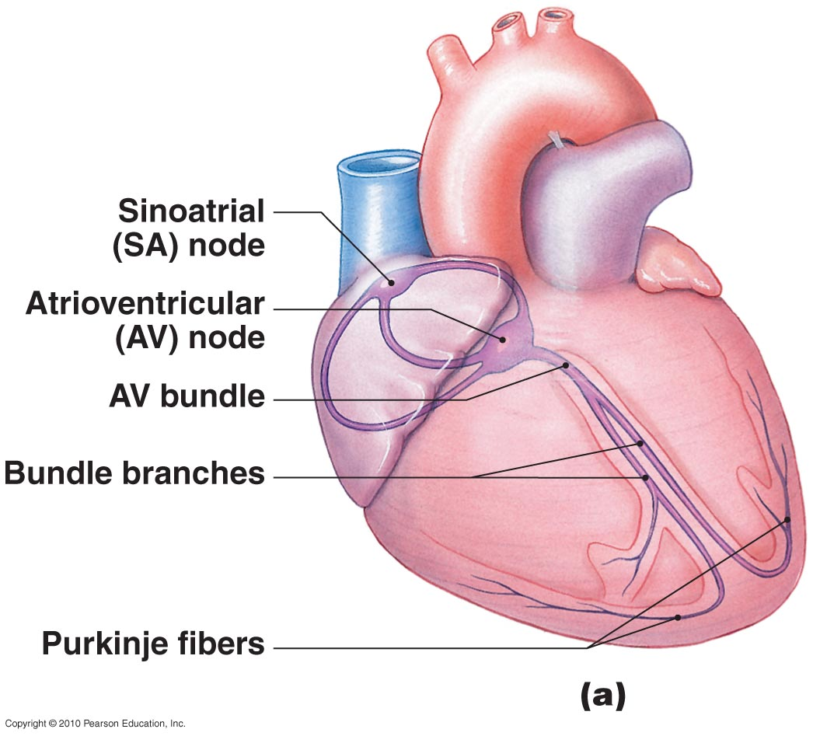
The Conducting System
Figure 12-9a

Slide 54
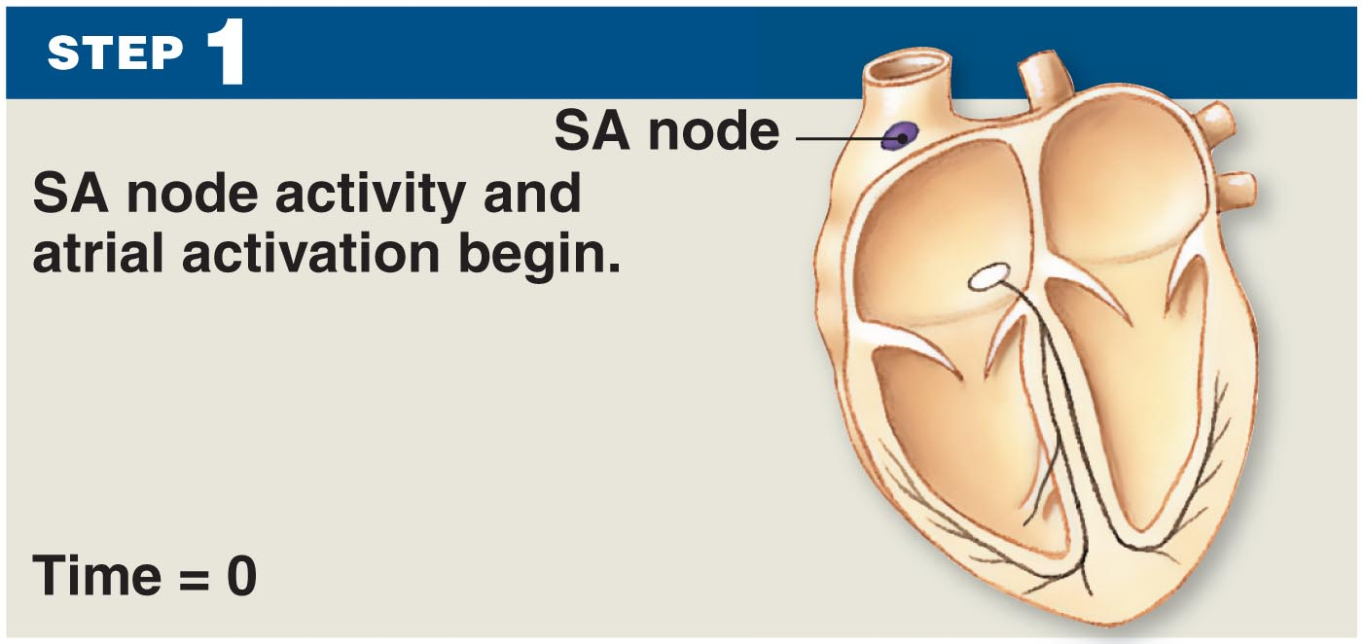
The Conducting System
Figure 12-9

Slide 55
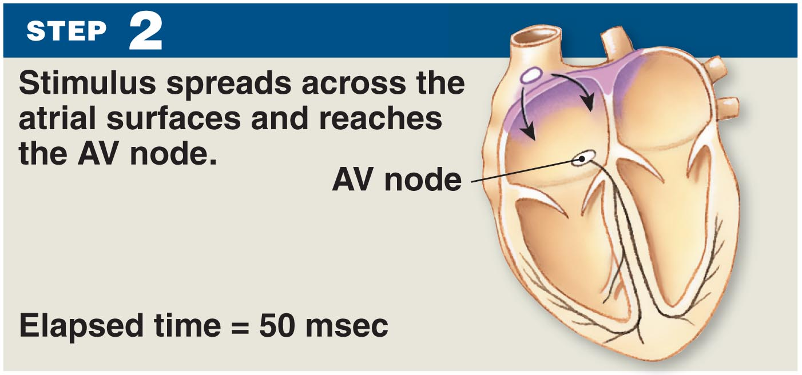
The Conducting System
Figure 12-9

Slide 56
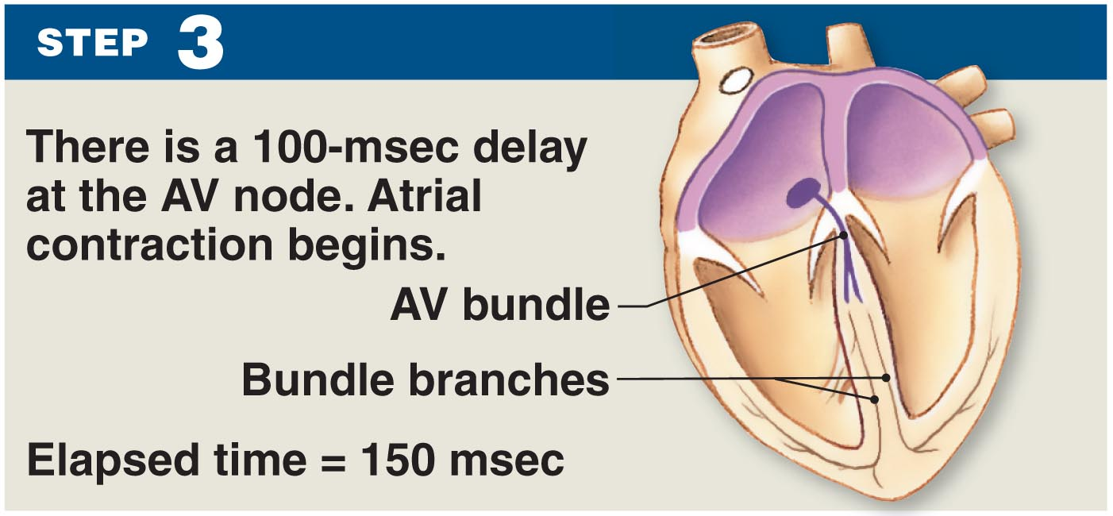
The Conducting System
Figure 12-9

Slide 57
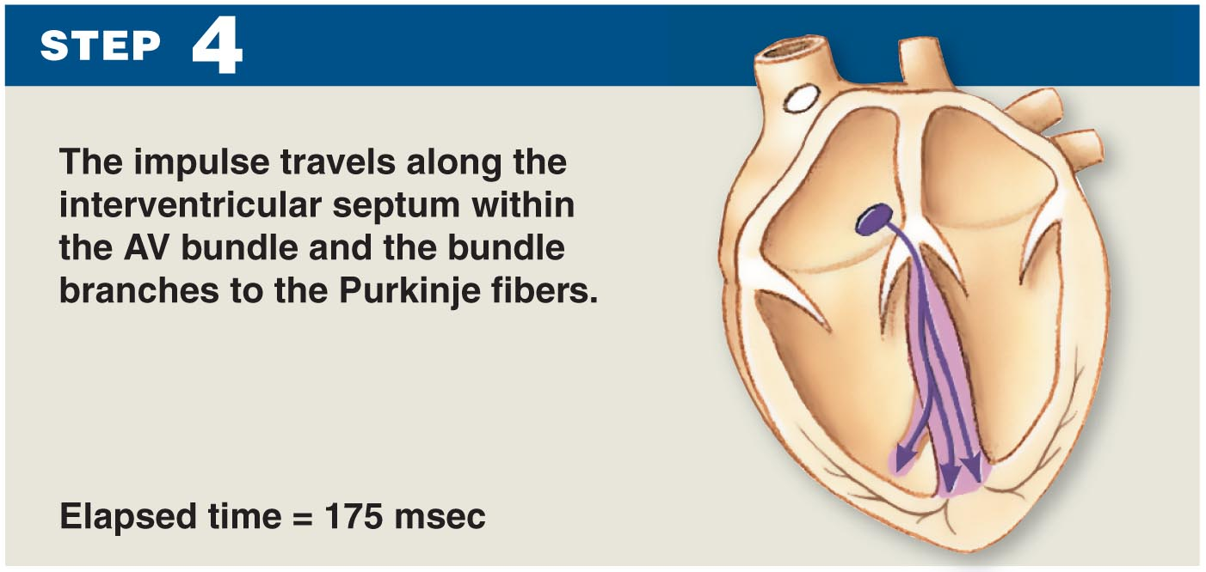
The Conducting System
Figure 12-9

Slide 58
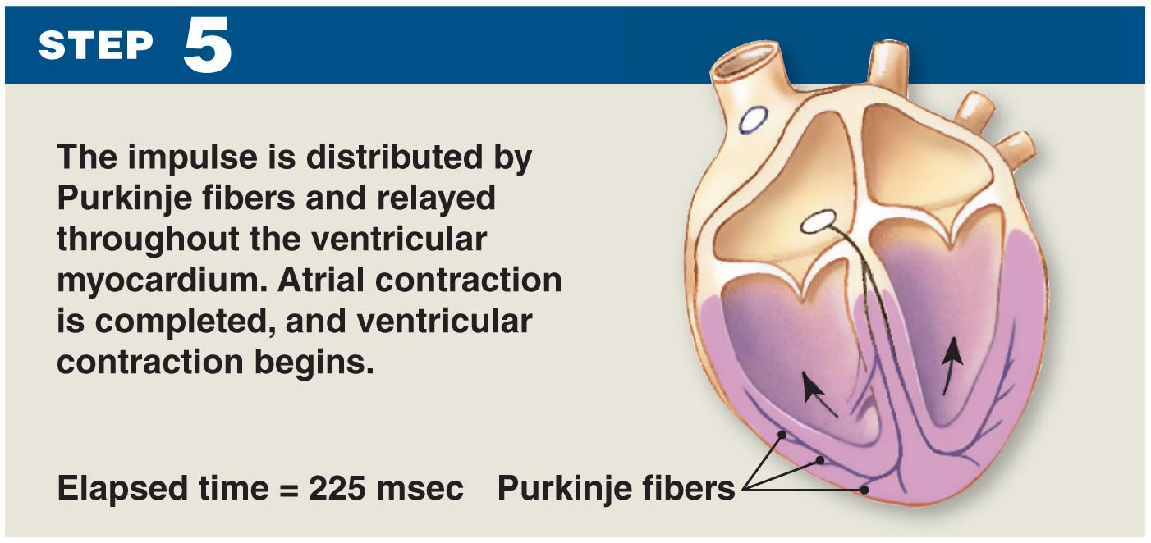
The Conducting System
Figure 12-9

Slide 59
The Conducting System
Abnormal Pacemaker Function
  Bradycardia: abnormally slow heart rate
  Tachycardia: abnormally fast heart rate
  Ectopic pacemaker:
    Abnormal cells
    Generate high rate of action potentials
    Bypass conducting system
    Disrupt ventricular contractions

Slide 60
The Electrocardiogram
A recording of electrical events in the heart
Obtained by electrodes at specific body locations
Abnormal patterns diagnose damage

Slide 61
The Electrocardiogram
Features of an ECG
  P wave:
    Atria depolarize
  QRS complex:
    Ventricles depolarize
  T wave:
    Ventricles repolarize

Slide 62
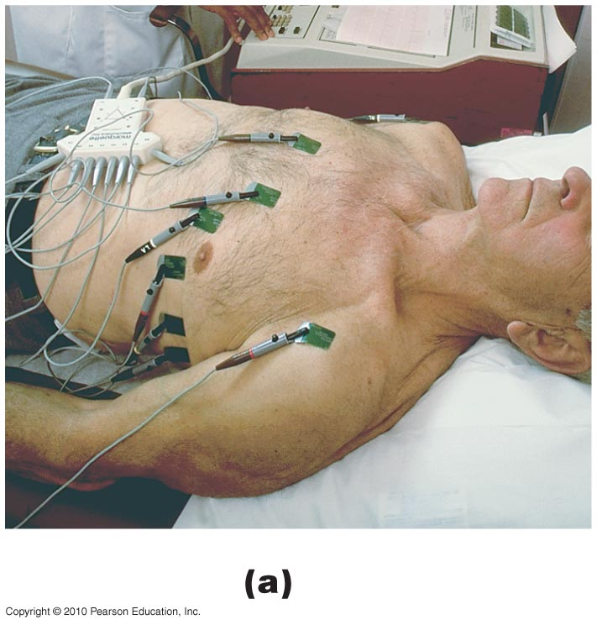
The Electrocardiogram
Figure 12-10a

Slide 63
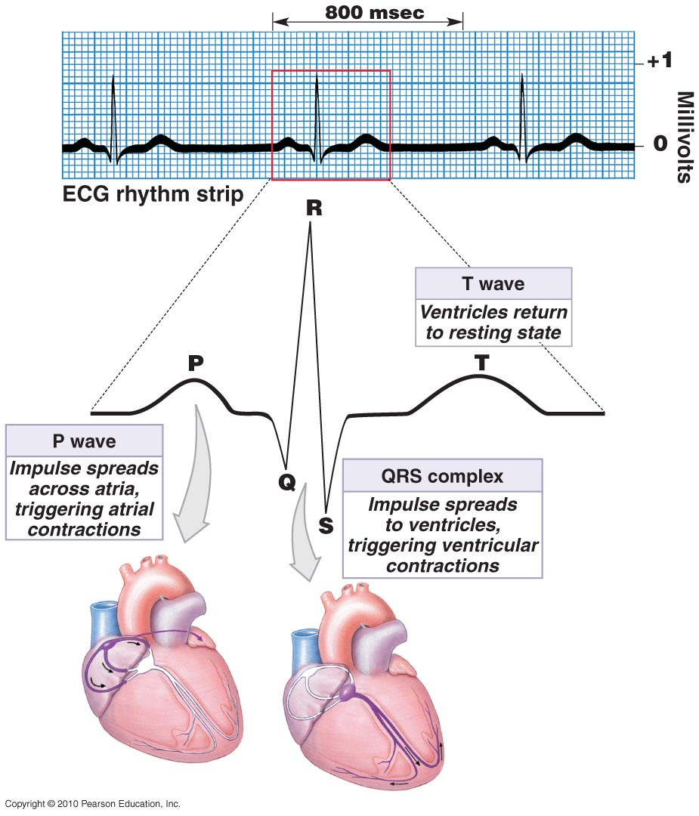
Figure 12-10b

Slide 64
12-3: Events during a complete heartbeat make up a cardiac cycle

Slide 65
The Cardiac Cycle
Cardiac cycle = the period between the start of one heartbeat and the beginning of the next
Includes both contraction and relaxation

Slide 66
The Cardiac Cycle
Phases of the Cardiac Cycle
  Within any one chamber:
    Systole (contraction)
    Diastole (relaxation)

Slide 67
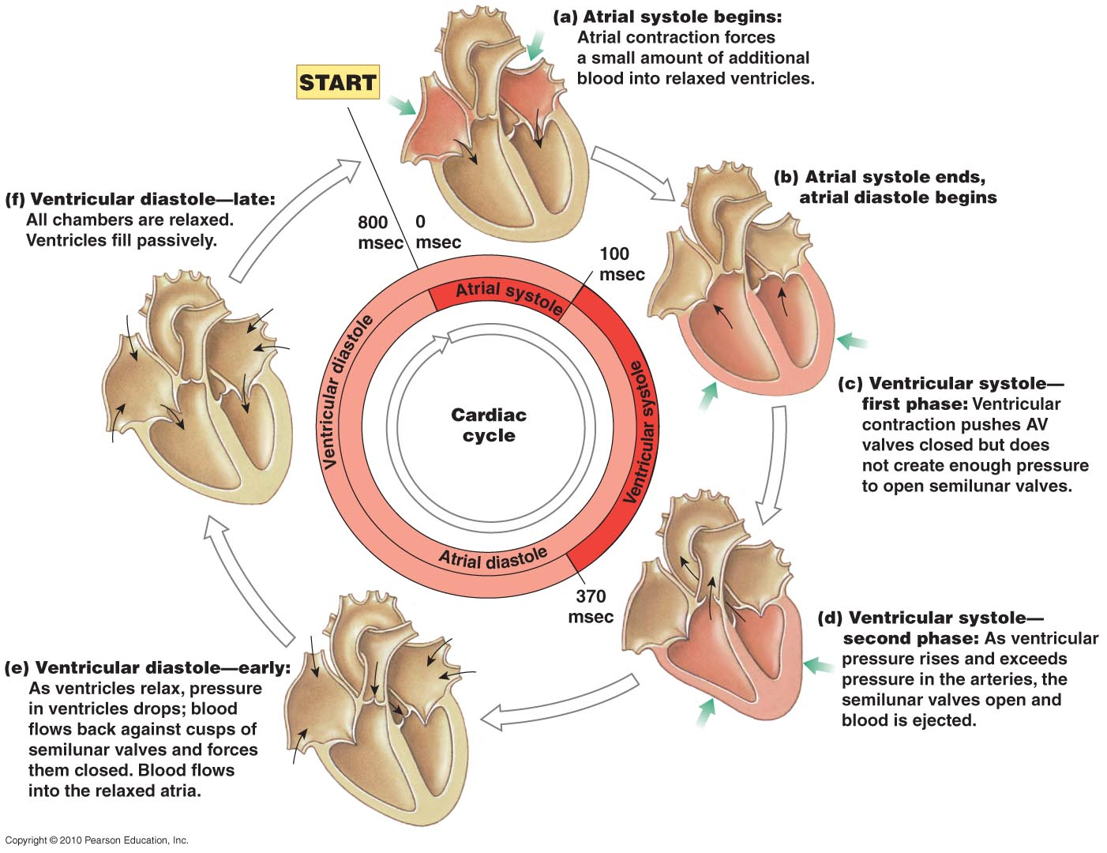
Figure 12-11

Slide 68
The Cardiac Cycle
Blood Pressure
  In any chamber:
    Rises during systole
    Falls during diastole
  Blood flows from high to low pressure:
    Controlled by timing of contractions
    Directed by one-way valves

Slide 69
The Cardiac Cycle
Cardiac Cycle and Heart Rate
  At 75 beats per minute:
    Cardiac cycle lasts about 800 msecs
  When heart rate increases:
    All phases of cardiac cycle shorten, particularly diastole

Slide 70
Heart Sounds
S₁
  Loud sounds
  Produced by AV valves
S₂
  Loud sounds
  Produced by semilunar valves
S₃, S₄
  Soft sounds
  Blood flow into ventricles and atrial contraction

Slide 71
12-4: Heart dynamics examines the factors that affect cardiac output

Slide 72
Cardiodynamics
Cardiac Output: volume of blood being pumped by the heart
CO = HR × SV
  CO = cardiac output (mL/min)
  HR = heart rate (beats/min)
  SV = stroke volume (mL/beat)

Slide 73
Cardiodynamics
Factors Affecting Cardiac Output
  Cardiac output:
    Adjusted by changes in heart rate or stroke volume
  Heart rate:
    Adjusted by autonomic nervous system or hormones
  Stroke volume:
    Adjusted by changing EDV or ESV
Notes:
EDV: End diastolic volume
ESV: End systolic volume

Slide 74
Blood Volume Reflexes
Atrial Reflex
  Also called Bainbridge reflex
  Adjusts heart rate in response to venous return
  Stretch receptors in right atrium:
    Trigger increase in heart rate
    Through increased sympathetic activity

Slide 75
Autonomic Innervation
Factors Affecting the Heart Rate
  Cardiac plexuses: innervate heart
  Vagus nerves (X): carry parasympathetic preganglionic fibers to small ganglia in cardiac plexus
  Cardiac centers of medulla oblongata:
    Cardioacceleratory center controls sympathetic neurons (increases heart rate)
    Cardioinhibitory center controls parasympathetic neurons (slows heart rate)

Slide 76
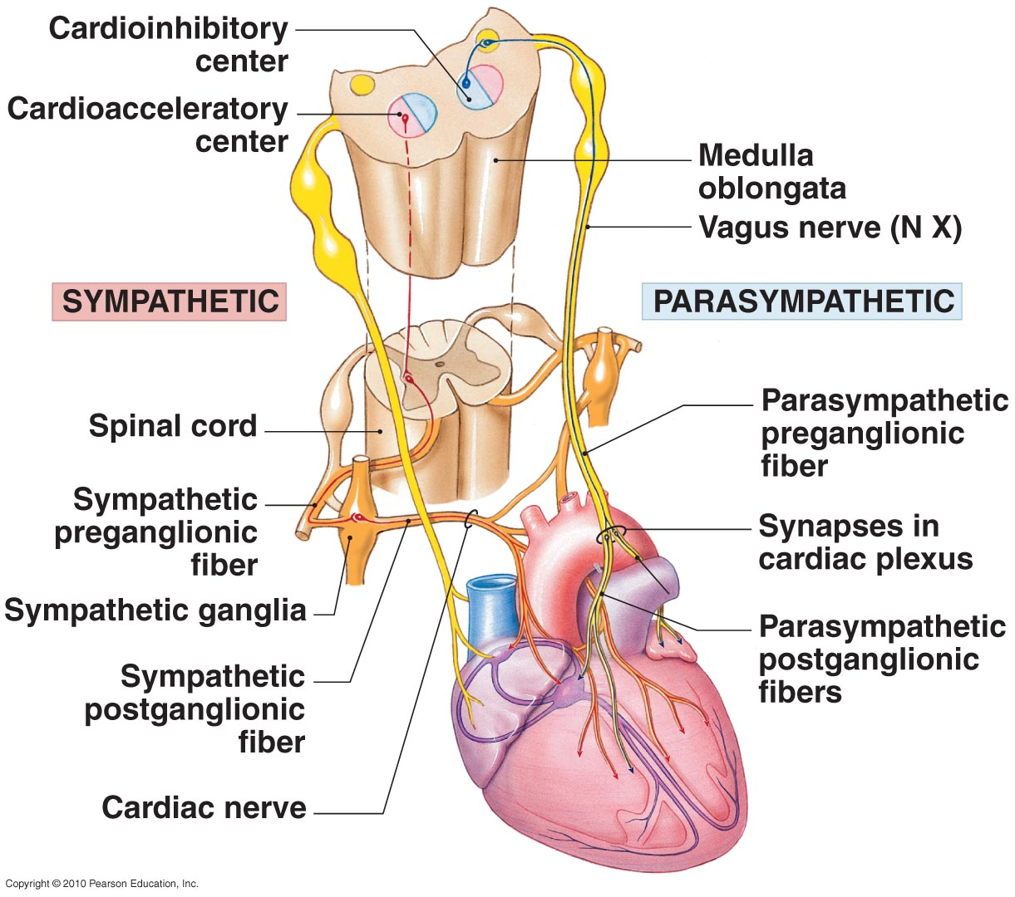
Autonomic Innervation
Figure 12-12

Slide 77
Autonomic Innervation
Autonomic Affects on Stroke Volume
  Sympathetic stimulation:
    NE released by postganglionic fibers of cardiac nerves
    Epinephrine and NE released by suprarenal (adrenal) medullae
    Causes ventricles to contract with more force
    Increases ejection fraction and decreases ESV

Slide 78
Autonomic Innervation
Autonomic Affects on Stroke Volume
  Parasympathetic activity:
    Acetylcholine released by vagus nerves
    Reduces force of cardiac contractions

Slide 79
Hormones
Many hormones affect heart contraction
Pharmaceutical drugs mimic hormone actions
  Stimulate or block beta receptors
  Affect calcium ions (e.g., calcium channel blockers)

