Slide 1
Chapter 6
0
How Cells Harvest Chemical Energy
Lecture by Richard L. Myers

Slide 2
Introduction: How Is a Marathoner Different from a Sprinter?
Individuals inherit various percentages of the two main types of muscle fibers, slow and fast
  The difference between the two is the process each uses to make ATP
  Slow fibers make it aerobically using oxygen
  Fast fibers work anaerobically without oxygen
Copyright © 2009 Pearson Education, Inc.

Slide 3
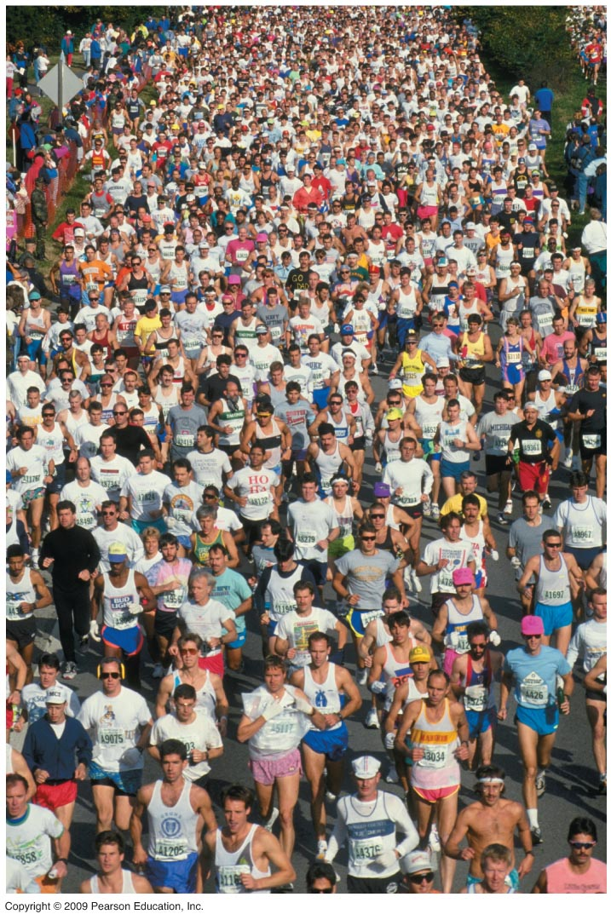
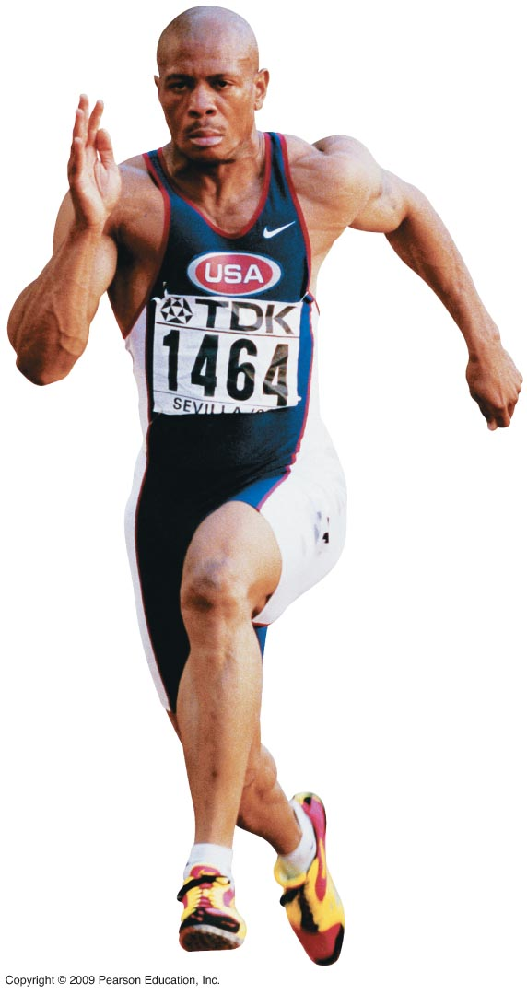

Slide 4
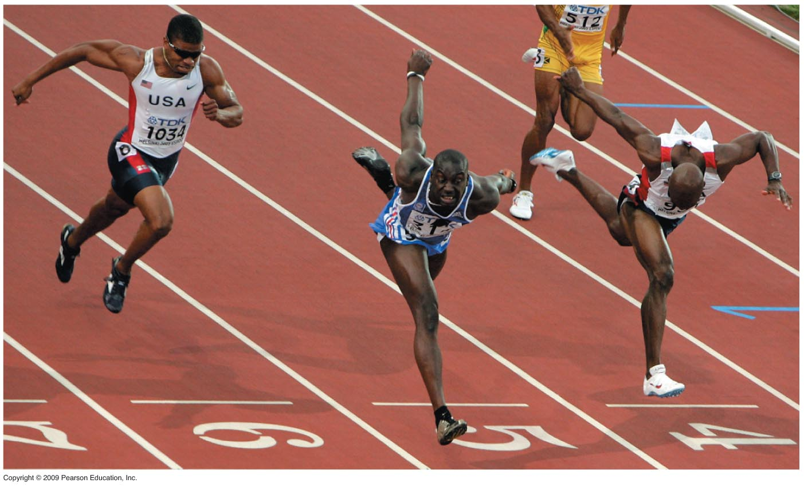

Slide 5
Introduction: How Is a Marathoner Different from a Sprinter?
The percentage of slow and fast muscle fibers determines the difference between track athletes
  Those with a large percentage of slow fibers make the best long-distance runners
  Those with more fast fibers are good sprinters
All of our cells harvest chemical energy (ATP) from our food
Copyright © 2009 Pearson Education, Inc.
Notes:
Aerobic breakdown of food is called cellular respiration.

Slide 6
INTRODUCTION TO CELLULAR RESPIRATION
Copyright © 2009 Pearson Education, Inc.

Slide 7
6.1 Photosynthesis and cellular respiration provide energy for life
Energy is necessary for life processes
  These include growth, transport, manufacture, movement, reproduction, and others
  Energy that supports life on Earth is captured from sun rays reaching Earth through plant, algae, protist, and bacterial photosynthesis
Copyright © 2009 Pearson Education, Inc.
Notes:
During photosynthesis, light energy is converted to chemical energy.
Student Misconceptions and Concerns
1. Students should be cautioned against the assumption that energy is created when it is converted from one form to another. This might be a good time to review the principle of conservation of energy (the first law of thermodynamics addressed in Module 5.11).
Teaching Tips
1. You might wish to elaborate on the amount of solar energy striking Earth. Every day Earth is bombarded with solar radiation equal to the energy of 100 million atomic bombs. Of the tiny fraction of light that reaches photosynthetic organisms, only about 1% is converted to chemical energy by photosynthesis.
2. Energy coupling at the cellular level may be new to many students, but it is a familiar concept when related to the use of money in our society. Students might be discouraged if the only benefit of work was the ability to make purchases from the employer. (We all might soon tire of a fast-food job that only paid its employees in food!) Money permits the coupling of a generation of value (a paycheck, analogous to an energy-releasing reaction) to an energy-consuming reaction (money, which allows us to make purchases in distant locations). This idea of earning and spending is a common concept we all know well.

Slide 8
6.1 Photosynthesis and cellular respiration provide energy for life
Energy in sunlight is used in photosynthesis to make glucose from CO₂ and H₂O with release of O₂
Other organisms use the O₂ and energy in sugar and release CO₂ and H₂O
Together, these two processes are responsible for the majority of life on Earth
Copyright © 2009 Pearson Education, Inc.
Notes:
One can, therefore, say that life on Earth is solar powered.
For the Discovery Video Space Plants, go to the Animation and Video Files.
Student Misconceptions and Concerns
1. Students should be cautioned against the assumption that energy is created when it is converted from one form to another. This might be a good time to review the principle of conservation of energy (the first law of thermodynamics addressed in Module 5.11).
Teaching Tips
1. You might wish to elaborate on the amount of solar energy striking Earth. Every day Earth is bombarded with solar radiation equal to the energy of 100 million atomic bombs. Of the tiny fraction of light that reaches photosynthetic organisms, only about 1% is converted to chemical energy by photosynthesis.
2. Energy coupling at the cellular level may be new to many students, but it is a familiar concept when related to the use of money in our society. Students might be discouraged if the only benefit of work was the ability to make purchases from the employer. (We all might soon tire of a fast-food job that only paid its employees in food!) Money permits the coupling of a generation of value (a paycheck, analogous to an energy-releasing reaction) to an energy-consuming reaction (money, which allows us to make purchases in distant locations). This idea of earning and spending is a common concept we all know well.

Slide 9
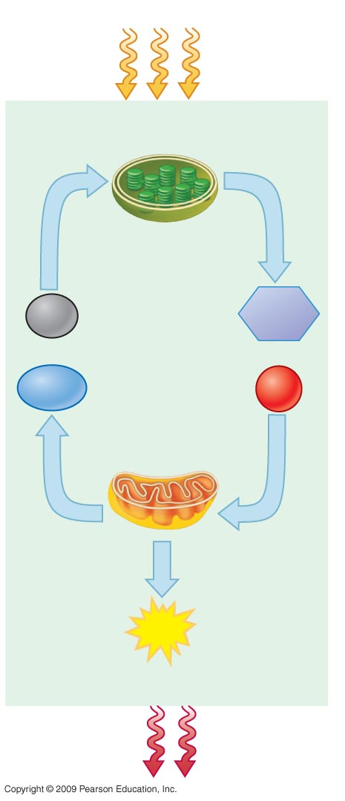
Sunlight energy
Energy Coupling
ECOSYSTEM
Photosynthesis
in chloroplasts
CO₂
Glucose
+
+
H₂O
O₂
Cellular respiration
in mitochondria
ATP
(for cellular work)
Heat energy
Notes:
Figure 6.1 The connection between photosynthesis and cellular respiration.

Slide 10
6.2 Breathing supplies oxygen to our cells for use in cellular respiration and removes carbon dioxide
Breathing and cellular respiration are closely related
  Breathing is necessary for exchange of CO₂ produced during cellular respiration for atmospheric O₂
  Cellular respiration uses O₂ to help harvest energy from glucose and produces CO₂ in the process
Copyright © 2009 Pearson Education, Inc.
Notes:
The purpose of cellular respiration is to produce ATP.
Student Misconceptions and Concerns
1. Students should be cautioned against the assumption that energy is created when it is converted from one form to another. This might be a good time to review the principle of conservation of energy (the first law of thermodynamics addressed in Module 5.11).
Teaching Tips
1. Energy coupling at the cellular level may be new to many students, but it is a familiar concept when related to the use of money in our society. Students might be discouraged if the only benefit of work was the ability to make purchases from the employer. (We all might soon tire of a fast-food job that only paid its employees in food!) Money permits the coupling of a generation of value (a paycheck, analogous to an energy-releasing reaction) to an energy-consuming reaction (money, which allows us to make purchases in distant locations). This idea of earning and spending is a common concept we all know well.

Slide 11
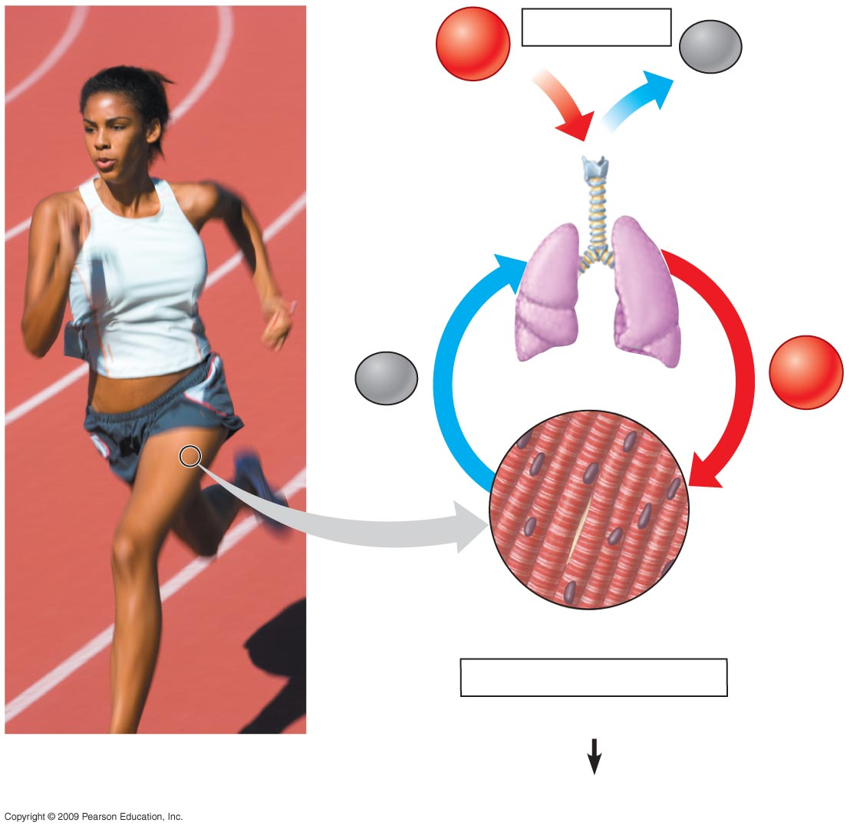
O₂
Breathing
CO₂
Lungs
CO₂
Bloodstream
O₂
Muscle cells carrying out
Cellular Respiration
Glucose + O₂
CO₂ + H₂O + ATP
Notes:
Figure 6.2 The connection between breathing and cellular respiration.

Slide 12
6.3 Cellular respiration banks energy in ATP molecules
Cellular respiration is an exergonic process that transfers energy from the bonds in glucose to ATP
  Cellular respiration produces 38 ATP molecules from each glucose molecule
  Other foods (organic molecules) can be used as a source of energy as well
Copyright © 2009 Pearson Education, Inc.
Notes:
Respiration only retrieves 40% of the energy in a glucose molecule. The other 60% of the energy is released as heat. We use this heat to maintain a relatively steady body temperature near 37°C (98–99°F). This is about the same amount of heat generated by a 75-watt incandescent light bulb.
Organic compounds possess potential energy as a result of their arrangement of atoms.
Compounds that can participate in exergonic reactions can act as food.
Actually, cellular respiration includes both aerobic and anaerobic processes. However, it is generally used to refer to the aerobic process.
It takes about 10 million ATP molecules per second to power one active muscle cell.
Student Misconceptions and Concerns
1. Students should be cautioned against the assumption that energy is created when it is converted from one form to another. This might be a good time to review the principle of conservation of energy (the first law of thermodynamics addressed in Module 5.11).
2. Students often fail to realize that aerobic metabolism is a process generally similar to the burning of wood in a fireplace or campfire or the burning of gasoline in an automobile engine. Noting these general similarities can help students comprehend the overall reaction and heat generation associated with these processes.
Teaching Tips
1. Energy coupling at the cellular level may be new to many students, but it is a familiar concept when related to the use of money in our society. Students might be discouraged if the only benefit of work was the ability to make purchases from the employer. (We all might soon tire of a fast-food job that only paid its employees in food!) Money permits the coupling of a generation of value (a paycheck, analogous to an energy-releasing reaction) to an energy-consuming reaction (money, which allows us to make purchases in distant locations). This idea of earning and spending is a common concept we all know well.
2. During cellular respiration, our cells convert about 40% of our food energy to useful work. The other 60% of the energy is released as heat. We use this heat to maintain a relatively steady body temperature near 37°C (98–99°F). This is about the same amount of heat generated by a 75-watt incandescent lightbulb. If you choose to include a discussion of heat generation from aerobic metabolism, consider the following.
A. Ask your students why they feel warm when it is 30°C (86°F) outside, if their core body temperature is 37°C (98.6°F). Shouldn’t they feel cold? The answer is, our bodies are always producing heat. At these higher temperatures, we are producing more heat than we need to maintain a body temperature around 37°C. Thus, we sweat and behave in ways that helps us get rid of the extra heat from cellular respiration.
B. Share this calculation with your students. Depending upon a person’s size and level of activity, a human might burn 2,000 dietary calories (kilocalories) a day. This is enough energy to raise the temperature of 20 liters of liquid water from 0 to 100°C. This is something to think about the next time you heat water on the stove! (Notes: Consider bringing a 2-liter bottle as a visual aid, or ten 2-liter bottles to make the point above. It takes 100 calories to raise 1 liter of water 100°C; it takes much more energy to melt ice or evaporate water as steam.)

Slide 13
6.4 CONNECTION: The human body uses energy from ATP for all its activities
The average adult human needs about 2,200 kcal of energy per day
  A kilocalorie (kcal) is the quantity of heat required to raise the temperature of 1 kilogram (kg) of water by 1ºC
  This energy is used for body maintenance and for voluntary activities
Copyright © 2009 Pearson Education, Inc.
Notes:
Remember that we are not producing energy in cellular respiration, but rather releasing it from organic molecules. We are simply securing energy that was put in food by photosynthesis.
Student Misconceptions and Concerns
1. Students should be cautioned against the assumption that energy is created when it is converted from one form to another. This might be a good time to review the principle of conservation of energy (the first law of thermodynamics addressed in Module 5.11).
Teaching Tips
1. You might share with your students that it takes about 10 million ATP molecules per second to power one active muscle cell.

Slide 14
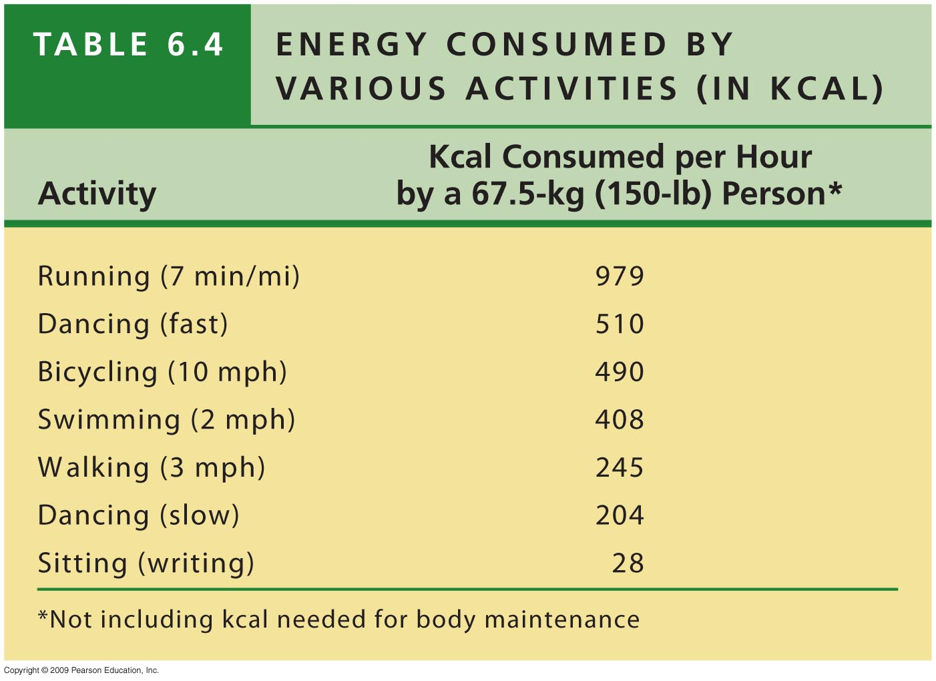
Notes:
Table 6.4 Energy Consumed by Various Activities (in kcal).

Slide 15
6.5 Cells tap energy from electrons “falling” from organic fuels to oxygen
The energy necessary for life is contained in the arrangement of electrons in chemical bonds in organic molecules
An important question is how do cells extract this energy?
Copyright © 2009 Pearson Education, Inc.
Notes:
Energy must be added to pull an electron away from an atom, just as energy is required to push a ball uphill.
Student Misconceptions and Concerns
1. Students should be cautioned against the assumption that energy is created when it is converted from one form to another. This might be a good time to review the principle of conservation of energy (the first law of thermodynamics addressed in Module 5.11).
2. The advantage of the gradual degradation of glucose may not be obvious to some students. Many analogies exist that reveal the advantages of short and steady steps. Fuel in an automobile is burned slowly to best utilize the energy released from the fuel. A few fireplace logs release gradual heat to keep a room temperature steady. In both situations, excessive use of fuel becomes wasteful, reducing the efficiencies of the systems.

Slide 16
6.5 Cells tap energy from electrons “falling” from organic fuels to oxygen
When the carbon-hydrogen bonds of glucose are broken, electrons are transferred to oxygen
  Oxygen has a strong tendency to attract electrons
Copyright © 2009 Pearson Education, Inc.
Notes:
Biochemists say that electrons “fall” to oxygen to indicate that the electrons move down an energy gradient. The shift of electrons from carbon and hydrogen to oxygen provides a more stable state for these atoms.
Student Misconceptions and Concerns
1. Students should be cautioned against the assumption that energy is created when it is converted from one form to another. This might be a good time to review the principle of conservation of energy (the first law of thermodynamics addressed in Module 5.11).
2. The advantage of the gradual degradation of glucose may not be obvious to some students. Many analogies exist that reveal the advantages of short and steady steps. Fuel in an automobile is burned slowly to best utilize the energy released from the fuel. A few fireplace logs release gradual heat to keep a room temperature steady. In both situations, excessive use of fuel becomes wasteful, reducing the efficiencies of the systems.

Slide 17
6.5 Cells tap energy from electrons “falling” from organic fuels to oxygen
Energy can be released from glucose by simply burning it
The energy is dissipated as heat and light and is not available to living organisms
Copyright © 2009 Pearson Education, Inc.
Notes:
With burning, energy is released from glucose all at once, and cannot be harnessed for cellular work.
Student Misconceptions and Concerns
1. Students should be cautioned against the assumption that energy is created when it is converted from one form to another. This might be a good time to review the principle of conservation of energy (the first law of thermodynamics addressed in Module 5.11).
2. The advantage of the gradual degradation of glucose may not be obvious to some students. Many analogies exist that reveal the advantages of short and steady steps. Fuel in an automobile is burned slowly to best utilize the energy released from the fuel. A few fireplace logs release gradual heat to keep a room temperature steady. In both situations, excessive use of fuel becomes wasteful, reducing the efficiencies of the systems.

Slide 18
6.5 Cells tap energy from electrons “falling” from organic fuels to oxygen
On the other hand, cellular respiration is the controlled breakdown of organic molecules
  Energy is released in small amounts that can be captured by a biological system and stored in ATP
Copyright © 2009 Pearson Education, Inc.
Notes:
In respiration, organic fuels are broken down in a series of steps, each one catalyzed by an enzyme.
Student Misconceptions and Concerns
1. Students should be cautioned against the assumption that energy is created when it is converted from one form to another. This might be a good time to review the principle of conservation of energy (the first law of thermodynamics addressed in Module 5.11).
2. The advantage of the gradual degradation of glucose may not be obvious to some students. Many analogies exist that reveal the advantages of short and steady steps. Fuel in an automobile is burned slowly to best utilize the energy released from the fuel. A few fireplace logs release gradual heat to keep a room temperature steady. In both situations, excessive use of fuel becomes wasteful, reducing the efficiencies of the systems.

Slide 19
6.5 Cells tap energy from electrons “falling” from organic fuels to oxygen
A cellular respiration equation is helpful to show the changes in hydrogen atom distribution
  Glucose loses its hydrogen atoms and is ultimately converted to CO₂
  At the same time, O₂ gains hydrogen atoms and is converted to H₂O
    Loss of electrons is called oxidation
    Gain of electrons is called reduction
Copyright © 2009 Pearson Education, Inc.
Notes:
The movement of electrons is called an oxidation-reduction or redox reaction.
The combustion of gasoline in an automobile engine is also a redox reaction: the energy released pushes the pistons.
Our main energy foods are carbohydrates and fats because they are reservoirs of large numbers of electrons associated with hydrogen.
You may want to tell your students that a hydrogen atom consists of an electron and a proton, and although we have only considered the electron up to now, the proton becomes important later in the synthesis of ATP.
Student Misconceptions and Concerns
1. Students should be cautioned against the assumption that energy is created when it is converted from one form to another. This might be a good time to review the principle of conservation of energy (the first law of thermodynamics addressed in Module 5.11).
2. The advantage of the gradual degradation of glucose may not be obvious to some students. Many analogies exist that reveal the advantages of short and steady steps. Fuel in an automobile is burned slowly to best utilize the energy released from the fuel. A few fireplace logs release gradual heat to keep a room temperature steady. In both situations, excessive use of fuel becomes wasteful, reducing the efficiencies of the systems.

Slide 20

Loss of hydrogen atoms
(oxidation)
C₆H₁₂O₆ + 6 O₂
6 CO₂ + 6 H₂O + Energy
Glucose
(ATP)
Gain of hydrogen atoms
(reduction)
Notes:
Figure 6.5A Rearrangement of hydrogen atoms (with their electrons) in the redox reactions of cellular respiration.

Slide 21
6.5 Cells tap energy from electrons “falling” from organic fuels to oxygen
Enzymes are necessary to oxidize glucose and other foods
  The enzyme that removes hydrogen from an organic molecule is called dehydrogenase
  Dehydrogenase requires a coenzyme called NAD⁺ (nicotinamide adenine dinucleotide) to shuttle electrons
    NAD⁺ can become reduced when it accepts electrons and oxidized when it gives them up
Copyright © 2009 Pearson Education, Inc.
Notes:
Students should probably be reminded that the -ase on a word indicates an enzyme and that often the word is descriptive of the enzyme’s activity.
NAD⁺ is a derivative of the vitamin niacin.
Student Misconceptions and Concerns
1. Students should be cautioned against the assumption that energy is created when it is converted from one form to another. This might be a good time to review the principle of conservation of energy (the first law of thermodynamics addressed in Module 5.11).
2. The advantage of the gradual degradation of glucose may not be obvious to some students. Many analogies exist that reveal the advantages of short and steady steps. Fuel in an automobile is burned slowly to best utilize the energy released from the fuel. A few fireplace logs release gradual heat to keep a room temperature steady. In both situations, excessive use of fuel becomes wasteful, reducing the efficiencies of the systems.

Slide 22
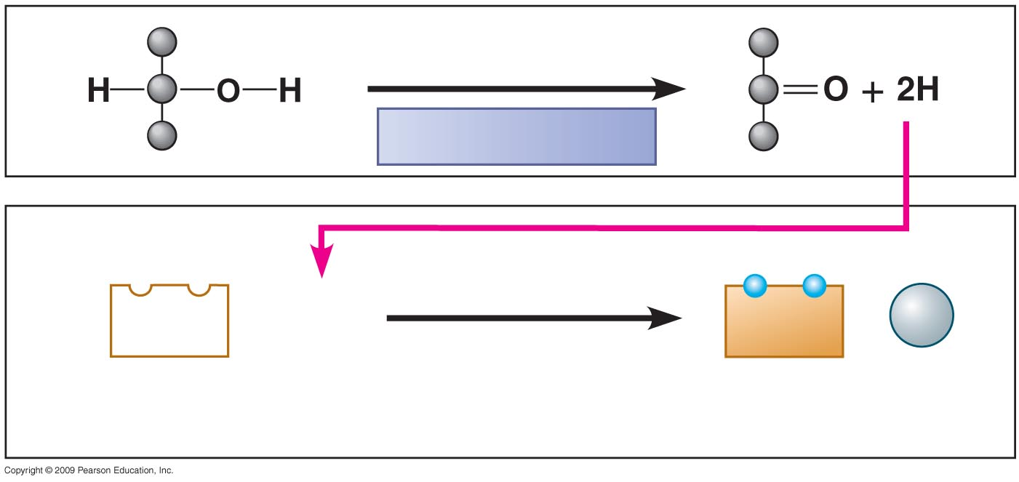
Oxidation
Dehydrogenase
Reduction
NAD⁺
+ 2 H
NADH
+
H⁺
(carries
2 electrons)
2 H⁺ + 2 e–
Notes:
Figure 6.5B A pair of redox reactions, occurring simultaneously.

Slide 23
6.5 Cells tap energy from electrons “falling” from organic fuels to oxygen
The transfer of electrons to NAD⁺ results in the formation of NADH, the reduced form of NAD⁺
  In this situation, NAD⁺ is called an electron acceptor, but it eventually becomes oxidized (loses an electron) and is then called an electron donor
Copyright © 2009 Pearson Education, Inc.
Notes:
Electrons are removed, transferred, and accepted in pairs.
Student Misconceptions and Concerns
1. Students should be cautioned against the assumption that energy is created when it is converted from one form to another. This might be a good time to review the principle of conservation of energy (the first law of thermodynamics addressed in Module 5.11).
2. The advantage of the gradual degradation of glucose may not be obvious to some students. Many analogies exist that reveal the advantages of short and steady steps. Fuel in an automobile is burned slowly to best utilize the energy released from the fuel. A few fireplace logs release gradual heat to keep a room temperature steady. In both situations, excessive use of fuel becomes wasteful, reducing the efficiencies of the systems.

Slide 24
6.5 Cells tap energy from electrons “falling” from organic fuels to oxygen
There are other electron “carrier” molecules that function like NAD⁺
  They form a staircase where the electrons pass from one to the next down the staircase
  These electron carriers collectively are called the electron transport chain, and as electrons are transported down the chain, ATP is generated
Copyright © 2009 Pearson Education, Inc.
Notes:
Electron transport occurs in the cell’s inner membrane of a mitochondrion.
The final electron acceptor is oxygen, and the product of this reaction is water.
Student Misconceptions and Concerns
1. Students should be cautioned against the assumption that energy is created when it is converted from one form to another. This might be a good time to review the principle of conservation of energy (the first law of thermodynamics addressed in Module 5.11).
2. The advantage of the gradual degradation of glucose may not be obvious to some students. Many analogies exist that reveal the advantages of short and steady steps. Fuel in an automobile is burned slowly to best utilize the energy released from the fuel. A few fireplace logs release gradual heat to keep a room temperature steady. In both situations, excessive use of fuel becomes wasteful, reducing the efficiencies of the systems.

Slide 25
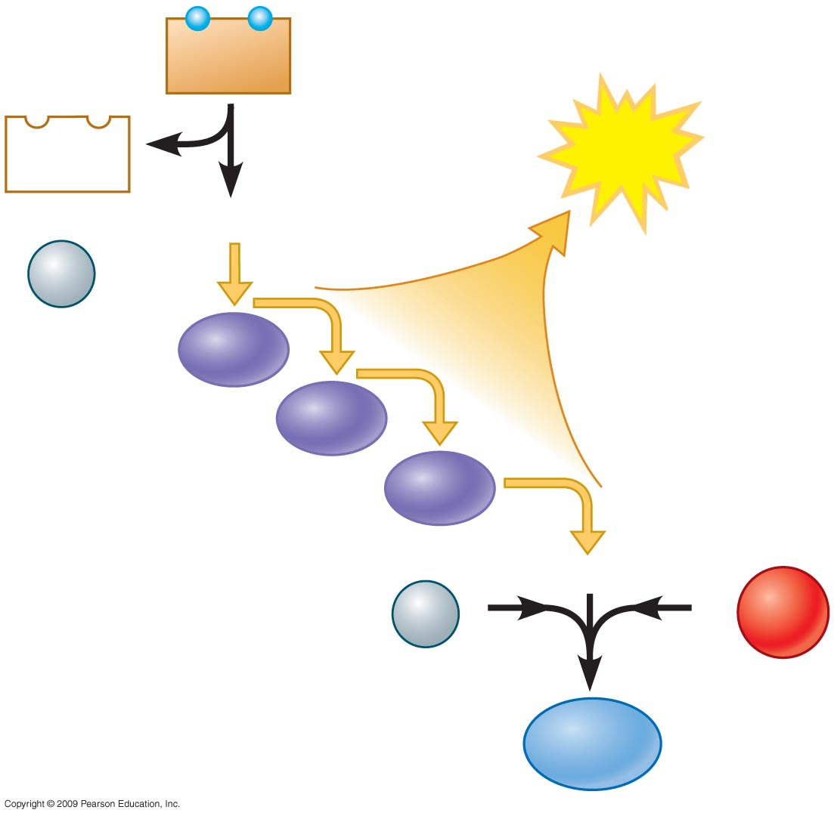
NADH
NAD⁺
ATP
+
2e–
Controlled
release of
energy for
synthesis
of ATP
H⁺
Electron transport
chain
2e–
H⁺
1
−
2
O₂
H₂O
Notes:
Figure 6.5C In cellular respiration, electrons fall down an energy staircase and finally reduce O₂.

Slide 26
STAGES OF CELLULAR RESPIRATION
AND FERMENTATION
Copyright © 2009 Pearson Education, Inc.

Slide 27
6.6 Overview: Aerobic cellular respiration occurs in three main stages
Stage 1: Glycolysis
  Glycolysis begins respiration by breaking glucose, a six-carbon molecule, into two molecules of a three-carbon compound called pyruvate
  This stage occurs in the cytoplasm
Copyright © 2009 Pearson Education, Inc.
Notes:
The term glycolysis means “splitting of sugar.”
Student Misconceptions and Concerns
1. Perhaps more than anywhere else in general biology, students studying aerobic metabolism may fail to see the forest for the trees. Students may focus on the details of each stage of aerobic metabolism and devote little attention to the overall process and products. Consider emphasizing the products and energy yields associated with glycolysis, the citric acid cycle, and oxidative phosphorylation before detailing the specifics of each reaction.
2. The location within a cell in which each reaction takes place is often forgotten in the details of the chemical processes, but it is important to emphasize. Consider using Figure 6.12 as a common reference to locate each stage as you discuss the details of cellular respiration.
3. Students frequently think that plants have chloroplasts instead of mitochondria. Take care to point out the need for mitochondria in plants when photosynthesis is not efficient or possible (such as during the night).

Slide 28
6.6 Overview: Aerobic cellular respiration occurs in three main stages
Stage 2: The citric acid cycle
  The citric acid cycle breaks down pyruvate into carbon dioxide and supplies the third stage with electrons
  This stage occurs in the mitochondria
Copyright © 2009 Pearson Education, Inc.
Notes:
The citric acid cycle has eight steps, each catalyzed by a particular enzyme.
Student Misconceptions and Concerns
1. Perhaps more than anywhere else in general biology, students studying aerobic metabolism may fail to see the forest for the trees. Students may focus on the details of each stage of aerobic metabolism and devote little attention to the overall process and products. Consider emphasizing the products and energy yields associated with glycolysis, the citric acid cycle, and oxidative phosphorylation before detailing the specifics of each reaction.
2. The location within a cell in which each reaction takes place is often forgotten in the details of the chemical processes, but it is important to emphasize. Consider using Figure 6.12 as a common reference to locate each stage as you discuss the details of cellular respiration.
3. Students frequently think that plants have chloroplasts instead of mitochondria. Take care to point out the need for mitochondria in plants when photosynthesis is not efficient or possible (such as during the night).

Slide 29
6.6 Overview: Aerobic cellular respiration occurs in three main stages
Stage 3: Oxidative phosphorylation
  During this stage, electrons are shuttled through the electron transport chain
  As a result, ATP is generated through oxidative phosphorylation associated with chemiosmosis
  This stage occurs in the inner mitochondrion membrane
Copyright © 2009 Pearson Education, Inc.
Notes:
Many of the electron carriers in the electron transport are proteins called cytochromes that have an important component called heme that has an iron atom that accepts and donates electrons.
Student Misconceptions and Concerns
1. Perhaps more than anywhere else in general biology, students studying aerobic metabolism may fail to see the forest for the trees. Students may focus on the details of each stage of aerobic metabolism and devote little attention to the overall process and products. Consider emphasizing the products and energy yields associated with glycolysis, the citric acid cycle, and oxidative phosphorylation before detailing the specifics of each reaction.
2. The location within a cell in which each reaction takes place is often forgotten in the details of the chemical processes, but it is important to emphasize. Consider using Figure 6.12 as a common reference to locate each stage as you discuss the details of cellular respiration.
3. Students frequently think that plants have chloroplasts instead of mitochondria. Take care to point out the need for mitochondria in plants when photosynthesis is not efficient or possible (such as during the night).

Slide 30
6.6 Overview: Aerobic cellular respiration occurs in three main stages
During the transport of electrons, a concentration gradient of H⁺ ions is formed across the inner membrane into the intermembrane space
  The potential energy of this concentration gradient is used to make ATP by a process called chemiosmosis
  The concentration gradient drives H⁺ through ATP synthases and enzymes found in the membrane, and ATP is produced
Copyright © 2009 Pearson Education, Inc.
Notes:
From studying the structure of ATP synthase, scientists have learned how the flow of H⁺ through this large enzyme powers ATP generation.
The authors develop an analogy between the function of the inner mitochondrial membrane and a dam. A reservoir of hydrogen ions is built up between the inner and outer mitochondrial membranes, like a dam holding back water. As the hydrogen ions move down their concentration gradient, they “spin” the ATP synthase, which helps generate ATP. In a dam, water rushing downhill turns giant turbines, which generate electricity.
For the BioFlix Animation Cellular Respiration, go to the Animation and Video Files.
Student Misconceptions and Concerns
1. Perhaps more than anywhere else in general biology, students studying aerobic metabolism may fail to see the forest for the trees. Students may focus on the details of each stage of aerobic metabolism and devote little attention to the overall process and products. Consider emphasizing the products and energy yields associated with glycolysis, the citric acid cycle, and oxidative phosphorylation before detailing the specifics of each reaction.
2. The location within a cell in which each reaction takes place is often forgotten in the details of the chemical processes, but it is important to emphasize. Consider using Figure 6.12 as a common reference to locate each stage as you discuss the details of cellular respiration.
3. Students frequently think that plants have chloroplasts instead of mitochondria. Take care to point out the need for mitochondria in plants when photosynthesis is not efficient or possible (such as during the night).

Slide 31
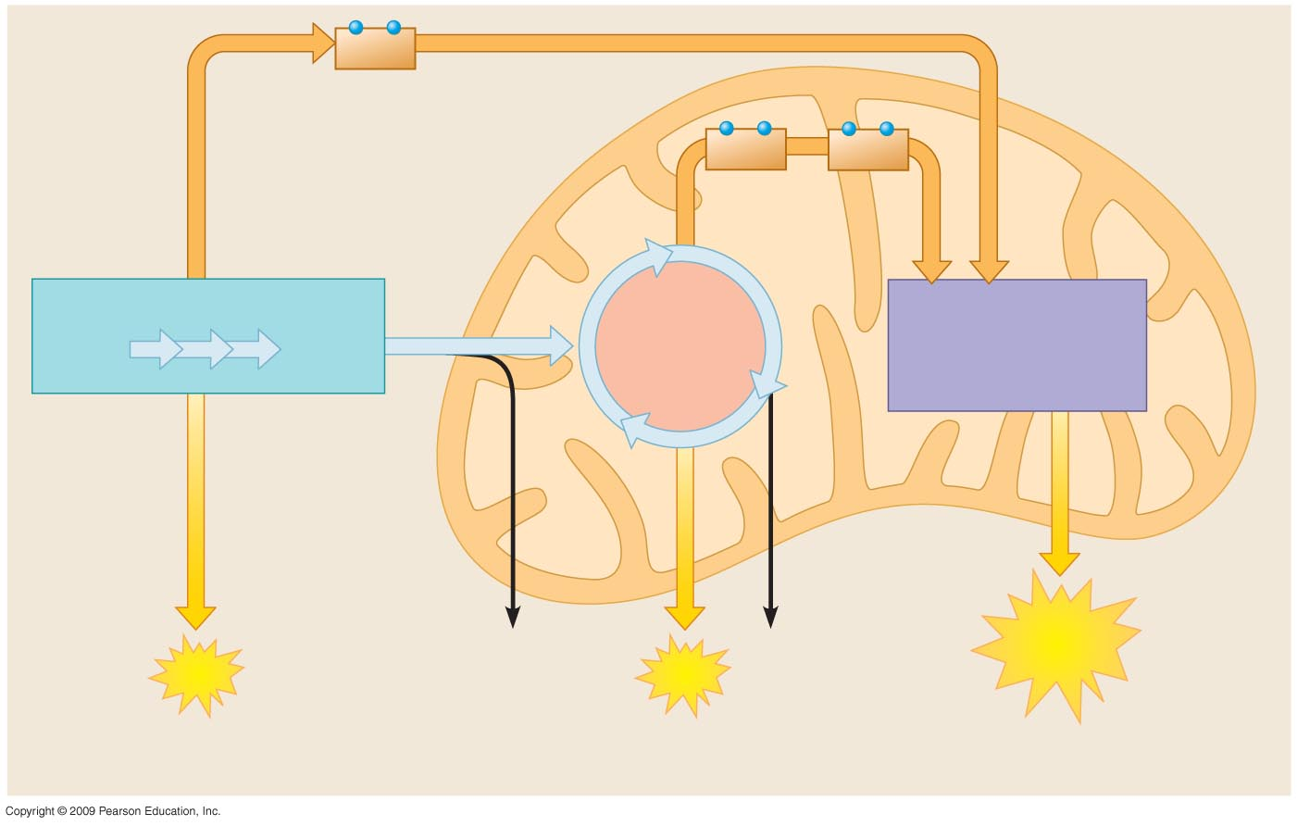
NADH
High-energy electrons
carried by NADH
Mitochondrion
NADH
FADH₂
and
GLYCOLYSIS
OXIDATIVE
PHOSPHORYLATION
(Electron Transport
and Chemiosmosis)
Glucose
Pyruvate
CITRIC ACID
CYCLE
Cytoplasm
Inner
mitochondrial
membrane
CO₂
CO₂
ATP
ATP
ATP
Substrate-level
phosphorylation
Substrate-level
phosphorylation
Oxidative
phosphorylation
Notes:
Figure 6.6 An overview of cellular respiration.

Slide 32
6.7 Glycolysis harvests chemical energy by oxidizing glucose to pyruvate
In glycolysis, a single molecule of glucose is enzymatically cut in half through a series of steps to produce two molecules of pyruvate
  In the process, two molecules of NAD⁺ are reduced to two molecules of NADH
  At the same time, two molecules of ATP are produced by substrate-level phosphorylation
Copyright © 2009 Pearson Education, Inc.
Notes:
Glycolysis is an example of a metabolic pathway. It consists of a sequence of nine steps, each step mediated by a specific enzyme.
The ATP produced in glycolysis accounts for only 5% of the energy that can be enzymatically extracted from a glucose molecule. The NADH molecules will account for another 15%.
Student Misconceptions and Concerns
1. Perhaps more than anywhere else in general biology, students studying aerobic metabolism may fail to see the forest for the trees. Students may focus on the details of each stage of aerobic metabolism and devote little attention to the overall process and products. Consider emphasizing the products and energy yields associated with glycolysis, the citric acid cycle, and oxidative phosphorylation before detailing the specifics of each reaction.
2. The location within a cell in which each reaction takes place is often forgotten in the details of the chemical processes, but it is important to emphasize. Consider using Figure 6.12 as a common reference to locate each stage as you discuss the details of cellular respiration.
3. Students frequently think that plants have chloroplasts instead of mitochondria. Take care to point out the need for mitochondria in plants when photosynthesis is not efficient or possible (such as during the night).
Teaching Tips
1. The production of NADH through glycolysis and the Krebs cycle, as compared to the direct production of ATP, can get confusing for students. Help students understand that NADH molecules have a value to be cashed in by the electron transport chain. The NADH can therefore be thought of as casino chips, accumulated along the way to be cashed in at the electron transport cashier.

Slide 33
6.7 Glycolysis harvests chemical energy by oxidizing glucose to pyruvate
In substrate-level phosphorylation, an enzyme transfers a phosphate group from a substrate molecule to ADP, forming ATP
  This ATP can be used immediately, but NADH must be transported through the electron transport chain to generate additional ATP
Copyright © 2009 Pearson Education, Inc.
Notes:
There is still considerable energy in the two molecules of pyruvate.
Student Misconceptions and Concerns
1. Perhaps more than anywhere else in general biology, students studying aerobic metabolism may fail to see the forest for the trees. Students may focus on the details of each stage of aerobic metabolism and devote little attention to the overall process and products. Consider emphasizing the products and energy yields associated with glycolysis, the citric acid cycle, and oxidative phosphorylation before detailing the specifics of each reaction.
2. The location within a cell in which each reaction takes place is often forgotten in the details of the chemical processes, but it is important to emphasize. Consider using Figure 6.12 as a common reference to locate each stage as you discuss the details of cellular respiration.
3. Students frequently think that plants have chloroplasts instead of mitochondria. Take care to point out the need for mitochondria in plants when photosynthesis is not efficient or possible (such as during the night).
Teaching Tips
1. The production of NADH through glycolysis and the Krebs cycle, as compared to the direct production of ATP, can get confusing for students. Help students understand that NADH molecules have a value to be cashed in by the electron transport chain. The NADH can therefore be thought of as casino chips, accumulated along the way to be cashed in at the electron transport cashier.

Slide 34
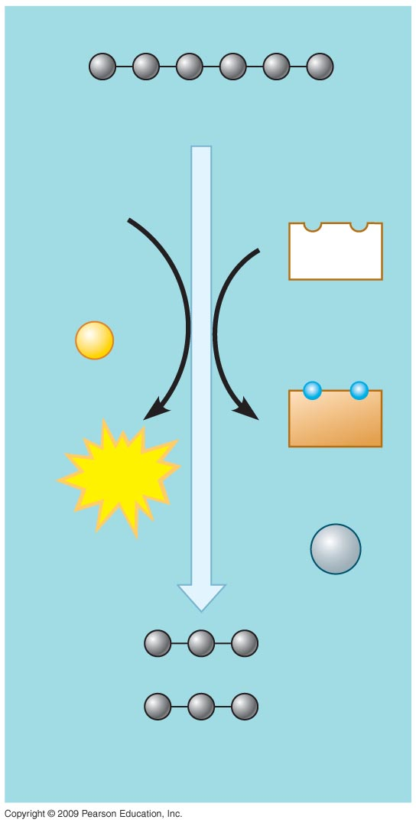
Glucose
2 ADP
2
NAD⁺
+
2
P
2
NADH
2
ATP
+
2
H⁺
2 Pyruvate
Notes:
Figure 6.7A An overview of glycolysis.

Slide 35
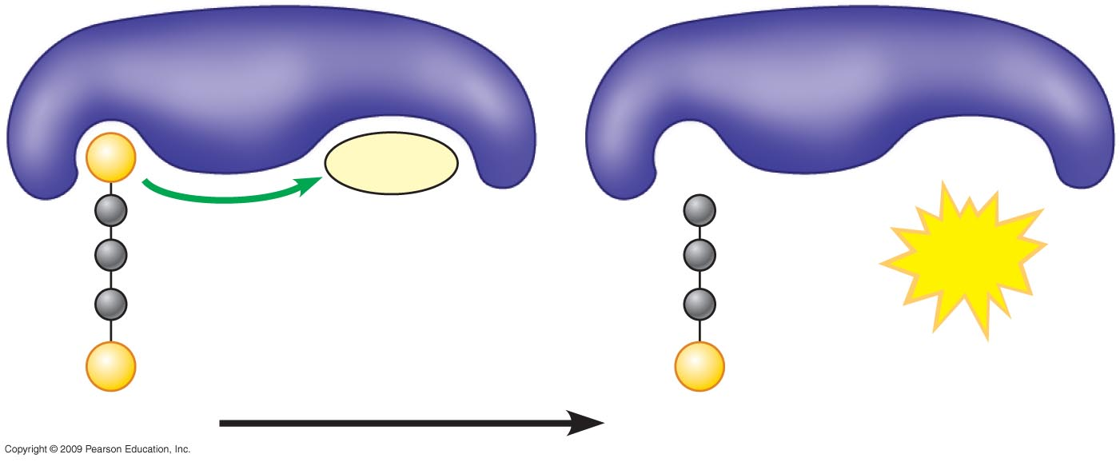
Enzyme
Enzyme
P
ADP
+
ATP
P
P
Substrate
Product
Notes:
Figure 6.7B Substrate-level phosphorylation: transfer of a phosphate group P from a substrate to ADP, producing ATP.

Slide 36
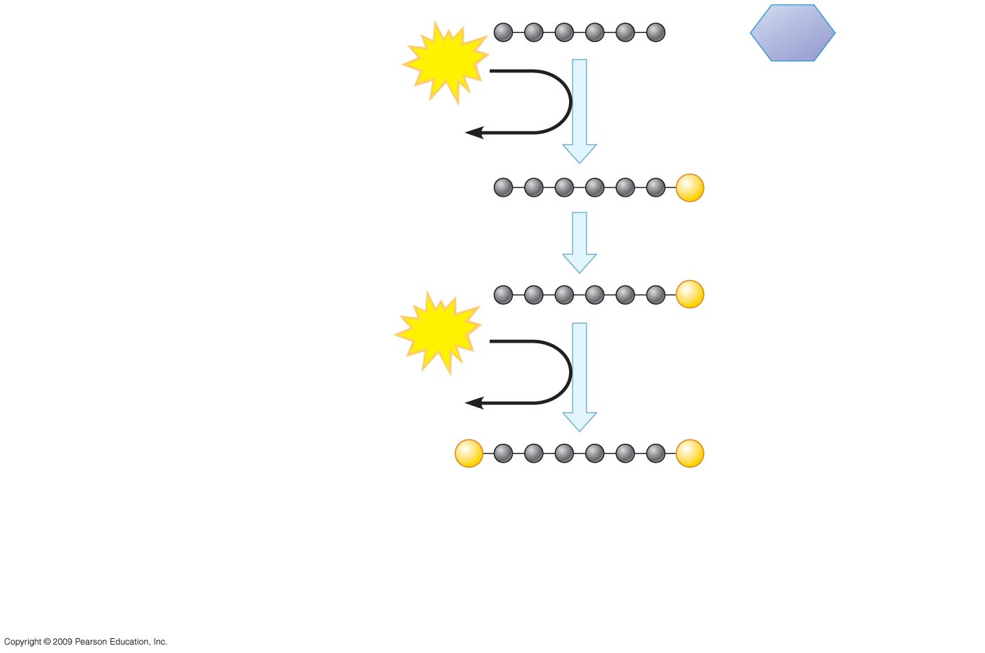
ENERGY
INVESTMENT
PHASE
Glucose
ATP
Steps – A fuel molecule is energized,
using ATP.
Step
1
3
1
ADP
P
Glucose-6-phosphate
2
P
Fructose-6-phosphate
ATP
3
ADP
P
P
Fructose-1,6-bisphosphate
Notes:
Figure 6.7C Details of glycolysis.

Slide 37
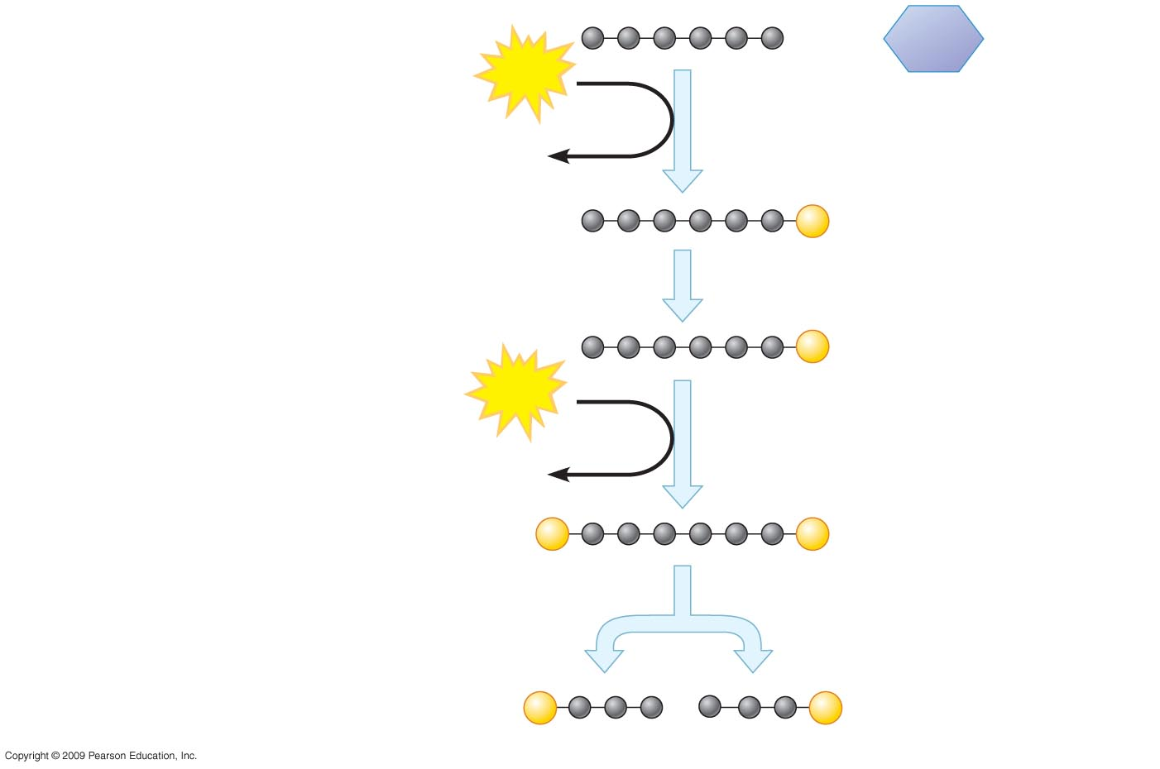
ENERGY
INVESTMENT
PHASE
Glucose
ATP
Steps – A fuel molecule is energized,
using ATP.
Step
1
3
1
ADP
P
Glucose-6-phosphate
2
P
Fructose-6-phosphate
ATP
3
ADP
P
P
Fructose-1,6-bisphosphate
Step A six-carbon intermediate splits
Into two three-carbon intermediates.
4
4
P
P
Glyceraldehyde-3-
phosphate (G3P)
Notes:
Figure 6.7C Details of glycolysis.

Slide 38
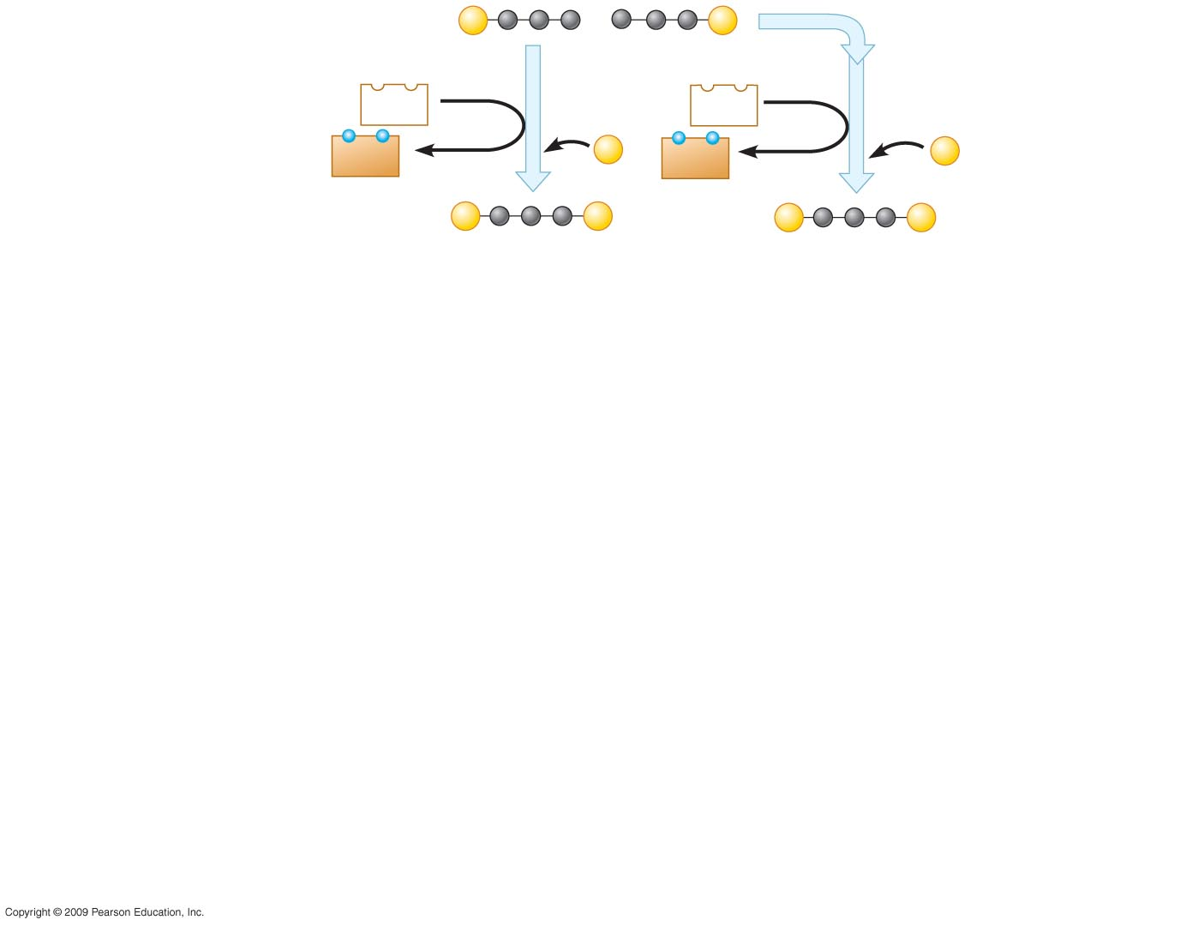
P
P
Glyceraldehyde-3-phosphate
(G3P)
Step A redox reaction
generates NADH.
NAD⁺
5
NAD⁺
5
5
ENERGY PAYOFF PHASE
NADH
P
NADH
P
+ H⁺
+ H⁺
P
P
P
P
1,3-Bisphosphoglycerate
Notes:
Figure 6.7C Details of glycolysis.

Slide 39
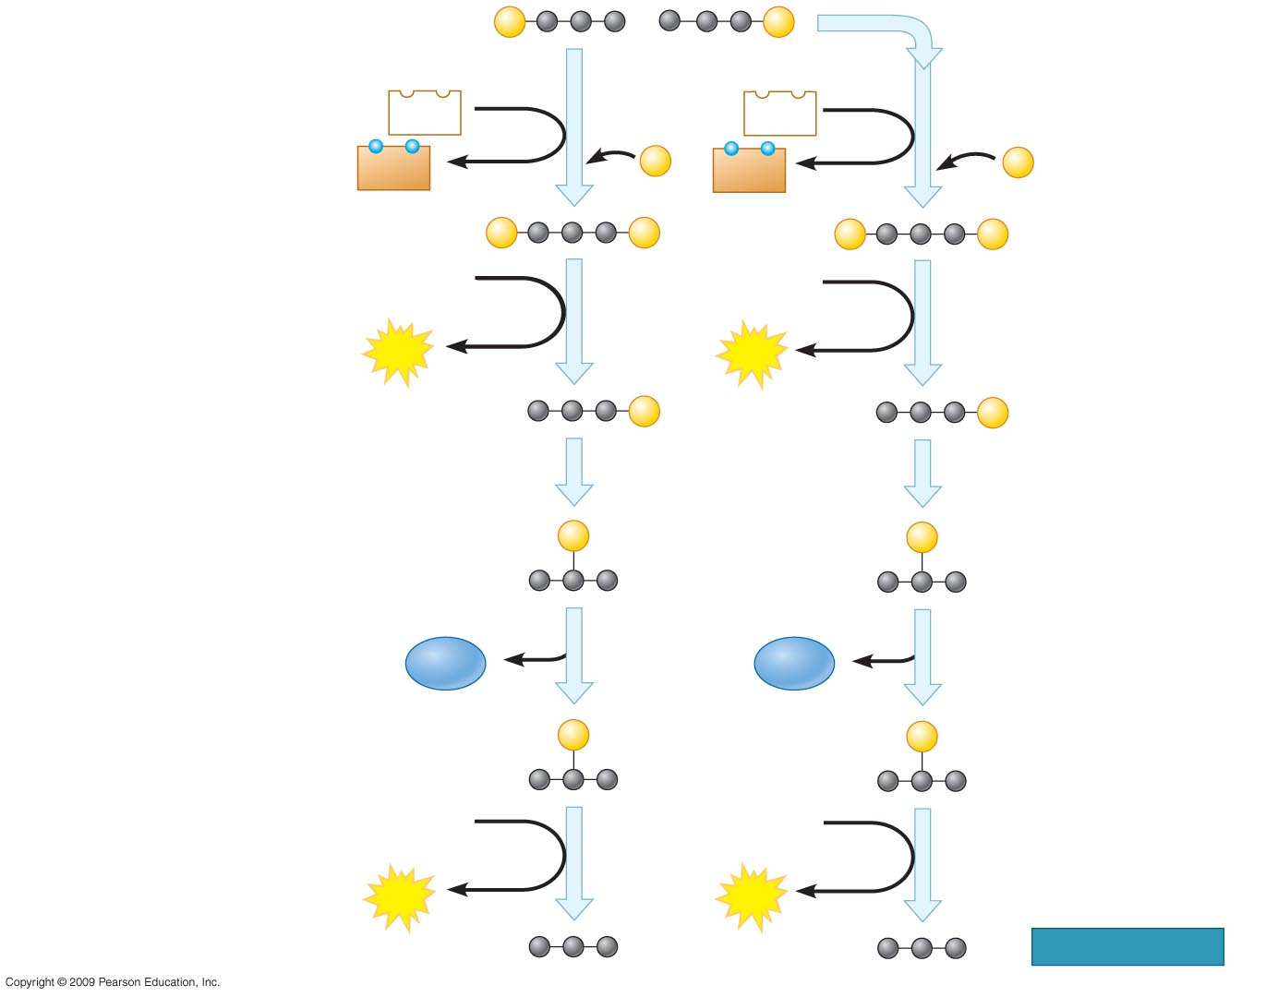
P
P
Glyceraldehyde-3-phosphate
(G3P)
Step A redox reaction
generates NADH.
NAD⁺
5
NAD⁺
5
5
ENERGY PAYOFF PHASE
NADH
P
NADH
P
+ H⁺
+ H⁺
P
P
P
P
1,3-Bisphosphoglycerate
ADP
ADP
6
6
ATP
ATP
P
P
3-Phosphoglycerate
7
7
Steps – ATP and pyruvate
are produced.
6
9
P
P
2-Phosphoglycerate
H₂O
8
H₂O
8
P
P
Phosphoenolpyruvate
(PEP)
ADP
ADP
9
9
ATP
ATP
Pyruvate
Notes:
Figure 6.7C Details of glycolysis.

Slide 40
6.8 Pyruvate is chemically groomed for the citric acid cycle
The pyruvate formed in glycolysis is transported to the mitochondria, where it is prepared for entry into the citric acid cycle
  The first step is removal of a carboxyl group that forms CO₂
  The second is oxidization of the two-carbon compound remaining
  Finally, coenzyme A binds to the two-carbon fragment forming acetyl coenzyme A
Copyright © 2009 Pearson Education, Inc.
Notes:
Coenzyme A is abbreviated CoA and is the molecule that shuttles fuel into the citric acid cycle.
Student Misconceptions and Concerns
1. Perhaps more than anywhere else in general biology, students studying aerobic metabolism may fail to see the forest for the trees. Students may focus on the details of each stage of aerobic metabolism and devote little attention to the overall process and products. Consider emphasizing the products and energy yields associated with glycolysis, the citric acid cycle, and oxidative phosphorylation before detailing the specifics of each reaction.
2. The location within a cell in which each reaction takes place is often forgotten in the details of the chemical processes, but it is important to emphasize. Consider using Figure 6.12 as a common reference to locate each stage as you discuss the details of cellular respiration.
3. Students frequently think that plants have chloroplasts instead of mitochondria. Take care to point out the need for mitochondria in plants when photosynthesis is not efficient or possible (such as during the night).
Teaching Tips
1. The production of NADH through glycolysis and the Krebs cycle, as compared to the direct production of ATP, can get confusing for students. Help students understand that NADH molecules have a value to be cashed in by the electron transport chain. The NADH can therefore be thought of as casino chips, accumulated along the way to be cashed in at the electron transport cashier.

Slide 41
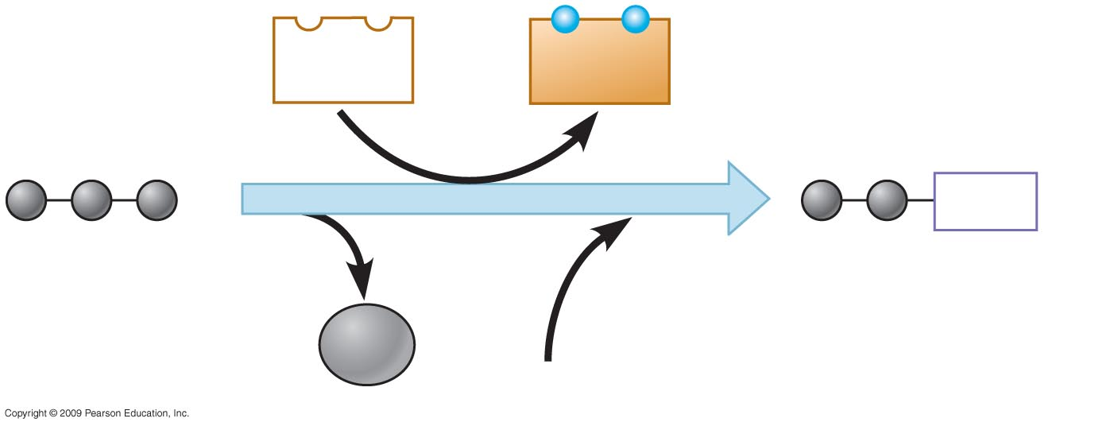
NAD⁺
NADH
+ H⁺
2
CoA
Pyruvate
1
Acetyl coenzyme A
3
CO₂
Coenzyme A
Notes:
Figure 6.8 The conversion of pyruvate to acetyl CoA.

Slide 42
6.9 The citric acid cycle completes the oxidation of organic molecules, generating many NADH and FADH₂ molecules
With the help of CoA, the acetyl (two-carbon) compound enters the citric acid cycle
  At this point, the acetyl group associates with a four-carbon molecule forming a six-carbon molecule
  The six-carbon molecule then passes through a series of redox reactions that regenerate the four-carbon molecule (thus the “cycle” designation)
Copyright © 2009 Pearson Education, Inc.
Notes:
The citric acid cycle is also called the Krebs cycle.
There are huge energy benefits related to the Krebs cycle. Produced are 2 ATP, 6 NADH, and 2 FADH₂.
For the BLAST Animation Energy: Krebs Cycle, go to the Animation and Video Files.
Student Misconceptions and Concerns
1. Perhaps more than anywhere else in general biology, students studying aerobic metabolism may fail to see the forest for the trees. Students may focus on the details of each stage of aerobic metabolism and devote little attention to the overall process and products. Consider emphasizing the products and energy yields associated with glycolysis, the citric acid cycle, and oxidative phosphorylation before detailing the specifics of each reaction.
2. The location within a cell in which each reaction takes place is often forgotten in the details of the chemical processes, but it is important to emphasize. Consider using Figure 6.12 as a common reference to locate each stage as you discuss the details of cellular respiration.
3. Students frequently think that plants have chloroplasts instead of mitochondria. Take care to point out the need for mitochondria in plants when photosynthesis is not efficient or possible (such as during the night).
Teaching Tips
1. The production of NADH through glycolysis and the Krebs cycle, as compared to the direct production of ATP, can get confusing for students. Help students understand that NADH molecules have a value to be cashed in by the electron transport chain. The NADH can therefore be thought of as casino chips, accumulated along the way to be cashed in at the electron transport cashier.

Slide 43
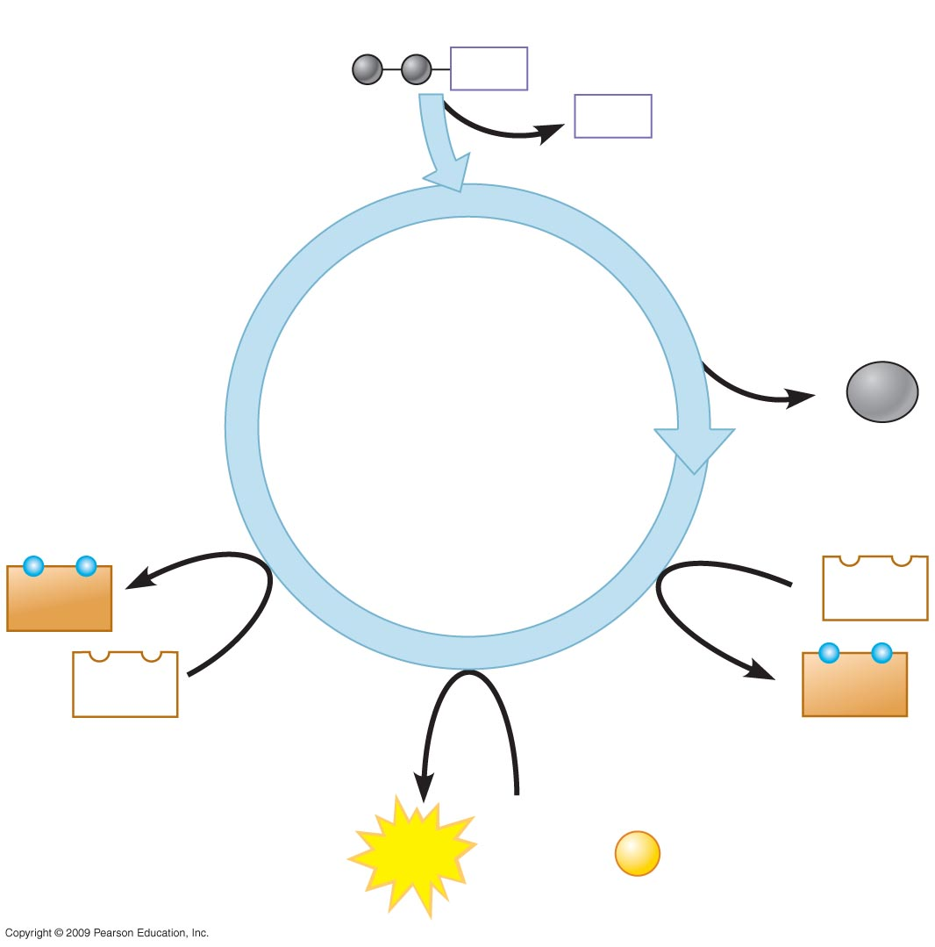
Acetyl CoA
CoA
CoA
2
CO₂
CITRIC ACID CYCLE
FADH₂
3
NAD⁺
FAD
3
NADH

3 H⁺
ATP
ADP +
P
Notes:
Figure 6.9A An overview of the citric acid cycle: Two carbons enter the cycle through acetyl CoA, and 2 CO₂, 3 NADH, 1 FADH₂, and 1 ATP exit the cycle.

Slide 44
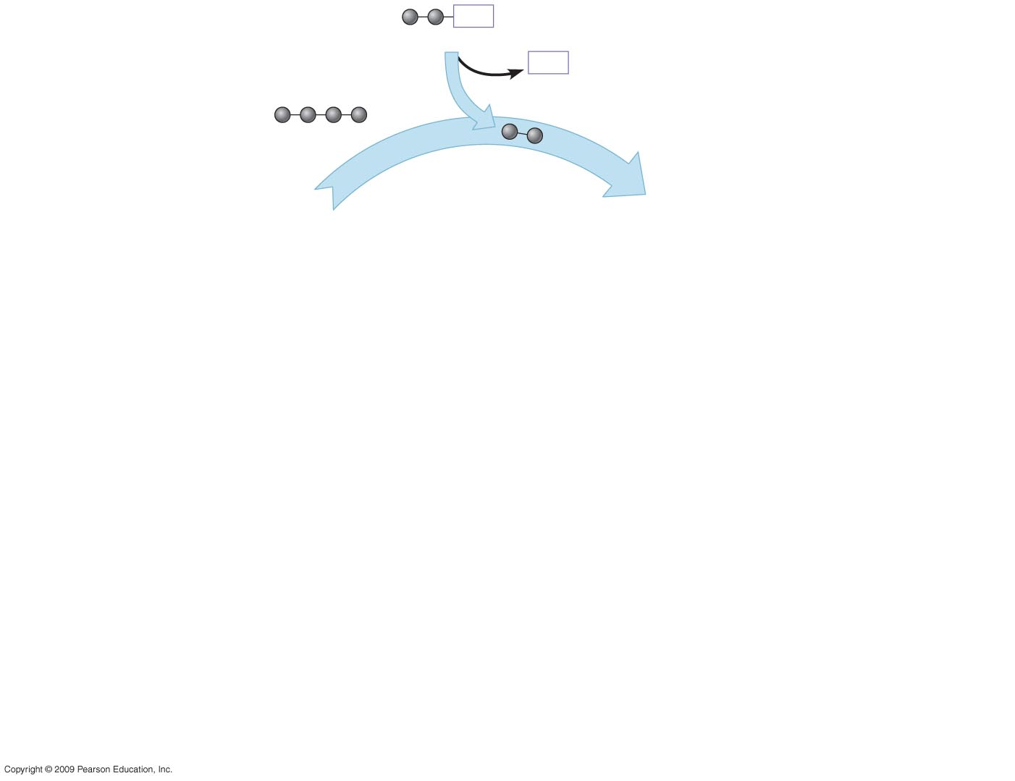
CoA
Acetyl CoA
CoA
2 carbons enter cycle
Oxaloacetate
1
CITRIC ACID CYCLE
Step
Acetyl CoA stokes the furnace.
1
Notes:
Figure 6.9B Details of the citric acid cycle.

Slide 45
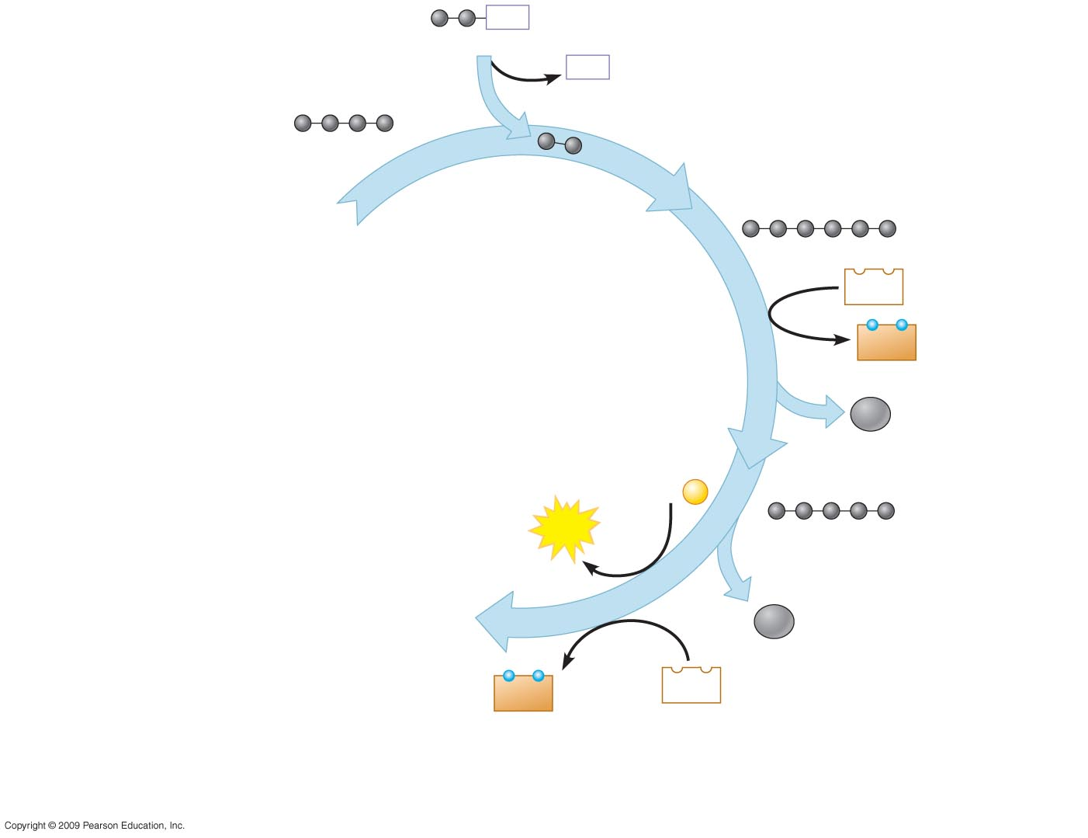
CoA
Acetyl CoA
CoA
2 carbons enter cycle
Oxaloacetate
1
Citrate
NAD⁺
2
NADH
+ H⁺
CITRIC ACID CYCLE
CO₂
leaves cycle
ADP +
P
ATP
Alpha-ketoglutarate
3
CO₂
leaves cycle
NADH
+ H⁺
NAD⁺
Step
Acetyl CoA stokes the furnace.
Steps –
NADH, ATP, and CO₂ are generated
during redox reactions.
1
2
3
Notes:
Figure 6.9B Details of the citric acid cycle.

Slide 46
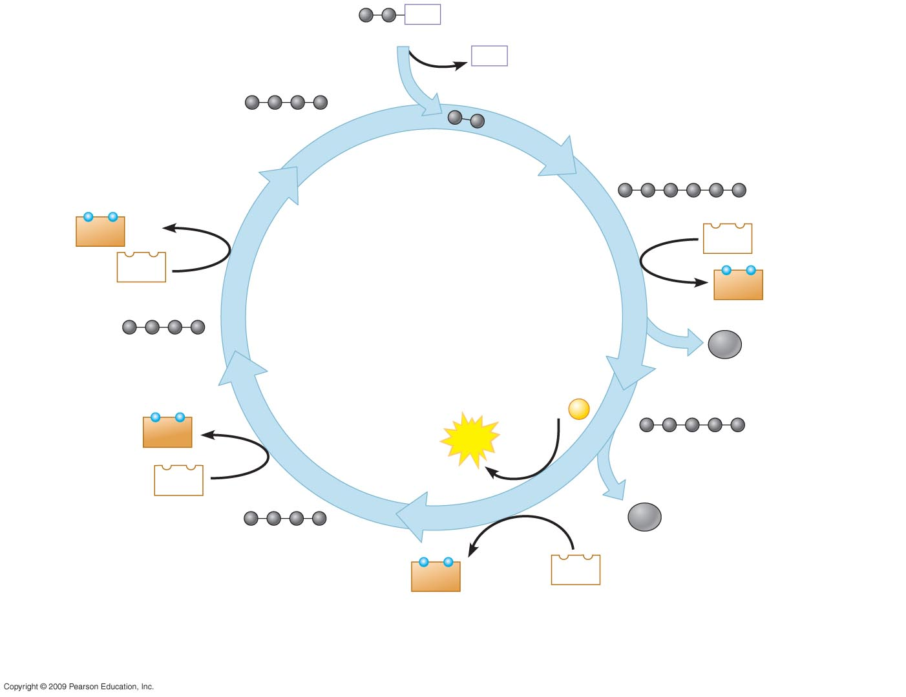
CoA
Acetyl CoA
CoA
2 carbons enter cycle
Oxaloacetate
1
Citrate
NADH
+ H⁺
NAD⁺
NAD⁺
5
2
NADH
+ H⁺
CITRIC ACID CYCLE
Malate
CO₂
leaves cycle
ADP +
P
FADH₂
4
ATP
Alpha-ketoglutarate
FAD
3
CO₂
leaves cycle
Succinate
NADH
+ H⁺
NAD⁺
Step
Acetyl CoA stokes the furnace.
Steps –
NADH, ATP, and CO₂ are generated
during redox reactions.
Steps –
Redox reactions generate FADH₂
and NADH.
1
2
3
4
5
Notes:
Figure 6.9B Details of the citric acid cycle.

Slide 47
6.10 Most ATP production occurs by oxidative phosphorylation
Oxidative phosphorylation involves electron transport and chemiosmosis and requires an adequate supply of oxygen
  NADH and FADH₂ and the inner membrane of the mitochondria are also involved
  A H⁺ ion gradient formed from all of the redox reactions of glycolysis and the citric acid cycle provide energy for the synthesis of ATP
Copyright © 2009 Pearson Education, Inc.
Notes:
The extensive folds of the mitochondrial membranes provide space for thousands of copies of the electron transport chain and many ATP synthase complexes.
The process is called oxidative phosphorylation because the energy is derived from the oxidation-reduction reactions of the electron transport chain and is used to phosphorylate ADP.
Student Misconceptions and Concerns
1. Perhaps more than anywhere else in general biology, students studying aerobic metabolism may fail to see the forest for the trees. Students may focus on the details of each stage of aerobic metabolism and devote little attention to the overall process and products. Consider emphasizing the products and energy yields associated with glycolysis, the citric acid cycle, and oxidative phosphorylation before detailing the specifics of each reaction.
2. The location within a cell in which each reaction takes place is often forgotten in the details of the chemical processes, but it is important to emphasize. Consider using Figure 6.12 as a common reference to locate each stage as you discuss the details of cellular respiration.
3. Students frequently think that plants have chloroplasts instead of mitochondria. Take care to point out the need for mitochondria in plants when photosynthesis is not efficient or possible (such as during the night).
Teaching Tips
1. The production of NADH through glycolysis and the Krebs cycle, as compared to the direct production of ATP, can get confusing for students. Help students understand that NADH molecules have a value to be cashed in by the electron transport chain. The NADH can therefore be thought of as casino chips, accumulated along the way to be cashed in at the electron transport cashier.
2. As you relate the structure of the inner mitochondrial membrane to its functions, challenge students to explain the adaptive advantage of the many folds of this inner membrane (see Figure 6.6). (These folds greatly increase the surface area available for the associated reactions).
3. The authors develop an analogy between the function of the inner mitochondrial membrane and a dam. A reservoir of hydrogen ions is built up between the inner and outer mitochondrial membranes, like a dam holding back water. As the hydrogen ions move down their concentration gradient, they “spin” the ATP synthase, which helps generate ATP. In a dam, water rushing downhill turns giant turbines, which generate electricity.

Slide 48
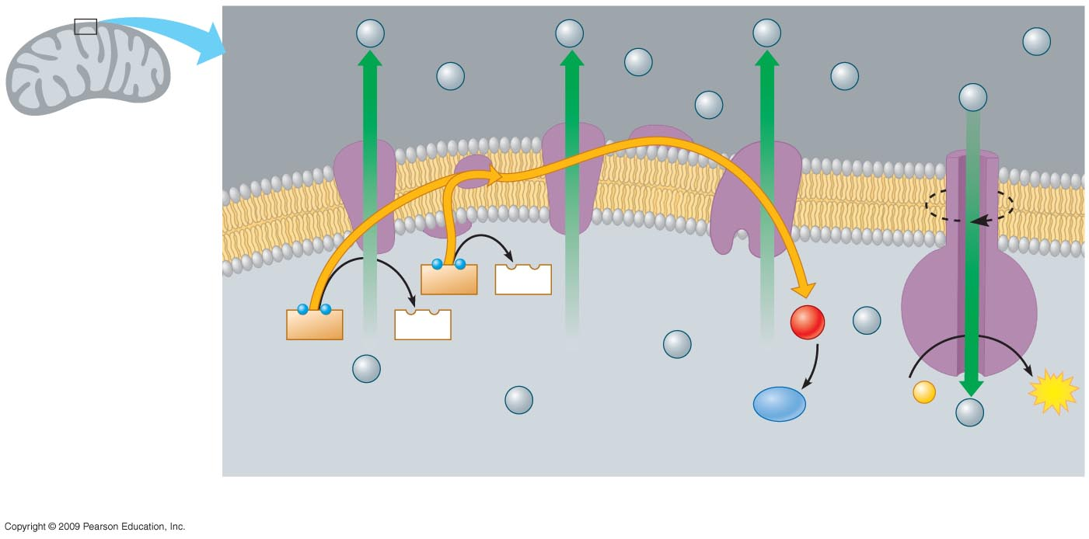
H⁺
H⁺
H⁺
H⁺
Protein
complex
of electron
carriers
H⁺
H⁺
H⁺
Electron
carrier
H⁺
H⁺
ATP
synthase
Intermembrane
space
Inner
mitochondrial
membrane
Electron
flow
FADH₂
FAD
NADH
NAD⁺
1
−
2
O₂
+ 2
H⁺
H⁺
Mitochondrial
matrix
H⁺
H⁺
H₂O
ADP +
P
ATP
H⁺
Electron Transport Chain
Chemiosmosis
OXIDATIVE PHOSPHORYLATION
Notes:
Figure 6.10 Oxidative phosphorylation, using electron transport and chemiosmosis in the mitochondrion.

Slide 49
6.11 CONNECTION: Certain poisons interrupt critical events in cellular respiration
There are three different categories of cellular poisons that affect cellular respiration
  The first category blocks the electron transport chain (for example, rotenone, cyanide, and carbon monoxide)
  The second inhibits ATP synthase (for example, oligomycin)
  Finally, the third makes the membrane leaky to hydrogen ions (for example, dinitrophenol)
Copyright © 2009 Pearson Education, Inc.
Notes:
Poisons like pesticides and antibiotics are obviously useful, but others are not.
Student Misconceptions and Concerns
1. Perhaps more than anywhere else in general biology, students studying aerobic metabolism may fail to see the forest for the trees. Students may focus on the details of each stage of aerobic metabolism and devote little attention to the overall process and products. Consider emphasizing the products and energy yields associated with glycolysis, the citric acid cycle, and oxidative phosphorylation before detailing the specifics of each reaction.
2. The location within a cell in which each reaction takes place is often forgotten in the details of the chemical processes, but it is important to emphasize. Consider using Figure 6.12 as a common reference to locate each stage as you discuss the details of cellular respiration.
3. Students frequently think that plants have chloroplasts instead of mitochondria. Take care to point out the need for mitochondria in plants when photosynthesis is not efficient or possible (such as during the night).
Teaching Tips
1. Module 6.11 explores the many points in cellular respiration where poisons may produce their deadly effects. Like any complex process, such as an engine of a car or the cooperation of athletes on a team, the results depend upon the proper functioning of each part. Poisons can stop a metabolic pathway by disrupting a single step in the process.

Slide 50
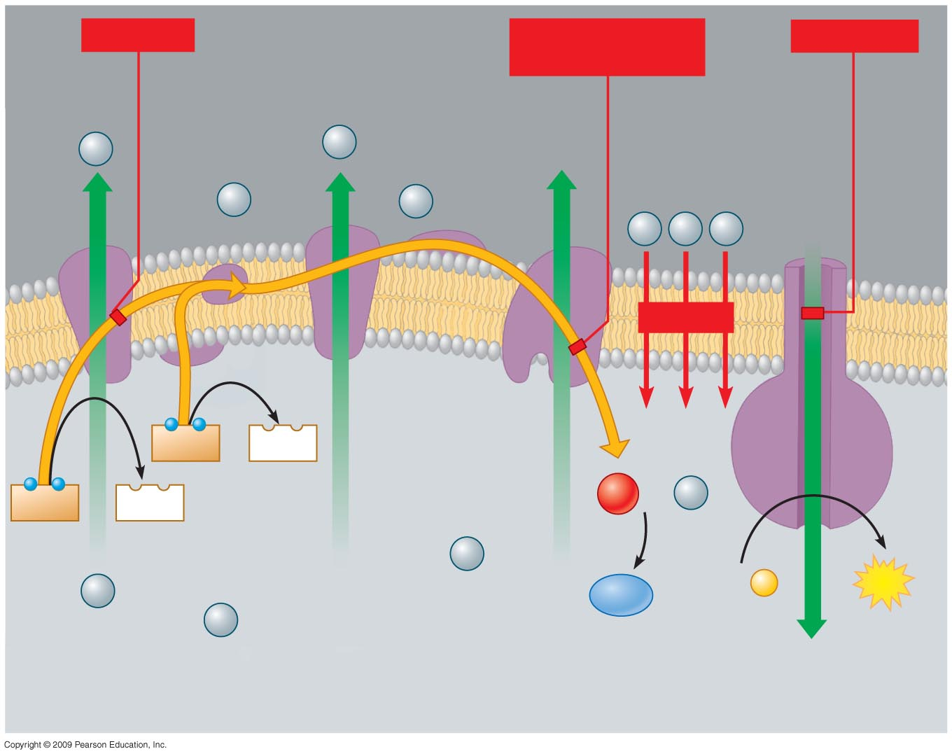
Rotenone
Cyanide,
carbon monoxide
Oligomycin
H⁺
H⁺
H⁺
H⁺
ATP
synthase
H⁺
H⁺
H⁺
DNP
FADH₂
FAD
NADH
NAD⁺
1
−
2
O₂
+ 2
H⁺
H⁺
H⁺
H₂O
ADP +
P
ATP
H⁺
Electron Transport Chain
Chemiosmosis
Notes:
Figure 6.11 The effects of five poisons on the electron transport chain and chemiosmosis.

Slide 51
6.12 Review: Each molecule of glucose yields many molecules of ATP
Recall that the energy payoff of cellular respiration involves (1) glycolysis, (2) alteration of pyruvate, (3) the citric acid cycle, and (4) oxidative phosphorylation
  The total yield of ATP molecules per glucose molecule has a theoretical maximum of about 38
  This is about 40% of a glucose molecule potential energy
  Additionally, water and CO₂ are produced
Copyright © 2009 Pearson Education, Inc.
Notes:
The maximum ATP yield depends on an adequate supply of oxygen. However, some organisms can generate ATP without oxygen by a process called fermentation.
Student Misconceptions and Concerns
1. Perhaps more than anywhere else in general biology, students studying aerobic metabolism may fail to see the forest for the trees. Students may focus on the details of each stage of aerobic metabolism and devote little attention to the overall process and products. Consider emphasizing the products and energy yields associated with glycolysis, the citric acid cycle, and oxidative phosphorylation before detailing the specifics of each reaction.
2. The location within a cell in which each reaction takes place is often forgotten in the details of the chemical processes, but it is important to emphasize. Consider using Figure 6.12 as a common reference to locate each stage as you discuss the details of cellular respiration.
3. Students frequently think that plants have chloroplasts instead of mitochondria. Take care to point out the need for mitochondria in plants when photosynthesis is not efficient or possible (such as during the night).
Teaching Tips
1. Students should be reminded that the ATP yield of up to 38 ATP per glucose molecule is only a potential. The complex chemistry of aerobic metabolism can yield this amount only under ideal conditions, when every substrate and enzyme is immediately available. Such circumstances may occur only rarely in a working cell.

Slide 52
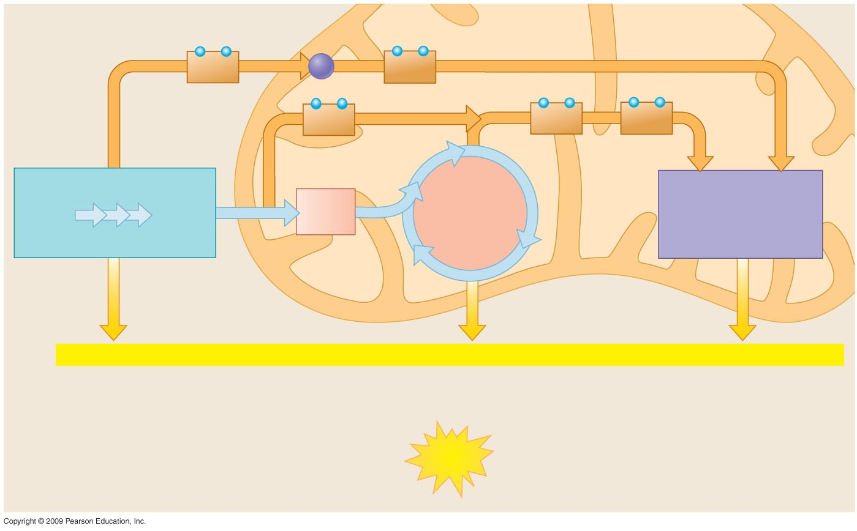
Electron shuttle
across membrane
Cytoplasm
Mitochondrion
2
NADH
2
NADH
(or 2 FADH₂)
2
NADH
6
NADH
2
FADH₂
GLYCOLYSIS
2
Pyruvate
OXIDATIVE
PHOSPHORYLATION
(Electron Transport
and Chemiosmosis)
2 Acetyl
CoA
CITRIC ACID
CYCLE
Glucose
+ 2 ATP
+ 2 ATP
+ about 34 ATP
by substrate-level
phosphorylation
by substrate-level
phosphorylation
by oxidative phosphorylation
Maximum per glucose:
About
38 ATP
Notes:
Figure 6.12 An estimated tally of the ATP produced by substrate-level and oxidative phosphorylation in cellular respiration.

Slide 53
6.13 Fermentation enables cells to produce ATP without oxygen (anaerobic cellular respiration)
Fermentation is an anaerobic (without oxygen) energy-generating process
  It takes advantage of glycolysis, producing two ATP molecules and reducing NAD⁺ to NADH
  The trick is to oxidize the NADH without passing its electrons through the electron transport chain to oxygen
Copyright © 2009 Pearson Education, Inc.
Notes:
Fermentation captures significantly less energy from a glucose molecule than is captured from glucose through respiration.
Student Misconceptions and Concerns
1. Perhaps more than anywhere else in general biology, students studying aerobic metabolism may fail to see the forest for the trees. Students may focus on the details of each stage of aerobic metabolism and devote little attention to the overall process and products. Consider emphasizing the products and energy yields associated with glycolysis, the citric acid cycle, and oxidative phosphorylation before detailing the specifics of each reaction.
2. The location within a cell in which each reaction takes place is often forgotten in the details of the chemical processes, but it is important to emphasize. Consider using Figure 6.12 as a common reference to locate each stage as you discuss the details of cellular respiration.
3. Students frequently think that plants have chloroplasts instead of mitochondria. Take care to point out the need for mitochondria in plants when photosynthesis is not efficient or possible (such as during the night).
4. Students may expect that fermentation will produce alcohol and maybe even carbon dioxide. Take the time to clarify the different possible products of fermentation and correct this general misconception.
Teaching Tips
1. The text notes that some microbes are useful in the dairy industry because they produce lactic acid. However, the impact of acids on milk may not be obvious to many students. Consider a simple demonstration mixing about equal portions of milk (skim or 2%) with some acid (vinegar will work). Notice the accumulation of strands of milk curd (protein) on the side of the container and stirring device.
2. Dry wines are produced when the yeast cells use up all or most of the sugar available. Sweet wines result when the alcohol accumulates enough to inhibit fermentation before the sugar is depleted.
3. Exposing fermenting yeast to oxygen will slow or stop the process, because the yeast will switch back to aerobic respiration. When fermentation is rapid, the carbon dioxide produced drives away the oxygen immediately above the wine. However, as fermentation slows down, the wine must be sealed to prevent oxygen exposure and permit the fermentation process to finish.

Slide 54
6.13 Fermentation enables cells to produce ATP without oxygen (anaerobic cellular respiration)
Your muscle cells and certain bacteria can oxidize NADH through lactic acid fermentation
  NADH is oxidized to NAD⁺ when pyruvate is reduced to lactate
  In a sense, pyruvate is serving as an “electron sink,” a place to dispose of the electrons generated by oxidation reactions in glycolysis
Copyright © 2009 Pearson Education, Inc.
Notes:
Fermentations are used by the dairy industry to make cheese and yogurt, while other industries produce soy sauce and sauerkraut through fermentation reactions.
Student Misconceptions and Concerns
1. Perhaps more than anywhere else in general biology, students studying aerobic metabolism may fail to see the forest for the trees. Students may focus on the details of each stage of aerobic metabolism and devote little attention to the overall process and products. Consider emphasizing the products and energy yields associated with glycolysis, the citric acid cycle, and oxidative phosphorylation before detailing the specifics of each reaction.
2. The location within a cell in which each reaction takes place is often forgotten in the details of the chemical processes, but it is important to emphasize. Consider using Figure 6.12 as a common reference to locate each stage as you discuss the details of cellular respiration.
3. Students frequently think that plants have chloroplasts instead of mitochondria. Take care to point out the need for mitochondria in plants when photosynthesis is not efficient or possible (such as during the night).
4. Students may expect that fermentation will produce alcohol and maybe even carbon dioxide. Take the time to clarify the different possible products of fermentation and correct this general misconception.
Teaching Tips
1. The text notes that some microbes are useful in the dairy industry because they produce lactic acid. However, the impact of acids on milk may not be obvious to many students. Consider a simple demonstration mixing about equal portions of milk (skim or 2%) with some acid (vinegar will work). Notice the accumulation of strands of milk curd (protein) on the side of the container and stirring device.
2. Dry wines are produced when the yeast cells use up all or most of the sugar available. Sweet wines result when the alcohol accumulates enough to inhibit fermentation before the sugar is depleted.
3. Exposing fermenting yeast to oxygen will slow or stop the process, because the yeast will switch back to aerobic respiration. When fermentation is rapid, the carbon dioxide produced drives away the oxygen immediately above the wine. However, as fermentation slows down, the wine must be sealed to prevent oxygen exposure and permit the fermentation process to finish.

Slide 55
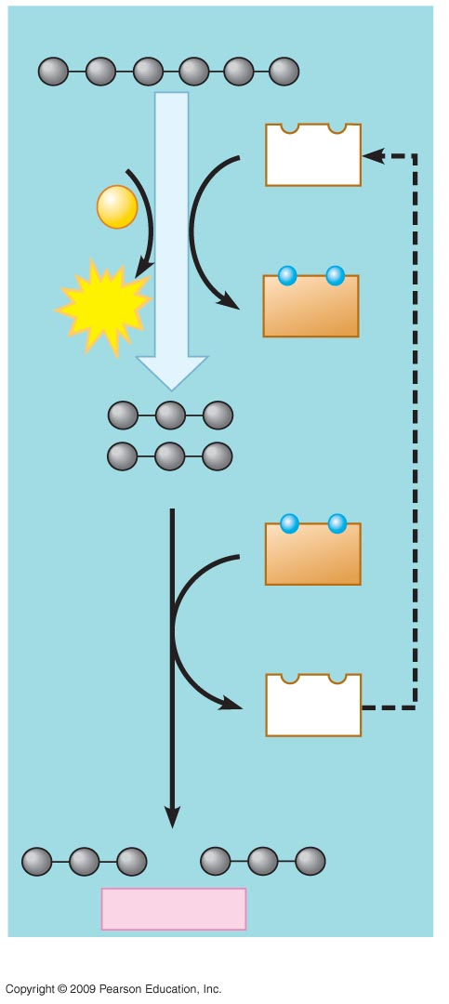
Glucose
Lactic acid
fermentation
2 ADP
2
NAD⁺
+
2
P
GLYCOLYSIS
2
ATP
2
NADH
2 Pyruvate
2
NADH
2
NAD⁺
2 Lactate
Notes:
Figure 6.13A Lactic acid fermentation oxidizes NADH to NAD⁺ and produces lactate.

Slide 56
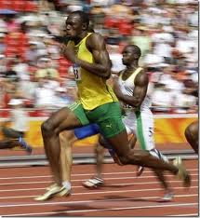
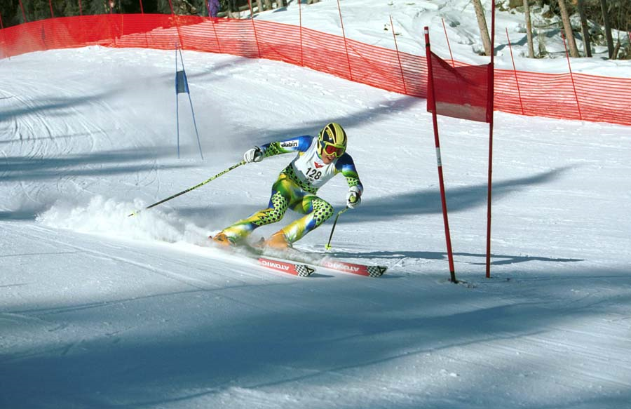
Lactic Acid Fermentation

Slide 57
6.13 Fermentation enables cells to produce ATP without oxygen (anaerobic cellular fermentation)
The baking and winemaking industry have used alcohol fermentation for thousands of years
  Yeasts are single-celled fungi that not only can use respiration for energy but can ferment under anaerobic conditions
  They convert pyruvate to CO₂ and ethanol while oxidizing NADH back to NAD⁺
Copyright © 2009 Pearson Education, Inc.
Notes:
The carbon dioxide provides the bubbles in beer and champagne and also the bubbles in dough that cause bread to rise.
Student Misconceptions and Concerns
1. Perhaps more than anywhere else in general biology, students studying aerobic metabolism may fail to see the forest for the trees. Students may focus on the details of each stage of aerobic metabolism and devote little attention to the overall process and products. Consider emphasizing the products and energy yields associated with glycolysis, the citric acid cycle, and oxidative phosphorylation before detailing the specifics of each reaction.
2. The location within a cell in which each reaction takes place is often forgotten in the details of the chemical processes, but it is important to emphasize. Consider using Figure 6.12 as a common reference to locate each stage as you discuss the details of cellular respiration.
3. Students frequently think that plants have chloroplasts instead of mitochondria. Take care to point out the need for mitochondria in plants when photosynthesis is not efficient or possible (such as during the night).
4. Students may expect that fermentation will produce alcohol and maybe even carbon dioxide. Take the time to clarify the different possible products of fermentation and correct this general misconception.
Teaching Tips
1. The text notes that some microbes are useful in the dairy industry because they produce lactic acid. However, the impact of acids on milk may not be obvious to many students. Consider a simple demonstration mixing about equal portions of milk (skim or 2%) with some acid (vinegar will work). Notice the accumulation of strands of milk curd (protein) on the side of the container and stirring device.
2. Dry wines are produced when the yeast cells use up all or most of the sugar available. Sweet wines result when the alcohol accumulates enough to inhibit fermentation before the sugar is depleted.
3. Exposing fermenting yeast to oxygen will slow or stop the process, because the yeast will switch back to aerobic respiration. When fermentation is rapid, the carbon dioxide produced drives away the oxygen immediately above the wine. However, as fermentation slows down, the wine must be sealed to prevent oxygen exposure and permit the fermentation process to finish.

Slide 58
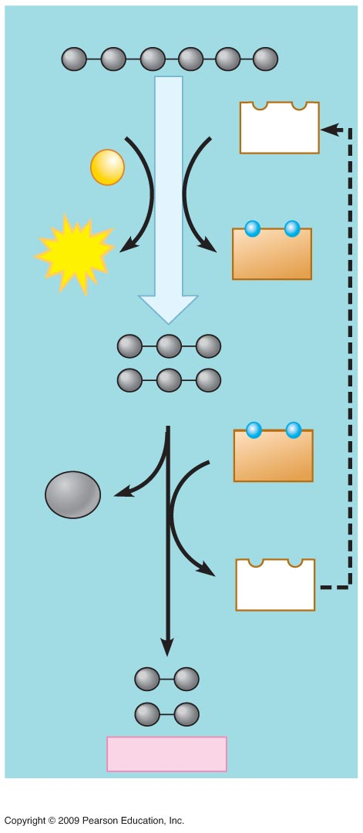
Glucose
Alcohol
fermentation
2 ADP
2
NAD⁺
+
2
P
GLYCOLYSIS
2
ATP
2
NADH
2 Pyruvate
2
NADH
2
CO₂
released
2
NAD⁺
2 Ethanol
Notes:
Figure 6.13B Alcohol fermentation oxidizes NADH to NAD⁺ and produces ethanol and CO₂.

Slide 59
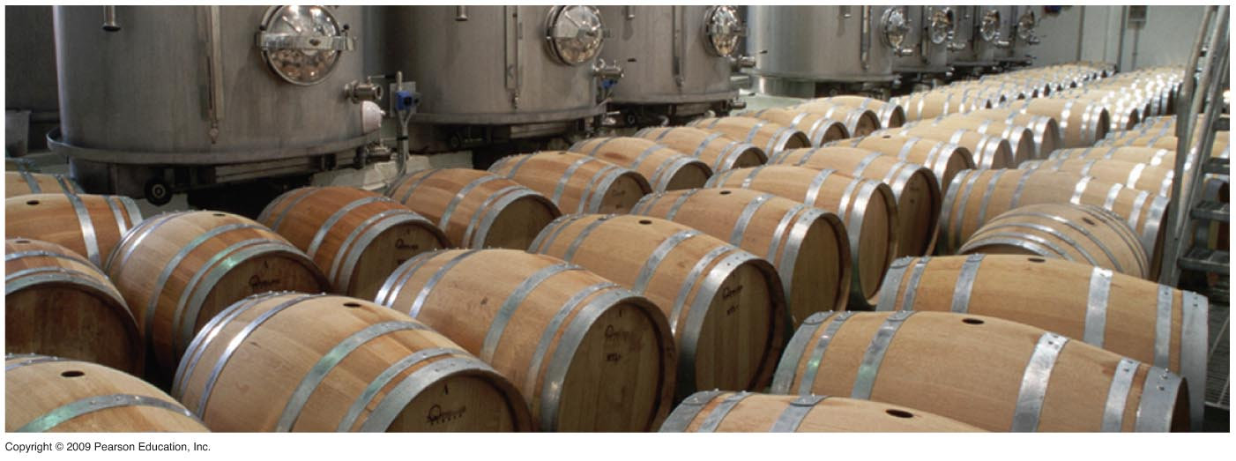
Notes:
Figure 6.13C Fermentation vats for wine.

Slide 60
6.14 EVOLUTION CONNECTION: Glycolysis evolved early in the history of life on Earth
Glycolysis is the universal energy-harvesting process of living organisms
  So, all cells can use glycolysis for the energy necessary for viability
  The fact that glycolysis has such a widespread distribution is good evidence for evolution
Copyright © 2009 Pearson Education, Inc.
Notes:
Ancient prokaryotes probably used glycolysis to make ATP long before oxygen was present in Earth’s atmosphere.
Student Misconceptions and Concerns
1. Perhaps more than anywhere else in general biology, students studying aerobic metabolism may fail to see the forest for the trees. Students may focus on the details of each stage of aerobic metabolism and devote little attention to the overall process and products. Consider emphasizing the products and energy yields associated with glycolysis, the citric acid cycle, and oxidative phosphorylation before detailing the specifics of each reaction.
2. The location within a cell in which each reaction takes place is often forgotten in the details of the chemical processes, but it is important to emphasize. Consider using Figure 6.12 as a common reference to locate each stage as you discuss the details of cellular respiration.
3. Students frequently think that plants have chloroplasts instead of mitochondria. Take care to point out the need for mitochondria in plants when photosynthesis is not efficient or possible (such as during the night).
Teaching Tips
1. The widespread occurrence of glycolysis, which takes place in the cytosol and independent of organelles, suggests that this process had an early evolutionary origin. Since atmospheric oxygen was not available in significant amounts during the early stages of Earth’s history, and glycolysis does not require oxygen, it is likely that this chemical pathway was used by the prokaryotes in existence at that time. Students focused on the evolution of large, readily apparent structures such as wings and teeth may have never considered the evolution of cellular chemistry.

Slide 61
INTERCONNECTIONS BETWEEN MOLECULAR BREAKDOWN
AND SYNTHESIS
Copyright © 2009 Pearson Education, Inc.

Slide 62
6.15 Cells use many kinds of organic molecules as fuel for cellular respiration
Although glucose is considered to be the primary source of sugar for respiration and fermentation, there are actually three sources of molecules for generation of ATP
  Carbohydrates (disaccharides)
  Proteins (after conversion to amino acids)
  Fats
Copyright © 2009 Pearson Education, Inc.
Notes:
Teaching Tips
1. The same mass of fat stores nearly twice as many calories (about 9 kcal per gram) as an equivalent mass of protein or carbohydrates (about 4.5–5 kcal per gram). Fat is therefore an efficient way to store energy in animals and many plants. To store an equivalent amount of energy in the form of carbohydrates or proteins would require about twice the mass, adding a significant burden to the organism’s structure. (For example, if you were 20 lbs overweight, you would be nearly 40 lbs overweight if the same energy were stored as carbohydrates or proteins instead of fat).
2. Figure 6.15 is an important visual synthesis of the diverse fuels that can enter into cellular respiration and the various stages of this process. Figures such as this can serve as a visual anchor to integrate the many aspects of this chapter.
3. The final modules in this chapter may raise questions about obesity and proper diet. The Centers for Disease Control and Prevention website, www.cdc.gov/nccdphp/dnpa/, discusses many aspects of nutrition, obesity, and general physical fitness and is a useful reference for teachers and students.

Slide 63
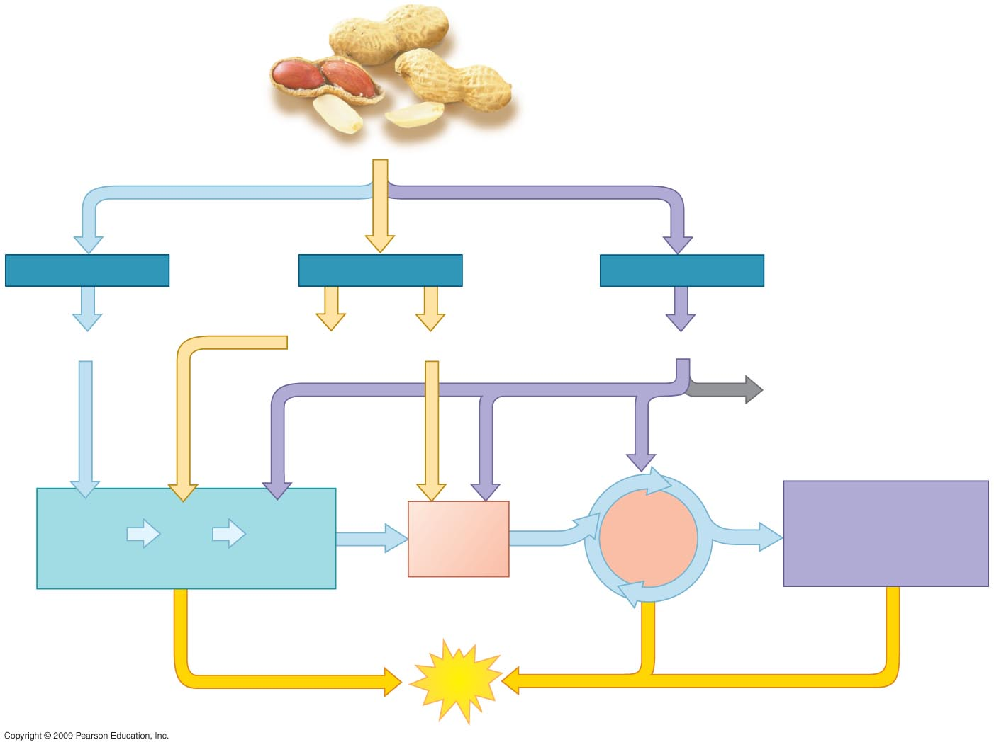
Food, such as
peanuts
Carbohydrates
Fats
Proteins
Sugars
Glycerol
Fatty acids
Amino acids
Amino
groups
OXIDATIVE
PHOSPHORYLATION
(Electron Transport
and Chemiosmosis)
Acetyl
CoA
CITRIC
ACID
CYCLE
Glucose
G3P
Pyruvate
GLYCOLYSIS
ATP
Notes:
Figure 6.15 Pathways that break down various food molecules.

Slide 64
6.16 Food molecules provide raw materials for biosynthesis
Many metabolic pathways are involved in biosynthesis of biological molecules
  To survive, cells must be able to biosynthesize molecules that are not present in its foods
  Often the cell will convert the intermediate compounds of glycolysis and the citric acid cycle to molecules not found in food
Copyright © 2009 Pearson Education, Inc.
Notes:
For BLAST Animation Building a Protein, go to Animation and Video Files.
Student Misconceptions and Concerns
1. Many students may only view nutrients as sources of calories. As noted in Module 6.16, the monomers of many nutrients are recycled into synthetic pathways of organic molecules.
Teaching Tips
1. The final modules in this chapter may raise questions about obesity and proper diet. The Centers for Disease Control and Prevention website, www.cdc.gov/nccdphp/dnpa/, discusses many aspects of nutrition, obesity, and general physical fitness and is a useful reference for teachers and students.

Slide 65
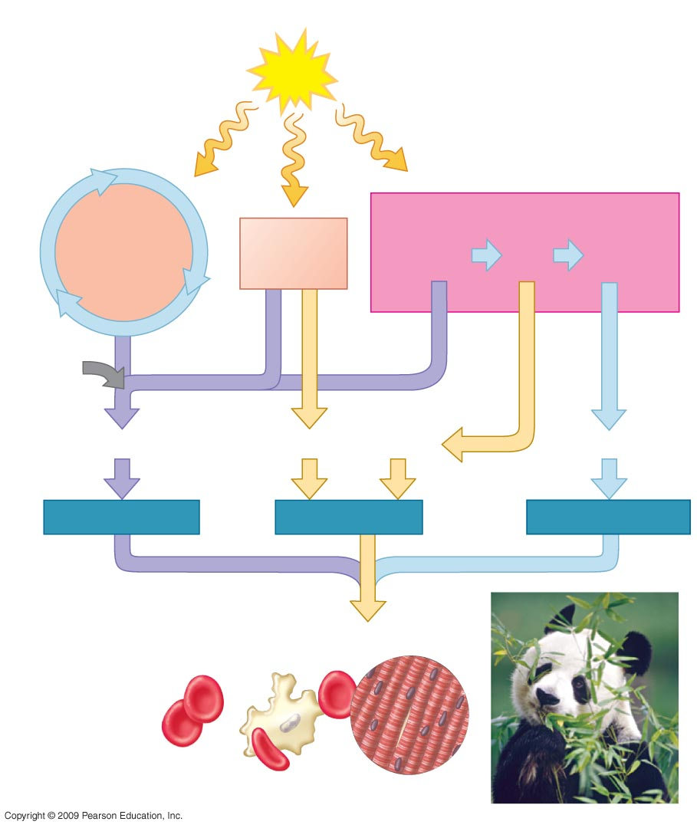
ATP needed to drive biosynthesis
ATP
CITRIC
ACID
CYCLE
GLUCOSE SYNTHESIS
Acetyl
CoA
Pyruvate
G3P
Glucose
Amino
groups
Amino acids
Fatty acids
Glycerol
Sugars
Proteins
Fats
Carbohydrates
Cells, tissues, organisms
Notes:
Figure 6.16 Biosynthesis of large organic molecules from intermediates of cellular respiration.

Slide 66
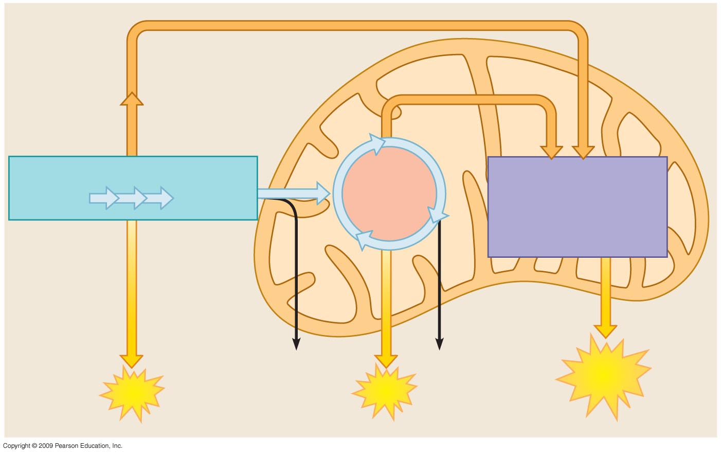
Cytoplasm
NADH
Mitochondrion
NADH and FADH₂
Glycolysis
Citric
acid
cycle
Oxidative
phosphorylation
(Electron Transport
and Chemiosmosis)
Glucose
Pyruvate
CO₂
CO₂
ATP
ATP
ATP

Slide 67
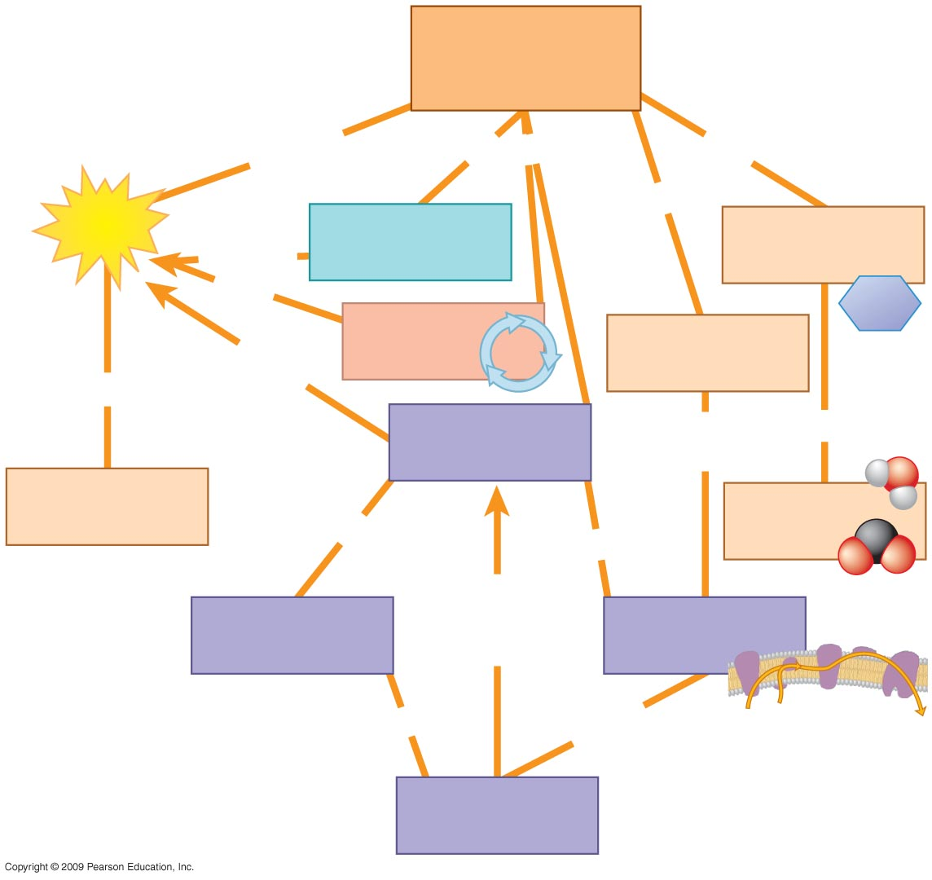
Cellular
respiration
generates
has three stages
oxidizes
uses
ATP
(a)
glucose and
organic fuels
produce
some
C₆H₁₂O₆
(b)
(d)
produces
many
energy for
(c)
to pull
electrons down
to
cellular work
(f)
by process called
uses
H⁺ diffuse
through
ATP synthase
chemiosmosis
(e)
uses
pumps H⁺ to create
H⁺ gradient

Slide 68
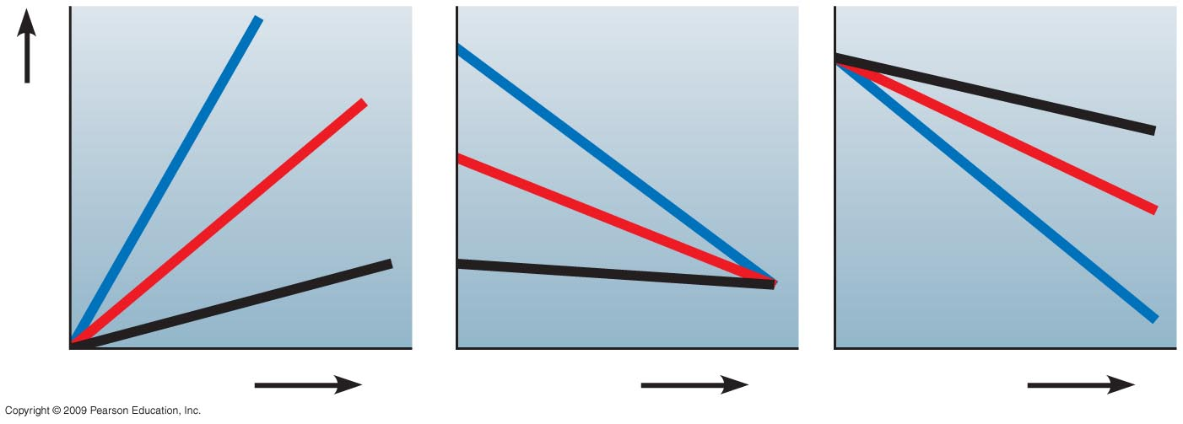
0.3
0.3
0.2
0.1
0.2
0.2
Color intensity
0.1
0.1
0.3
a. Time
b. Time
c. Time

Slide 69
You should now be able to
Explain how photosynthesis and cellular respiration are necessary to provide energy that is required to sustain your life
Explain why breathing is necessary to support cellular respiration
Describe how cellular respiration produces energy that can be stored in ATP
Explain why ATP is required for human activities
Copyright © 2009 Pearson Education, Inc.

Slide 70
You should now be able to
Describe the process of energy production from movement of electrons
List and describe the three main stages of cellular respiration
Describe the major steps of glycolysis and explain why glycolysis is considered to be a metabolic pathway
Explain how pyruvate is altered to enter the citric acid cycle and why coenzymes are important to the process
Copyright © 2009 Pearson Education, Inc.

Slide 71
You should now be able to
Describe the citric acid cycle as a metabolic pathway designed for generating additional energy from glucose
Discuss the importance of oxidative phosphorylation in producing ATP
Describe useful applications of poisons that interrupt critical steps in cellular respiration
Review the steps in oxidation of a glucose molecule aerobically
Copyright © 2009 Pearson Education, Inc.

Slide 72
You should now be able to
Compare respiration and fermentation
Provide evidence that glycolysis evolved early in the history of life on Earth
Provide criteria that a molecule must possess to be considered a fuel for cellular respiration
Discuss the mechanisms that cells use to biosynthesize cell components from food
Copyright © 2009 Pearson Education, Inc.

