Slide 1
Chapter 7
Photosynthesis: Using Light to Make Food
0
Lecture by Richard L. Myers

Slide 2
Introduction: Plant Power
Plants use water and atmospheric carbon dioxide to produce a simple sugar and liberate oxygen
  Earth’s plants produce 160 billion metric tons of sugar each year through photosynthesis, a process that converts solar energy to chemical energy
  Sugar is food for humans and for animals that we consume
Copyright © 2009 Pearson Education, Inc.
Notes:
Photosynthesis nourishes almost the entire living world directly or indirectly. Almost all plants are autotrophs, meaning that they sustain themselves without eating anything derived from other living beings.
Plants produce oxygen, a by-product of photosynthesis, that is used in respiration.
The solar energy used in photosynthesis traveled 150 million kilometers from the sun to Earth to be converted into chemical energy.
You may want to reintroduce the terms producers and consumers within the context of this chapter.

Slide 3
Introduction: Plant Power
Scientists have suggested that plants can be used in “energy plantations” to create a fuel source to replace fossil fuels
  This would be an excellent energy solution, because air pollution, acid precipitation, and greenhouse gases could be significantly reduced
Copyright © 2009 Pearson Education, Inc.
Notes:
The importance of greenhouse gases that lead to global warming will be discussed later in this chapter.
Although photosynthesis occurs on a microscopic level, when carried out repeatedly in plants around the world, it is responsible for an enormous amount of product.

Slide 4
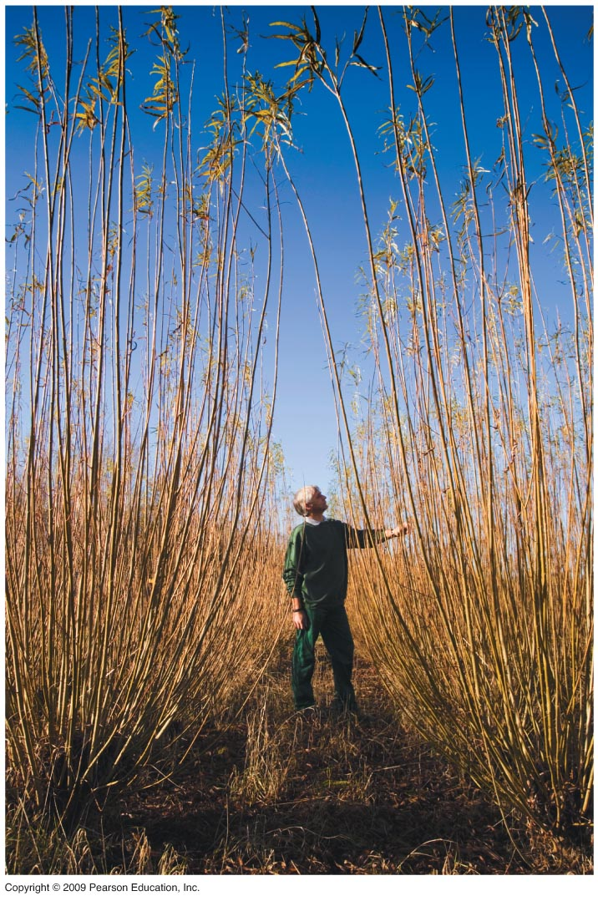

Slide 5
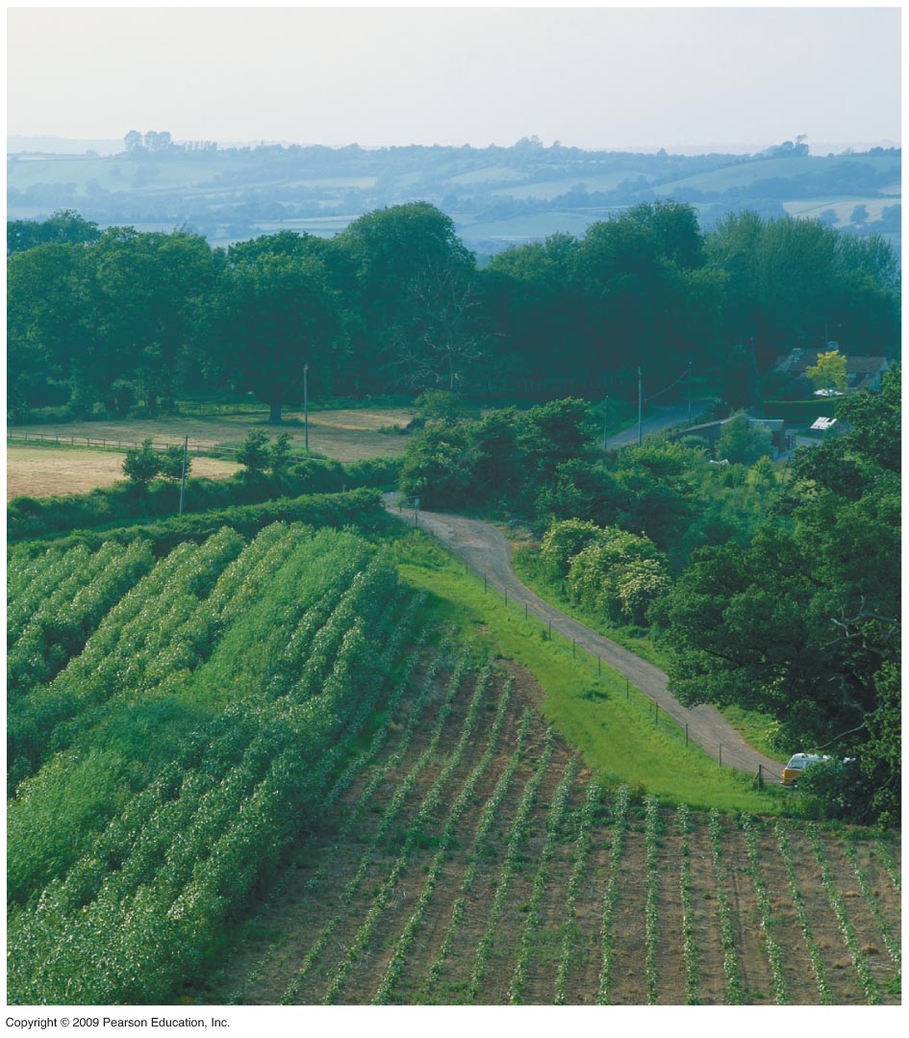

Slide 6
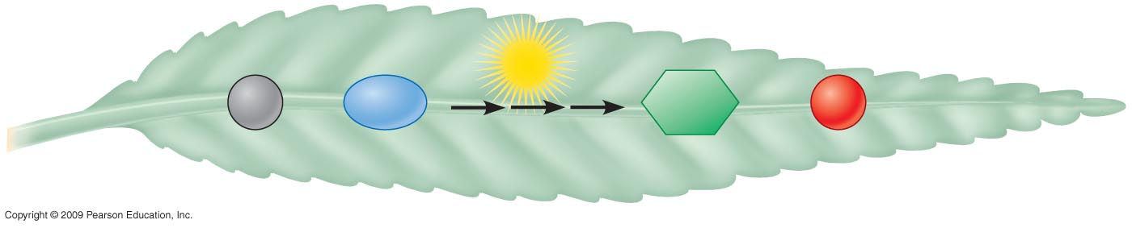
Light
energy
6
CO₂
+ 6
H₂O
C₆H₁₂O₆
+ 6
O₂
Carbon dioxide
Water
Photosynthesis
Glucose
Oxygen gas

Slide 7
AN OVERVIEW
OF PHOTOSYNTHESIS
Copyright © 2009 Pearson Education, Inc.

Slide 8
7.1 Autotrophs are the producers of the biosphere
Autotrophs are living things that are able to make their own food without using organic molecules derived from any other living thing
  Autotrophs that use the energy of light to produce organic molecules are called photoautotrophs
  Most plants, algae and other protists, and some prokaryotes are photoautotrophs
Copyright © 2009 Pearson Education, Inc.
Notes:
A very interesting class of autotrophs are the autotrophic bacteria that use carbon dioxide to synthesize organic molecules without solar energy.

Slide 9
7.1 Autotrophs are the producers of the biosphere
The ability to photosynthesize is directly related to the structure of chloroplasts
  Chloroplasts are organelles consisting of photosynthetic pigments, enzymes, and other molecules grouped together in membranes
Copyright © 2009 Pearson Education, Inc.
Notes:
There are about half a million chloroplasts per square millimeter of leaf surface.
Chloroplast membranes are similar to mitochondrial membranes in that both are important in energy-harvesting duties of the cell.

Slide 10
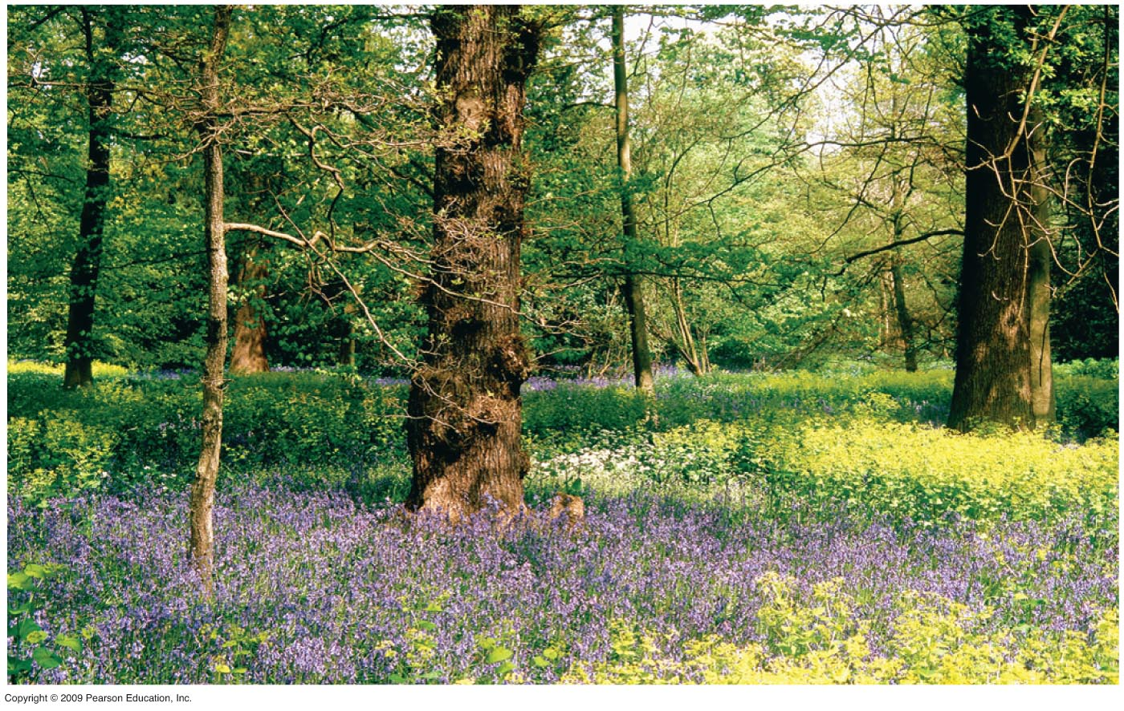
Notes:
Figure 7.1A Forest plants.

Slide 11
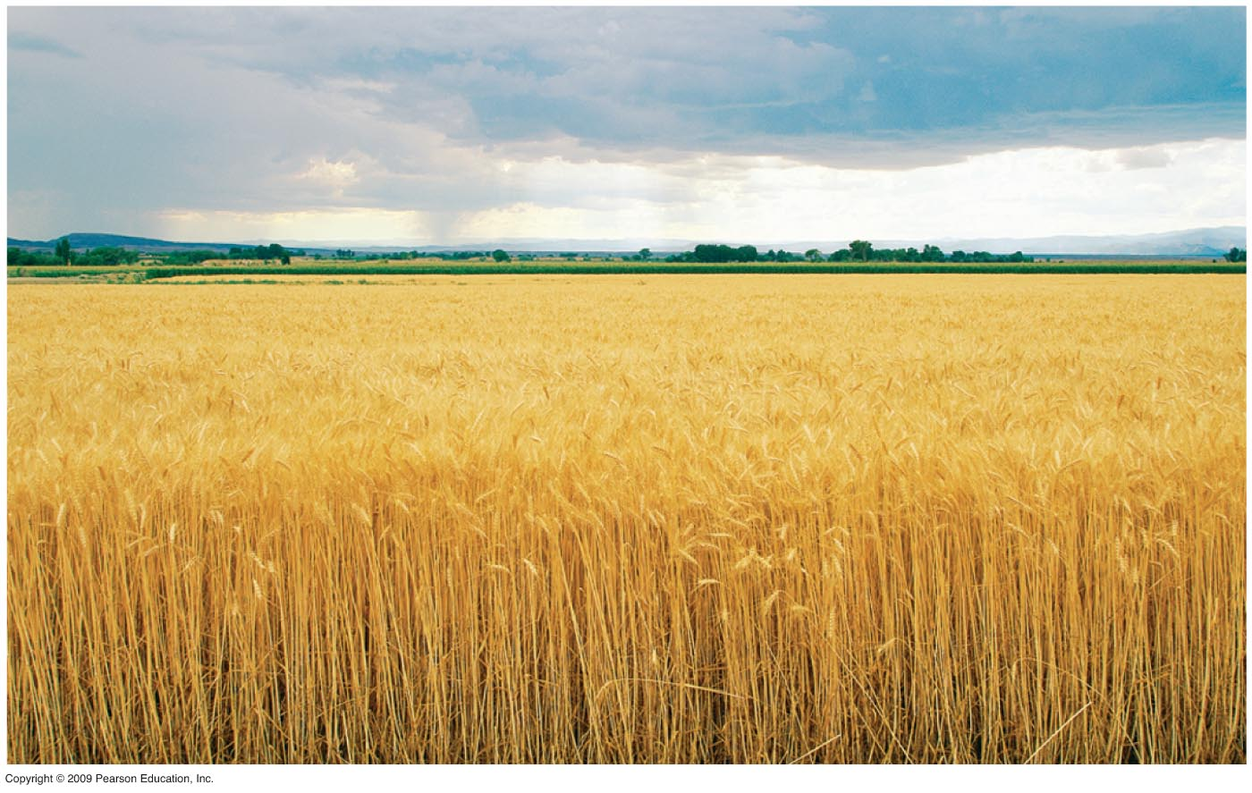
Notes:
Figure 7.1B Wheat field.

Slide 12
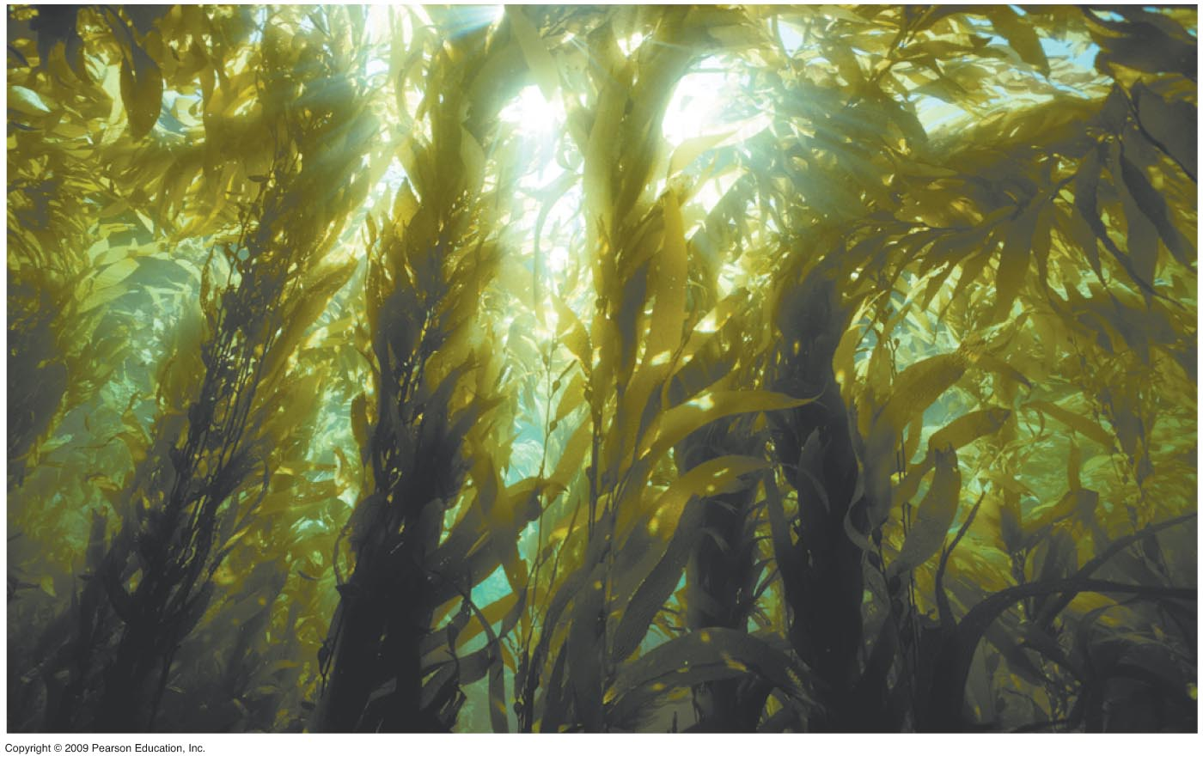
Notes:
Figure 7.1C Kelp, a large algae.

Slide 13
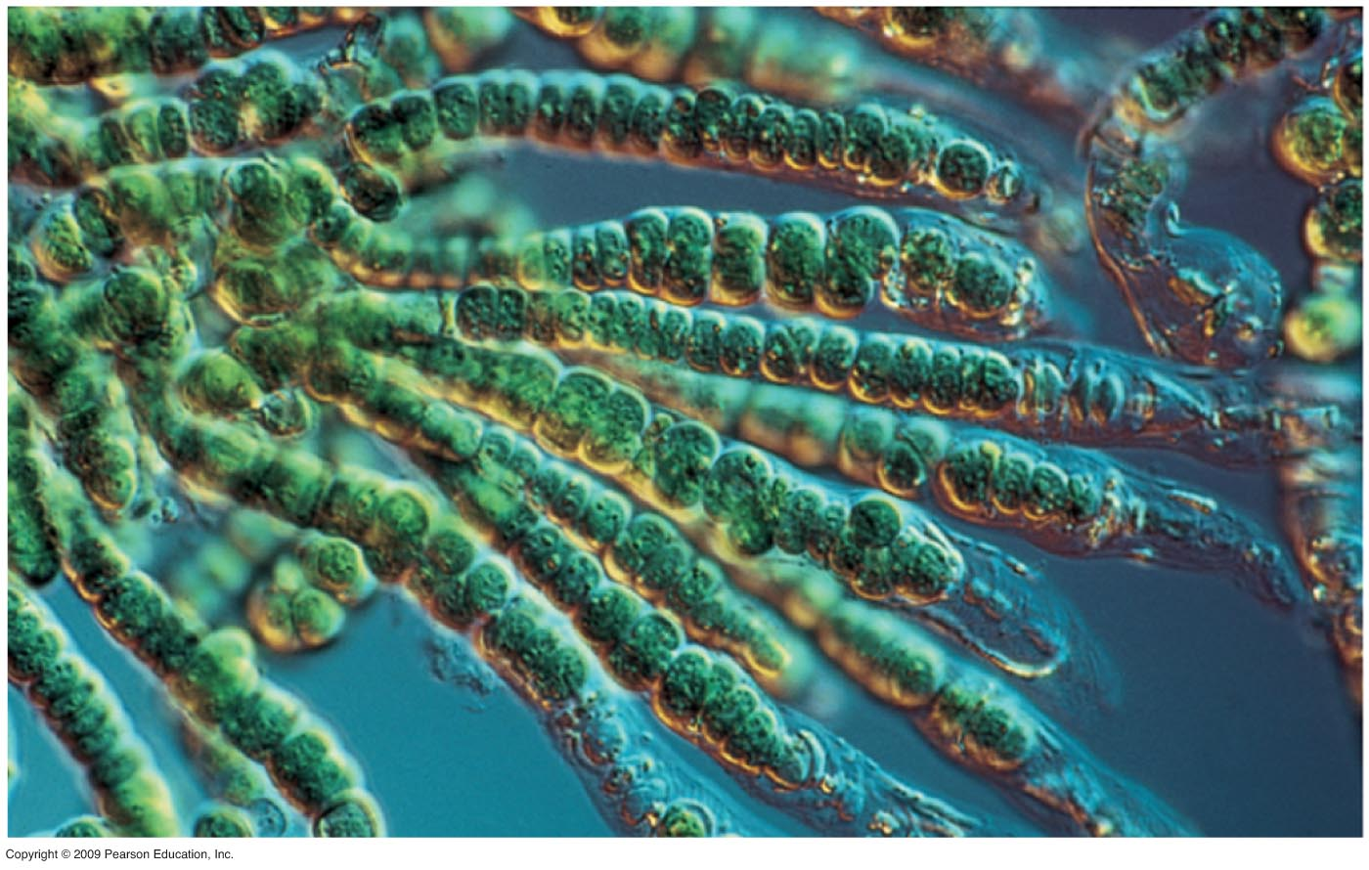
Notes:
Figure 7.1D Micrograph of cyanobacteria (photosynthetic bacteria).

Slide 14
7.2 Photosynthesis occurs in chloroplasts in plant cells
Chloroplasts are the major sites of photosynthesis in green plants
  Chlorophyll, an important light absorbing pigment in chloroplasts, is responsible for the green color of plants
  Chlorophyll plays a central role in converting solar energy to chemical energy
Copyright © 2009 Pearson Education, Inc.
Notes:
Chlorophyll absorbs light energy and drives the synthesis of organic molecules.

Slide 15
7.2 Photosynthesis occurs in chloroplasts in plant cells
Chloroplasts are concentrated in the cells of the mesophyll, the green tissue in the interior of the leaf
Stomata are tiny pores in the leaf that allow carbon dioxide to enter and oxygen to exit
Veins in the leaf deliver water absorbed by roots
Copyright © 2009 Pearson Education, Inc.
Notes:
Leaves also use veins to export sugar to roots and other nonphotosynthetic parts of the plant.

Slide 16
7.2 Photosynthesis occurs in chloroplasts in plant cells
An envelope of two membranes encloses the stroma, the dense fluid within the chloroplast
A system of interconnected membranous sacs called thylakoids segregates the stroma from another compartment, the thylakoid space
  Thylakoids are concentrated in stacks called grana
Copyright © 2009 Pearson Education, Inc.
Notes:
Chlorophyll resides in the thylakoid membranes.

Slide 17
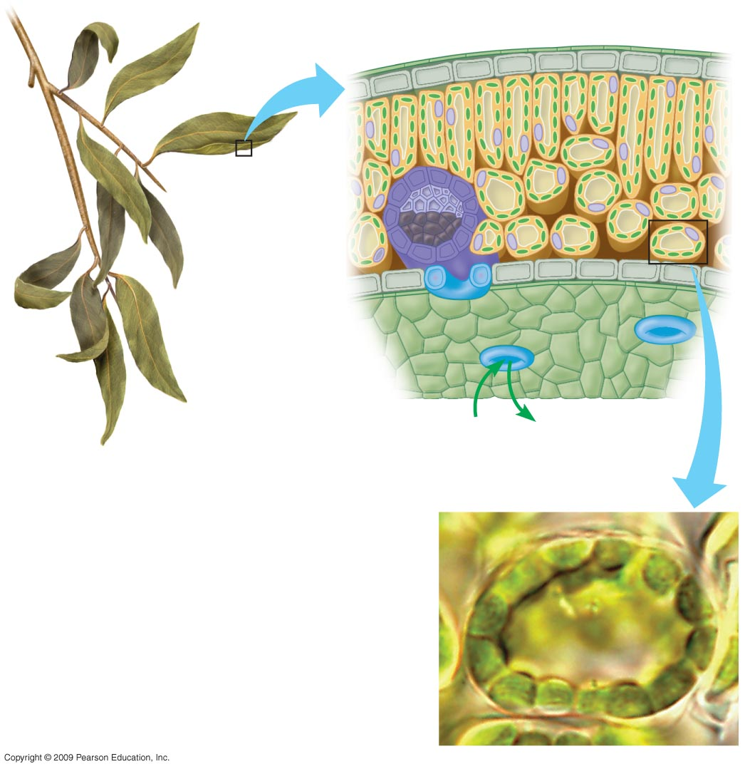
Leaf Cross Section
Leaf
Mesophyll
Vein
CO₂
O₂
Stoma
Mesophyll Cell
Chloroplast
Notes:
Figure 7.2 The location and structure of chloroplasts.

Slide 18
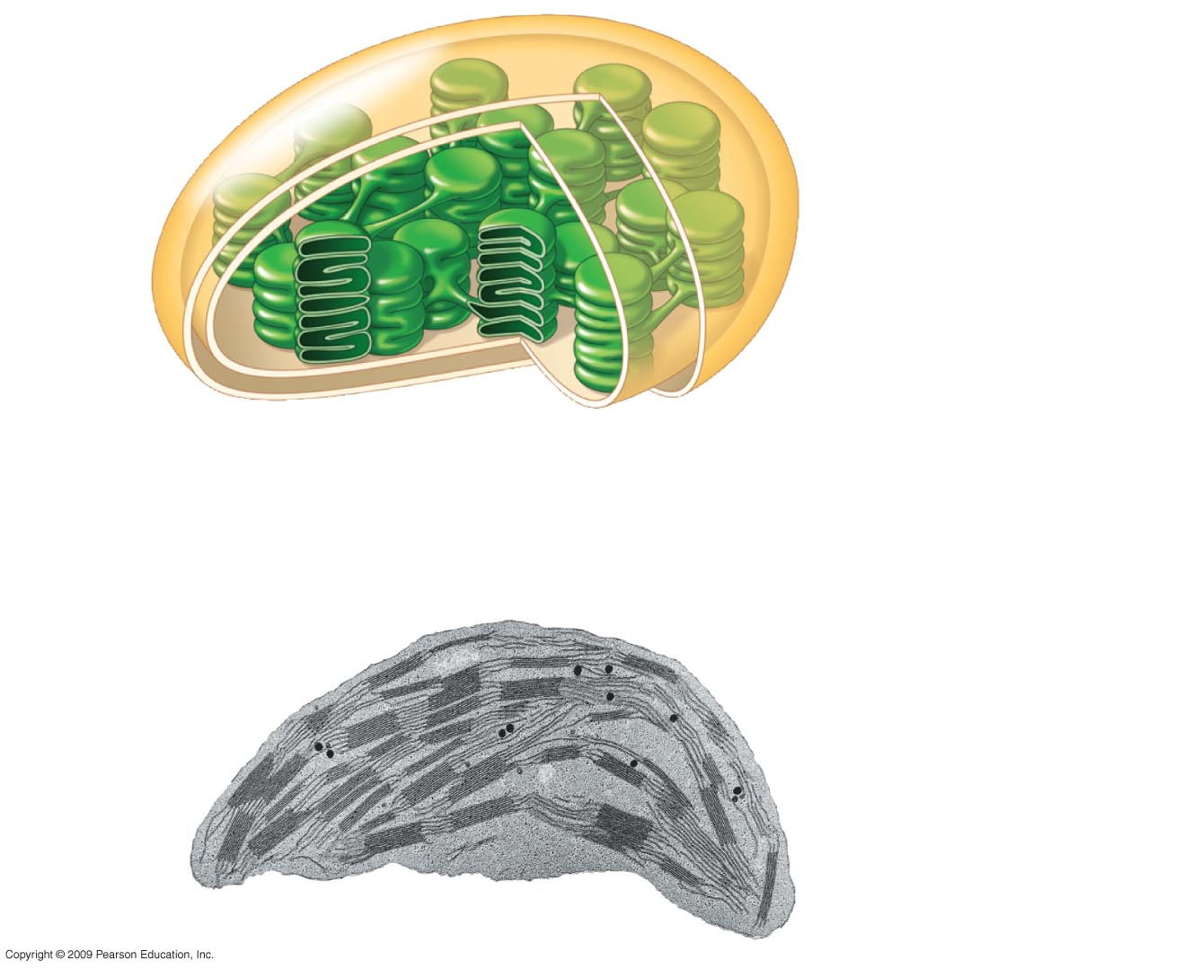
Chloroplast
Outer and inner
membranes
Thylakoid
Intermembrane
space
Stroma
Granum
Thylakoid
space
Notes:
Figure 7.2 The location and structure of chloroplasts.

Slide 19
7.3 Plants produce O₂ gas by splitting water
Scientists have known for a long time that plants produce O₂, but early on they assumed it was extracted from CO₂ taken into the plant
  Using a heavy isotope of oxygen, ¹⁸O, they showed with tracer experiments that O₂ actually comes from H₂O
Copyright © 2009 Pearson Education, Inc.
Notes:
C. B. van Niel of Stanford University hypothesized that plants split water into hydrogen and oxygen. His hypothesis was confirmed 20 years later.
A significant result of photosynthesis is the extraction of hydrogen from water and its incorporation into sugar. Oxygen is a waste product of photosynthesis.
The chloroplast is the site where water is split into hydrogen and oxygen.

Slide 20
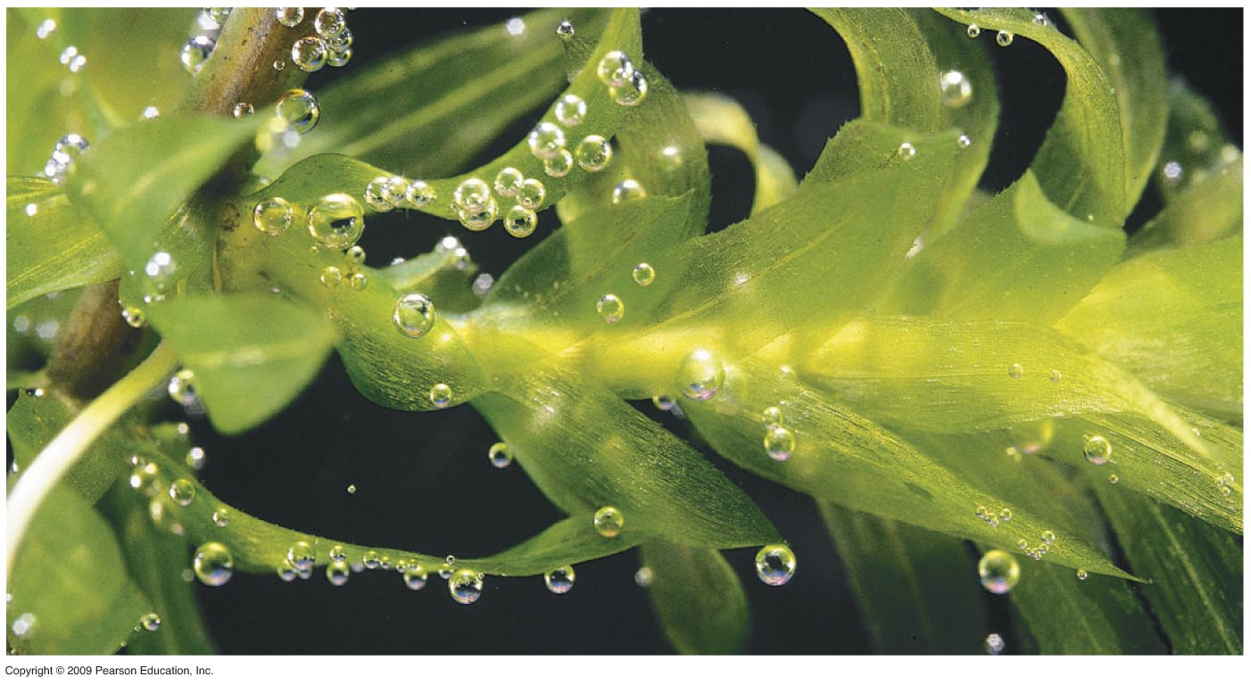
Notes:
Figure 7.3A Oxygen bubbles on the leaves of an aquatic plant.

Slide 21

Experiment 1
6 CO₂ + 12 H₂O
C₆H₁₂O₆ + 6 H₂O + 6 O₂
Not
labeled
Experiment 2
6 CO₂ + 12 H₂O
C₆H₁₂O₆ + 6 H₂O + 6 O₂
Labeled
Notes:
Figure 7.3B Experiments tracking the oxygen atoms in photosynthesis.

Slide 22
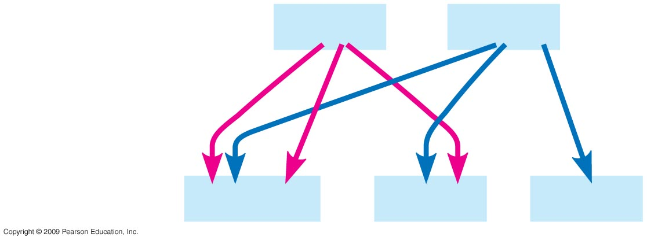
Reactants:
6 CO₂
12 H₂O
Products:
C₆H₁₂O₆
6 H₂O
6 O₂
Notes:
Figure 7.3C Fates of all the atoms in photosynthesis.

Slide 23
7.4 Photosynthesis is a redox process, as is cellular respiration
Photosynthesis, like respiration, is a redox (oxidation-reduction) process
  Water molecules are split apart by oxidation, which means that they lose electrons along with hydrogen ions (H⁺)
  Then CO₂ is reduced to sugar as electrons and hydrogen ions are added to it
Copyright © 2009 Pearson Education, Inc.
Notes:
The simple sugar produced in photosynthesis is glucose, using a number of energy-releasing redox reactions.

Slide 24
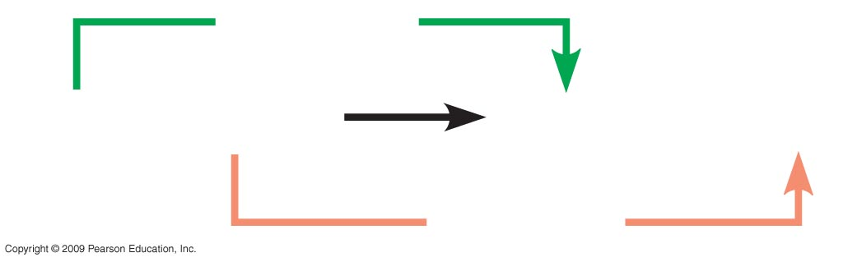
Reduction
6 CO₂ + 6 H₂O
C₆H₁₂O₆ + 6 O₂
Oxidation
Notes:
Figure 7.4A Photosynthesis (uses light energy).

Slide 25
7.4 Photosynthesis is a redox process, as is cellular respiration
Recall that cellular respiration uses redox reactions to harvest the chemical energy stored in a glucose molecule
  This is accomplished by oxidizing the sugar and reducing O₂ to H₂O
  The electrons lose potential as they travel down an energy hill, the electron transport system
  In contrast, the food-producing redox reactions of photosynthesis reverse the flow and involve an uphill climb
Copyright © 2009 Pearson Education, Inc.
Notes:
In respiration, mitochondria harness chemical energy to synthesize ATP.
In photosynthesis, the energy boost is provided by light and occurs in chloroplasts. Eventually, ATP is synthesized.

Slide 26
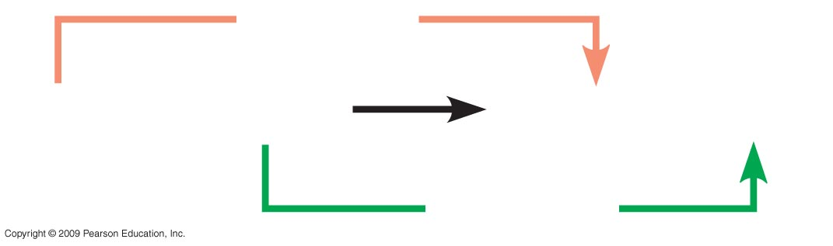
Oxidation
C₆H₁₂O₆ + 6 O₂
6 CO₂ + 6 H₂O
Reduction
Notes:
Figure 7.4B Cellular respiration (releases chemical energy).

Slide 27
7.4 Photosynthesis is a redox process, as is cellular respiration
In photosynthesis, electrons gain energy by being boosted up an energy hill
  Light energy captured by chlorophyll molecules provides the boost for the electrons
  As a result, light energy is converted to chemical energy, which is stored in the chemical bonds of sugar molecules
Copyright © 2009 Pearson Education, Inc.
Notes:
The sugar produced in photosynthesis is stored for later use or as raw material for biosynthesis of new plant material.

Slide 28
7.5 Overview: The two stages of photosynthesis are linked by ATP and NADPH
Actually, photosynthesis occurs in two metabolic stages
  One stage involves the light reactions
  In the light reactions, light energy is converted in the thylakoid membranes to chemical energy and O₂
  Water is split to provide the O₂ as well as electrons
Copyright © 2009 Pearson Education, Inc.
Notes:
The two metabolic stages are the light reactions and the Calvin cycle.

Slide 29
7.5 Overview: The two stages of photosynthesis are linked by ATP and NADPH
H⁺ ions reduce NADP⁺ to NADPH, which is an electron carrier similar to NADH
  NADPH is temporarily stored and then shuttled into the Calvin cycle where it is used to make sugar
  Finally, the light reactions generate ATP
Copyright © 2009 Pearson Education, Inc.
Notes:
Catabolic processes like cellular respiration generally use NAD⁺ as the initial hydrogen acceptor, while anabolic reactions, such as photosynthesis, use NADP⁺.
Sugar is not produced in the light reactions; it is not produced until the Calvin cycle, the second stage of photosynthesis.

Slide 30
7.5 Overview: The two stages of photosynthesis are linked by ATP and NADPH
The second stage is the Calvin cycle, which occurs in the stroma of the chloroplast
  It is a cyclic series of reactions that builds sugar molecules from CO₂ and the products of the light reactions
  During the Calvin cycle, CO₂ is incorporated into organic compounds, a process called carbon fixation
Copyright © 2009 Pearson Education, Inc.
Notes:
The Calvin cycle was named for the Nobel laureate, Melvin Calvin, who traced the path of carbon in the cycle.

Slide 31
7.5 Overview: The two stages of photosynthesis are linked by ATP and NADPH
NADPH produced by the light reactions provides the electrons for reducing carbon in the Calvin cycle
  ATP from the light reactions provides chemical energy for the Calvin cycle
  The Calvin cycle is often called the dark (or light-independent) reactions
Copyright © 2009 Pearson Education, Inc.
Notes:
The Calvin cycle occurs during daytime in most plants when the light reactions are powering the cycle’s sugar assembly line.

Slide 32
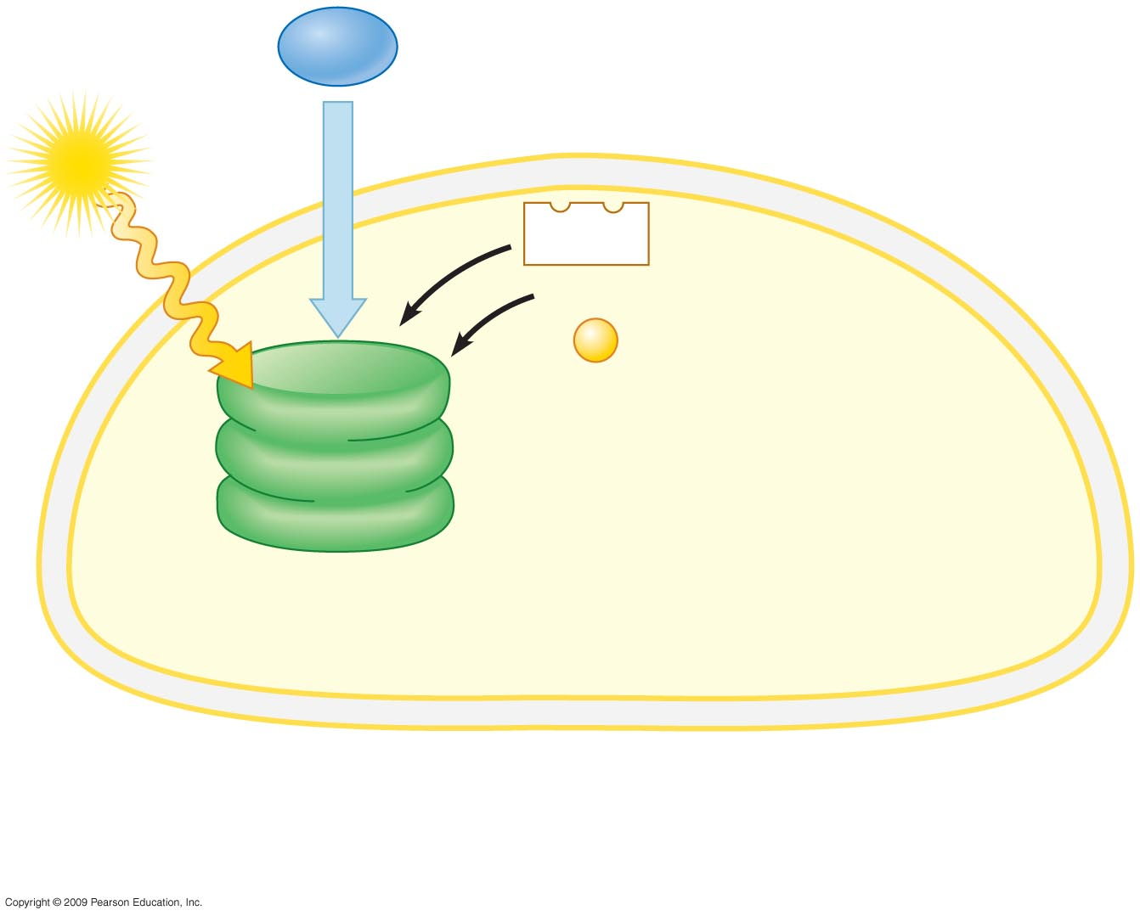
H₂O
Chloroplast
Light
NADP⁺
ADP

P
LIGHT
REACTIONS
(in thylakoids)
Notes:
Figure 7.5 An overview of the two stages of photosynthesis that take place in a chloroplast.
Figure 7.5 is an important visual organizer that notes the key structures and functions of the two stages of photosynthesis. This figure reminds students where water and sunlight are used in the thylakoid membranes to generate oxygen, ATP, and NADPH. The second step, in the stroma, reveals the use of carbon dioxide, ATP, and NADPH to generate carbohydrates.

Slide 33
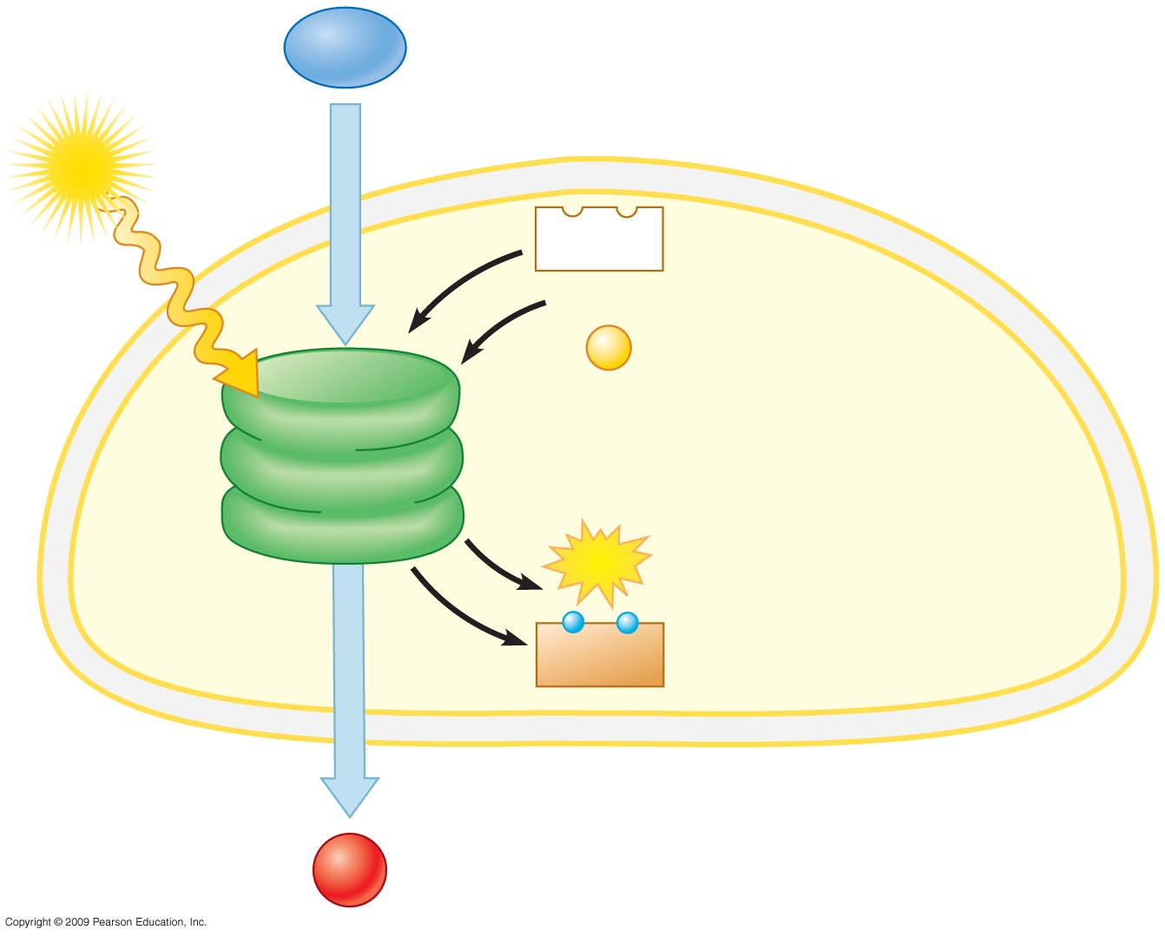
H₂O
Chloroplast
Light
NADP⁺
ADP

P
LIGHT
REACTIONS
(in thylakoids)
ATP
Electrons
NADPH
O₂
Notes:
Figure 7.5 An overview of the two stages of photosynthesis that take place in a chloroplast.
Figure 7.5 is an important visual organizer that notes the key structures and functions of the two stages of photosynthesis. This figure reminds students where water and sunlight are used in the thylakoid membranes to generate oxygen, ATP, and NADPH. The second step, in the stroma, reveals the use of carbon dioxide, ATP, and NADPH to generate carbohydrates.

Slide 34
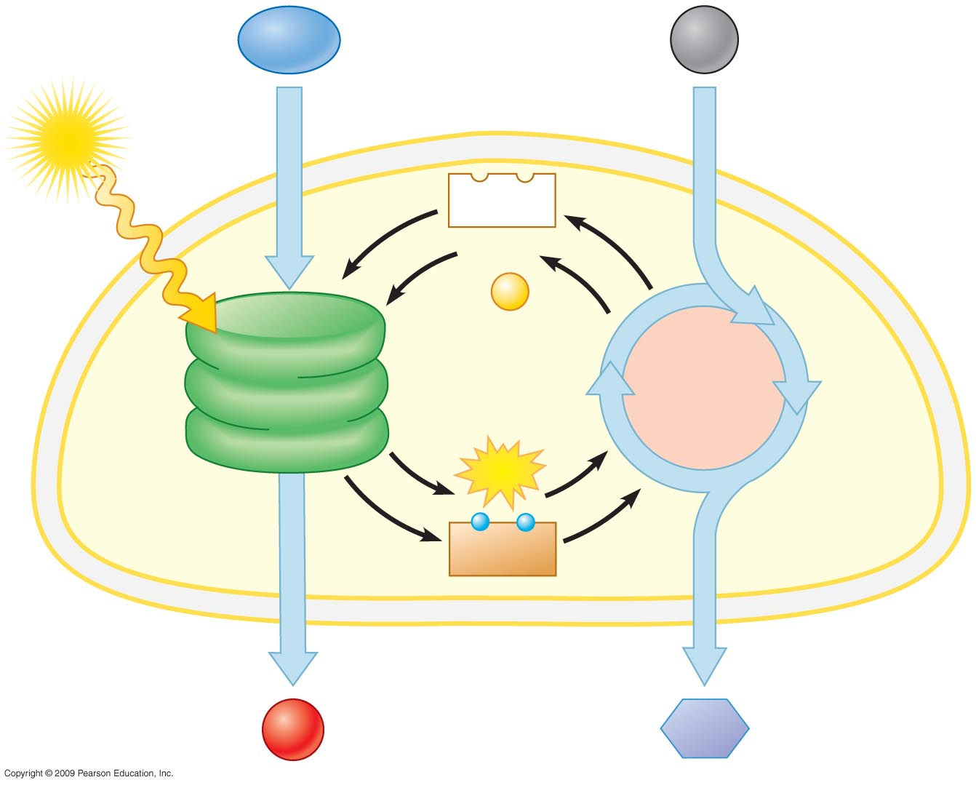
H₂O
CO₂
Chloroplast
Light
NADP⁺
ADP

P
LIGHT
REACTIONS
CALVIN
CYCLE
(in thylakoids)
(in stroma)
ATP
Electrons
NADPH
O₂
Sugar
Notes:
Figure 7.5 An overview of the two stages of photosynthesis that take place in a chloroplast.
Figure 7.5 is an important visual organizer that notes the key structures and functions of the two stages of photosynthesis. This figure reminds students where water and sunlight are used in the thylakoid membranes to generate oxygen, ATP, and NADPH. The second step, in the stroma, reveals the use of carbon dioxide, ATP, and NADPH to generate carbohydrates.

Slide 35
THE LIGHT REACTIONS: CONVERTING SOLAR ENERGY TO CHEMICAL ENERGY
Copyright © 2009 Pearson Education, Inc.

Slide 36
7.6 Visible radiation drives the light reactions
Sunlight contains energy called electromagnetic energy or radiation
  Visible light is only a small part of the electromagnetic spectrum, the full range of electromagnetic wavelengths
  Electromagnetic energy travels in waves, and the wavelength is the distance between the crests of two adjacent waves
Copyright © 2009 Pearson Education, Inc.

Slide 37
7.6 Visible radiation drives the light reactions
Light behaves as discrete packets of energy called photons
  A photon is a fixed quantity of light energy, and the shorter the wavelength, the greater the energy
Copyright © 2009 Pearson Education, Inc.
Notes:
Shorter wavelengths such as gamma rays and X-rays contain much more energy than the longer wavelengths, such as radio waves.

Slide 38
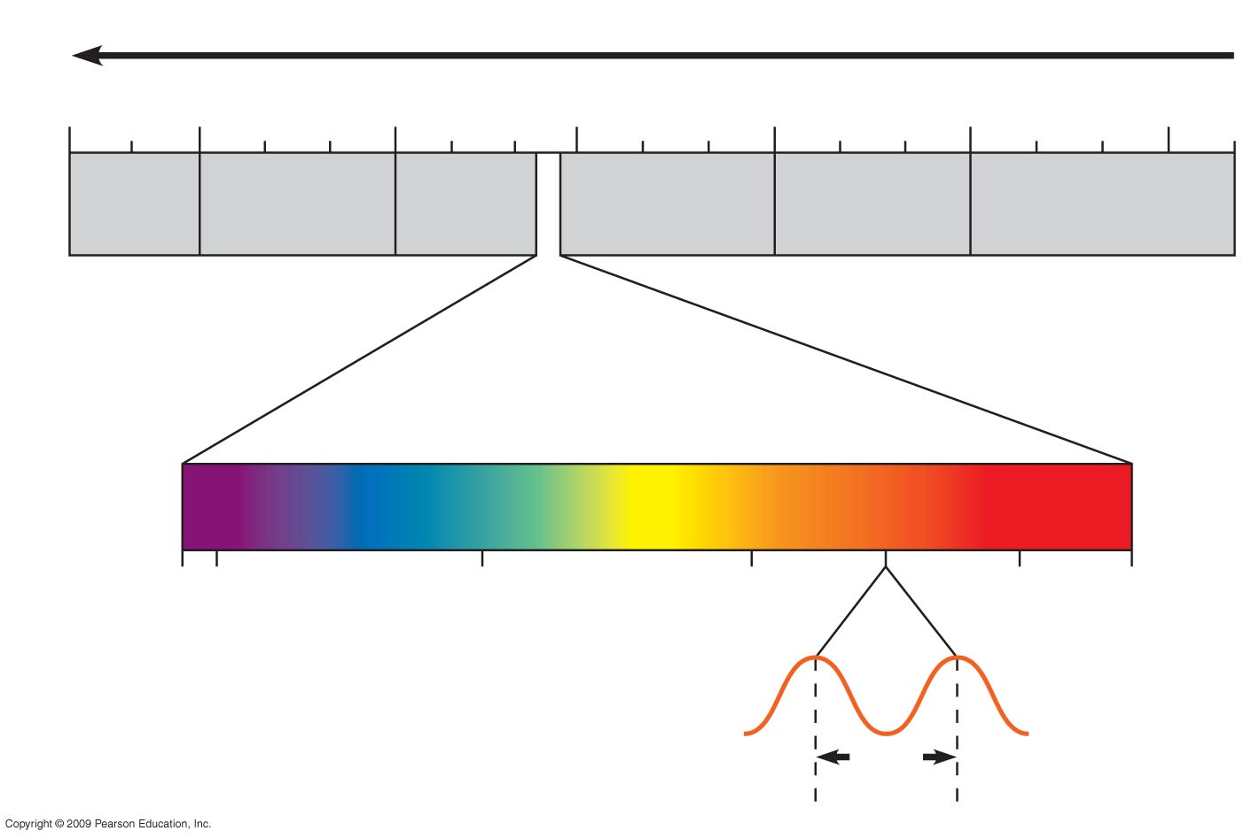
Increasing energy
10^{–5} nm
10^{–3} nm
1 nm
10³ nm
10⁶ nm
1 m
10³ m
Gamma
rays
X-rays
UV
Infrared
Micro-
waves
Radio
waves
Visible light
380
400
500
600
700
750
Wavelength (nm)
650
nm
Notes:
Figure 7.6A The electromagnetic spectrum and the wavelengths of visible light. (A wavelength of 650 nm is illustrated.)

Slide 39

7.6 Visible radiation drives the light reactions
Pigments, molecules that absorb light, are built into the thylakoid membrane
  Plant pigments absorb some wavelengths of light and transmit others
  We see the color of the wavelengths that are transmitted; for example, chlorophyll transmits green
Animation: Light and Pigments
Copyright © 2009 Pearson Education, Inc.
Notes:
Each type of pigment absorbs certain wavelengths of light because it is able to absorb the specific amount of energy in those photons.

Slide 40
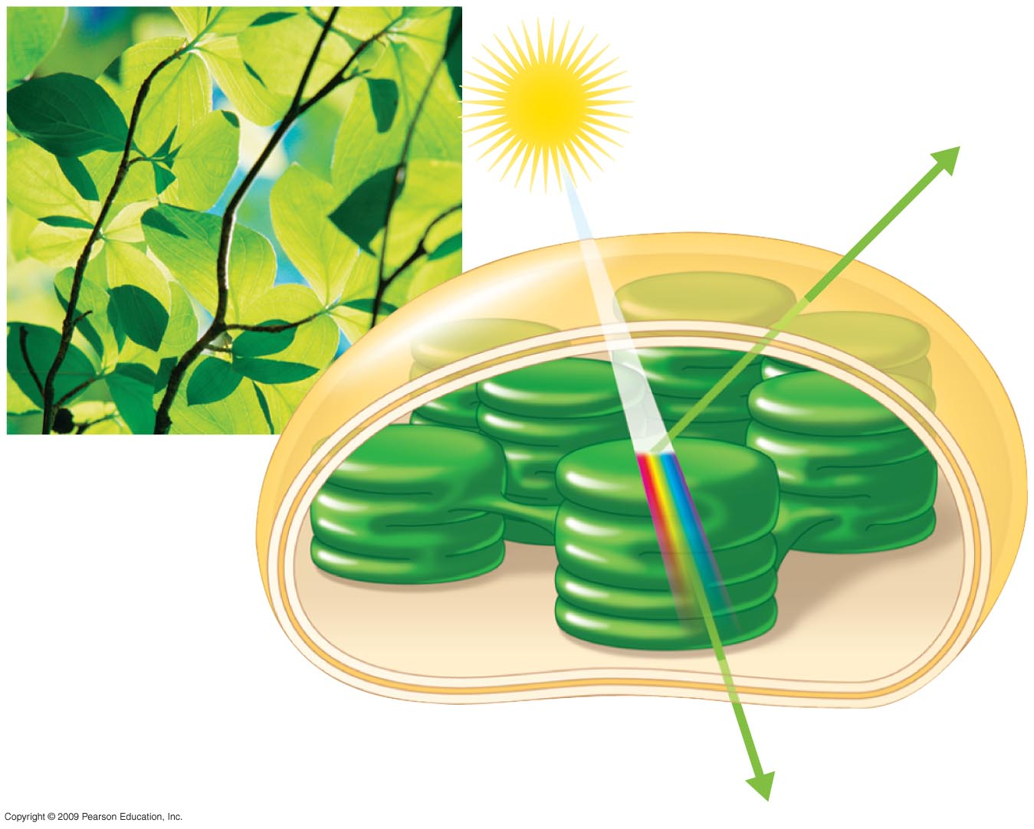
Light
Reflected
light
Chloroplast
Absorbed
light
Thylakoid
Transmitted
light
Notes:
Figure 7.6B The interaction of light with a chloroplast.

Slide 41
7.6 Visible radiation drives the light reactions
Chloroplasts contain several different pigments and all absorb light of different wavelengths
  Chlorophyll a absorbs blue violet and red light and reflects green
  Chlorophyll b absorbs blue and orange and reflects yellow-green
  The carotenoids absorb mainly blue-green light and reflect yellow and orange
Copyright © 2009 Pearson Education, Inc.
Notes:
The colors of fall foliage in certain parts of the world are due partly to the yellow-orange hues of longer lasting carotenoids that show through once the green chlorophyll breaks down.

Slide 42
7.7 Photosystems capture solar power
Pigments in chloroplasts are responsible for absorbing photons (capturing solar power), causing release of electrons
  The electrons jump to a higher energy level—the excited state—where electrons are unstable
  The electrons drop back down to their “ground state,” and, as they do, release their excess energy
Copyright © 2009 Pearson Education, Inc.

Slide 43
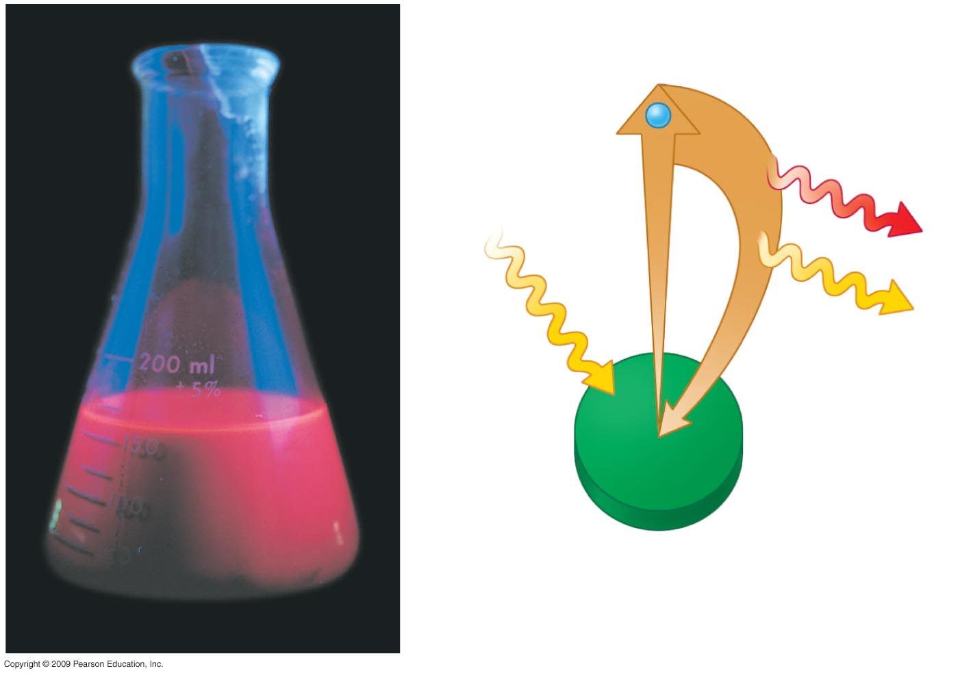
Excited state
e–
Heat
Photon
Photon
(fluorescence)
Ground state
Chlorophyll
molecule
Notes:
Figure 7.7A A solution of chlorophyll glowing red when illuminated (left); a diagram of an isolated, light-excited chlorophyll molecule that releases a photon of red light (right).

Slide 44
7.7 Photosystems capture solar power
The energy released could be lost as heat or light, but rather it is conserved as it is passed from one molecule to another molecule
  All of the components to accomplish this are organized in thylakoid membranes in clusters called photosystems
    Photosystems are light-harvesting complexes surrounding a reaction center complex
Copyright © 2009 Pearson Education, Inc.
Notes:
Because of their functions, you can think of photosystems as light-gathering antennae.

Slide 45
7.7 Photosystems capture solar power
The energy is passed from molecule to molecule within the photosystem
  Finally it reaches the reaction center where a primary electron acceptor accepts these electrons and consequently becomes reduced
  This solar-powered transfer of an electron from the reaction center pigment to the primary electron acceptor is the first step of the light reactions
Copyright © 2009 Pearson Education, Inc.

Slide 46
7.7 Photosystems capture solar power
Two types of photosystems have been identified and are called photosystem I and photosystem II
  Each type of photosystem has a characteristic reaction center
    Photosystem II, which functions first, is called P680 because its pigment absorbs light with a wavelength of 680 nm
    Photosystem I, which functions next, is called P700 because it absorbs light with a wavelength of 700 nm
Copyright © 2009 Pearson Education, Inc.
Notes:
The photosystems were named in order of their discovery, not in order of their function.

Slide 47
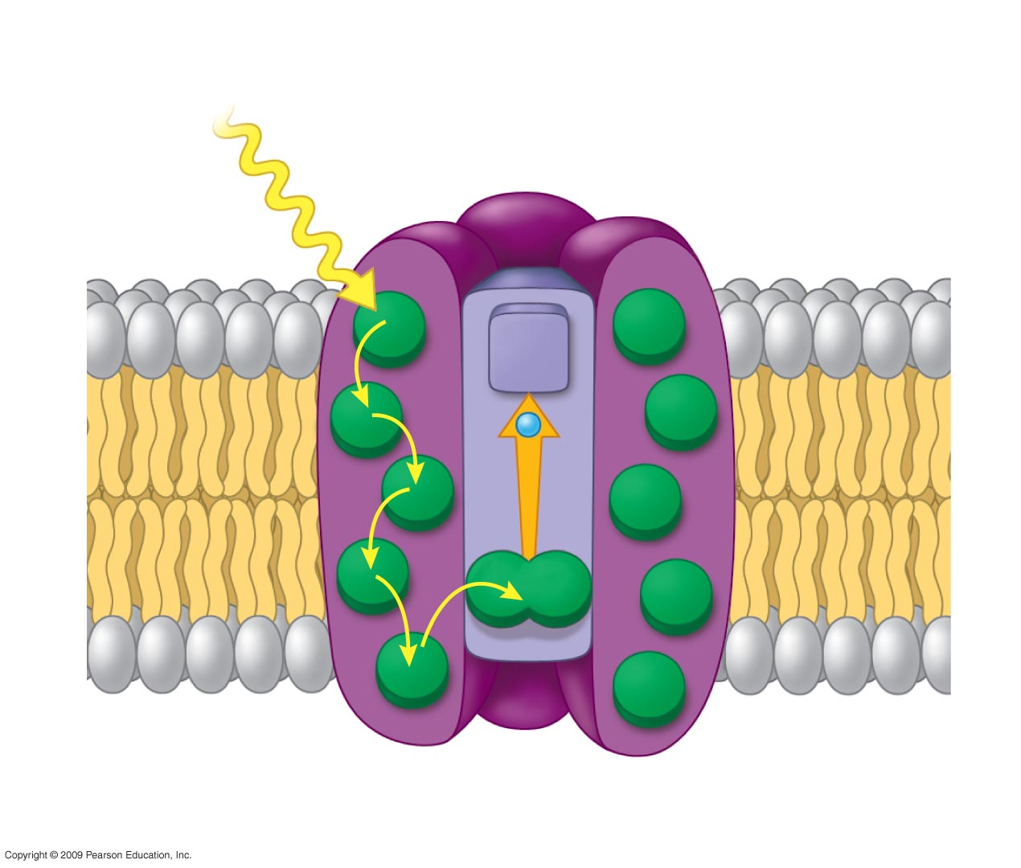
Photosystem
Light-harvesting
complexes
Reaction
center complex
Photon
Primary electron
acceptor
e–
Thylakoid membrane
Transfer
of energy
Pigment
molecules
Pair of
Chlorophyll a molecules
Notes:
Figure 7.7B Light-excited chlorophyll embedded in a photosystem: Its electron is transferred to a primary electron acceptor before it returns to ground state.

Slide 48
7.8 Two photosystems connected by an electron transport chain generate ATP and NADPH
During the light reactions, light energy is transformed into the chemical energy of ATP and NADPH
  To accomplish this, electrons removed from water pass from photosystem II to photosystem I and are accepted by NADP⁺
  The bridge between photosystems II and I is an electron transport chain that provides energy for the synthesis of ATP
Copyright © 2009 Pearson Education, Inc.

Slide 49
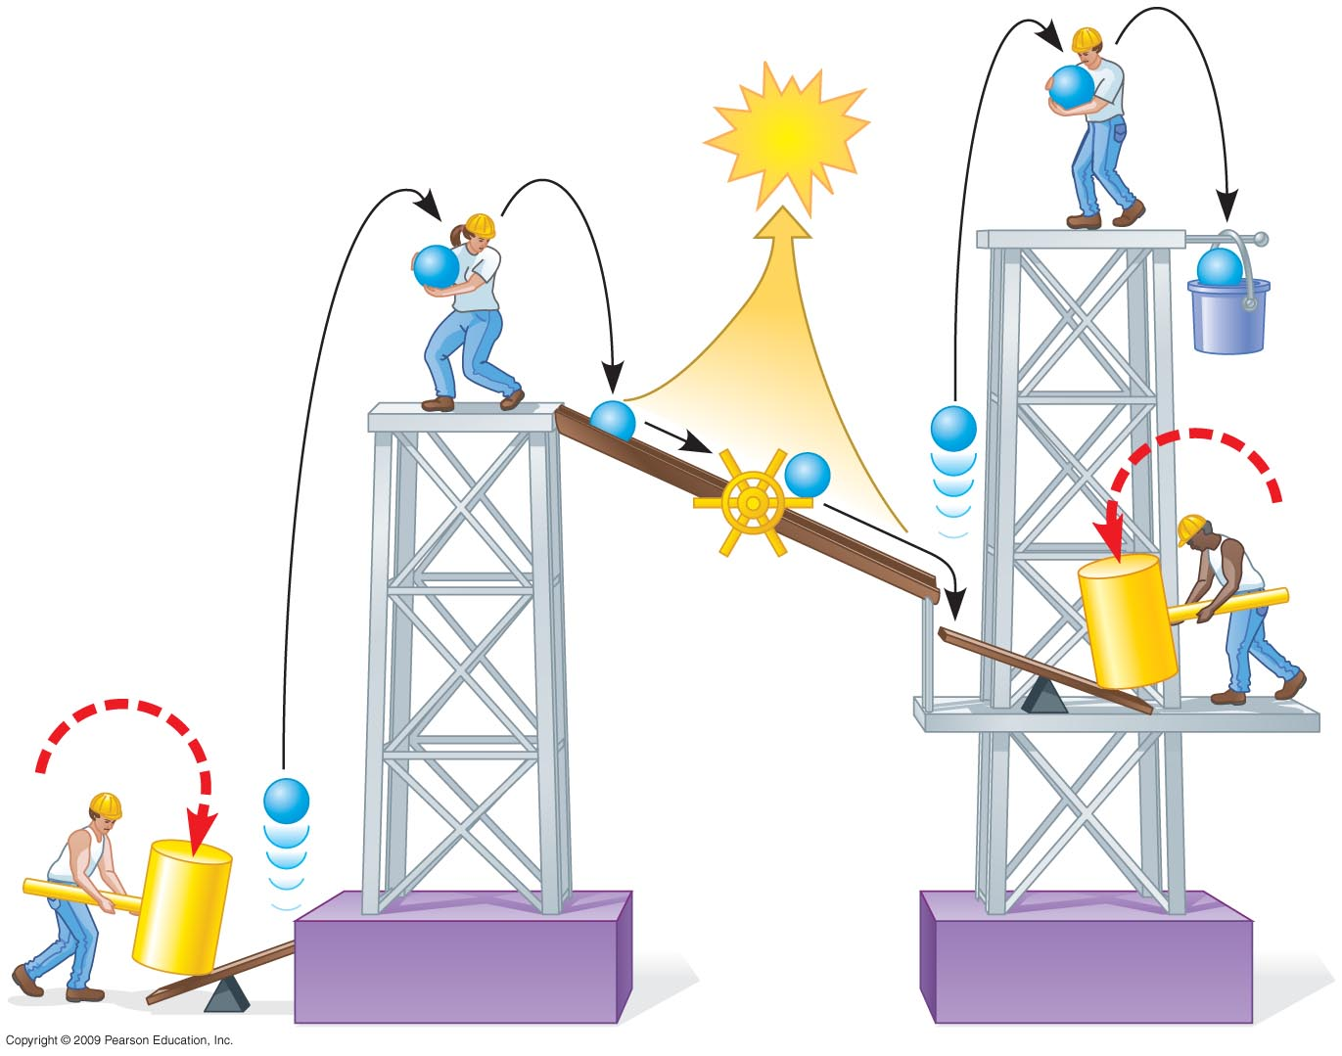
e–
ATP
e–
e–
NADPH
e–
e–
e–
Mill
makes
ATP
Photon
e–
Photon
Photosystem II
Photosystem I
Notes:
Figure 7.8B A mechanical analogy of the light reactions.
Although Figure 7.8B can be very effective, students might need to be carefully led through the analogy to understand precisely what is represented.

Slide 50
7.8 Two photosystems connected by an electron transport chain generate ATP and NADPH
NADPH, ATP, and O₂ are the products of the light reactions
Copyright © 2009 Pearson Education, Inc.

Slide 51
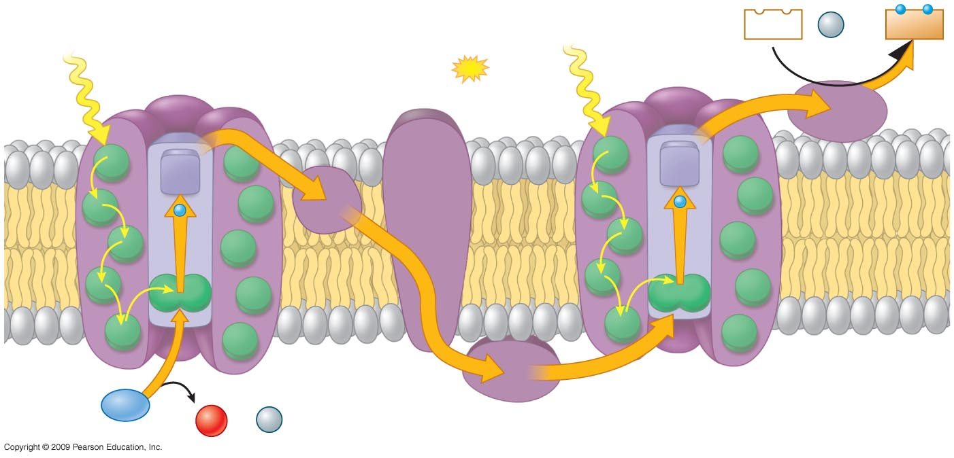
Electron transport chain
Provides energy for
synthesis of
by chemiosmosis
Photon
NADP⁺
+
H⁺
NADPH
Photon
Photosystem II
ATP
Photosystem I
6
Stroma
1
Primary
acceptor
Primary
acceptor
2
e–
e–
Thylakoid
mem-
brane
4
5
P680
P700
Thylakoid
space
3
H₂O
H⁺
1
−
2
O₂
+ 2
Notes:
Figure 7.8A Electron flow in the light reactions of photosynthesis: Both photosystems and the electron transport chain that connects them are located in the thylakoid membrane. The energy from light drives electrons from water to NADPH.

Slide 52
7.9 Chemiosmosis powers ATP synthesis in the light reactions
Interestingly, chemiosmosis is the mechanism that not only is involved in oxidative phosphorylation in mitochondria but also generates ATP in chloroplasts
  ATP is generated because the electron transport chain produces a concentration gradient of hydrogen ions across a membrane
Copyright © 2009 Pearson Education, Inc.
Notes:
The gradient is produced as the electron transport chain passes electrons down the chain.

Slide 53
7.9 Chemiosmosis powers ATP synthesis in the light reactions
ATP synthase couples the flow of H⁺ to the phosphorylation of ADP
  The chemiosmotic production of ATP in photosynthesis is called photophosphorylation
Copyright © 2009 Pearson Education, Inc.
Notes:
Students should realize that electrons flowing between the two photosystems do not end up at a low energy level in water as they do in respiration; instead they are stored at a high state of potential energy in NADPH.

Slide 54
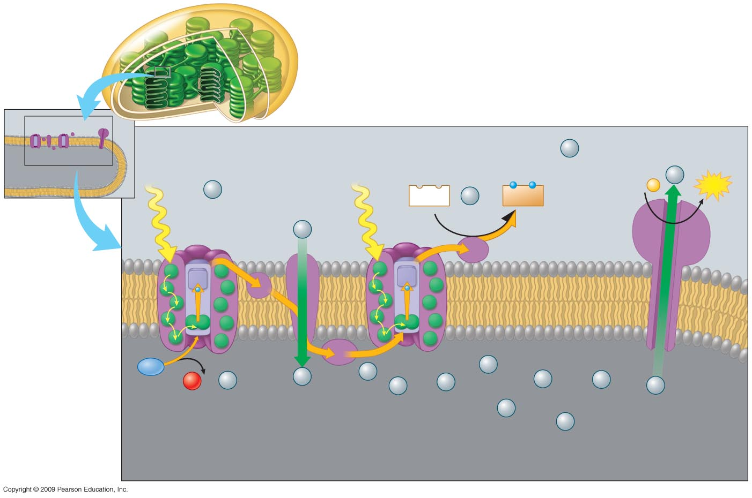
Chloroplast
Stroma (low H⁺
concentration)
H⁺
Light
Light
ADP +
P
H⁺
ATP
H⁺
NADP⁺
+
H⁺
NADPH
H⁺
Thylakoid
membrane
H₂O
H⁺
H⁺
1
−
2
O₂
+ 2
H⁺
H⁺
H⁺
H⁺
H⁺
H⁺
H⁺
Photosystem II
Electron
transport
chain
Photosystem I
H⁺
ATP synthase
H⁺
Thylakoid space
(high H⁺ concentration)
Notes:
Figure 7.9 The production of ATP by chemiosmosis in photosynthesis: The small diagram on the upper left illustrates the location of the components of the light reactions in a thylakoid membrane. Numerous copies of these components are present in each thylakoid.

Slide 55
THE CALVIN CYCLE: CONVERTING CO₂ TO SUGARS
Copyright © 2009 Pearson Education, Inc.

Slide 56
7.10 ATP and NADPH power sugar synthesis in the Calvin cycle
The Calvin cycle makes sugar within a chloroplast
  To produce sugar, the necessary ingredients are atmospheric CO₂, ATP, and NADPH, which were generated in the light reactions
  Using these three ingredients, an energy-rich, three-carbon sugar called glyceraldehyde-3-phosphate (G3P) is produced
    A plant cell may then use G3P to make glucose and other organic molecules
Copyright © 2009 Pearson Education, Inc.
Notes:
The Calvin cycle is called a “cycle” because the starting material is regenerated as the process occurs.

Slide 57
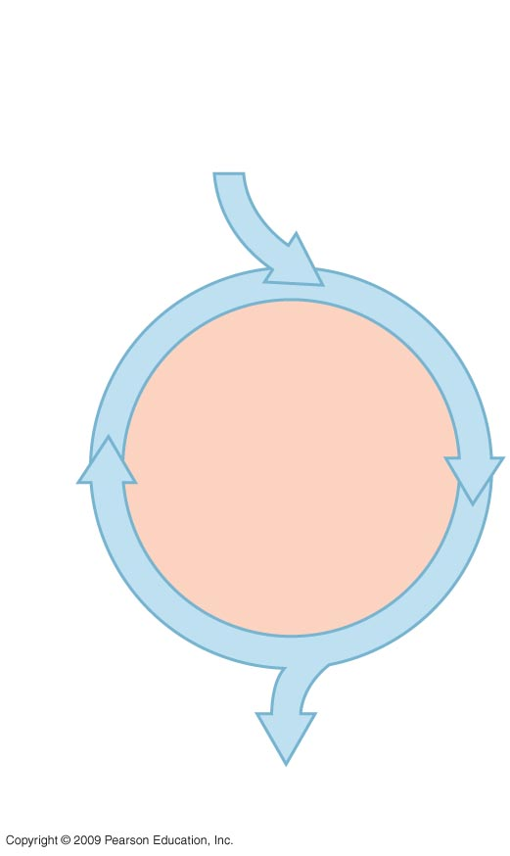
CO₂
ATP
NADPH
Input
CALVIN
CYCLE
Output:
G3P
Notes:
Figure 7.10A An overview of the Calvin cycle.

Slide 58
7.10 ATP and NADPH power sugar synthesis in the Calvin cycle
The starting material for the Calvin cycle is a five-carbon sugar named ribulose bisphosphate (RuBP)
  The next step is a carbon (CO₂) fixation step aided by an enzyme called rubisco
  This is repeated over and over, one carbon at a time
Copyright © 2009 Pearson Education, Inc.
Notes:
To synthesize one G3P molecule, the Calvin cycle consumes nine ATP and six NADPH molecules, which were provided by the light reactions.

Slide 59
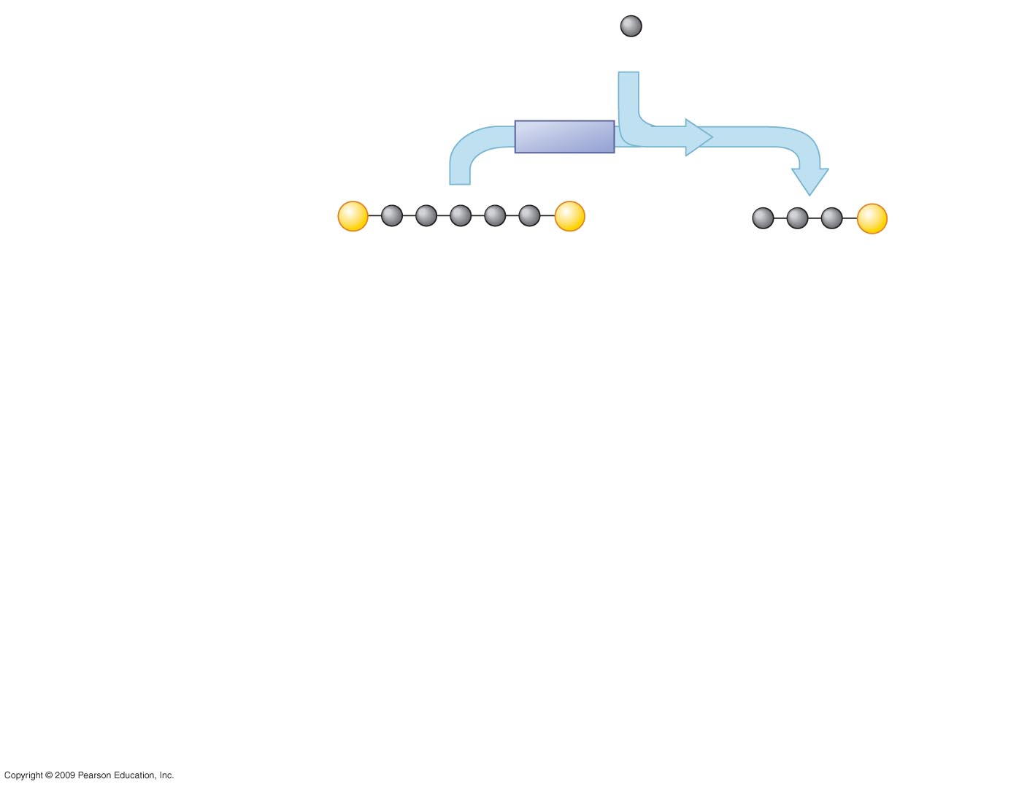
1
Step Carbon fixation
Input:
3
CO₂
Rubisco
1
3
P
P
6
P
RuBP
3-PGA
CALVIN
CYCLE
Notes:
Figure 7.10B Details of the Calvin cycle, which takes place in the stroma of a chloroplast.

Slide 60
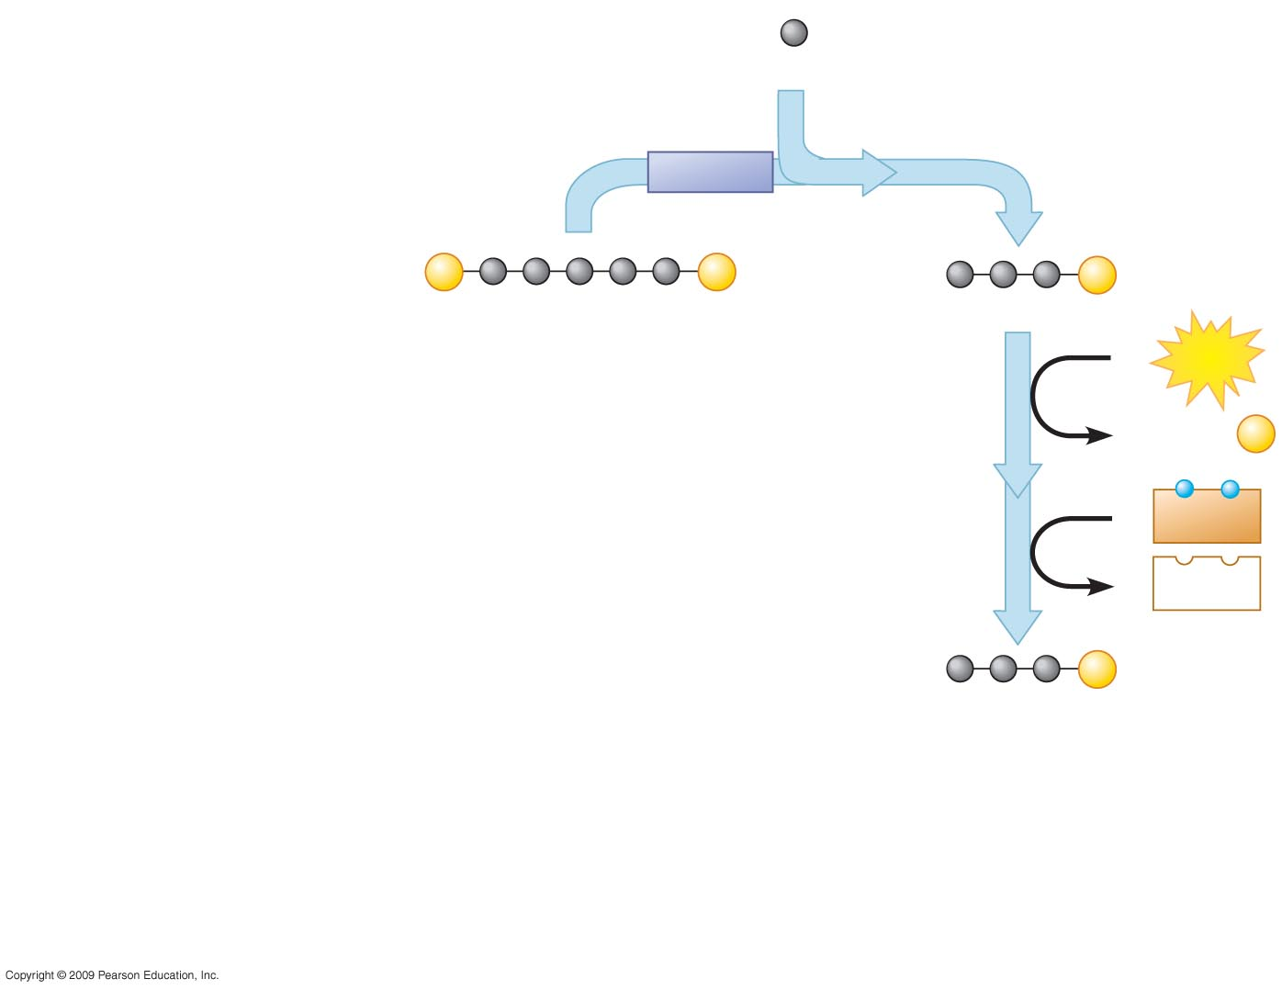
1
Step Carbon fixation
Input:
3
CO₂
Rubisco
1
Step Reduction
2
3
P
P
6
P
RuBP
3-PGA
6
ATP
6 ADP +
P
CALVIN
CYCLE
2
6
NADPH
6
NADP⁺
6
P
G3P
Notes:
Figure 7.10B Details of the Calvin cycle, which takes place in the stroma of a chloroplast.

Slide 61
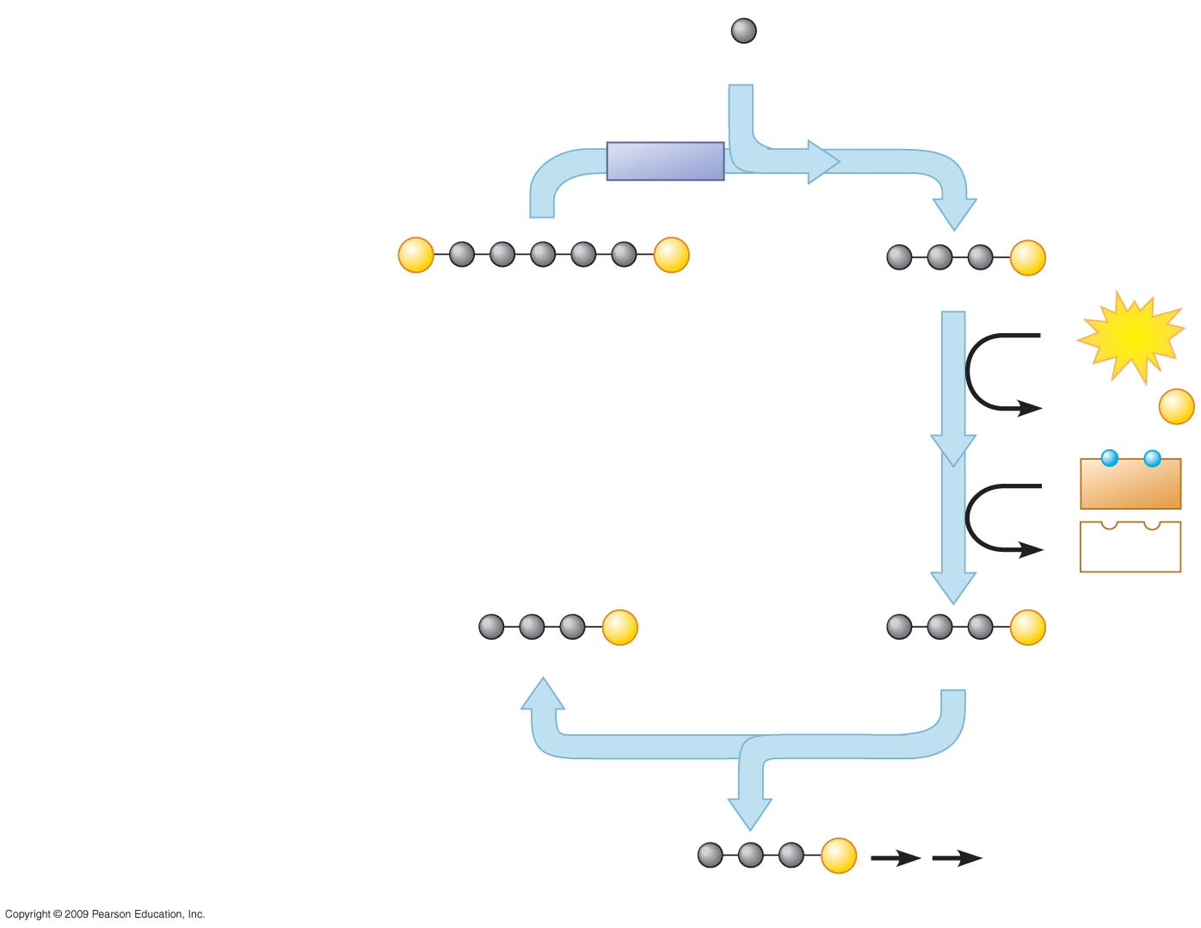
1
Step Carbon fixation
Input:
3
CO₂
Rubisco
1
Step Reduction
2
3
P
P
6
P
RuBP
3-PGA
6
ATP
6 ADP +
P
Step Release of one
molecule of G3P
CALVIN
CYCLE
2
3
6
NADPH
6
NADP⁺
5
P
6
P
G3P
G3P
3
Glucose
and other
compounds
Output:
1
P
G3P
Notes:
Figure 7.10B Details of the Calvin cycle, which takes place in the stroma of a chloroplast.

Slide 62
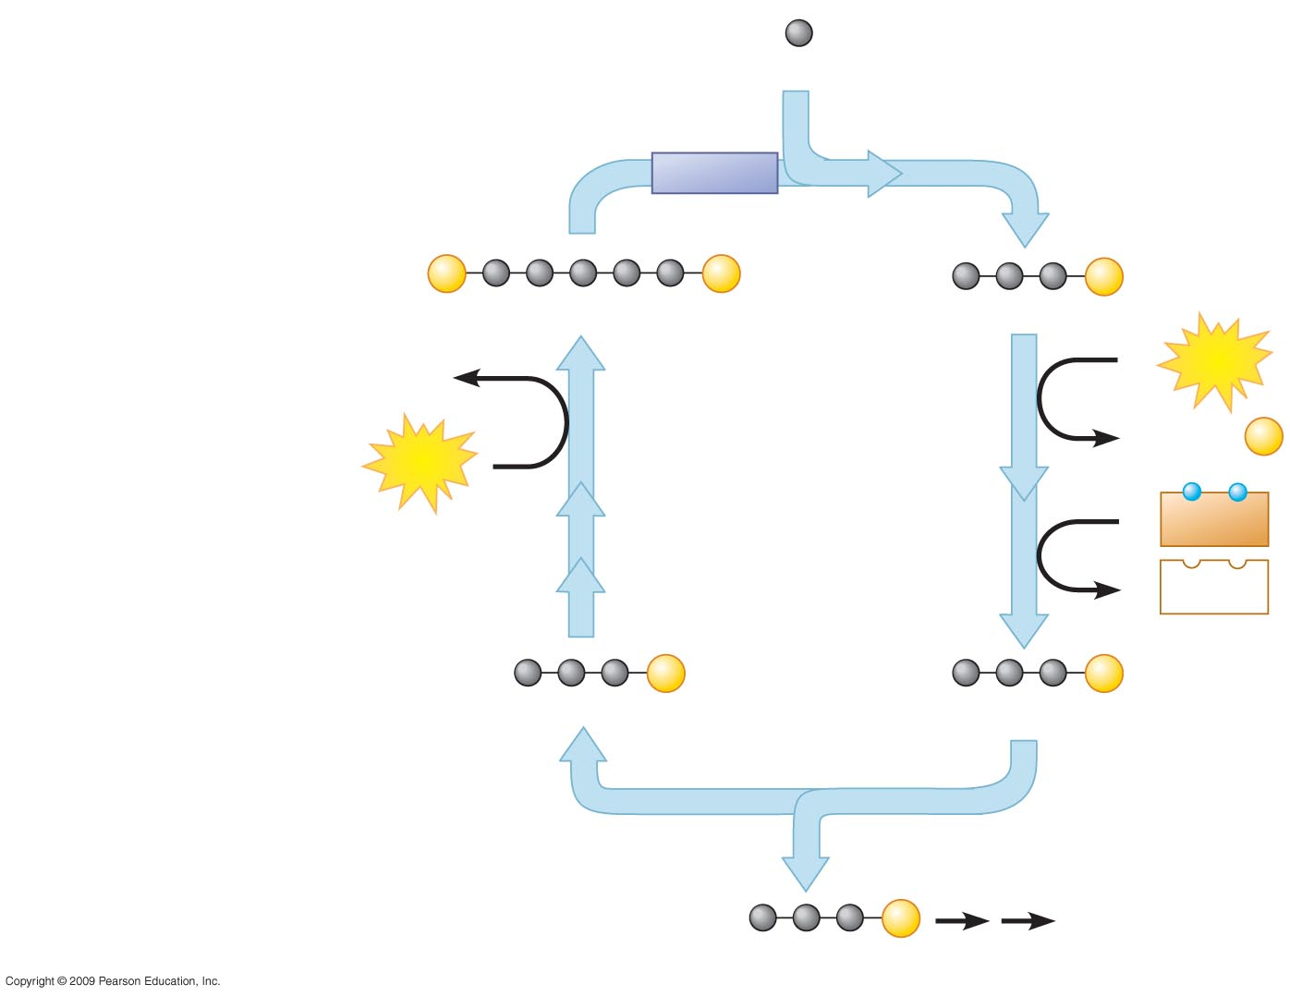
1
Step Carbon fixation
Input:
3
CO₂
Rubisco
1
Step Reduction
2
3
P
P
6
P
RuBP
3-PGA
3 ADP
6
ATP
6 ADP +
P
3
ATP
CALVIN
CYCLE
Step Release of one
molecule of G3P
4
2
3
6
NADPH
6
NADP⁺
5
P
6
P
Step Regeneration of RuBP
4
G3P
G3P
3
Glucose
and other
compounds
Output:
1
P
G3P
Notes:
Figure 7.10B Details of the Calvin cycle, which takes place in the stroma of a chloroplast.

Slide 63
PHOTOSYNTHESIS REVIEWED AND EXTENDED
Copyright © 2009 Pearson Education, Inc.

Slide 64
7.11 Review: Photosynthesis uses light energy, CO₂, and H₂O to make food molecules
The chloroplast, which integrates the two stages of photosynthesis, makes sugar from CO₂
  All but a few microscopic organisms depend on the food-making machinery of photosynthesis
  Plants make more food than they actually need and stockpile it as starch in roots, tubers, and fruits
Copyright © 2009 Pearson Education, Inc.
Notes:
Although photosynthesizers produce sugar for self-consumption, their sugar is a source for virtually all other organisms on Earth.

Slide 65
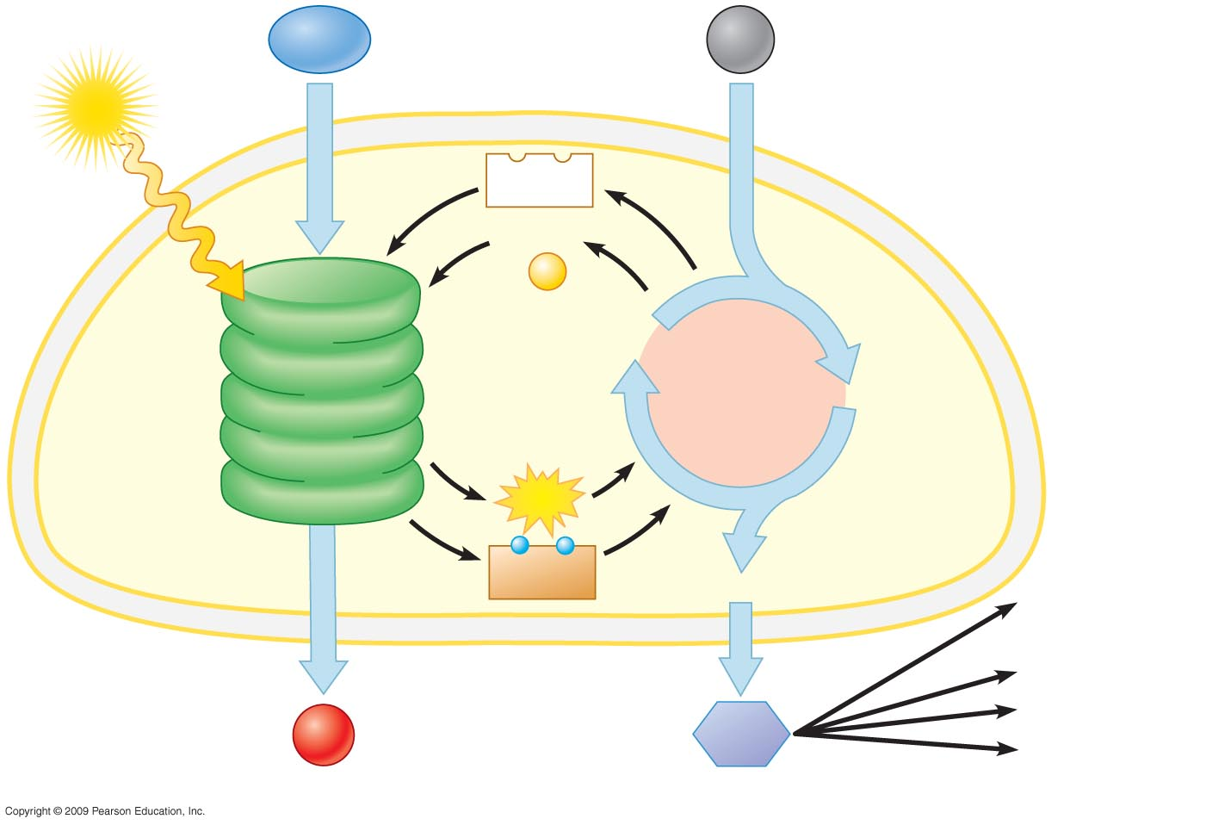
H₂O
CO₂
Chloroplast
Light
NADP⁺
ADP
+
P
Photosystem II
RuBP
Electron
transport
chains
CALVIN
CYCLE
3-PGA
(in stroma)
Thylakoid
membranes
Photosystem I
ATP
Stroma
NADPH
G3P
Cellular
respiration
Cellulose
Starch
O₂
Sugars
Other organic
compounds
LIGHT REACTIONS
CALVIN CYCLE
Notes:
Figure 7.11 A summary of the chemical processes of photosynthesis.

Slide 66
7.12 EVOLUTION CONNECTION: Adaptations that save water in hot, dry climates evolved in C₄ and CAM plants
In hot climates, plant stomata close to reduce water loss so oxygen builds up
  Rubisco adds oxygen instead of carbon dioxide to RuBP and produces a two-carbon compound, a process called photorespiration
  Unlike photosynthesis, photorespiration produces no sugar, and unlike respiration, it produces no ATP
Copyright © 2009 Pearson Education, Inc.
Notes:
Botanists believe photorespiration is an evolutionary relic, left from times when there was little oxygen in the atmosphere.

Slide 67
7.12 EVOLUTION CONNECTION: Adaptations that save water in hot, dry climates evolved in C₄ and CAM plants
Some plants have evolved a means of carbon fixation that saves water during photosynthesis
  One group can shut its stomata when the weather is hot and dry to conserve water but is able to make sugar by photosynthesis
  These are called the C₄ plants because they first fix carbon dioxide into a four-carbon compound
Copyright © 2009 Pearson Education, Inc.

Slide 68
7.12 EVOLUTION CONNECTION: Adaptations that save water in hot, dry climates evolved in C₄ and CAM plants
Another adaptation to hot and dry environments has evolved in the CAM plants, such as pineapples and cacti
  CAM plants conserve water by opening their stomata and admitting CO₂ only at night
  When CO₂ enters, it is fixed into a four-carbon compound, like in C₄ plants, and in this way CO₂ is banked
  It is released into the Calvin cycle during the day
Copyright © 2009 Pearson Education, Inc.
Notes:
For the BLAST Animation Photosynthesis: Light-Independent Reactions, go to Animation and Video Files.

Slide 69
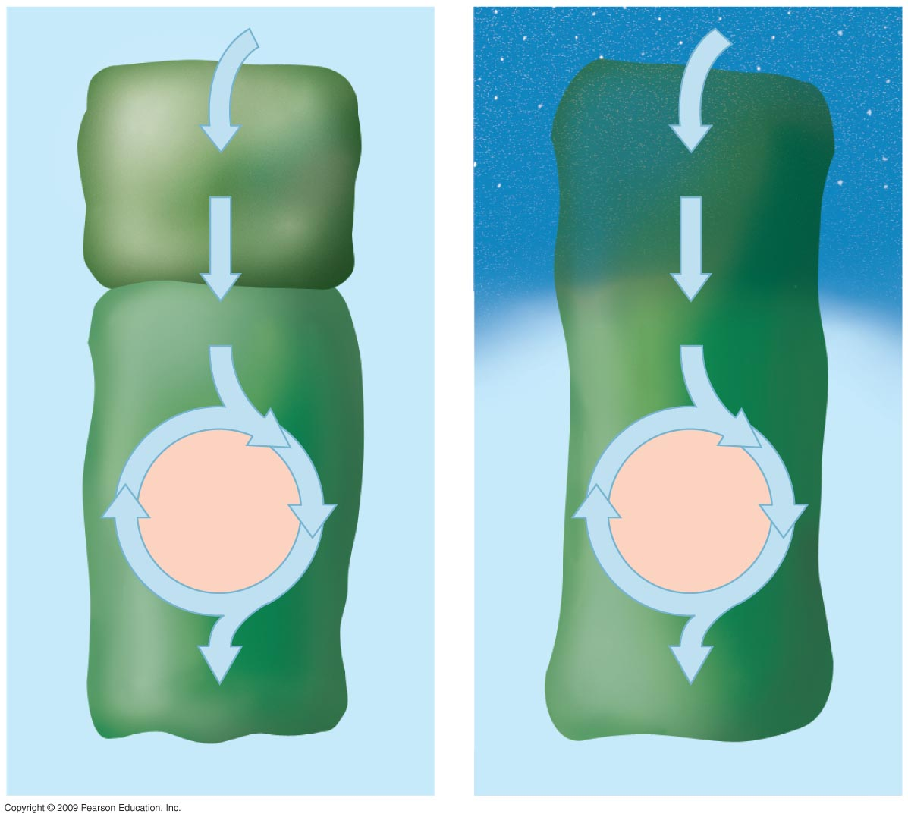
Mesophyll
cell
CO₂
CO₂
Night
4-C compound
4-C compound
CO₂
CO₂
CALVIN
CYCLE
CALVIN
CYCLE
Bundle-
sheath
cell
3-C sugar
3-C sugar
C₄ plant
CAM plant
Day
Notes:
Figure 7.12 Comparison of photosynthesis in C₄ and CAM plants: In both pathways, CO₂ is first incorporated into a four-carbon compound, which then provides CO₂ to the Calvin cycle.

Slide 70
PHOTOSYNTHESIS,
SOLAR RADIATION,
AND EARTH’S ATMOSPHERE
Copyright © 2009 Pearson Education, Inc.

Slide 71
7.13 CONNECTION: Photosynthesis moderates global warming
The greenhouse effect results from solar energy warming our planet
  Gases in the atmosphere (often called greenhouse gases), including CO₂, reflect heat back to Earth, keeping the planet warm and supporting life
  However, as we increase the level of greenhouse gases, Earth’s temperature rises above normal, initiating problems
Copyright © 2009 Pearson Education, Inc.

Slide 72
7.13 CONNECTION: Photosynthesis moderates global warming
Increasing concentrations of greenhouse gases lead to global warming, a slow but steady rise in Earth’s surface temperature
  The extraordinary rise in CO₂ is mostly due to the combustion of carbon-based fossil fuels
  The consequences of continued rise will be melting of polar ice, changing weather patterns, and spread of tropical disease
Copyright © 2009 Pearson Education, Inc.

Slide 73
7.13 CONNECTION: Photosynthesis moderates global warming
Perhaps photosynthesis can mitigate the increase in atmospheric CO₂
  However, there is increasing widespread deforestation, which aggravates the global warming problem
Copyright © 2009 Pearson Education, Inc.

Slide 74
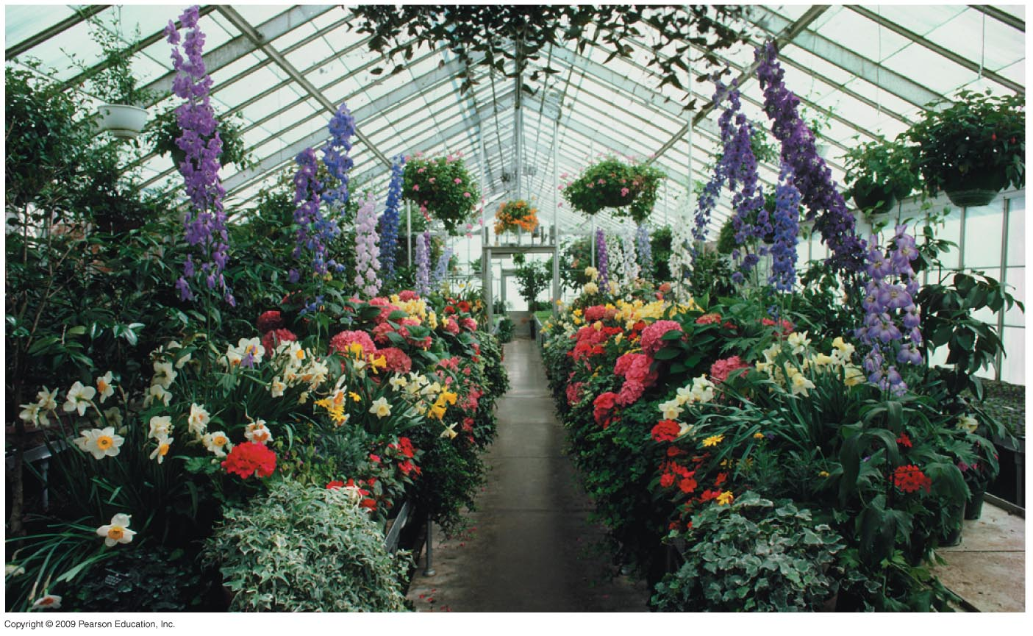
Notes:
Figure 7.13A Plants growing in a greenhouse.

Slide 75
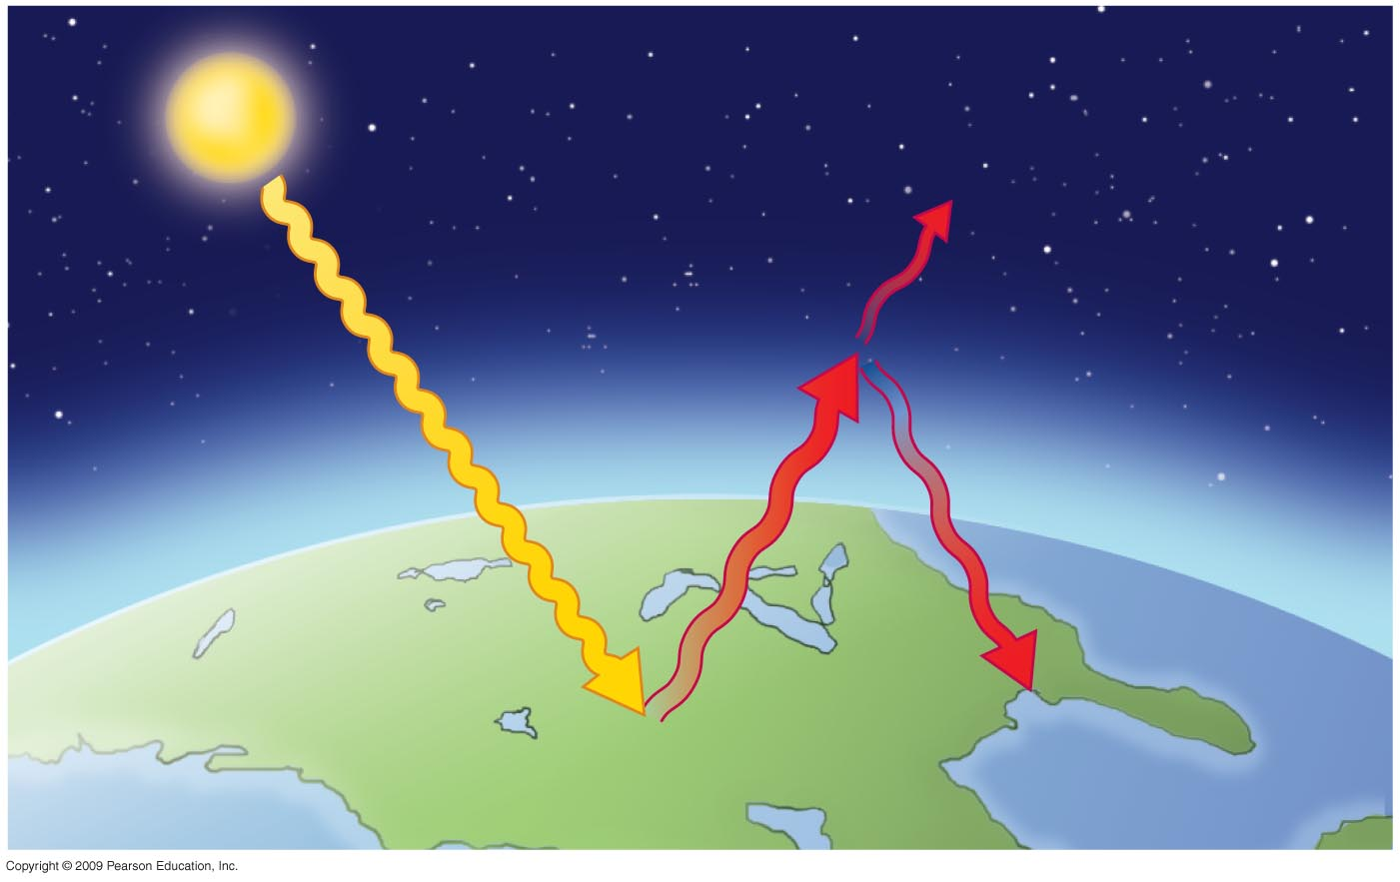
Some heat
energy escapes
into space
Sunlight
Atmosphere
Radiant heat
trapped by CO₂
and other gases
Notes:
Figure 7.13B CO₂ in the atmosphere and global warming.

Slide 76
7.14 TALKING ABOUT SCIENCE: Mario Molina talks about Earth’s protective ozone layer
Mario Molina at the University of California, San Diego, received a Nobel Prize for research on damage to the ozone layer
  Ozone provides a protective layer (the ozone layer) in our atmosphere to filter out powerful ultraviolet radiation
  Dr. Molina showed that industrial chemicals called chlorofluorocarbons, or CFCs, deplete the ozone layer
Copyright © 2009 Pearson Education, Inc.

Slide 77
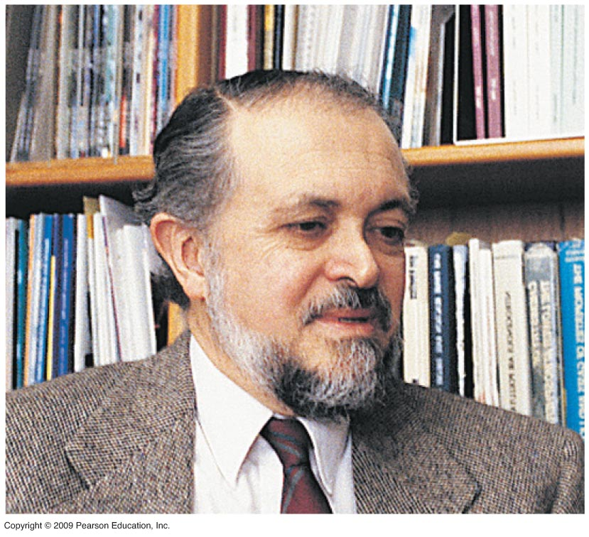
Notes:
Figure 7.14A Mario Molina.

Slide 78
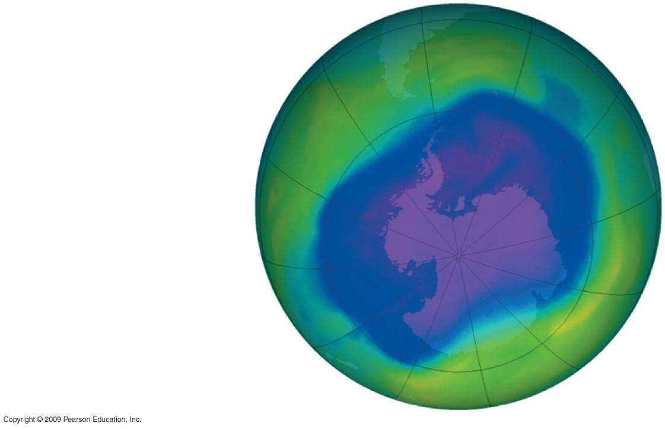
Southern tip of
South America
Antarctica
Notes:
Figure 7.14B The ozone hole in the Southern Hemisphere, spring 2006.

Slide 79
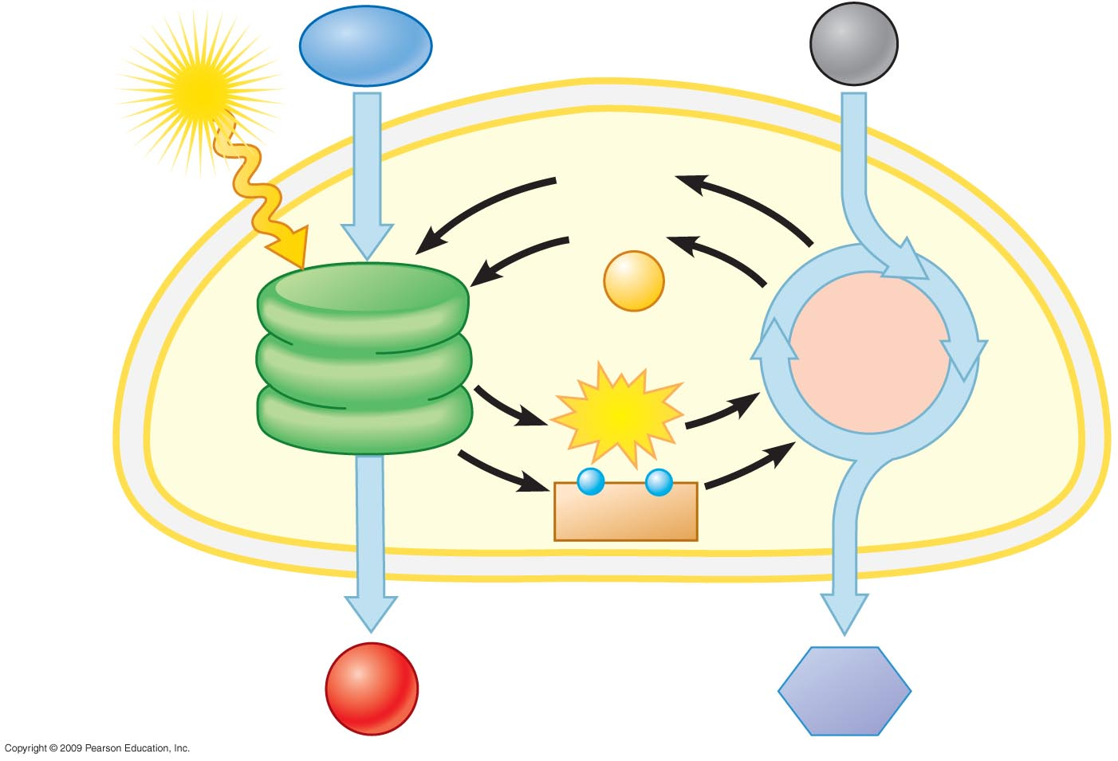
Chloroplast
H₂O
CO₂
Light
NADP⁺
Stroma
Thylakoid
membranes
ADP

P
Light
reactions
Calvin
cycle
ATP
NADPH
O₂
Sugar

Slide 80
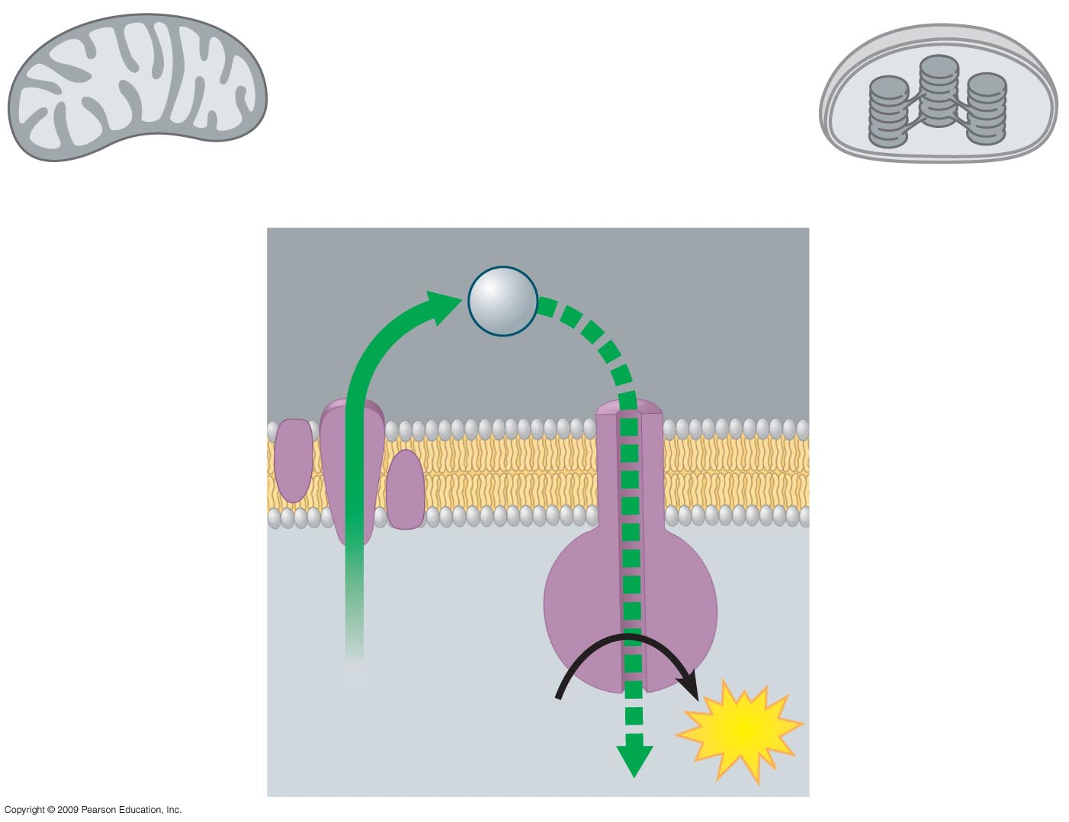
Mitochondrion
structure
Chloroplast
structure
Intermembrane
space
H⁺
c.
Membrane
Matrix
d.
a.
b.
e.

Slide 81
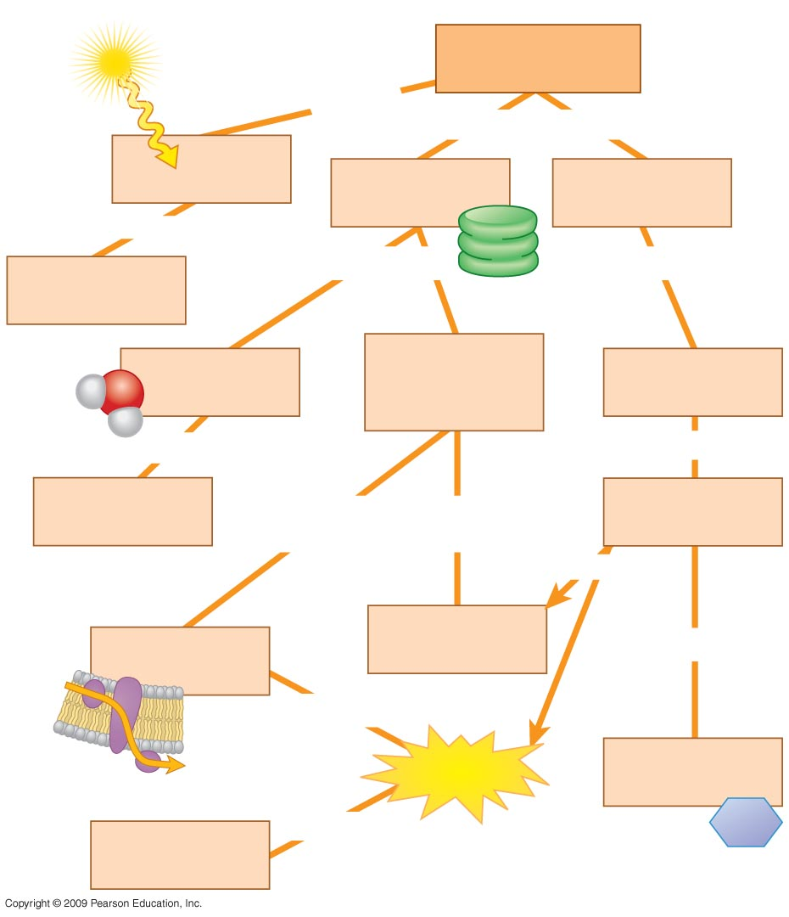
Photosynthesis
converts
includes both
(a)
(b)
(c)
to
chemical
energy
in which
in which
light-excited
electrons of
chlorophyll
CO₂ is fixed to
RuBP
H₂O is split
and
and then
(d)
are passed
down
reduce
NADP⁺ to
(h)
using
(f)
to produce
(e)
producing
(g)
sugar
(G3P)
by
chemiosmosis

Slide 82
You should now be able to
Explain the value of autotrophs as producers
Provide a general description of photosynthesis in chloroplasts
Explain how plants are able to produce oxygen as a product of photosynthesis
Contrast photosynthesis to respiration in terms of redox reactions
Describe the importance of visible radiation to photosynthesis
Copyright © 2009 Pearson Education, Inc.

Slide 83
You should now be able to
Describe plant photosystems and their function in photosynthesis
Describe the linkage (connection) between the two plant photosystems
Describe how chemiosmosis powers ATP synthesis in plants
Discuss the Calvin cycle and how it uses ATP and NADPH
Copyright © 2009 Pearson Education, Inc.

Slide 84
You should now be able to
Describe two plant adaptations that save water in hot, dry climates
Detail how photosynthesis could help moderate globing warming
Discuss the importance of the Earth’s protective ozone layer
Copyright © 2009 Pearson Education, Inc.

