Slide 1
Energetics Review

Slide 2
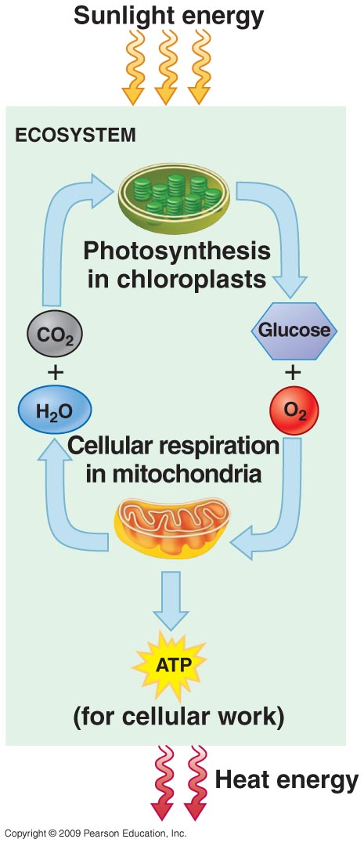

Slide 3
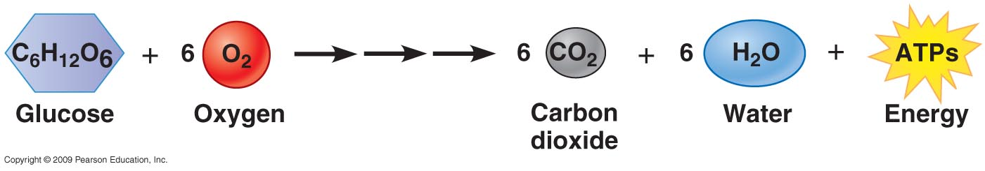
Overall Chemical Reaction for Aerobic Cellular Respiration

Slide 4
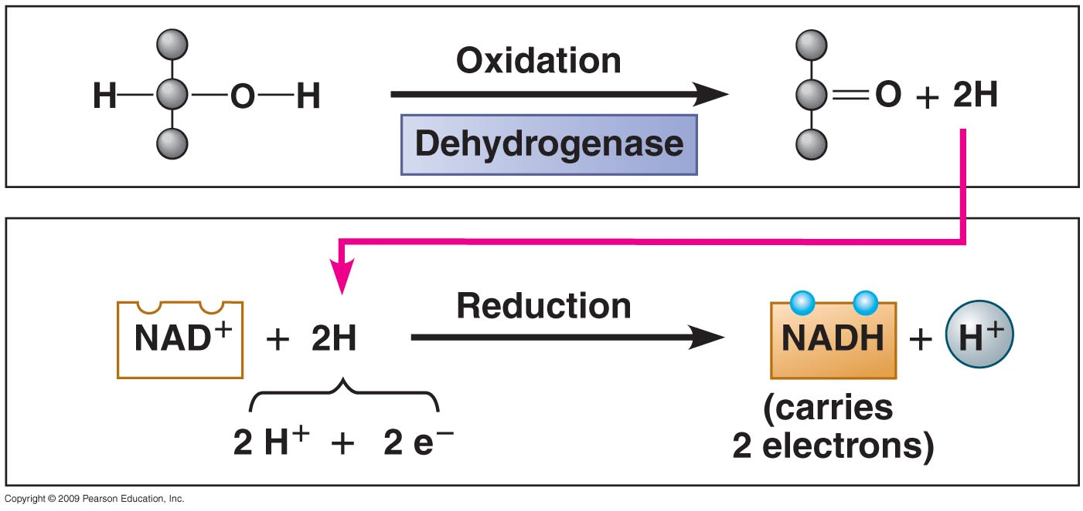
Oxidation of Pyruvate;
Reduction of NAD+

Slide 5
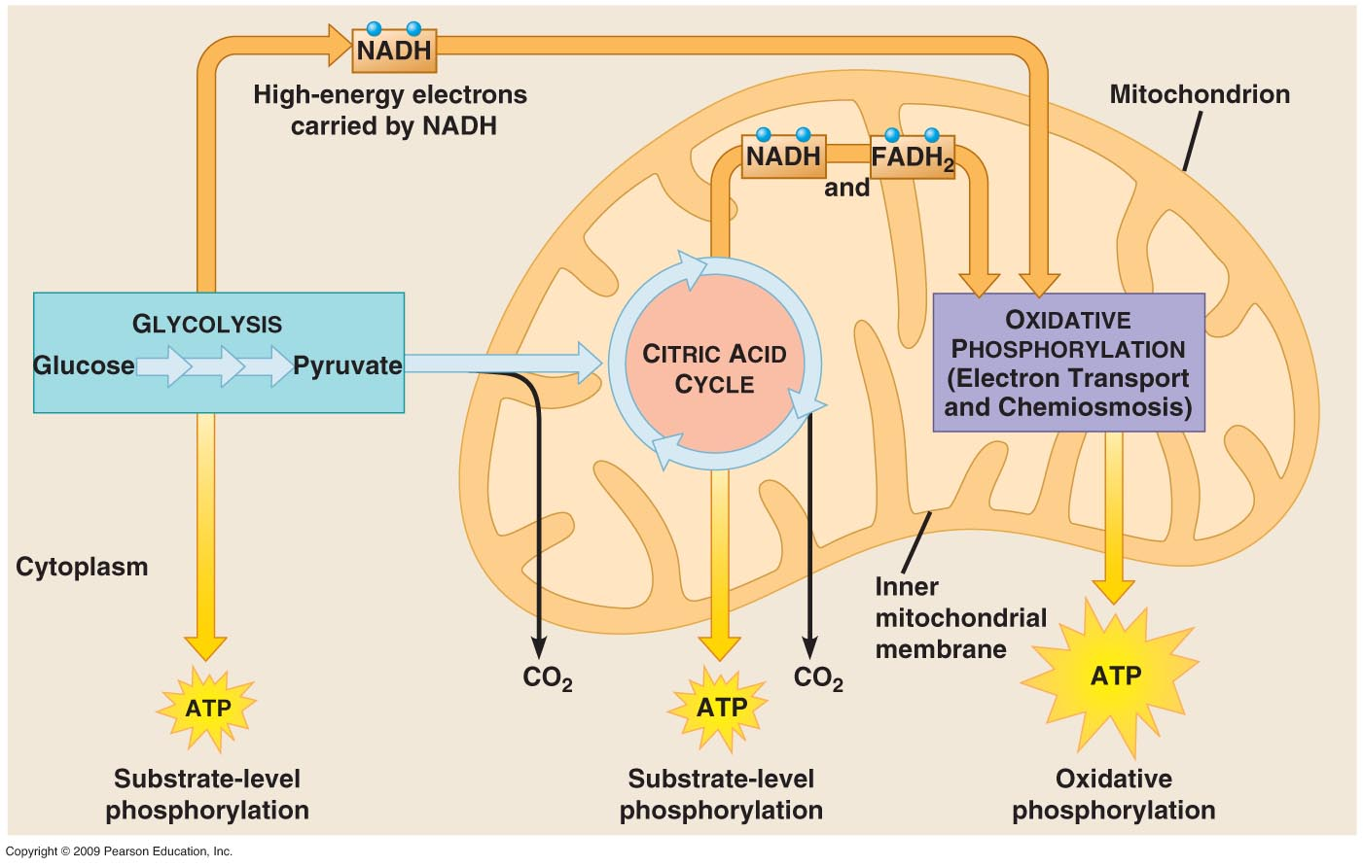

Slide 6
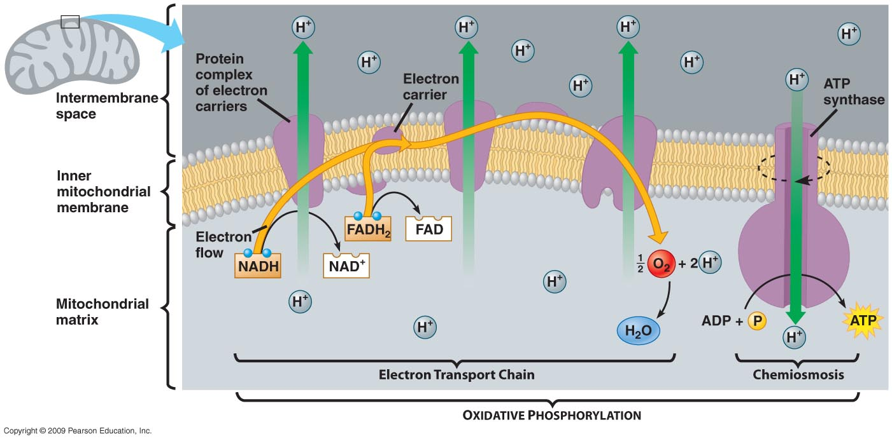
Oxidative Phosphorylation

Slide 7
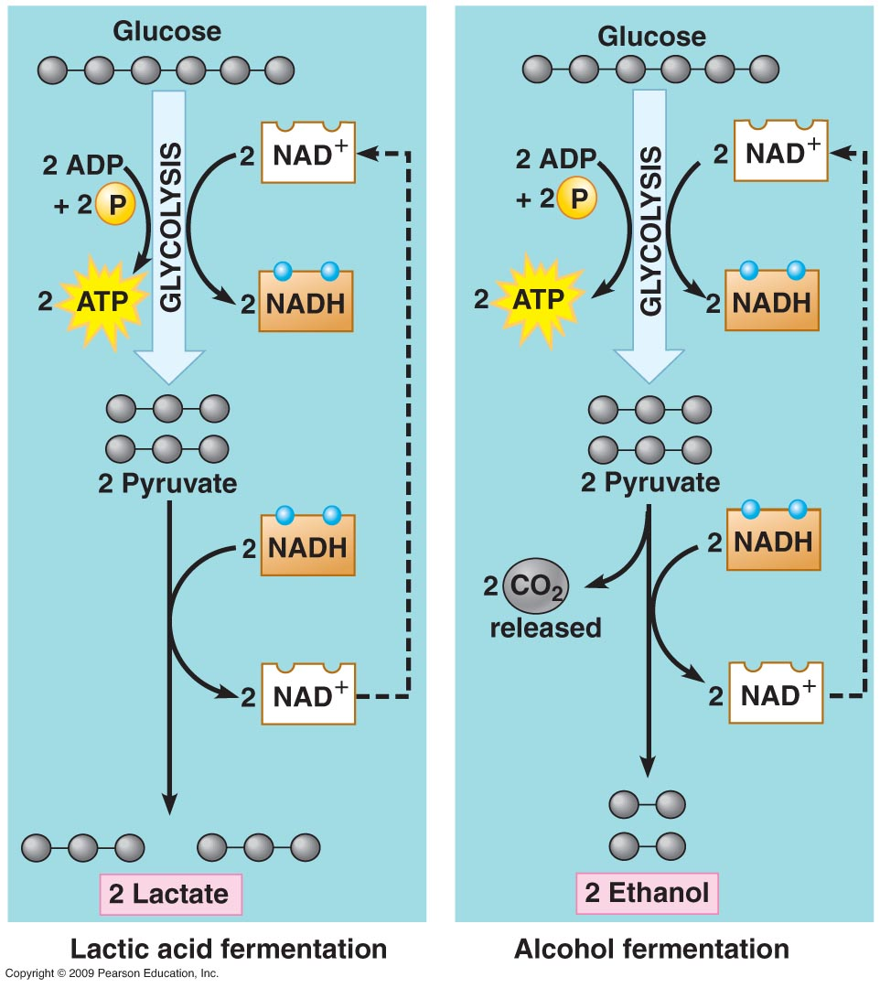
Fermentation: Anaerobic CR

Slide 8
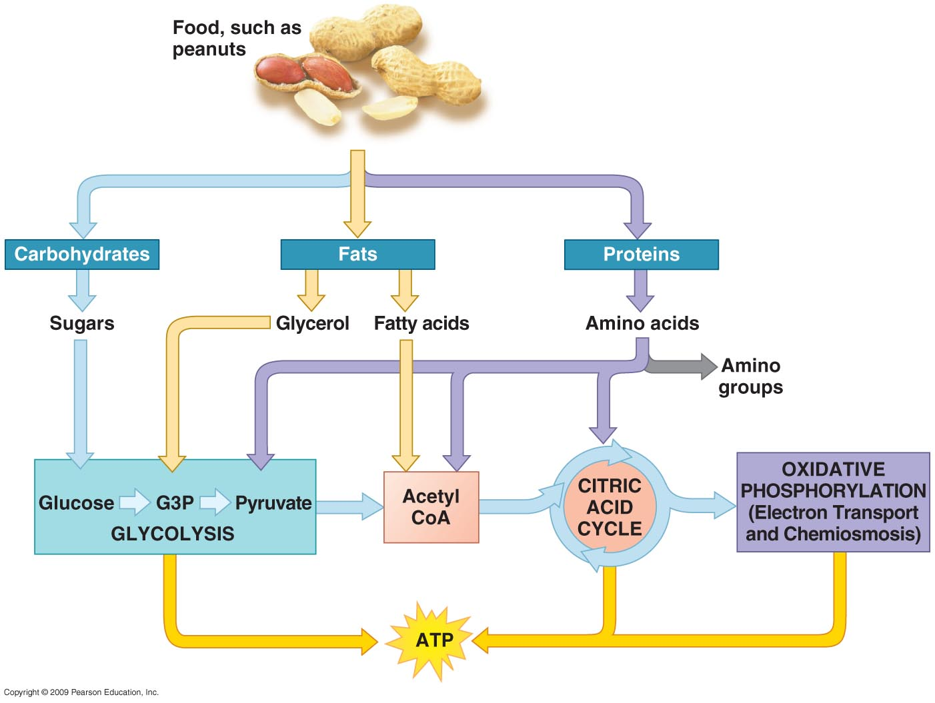

Slide 9
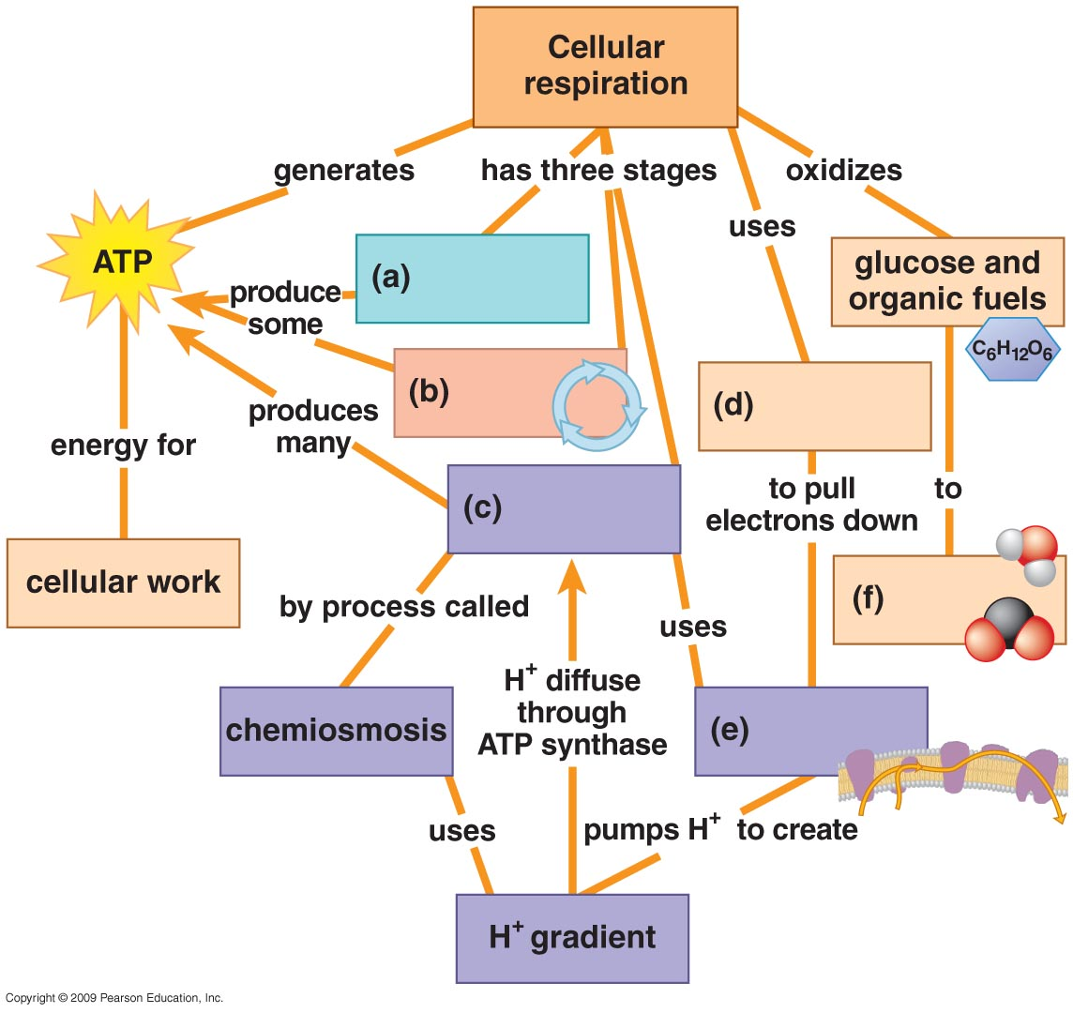

Slide 10
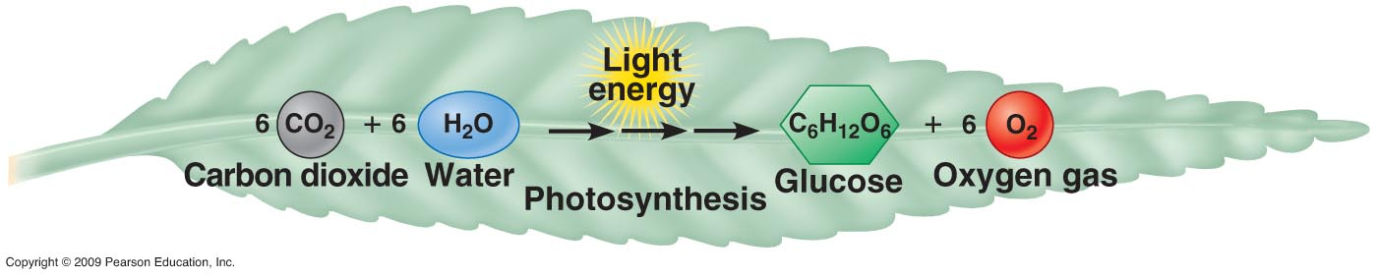
Chemical Reaction for Photosynthesis

Slide 11
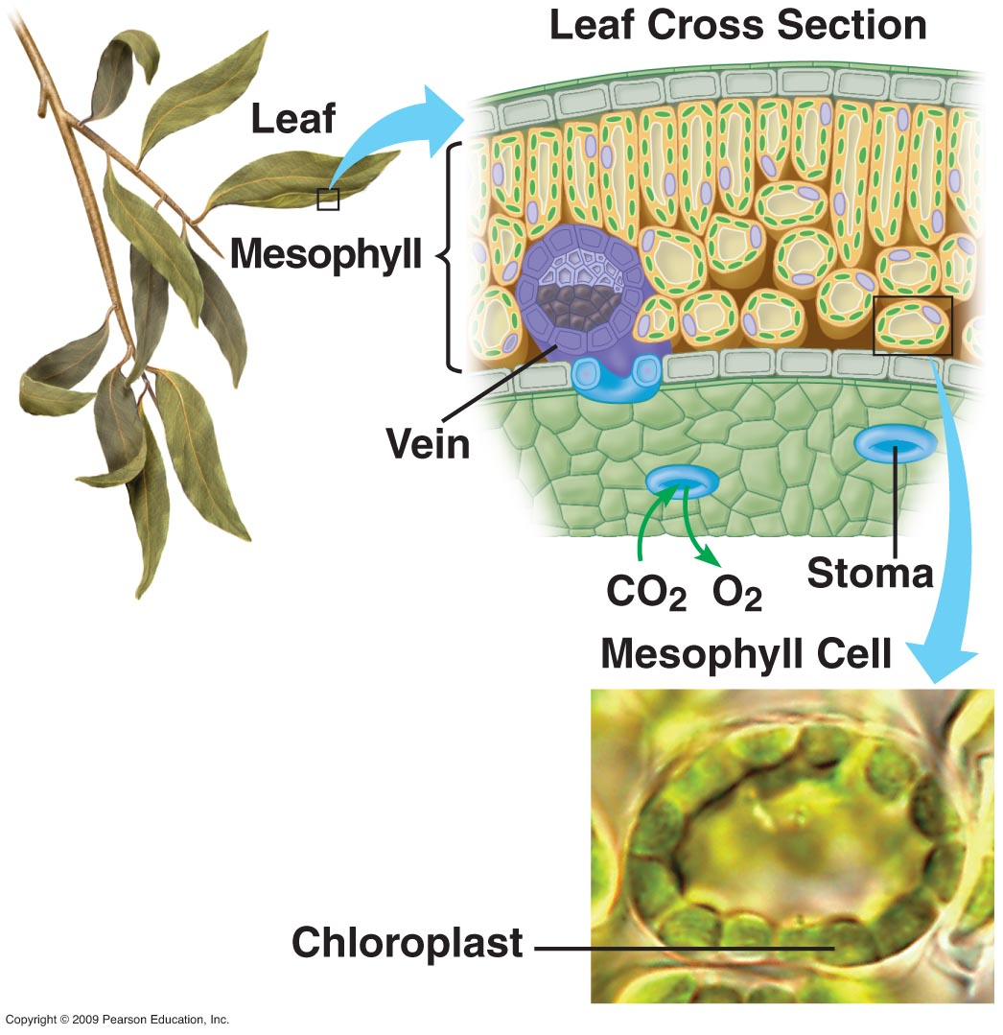
Leaf Anatomy

Slide 12
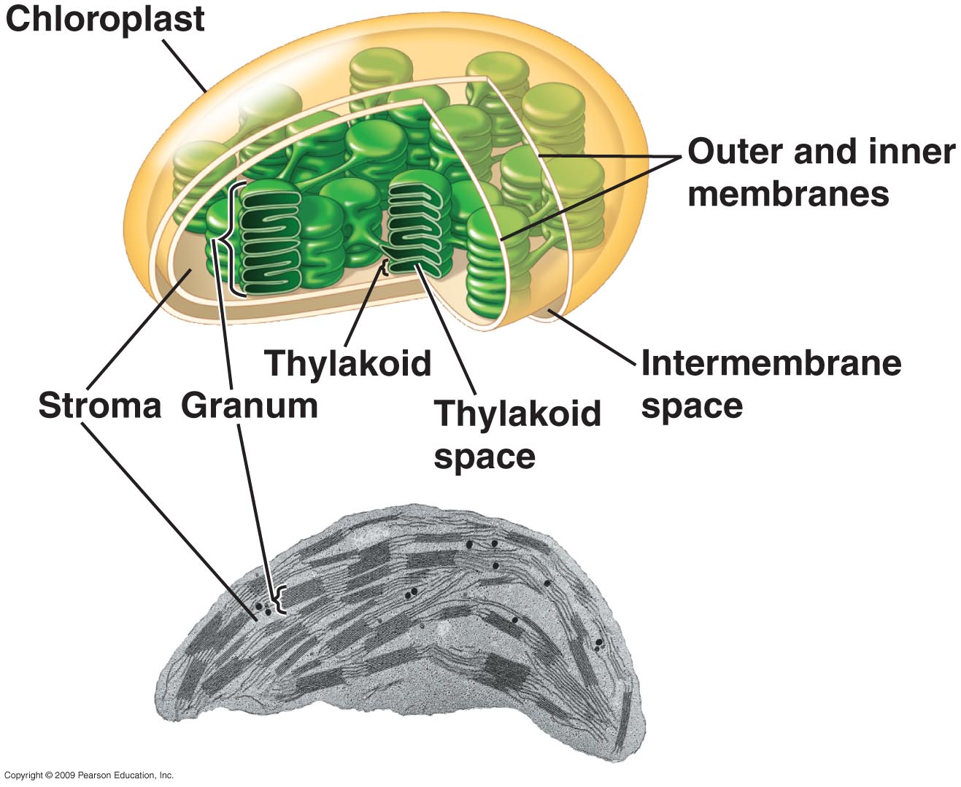

Slide 13
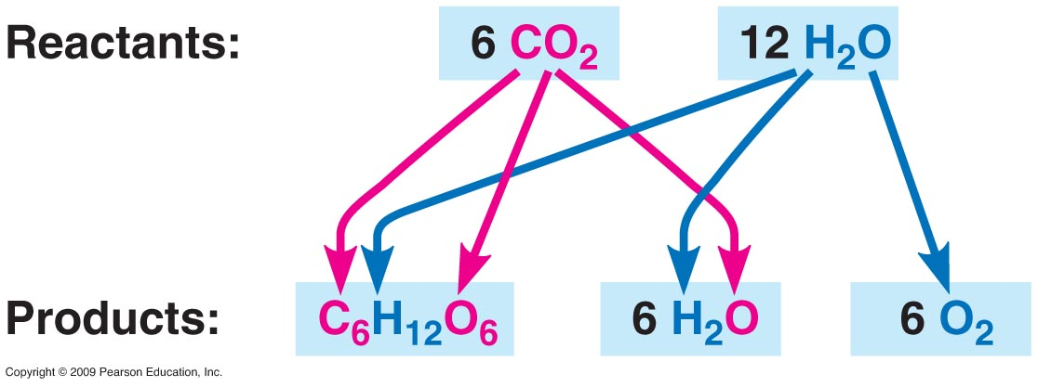
What happens to the reactants?

Slide 14
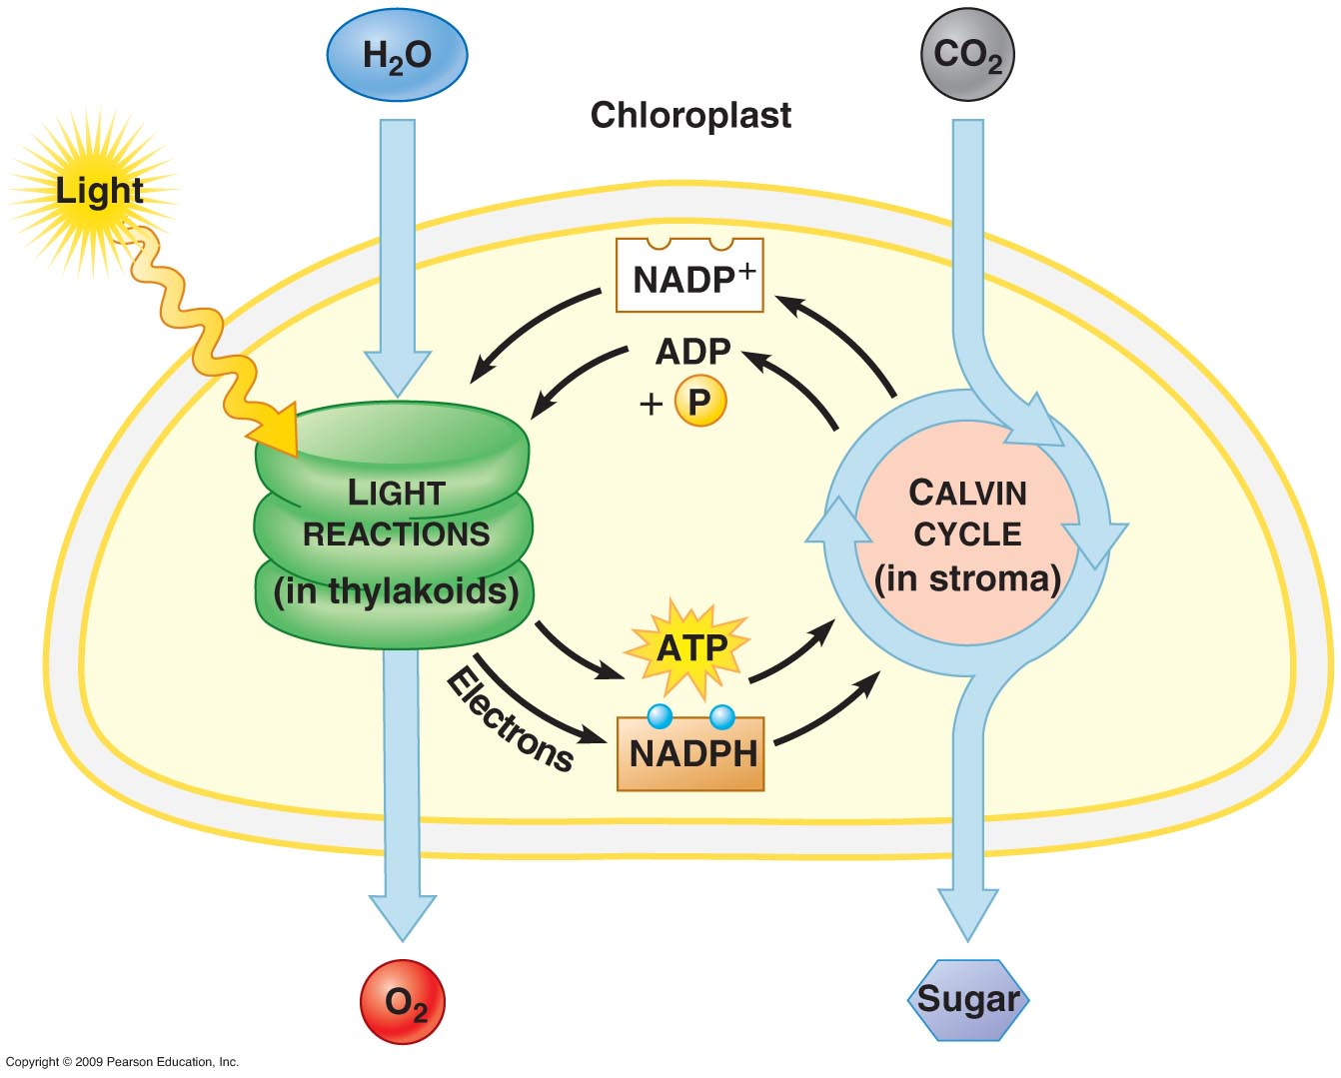
Overview of Photosynthesis

Slide 15
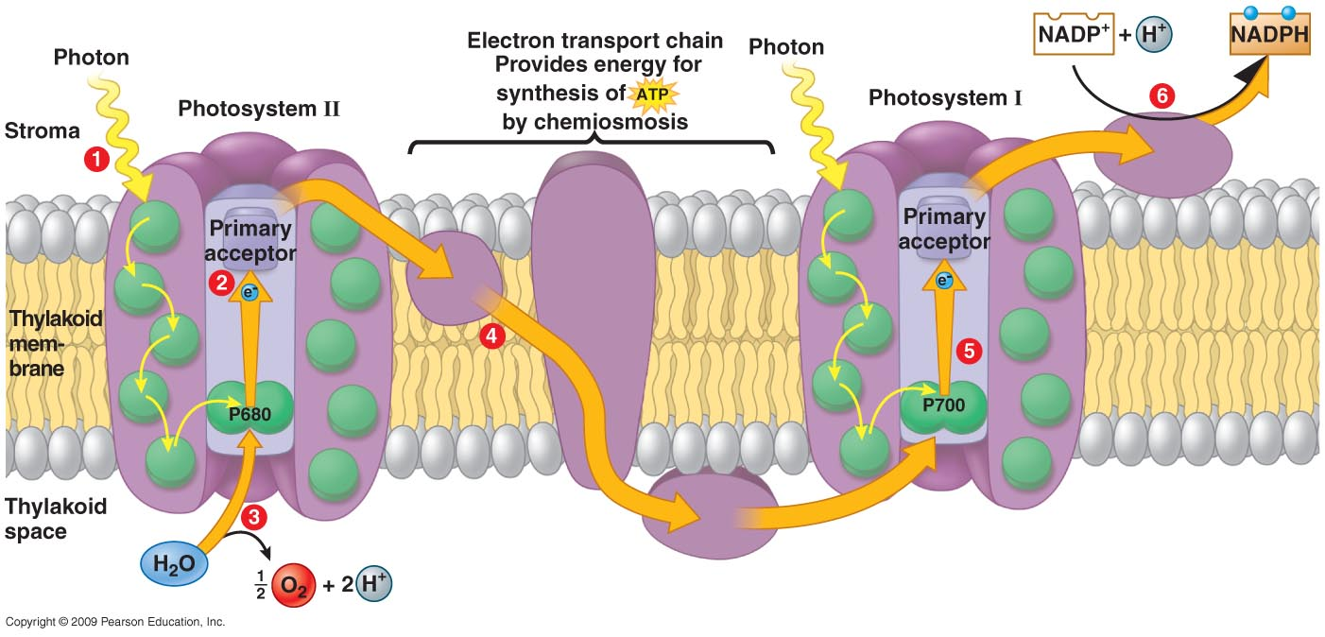
Light Dependent Reactions

Slide 16
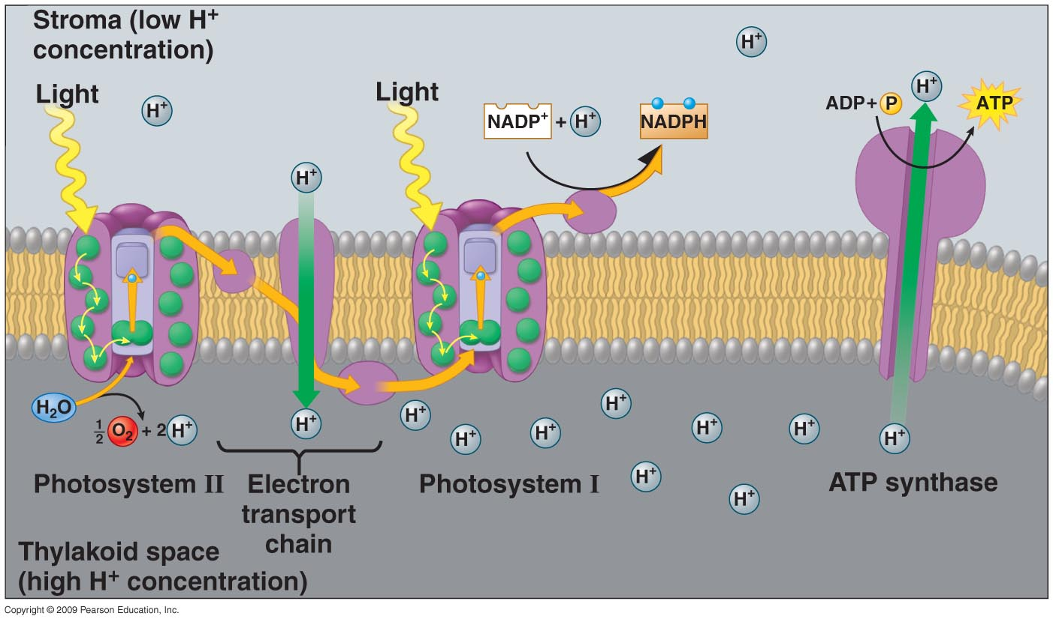
Light Dependent Rxns & Chemiosmosis

Slide 17
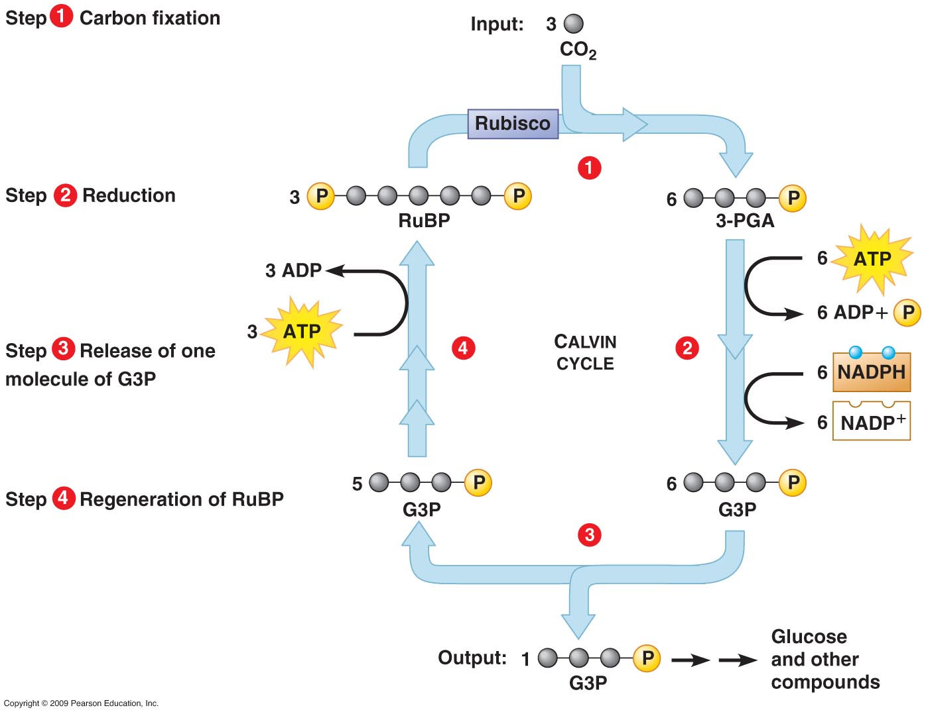
Calvin Cycle

Slide 18
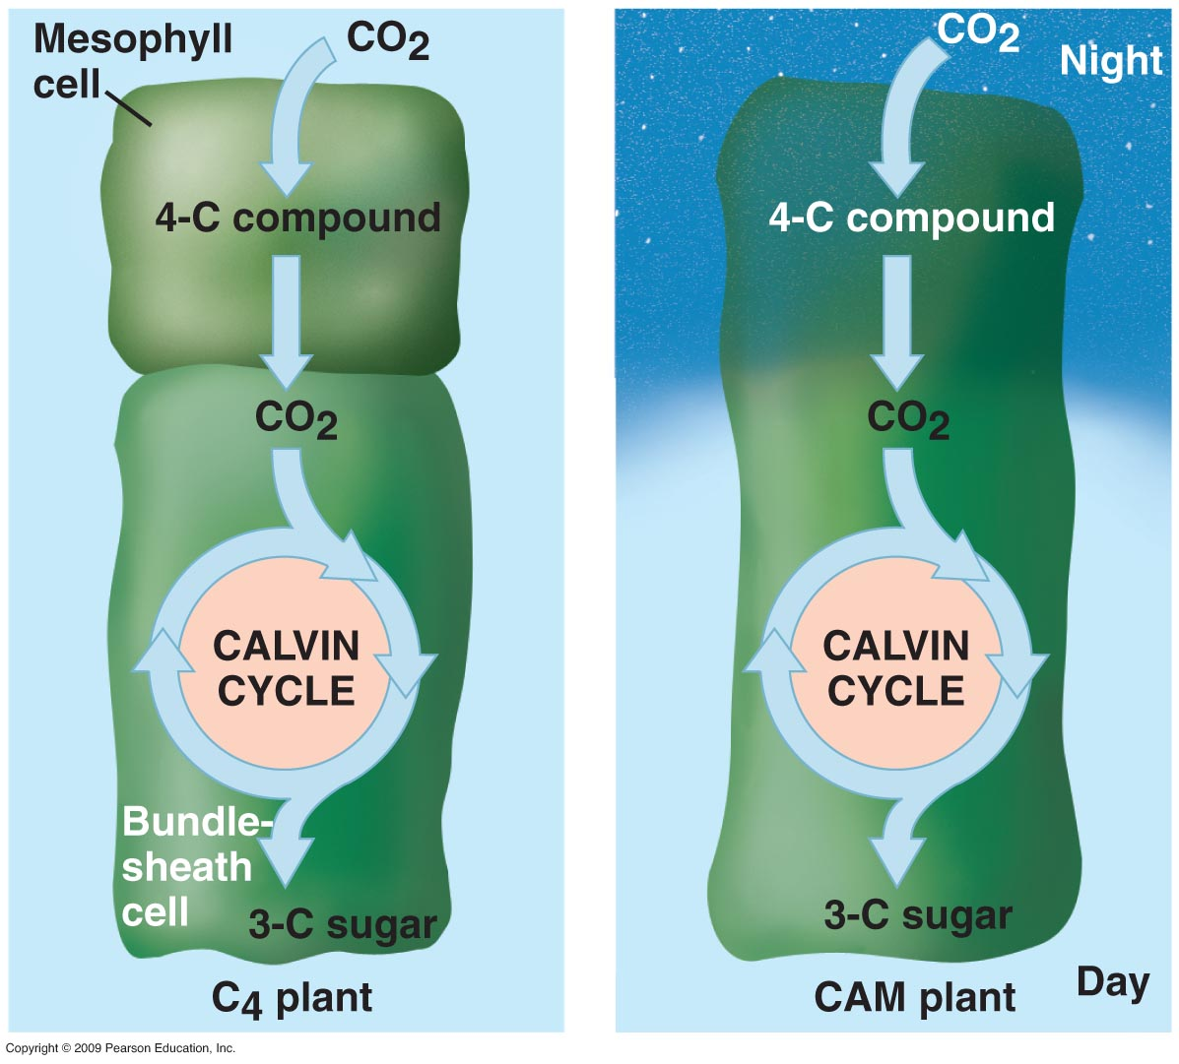

Slide 19
