Slide 1
Introduction to Anatomy and Physiology
Chapters 1, 2 and 3

Slide 2
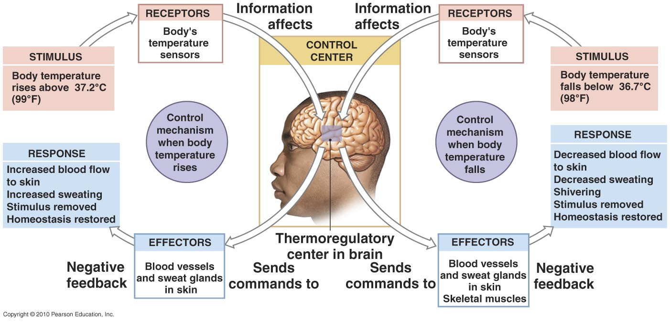
Figure 1.4

Slide 3
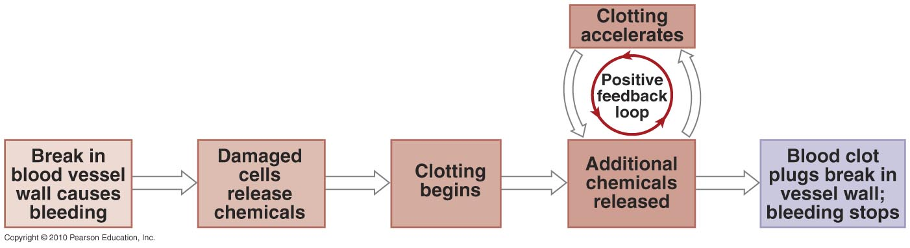
Figure 1.5

Slide 4
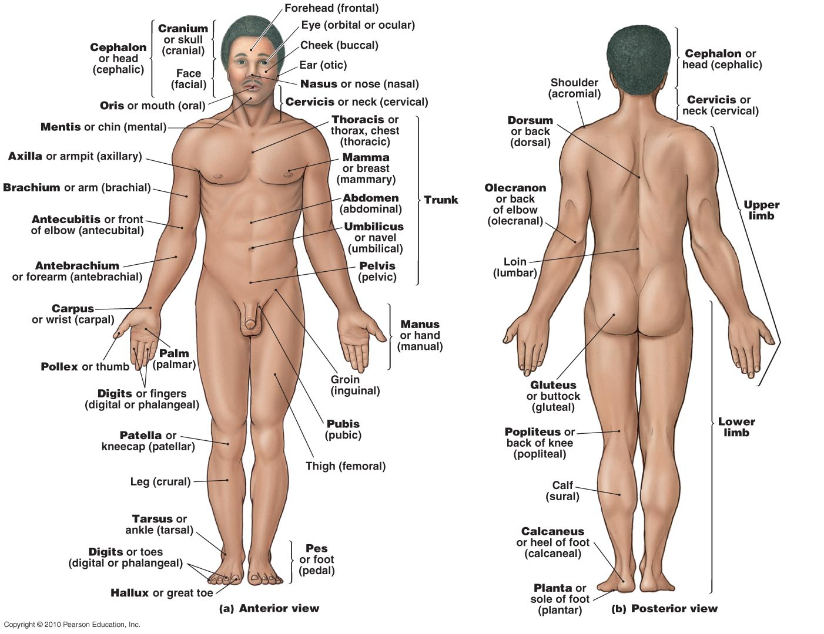
Figure 1.6

Slide 5
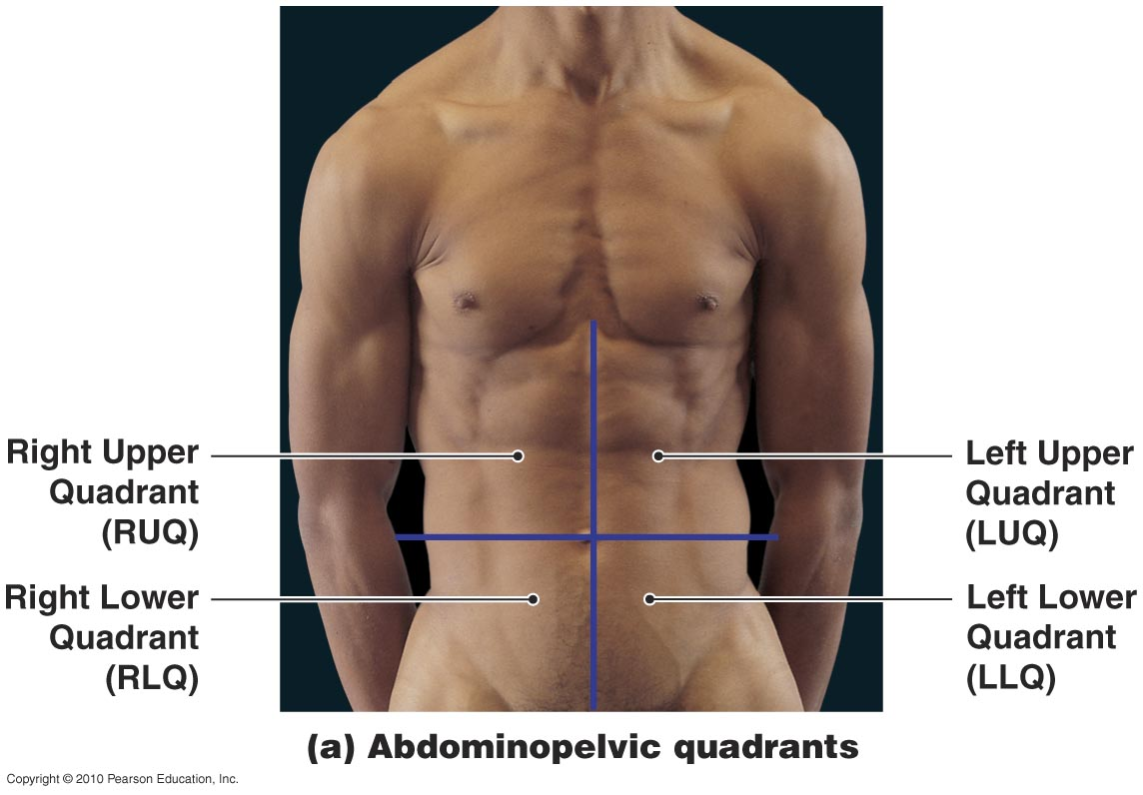
Figure 1.7a

Slide 6
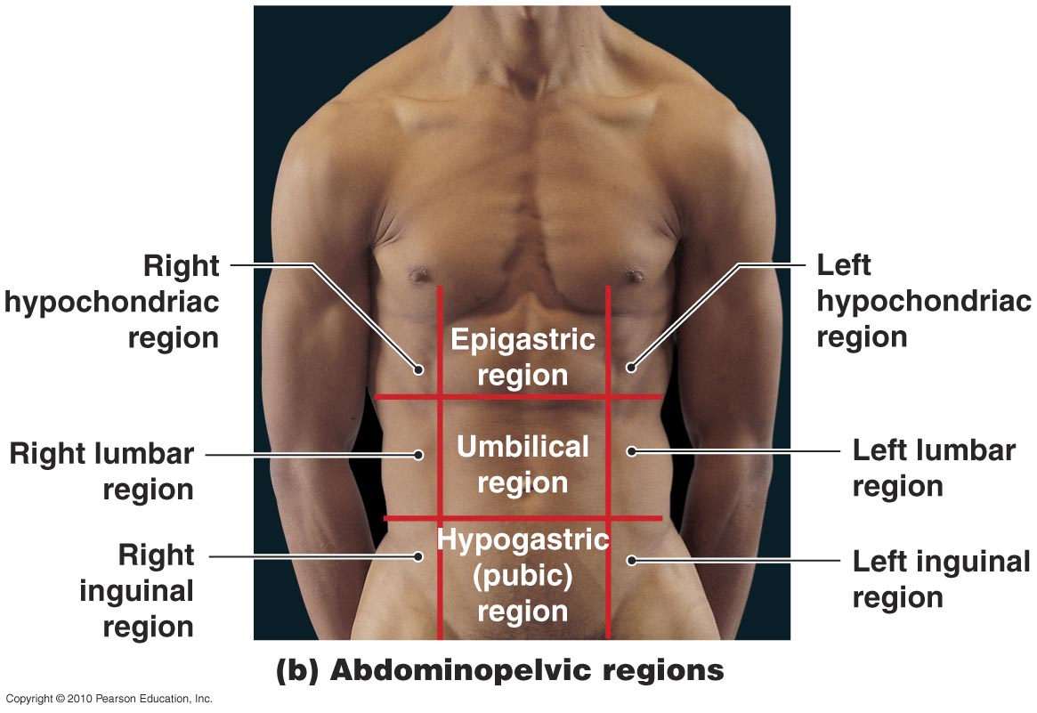
Figure 1.7b

Slide 7
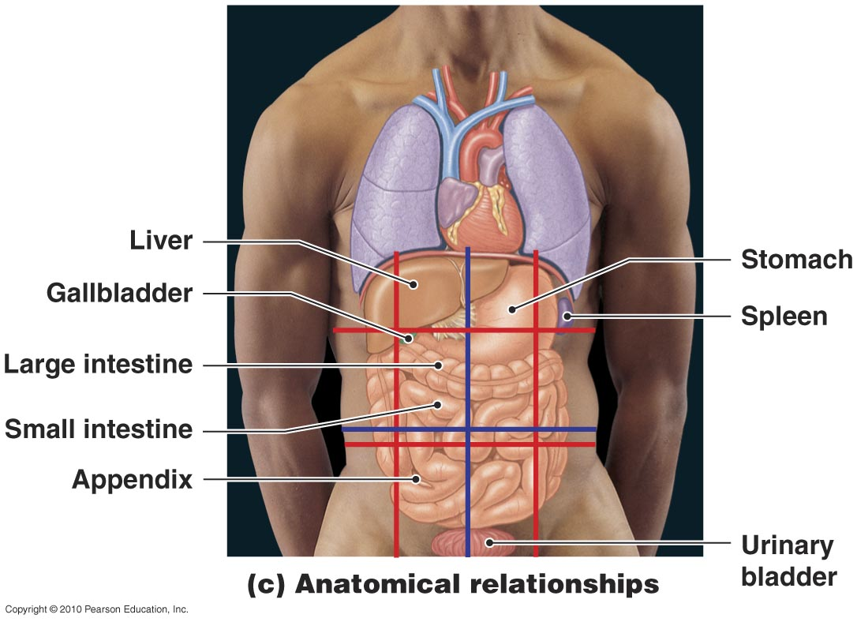
Figure 1.7c

Slide 8
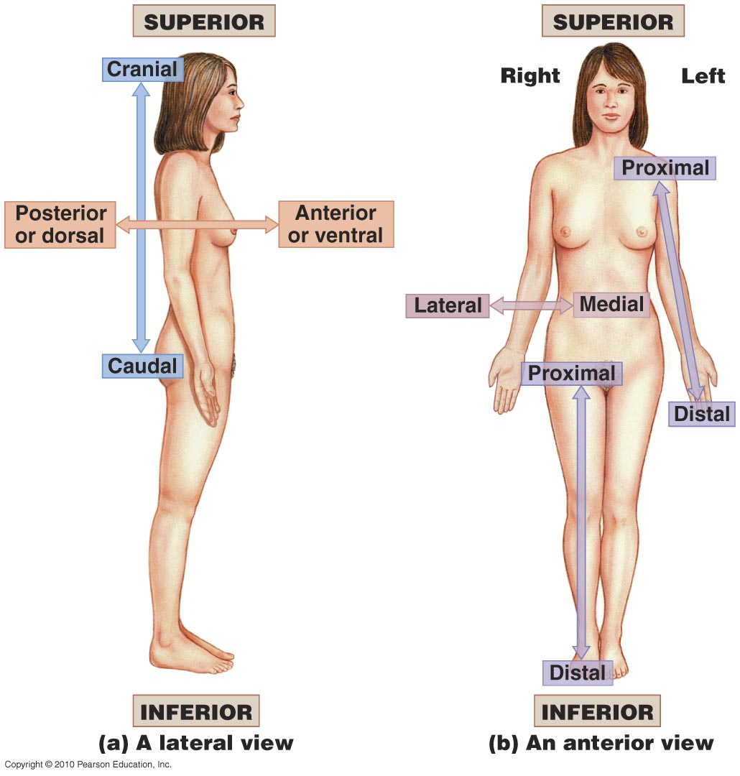
Figure 1.8

Slide 9
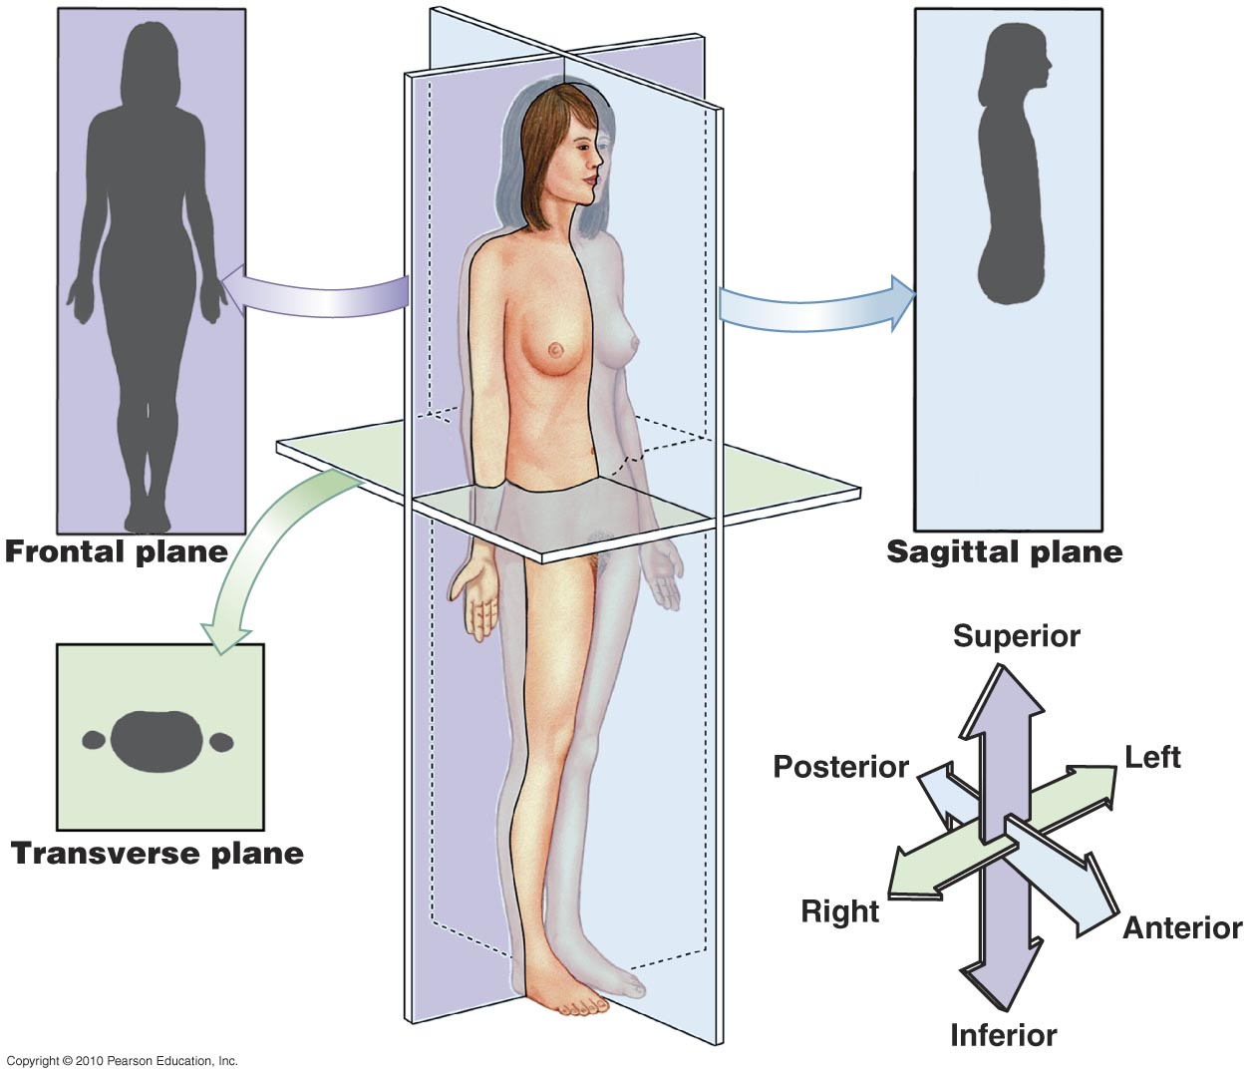
Figure 1.9

Slide 10
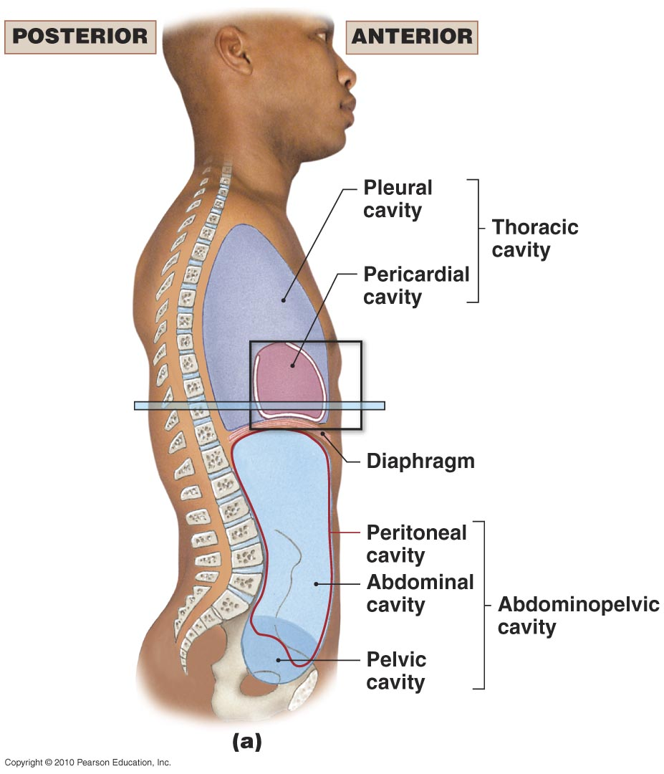
Figure 1.10a

Slide 11
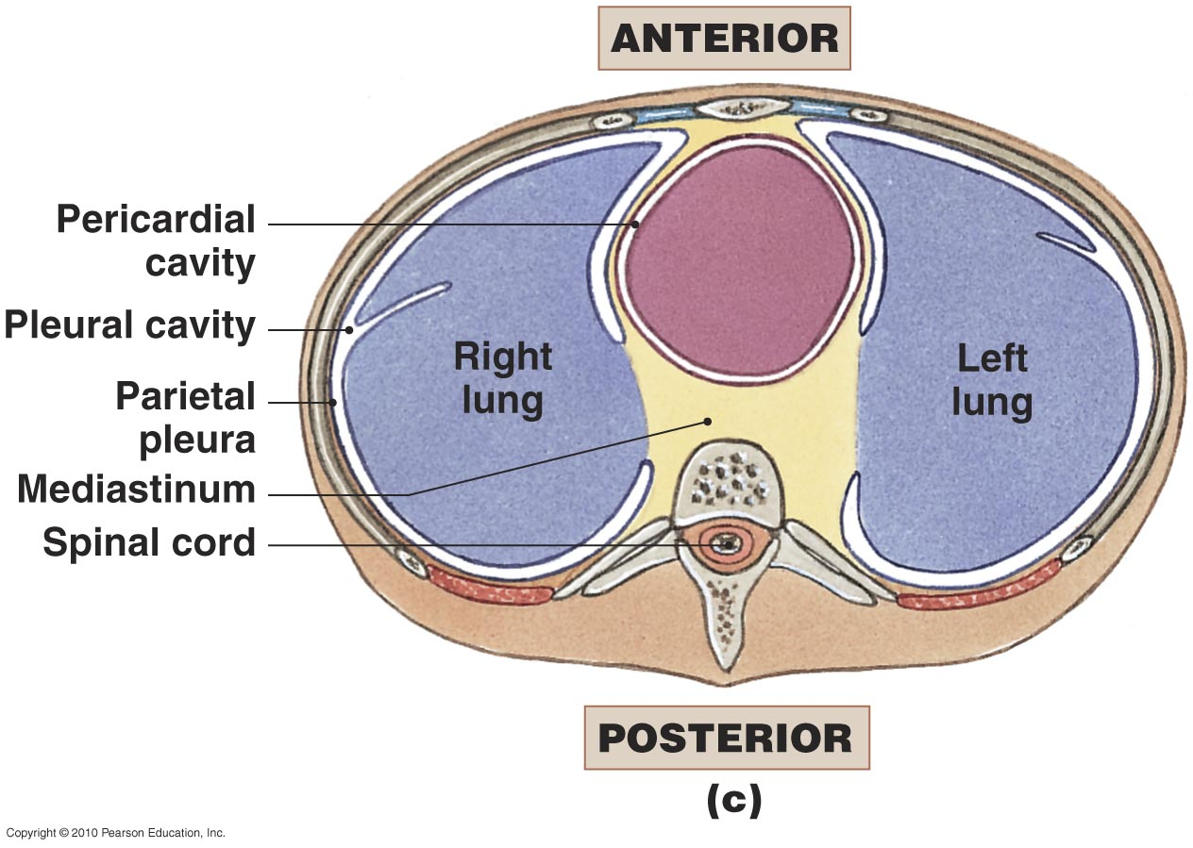
Figure 1.10c

Slide 12
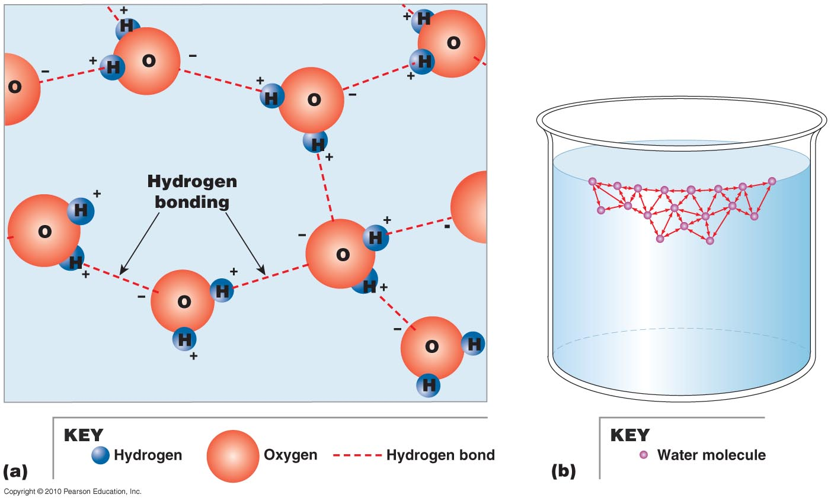
Figure 2.6

Slide 13
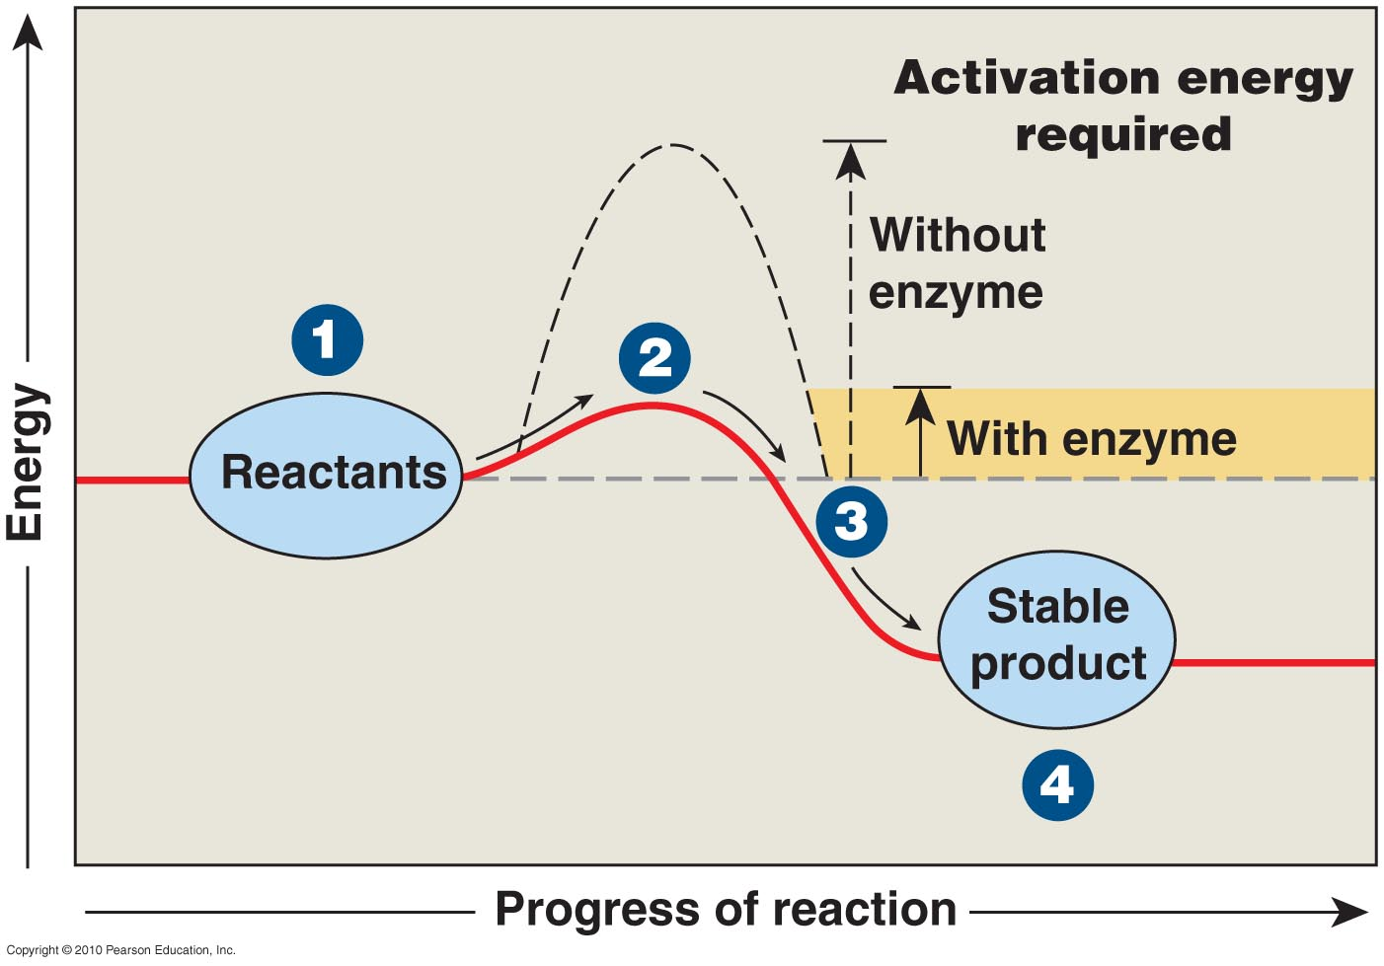
Figure 2.7

Slide 14
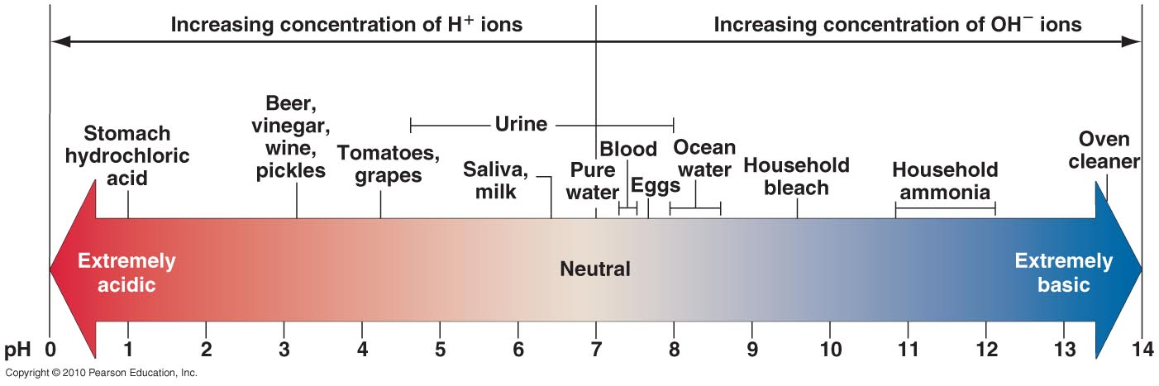
Figure 2.9

Slide 15
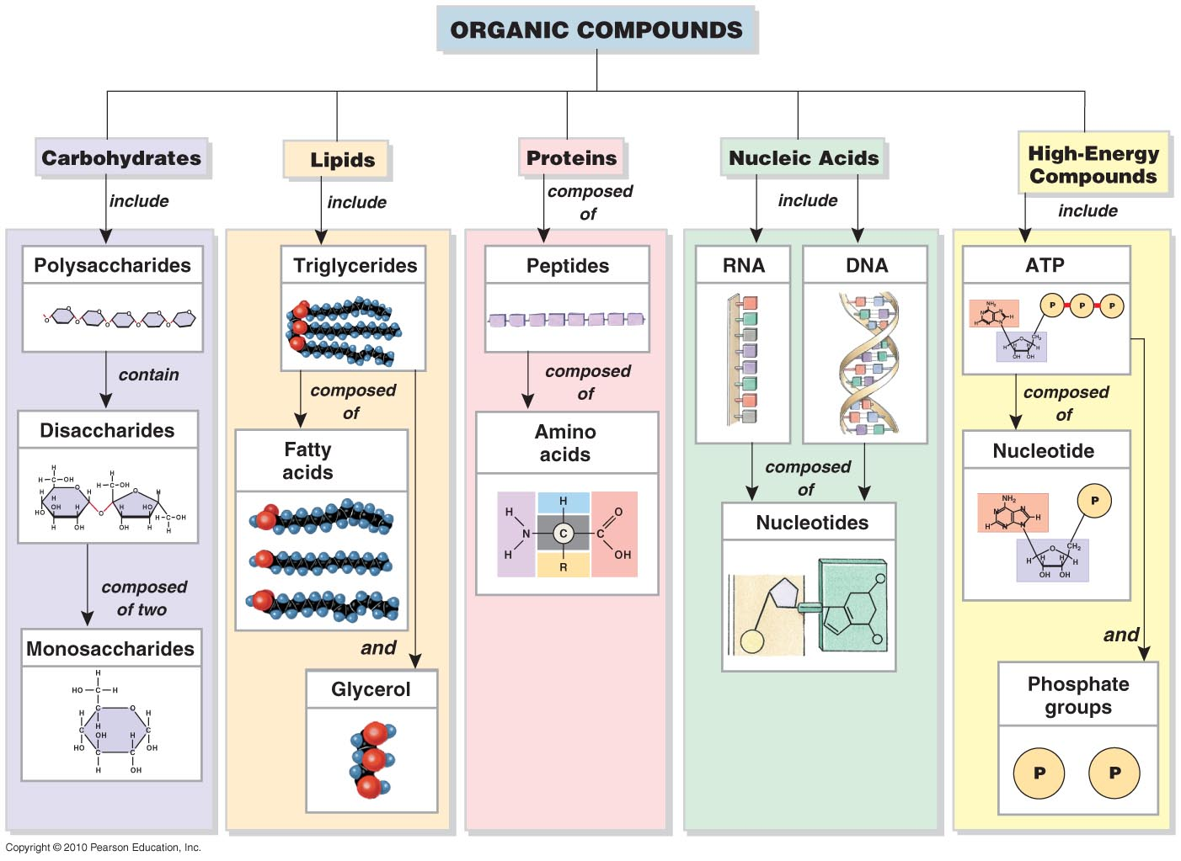
Figure 2.22

Slide 16
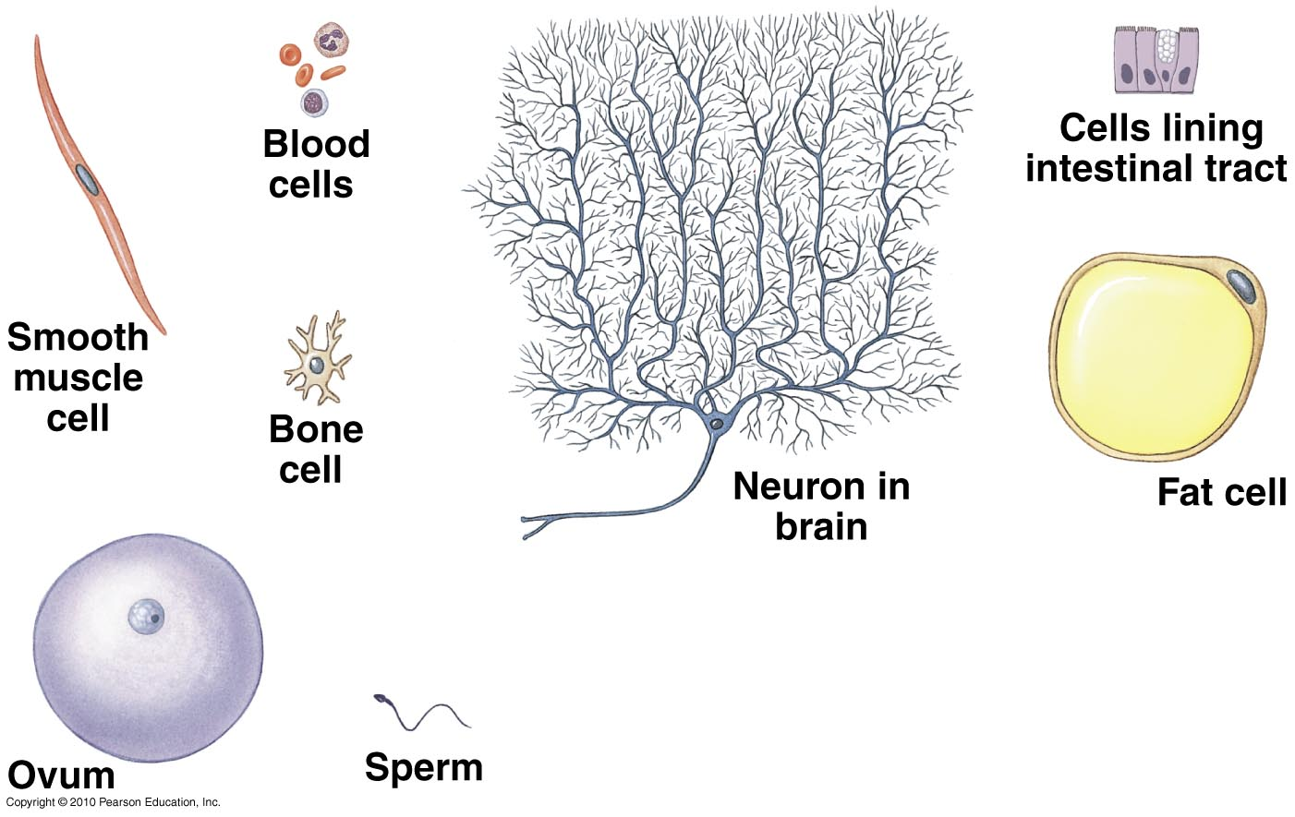
Figure 3.1

Slide 17
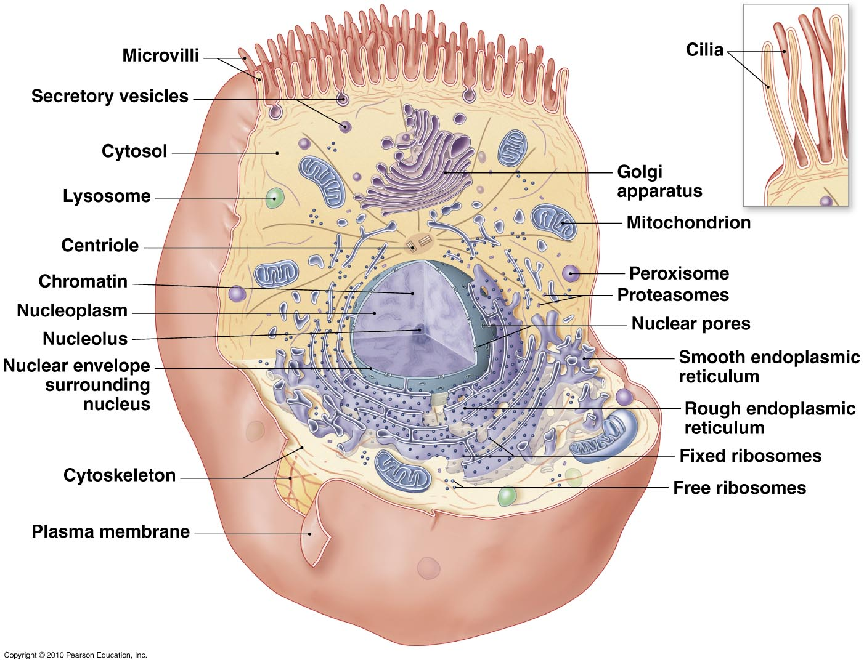
Figure 3.2

Slide 18
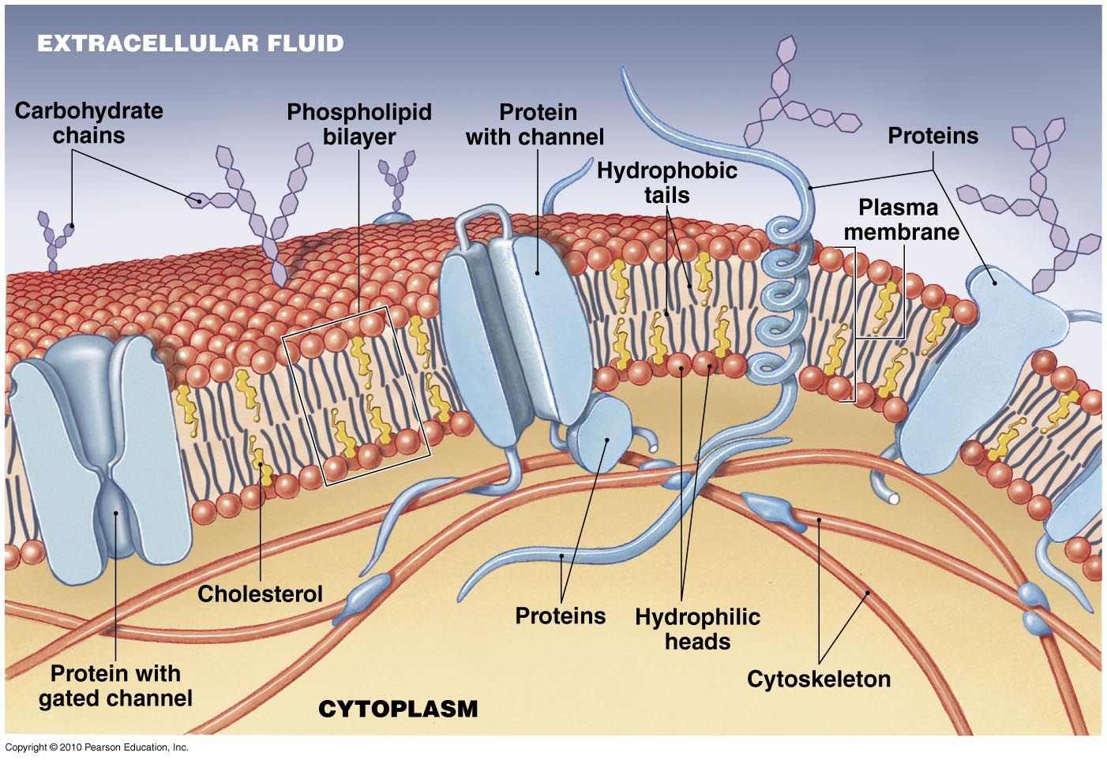
Figure 3.3

Slide 19
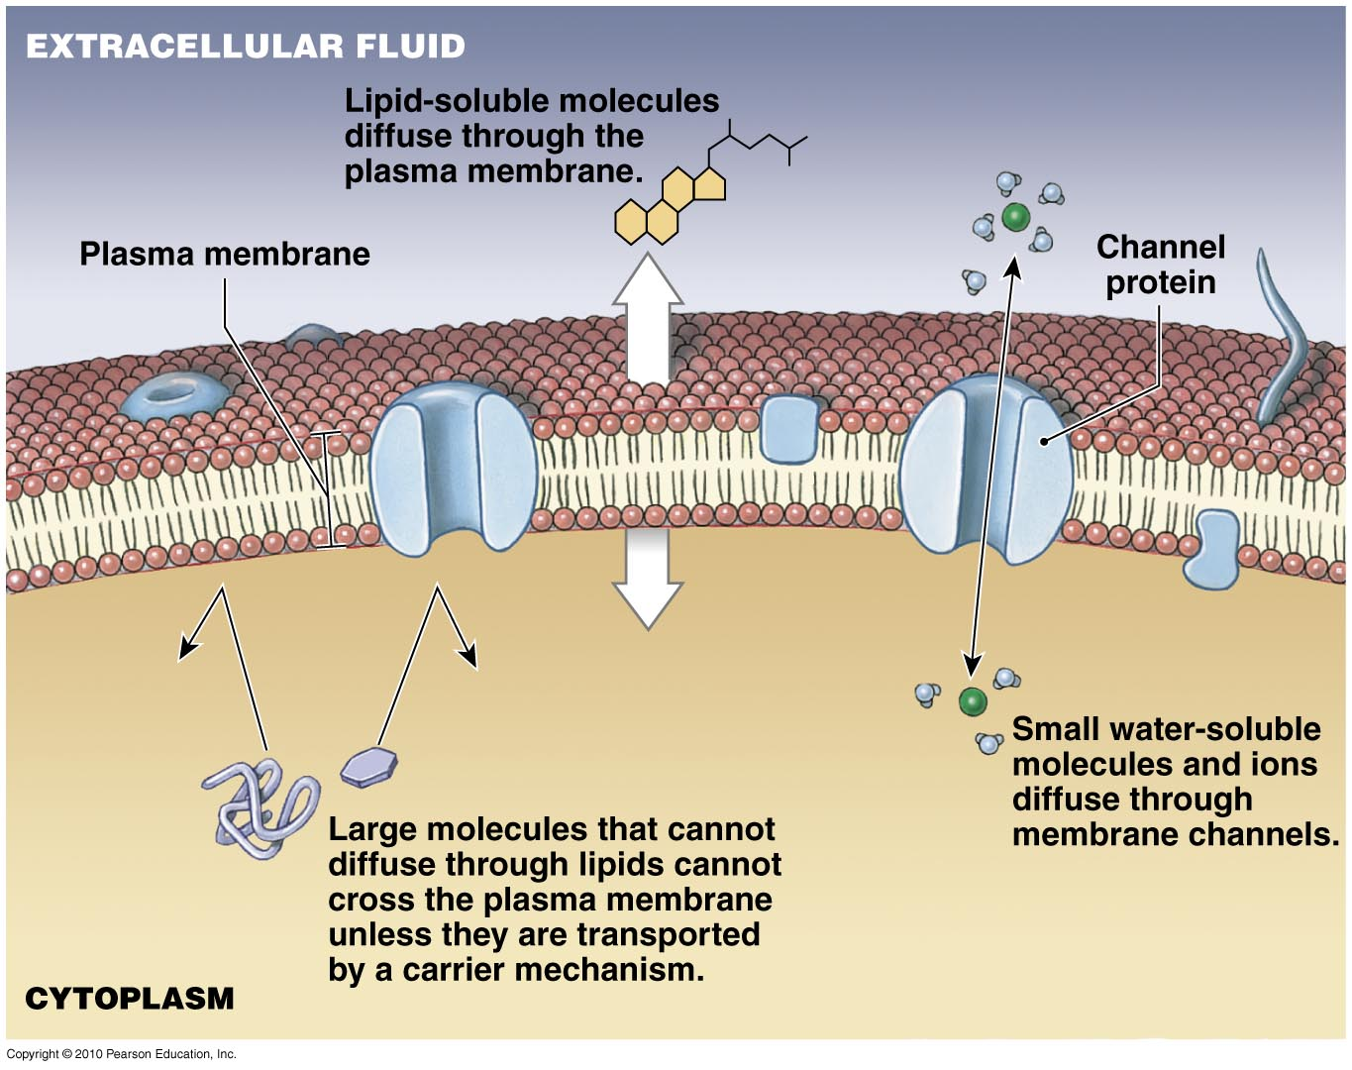
Figure 3.5

Slide 20
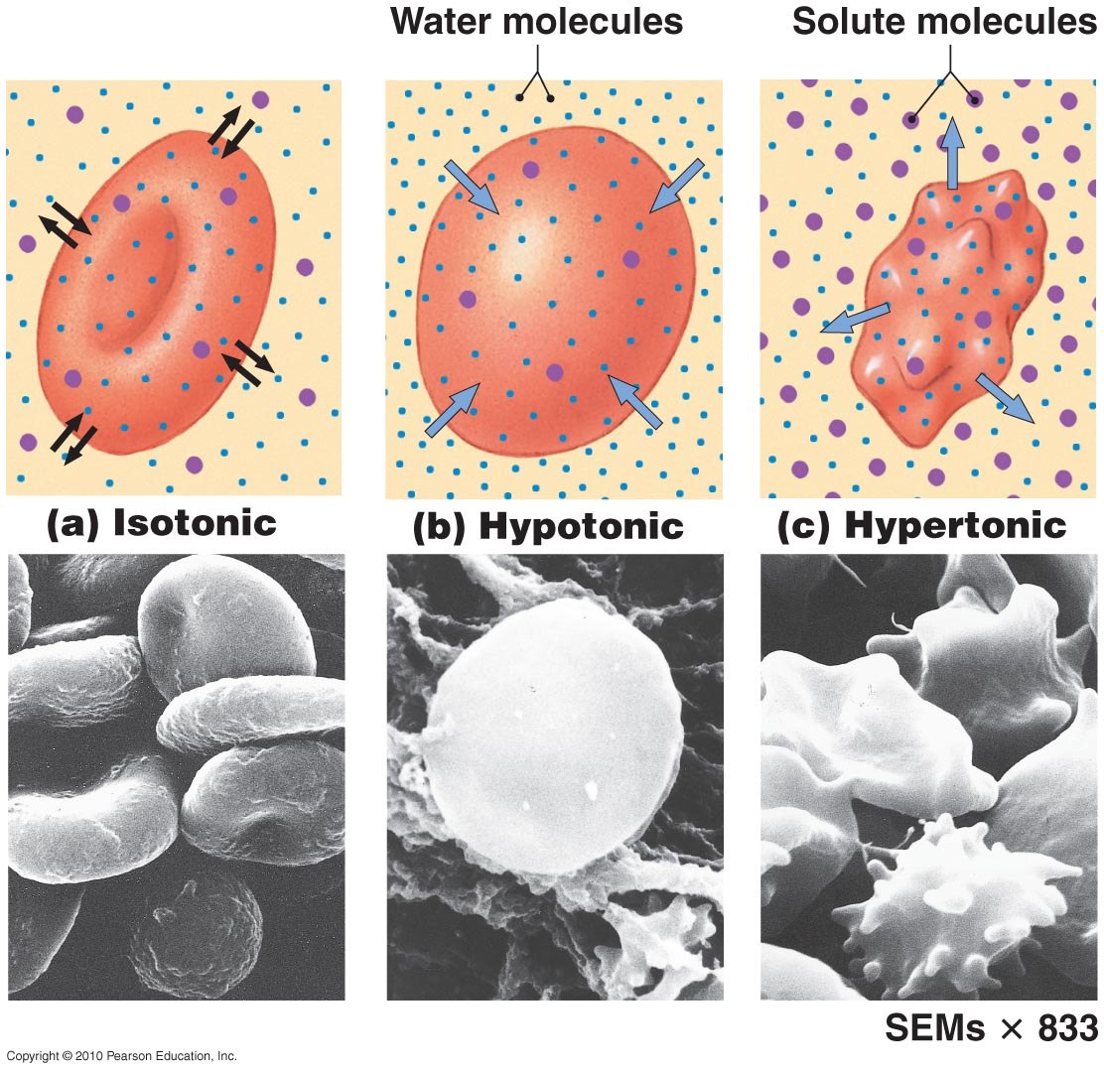
Figure 3.7

Slide 21
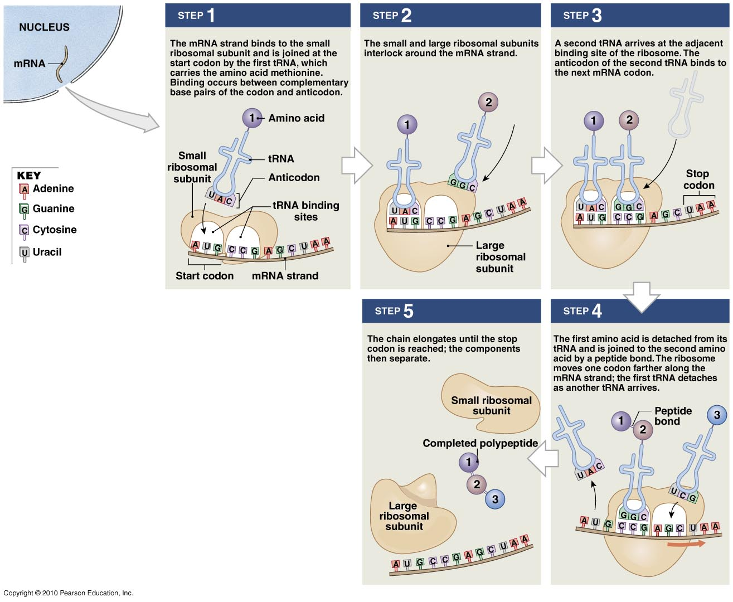
Figure 3.19

Slide 22
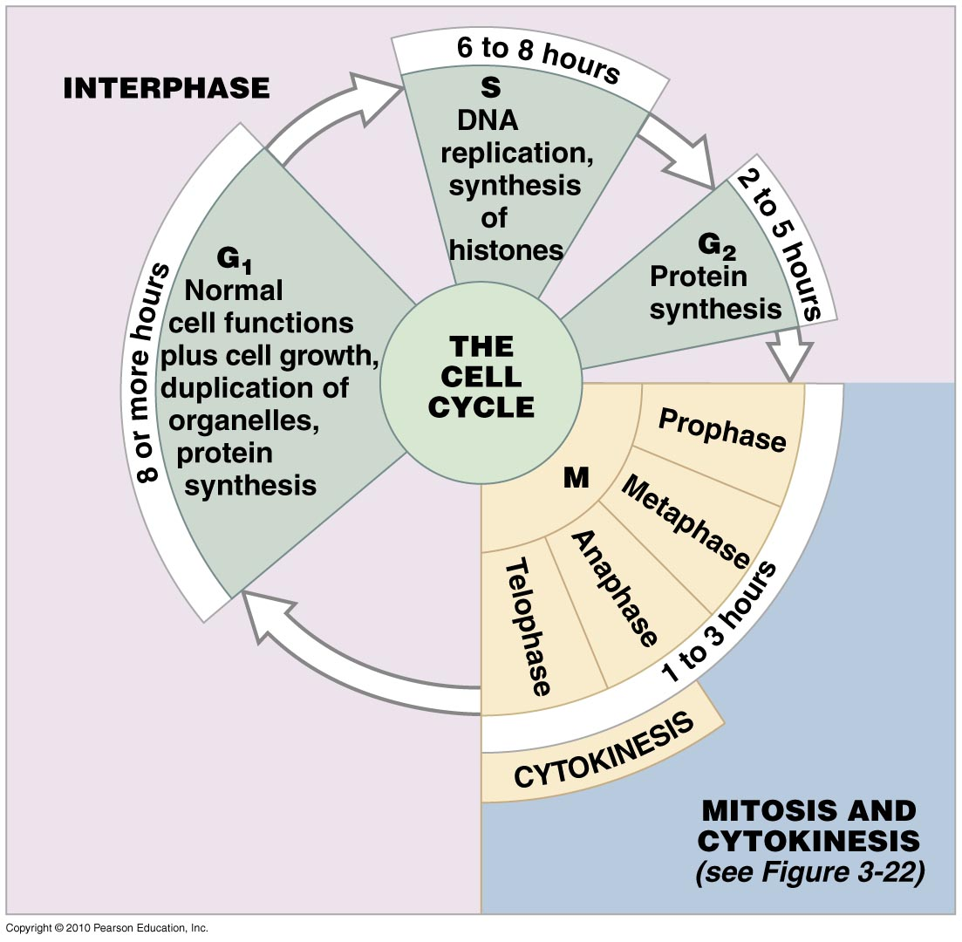
Figure 3.20

Slide 23
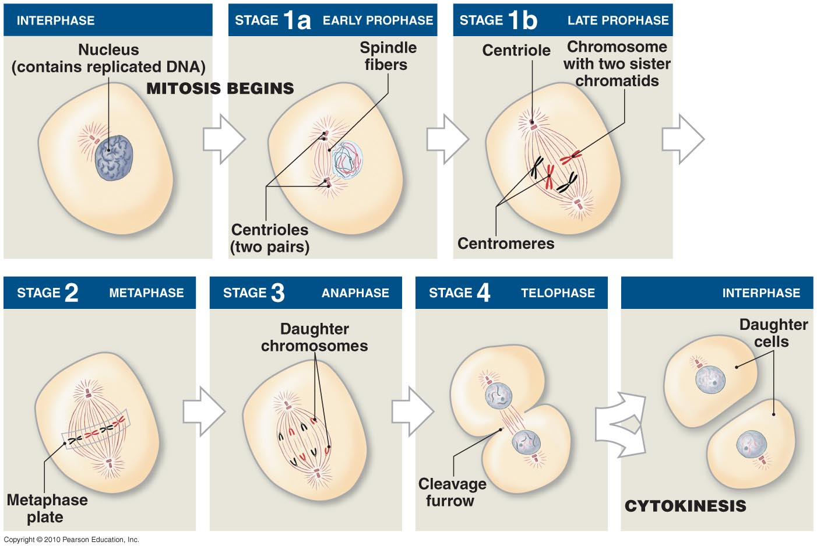
Figure 3.22

Slide 24
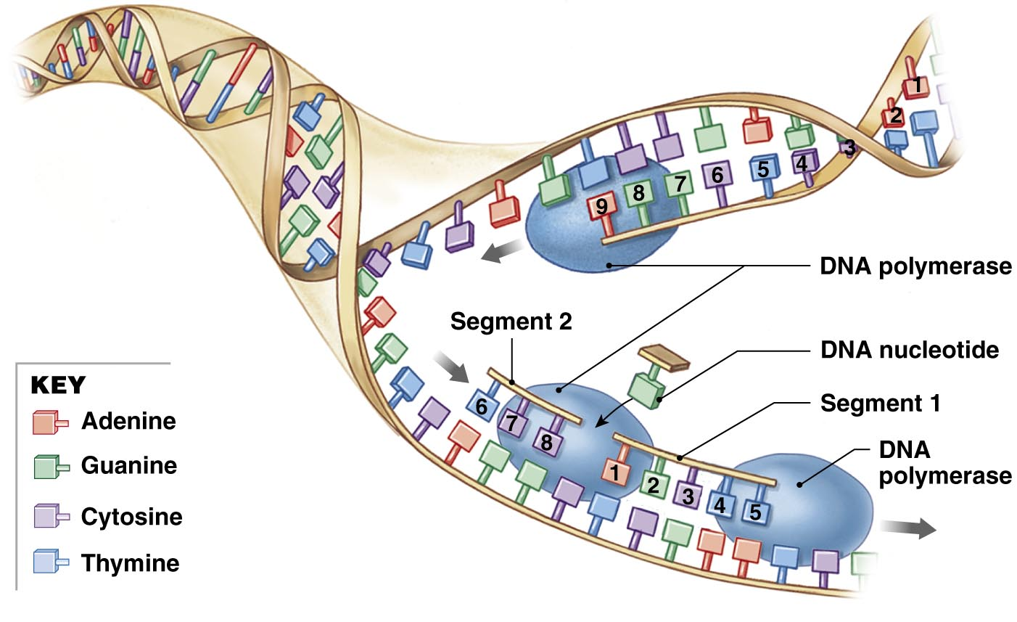
Figure 3.21

