Slide 1

Jeopardy!
Nervous System

Slide 2

Choose Your Question
Final
Nervous System | Cellular Organization | Neuron Function/ Communication | Central Nervous System | Peripheral Nervous System | Autonomic Nervous System
200 | 200 | 200 | 200 | 200 | 200
400 | 400 | 400 | 400 | 400 | 400
600 | 600 | 600 | 600 | 600 | 600
800 | 800 | 800 | 800 | 800 | 800
1000 | 1000 | 1000 | 1000 | 1000 | 1000

Slide 3
Click a Dollar Amount to Choose a Question
back

Slide 4
FINAL JEOPARDY
Category-
Central Nervous System
The answer is….

Slide 5
Final Jeopardy
Four Types of Neuroglial Cells Found in Central Nervous System
back

Slide 6
Click a Dollar Amount to Choose a Question
back

Slide 7
Answers
Final Jeopardy Answer- Astrocytes, Oligodendrocytes, microglia, ependymal
Nervous System | Cellular Organization | Neuron Function/ Communication | Central Nervous System | Peripheral Nervous System | Autonomic Nervous System
CNS | Neurons | Action Potential | Cerebrum, Cerebellum, Brain Stem | Ganglia | Monosynaptic reflex (simple)
PNS | Neuroglia | Saltatory Propagation | Gyrus, sulcus | Cranial Nerves (12) | Polysynaptic reflex (complex)
Afferent Division | Interneurons | Synapse | Epithalamus, hypothalamus, thalamus | Nerve Plexus | Sympathetic Division
Efferent Division | Schwann cells | Neuronal pools | Limbic System | Reflex | Parasympathetic Division
Somatic Nervous System | Unipolar, Bipolar, Multipolar | Neurotransmitters | Dorsal Root Ganglia, Ventral Root Ganglia | Dermatome | Reflex Arc

Slide 8
Click a Dollar Amount to Choose a Question
back

Slide 9
Nervous System
200
Brain and the spinal cord make up this division of the human nervous system
back

Slide 10
Click a Dollar Amount to Choose a Question
back

Slide 11
Nervous System
400
This division of the human nervous system is made up of all the nervous tissue outside the CNS
back

Slide 12
Click a Dollar Amount to Choose a Question
back

Slide 13
Nervous System
600
This division of the PNS brings sensory information to the CNS
back

Slide 14
Click a Dollar Amount to Choose a Question
back

Slide 15
Nervous System
800
This division of the PNS carries motor commands to muscles, glands and tissues
back

Slide 16
Click a Dollar Amount to Choose a Question
back

Slide 17
Daily
Double

Slide 18
Click a Dollar Amount to Choose a Question
back

Slide 19
Nervous System
1000
This division of the PNS provides voluntary control over skeletal muscular contractions
back

Slide 20
Click a Dollar Amount to Choose a Question
back

Slide 21
Click a Dollar Amount to Choose a Question
back

Slide 22
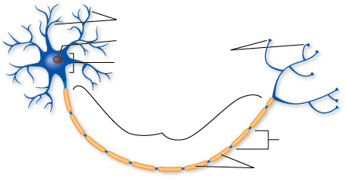
Cellular Organization
200
Illustrated below is a cell type responsible for transferring and processing information
back

Slide 23
Click a Dollar Amount to Choose a Question
back

Slide 24
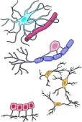
Cellular Organization
400
Cells (in the drawing) provide a supporting network for neural tissue
back

Slide 25
Click a Dollar Amount to Choose a Question
back

Slide 26
Cellular Organization
600
Cells found between sensory and motor neurons; analyzing sensory information and coordinating motor responses
back

Slide 27
Click a Dollar Amount to Choose a Question
back

Slide 28
Cellular Organization
800
These cells synthesize myelin
for the axons in the PNS
back

Slide 29
Click a Dollar Amount to Choose a Question
back

Slide 30
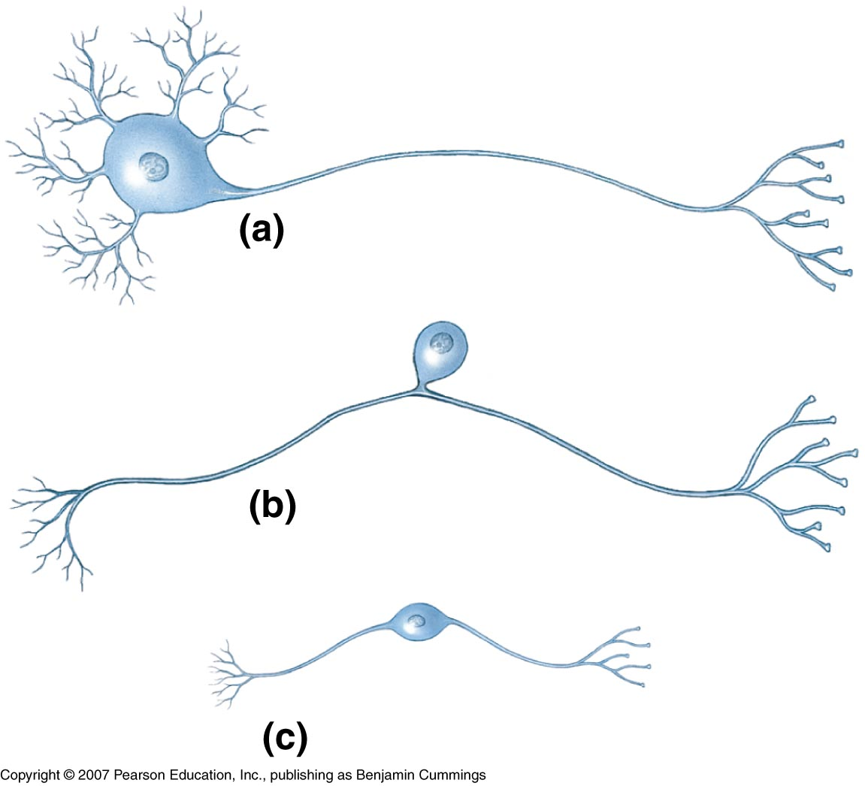
Cellular Organization
1000
The three types of structural neurons pictured below
back

Slide 31
Click a Dollar Amount to Choose a Question
back

Slide 32
Neuron Function/Communication
200
An electrical signal affecting the entire surface of a cell’s membrane
back

Slide 33
Click a Dollar Amount to Choose a Question
back

Slide 34
Neuron Function/Communication
400
The action potential leaps from node to node, greatly increasing processing speeds along the axons
back

Slide 35
Click a Dollar Amount to Choose a Question
back

Slide 36
Neuron Function/Communication
600
The communication gap between neural cells; chemical transmitters diffuse across this gap
back

Slide 37
Click a Dollar Amount to Choose a Question
back

Slide 38
Neuron Function/Communication
800
Organized groups of interconnected neurons with specific functions; may be described as convergent or divergent
back

Slide 39
Click a Dollar Amount to Choose a Question
back

Slide 40
Neuron Function/Communication
1000
Norepinephrine, GABA acid, serotonin and ACh are examples of these molecules
back

Slide 41
Click a Dollar Amount to Choose a Question
back

Slide 42
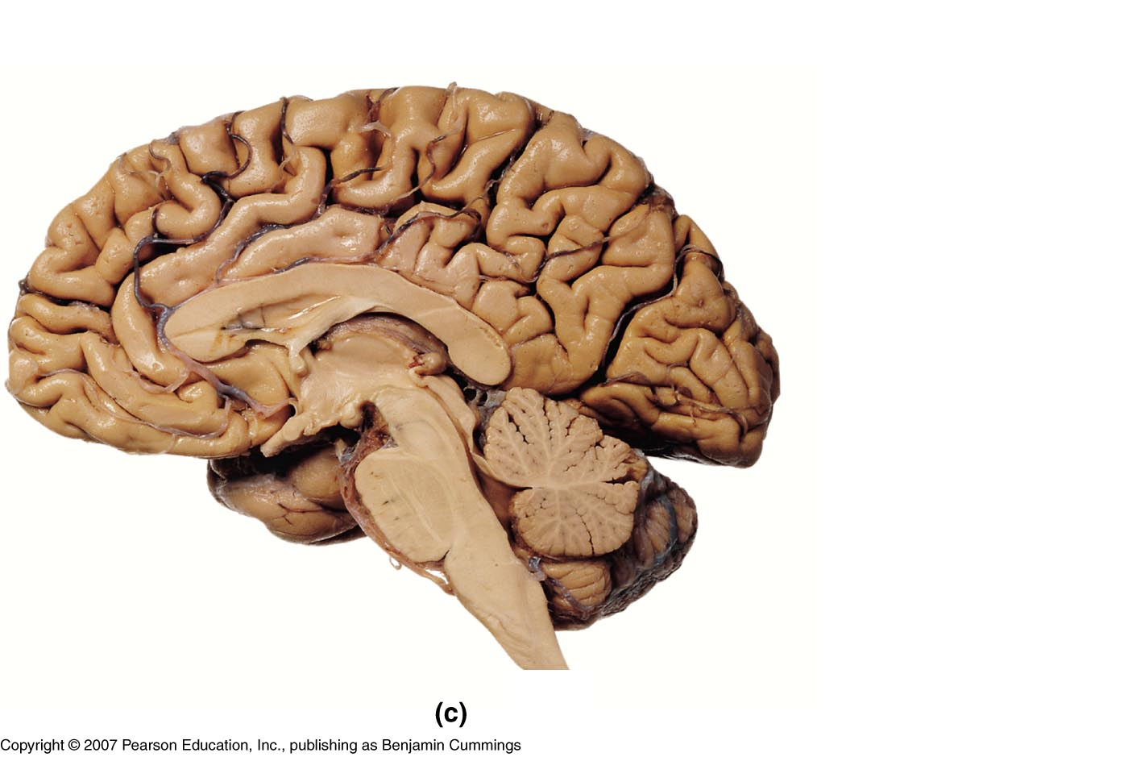
CNS
200
Three main sections of the human brain
back

Slide 43
Click a Dollar Amount to Choose a Question
back

Slide 44
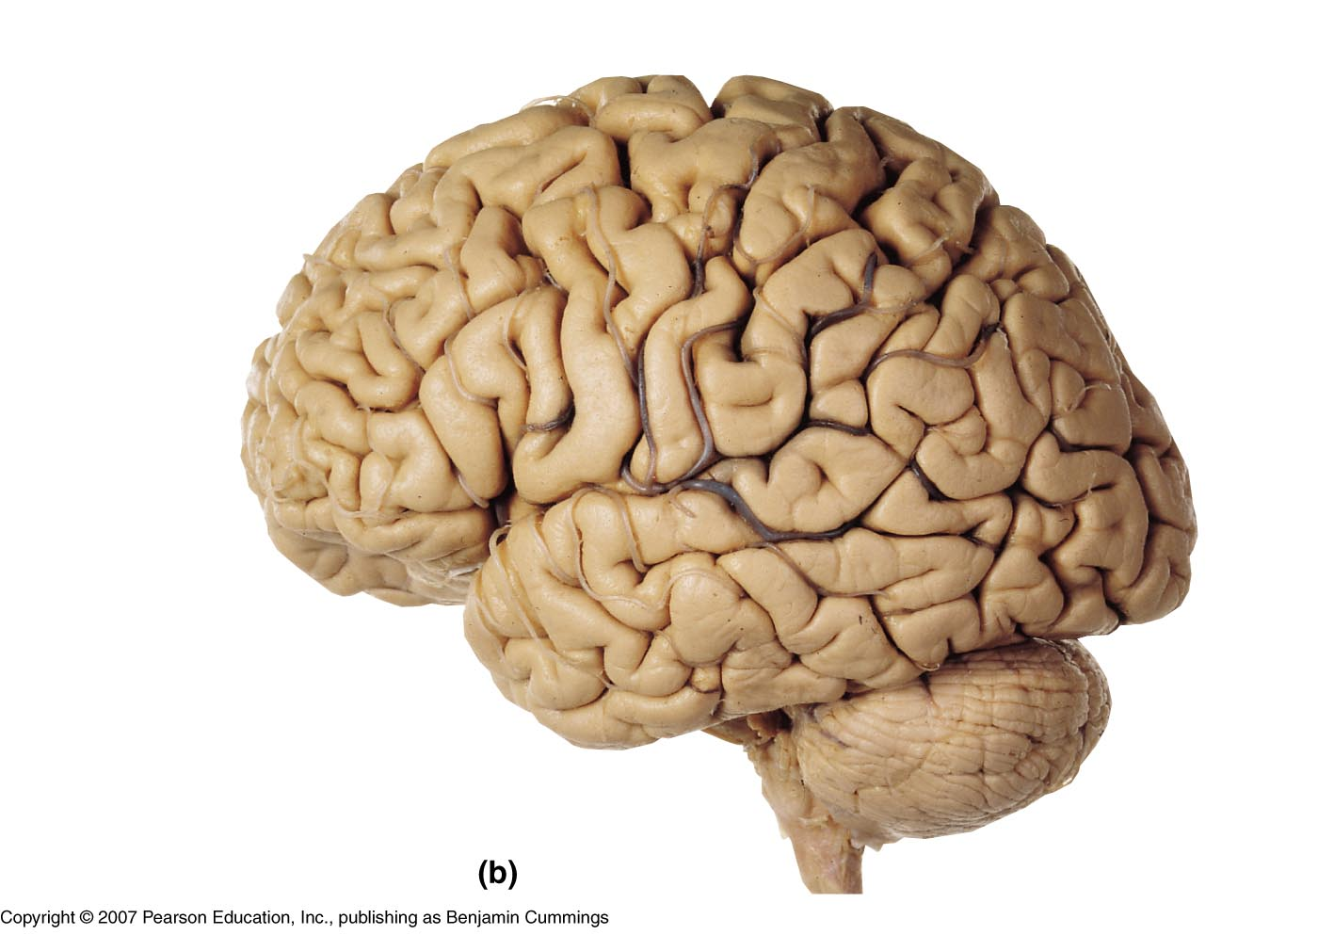
CNS
400
(a) Elevated ridges are called_______
(b) Shallow depressions are called _______
back

Slide 45
Click a Dollar Amount to Choose a Question
back

Slide 46
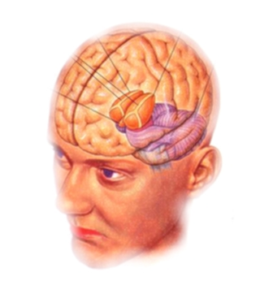
CNS
600
The diencephalon, a switching and relay center , is composed of __________
back

Slide 47
Click a Dollar Amount to Choose a Question
back

Slide 48
Daily
Double

Slide 49
CNS
800
Involved in learning, memory and intense emotions
back

Slide 50
Click a Dollar Amount to Choose a Question
back

Slide 51
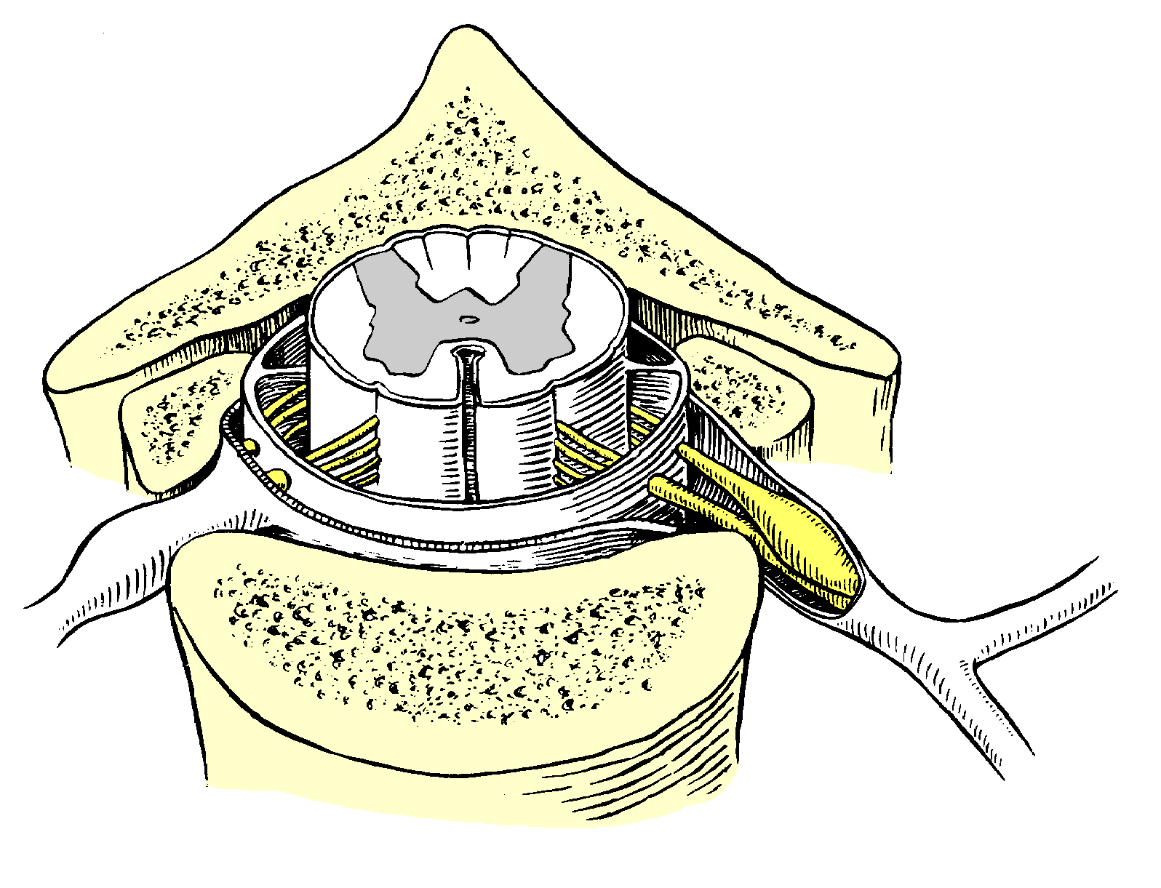
CNS
1000
These spinal segments combined make up the spinal nerves; one receiving sensory information and the other delivering the motor response
back

Slide 52
Click a Dollar Amount to Choose a Question
back

Slide 53
PNS
200
Clusters of neural cell bodies
back

Slide 54
Click a Dollar Amount to Choose a Question
back

Slide 55
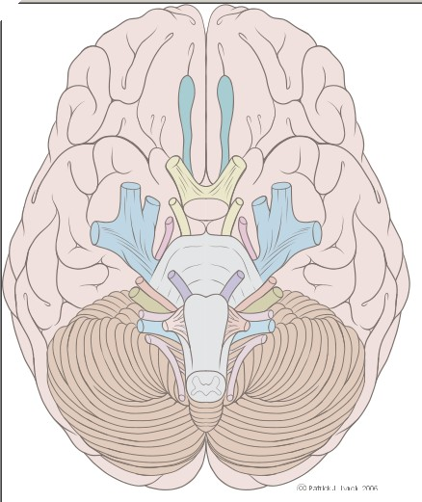
PNS
400
Despite being connected to the brain, these nerves are part of the PNS
back

Slide 56
Click a Dollar Amount to Choose a Question
back

Slide 57

PNS
600
Complex interwoven networks of spinal nerves bundled into three major groupings
back

Slide 58
Click a Dollar Amount to Choose a Question
back

Slide 59
PNS
800
An automatic involuntary response to a specific stimulus
back

Slide 60
Click a Dollar Amount to Choose a Question
back

Slide 61
PNS
1000
Each pair of spinal nerves monitors a specific region of body surface called ___________; providing sensory information to the spinal cord
back

Slide 62
Click a Dollar Amount to Choose a Question
back

Slide 63
ANS
200
Simplest reflex arc where a sensory neuron synapses directly on a motor neuron
back

Slide 64
Click a Dollar Amount to Choose a Question
back

Slide 65
ANS
400
A reflex arc which has at least one interneuron between a sensory afferent neuron and a motor efferent neuron
back

Slide 66
Click a Dollar Amount to Choose a Question
back

Slide 67
ANS
600
“Fight or flight” response system
back

Slide 68
Click a Dollar Amount to Choose a Question
back

Slide 69
ANS
800
“Rest and repose” system
back

Slide 70
Click a Dollar Amount to Choose a Question
back

Slide 71
ANS
1000
Comprised of a stimulus, receptor, sensory neuron, motor neuron and effector
back

Slide 72
Click a Dollar Amount to Choose a Question
back

