Slide 1
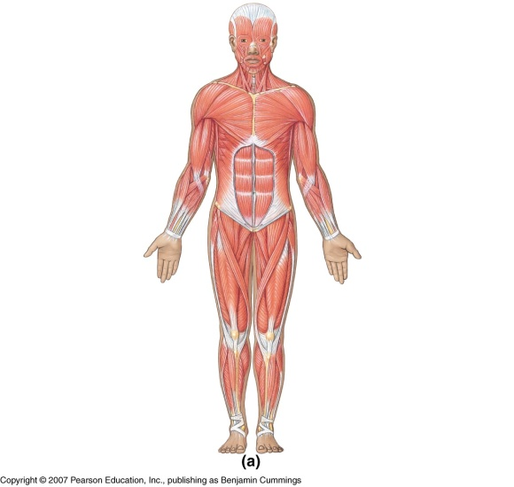
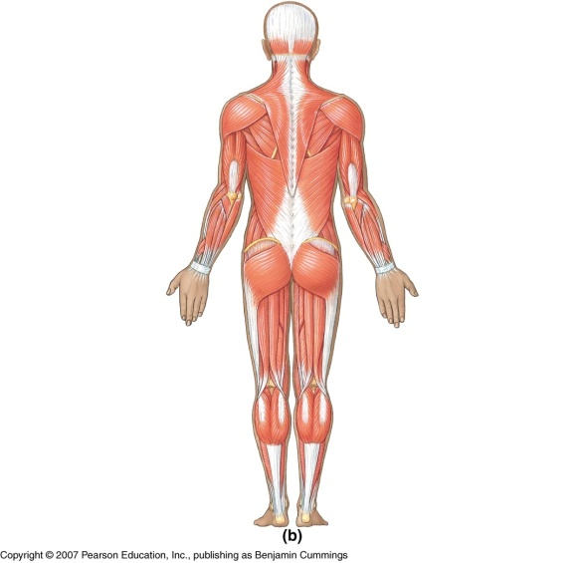
Selected Muscles
Axial and Appendicular Skeletal Muscles

Slide 2
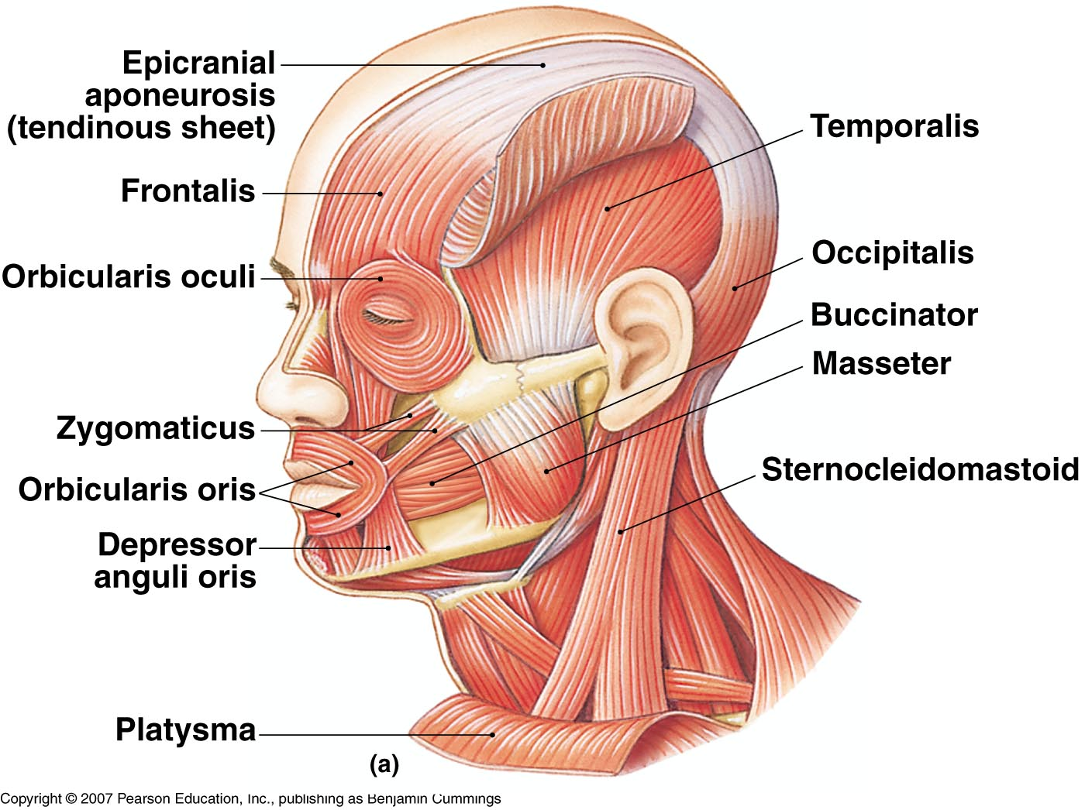
Muscles of the Head and Neck
Figure 7-12(a)

Slide 3
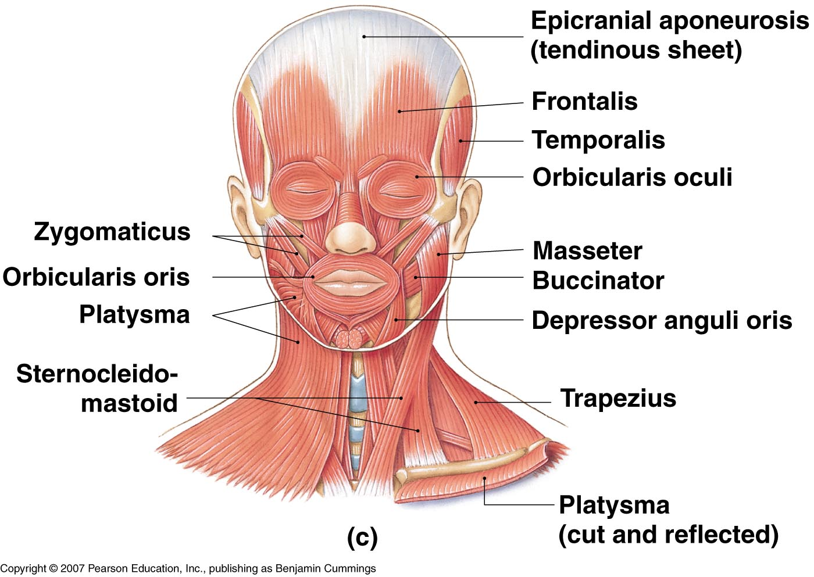
Muscles of the Head and Neck
Figure 7-12(c)

Slide 4
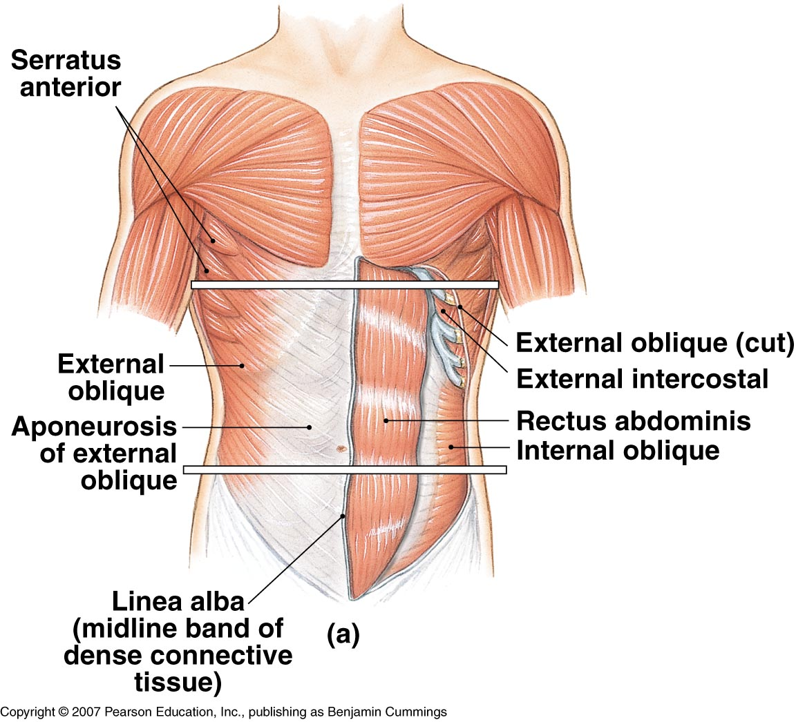
Oblique and Rectus Muscles and the Diaphragm
Figure 7-15(a)

Slide 5
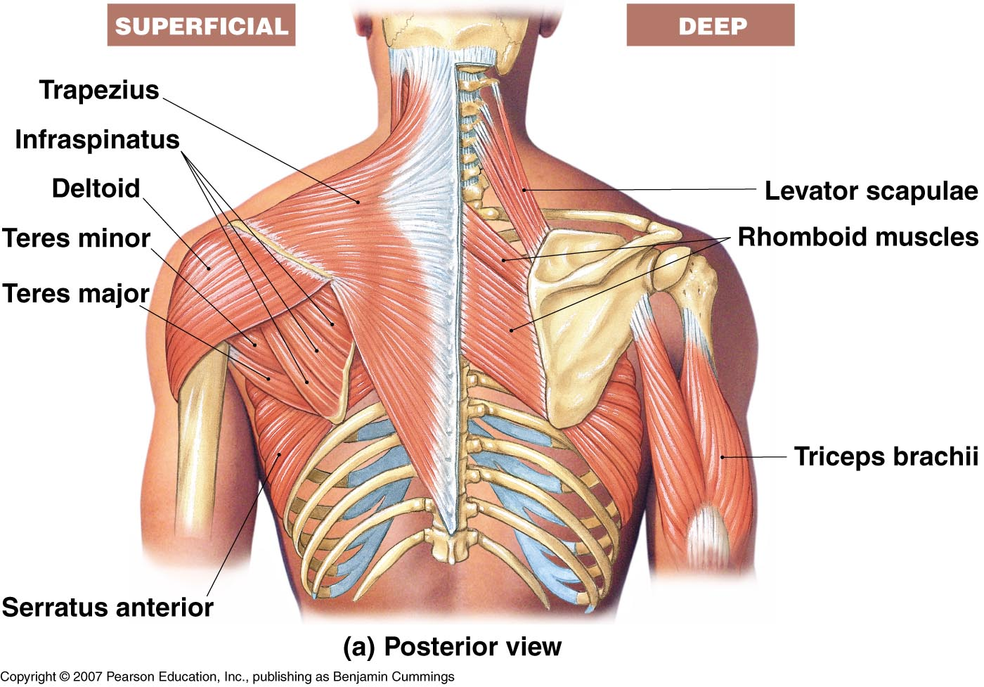
Muscles of the Shoulder
Figure 7-17(a)

Slide 6
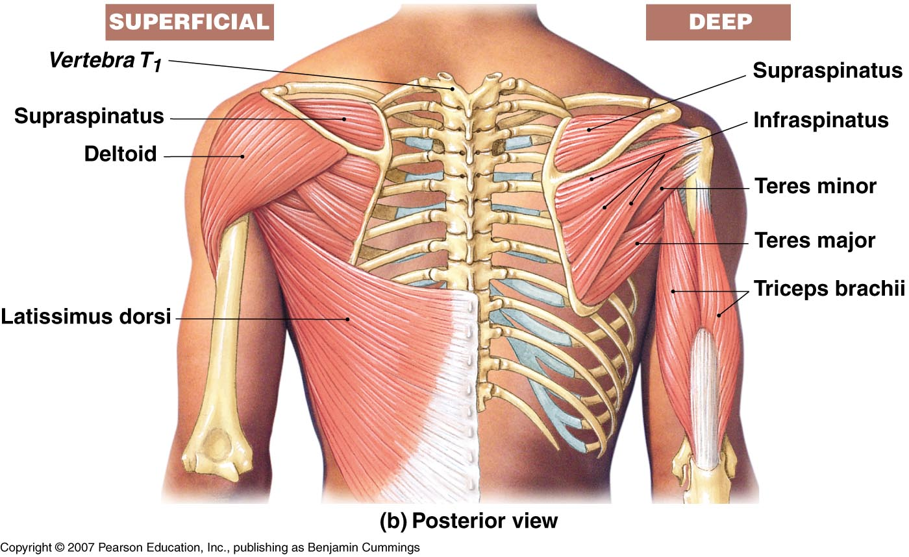
Anatomy of the Muscular System
Muscles that Move the Arm
Figure 7-18(b)

Slide 7
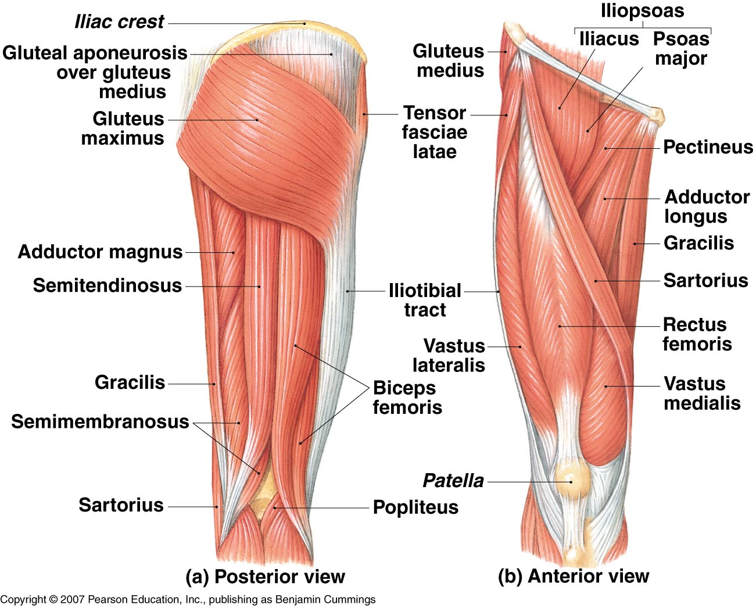
Muscles That Move the Leg
Figure 7-21

Slide 8
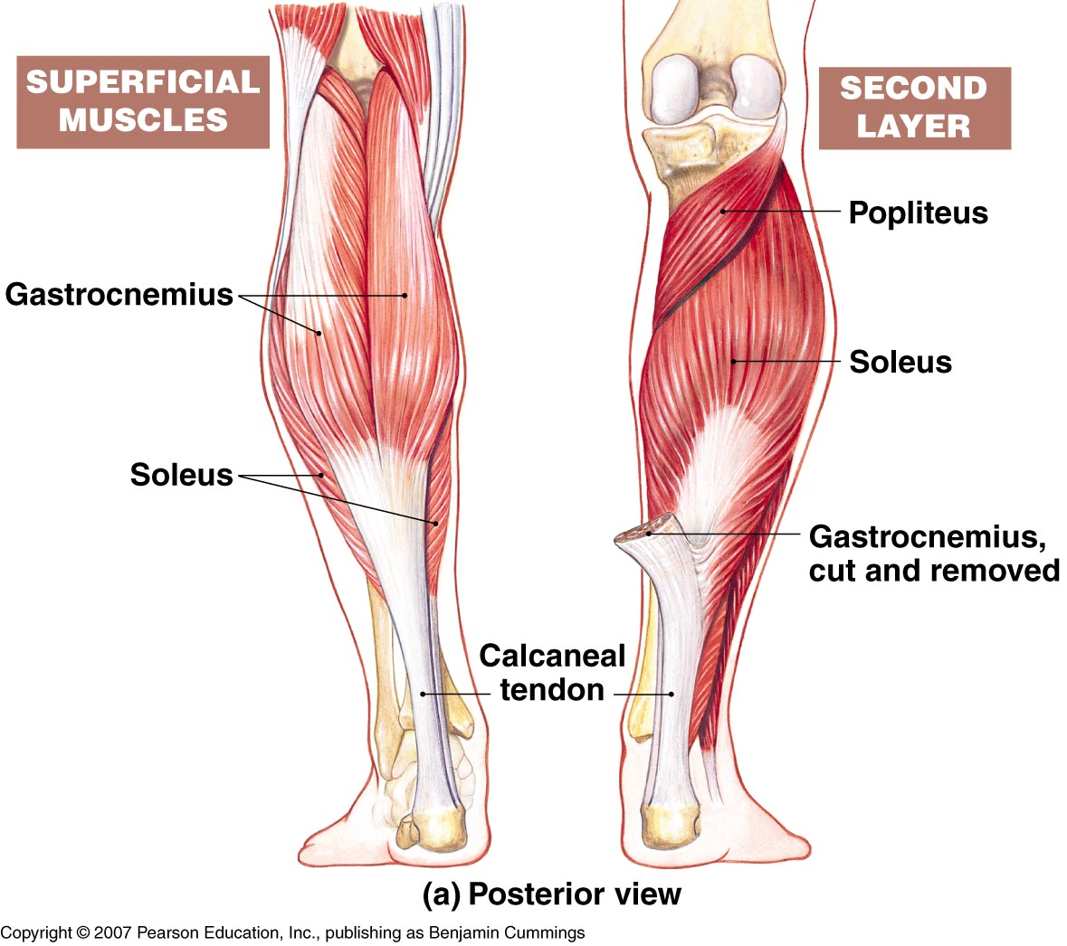
Muscles That Move the Foot and Toes
Figure 7-22(a)

