Slide 1
The Blue People of Kentucky
Fugates of Troublesome Creek

Slide 2
Introduction
Six generations after a French orphan named Martin Fugate settled on the banks of eastern Kentucky's Troublesome Creek with his redheaded American bride, his great-great-great great grandson was born in a modern hospital not far from where the creek still runs.
The boy inherited his father's lankiness and his mother's slightly nasal way of speaking.
What he got from Martin Fugate was dark blue skin. "It was almost purple," his father recalls.

Slide 3
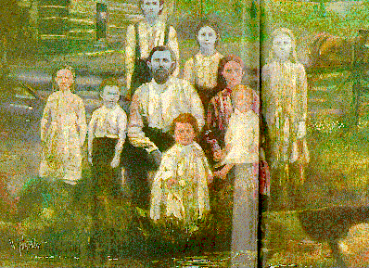
Fugate Family of Appalachia

Slide 4
Background
Yes, once upon a time, and potentially still today, blue people lived in Kentucky. The Fugates, who moved there in the 1800s, carried Methemoglobinemia, a disease which prevents the blood from carrying the proper amount of oxygen and, in turn, gives the skin a bluish tint. As folks in Kentucky are wont to do, they intermarried quite a bit until a whole bunch of blue people were roaming the countryside like an indigo “The Hills Have Eyes.” Then one day in 1960, a doctor came along, quickly diagnosed the problem, and prescribed the missing enzyme to the blue ones. Within minutes, they pinked right up and no longer felt blue, at least in appearance.

Slide 5
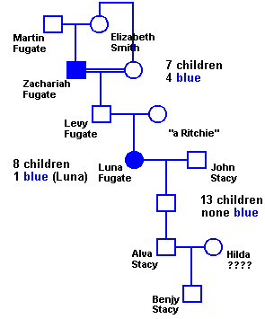
Fugate Family Pedigree

Slide 6

Ingesting elemental silver can also turn the skin blue. This man, Paul Karason, rubbed colloidal silver on his face and skin many years ago to treat a skin condition, which made him slowly turn a bluish/grey color.
Image via Wunderkabinett

